Slide 1

Version Control Mastery
Mastering Git
A Comprehensive Guide to Version Control
Branching Strategies
Team Collaboration
Best Practices

Slide 2
Overview
What We'll Cover
01
Understanding Version Control
05
Branching Strategies & Workflows
Learn what version control is, its evolution, and why Git became the industry standard
Compare GitFlow, GitHub Flow, and Trunk-Based Development approaches
02
Git Architecture & Core Concepts
06
Remote Repositories & Collaboration
Explore Git's unique approach, the three states, and internal structure
Learn to work with remote repos, push, pull, and collaborate with teams
03
Essential Git Commands
Master the commands you'll use every day in your development workflow
07
Git Best Practices
Professional tips for commits, workflows, and team collaboration
04
The Three States of Git
Learning Outcome
Understand modified, staged, and committed states and how files flow between them
By the end, you'll have the knowledge and confidence to use Git effectively in any development project

Slide 3

Chapter 01
Understanding
Version Control
The foundation of modern software development

Slide 4
Fundamentals
What is Version Control?
Version Control is a system that records changes to a file or set of files over time so that you can recall specific versions later. Think of it as a time machine for your code.
Real-World Scenarios
Every modification is tracked as a version, creating a complete history of your project's evolution. This enables developers to collaborate seamlessly, experiment safely, and recover from mistakes.
Team Development: Five developers working on different features simultaneously without stepping on each other's toes
Bug Recovery: A critical bug is introduced—revert to the last stable version in seconds
Track History
Collaboration
See who made what changes, when, and why with complete audit trails
Multiple developers work on the same project without conflicts
Code Review: Review every change before it enters the main codebase
Experimentation: Try new ideas in isolated branches without affecting production
Backup & Restore
Parallel Development
Revert to any previous version when something goes wrong
Work on multiple features simultaneously with branching
"Version control is not optional in modern software development—it's as essential as the code itself."
— Industry Standard Practice

Slide 5
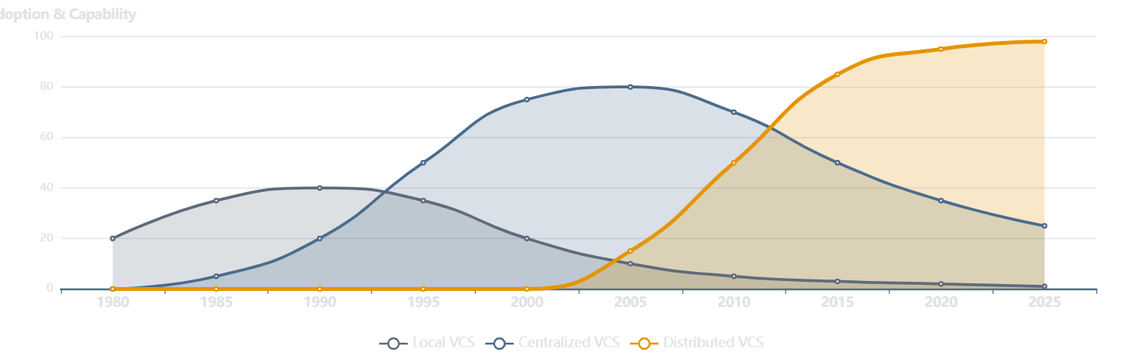
History
Evolution of Version Control Systems
Local VCS
Centralized VCS
Distributed VCS
Single developer, local database
Single central server, multiple clients
Every client has full repository copy
Example: RCS (1982)
Examples: CVS, SVN (1990s)
Examples: Git, Mercurial (2005+)

Slide 6
Origin Story
The Birth of Git
Created by Linus Torvalds
Git's Rapid Adoption
Creator of Linux Kernel
Linux Kernel
2005
In 2005, after the relationship with BitKeeper broke down, Linus Torvalds needed a new version control system for Linux kernel development. He built Git in just two weeks.
Ruby on Rails
2008
Android
2008
Git's Design Goals
jQuery
2009
Speed
Fast operations, even on large projects
Stack Overflow Survey
90%+ developers
Simple Design
Clean, straightforward workflow
Non-linear Development
Strong branching and merging support
Fully Distributed
Industry Standard
Every copy is a full repository
Today, Git is the dominant version control system used by millions of developers worldwide, powering platforms like GitHub, GitLab, and Bitbucket.
Handle Large Projects
Efficient with massive codebases

Slide 7

Chapter 02
Git Architecture
& Core Concepts
Understanding how Git works under the hood

Slide 8
Core Concepts
Git's Unique Approach
Snapshots, Not Differences
Git Has Integrity
Unlike other VCS that store file differences, Git stores snapshots of your entire project at each commit. Think of it like taking photos of your project state.
Everything in Git is checksummed using SHA-1 before storage. Every file and commit has a unique 40-character hash. It's impossible to change anything without Git knowing.
Benefit: Instant access to any project state without applying patches
Benefit: Data integrity guaranteed, no silent corruption
Nearly Every Operation Is Local
Git Generally Only Adds Data
Most Git operations only need local files and resources. You can work offline, browse history, and create branches without network access.
When you perform actions in Git, nearly all of them only add data to the database. It's very difficult to lose committed work or get anything into an unrecoverable state.
Benefit: Lightning-fast operations, work anywhere
Benefit: Safety net—hard to permanently lose work

Slide 9
Core Workflow
The Three States of Git
Basic Git Workflow
1
Modify Files
File State Transitions
Edit files in your working tree
2
Stage Changes
Selectively stage with git add
3
Commit
Save with git commit
Modified
git add
Staged
git commit
Committed
Changed but
not staged
Marked for
next commit
Safely stored
in database
# Example workflow
$ git add file.txt # Stage file
$ git commit -m "Add feature" # Commit
Working Tree
Staging Area
Git Directory
Single checkout of one version of the project. Files you edit live here.
Also called "index". Stores what will go into your next commit.
The .git folder. Stores metadata and object database for your project.
Pro Tip
The staging area lets you craft your commits carefully—stage only related changes together for clean history.

Slide 10
Internal Structure
Inside the .git Directory
Directory Structure
config
Project-specific configuration settings (remote URLs, branch tracking, aliases)
.git/
├── config# Configuration
description
├── description# Repo description
Used only by GitWeb program for repository description
├── HEAD# Current branch ref
├── index# Staging area
├── hooks/# Scripts
├── info/# Exclude patterns
HEAD
├── objects/# All content
Points to the current branch you have checked out
└── refs/# Branch refs
hooks/
Client-side or server-side hook scripts for automation
objects/
Stores all content for your database (commits, trees, blobs, tags)
Content-Addressable Filesystem
Git is essentially a key-value data store. You insert any content, and Git returns a unique key (SHA-1 hash) you can use to retrieve it later.
refs/
Stores pointers to commit objects (branches, tags, remotes)

Slide 11
Chapter 03
Essential Git
Commands
Master the commands you'll use every day

Slide 12
Setup
Getting Started with Git
Installation Verification
Configuration Levels
# Check Git version
--system
System Level
$ git --version
/etc/gitconfig — applies to all users
git version 2.40.0
--global
Global Level
If Git is installed, you'll see the version number. If not, download from git-scm.com
~/.gitconfig — applies to your user
--local
Local Level
.git/config — specific to current repo
Initial Configuration
# Set your identity
# View all configurations
$ git config --global user.name "Your Name"
$ git config --list --show-origin
$ git config --global user.email "your@email.com"
# View specific setting
# Set default editor
$ git config user.name
$ git config --global core.editor "code --wait"
# Set default branch name
$ git config --global init.defaultBranch main
Windows Paths
System config: C:\ProgramData\Git\config
These settings identify you in every commit you make. Use --global to set for all repositories.

Slide 13
Repository Setup
Creating and Cloning Repositories
Initialize a New Repository
Clone an Existing Repository
Convert an existing directory into a Git repository. This creates a new .git subdirectory.
Create a local copy of a remote repository, including all files, branches, and complete history.
# Navigate to your project
# Clone with HTTPS
$ cd /path/to/your/project
$ git clone https://github.com/user/repo.git
# Initialize Git repository
# Clone with SSH (recommended)
$ git init
$ git clone git@github.com:user/repo.git
Initialized empty Git repository in /project/.git/
# Clone to specific directory
$ git clone my-project
What happens: Creates .git directory with all necessary repository files
What happens: Downloads full repository with all history, creates remote connection named "origin"
When to Use Each Method
git init: Starting a new project from scratch
Security Note
SSH is more secure than HTTPS and doesn't require entering credentials repeatedly. Set up SSH keys for seamless authentication.
git clone: Contributing to existing projects

Slide 14
Status & Tracking
Tracking Changes with Git Status
Understanding git status
Status Code Reference
The git status command shows the working tree status—what files are modified, staged, or untracked.
??
Untracked file
A
Added (staged)
$ git status
On branch main
M
Modified
Changes to be committed:
(use "git restore --staged ..." to unstage)
MM
Staged & modified
modified: README.md
Changes not staged for commit:
D
Deleted
(use "git add ..." to update)
modified: main.js
R
Renamed
Untracked files:
(use "git add ..." to include)
UU
Conflicted
new-file.txt
Pro Tip
# Short status format (recommended)
Use git status -s for a quick overview. Left column = staging area, Right column = working tree.
$ git status -s
M README.md # Staged
M main.js # Modified, not staged
?? new-file.txt # Untracked

Slide 15
Daily Workflow
The Basic Git Workflow
The Git Workflow Cycle
Writing Good Commit Messages
1
Edit Files
✓ Good
Make changes to files in your working directory
Add password validation to login form
# Edit files with your editor
$ code main.js
✗ Bad
fixed stuff
2
Stage Changes
Select which changes to include in the next commit
Use imperative mood ("Add" not "Added")
First line under 50 characters
$ git add main.js # Stage specific file
Describe what and why, not how
$ git add . # Stage all changes
3
Commit Changes
# Complete example
Save staged changes to the repository with a message
$ git add .
$ git commit -m "Implement user login"
$ git commit -m "Add user authentication"
$ git status # Verify clean state
Remember
Commit early, commit often. Small, focused commits are easier to review and debug than large ones.

Slide 16
File Management
Managing Untracked Files with .gitignore
What is .gitignore?
Pattern Syntax
A .gitignore file tells Git which files or directories to ignore—preventing them from being accidentally committed to your repository.
# Comments start with #
*.log # Ignore all .log files
node_modules/ # Ignore entire directory
Why use .gitignore?
build/ # Ignore build output
.env # Ignore environment files
Keep sensitive data (API keys, passwords) out of version control
!.env.example # But track this one
Exclude build artifacts and generated files
/temp.txt # Ignore only in root
Prevent IDE/editor configuration files from cluttering the repo
*
Matches any characters
Ignore dependency directories (node_modules, vendor)
/
Directory separator
!
Negates pattern
# Create .gitignore file
#
Comment
$ touch .gitignore
# Check ignored files
$ git status --ignored
Best Practice
Create .gitignore immediately when starting a project. GitHub provides templates for different languages and frameworks.

Slide 17
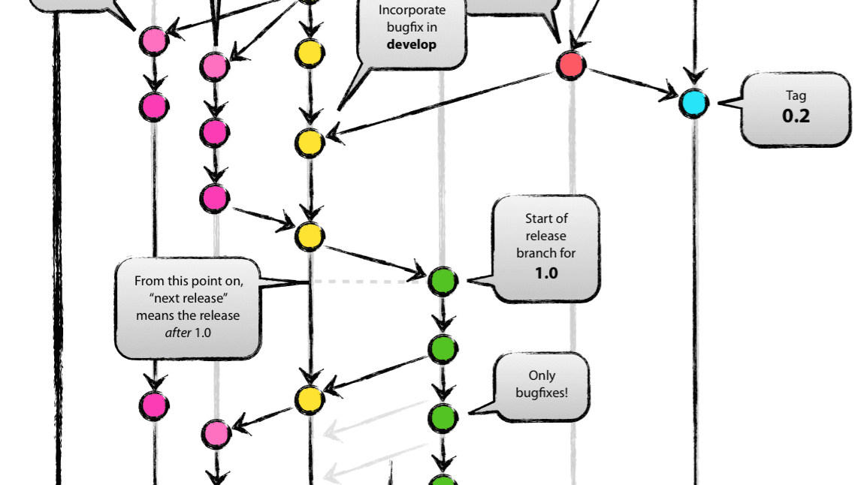
Chapter 04
Branching
Strategies & Workflows
Organize your development with effective branching

Slide 18
Branching Basics
Understanding Git Branches
What is a Branch?
Essential Branch Commands
A branch is a lightweight, movable pointer to a commit. When you create a branch, you're creating a new pointer to your current commit.
# List all branches
$ git branch
# Create a new branch
Why branches matter:
$ git branch feature-name
Parallel Development: Work on multiple features simultaneously
# Switch to a branch
Feature Isolation: Keep unstable code separate from production
$ git checkout feature-name
Safe Experimentation: Try new ideas without risk
# Create and switch (shortcut)
$ git checkout -b feature-name
Code Review: Review changes before merging to main
# Delete a branch
$ git branch -d feature-name
Branches in Git are incredibly lightweight—creating a branch takes milliseconds and consumes minimal storage.
Branch Naming Conventions
feature/login-page
New features
bugfix/header-alignment
Bug fixes
hotfix/security-patch
Urgent fixes
user/john/api-refactor
Personal branches

Slide 19
Branching Strategy
GitFlow Workflow
GitFlow Branch Structure
GitFlow Workflow
main
1
Feature Development
Production-ready code
Create feature/* from develop → work → merge to develop
Always stable, tagged releases
2
Release Preparation
Create release/* from develop → finalize → merge to main & develop
develop
Integration branch
3
Hotfix Production
Latest development changes
Create hotfix/* from main → fix → merge to main & develop
feature/*
New features
Branch from develop, merge back
Pros & Cons
release/*
✓ Advantages
✗ Disadvantages
Release preparation
• Structured releases
• Complex workflow
Branch from develop, merge to main & develop
• Parallel development
• Many branches
• Clear separation
• Slower releases
hotfix/*
Urgent production fixes
• Stable production
• Merge overhead
Branch from main, merge to main & develop
Best for: Teams with scheduled releases, enterprise projects, multiple versions

Slide 20
Modern Workflows
GitHub Flow & Trunk-Based Development
GitHub Flow
Trunk-Based Development
A lightweight, branch-based workflow designed for teams practicing continuous deployment.
All developers work on a single branch (main) with very short-lived feature branches (hours, not days).
Simple Structure:
Key Principles:
main
Always deployable
Frequent commits to main (multiple times daily)
feature/*
Short-lived branches
Feature flags hide incomplete work
Branches live < 1 day
Create branch from main
Strong CI/CD pipeline required
Add commits
Open Pull Request
✓ Benefits
✗ Challenges
Review and merge
• Minimal merge conflicts
• Requires discipline
Deploy immediately
• Fast feedback
• Feature flags needed
• True CI/CD
• Strong testing
• Small changes
• Team coordination
Best for: Web apps, CI/CD teams, fast iteration
Best for: Experienced teams, microservices, continuous deployment

Slide 21

Chapter 05
Remote Repositories
& Collaboration
Working with teams using remote repositories

Slide 22
Remote Setup
Connecting to Remote Repositories
What is a Remote?
Connecting Local to Remote
A remote repository is a version of your project hosted on the internet or network. It enables collaboration by allowing multiple developers to share and synchronize their work.
1. Create Remote Repository
On GitHub/GitLab, create a new empty repository
2. Connect Local Repository
Popular Hosting Platforms:
$ git remote add origin \
GitHub
GitLab
git@github.com:user/repo.git
Bitbucket
AWS CodeCommit
3. Push Your Code
$ git push -u origin main
# -u sets upstream for future pushes
Remote Commands
# View remotes
$ git remote -v
# Add a remote
Authentication Methods
$ git remote add origin
SSH (Recommended)
# Rename remote
Secure, no password prompts after setup
$ git remote rename old new
HTTPS
# Remove remote
Simple, works everywhere, requires credentials
$ git remote remove origin
Personal Access Tokens
Replace passwords for API/HTTPS access

Slide 23
Synchronization
Synchronizing Changes: Fetch, Pull, and Push
git fetch
git pull
git push
Downloads changes from remote repository without merging them into your working branch.
Fetches changes from remote and automatically merges them into your current branch.
Uploads your local commits to the remote repository.
# Fetch from default remote
# Pull from default remote
# Push to default remote
$ git fetch
$ git pull
$ git push
# Fetch from specific remote
# Pull specific branch
# Push specific branch
$ git fetch origin
$ git pull origin main
$ git push origin feature
# Push and set upstream
Use when: You want to see what others have done before merging
Equivalent to: git fetch + git merge
$ git push -u origin main
Requires: Your branch must be up-to-date with remote
Typical Workflow
$ git pull # Get latest changes
Caution
$ git add .
Stores fetched changes in remote-tracking branches (origin/main)
Pull can create merge conflicts if local and remote changes overlap. Commit or stash local changes first.
$ git commit -m "message"
$ git push # Share your work

Slide 24

Chapter 06
Git Best
Practices
Professional tips for effective version control

Slide 25
Professional Tips
Commit Best Practices
Writing Good Commit Messages
Commit Frequency
Format
✓ Commit Early, Commit Often
Small commits are easier to review and revert
Add user authentication to login page
# Blank line
✓ Don't Commit Broken Code
Implement password validation and
Ensure code compiles and tests pass
session management for secure login.
Closes #123
✓ Review Before Committing
Use imperative mood ("Add" not "Added")
Use git diff to review your changes
First line under 50 characters
Describe what and why, not how
Reference issue numbers when applicable
Branch Naming
# Good examples
Atomic Commits
feature/user-authentication
Each commit should represent one logical change. Don't mix feature work with bug fixes or refactoring in the same commit.
bugfix/login-validation-error
hotfix/security-vulnerability
docs/api-documentation-update
Use descriptive, lowercase names
Include ticket/issue numbers when applicable

Slide 26
Team Collaboration
Workflow Best Practices
Collaboration
Branch Management
Quality & History
1
Always Pull Before Pushing
4
Keep Branches Short-Lived
7
Tag Releases
Get latest changes first to avoid conflicts
Merge within days, not weeks
Use semantic versioning (v1.2.3)
2
Use Feature Branches
5
Delete Merged Branches
8
Clean Commit History
Isolate all work in dedicated branches
Keep repository clean and organized
Use rebase for local cleanup
3
Create Pull Requests
6
Use .gitignore
9
Test Before Pushing
Require code review before merging
Exclude build artifacts and secrets
Ensure CI/CD passes
Semantic Versioning
Pro Tip
# Clean up merged branches
MAJOR: Breaking changes
Two reviewers is the optimal number for effective code review.
$ git branch --merged | \
MINOR: New features
grep -v "\*" | xargs git branch -d
PATCH: Bug fixes

Slide 27

Start Your Git Journey
Git is more than a tool—it's a mindset. Embrace version control to write better code, collaborate effectively, and build with confidence.
Commit Often
Branch Wisely
Keep Learning
Small, focused commits tell a clear story
Use strategies that fit your team
Git mastery is a continuous journey
$ git commit -m "Begin your version control adventure"

