Slide 1
Infrastructure Monitoring
Complete Overview — Tools, Concepts & Best Practices
DevOps & SRE Essentials • 2026

Slide 2
Why Monitoring is Critical
You can't fix what you can't see.
• Ensures system availability and uptime
• Detects issues before users notice
• Helps in performance optimization
• Supports business continuity
Trainer Note
Give example: "If CPU spikes at 2 AM, monitoring alerts before customers complain."

Slide 3
Types of Monitoring
Monitoring is divided into 5 major areas — layers of visibility from system to security
Infrastructure Monitoring
Synthetic Monitoring
KPI / Business Monitoring
Log Monitoring
Security Monitoring
System health & metrics
Simulate user behavior
Track business metrics
Debug & audit trails
Threat detection
Trainer Note: Explain this as layers of visibility — from system → user → business → security

Slide 4
Infrastructure Monitoring
What it means
Tools
Tracking health of servers, containers, databases, networks
Prometheus
CPU usage
AWS CloudWatch
Memory usage
Disk I/O
Nagios
Network traffic
Trainer Note: "Think of this as checking vital signs of your system."

Slide 5
How Infrastructure Monitoring Works
Metrics Collected
Time-Series Database
Dashboards & Visualization
Alerts Triggered
Example
CPU > 80% → Alert sent to on-call engineer → Investigate & scale

Slide 6
Synthetic Monitoring
What it means
Tools
Simulating user behavior to test system health from the outside
Pingdom
Open website homepage
Login flow
Datadog Synthetic
API response check
Trainer Note: "Even if servers are fine, user journey might be broken — this catches that."

Slide 7
Synthetic Monitoring — Use Cases
Website uptime monitoring
API availability testing
Checkout flow validation
SLA monitoring
Ensure site is reachable 24/7
Verify endpoints respond correctly
Test critical user journeys
Measure against commitments
Example
If login API fails → alert immediately → prevent user lockout

Slide 8
KPI / Business Monitoring
What it means
Tool
Tracking business-level metrics to connect tech performance to business outcomes
Google Analytics
Active users
Tracks traffic, conversions, and user behavior across web and mobile
Conversion rate
Bounce rate
Session duration

Slide 9
KPI vs Technical Monitoring
Technical Monitoring
KPI Monitoring
CPU, Memory, Disk
Users, Revenue, Conversions
Server health
Business health
DevOps / SRE focus
Product / Marketing focus
Latency, Error rates
Bounce rate, AOV

Slide 10
Log Monitoring
What it means
Tools
Analyzing system logs for debugging, auditing, and error tracking
Loki
Application logs
Error logs
Grafana
Access logs
CloudWatch Logs
[INFO] 2026-04-25 14:32:01 Server started successfully
[WARN] 2026-04-25 14:35:12 High memory usage detected
[ERROR] 2026-04-25 14:36:45 Database connection timeout
[INFO] 2026-04-25 14:37:02 Retry attempt 1/3

Slide 11
Why Logs Matter
Root Cause Analysis
Error Tracking
Trace exactly what went wrong and when
Capture stack traces and exception details
Audit Compliance
Production Debugging
Meet regulatory and security requirements
Fix issues without reproducing locally
Example
"500 error → check logs → find database timeout → fix connection pool"

Slide 12
Security Monitoring
What it means
Tools
Monitoring threats, attacks, and vulnerabilities across infrastructure
AWS GuardDuty
Intrusion detection
Anomaly detection
Datadog Security
Threat intelligence

Slide 13

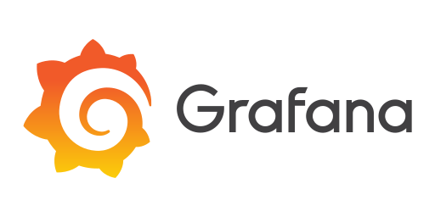


Real-World Monitoring Stack
Example architecture showing how tools complement each other
Prometheus
Metrics collection & alerting
Architecture Flow
Grafana
Dashboards & visualization
Apps & Services
Loki
Log aggregation & search
Collectors
CloudWatch
AWS integration & native metrics
Storage
GuardDuty
Security threat detection
Visualize & Alert
Trainer Note: Show how tools complement each other — no single tool does everything

Slide 14
Alerting Strategy
Actionable
Not Noisy
Threshold + Trend
Every alert must have a clear next step — no "just FYI" alerts
Avoid alert fatigue — group related issues, use cooldowns
Combine static thresholds with anomaly detection
Alert Examples
CPU > 80% for 5 min → Scale up or investigate process
API latency > 2 sec → Check database or downstream service
Error rate > 1% → Deploy rollback or hotfix
Disk usage > 90% → Clean logs or expand storage

Slide 15
Common Mistakes
1
Too Many Alerts
2
Monitor Only Infra
Alert fatigue causes teams to ignore real issues
Missing user experience and business impact
3
No Dashboards
4
Ignoring Logs
Flying blind without centralized visibility
Logs are the source of truth for debugging

Slide 16
Best Practices
✓
Combine All Types
Infrastructure + Synthetic + KPI + Logs + Security
✓
Use Dashboards
Centralized visibility for all teams
✓
Automate Alerts
Reduce MTTR with smart, actionable alerts
✓
Review Regularly
Metrics and thresholds evolve — keep them current
✓
Document Runbooks
Every alert should link to a response procedure

Slide 17
End-to-End Monitoring Pipeline
System
Metrics
Logs
Dashboards
Alerts
Action
Apps, servers, containers
Collect & aggregate
Capture & index
Visualize & analyze
Trigger & notify
Respond & resolve
Complete visibility from system health to business impact

Slide 18
Summary
Infrastructure
Synthetic
KPI
System health & metrics
User experience simulation
Business metrics & growth
Logs
Security
Debugging & audit trails
Threat detection & compliance
Monitoring improves reliability, performance, security, and user experience — invest in it early.

Slide 19


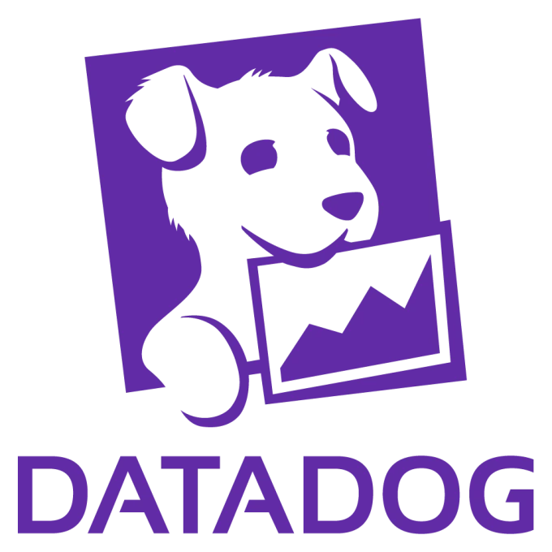
1. Infrastructure Monitoring Tools
Prometheus
AWS CloudWatch
Nagios
Open-source metrics monitoring (CNCF standard)
AWS-native monitoring & logging
Classic infra & network monitoring
Zabbix
Datadog
Enterprise open-source monitoring
SaaS full-stack observability platform

Slide 20



2. Visualization & Dashboarding
Grafana
Kibana
Dashboard & visualization platform
Visualization for Elasticsearch
Tableau
Power BI
Business analytics dashboards
Microsoft analytics dashboards

Slide 21



3. Log Monitoring / Observability
Loki
Elasticsearch
Logstash
Log aggregation (Grafana stack)
Log storage & search engine
Log pipeline processor
Fluentd
Splunk
Log collector & forwarder
Enterprise log analytics platform
Logo: https://upload.wikimedia.org/wikipedia/common...

Slide 22



4. Synthetic Monitoring
Pingdom
Datadog Synthetic
Website uptime & synthetic checks
API & user journey testing
New Relic
UptimeRobot
Full-stack monitoring + synthetic
Simple uptime monitoring

Slide 23



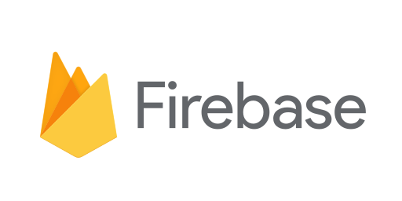
5. KPI / Business Monitoring
Google Analytics
Mixpanel
Website & user analytics
Product analytics
Amplitude
Firebase Analytics
Behavioral analytics
App analytics (mobile/web)

Slide 24
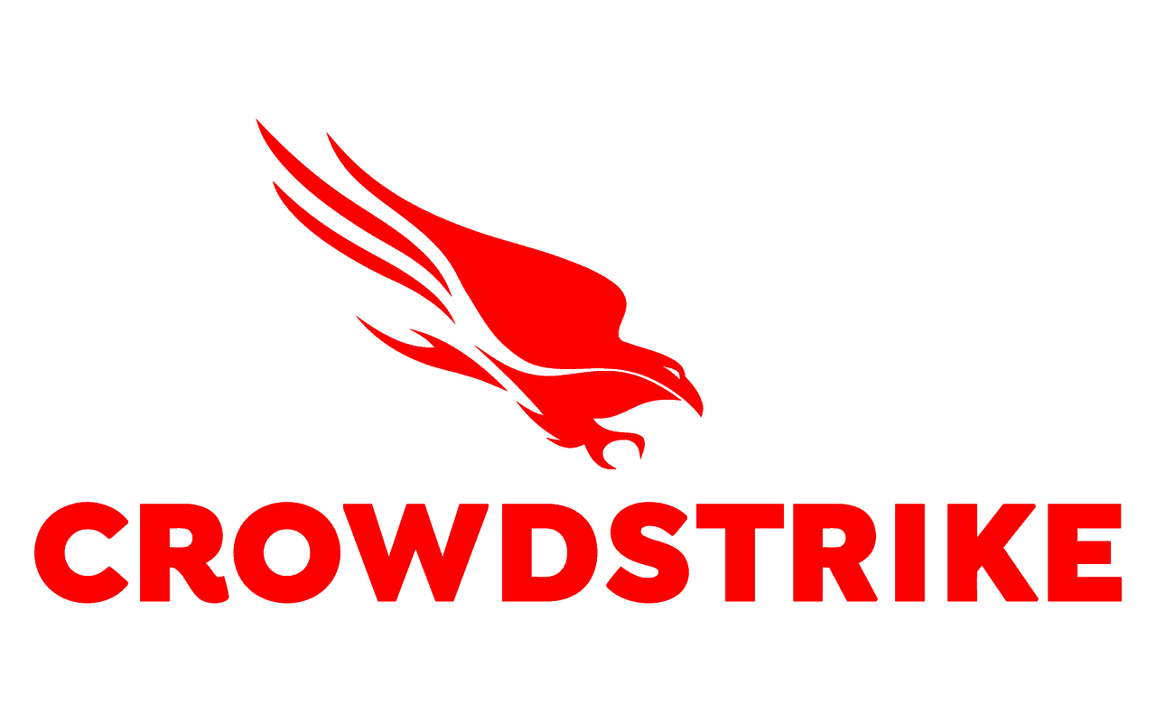
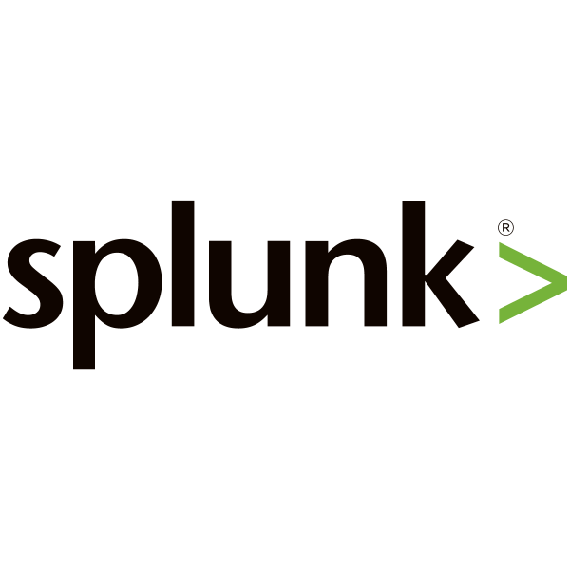
6. Security Monitoring
AWS GuardDuty
CrowdStrike
Threat detection in AWS
Endpoint security monitoring
Splunk Security
Datadog Security
SIEM & threat analysis
Cloud security monitoring

Slide 25


7. Modern Observability Platforms (All-in-One)
Datadog
Dynatrace
New Relic
Metrics + Logs + APM
AI-powered observability
Full-stack observability
SigNoz
Grafana Cloud
Open-source observability
Managed observability stack

