Slide 1

From Classroom to Cybersecurity Career
How Security Works in the Real World — a practical guide to bridging the gap between your engineering coursework and what companies actually expect from security analysts and interns.
PENETRATION TESTING
SOC OPERATIONS
CLOUD SECURITY

Slide 2
The Reality of Cybersecurity
Security is not about hoodies and zero-days. It is about protecting revenue, intellectual property, and system availability. If a company's web application goes down, they lose millions. We are risk managers disguised as engineers.
$4.44M
$10.22M
Global Breach Cost
US Average
Average cost per breach worldwide
Highest regional breach cost globally
₹220M
20%
India Average
Shadow AI Breaches
All-time high — companies pay for prevention
Employees using unauthorized LLMs with sensitive data
Top Attack Vectors
What Companies Actually Protect
Phishing & Social Engineering — 18% of breaches in India
Third-party vendor compromises — 17% of breaches
Shadow AI — unauthorized use of public LLMs with sensitive data
Revenue streams and intellectual property
Regulatory compliance (GDPR, ISO 27001, SOC 2)
System availability and uptime
Customer trust and brand reputation

Slide 3
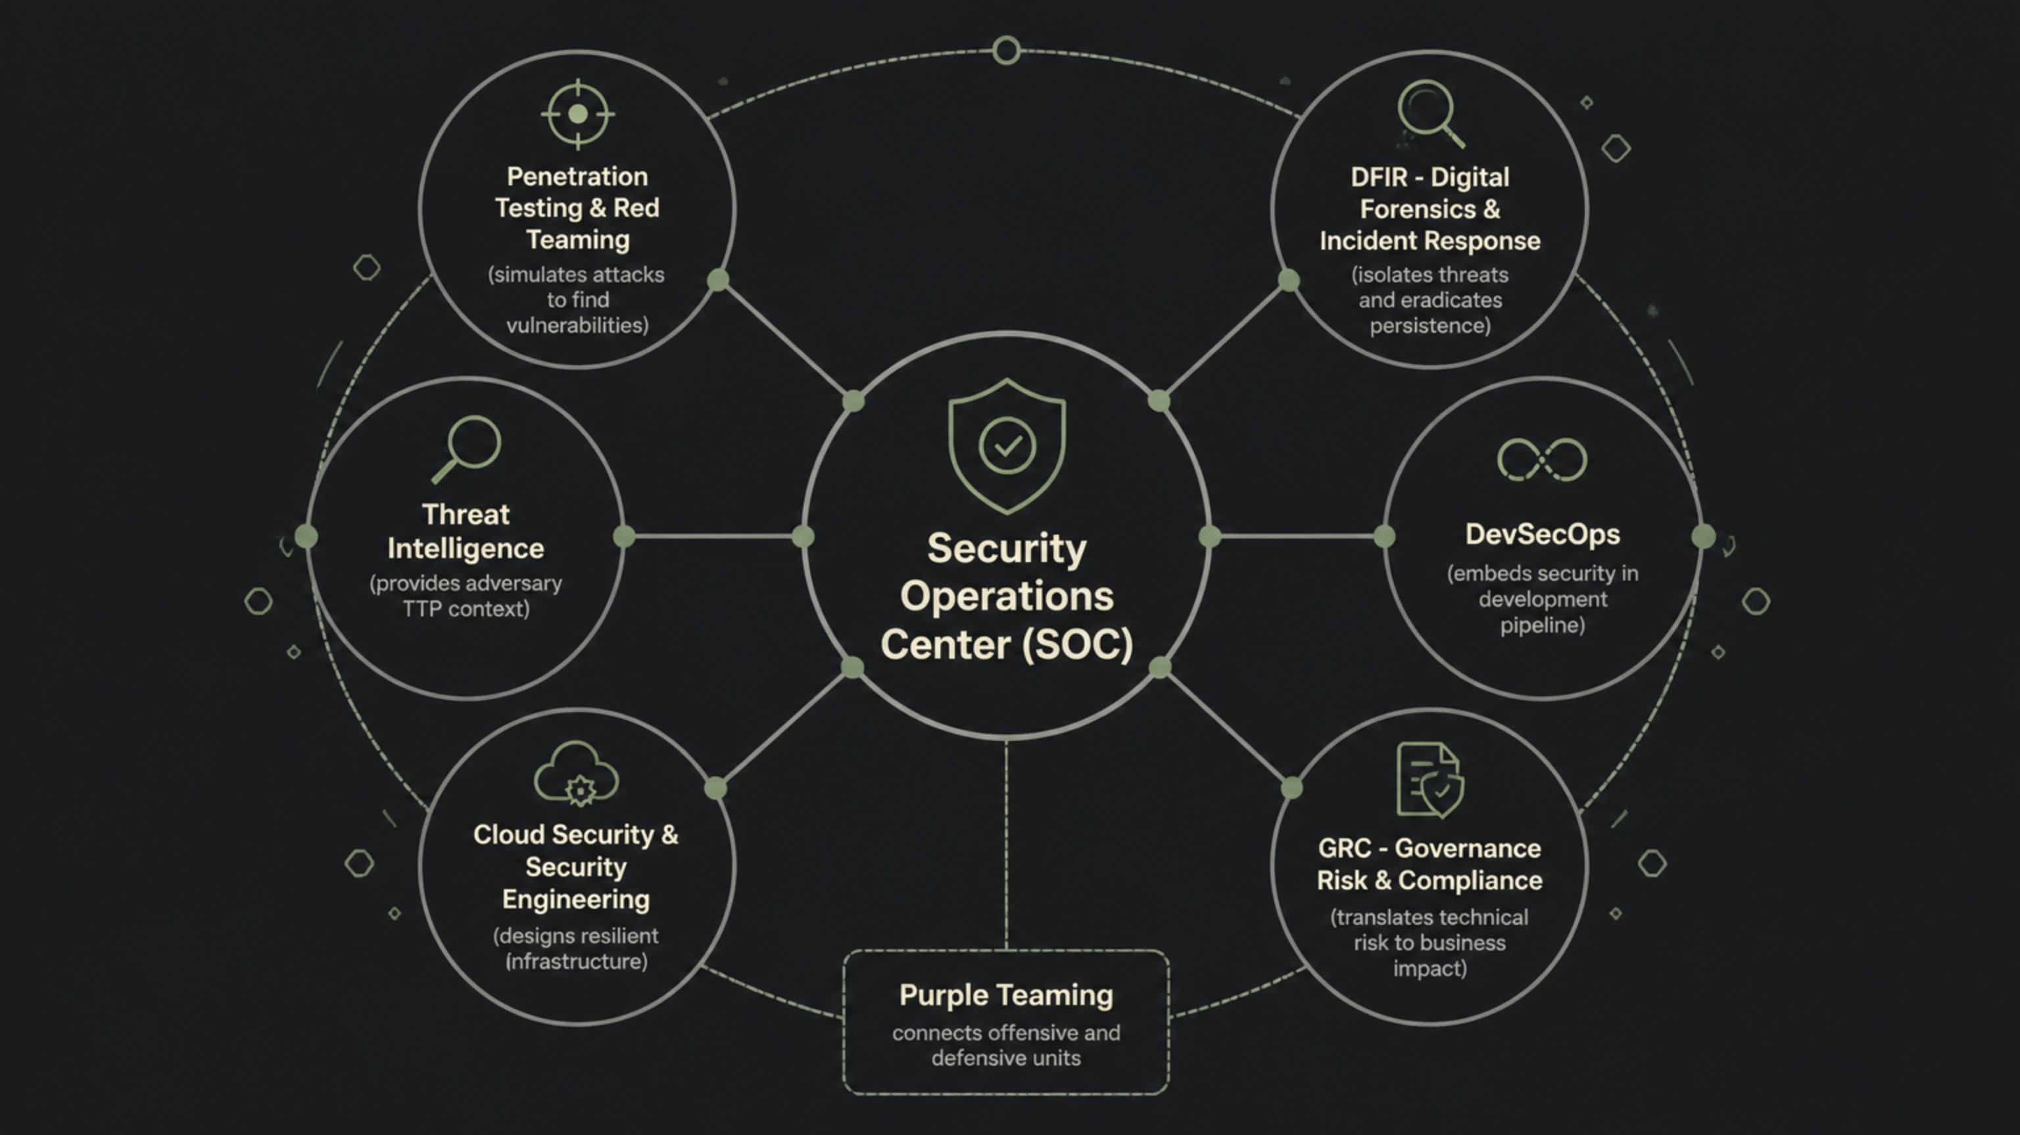
Cybersecurity as an Interdependent Ecosystem
Security is not a monolithic function — it is a matrix of continuous collaboration across specialized domains. Understanding how these teams interlock is foundational to corporate readiness.
The convergence of offensive and defensive operations through Purple Teaming represents the mature state of corporate security — where findings from red team exercises directly refine SOC detection engineering and incident response playbooks.

Slide 4
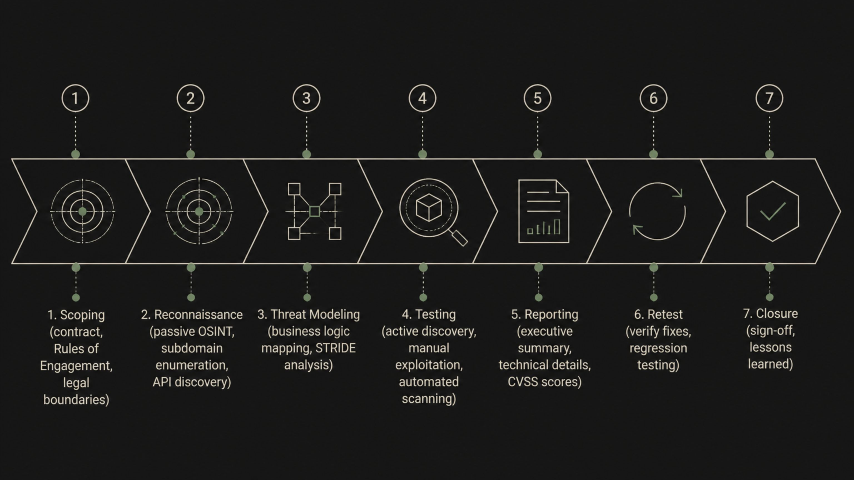
Security in the SDLC & The Engagement Workflow
A major mistake freshers make is thinking security happens after an app is built. In a Secure Software Development Framework (SSDF), we embed security early. Finding a bug during design costs $1; finding it in production costs $10,000. The same principle applies to engagements: every penetration test follows a structured, legally scoped workflow from contract to closure.
Where Security Fits in Development
Key Engagement Principles
Design: Threat Modeling
Dev: SAST & SCA scanning
Test: DAST & manual pentesting
Deploy: IaC scanning, hardening
Monitor: SIEM, anomaly detection
Scanning out of scope = legal liability
Passive recon before any active testing
Translate technical risk to business impact
Developer discussion is part of the job

Slide 5
The Secure Software Development Lifecycle
A pervasive misconception among entry-level practitioners is that security is a reactive phase appended at the end. In modern enterprise environments, security is woven into every phase of the SDLC. NIST's SSDF provides the structured methodology for this integration.
SDLC Phase
Security Integration
Core Tools & Methodologies
Requirements
Defining security and compliance needs (DPDP, GDPR) with initial risk assessment before coding begins.
Risk matrices, Compliance frameworks, Threat Modeling
Design
Architectural reviews identifying trust boundaries and potential attack vectors based on business logic.
STRIDE, PASTA, LINDDUN methodologies
Development
Engineers adhere to secure coding standards while automated systems scan for flawed logic and vulnerable dependencies.
IDE Plugins, SAST, SCA
Testing
Manual and automated exploits validate security controls in a runtime staging environment.
DAST, Manual Penetration Testing
Deployment
Infrastructure hardening, container security, and configuration management verification.
IaC Scanning, CSPM
Monitoring
Continuous telemetry analysis, anomaly detection, and incident response for rapid zero-day containment.
SIEM, SOAR, Bug Bounty, RASP
Lessons Learned
Post-incident analysis feeds telemetry back into Requirements to prevent historical recurrence.
Root Cause Analysis (RCA), Developer Retraining

Slide 6

Real Vulnerabilities: The Modern Attack Surface
The OWASP Top 10:2025 reflects the shift toward cloud-native and API-driven ecosystems. Understanding these vulnerabilities through architecture, exploitation, and mitigation is essential pedagogical grounding.
Broken Authentication
SQL Injection (SQLi)
Fragile session management and credential stuffing lead to total account takeover. Mitigation: Enforce MFA, use peer-reviewed auth frameworks, and avoid custom cryptographic logic.
User input concatenated into database queries allows attackers to bypass authentication or exfiltrate entire tables. Mitigation: Exclusive use of parameterized queries or prepared statements.
Cross-Site Scripting (XSS)
BOLA / IDOR
Untrusted input rendered as executable JavaScript enables session hijacking and credential theft. Mitigation: Context-aware output encoding and a robust Content Security Policy (CSP).
Manipulating API parameters to access another user's private data. Mitigation: Enforce access control centrally on the server — verify the session has explicit permission for the requested object.
SSRF & Cloud Metadata Theft
JWT Algorithm Confusion
Forcing servers to query internal infrastructure, often stealing IAM credentials via cloud metadata endpoints. Mitigation: Network-level egress filtering and disabling unnecessary metadata services.
Attackers exploit the "none" algorithm or brute-force weak HMAC keys to forge administrative tokens. Mitigation: Reject "none", validate algorithm type, and use cryptographically secure secrets.

Slide 7
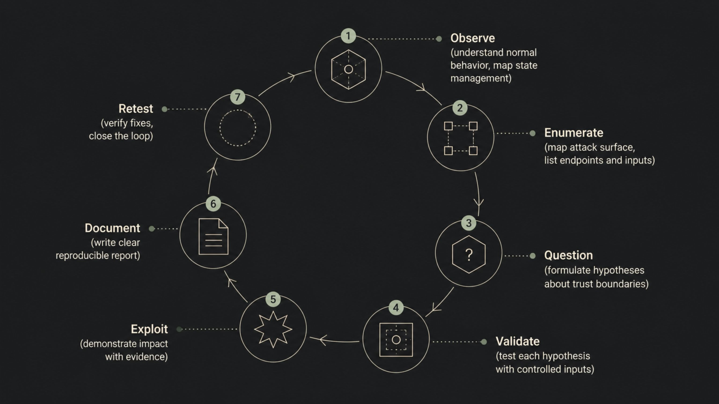
The Hacker Mindset & How We Actually Test
Tools don't hack — engineers do. You must first observe how an application maintains state. If you don't understand how a shopping cart works normally, you will never figure out how to bypass its pricing logic. We start wide with recon, use automation for low-hanging fruit, and spend 80% of our time manually testing complex logic flaws that scanners miss.
Manual Testing with Burp Suite
Automated Testing with OWASP ZAP
Intercept HTTP traffic before it hits the server
Decode base64 JWT payloads in Repeater
Modify claims (e.g., role: user → role: admin)
If signature isn't validated — you own the app
Dynamic Application Security Testing (DAST)
Crawl applications and analyze security headers
Test authentication flows and session management
Export JSON/CSV reports directly into CI/CD pipelines

Slide 8
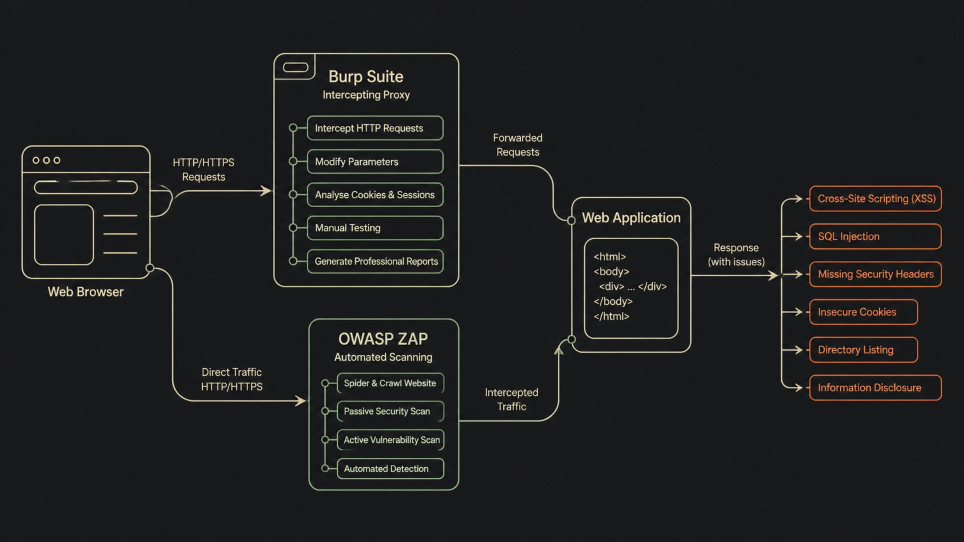
Web Application Security Testing Workflow
Understanding how to practically approach web application security is crucial. This workflow outlines the key tools, techniques, and mindsets required to effectively identify and mitigate vulnerabilities in modern web applications, moving from manual interception to automated scanning.
Reconnaissance
Proxy Configuration
Crawl
Manual Testing
Automated Scanning
Validate Findings
Risk Assessment
Report Generation
This comprehensive workflow ensures that web applications are thoroughly tested against a wide array of vulnerabilities, covering both manual and automated approaches to provide a robust security posture.

Slide 9
The Corporate Security Assessment Workflow
A standard corporate engagement follows a rigorous, linear progression of analytical thought — not a chaotic execution of scanning tools. Clear communication, risk mitigation, and minimal client disruption are paramount at every phase.
01
02
Scoping
Reconnaissance & Enumeration
Rules of engagement, target assets, excluded subnets, and testing windows are legally defined and approved.
Passive and active information gathering — mapping the external attack surface, exposed APIs, and subdomains.
03
04
Threat Modeling
Testing & Exploitation
Hypothesizing attack vectors based on the specific business logic and architecture of the target application.
Transitioning from automated scanning to manual exploitation, validating hypothesized vulnerabilities with precision.
05
06
Evidence & Reporting
Developer Discussion & Retesting
Translating technical risk into business impact with actionable, contextualized remediation guidance for developers.
Collaborating with software teams on architectural remediation, then formally verifying fixes before project closure.

Slide 10





The Hacker Mindset: Methodology Over Tools
Teaching tools without methodology produces technicians, not engineers. The hacker mindset is a structured process of scientific inquiry — continuously questioning trust boundaries and system behavior.
Live Demonstration Principles
Observe
Effective demonstrations use controlled academic environments — never live public targets. Key exercises include:
Interact organically with the target, mapping business logic and state management.
Intercepting HTTP requests via Burp Suite and decoding Base64 JWT payloads
Manually altering permission claims and observing cryptographic signature rejection
Using Nmap to explain TCP SYN scan mechanics and open port identification
Enumerating hidden directories via automated fuzzing and testing REST APIs for excessive data exposure
Bypassing CSP by locating trusted but vulnerable external endpoints
Enumerate
Quantify the attack surface — endpoints, parameters, technologies, and versions.
Hypothesize
Formulate theories about logical flaws based on architectural observations.
Validate & Exploit
Manually manipulate application state to confirm and demonstrate maximum realistic impact.
Document & Retest
Generate clear evidence narratives, then verify patches are robust post-remediation.

Slide 11
Bridging the Gap: What Employers Actually Expect
India produces ~1.5 million IT graduates annually, yet faces a shortfall of 500,000–1,000,000 cybersecurity professionals by 2026. The paradox: theoretical instruction without hands-on defensive engineering mindsets.
Common Disqualifying Patterns
What Corporate Employers Seek
Tool dependency without protocol understanding
Curiosity & independent problem-solving — the primary differentiator at entry level
Linux internals, TCP/IP networking, and Git version control
Cloud fundamentals and REST API mechanics
Ability to articulate technical findings to non-technical stakeholders
Meticulous documentation and report-writing capability
Foundational competence over CISO-level expertise
Candidates run scanners but cannot explain HTTP, TCP/IP, or read basic code syntax.
Certificate collection without documentation skills
Report writing constitutes a significant portion of daily responsibilities — yet is routinely ignored.
Offensive-only focus
Ignoring defense, compliance, and cloud architecture signals a lack of professional maturity.

Slide 12
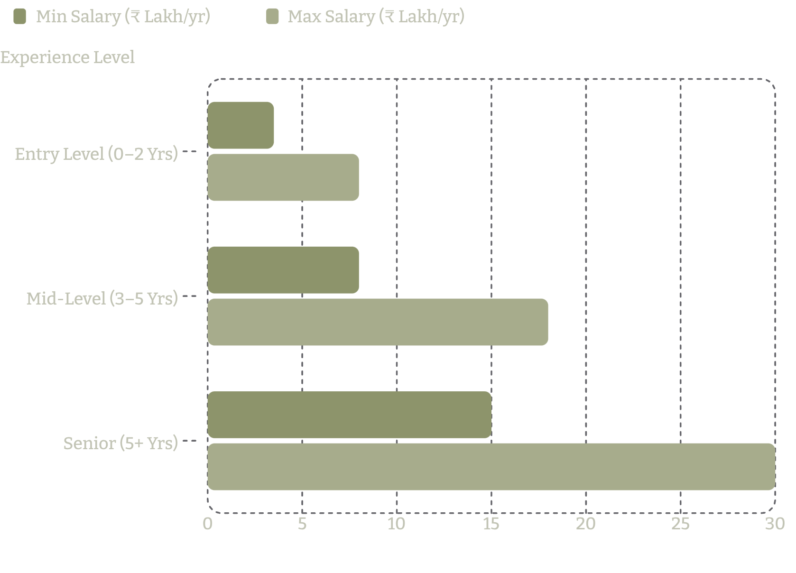
Career Preparation: ATS, Interviews & the Salary Landscape
Before human eyes evaluate a resume, it must survive an Applicant Tracking System. Technical interviews probe foundational depth — not tool familiarity. Understanding these mechanics is itself a security skill.
Feature
Traditional Academic Resume
ATS-Optimized Security Resume
Formatting
Multi-column, complex graphics, unique fonts
Single-column, standard fonts, plain text headers
Content Focus
Extracurricular activities, GPA, coursework
Hands-on labs, CVE research, GitHub repositories
Skill Listing
Vague terms (e.g., "Good at hacking")
Specific methodologies (e.g., "OWASP Top 10," "Threat Modeling")
Experience
Passive descriptions (e.g., "Learned Python")
Actionable metrics (e.g., "Automated log parsing using Python")
Core Interview Topics
India Salary Benchmarks (Pune)
DNS resolution — recursive flow from browser cache to authoritative name servers
AuthN vs AuthZ — identity verification versus permission enforcement
HTTPS handshake — TLS certificate validation, cipher negotiation, symmetric key exchange
TCP vs UDP — three-way handshake, reliability, and use-case differentiation
REST & JWT — HTTP methods, stateless architecture, token structure and signature validation
CIDR notation — network prefixes, subnet calculation, and firewall configuration
Certified candidates with practical lab experience command a 15–25% salary premium at entry level. Specialization in cloud security or threat hunting can double or triple mid-level compensation.

Slide 13

What Companies Actually Expect from You
We do not expect you to be a CISO. We expect you to know how to use the Linux command line, understand how an API works, and explain a vulnerability to a non-technical manager clearly. Your resume will be parsed by an ATS before a human sees it — keep it clean, use action verbs, and include GitHub links with real projects.
❌ Why Resumes Get Rejected
✅ The Intern Wishlist
Only knowing Kali Linux tools without understanding underlying HTTP or networking
Collecting certificates without hands-on practice
Cannot explain a TCP three-way handshake
Terrible report writing — findings must be reproducible
Fancy two-column layouts that break ATS parsing
Deep curiosity and structured problem-solving
Solid Linux CLI and networking fundamentals
Understanding of REST APIs, Git, and HTTP
Strong communication and documentation skills
GitHub with homelab projects and CVE research
Interview tip: When asked about HTTPS, don't just say "it's secure." Explain that the browser verifies the certificate, uses asymmetric cryptography to exchange a symmetric session key, then uses that key for fast encrypted data transfer. That answer gets you hired.

Slide 14
From First Year to First Job: Your Roadmap
Don't rush into hacking before you understand how computers talk to each other. Build your foundation first. Organizations using AI extensively in security save $1.9 million on breach costs — but attackers are using it too. If you can secure Large Language Models against prompt injection, you will have a job for the next decade.
Year 1
1
Networking fundamentals, Linux CLI, Computer Architecture, TCP/IP and DNS
2
Year 2
Python/Bash scripting, Web & HTTP, Databases, basic cryptography
Year 3
3
OWASP Top 10, Burp Suite, Active Directory labs, TryHackMe paths
4
Year 4
Bug bounties, internships, specialized certs, cloud & Kubernetes security
🤖 AI in Defense
⚔️ AI in Offense
☁️ Future Skills
SOC automation, log correlation, deobfuscation, anomaly detection at scale
Deepfakes, automated phishing, prompt injection, LLM data poisoning
Cloud & Kubernetes security, Zero Trust architectures, Detection Engineering

Slide 15

The Roadmap Forward: AI, Internships & Lifelong Learning
The transition from classroom to career requires a deliberate pedagogical shift — from passive theory consumption to active engineering methodology. AI is reshaping the discipline; adaptability is the ultimate competitive advantage.
Year 1
Year 3
Master computer architecture, Linux CLI, OSI model, and TCP/IP networking fundamentals.
OWASP Top 10 labs, interception proxies (Burp Suite), Active Directory, and containerization basics.
1
2
3
4
Year 2
Year 4
Python/Bash scripting, HTTP mechanics, REST APIs, and database fundamentals with SQL.
Secure internships, bug bounties, open-source contributions, and entry-level practical certifications.
AI's Dual-Edged Impact
Essential Platforms & Resources
AI-driven SOC operations save $1.9M per breach and reduce containment time by ~80 days
16% of 2025 breaches involved AI-assisted phishing and deepfake social engineering
Prompt Injection is now a distinct vulnerability class — manipulating LLMs to bypass guardrails
AI-generated code requires aggressive security review before deployment
Hack The Box & TryHackMe — hands-on practical execution environments
PortSwigger Web Security Academy — modern web vulnerability labs aligned to OWASP
MITRE ATT&CK — adversarial framework for threat intelligence and detection engineering
OWASP Community — standards, projects, and professional networking
Four-Week Internship Lifecycle — Immersive Learning → Shadowing → Hands-on Execution → Independent Output
The cybersecurity talent gap is vast — but it will be bridged by educational initiatives that align academic rigor with the uncompromising realities of the corporate security landscape.

Slide 16

Resources & Next Steps
You do not need a corporate job to start building real skills today. The best security engineers are self-taught problem solvers who document everything. Use these platforms to practice, earn recognition, and build a portfolio that speaks louder than any certificate.
🎯 Practice Platforms
📚 Essential Free Resources
HackerOne — Real-world bug bounties on live programs
Bugcrowd — Crowdsourced security testing marketplace
TryHackMe — Guided learning paths for beginners
Hack The Box — Advanced exploitation challenges
PortSwigger Web Security Academy — Best free web hacking resource, built by Burp Suite creators
OWASP Guidelines & Cheat Sheets — Industry-standard vulnerability references
MITRE ATT&CK Framework — Adversary tactics and techniques database
🔗 Connect With Us
Scan the QR code to apply for our Summer and Winter internship batches. Mention you attended this session. We are actively looking for curious engineers.
Open Q&A: Ask anything about careers, tools, day-to-day life in security, or how to break into the industry. The floor is yours.

