Slide 1
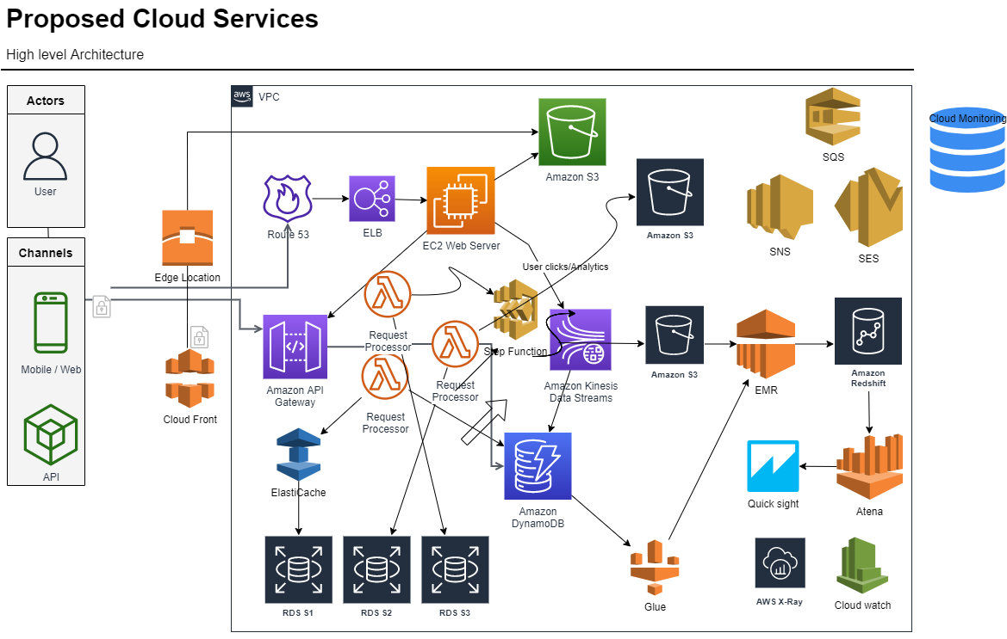

Slide 2
Implementation Way of working
The Client sends a Play request to Backend running on AWS. That request is handled by AWS Load balancer (ELB)
AWS ELB will forward that request to API Gateway Service running on AWS EC2 instances. The request will be applied to some predefined filters corresponding to business logics, then is forwarded to Application API for further handling.
Application API component is the core business logic behind youtube operations. There are several types of API corresponding to different user activities such as Signup API, Recommendation API for retrieving video recommendation.
Play API will call a microservice or a sequence of microservices to fulfill the request. Playback Apps service, Steering service and Cache Control service can be seen as a microservice in this diagram.
Microservices are mostly stateless small programs and can call each other as well. To control its cascading failure and enable resilience, each microservice is isolated from the caller processes by circuit breaker pattern and transaction are managed used step up function.
Microservices can send events for tracking user activities or other data to the Stream Processing Pipeline for either real-time processing of personalized recommendation or batch processing of business intelligence tasks.
The data coming out of the Stream Processing Pipeline can be persistent to other data stores such as AWS S3, EMR etc.

Slide 3
Thank YOU ! Q & A ?

