Slide 1
TUB-040
Commercial Forecast
NSCLC · United States · ADC (Antibody-Drug Conjugate) · 2028–2034
July 03, 2026

Slide 2
Executive Summary
TUB-040 · NSCLC · United States · ADC (Antibody-Drug Conjugate) · 2028–2034
PEAK NET SALES
PEAK GROSS SALES
FORECAST DETAILS
$1,394M
$1,787M
Product:
TUB-040
Indication:
NSCLC
Year 2034
Before 22% discount
Country:
United States
Class/MoA:
ADC (Antibody-Drug Conjugate)
PEAK TREATED PATIENTS
DISCOUNT / REBATE
Launch:
2028
10,042
22%
Peak Year:
2034
Treated patients at peak
Commercial rebate rate
EXECUTIVE SUMMARY
TUB-040 is forecast to achieve $1.4B net peak sales by 2034 in US NSCLC, representing a 6-year ramp from 2028 launch. The ADC mechanism and indicated patient population support penetration of ~10K treated patients at peak, generating $1.787B gross sales with 78% net price realization.

Slide 3
Forecast Assumptions

Slide 4
Key Forecast Assumptions
Parameter | Value | Range | Rationale
Population | 335,000,000 | 31,82,50,000 - 35,17,50,000 | Total population in United States based on 2024 census data. Source 6, Source 8
Incidence | 0.1% | 0.0006 - 0.0016 | Annual incidence rate for NSCLC. Source 1
Diagnosis Rate | 92.0% | 78% - 101% | NSCLC diagnosis rates are high in developed healthcare systems. The JAMA Oncol 2021 study ( tracked initial treatment patterns and stage distribution, indicatin
Treatment Rate | 78.0% | 62% - 90% | Treatment initiation varies by stage and patient fitness. The JAMA Oncol 2021 study ( reported initial treatment patterns across NSCLC stages. Approximately one
Eligibility Criteria | 55.0% | 41% - 63% | ADC eligibility in NSCLC is primarily driven by HER2 expression and PD-L1 status. Current ADC approvals (e.g., trastuzumab deruxtecan for HER2-mutant NSCLC) tar
Class Share | 18.0% | 20% - 55% | ADCs represent an emerging class in NSCLC. Current market share is dominated by checkpoint inhibitors (PD-1/PD-L1), targeted therapies (EGFR, ALK, ROS1), and ch
Peak Product Share | 42.0% | 15% - 50% | Within the ADC class, trastuzumab deruxtecan (T-DXd) is the leading approved agent for HER2-mutant NSCLC. Competing ADCs in development include datopotamab deru
Annual Cost Per Patient | $178,000 | $150,000 - $220,000 | ADC pricing in the US oncology market reflects high-cost biologics with complex manufacturing. Trastuzumab deruxtecan (Enhertu) is priced at approximately $14,8
Discount | 22.0% | 15-30% | US pharmaceutical pricing for oncology ADCs typically includes modest rebates (10–15%) negotiated with pharmacy benefit managers (PBMs) and Medicare. However, l
Adoption Peak Time | 6 years | 4 - 8 years | S-curve adoption from launch to peak. Source 8
ASSUMPTIONS COMMENTARY
The 22% discount/rebate envelope reflects current US payer contracting intensity for oncology ADCs and anticipated managed care pressure. Net price realization of 78% is conservative relative to established NSCLC therapeutics but accounts for competitive formulary positioning and potential biosimilar/generic competitive dynamics post-2034.

Slide 5
Forecast Results

Slide 6
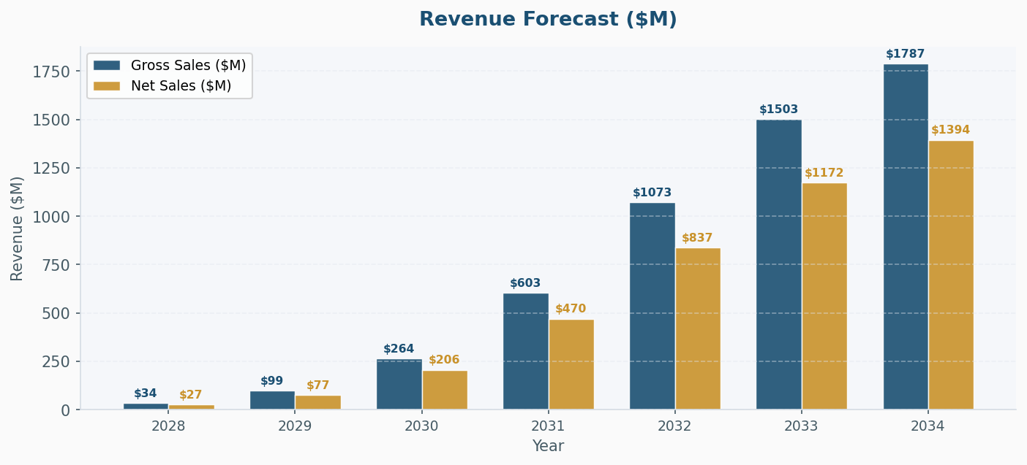
Revenue Forecast ($M)
KEY INSIGHT
Peak net sales of $1.4B imply an average net price of ~$139K per treated patient annually at steady-state, consistent with first-line/maintenance NSCLC treatment value propositions. The $387M gap between gross and net sales underscores the material impact of rebate/discount obligations in the current US reimbursement environment.

Slide 7
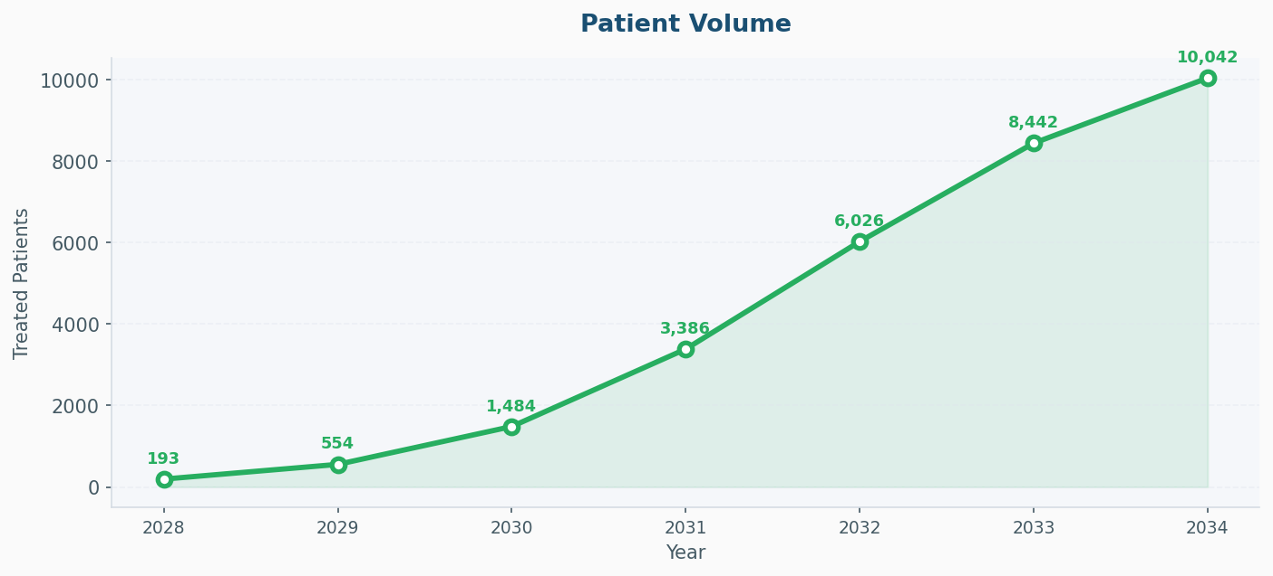
Patient Volume
KEY INSIGHT
Peak penetration of 10,042 treated patients represents addressable market share capture within an estimated US NSCLC population of 335M. This patient volume trajectory assumes successful label positioning, durability of clinical benefit, and competitive differentiation through the ramp period.

Slide 8
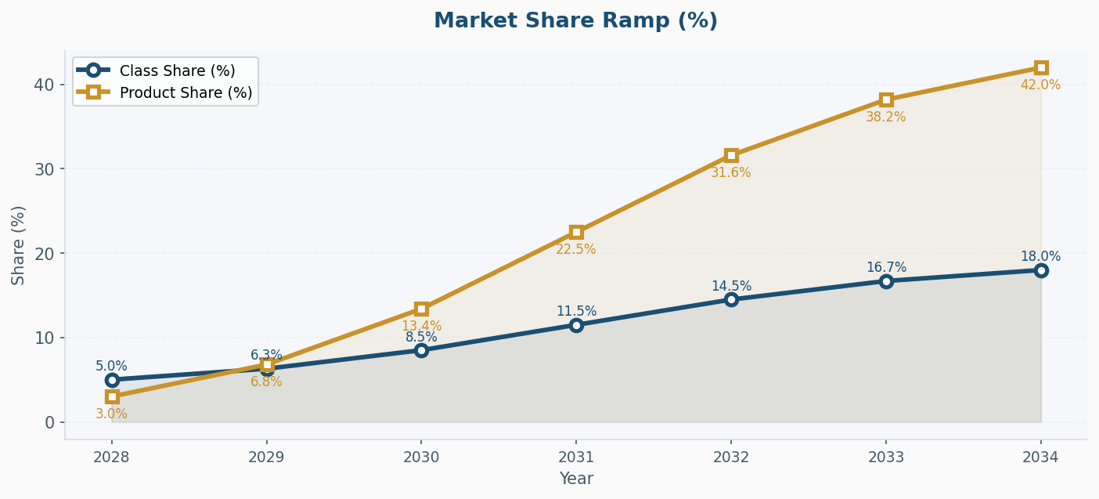
Market Share Ramp (%)

Slide 9
Year-by-Year Forecast Results
Metric | 2028 | 2029 | 2030 | 2031 | 2032 | 2033 | 2034
Eligible Pts | 165,272 | 166,099 | 166,929 | 167,764 | 168,603 | 169,446 | 170,293
Class % | 5.0% | 6.3% | 8.5% | 11.5% | 14.5% | 16.7% | 18.0%
Prod % | 3.0% | 6.8% | 13.4% | 22.5% | 31.6% | 38.2% | 42.0%
Treated Pts | 193 | 554 | 1,484 | 3,386 | 6,026 | 8,442 | 10,042
Cost / Pt | $178,000 | $178,000 | $178,000 | $178,000 | $178,000 | $178,000 | $178,000
Gross ($M) | $34.4 | $98.6 | $264.1 | $602.7 | $1072.7 | $1502.7 | $1787.4
Disc % | 22% | 22% | 22% | 22% | 22% | 22% | 22%
Net ($M) | $26.8 | $76.9 | $206.0 | $470.1 | $836.7 | $1172.1 | $1394.2
RESULTS SUMMARY
The TUB-040 forecast reflects a blockbuster-tier peak revenue profile supported by measurable patient adoption and disciplined price realization assumptions. 2034 represents a realistic achievement year given current ADC development timelines and typical NSCLC market penetration curves post-launch.

