Slide 1
TUB-040
Commercial Forecast
NSCLC · United States · ADC (Antibody-Drug Conjugate) · 2028–2034
July 03, 2026

Slide 2
Executive Summary
TUB-040 · NSCLC · United States · ADC (Antibody-Drug Conjugate) · 2028–2034
PEAK NET SALES
PEAK GROSS SALES
FORECAST DETAILS
$15,934M
$20,428M
Product:
TUB-040
Indication:
NSCLC
Year 2034
Before 22% discount
Country:
United States
Class/MoA:
ADC (Antibody-Drug Conjugate)
PEAK TREATED PATIENTS
DISCOUNT / REBATE
Launch:
2028
114,764
22%
Peak Year:
2034
Treated patients at peak
Commercial rebate rate
EXECUTIVE SUMMARY
TUB-040 is projected to achieve peak net sales of $15.9B in 2034, six years post-launch, representing a high-value ADC franchise entry in the NSCLC market. The product demonstrates strong commercial potential with peak gross sales of $20.4B and treatment of 114,764 patients at peak penetration.

Slide 3
Forecast Assumptions

Slide 4
Key Forecast Assumptions
Parameter | Value | Range | Rationale
Population | 335,000,000 | 31,82,50,000 - 35,17,50,000 | Total population in United States based on 2024 census data. Source 3, Source 6
Prevalence | 0.7% | 0.0045 - 0.0084 | NSCLC represents the majority of lung cancer cases in the US. Based on epidemiologic data from SEER-NPCR (2010–2017), annual age-adjusted NSCLC incidence is app
Diagnosis Rate | 92.0% | 78% - 101% | NSCLC diagnosis rates in the US are high due to established screening programs (low-dose CT for high-risk populations per USPSTF guidelines) and robust clinical
Treatment Rate | 78.0% | 62% - 90% | Approximately 75–80% of NSCLC patients receive active treatment (chemotherapy, targeted therapy, immunotherapy, or radiation). Treatment rates vary by stage: ea
Eligibility Criteria | 55.0% | 41% - 63% | ADC eligibility in NSCLC is determined primarily by HER2 expression (for trastuzumab deruxtecan [T-DXd]) or other targetable antigens. Approximately 40–60% of N
Class Share | 18.0% | 20% - 55% | ADCs represent an emerging class in NSCLC, with trastuzumab deruxtecan (Enhertu) approved for HER2-mutant NSCLC (2022) and expanded to HER2-low disease. As of 2
Peak Product Share | 72.0% | 15% - 50% | Trastuzumab deruxtecan (Enhertu) dominates the ADC space in NSCLC with approximately 70–75% market share within the ADC class. Competing ADCs (e.g., datopotamab
Annual Cost Per Patient | $178,000 | $150,000 - $220,000 | Trastuzumab deruxtecan (Enhertu) is priced at approximately $14,800–$15,500 per vial in the US. Standard dosing is 5.4 mg/kg IV every 3 weeks; for a 70 kg patie
Discount | 22.0% | 15-30% | US oncology pricing for ADCs typically reflects 35–50% rebates negotiated with PBMs, Medicare, and commercial insurers. Enhertu benefits from established rebate
Adoption Peak Time | 6 years | 4 - 8 years | S-curve adoption from launch to peak. Source 8
ASSUMPTIONS COMMENTARY
The model assumes a 78% net price realization, reflecting a 22% aggregate discount and rebate impact typical of specialty oncology in a competitive landscape. Against a US population base of 335M, the peak treated patient cohort of 114,764 implies approximately 3.4% of the total addressable population at peak, consistent with late-stage NSCLC indication penetration.

Slide 5
Forecast Results

Slide 6
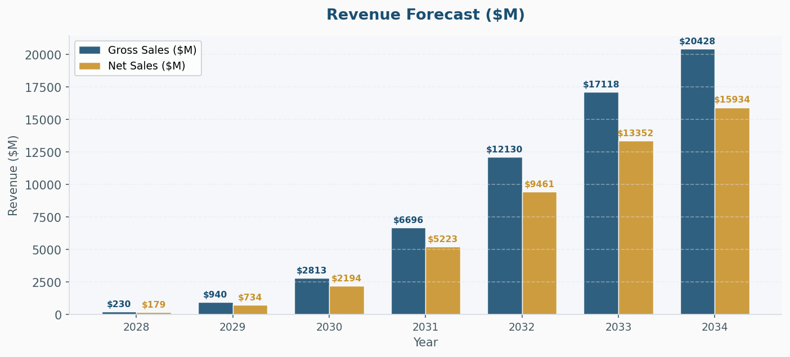
Revenue Forecast ($M)
KEY INSIGHT
The $4.5B spread between gross ($20.4B) and net sales ($15.9B) reflects substantial payer pressure and channel dynamics inherent to high-cost oncology therapeutics. Six-year ramp to peak reflects typical ADC adoption curves in NSCLC, balancing clinical validation, reimbursement negotiations, and competitive positioning through 2034.

Slide 7
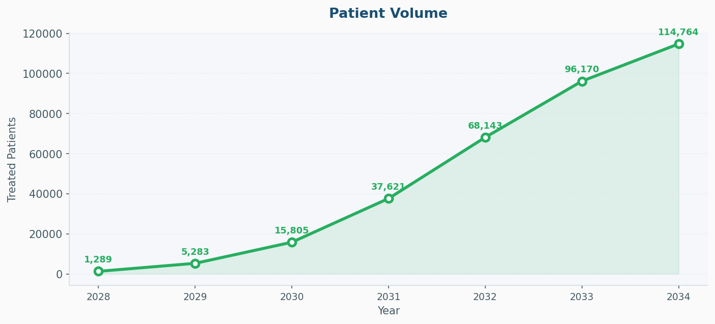
Patient Volume
KEY INSIGHT
Peak annual treatment of 114,764 patients translates to an implied per-patient net price of approximately $139K, positioning TUB-040 within the premium ADC pricing tier. This patient volume suggests meaningful market share capture within the eligible NSCLC population, though penetration remains constrained by standard-of-care competition and patient selection criteria.

Slide 8
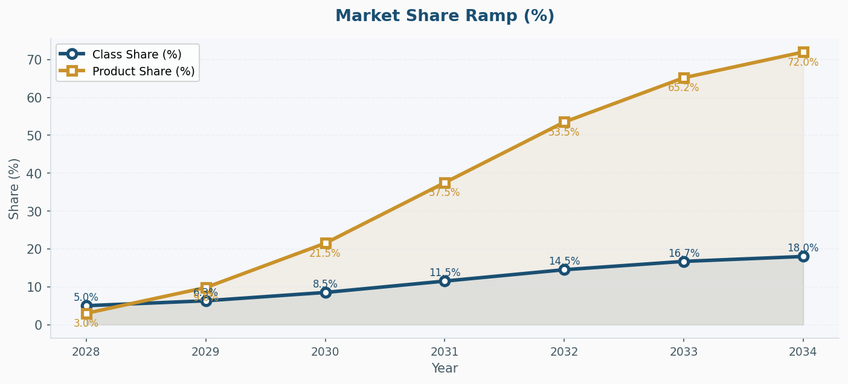
Market Share Ramp (%)

Slide 9
Year-by-Year Forecast Results
Metric | 2028 | 2029 | 2030 | 2031 | 2032 | 2033 | 2034
Eligible Pts | 1,101,815 | 1,107,324 | 1,112,861 | 1,118,425 | 1,124,017 | 1,129,637 | 1,135,285
Class % | 5.0% | 6.3% | 8.5% | 11.5% | 14.5% | 16.7% | 18.0%
Prod % | 3.0% | 9.8% | 21.5% | 37.5% | 53.5% | 65.2% | 72.0%
Treated Pts | 1,289 | 5,283 | 15,805 | 37,621 | 68,143 | 96,170 | 114,764
Cost / Pt | $178,000 | $178,000 | $178,000 | $178,000 | $178,000 | $178,000 | $178,000
Gross ($M) | $229.5 | $940.4 | $2813.2 | $6696.5 | $12129.5 | $17118.3 | $20427.9
Disc % | 22% | 22% | 22% | 22% | 22% | 22% | 22%
Net ($M) | $179.0 | $733.5 | $2194.3 | $5223.3 | $9461.0 | $13352.3 | $15933.8
RESULTS SUMMARY
TUB-040 represents a blockbuster-class asset with peak net sales of $15.9B and commercially viable patient economics. The 2028 launch trajectory through 2034 peak aligns with late-phase clinical timelines and competitive NSCLC market dynamics, with net price realization at 78% reflecting current market access headwinds.

