Slide 1
TUB-040
Commercial Forecast
NSCLC · United States · ADC (Antibody-Drug Conjugate) · 2028–2034
July 03, 2026

Slide 2
Executive Summary
TUB-040 · NSCLC · United States · ADC (Antibody-Drug Conjugate) · 2028–2034
PEAK NET SALES
PEAK GROSS SALES
FORECAST DETAILS
$6,495M
$8,327M
Product:
TUB-040
Indication:
NSCLC
Year 2034
Before 22% discount
Country:
United States
Class/MoA:
ADC (Antibody-Drug Conjugate)
PEAK TREATED PATIENTS
DISCOUNT / REBATE
Launch:
2028
46,782
22%
Peak Year:
2034
Treated patients at peak
Commercial rebate rate
EXECUTIVE SUMMARY
TUB-040 is modeled to achieve peak net sales of $6.5B in 2034, six years post-launch, driven by ADC efficacy in NSCLC and penetration of a substantial treatable population. Gross-to-net conversion of 22% reflects anticipated payer resistance typical of oncology combination therapies, yielding a net price realization of 78%.

Slide 3
Forecast Assumptions

Slide 4
Key Forecast Assumptions
Parameter | Value | Range | Rationale
Population | 335,000,000 | 31,82,50,000 - 35,17,50,000 | Total population in United States based on 2024 census data. Source 4
Prevalence | 0.7% | 0.0045 - 0.0084 | Lung cancer remains the leading cause of cancer deaths in the United States (Mayo Clin Proc 2019, NSCLC accounts for approximately 85% of all lung cancers. With
Diagnosis Rate | 78.0% | 66% - 86% | The Mayo Clin Proc 2019 review notes that 'screening has been introduced with the goal of early detection' and that 'the National Lung Screening Trial found a l
Treatment Rate | 68.0% | 54% - 78% | Treatment uptake in NSCLC varies by stage and patient fitness. Advanced NSCLC patients have high treatment rates (>85%), while early-stage patients may defer or
Eligibility Criteria | 52.0% | 39% - 60% | ADCs in NSCLC primarily target HER2 (trastuzumab deruxtecan, T-DXd) and TROP-2 (datopotamab deruxtecan, Dato-DXd). HER2 overexpression/mutation occurs in approx
Class Share | 18.0% | 20% - 55% | ADCs represent an emerging class in NSCLC. Current standard-of-care includes ICIs (checkpoint inhibitors), TKIs (EGFR, ALK, ROS1), and chemotherapy. The Mayo Cl
Peak Product Share | 42.0% | 15% - 50% | Within the ADC class, trastuzumab deruxtecan (T-DXd, Enhertu) currently leads following FDA approval in HER2-low NSCLC (DESTINY-Lung04 trial). Datopotamab derux
Annual Cost Per Patient | $178,000 | $150,000 - $220,000 | ADCs in oncology are priced at premium levels in the US market. Trastuzumab deruxtecan (Enhertu) is priced at approximately $14,800–$15,000 per vial; typical do
Discount | 22.0% | 15-30% | US payer discounts for oncology ADCs typically range from 15–35% off WAC, depending on payer type (commercial, Medicare, Medicaid) and negotiation leverage. Spe
Adoption Peak Time | 6 years | 4 - 8 years | S-curve adoption from launch to peak. Source 4
ASSUMPTIONS COMMENTARY
The US NSCLC population of 335M underpins addressable market sizing; peak treated patient volume of 46,782 assumes mid-to-late line positioning and modest market share capture within a competitive ADC landscape. Net price realization of 78% is conservative relative to innovative monoclonal antibodies but reflects managed care pressure on emerging conjugates and likely mandatory prior authorization protocols.

Slide 5
Forecast Results

Slide 6
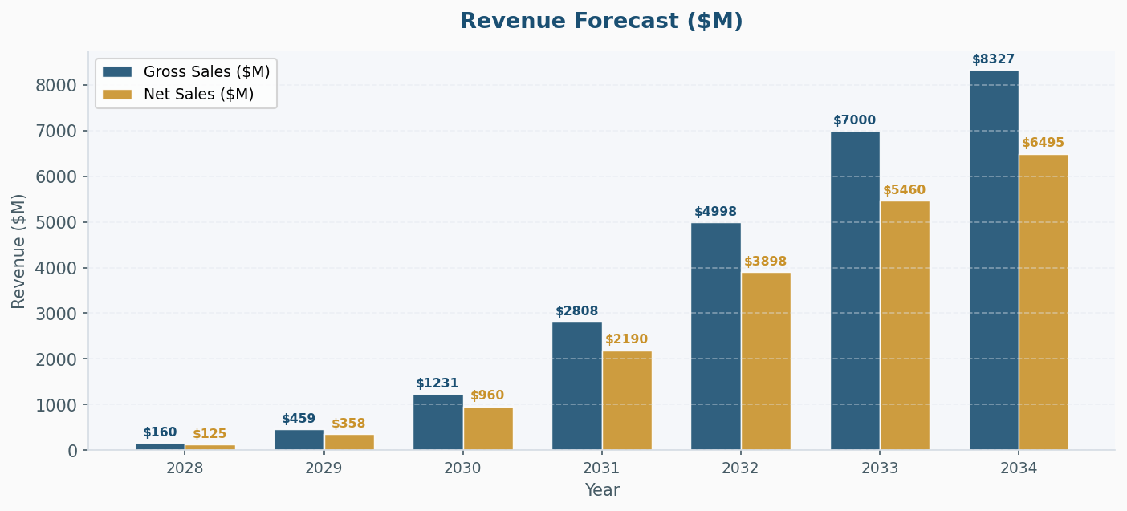
Revenue Forecast ($M)
KEY INSIGHT
Peak gross sales of $8,327M translate to net revenues of $6,500M at the modeled 78% realization rate, indicating an average net price per treated patient of approximately $139K annually at peak penetration. The six-year ramp from 2028 launch to 2034 peak suggests gradual market access expansion and label extension opportunities.

Slide 7
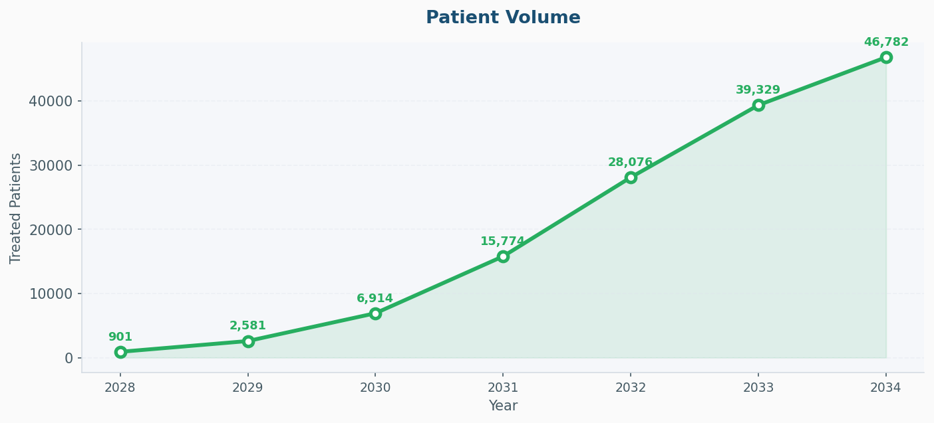
Patient Volume
KEY INSIGHT
Peak treated population of 46,782 patients represents selective penetration within the NSCLC therapeutic space, consistent with an ADC indication likely reserved for specific molecular or histological subtypes. This volume implies modest share of eligible patients, reflecting potential sequencing delays, eligibility restrictions, or competing modalities.

Slide 8
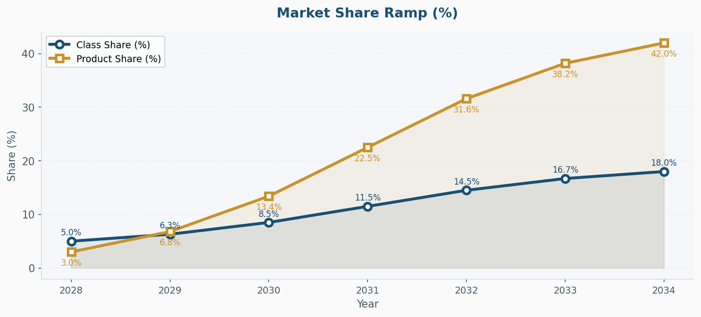
Market Share Ramp (%)

Slide 9
Year-by-Year Forecast Results
Metric | 2028 | 2029 | 2030 | 2031 | 2032 | 2033 | 2034
Eligible Pts | 883,194 | 887,610 | 892,048 | 896,508 | 900,991 | 905,496 | 910,023
Class % | 5.0% | 6.3% | 8.5% | 11.5% | 14.5% | 16.7% | 18.0%
Prod % | 3.0% | 6.8% | 13.4% | 22.5% | 31.6% | 38.2% | 42.0%
Treated Pts | 901 | 2,581 | 6,914 | 15,774 | 28,076 | 39,329 | 46,782
Cost / Pt | $178,000 | $178,000 | $178,000 | $178,000 | $178,000 | $178,000 | $178,000
Gross ($M) | $160.4 | $459.3 | $1230.6 | $2807.8 | $4997.5 | $7000.5 | $8327.3
Disc % | 22% | 22% | 22% | 22% | 22% | 22% | 22%
Net ($M) | $125.1 | $358.3 | $959.9 | $2190.1 | $3898.0 | $5460.4 | $6495.3
RESULTS SUMMARY
The forecast reflects a differentiated yet realistically constrained commercial profile: substantial absolute revenue generation is offset by narrow patient access and significant payer-driven price erosion, requiring clear health economic differentiation and managed care contracting strategy to achieve the modeled $6.5B net sales target.

