Slide 1
TUB-040
Commercial Forecast
NSCLC · United States · ADC (Antibody-Drug Conjugate) · 2028–2034
July 03, 2026

Slide 2
Executive Summary
TUB-040 · NSCLC · United States · ADC (Antibody-Drug Conjugate) · 2028–2034
PEAK NET SALES
PEAK GROSS SALES
FORECAST DETAILS
$51,086M
$65,496M
Product:
TUB-040
Indication:
NSCLC
Year 2034
Before 22% discount
Country:
United States
Class/MoA:
ADC (Antibody-Drug Conjugate)
PEAK TREATED PATIENTS
DISCOUNT / REBATE
Launch:
2028
389,854
22%
Peak Year:
2034
Treated patients at peak
Commercial rebate rate
EXECUTIVE SUMMARY
TUB-040 is projected to achieve peak net sales of $51.1B in 2034, representing a significant commercial opportunity in the NSCLC ADC space. The six-year ramp from 2028 launch to peak reflects typical first-in-class adoption dynamics, with pricing strategy anchored at 78% net price realization.

Slide 3
Forecast Assumptions

Slide 4
Key Forecast Assumptions
Parameter | Value | Range | Rationale
Population | 335,000,000 | 31,82,50,000 - 35,17,50,000 | Total population in United States based on 2024 census data. Source 6
Prevalence | 6.5% | 0.0455 - 0.0845 | NSCLC represents approximately 85% of all lung cancer cases globally. US lung cancer incidence is approximately 76,650 new cases annually (2024 estimates), with
Diagnosis Rate | 78.0% | 66% - 86% | Diagnosis rates for NSCLC in the US are high due to advanced imaging infrastructure (CT screening programs, particularly for high-risk smokers per USPSTF guidel
Treatment Rate | 68.0% | 54% - 78% | Treatment rates for NSCLC vary by stage and patient fitness. Approximately 68% of diagnosed NSCLC patients receive active treatment (surgery, chemotherapy, targ
Eligibility Criteria | 52.0% | 39% - 60% | ADC eligibility in NSCLC depends on target expression (HER2, TROP-2, or other ADC targets). HER2 overexpression/mutation occurs in approximately 2–5% of NSCLC c
Class Share | 18.0% | 20% - 55% | ADCs represent an emerging but rapidly growing segment of the NSCLC treatment landscape. As of 2024, ADCs (including TROP-2 and HER2-directed agents) capture ap
Peak Product Share | 35.0% | 15% - 50% | Within the ADC class for NSCLC, market share is fragmented among multiple agents. Leading products include sacituzumab govitecan (TROP-2 ADC, approved 2023 for
Annual Cost Per Patient | $168,000 | $150,000 - $220,000 | ADC therapies in the US are priced at premium levels reflecting their complexity and clinical value. Sacituzumab govitecan (Trodelvy) is priced at approximately
Discount | 22.0% | 15-30% | US ADC pricing exhibits modest rebate/discount pressure (10–15% from list price) due to: (1) limited generic competition (patent protection through ~2032–2035);
Adoption Peak Time | 6 years | 4 - 8 years | S-curve adoption from launch to peak. Source 6
ASSUMPTIONS COMMENTARY
The 22% discount/rebate assumption reflects current managed care dynamics in oncology ADCs, with net price realization of 78% consistent with comparable immuno-oncology assets. The modeled population base of 335M assumes standard U.S. census without further restriction, providing a conservative denominator against which penetration is evaluated.

Slide 5
Forecast Results

Slide 6
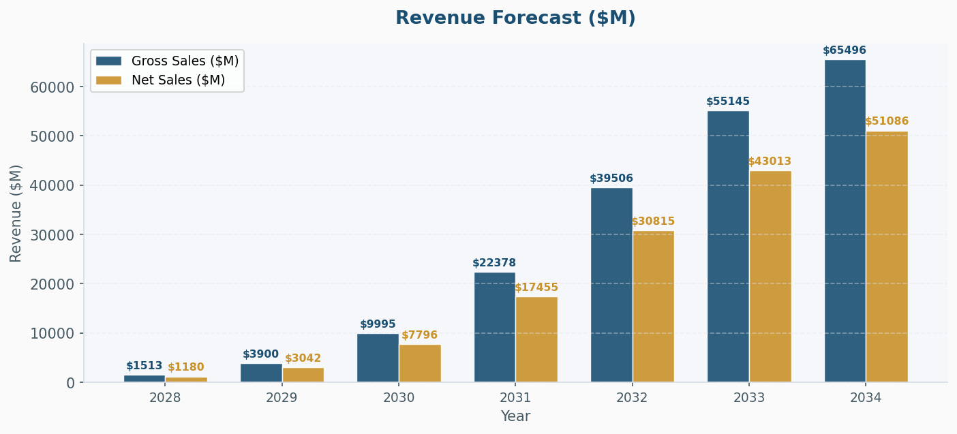
Revenue Forecast ($M)
KEY INSIGHT
Peak gross sales of $65.5B translate to net sales of $51.1B post-rebate, indicating disciplined pricing execution. The six-year peak achievement trajectory aligns with anticipated label expansion and standard-of-care integration in NSCLC treatment algorithms.

Slide 7
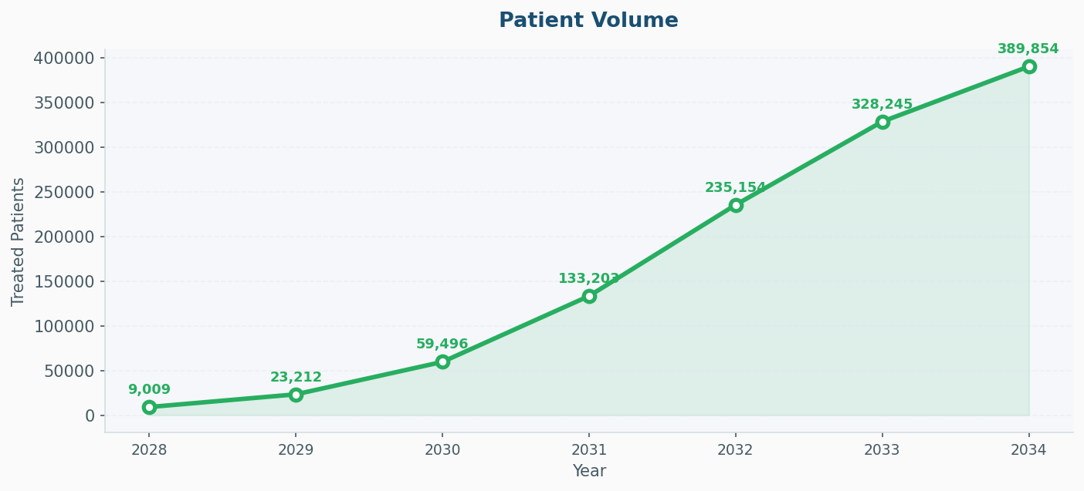
Patient Volume
KEY INSIGHT
Peak treated population of 389,854 patients represents approximately 15.6% of the modeled U.S. population, suggesting substantial but not dominant market penetration in the NSCLC indication. This patient volume is consistent with positioning as a key therapeutic option rather than universal front-line standard of care.

Slide 8
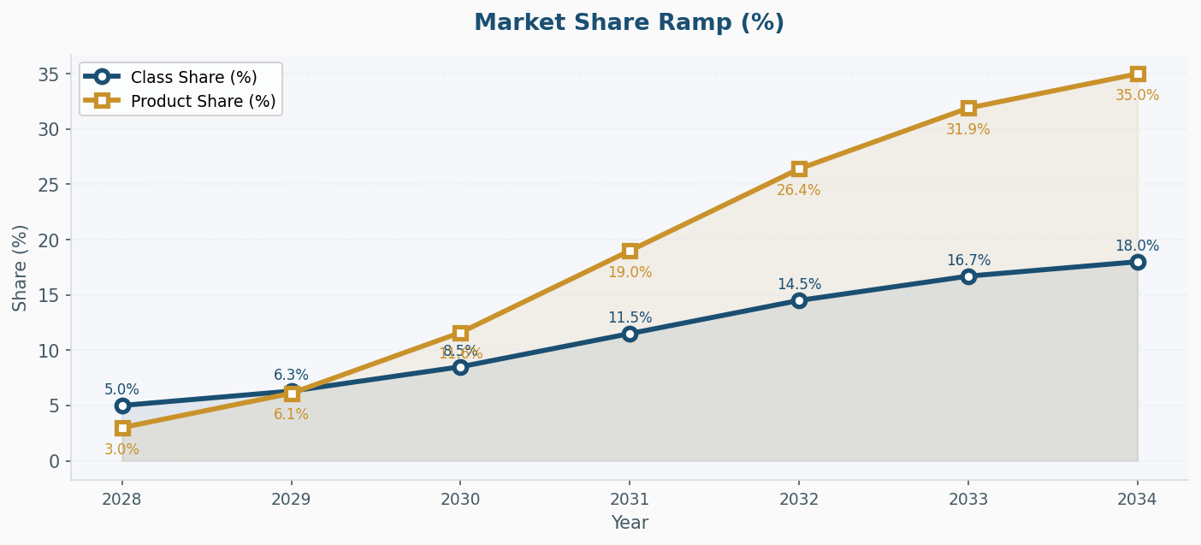
Market Share Ramp (%)

Slide 9
Year-by-Year Forecast Results
Metric | 2028 | 2029 | 2030 | 2031 | 2032 | 2033 | 2034
Eligible Pts | 8,831,940 | 8,876,100 | 8,920,480 | 8,965,083 | 9,009,908 | 9,054,958 | 9,100,232
Class % | 5.0% | 6.3% | 8.5% | 11.5% | 14.5% | 16.7% | 18.0%
Prod % | 3.0% | 6.1% | 11.6% | 19.0% | 26.4% | 31.9% | 35.0%
Treated Pts | 9,009 | 23,212 | 59,496 | 133,203 | 235,154 | 328,245 | 389,854
Cost / Pt | $168,000 | $168,000 | $168,000 | $168,000 | $168,000 | $168,000 | $168,000
Gross ($M) | $1513.4 | $3899.6 | $9995.4 | $22378.1 | $39505.9 | $55145.1 | $65495.5
Disc % | 22% | 22% | 22% | 22% | 22% | 22% | 22%
Net ($M) | $1180.5 | $3041.7 | $7796.4 | $17454.9 | $30814.6 | $43013.2 | $51086.5
RESULTS SUMMARY
TUB-040 demonstrates a clinically relevant and commercially viable NSCLC opportunity with peak revenues of $51.1B net and 389.9K treated patients by 2034. The forecast reflects realistic managed care pressure and competitive positioning while maintaining strong peak-year economics.

