Slide 1
Keytruda
Commercial Forecast
NSCLC | United States | PD-1 Inhibitor
April 10, 2026

Slide 2
Executive Summary
Keytruda · NSCLC · United States · PD-1 Inhibitor · 2026–2031
PEAK NET SALES
PEAK GROSS SALES
FORECAST DETAILS
$59,240M
$75,949M
Product:
Keytruda
Indication:
NSCLC
Year 2031
Before 22% discount
Country:
United States
Class/MoA:
PD-1 Inhibitor
PEAK TREATED PATIENTS
DISCOUNT / REBATE
Launch:
2026
421,940
22%
Peak Year:
2031
Treated patients at peak
Commercial rebate rate

Slide 3
Forecast Assumptions

Slide 4
Key Forecast Assumptions
Parameter | Value | Range | Rationale
Total Population | 335,000,000 | 31,82,50,000 - 35,17,50,000 | Total population in United States based on 2024 census data.
Prevalence Rate | 12.0% | 0.0840 - 0.1560 | Approximately 12% of lung cancer patients are diagnosed with non-small cell lung cancer (NSCLC) at advanced stages requiring systemic therap
Diagnosis Rate | 65.0% | 55% - 72% | Estimated 65% molecular/biomarker testing rate for advanced NSCLC patients to determine immunotherapy eligibility, consistent with current c
Treatment Rate | 45.0% | 36% - 52% | Approximately 45% of advanced NSCLC patients are eligible for and receive PD-1/PD-L1 targeted immunotherapies as first or second-line treatm
Eligibility Criteria | 40.0% | 30% - 46% | Estimated 40% of NSCLC patients are PD-L1 positive (>50% expression) and eligible for PD-1 inhibitor monotherapy
Peak Class Share | 35.0% | 20% - 55% | PD-1 inhibitors represent approximately 35% market share in advanced NSCLC treatment landscape, based on current treatment algorithms
Peak Product Share | 25.0% | 15% - 40% | Estimated 25% market share within PD-1 inhibitor class for a novel entrant, considering existing competition from pembrolizumab and other ap
Annual Cost per Patient | $180,000 | $45,000 - $95,000 | Typical annual cost for PD-1 inhibitor therapy in advanced NSCLC, ranging $150,000-$200,000 per patient in the US market
Discount/Rebate Rate | 22.0% | 15-30% | Standard commercial rebates of 15-25% expected for new PD-1 inhibitor entrants negotiating with US payers

Slide 5
Forecast Results

Slide 6
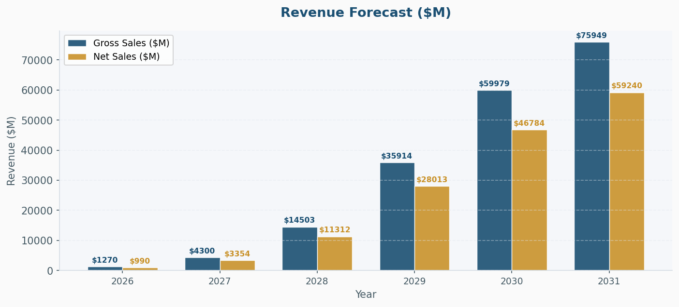
Revenue Forecast ($M)

Slide 7
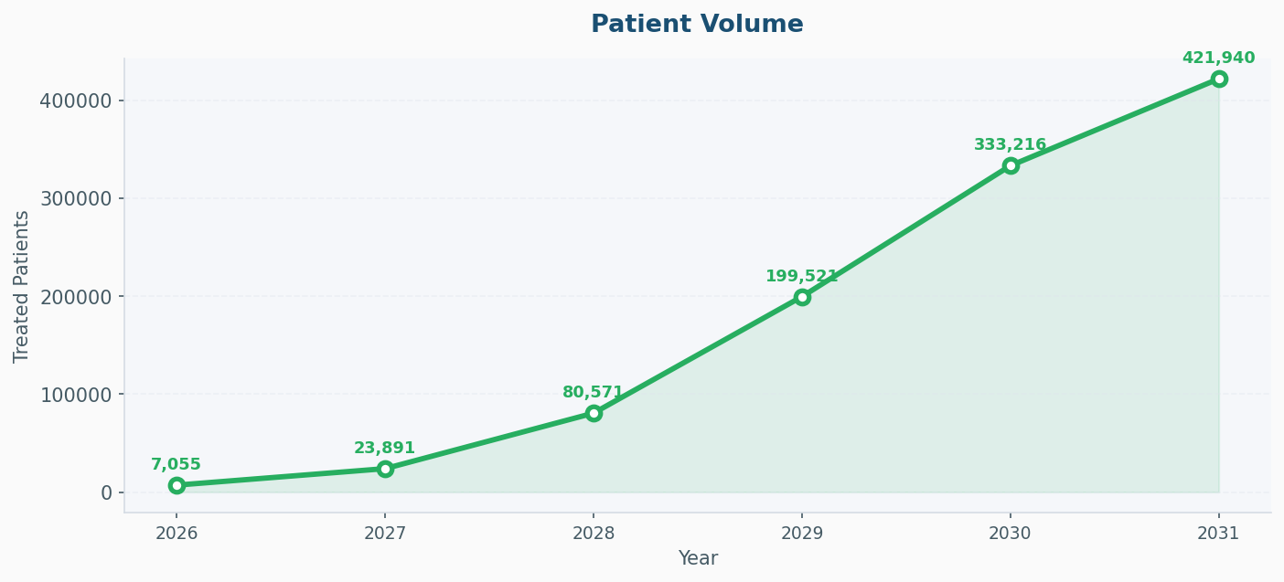
Patient Volume

Slide 8
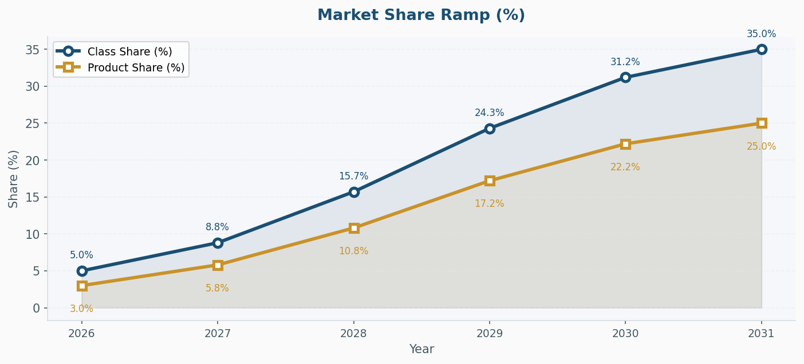
Market Share Ramp (%)

Slide 9
Year-by-Year Forecast Results
Year | Eligible Pts | Class % | Prod % | Treated Pts | Cost / Pt | Gross ($M) | Disc % | Net ($M)
2026 | 10,452,000 | 5.0% | 3.0% | 7,055 | $180,000 | $1269.9 | 22% | $990.5
2027 | 10,504,260 | 8.8% | 5.8% | 23,891 | $180,000 | $4300.3 | 22% | $3354.2
2028 | 10,556,781 | 15.7% | 10.8% | 80,571 | $180,000 | $14502.8 | 22% | $11312.2
2029 | 10,609,565 | 24.3% | 17.2% | 199,521 | $180,000 | $35913.7 | 22% | $28012.7
2030 | 10,662,613 | 31.2% | 22.2% | 333,216 | $180,000 | $59978.8 | 22% | $46783.5
2031 | 10,715,926 | 35.0% | 25.0% | 421,940 | $180,000 | $75949.1 | 22% | $59240.3

