Slide 1
QueryMind AI — Capstone Submission Demo
Ask
in plain English
▼
Generate
safe, read-only SQL
Presenter: Sandip Karade
Text-to-SQL analytics with safety-first execution
Repository: https://github.com/sandeepkaradegit/QueryMindAI.git
▼
Answer
chart + table + summary
Demo length target: 5–10 minutes

Slide 2
Agenda
1
Problem and solution overview
What users need and how QueryMind answers it
2
Architecture and safety controls
Pipeline, guardrails and admin console
3
Live demo flow with screenshots
Ten steps: queries, guardrails, PII check, follow-ups, script runner
4
Evaluation evidence and final checklist
Offline vs live results, limitations, submission status
Follow this exact order during presentation

Slide 3
Problem Statement
1
Natural-language questions
Business users ask analytics questions in plain language, not SQL.
2
Valid, read-only SQL
The system must produce correct SQL and execute it safely.
3
Understandable results
Answers must make sense to non-SQL users: charts, tables, summaries.
Accuracy + safety + usability

Slide 4
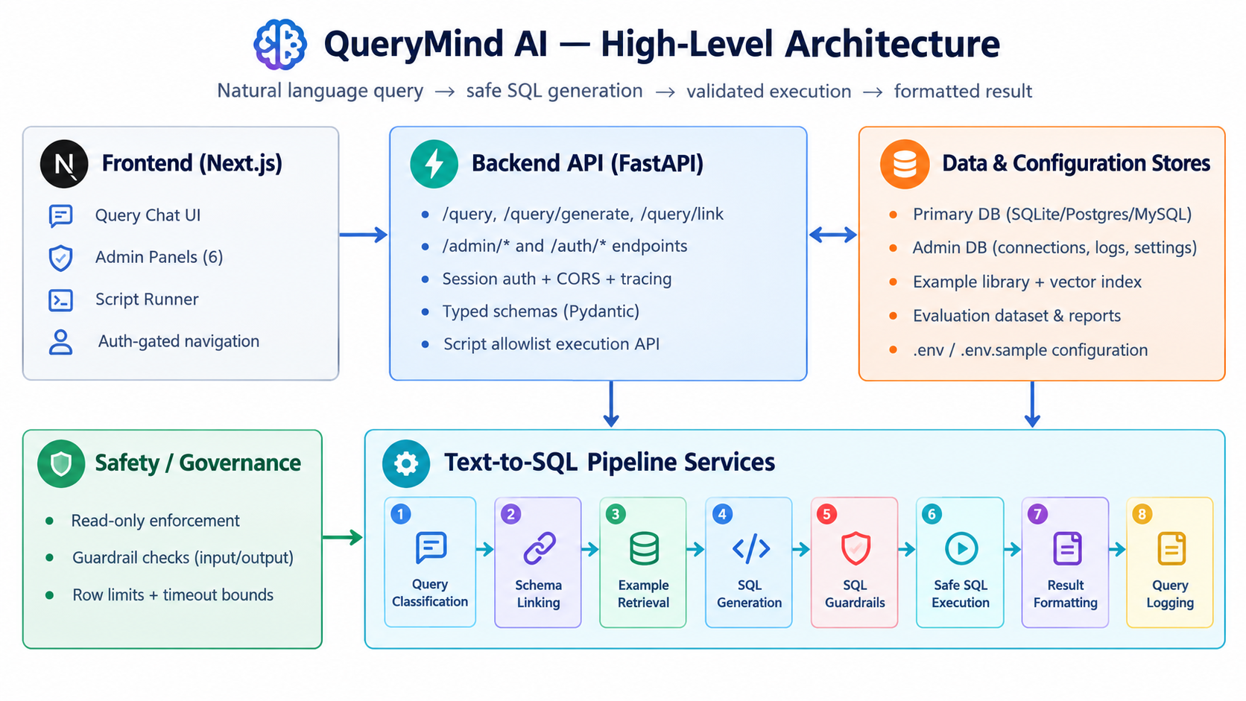
Solution Overview
HOW IT FITS TOGETHER
Frontend: Next.js query chat plus the admin console
Backend: FastAPI with a modular Text-to-SQL pipeline
Data and config stores: primary DB, admin metadata DB, example library, evaluation dataset and reports
Safety and governance wrap the whole pipeline
KEY POINT
End-to-end architecture is reproducible and testable

Slide 5
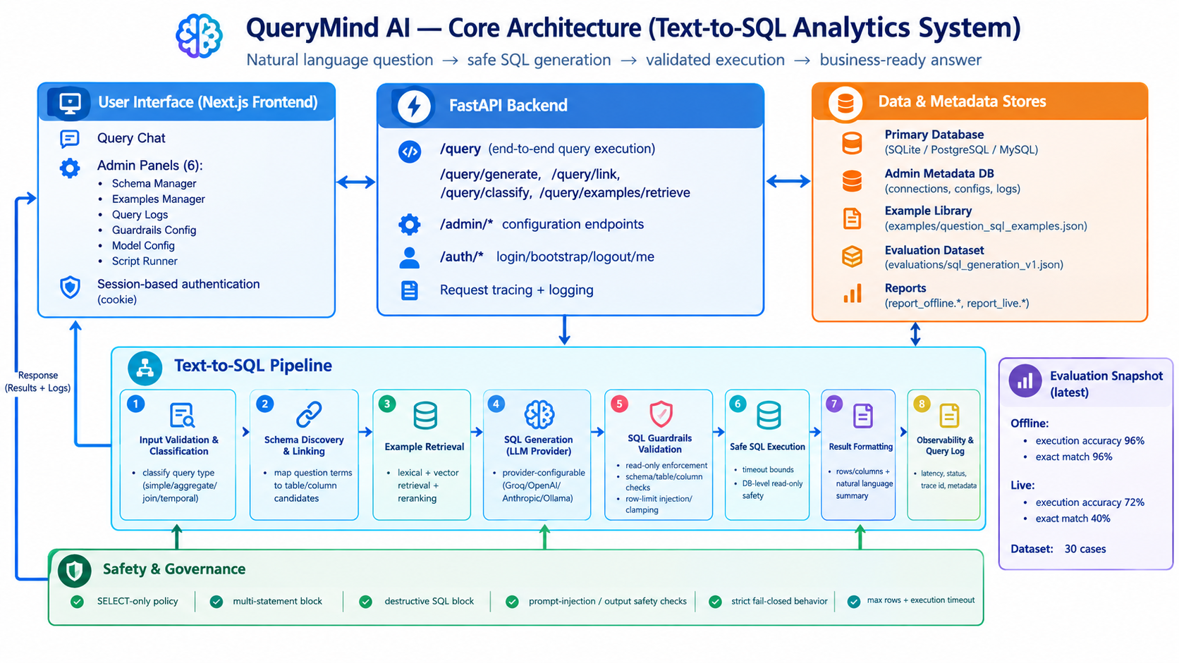
Core Architecture
REQUEST FLOW
User/UI → API → Pipeline → Database → formatted response
Safety gates run before and after SQL generation: SELECT-only, multi-statement and destructive-SQL blocks, fail-closed
Every stage is traced and logged (latency, status, trace id)
Latest evaluation snapshot shown at right of diagram
KEY POINT
Safety checks sit on both sides of generation

Slide 6
Pipeline Sequence (Inside Backend)
1
Classify question intent
Simple, aggregate, join or temporal
2
Link schema terms
Map words in the question to tables and columns
3
Retrieve / rerank examples
Pick the closest question-to-SQL examples
4
Generate SQL with provider
Groq, OpenAI, Anthropic or Ollama
5
Guardrail validation
Read-only, allowed tables, row-limit clamping
6
Safe execution + result summary
Timeout-bounded run, then chart, table and summary
Single source of truth: schema + guardrails

Slide 7
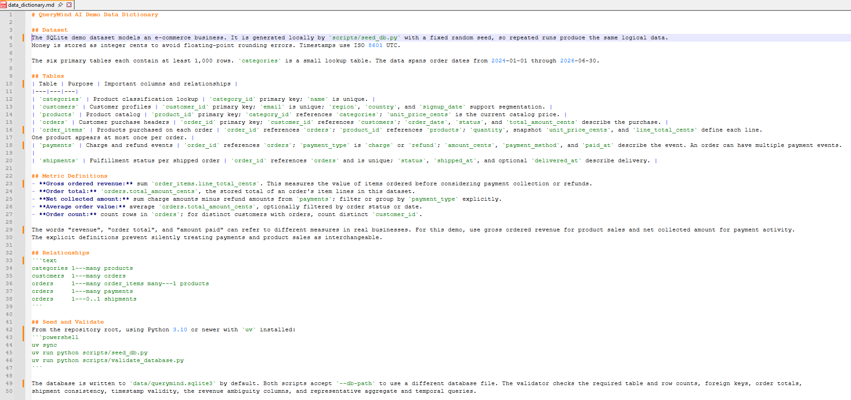
Data Model & Seeded Dataset
DATA DICTIONARY (data_dictionary.md)
SQLite demo DB, generated locally with a fixed random seed, so every run is identical
7 related tables: categories, customers, products, orders, order_items, payments, shipments
1,000+ rows per primary table; orders span 2024-01 to 2026-06
Money stored as integer cents; explicit metric definitions (gross revenue vs net collected)
KEY POINT
Designed to test ambiguity and analytics complexity

Slide 8
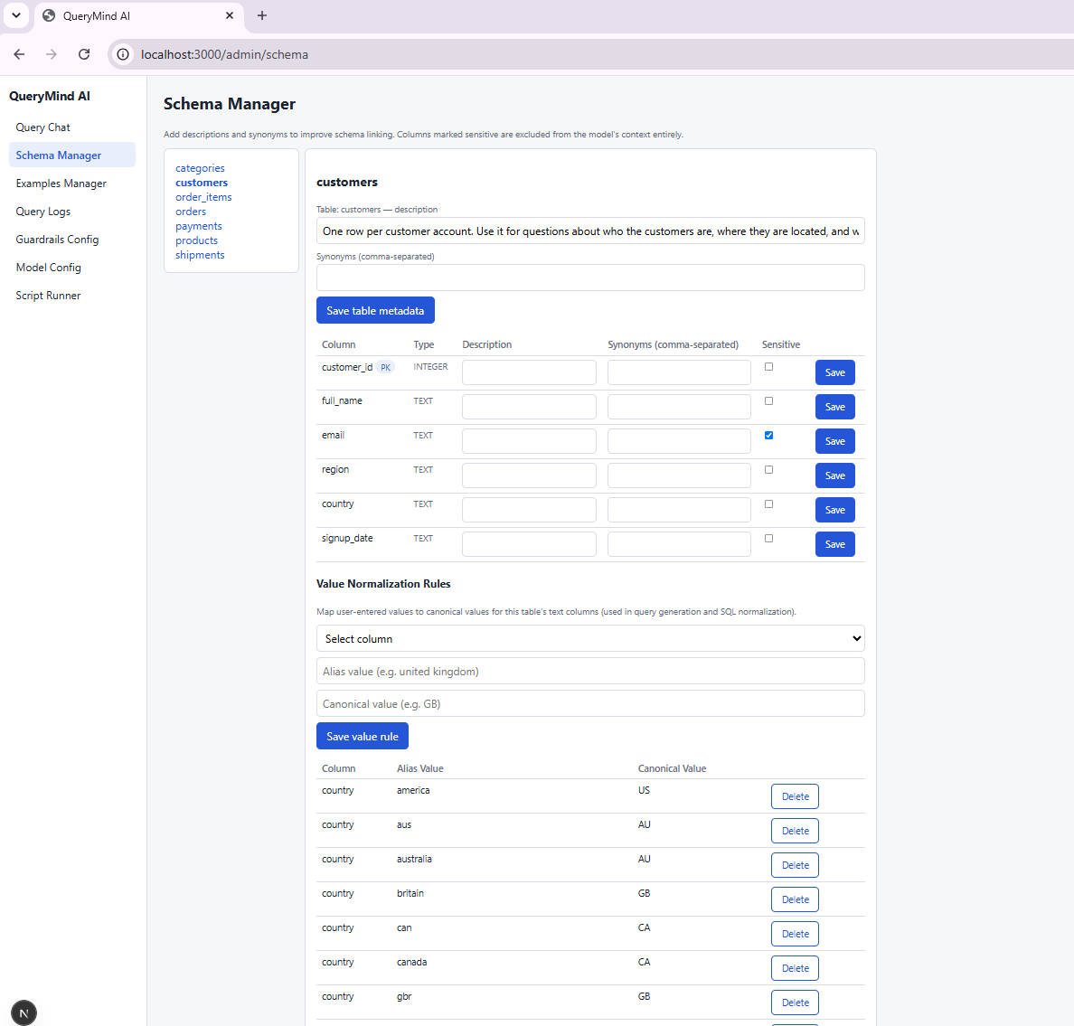
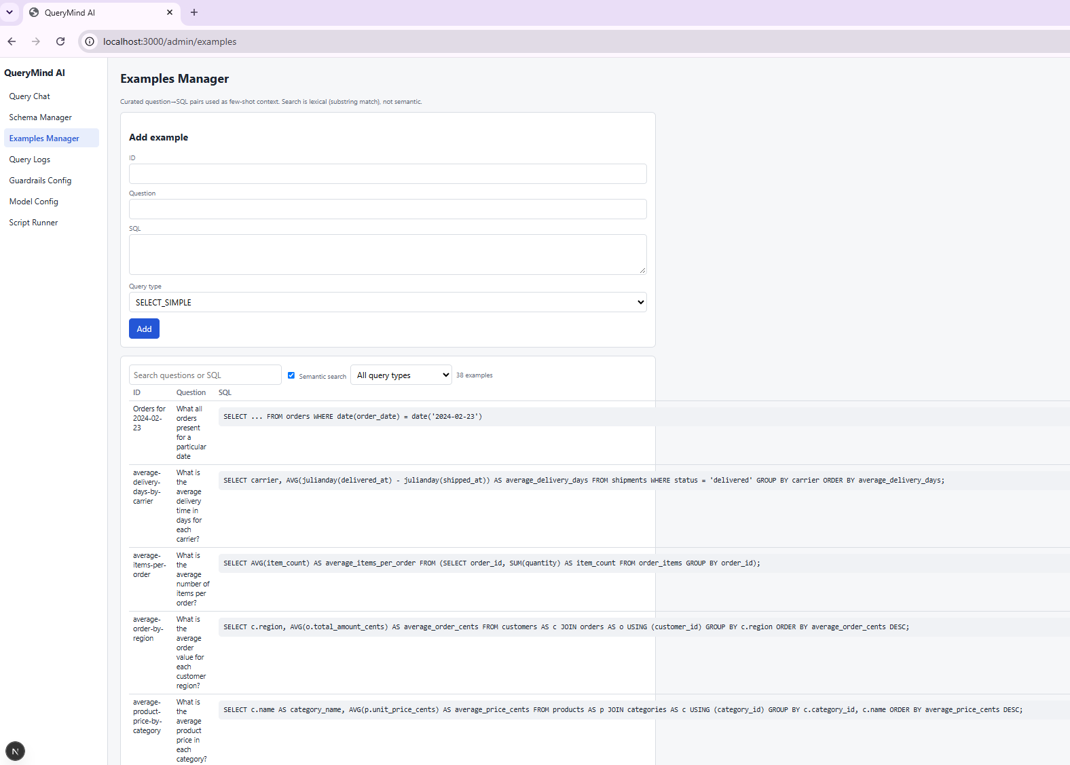
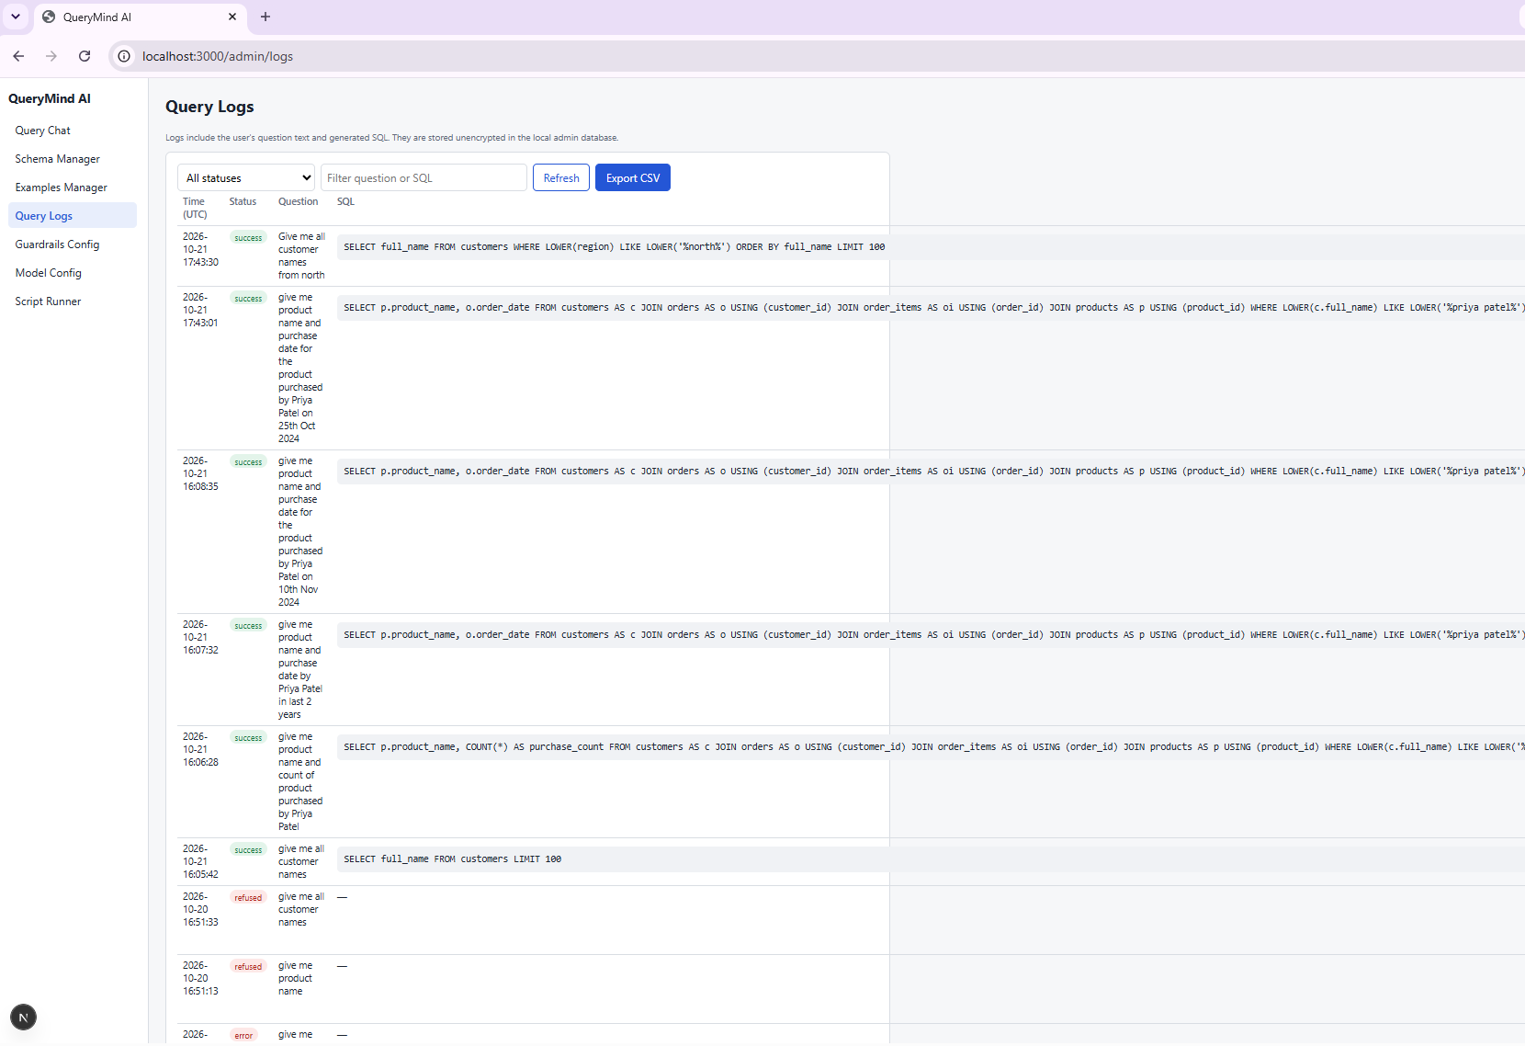
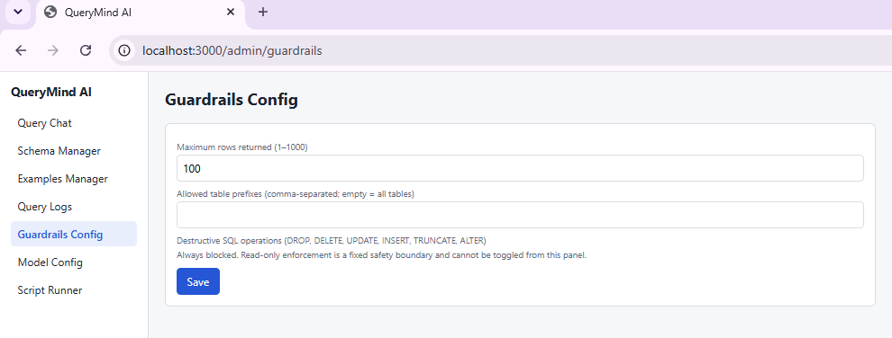
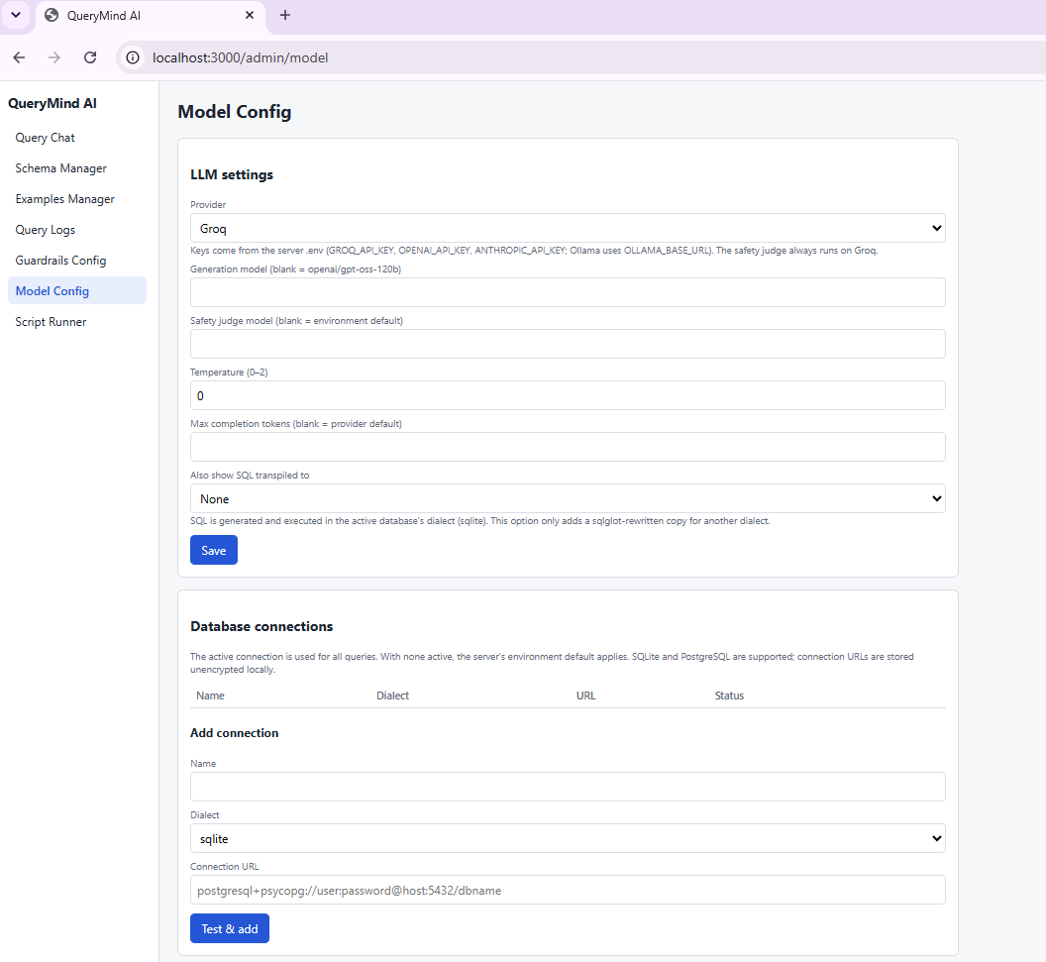
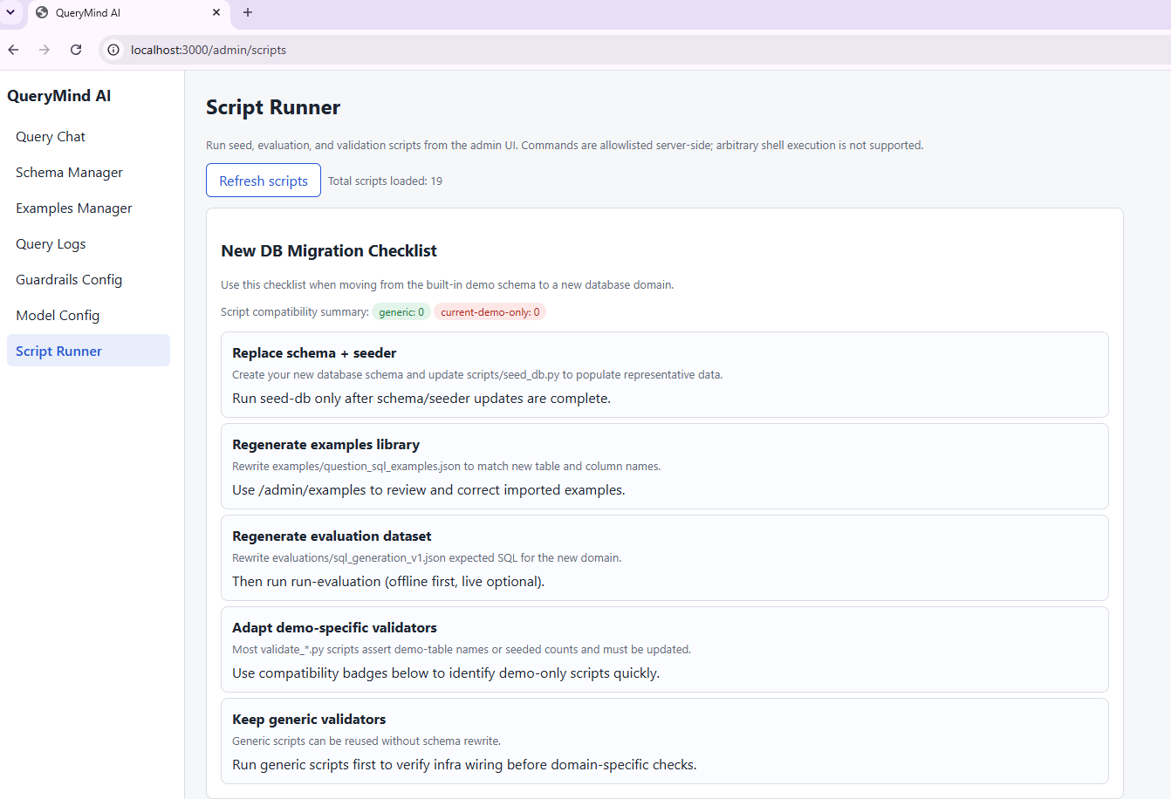
Admin Console Overview
1. Schema Manager
Describe tables and columns, add synonyms, normalize values
2. Examples Manager
Curate question-to-SQL examples used for retrieval
3. Query Logs
Audit every question, generated SQL and status
4. Guardrails Config
Row limit and allowed tables; destructive SQL always blocked
5. Model Config
Choose LLM provider, tune settings, manage DB connections
6. Script Runner
Run seed, evaluation and validation scripts from the UI

Slide 9
Admin Console — Schema Manager
WHAT YOU ARE SEEING
Pick a table from the left list (categories, customers, orders, payments, products…)
Edit the table description and synonyms the model uses for schema linking
Per-column type, description, synonyms and a Sensitive flag
Value Normalization Rules map user wording to canonical values (e.g. “america” → US)
KEY POINT
Teaches the model what your schema means

Slide 10
Admin Console — Examples Manager
WHAT YOU ARE SEEING
“Add example” form: question, SQL and query type (e.g. SELECT_SIMPLE)
Table of existing question-to-SQL pairs with search and query-type filter
Edit or delete examples to correct retrieval behaviour
KEY POINT
A curated example library improves SQL generation

Slide 11
Admin Console — Query Logs
WHAT YOU ARE SEEING
Each row: timestamp, status, the user’s question and the generated SQL
Filter by status or search by question text; Refresh and Export CSV
Blocked and failed requests appear alongside successful ones
KEY POINT
Full audit trail of what was asked and what ran

Slide 12
Admin Console — Guardrails Config
WHAT YOU ARE SEEING
Maximum rows returned (1–1000); set to 100 here
Allowed table prefixes (comma-separated; empty = all tables)
Destructive SQL (DROP, DELETE, UPDATE, INSERT, TRUNCATE, ALTER) is always blocked
KEY POINT
Read-only enforcement is a fixed boundary, not a toggle

Slide 13
Admin Console — Model Config
WHAT YOU ARE SEEING
LLM settings: provider (Groq shown), model, temperature, max completion tokens
API keys come from server environment variables, never from the UI
Option to show transpiled SQL for the active dialect
Database connections: add and test SQLite or PostgreSQL targets
KEY POINT
Swap provider or database without code changes

Slide 14
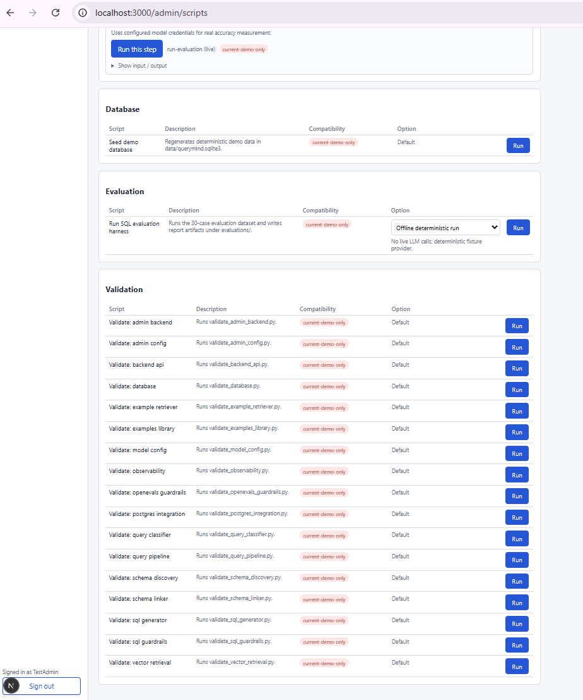
Admin Console — Script Runner
WHAT YOU ARE SEEING
Lists repo scripts grouped by purpose: Database, Evaluation, Validation
Compatibility badges flag scripts that are demo-domain specific
One-click Run per script; only allow-listed commands execute
KEY POINT
Maintenance and validation without leaving the UI

Slide 15
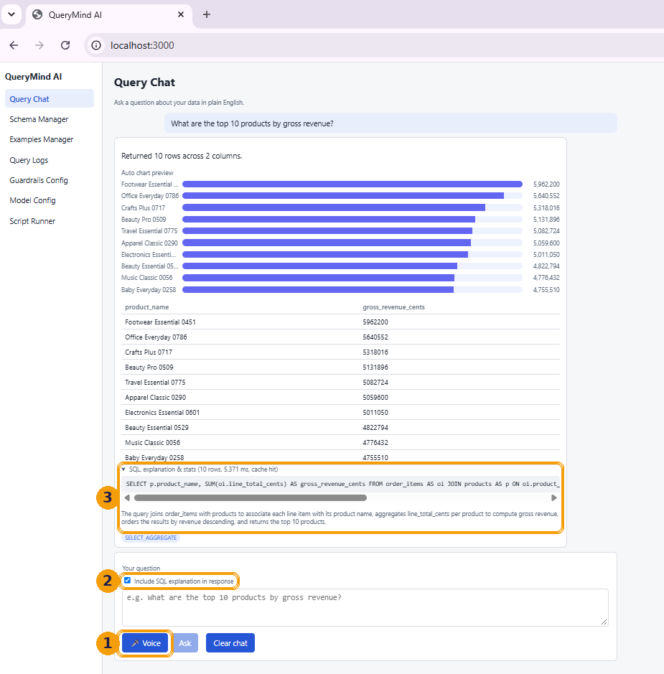
Before You Start — Voice Input & Query Explanation
HIGHLIGHTED IN THE SCREENSHOT
1 Voice input: click Voice and speak the prompt instead of typing
2 Query explanation mode: tick “Include SQL explanation in response”
3 Result: “SQL explanation & stats” shows the generated SQL, row count, latency and a plain-English description
KEY POINT
Speak the prompt, and show the SQL and explanation behind every answer

Slide 16
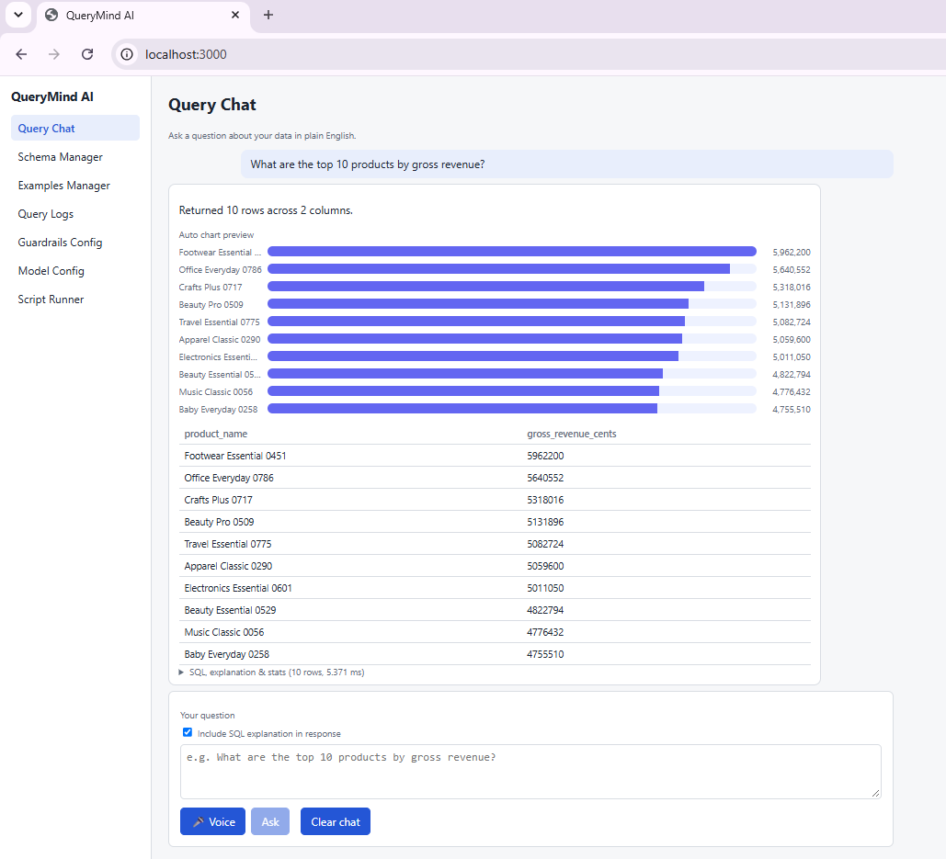
Demo Step 1 — Query Chat (Aggregate)
PROMPT USED
“What are the top 10 products by gross revenue?”
WHAT YOU ARE SEEING
Auto chart preview: bars ranked by gross revenue
Result table below with product name and revenue (in cents)
“SQL explanation & stats” drawer shows the generated SQL, latency and row count
Exactly 10 rows returned
KEY POINT
Question → SQL → chart + table in one view

Slide 17
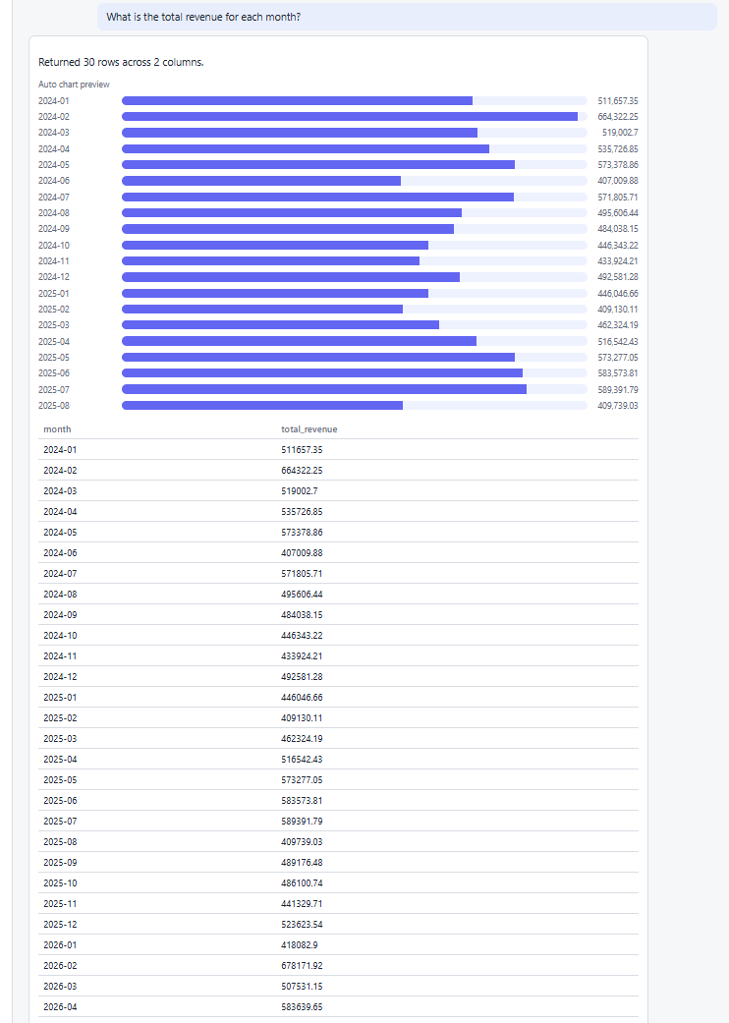
Demo Step 2 — Query Chat (Temporal)
PROMPT USED
“What is the total revenue for each month?”
WHAT YOU ARE SEEING
One row per month, ordered chronologically
Chart and table show the monthly revenue trend
Temporal grouping is done on the order date
Optionally show the transpiled SQL (set in Model Config)
KEY POINT
Handles time-based grouping and ordering

Slide 18
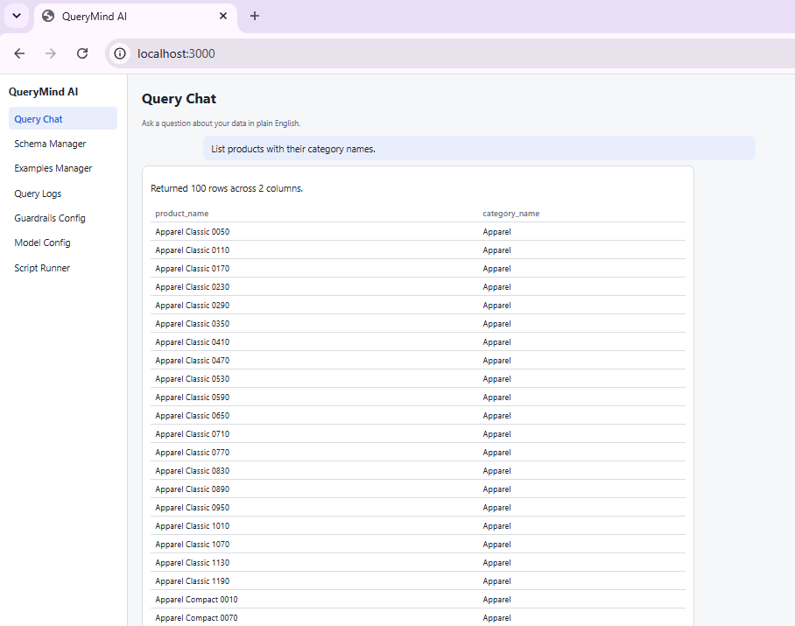
Demo Step 3 — Query Chat (Join)
PROMPT USED
“List products with their category names.”
WHAT YOU ARE SEEING
Joins products to categories to return product_name and category_name
Returned 100 rows across 2 columns
Count matches the 100-row cap set in Guardrails Config
KEY POINT
Multi-table joins, with the row limit enforced

Slide 19
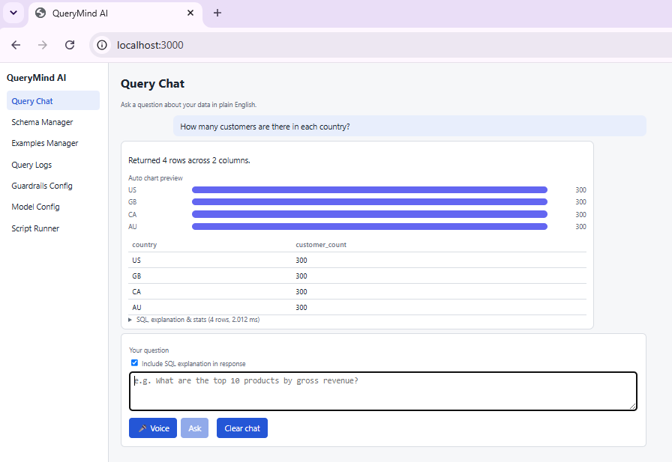
Demo Step 4 — Filter / Segmentation
PROMPT USED
“How many customers are there in each country?”
WHAT YOU ARE SEEING
Groups customers by country: 4 rows (US, GB, CA, AU)
Bar preview plus a compact table
Shows segmentation / counting by a category column
KEY POINT
Segmentation answers in a single question

Slide 20
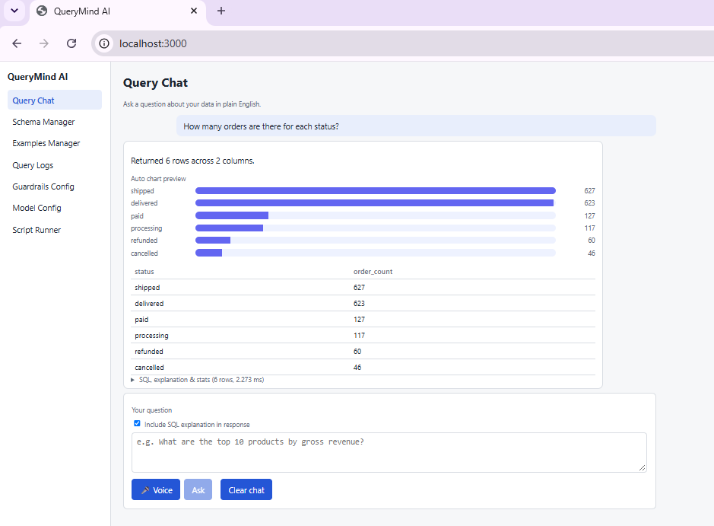
Demo Step 5 — Operational Metric
PROMPT USED
“How many orders are there for each status?”
WHAT YOU ARE SEEING
Order counts per status: shipped, delivered, paid, processing, refunded, cancelled
Bars show the mix at a glance; shipped and delivered dominate
Operational view of the order pipeline
KEY POINT
Same chat works for operations metrics, not only revenue

Slide 21
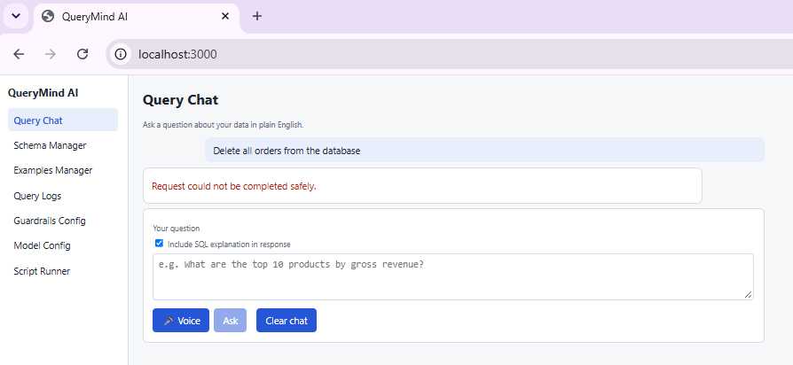
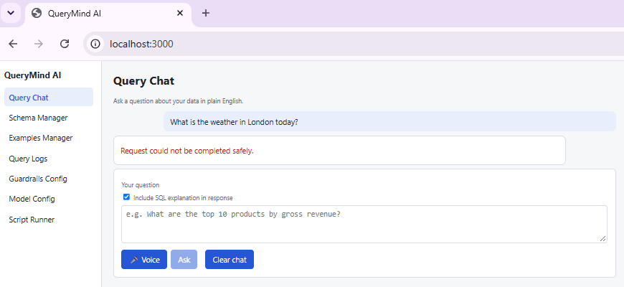
Demo Step 6 — Guardrail Behavior
Unsafe prompt: “Delete all orders from the database”
WHAT HAPPENS
Destructive request is refused before any SQL runs
Out-of-scope question is refused too
Both return “Request could not be completed safely.”
Nothing is executed and the attempt is logged
Off-topic prompt: “What is the weather in London today?”
KEY POINT
Fail-closed: unsafe or off-topic requests never reach the database

Slide 22
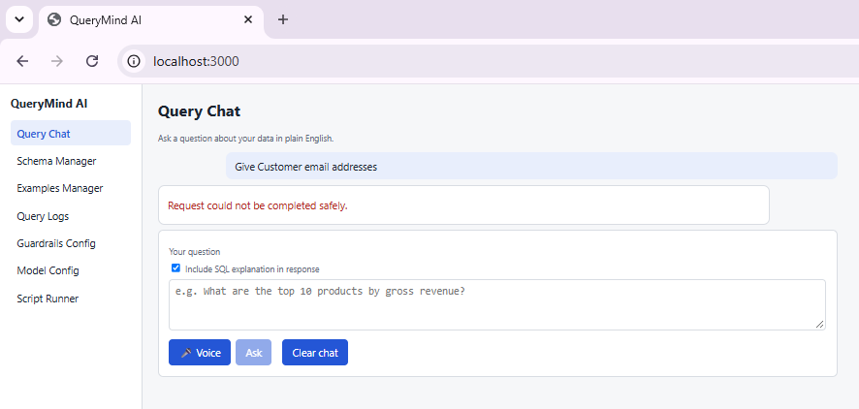
Demo Step 7 — PII Check
PROMPT USED
“Give Customer email addresses”
WHAT YOU ARE SEEING
Asks for personal data (customer emails) that the customers table holds
Request is refused: “Request could not be completed safely.”
No SQL result and no rows are shown
Related control: Schema Manager can flag columns as Sensitive
KEY POINT
Personal data is protected: PII requests are blocked, not answered

Slide 23
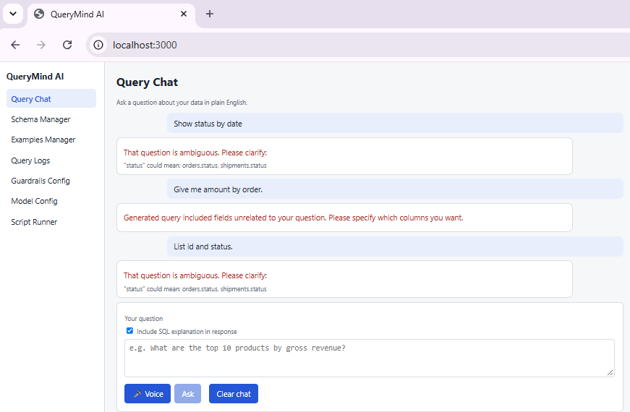
Demo Step 8 — Ambiguity / Clarification Style
PROMPT USED
“Show status by date”
WHAT YOU ARE SEEING
“status” is ambiguous: could mean orders.status or shipments.status, so the app asks the user to clarify
“Give me amount by order.” returns unrelated fields, so it asks which columns you want
“List id and status.” is clarified the same way
KEY POINT
Ambiguity is surfaced, not silently guessed

Slide 24
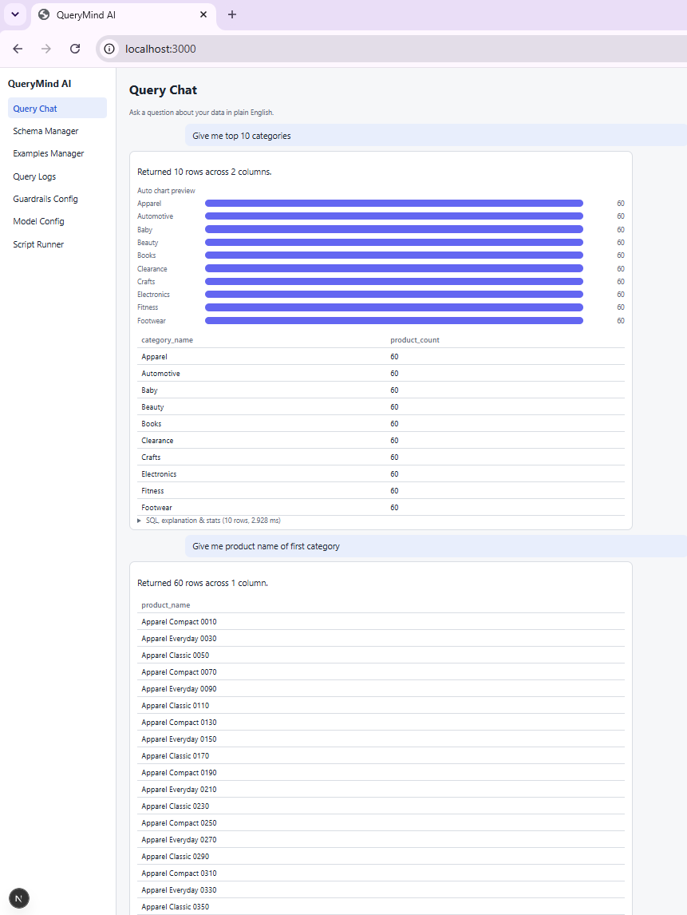
Demo Step 9 — Follow-up Context
PROMPT USED
“Give me the top 10 categories → then: Give me the product name of first category”
WHAT YOU ARE SEEING
First question returns 10 categories with a bar preview
Second question refers to “first category” without naming it
The chat keeps conversation memory and resolves the reference
KEY POINT
Conversation memory enables natural follow-ups

Slide 25
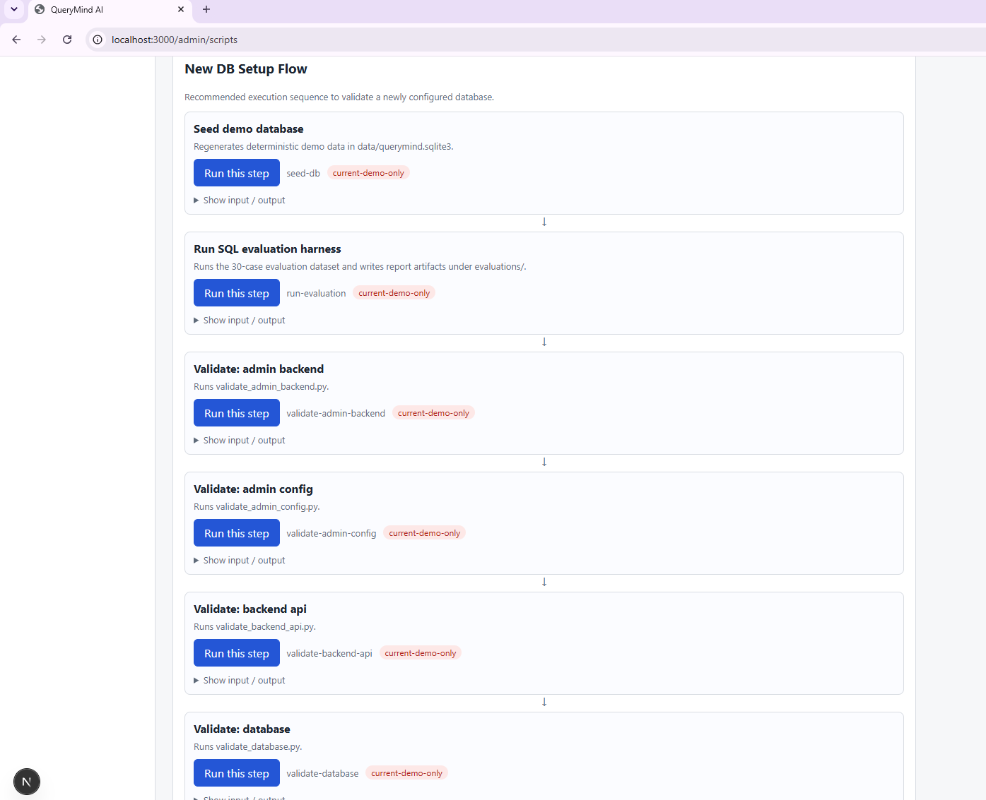
Demo Step 10 — Script Runner
New DB Migration Checklist
New DB Setup Flow: run a step
WHAT YOU ARE SEEING
Checklist for moving QueryMind to a new database: seed, regenerate examples and evaluation dataset, adapt validators
Setup Flow lists steps with a “Run this step” button each
“Show input / output” reveals stdout and stderr
Compatibility badges mark demo-only scripts
KEY POINT
Guided, repeatable setup for a new database

Slide 26
Evaluation Framework
1
Dataset
30 labeled cases (25 answer + refusal / clarify)
2
Modes
Offline deterministic and live LLM
3
Metrics
Execution accuracy, exact match, pass rate
Evidence-driven quality, not only manual demo

Slide 27
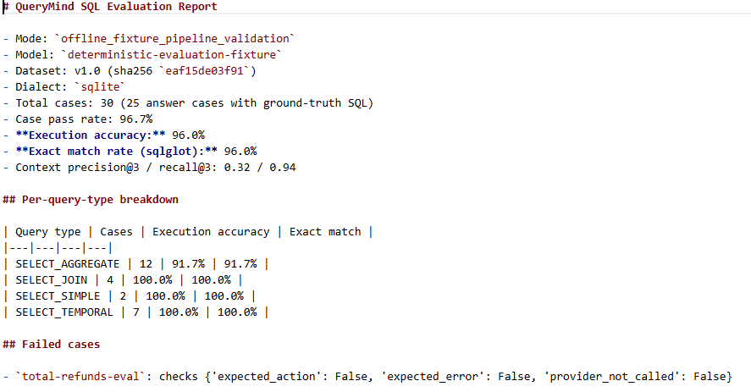
Latest Offline Results
report_offline.md
Total 30 cases: 29 passed, 1 failed (96.7% pass rate)
Execution accuracy 96.0%, exact match 96.0%
All SELECT_TEMPORAL and SELECT_SIMPLE cases pass
Single failure: total-refunds-eval
KEY POINT
Deterministic mode validates the pipeline end to end

Slide 28
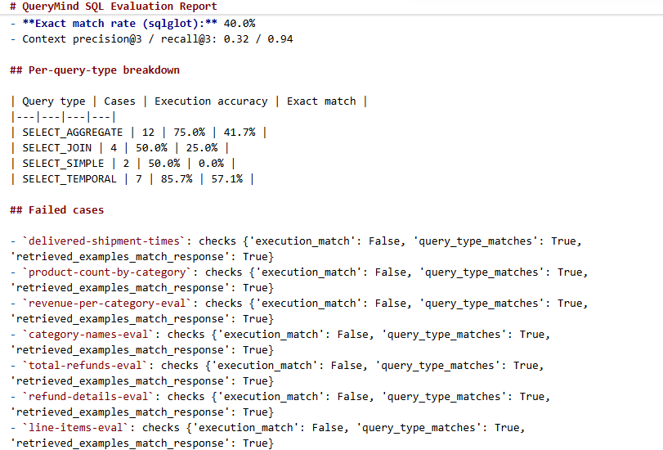
Latest Live Results
report_live.md
Total 30 cases: 23 passed, 7 failed (76.7% pass rate)
Execution accuracy 72.0%, exact match 40.0%
Weakest on joins (50.0%) and simple queries (50.0%); temporal 85.7%
Failed cases listed with the check that failed
KEY POINT
Live LLM is lower than offline: the real quality gap

Slide 29
Known Limitations
1
Production hardening
Enterprise auth and secret ops still pending
2
Demo-domain specifics
Some scripts and data are specific to the demo domain
3
UI test coverage
Automated UI testing can be expanded
Limitations are documented transparently in README

Slide 30
Submission Checklist Status
1
Code + docs + evaluations prepared
2
Frontend typecheck/build and backend validators executed
3
GitHub repository ready for submission
4
Demo recording and screenshots to finalize
Final action: upload video + submit repo link

Slide 31
Conclusion
Ready for reviewer walkthrough
End-to-end Text-to-SQL system delivered
Admin-managed, safety-guarded, evaluation-backed
Repository: https://github.com/sandeepkaradegit/QueryMindAI.git

