Slide 1


Advanced Database Management Systems Project
Group-7:
Sandeep Karanam_U94742075
Sandeep Reddy Nimma_U53426553
Greeshma Namana_U24918180
Rohit Vadlala_U93298968
Professor Clinton Daniel
University of South Florida

Slide 2
A detailed description of the
Database Management System
MariaDB

Slide 3
MariaDB
Free, open-source database system launched in 2009
Developed by Michael “Monty” Widenius, creator of MySQL
Considered as a fork and a drop-in replacement of MySQL
Developed because of concerns about the future of MySQL under Oracle’s management

Slide 4
Key Features
Improved Performance and Scalability
Aria Storage Engine
Reliability & Duplication
Enhanced SQL & Schema Features
JSON Handling
Expandability
Diverse Storage Options
Robust Security Measures

Slide 5
Core Functions
Data Retrieval: Index Structures, Query Optimizer, Buffer Pool, Read-Ahead Techniques
Data Manipulation: INSERT, UPDATE, DELETE, MERGE, LOAD DATA INFILE, DELAYED INSERTS
Data Integrity and Accuracy: PRIMARY KEY, FOREIGN KEY, UNIQUE, CHECK, NOT NULL, Atomicity, Consistency, Isolation, Durability
Concurrency Control: Versioned Records, Read Consistency, Phantom Reads Prevention, Row-level Locking, Shared and Exclusive Locks, Deadlock Detection
Redundancy Removal: Normalization, Decomposition, Referential Integrity, Storage Engines
Data Independence: Logical Data Independence, Physical Data Independence
Data Relationships: Foreign Keys, Referential Actions, Consistency Maintenance, Indexed Foreign Keys, Join Operations, Optimization

Slide 6
Advantages
Supports more storage engines, giving more user options
Can handle a larger number of connections, beneficial for high-traffic scenarios
Replication in MariaDB is twice as fast as in MySQL
Generally faster and easier to work
Allows creation of versioned tables, useful for managing historical data
Offers compatibility features with Oracle Database, thus easy user switching from Oracle
Supports a columnar storage format
Provides a distributed SQL database solution called MariaDB Xpand

Slide 7
A detailed description of the
KDDNuggets referenced data

Slide 8
About the Dataset: Bank Database Design
Objective
The primary goal of the bank database is to ensure seamless bank operations, focusing on the bank's structure, effective client interactions, and efficient data handling.
Data Source
The database is derived from the KDDNuggets referenced data
Consists of multiple discrete datasets, each related to various financial activities and transactions
Database Structure
To implement our strategy, we first create unique entities in the database, each corresponding to a different dataset.
These entities have appropriate preservation of the relationships and underlying structure among the various forms of banking information

Slide 9
Advantages of this Structured Methodology
Get valuable insights from the bank dataset
Improves the data management process overall
Enables us to monitor financial movements, examine transactional trends, examine client behavior
Offer insightful information to assist strategic decision-making in the financial industry.

Slide 10
About the Dataset: Bank Database Design
Unique Entities
Key Relationships
Additional Features
Optimization Strategies
Account: Represents client banking accounts
Account Types: Describes various account types
Branches: Provides information about bank branches
Clients: Focuses on client/customer information:
Transactions: Records all transactions between accounts
Transaction Types: Describes transaction types
Accounts to Branches
Accounts to Account Types
Clients to Accounts
Transactions to Accounts
Transactions to Transaction Types
Transaction Procedure: When a transaction takes place, this process records the information and modifies the source and destination accounts
This process also manages transaction costs, which vary according to the kind of transaction
Indexing: To expedite data retrieval processes, the database employs indexing on certain columns, which functions as a directory
Denormalization: When the same data is stored in multiple tables, there's a chance that the database design purposefully introduces redundancy. As a result, fewer joins are required, which lowers the complexity and processing time of some queries

Slide 11

Product - Transactional
The product described in the bank database we are working on is a sophisticated transactional banking system designed to efficiently handle and document everyday banking transactions

Slide 12
Transactional nature of product
Real-Time Processing
ACID Compliance
Normalized Schema
Detailed Record-Keeping
Data Integrity and Relationships
Concentrated on current data
Operational Effectiveness

Slide 13
Transactional nature of product
Real-Time Processing
Designed for immediate response to banking activities, crucial for accurate reporting of account balances and transactions
ACID Compliance
Atomicity: Ensures transactions are processed as a single unit, either completely succeeding or not at all
Consistency: Maintains business rules by ensuring the database remains consistent before and after transactions
Isolation : Protects transactions from the interference of concurrent transactions
Durability: Guarantees the permanence of a transaction once it has been committed
Normalized Schema
Aims for a design that minimizes redundancy and ensures data integrity through separate entities for clients, accounts, and transactions
Detailed Record-Keeping
Captures extensive details for each transaction, necessary for accurate transaction processing
Data Integrity and relationships
Utilizes primary and foreign keys to ensure that transactions are properly linked to the corresponding accounts and clients
Concentrated on current data
Prioritizes attributes like transaction dates, status, account balance, and transaction amounts to facilitate quick customer feedback and effective decision-making
Operational Effectiveness
The system is optimized for essential transactional operations (create, read, update, delete) rather than complex queries, highlighting its focus on transactional efficiency

Slide 14
Logical design of the database

Slide 15
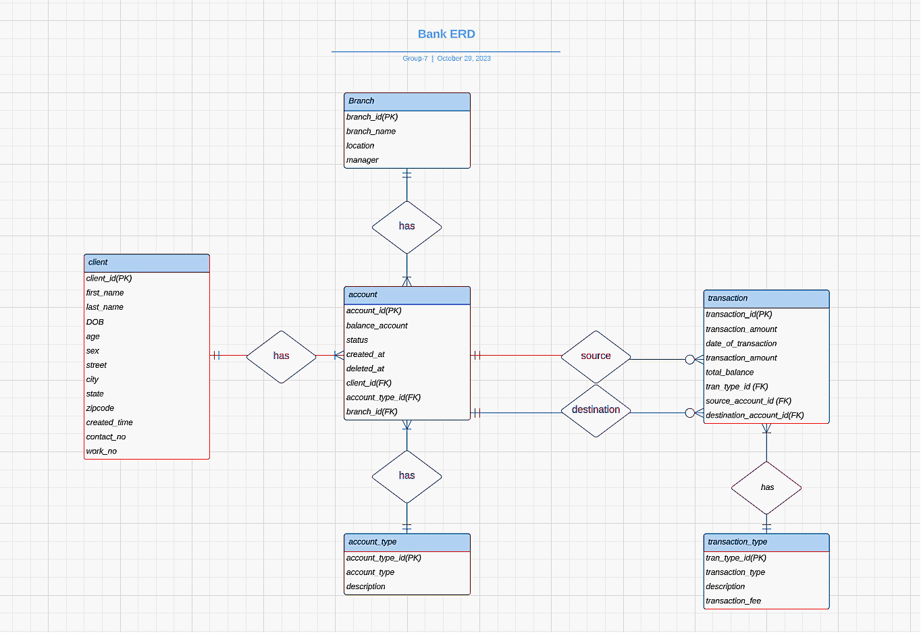
Entity Relationship Diagram

Slide 16
Entity Description
Key Points:
client_id: Unique identifier for clients.
Contains personal information like full name, DOB, age, sex, and address.
Contact details: contact_no, work_no.
created_time: Record creation timestamp.
Title: Account Entities and Relationships
Key Points:
Account Type Entity: Defines account categories.
Branch Entity: Details on bank branches.
Account Entity: Information on individual bank accounts, including client and branch associations.
Transaction Handling
Transaction Management
Key Points:
Transaction Entity: Captures details of each financial transaction.
Transaction Type Entity: Categorizes types of transactions and associated fees.
Account Management Entities
Client Entity Details

Slide 17
Data Structure Characteristics
Banking system data architecture:
Relational database framework
Key features:
Primary and foreign keys for relational integrity
Emphasis on normalization:
Minimizes data redundancy, ensures data integrity
Transactional integrity and account balance accuracy focus
Operational efficiency optimization
High throughput support for banking transactions
Rapid data retrieval and manipulation for CRUD operations
Preparedness for efficient and secure financial operations in a dynamic banking environment

Slide 18
Relationship descriptions
Cardinality
It is defined as the number of instances of one entity that can or must be associated with the number of instances of another entity.
Modality
It indicates whether the presence of an entity in a relationship is mandatory or optional.
Mandatory
The relationship must have an associated entity.
Optional
The entity may or may not have an associated entity in the relationship.

Slide 19
Relationship descriptions
Client-Account Relationship
Account-Transaction Relationship
Account Type-Account Relationship
Transaction Type-Transaction Relationship
Branch-Account Relationship
Client - Account:
1:N relationship
Each client may have multiple accounts
Each account is linked to a single client
Association is mandatory for accounts, optional for clients
Account - Transaction:
1:N cardinality between accounts and transactions
Each transaction is linked to one source and one destination account
An account can be part of numerous transactions
Mandatory for transactions, optional for accounts
Branch - Account:
1:N relationship
Each branch oversees multiple accounts
Mandatory for accounts, optional for branches
Account Type - Account:
1:N relationship
Each account belongs to a single type
Each account type can encompass multiple accounts
Mandatory relationship in both directions
Transaction Type - Transaction:
1:N relationship
Every transaction categorized by type
Each transaction type applicable to at least one transaction

Slide 20

CRUD Operations
CREATE
READ
UPDATE
DELETE

Slide 21
Create Operations
Create Operations: bank database is structured through carefully designed CREATE TABLE statements that establish distinct tables to efficiently organize and store essential data for our bank's daily operations.
Branch table:
branch_id (primary key), branch_name, location, manager.
Client table:
client_id (primary key), created_time, contact_no and work_no.
Account_type Table:
account_type_id (primary key), account_type, description.
account_id (primary key), balance_account, status, created_at, and deleted_at.
Transaction_type Table:
tran_type_id (primary key), transaction_type and description, transaction_fee.
Transaction Table:
transaction_id (primary key), transaction_amount, date_of_transaction, total_balance.
Account Table:
foreign keys connect the client, account_type, and branch tables to maintain relationships.
foreign keys connect the transaction_type and account tables, helping us identify the source and destination of funds.

Slide 22
Read Operations
SQL INSERT & LOAD DATA LOCAL INFILE are two methods to import data into MariaDB
SQL INSERT method for three tables
Three tables are populated using the LOAD DATA LOCAL INFILE
Ensured data formats match the STR_TO_DATE function requirements during imports.
Intentionally adjusted total_balance to NULL in INSERT statements as per design.
Verified the existence of tran_type_id, source_account_id, and destination_account_id to prevent foreign key constraints issues.
Rigorously checked database against constraints: NOT NULL, UNIQUE, and FOREIGN KEY.
Aimed for a smooth data import process with thorough validation.
Used error messages to guide effective troubleshooting and resolution of issues.

Slide 23
Update Operations
SQL UPDATE statements modify records in transaction and account tables.
Apply business rules to ensure accurate total balance updates.
Two main types of SQL UPDATE statements used:
Update client age from DOB for current age.
Adjust total_balance in transaction table based on transaction type, reflecting accurate financial records.

Slide 24
Delete Operations
- Utilized DELETE FROM statement to remove "void transactions" in the transaction table.
- Void transactions are those with a NULL amount, excluding "balance enquiry" types.
- Deletion conditions: NULL amount and not a balance enquiry (transaction type not equal to 5).
- Retains legitimate NULL amount cases like balance enquiries.

Slide 25
Business Questions

Slide 26
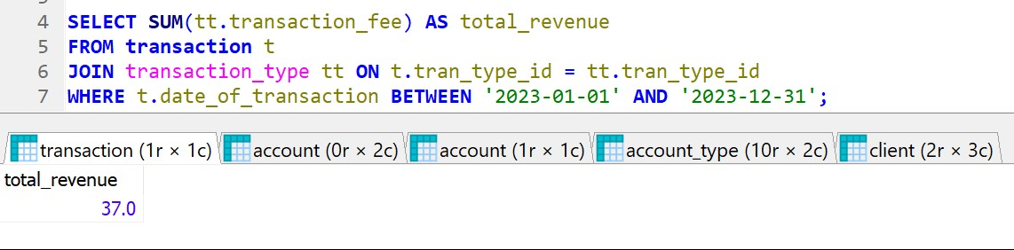
Question: What is the total revenue generated from transaction fees for a given time period?
Answer: The total revenue generated from transaction fees in the year 2023 amounted to $37.

Slide 27
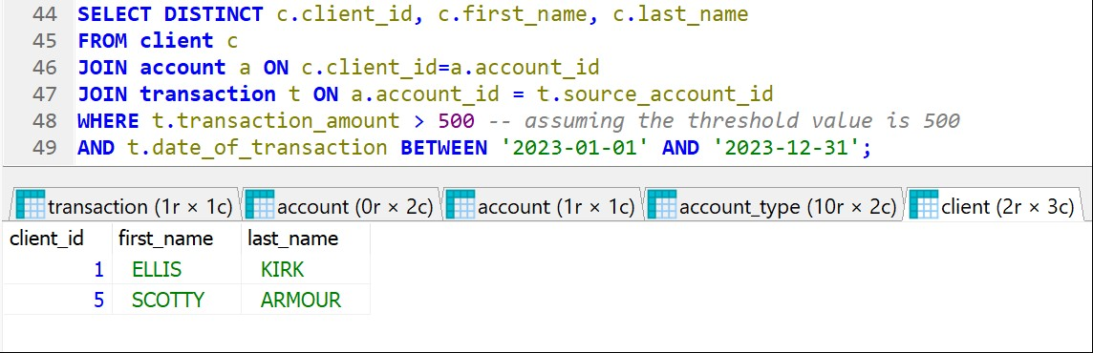
Question: Which clients have performed transactions over a certain high-value threshold in the last year?
Answer: In the last year, two clients, Ellis Kirk and Scotty Armour, performed transactions exceeding the high-value threshold of $500.

Slide 28
Thank You

Slide 29
Resources:
https://www.google.com/url?sa=i&url=https%3A%2F%2Fgithub.com%2Fmariadb&psig=AOvVaw2EoUm1NdOMRQ9AfQ6ob0jZ&ust=1699375455289000&source=images&cd=vfe&opi=89978449&ved=0CBEQjRxqFwoTCOiQgoXpr4IDFQAAAAAdAAAAABAE
https://dv-website.s3.amazonaws.com/uploads/2022/08/pg_datamanagementsystems_aug22.jpg
https://cdn2.vectorstock.com/i/1000x1000/89/56/bank-database-options-rounded-icon-vector-17348956.jpg

