Slide 2
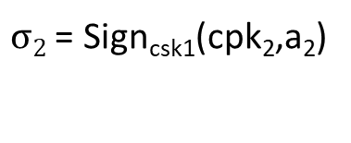
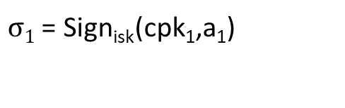

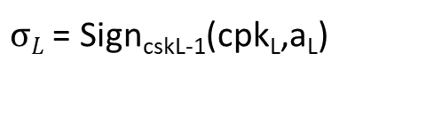
Level Issuer
.
.
0
ipk , isk
$σ1$ = Sign_{isk}(cpk₁,a₁)
a₁
1
cpk₁ , csk₁
$σ2$ = Sign_{csk1}(cpk₂,a₂)
a₂
2
cpk₂ , csk₂
L-1
cpk_{L-1} , csk_{L-1}
$σL$ = Sign_{cskL-1}(cpk_{L},a_{L})
a_{L}
L
cpk_{L} , csk_{L}
Cred_{L} = (<$σi$, a_{i}, cpk_{i}> ^{L} , csk_{L})
i=1

Slide 3
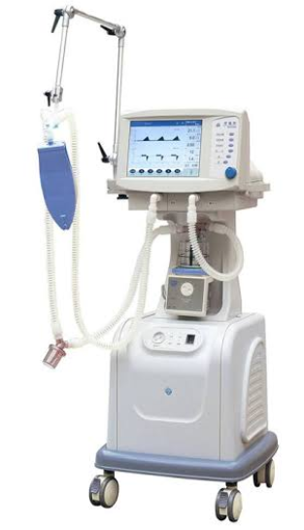

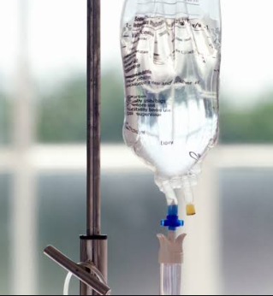
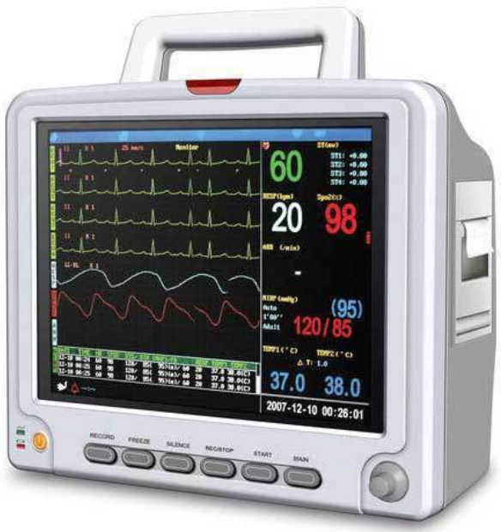
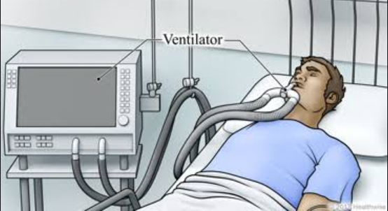
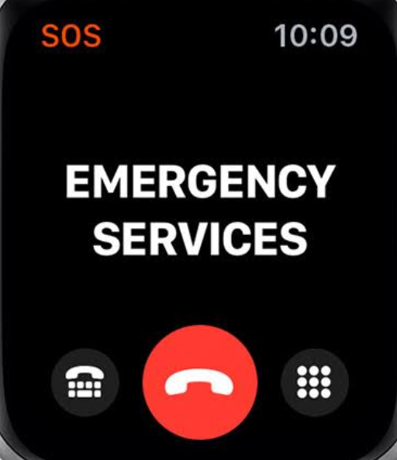

ECG
Ventilator
HMS
IV Injector
patient
EMS
Ambulance

