Slide 1
MEN
MONGO DB | EXPRESS JS
NODE JS
SANDEEP GUPTA
SENIOR S/W ENGINEER , TEAM LEAD

Slide 2
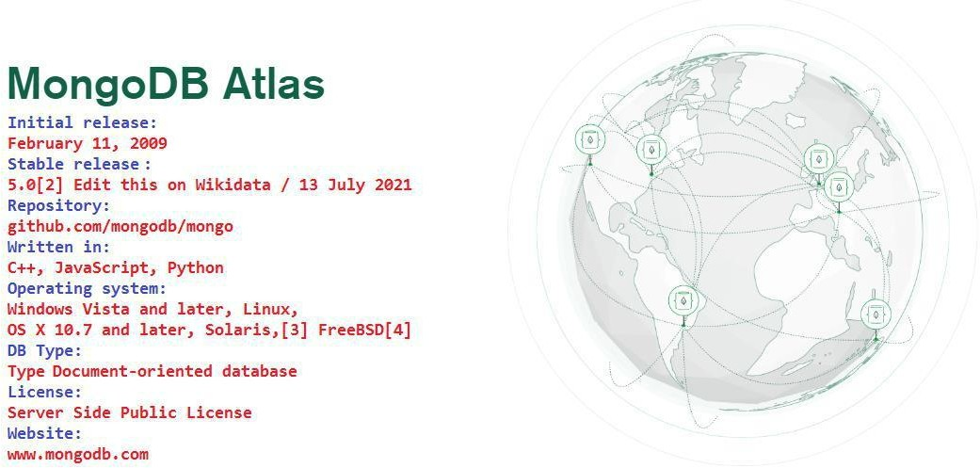

Slide 3
What is Mongo DB
Advantages of MongoDB over RDBMS
Why Use MongoDB?

Slide 4
Characteristic of Mongo DB
Where to Use MongoDB?
What is No SQL

Slide 5
Types of No SQL
Applications of Mongo DB
Installation

Slide 6
MONGO DB COMMANDS

Slide 7
see all db
create new db
creating collections
show collections
Insert document inside collection
show docs created inside collection
Updating specific field inside any record.
Adding new field to existing record.

Slide 8
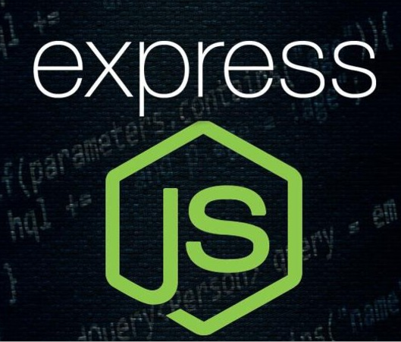

Slide 9
EXPRESSJS – OVERVIEW
EXPRESSJS – ENVIRONMENT
EXPRESSJS – HELLO WORLD

Slide 10
EXPRESSJS – ROUTING
EXPRESSJS – HTTP METHODS
EXPRESSJS – URL BUILDING

Slide 11
EXPRESSJS – MIDDLEWARE
EXPRESSJS – TEMPLATING
EXPRESSJS – COOKIES

Slide 12
EXPRESSJS – SESSIONS
EXPRESSJS – AUTHENTICATION
EXPRESSJS – RESTFUL APIS

Slide 13
EXPRESSJS – ERROR HANDLING
EXPRESSJS – DEBUGGING

Slide 14
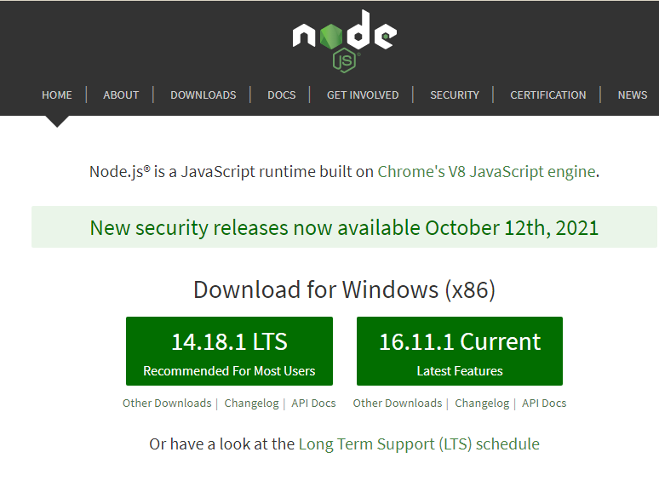

Slide 15
1. Foundation
2. Introduction to Node JS Framework
3. Installing NodeJs

Slide 16
4. Using NodeJs to execute scripts.
5. Node Package Manager
6. package.json configuration

Slide 17
7. Global Vs Local Package Installation
8. HTTP Protocall

Slide 18
9. Building HTTP Server
10. Rendering a response.
11. Using RePresentational State Transfer.
12. Nodemon

