Slide 1
mindZcloud Technologies
Online training portal
Sandip Akolkar
contact@mindzcoud.com
www.mindzcloud.com
@mindzcloud – facebook.com/mindzcloud

Slide 2
Hi, Every One!
Picture Place Holder
A Little About Me:
I am Sandip Akolkar working with MNC as Project Manager Testing , I have around 12+ years of Experience in IT industry in Manual , Automation , and Performance Testing .
I have good Exposure in Automation using Core Java + Selenium , Mobile Automation using Appium Tool , API Testing using SOAP UI and POSTMAN and Rest Assured , Angular UI Automation using Protractor and performance Testing using Jmeter Tool etc.
Sandip Akolkar
Project Manager - Testing

Slide 3

Test NG Framework Introduction for Selenium beginners

Slide 4
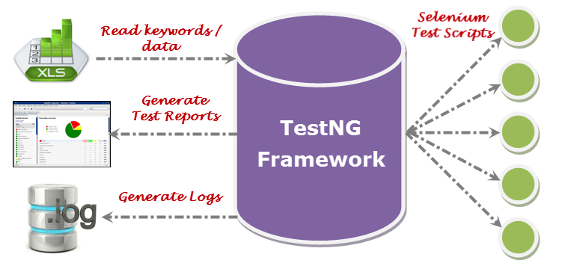
Why Test NG

Slide 5
Why Test NG
To Run test cases in the order which we provide ( Priority , alphabetical etc.)
We can run classes without using Main method and using annotations
To generate reports
We can Parameterize Tests
Group tests and execute only specific group
Implement logging using TestNG Listeners

Slide 6
Demo - Test NG Down load and Install

Slide 7
Demo –Imp TestNG Annotations
ANNOTATION | DESCRIPTION
@BeforeSuite | The annotated method will be executed before any tests declared inside a TestNG suite.
@AfterSuite | The annotated method will be executed after any tests declared inside a TestNG suite.
@BeforeTest | The annotated methods will be executed before ALL TESTS
@AfterTest | The annotated methods will be executed after ALL TEST CASES
@BeforeClass | BeforeClass annotated method is executed before any of the test method of a test class.
@AfterClass | AfterClass annotated method is executed after the execution of every test methods of a test class are executed.
@BeforeMethod | These annotated methods are executed before the execution of each test method.
@AfterMethod | These annotated methods are executed after the execution of each test method.
@Test | Marks a class or a method as a test method. If used at class level, all the public methods of a class will be considered as a test method.

Slide 8
Demo –Seleium + Test NG

Slide 9
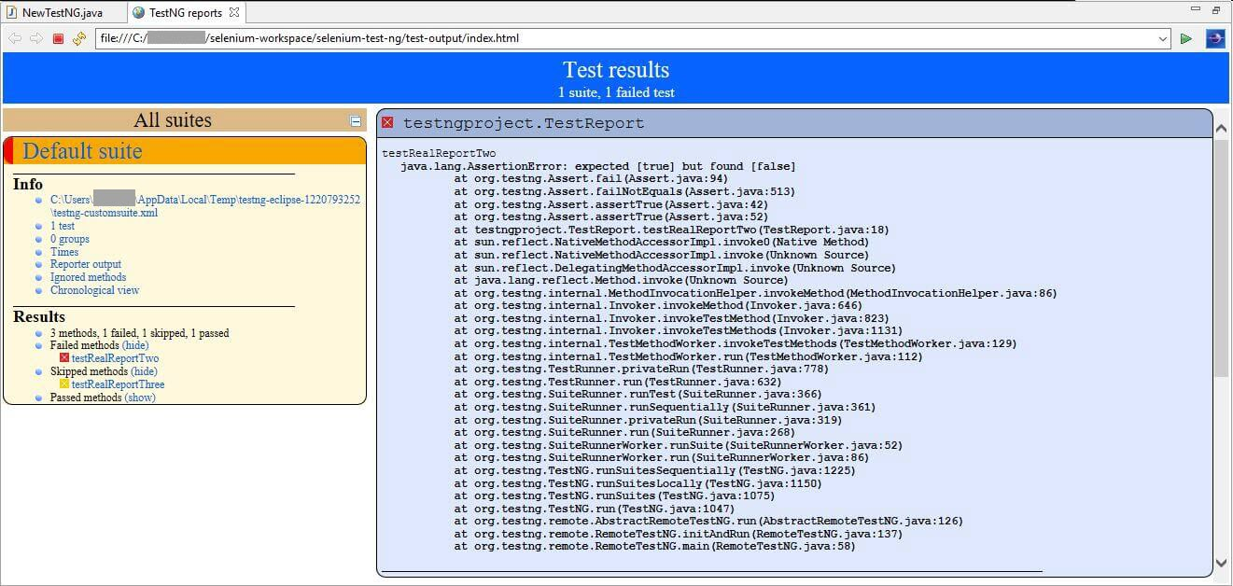
Demo –Imp TestNG Reports

Slide 10
Demo - Test NG XML and Parallel Test Execution
<!DOCTYPE suite SYSTEM "http://testng.org/testng-1.0.dtd">
<suite name="Parallel test suite" parallel="methods" thread-count="2">
<test name="Regression 1">
<classes>
<class name="com.parallel.TestParallelOne"/>
</classes>
</test>
</suite>

Slide 11
Demo - Test NG XML and GroupTest Execution
@Test(groups="Regression")
public void testCaseOne()
{
System.out.println("Im in testCaseOne - And in Regression Group");
}
@Test(groups="Regression")
public void testCaseTwo(){
System.out.println("Im in testCaseTwo - And in Regression Group");
}
@Test(groups="Smoke")
public void testCaseThree(){
System.out.println("Im in testCaseThree - And in Smoke Group");
}
<?xml version="1.0" encoding="UTF-8"?>
<suite name="Sample Suite">
<test name="testing">
<groups>
<run>
<include name="Regression"/>
</run>
</groups>
<classes>
<class name="com.example.group.groupExamples" />
</classes>
</test>
</suite>

Slide 12
How to take Screenshot in selenium

Slide 13
TakeScreenshot Class
TakesScreenshot scrShot =((TakesScreenshot)driver);
//Call getScreenshotAs method to create image file
File SrcFile=scrShot.getScreenshotAs(OutputType.FILE);
//Move image file to new destination
File DestFile=new File(fileWithPath);
//Copy file at destination
Files.copyFile(SrcFile, DestFile);

Slide 14
Log4J – Configuration Steps
Download and add Log 4J Jar File and
add to project external library
Create .Properties file under Project path
Add Logging configurations
Notes:
log4j.rootLogger=DEBUG,file log4j.appender.file=org.apache.log4j.RollingFileAppender log4j.appender.file.File=D:\\Guru99\\src\\Selenium.logs log4j.appender.file.maxFileSize=900KB log4j.appender.file.maxBackupIndex=5 log4j.appender.file.layout=org.apache.log4j.PatternLayout log4j.appender.file.layout.ConversionPattern=%d{ABSOLUTE} %5p %c<strong>{1}</strong>:%L - %m%n log4j.appender.file.Append=false
log4j.logger.devpinoyLogger=DEBUG, dest1 log4j.appender.dest1=org.apache.log4j.RollingFileAppender log4j.appender.dest1.maxFileSize=900KB log4j.appender.dest1.maxBackupIndex=6 log4j.appender.dest1.layout=org.apache.log4j.PatternLayout log4j.appender.dest1.layout.ConversionPattern=%d{dd/MM/yyyy HH:mm:ss} %c %m%n log4j.appender.dest1.File=D:\\ Guru99\\src\\Manual.logs log4j.appender.dest1.Append=false

Slide 15
Demo - Log4J – Logging
PropertyConfigurator.configure("log4j.properties");
Logger log = Logger.getLogger("devpinoyLogger");
log.debug("opening webiste");
Notes:
log4j.rootLogger=DEBUG,file log4j.appender.file=org.apache.log4j.RollingFileAppender log4j.appender.file.File=D:\\Guru99\\src\\Selenium.logs log4j.appender.file.maxFileSize=900KB log4j.appender.file.maxBackupIndex=5 log4j.appender.file.layout=org.apache.log4j.PatternLayout log4j.appender.file.layout.ConversionPattern=%d{ABSOLUTE} %5p %c<strong>{1}</strong>:%L - %m%n log4j.appender.file.Append=false
log4j.logger.devpinoyLogger=DEBUG, dest1 log4j.appender.dest1=org.apache.log4j.RollingFileAppender log4j.appender.dest1.maxFileSize=900KB log4j.appender.dest1.maxBackupIndex=6 log4j.appender.dest1.layout=org.apache.log4j.PatternLayout log4j.appender.dest1.layout.ConversionPattern=%d{dd/MM/yyyy HH:mm:ss} %c %m%n log4j.appender.dest1.File=D:\\ Guru99\\src\\Manual.logs log4j.appender.dest1.Append=false

Slide 16

Maven build tool Introduction

Slide 17
Maven – Build Tool
Maven is a powerful project management tool that is based on POM (project object model).
It is used for projects build, dependency and documentation.

Slide 18
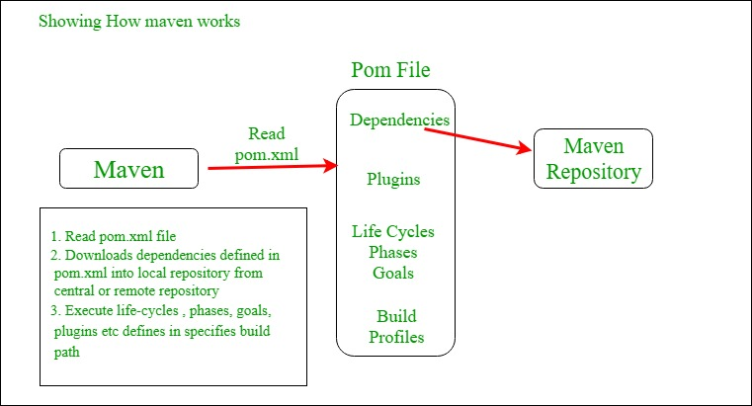
Maven – Lifecycle

Slide 19
Demo – Install Maven plugin from Eclipse Market Place

Slide 20
Automation Framework – Introduction
Framework can be defined as a set of guidelines which when followed produce beneficial results.
coding standards , test-data handling , object repository treatment etc.
Advantages:
Increase code re-usage
Reduced script maintenance cost
Higher portability

Slide 21
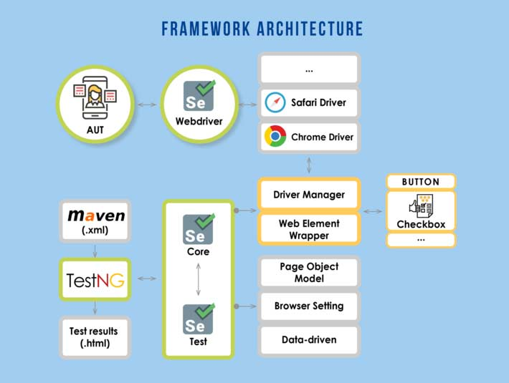
Automation Framework introduction

Slide 22
Automation Framework introduction
Framework Types
Data Driven
Hybrid
BDD
Keyword Drivern

Slide 23
Data Driver Automation Framework
Setup:
Test Case logic resides in Test Scripts E.g. In TestNG Class
Test Data is separated and kept outside the Test Scripts – E.g. in Excel or Class or Database
Advantages:
Changes to the Test Scripts do not affect the Test Data
Test Cases can be executed with multiple Sets of Data
A Variety of Test Scenarios can be executed by just varying the Test Data in the External Data File
Disadvantages:
More time is needed to plan and prepare both Test Scripts and Test Data

Slide 24
Keyword Driven Automation Framework
Setup:
3 basic components of a Keyword Driven Framework viz. Keyword , Application Map , Component Function.
3 basic components of a Keyword Driven Framework viz. Keyword , Application Map , Component Function.
Component function will read below tables
Object | Action | Argument
(APPLICATION MAP) | (KEYWORD)
WebEdit(UserName) | Set | abc@yahoo.com
WebEdit(Password) | Set | xxxxx
WebButton(OK) | Click
Window(Yahoo Mail) | Verify | Loads

Slide 25
Keyword Driven Automation Framework
Advantages
Provides high code re-usability
Test Tool Independent
Independent of Application Under Test, the same script works for AUT (with some limitations)
Tests can be designed with or without AUT
Disadvantages
Initial investment being pretty high, the benefits of this can only be realized if the application is considerably big and the test scripts are to be maintained for quite a few years.
High Automation expertise is required to create the Keyword Driven Framework.

Slide 26
BDD Automation Framework
Shifting from thinking in “tests” to thinking in “behavior”
Collaboration between Business stakeholders, Business Analysts, QA Team and developers
Ubiquitous language, it is easy to describe
Driven by Business Value
Extends Test Driven Development (TDD) by utilizing natural language that non technical stakeholders can understand
BDD frameworks such as Cucumber or JBehave are an enabler, acting a “bridge” between Business & Technical Language

Slide 27
Hybrid Automation Framework
Combination of all types of Frameworks

Slide 28
Cucumber Introduction

Slide 29
Cucumber Introduction
Feature: Eating too many cucumbers may not be good for you
Scenario: Eating a few is no problem
Given Alice is hungry
When she eats 3 cucumbers
Then she will be full
Cucumber reads executable specifications written in plain text
validates that the software does what those specifications say – I.e. Scenarios say

Slide 30
What is Gherkin ?
Gherkin is a set of grammar rules that makes plain text structured enough for Cucumber to understand
Gherkin documents are stored in .feature text files
Primary Keywords:
Feature
Rule (as of Gherkin 6)
Example (or Scenario)
Given, When, Then, And, But (steps)
Background
Scenario Outline (or Scenario Template)
Examples

Slide 31
Gherkin keywords introduction
Keyword | Usage
Feature | Main Feature Title
Scenario | Scenario Title
Examples: | Pipe separated Data Table
Scenario Outline | Scenario Title with parameters and Examples
Given | Precondition
When | Action
Then | Verification
And | Multiple Given , When and Then

Slide 32
Scenario and Scenario Outline Difference
Feature: Eating too many cucumbers may not be good for you
Scenario Outline: eating
Given there are <start> cucumbers
When I eat <eat> cucumbers
Then I should have <left> cucumbers
Examples:
| start | eat | left |
| 12 | 5 | 7 |
| 20 | 5 | 15 |
Feature: Eating too many cucumbers may not be good for you
Scenario: Eating a few is no problem
Given Alice is hungry
When she eats 3 cucumbers
Then she will be full

Slide 33
Demo - Install Cucumber and Setup cucumber Maven Project with Selenium
Install cucumber plugin from Eclipse Market place
Create Maven Project
Add Selenium + Cucumber Dependencies in POM File
Create Feature Folder under Project Folder
Create Feature File and add one feature and scenario
Create Step Definition Package and Steps Class under it
Create Runner Package and Runner-Junit Class under It
Copy Runner Class path in Maven Project POM configuration

Slide 34
Demo – Configure Runner Class to Run Feature Files

Slide 35
Demo – Run the Maven Install and Generate Glue Code

Slide 36
Demo – Add Selenium Steps in Glue Code

Slide 37
Demo – Run Maven Project and verify the Reports

Slide 38

Jenkins introduction

Slide 39
What is Jenkins
Jenkins is a software that allows continuous integration
Continuous Integration is a development practice that requires developers to integrate code into a shared repository at regular intervals
Continuous integration requires the developers to have frequent builds
The common practice is that whenever a code commit occurs, a build should be triggered.
Jenkins will be installed on a server where the central build will take place

Slide 40
How Jenkins works
Developer/Automation Tester Check in the Code
Jenkin Automatically Pick up the code and trigger build it may take help of maven
Jenkin Dashboard will show output on Dashboard or send email notifications

Slide 41
Demo - Download Jenkins and start Jenkins

Slide 42
Demo - Install Maven and Cucumber jenkin Plugins

Slide 43
Demo - Configure our cucumber test Project and run from Jenkins

Slide 44
Picture Place Holder
Thanks For Watching!
Don’t forget to tell your ideas or questions about this presentation and share it with us!
Contact us:
Lorem-email@domain.com
www.lorem-website.com
Lorem Street, Lorem Avenue, LA, United States
Notes:
To add your picture; drag and drop your picture into “Picture Place Holder”, then send it back to get the blur effect!

