Slide 1
WEB APPs using REact and ANguLAR
By -
Sandeep Kumar - 18BCS6556

Slide 2

Introduction
A web chat is a system that allows users to communicate in real-time using easily accessible web interfaces.
It is a type of Internet online chat distinguished by its simplicity and accessibility to users who do not wish to take the time to install and learn to use specialized chat software.

Slide 3
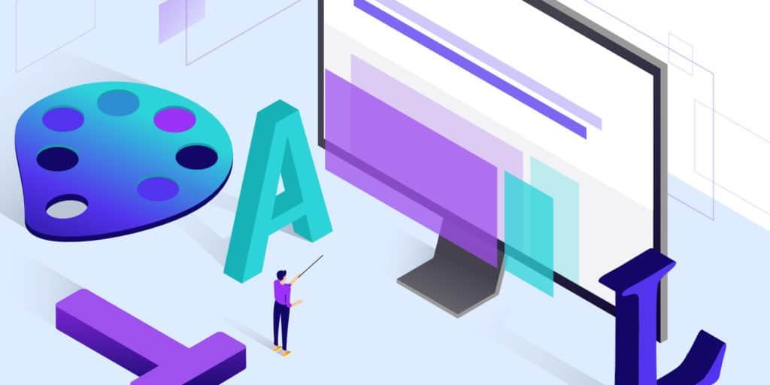
BENEFITS
Inexpensive
Quick connections
Reduces Communication gap.
Search classmates and teachers easily.
Search directly using UID.
Quick exits

Slide 4
NEWS WEB APP
Single page web Application for news headlines
connected to news API. ▪
Used ReactJs, HTML, CSS and JavaScript.

Slide 5
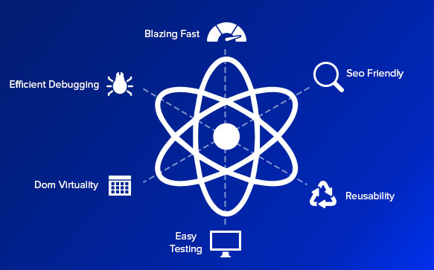
Technologies Used 1. React js
ReactJS is a declarative, efficient, and flexible JavaScript library for building reusable UI components. It is an open-source, component-based front end library which is responsible only for the view layer of the application. It was initially developed and maintained by Facebook and later used in its products like WhatsApp & Instagram.

Slide 6

2. ANGULAR
Angular is a TypeScript-based free and open-source web application framework led by the Angular Team at Google and by a community of individuals and corporations.

Slide 7
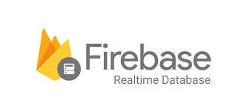
2. Firebase
Firebase is a Backend-as-a-Service(BaaS) which started as a YC11 startup. It grew up into a next-generation app-development platform on Google Cloud Platform
Firebase Features -
Real-time Database
Authentication
Hosting

Slide 8
THANK
YOU

