Slide 1

Myers’ PSYCHOLOGY
(7th Ed)
Chapter 13
Emotion
James A. McCubbin, PhD
Clemson University
Worth Publishers

Slide 2
Emotion
Emotion
  a response of the whole organism
    physiological arousal
    expressive behaviors
    conscious experience

Slide 3
Theories of Emotion
Does your heart pound because you are afraid... or are you afraid because you feel your heart pounding?

Slide 4
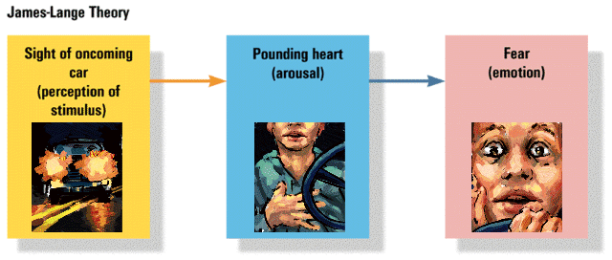
James-Lange
Theory of Emotion
Experience of emotion is awareness of physiological responses to emotion-arousing stimuli
Sight of
oncoming
car
(perception of
stimulus)
Pounding
heart
(arousal)
Fear
(emotion)

Slide 5
Cannon-Bard
Theory of Emotion
Pounding
heart
(arousal)
Emotion-arousing stimuli simultaneously trigger:
  physiological responses
  subjective experience of emotion
Sight of
oncoming
car
(perception of
stimulus)
Fear
(emotion)

Slide 6
Schachter’s Two-Factor Theory of Emotion
Pounding
heart
(arousal)
To experience emotion one must:
  be physically aroused
  cognitively label the arousal
Sight of
oncoming
car
(perception of
stimulus)
Fear
(emotion)
Cognitive
label
“I’m afraid”

Slide 7
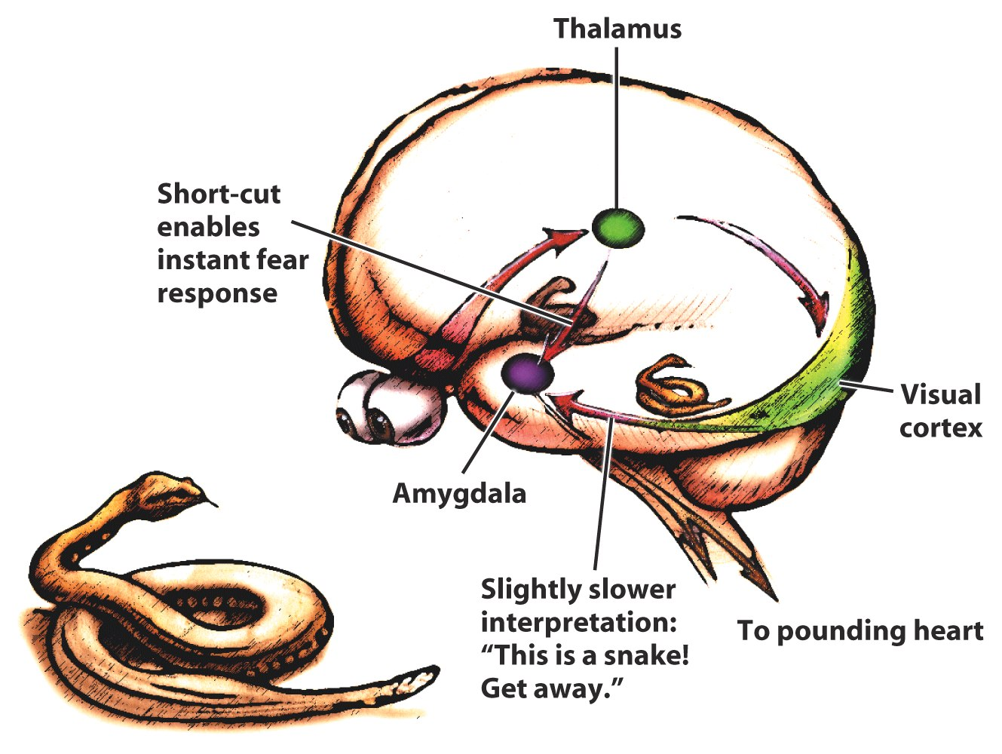
Cognition and Emotion
The brain’s shortcut for emotions

Slide 8
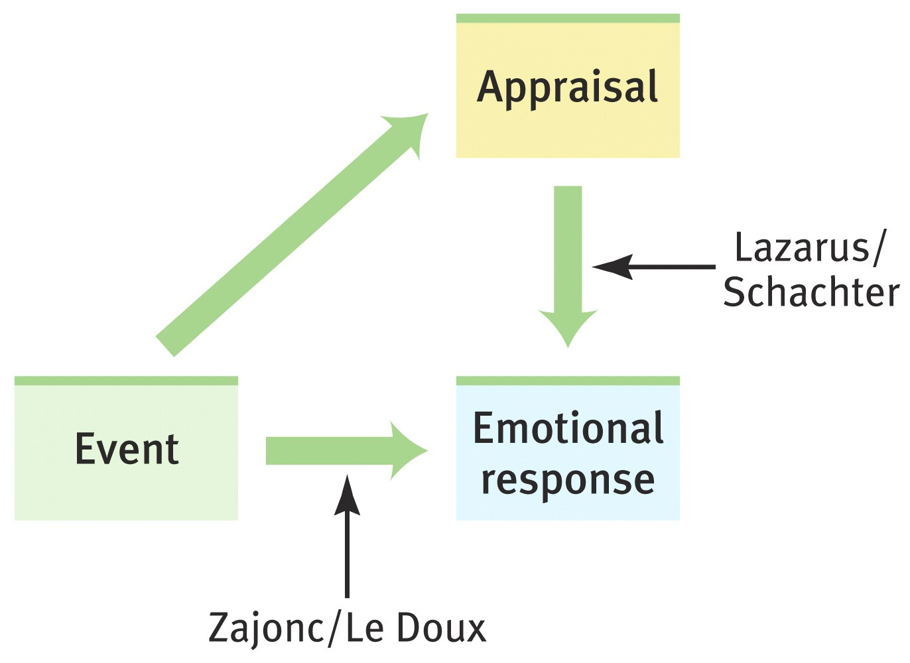
Two Routes to Emotion

Slide 9
Two Dimensions of Emotion
Positive
valence
pleasant
relaxation
joy
Low
arousal
High
arousal
fear
anger
sadness
Negative
valence

Slide 10
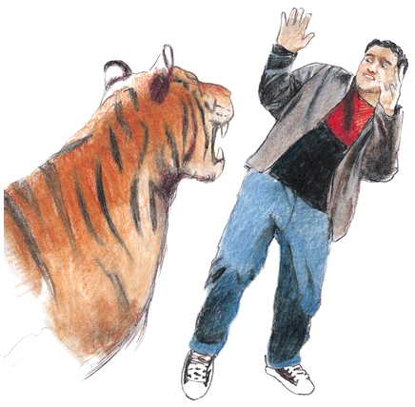
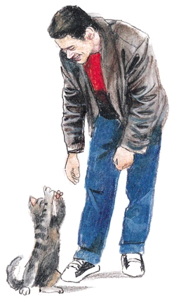
Emotion and Physiology
Autonomic nervous system controls
physiological arousal
Sympathetic
division (arousing)
Pupils dilate
Decreases
Perspires
Increases
Accelerates
Inhibits
Secrete stress
hormones
Parasympathetic
division (calming)
Pupils contract
Increases
Dries
Decreases
Slows
Activates
Decreases
secretion of
stress
hormones
EYES
SALIVATION
SKIN
RESPIRATION
HEART
DIGESTION
ADRENAL
GLANDS

Slide 11
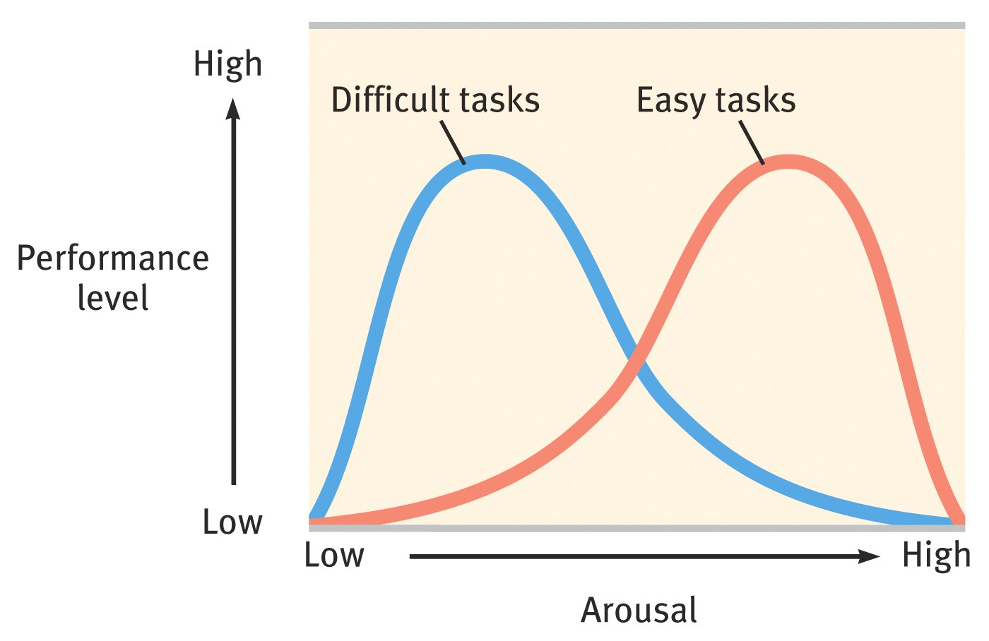
Arousal and Performance
Performance peaks at lower levels of arousal for difficult tasks, and at higher levels for easy or well-learned tasks

Slide 12
Emotion-
Lie Detectors
Polygraph
  machine commonly used in attempts to detect lies
  measures several of the physiological responses accompanying emotion
    perspiration
    cardiovascular
    breathing changes

Slide 13
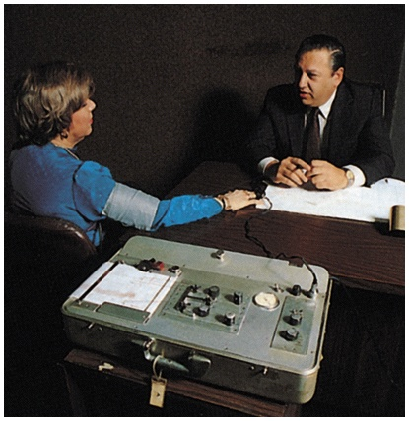
Emotion--A Polygraph Examination

Slide 14
Emotion--Lie Detectors
Control Question
  Up to age 18, did you ever physically harm anyone?
Relevant Question
  Did [the deceased] threaten to harm you in any way?
Relevant > Control --> Lie

Slide 15
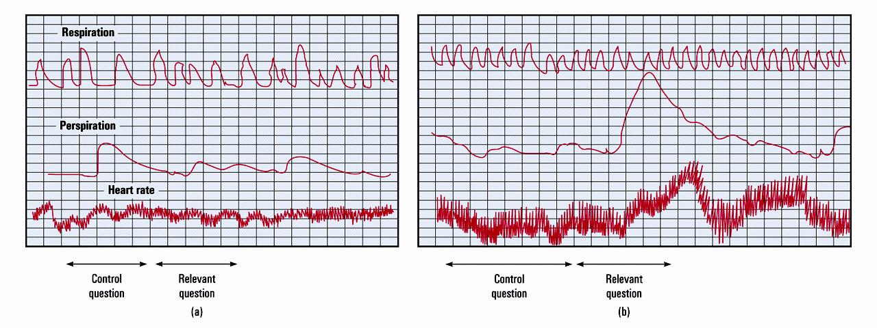
Emotion--
Lie Detectors
Respiration
Perspiration
Heart rate
Control
question
Relevant
question
Control
question
Relevant
question
(a)
(b)

Slide 16

Emotion--
Lie Detectors
Percentage
50 Innocents
50 Theives
  1/3 of innocent declared guilty
  1/4 of guilty declared innocent (from Kleinmuntz & Szucko, 1984)
80
70
60
50
40
30
20
10
0
Innocent
people
Guilty
people
Judged innocent by polygraph
Judged guilty by polygraph

Slide 17
Emotion--
Lie Detectors
Is 70% accuracy good?
  Assume 5% of 1000 employees actually guilty
    test all employees
    285 will be wrongly accused
What about 95% accuracy?
  Assume 1 in 1000 employees actually guilty
    test all employees (including 999 innocents)
    50 wrongly declared guilty
    1 of 51 testing positive are guilty (~2%)

Slide 18
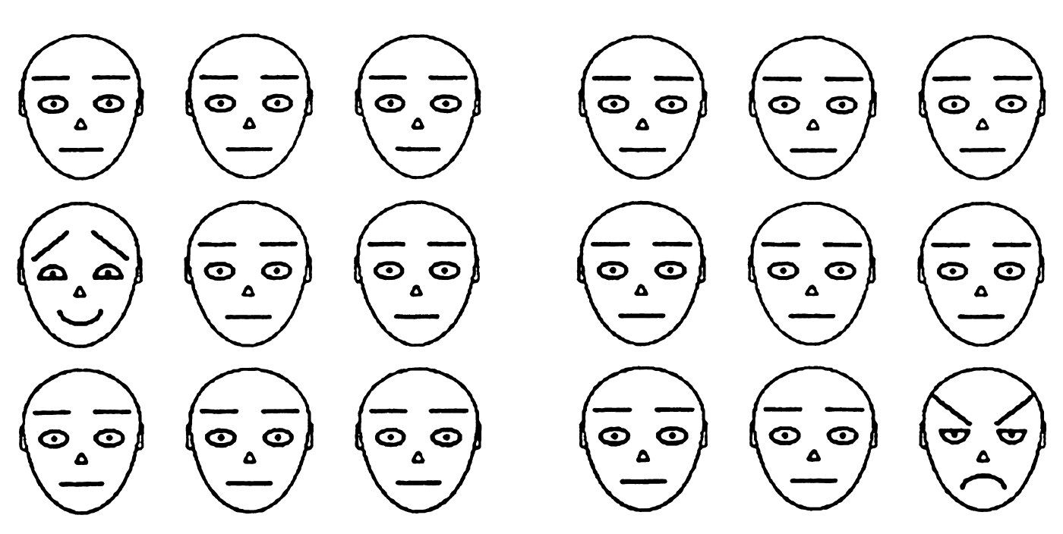
Expressed Emotion
People more speedily detect an angry face than a happy one (Ohman, 2001a)

Slide 19
Expressed Emotion
Gender and expressiveness
16
14
12
10
8
6
4
2
0
Number
of
expressions
Men
Women
Sad Happy Scary
Film Type

Slide 20
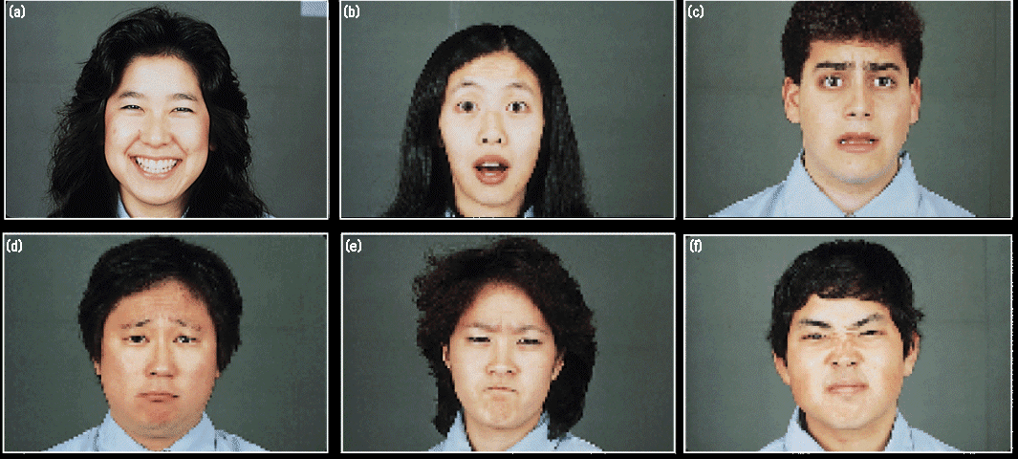
Expressed Emotion
Culturally universal expressions

Slide 21
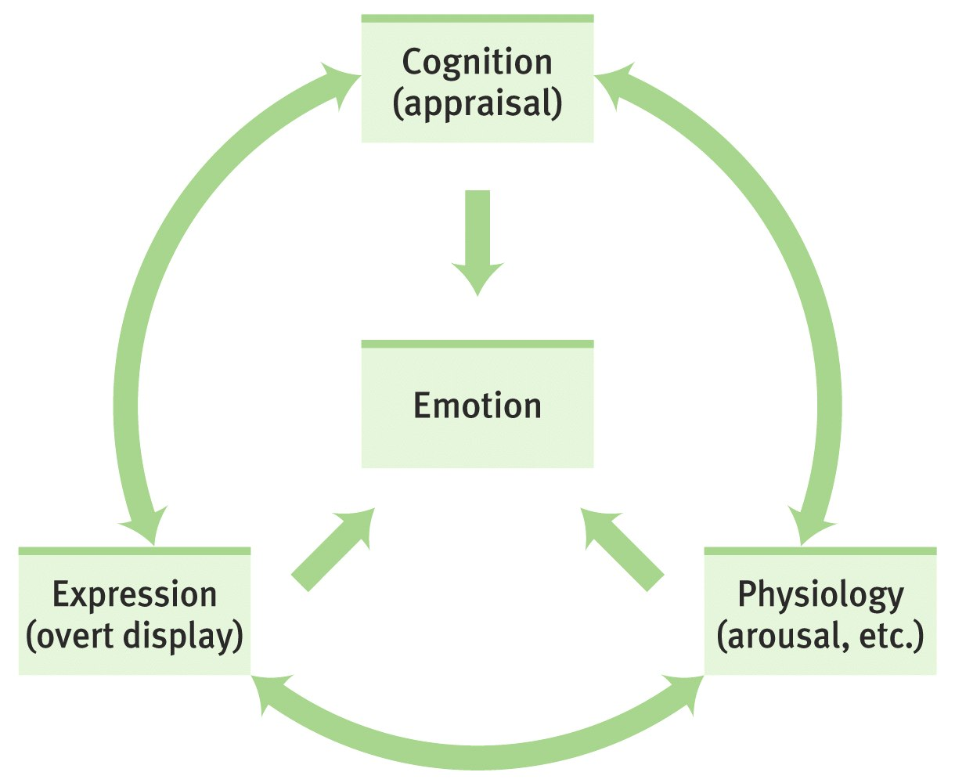
Experienced Emotion
The ingredients of emotion

Slide 22
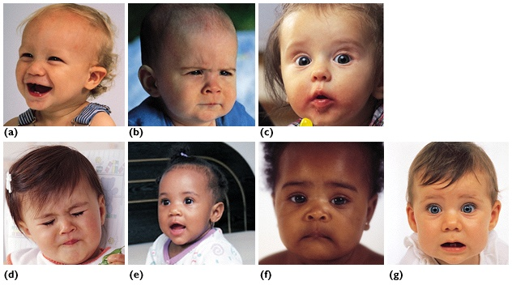
Experienced Emotion
Infants’ naturally occurring emotions

Slide 23
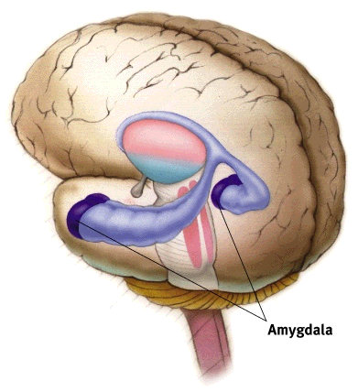
Experienced Emotion
The Amygdala--a neural key to fear learning

Slide 24
Experienced Emotion
Catharsis
  emotional release
  catharsis hypothesis
    “releasing” aggressive energy (through action or fantasy) relieves aggressive urges
Feel-good, do-good phenomenon
  people’s tendency to be helpful when already in a good mood

Slide 25
Experienced Emotion
Subjective Well-Being
  self-perceived happiness or satisfaction with life
  used along with measures of objective well-being
    physical and economic indicators to evaluate people’s quality of life

Slide 26
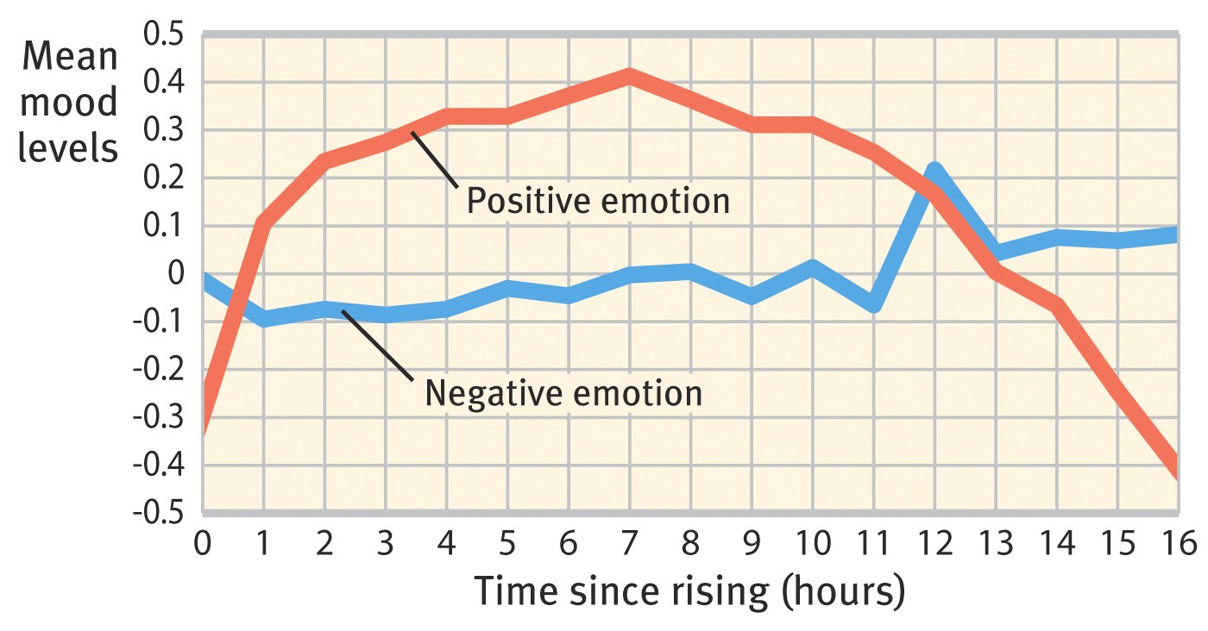
Experienced Emotion
Moods across the day

Slide 27
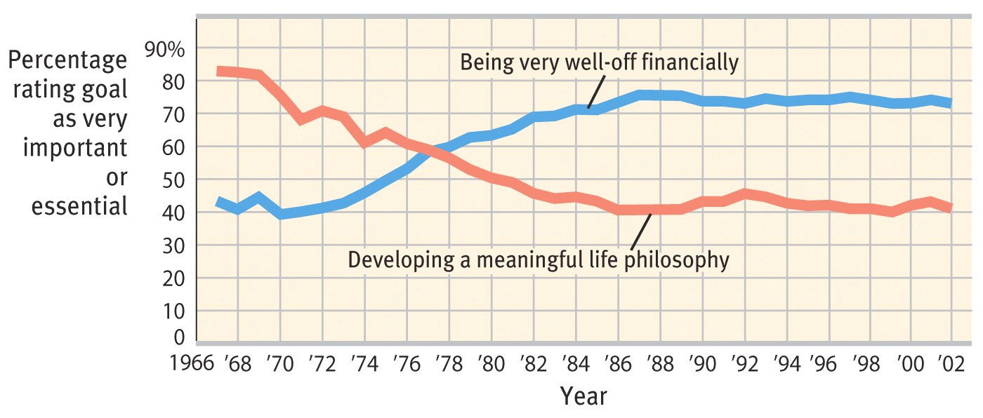
Experienced Emotion
Changing materialism

Slide 28
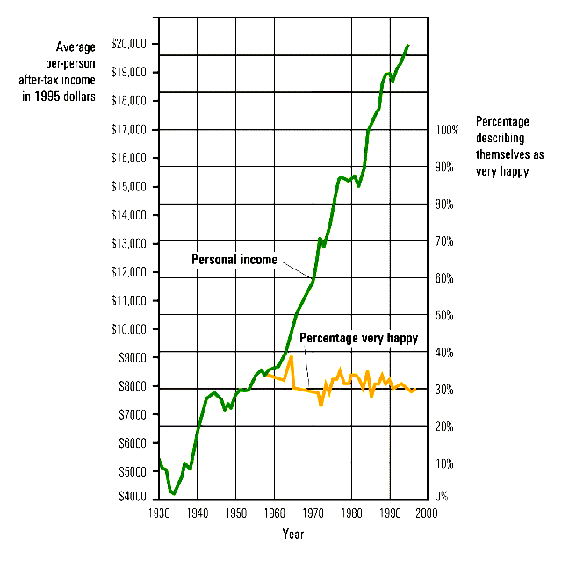
Experienced Emotion
Does money buy happiness?
Average
per-person
after-tax income
in 1995 dollars
$20,000
$19,000
$18,000
$17,000
$16,000
$15,000
$14,000
$13,000
$12,000
$11,000
$10,000
$9,000
$8,000
$7,000
$6,000
$5,000
$4,000
100%
90%
80%
70%
60%
50%
40%
30%
20%
10%
0%
Percentage
describing
themselves as
very happy
Personal income
Percentage very happy
1930 1940 1950 1960 1970 1980 1990 2000
Year

Slide 29
Experienced Emotion
Values and life satisfaction
0.6
0.4
0.2
0.0
-0.2
-0.4
Importance
scores
Money
Love
1.00 2.00 3.00 4.00 5.00 6.00 7.00
Life satisfaction

Slide 30
Experienced Emotion
Adaptation-Level Phenomenon
  tendency to form judgments relative to a “neutral” level
    brightness of lights
    volume of sound
    level of income
  defined by our prior experience
Relative Deprivation
  perception that one is worse off relative to those with whom one compares oneself

Slide 31
Happiness is...
Researchers Have Found That
Happy People Tend to
Have high self-esteem
(in individualistic countries)
Be optimistic, outgoing, and agreeable
Have close friendships or a satisfying
marriage
Have work and leisure that engage
their skills
Have a meaningful religious faith
Sleep well and exercise
However, Happiness Seems Not Much
Related to Other Factors, Such as
Age
Gender (women are more often
depressed, but also more often joyful)
Education levels
Parenthood (having children or not)
Physical attractiveness

