Slide 1
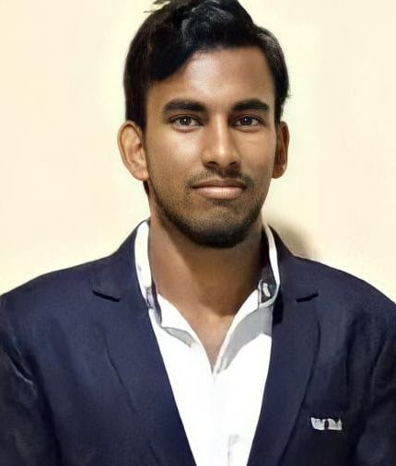


Pallamreddy Sandeep Kumar Reddy
Bachelor of Technology, Electronics and Communications : 2018 – 2022
Completed Az900 Certification
Analyst/Software Engineer
ITransform L&D Left Shift Batch
Skills
Mumbai
pallamreddy-sandeep-kumar.reddy@capgemini.com
C# | Basics, OOPS, Exception Handling ,Arrays ,Collection and Generics, Delegates and Events, File Io and Serialization.
.NET Framework | ADO.NET,ASP.NET with MVC5 an WEB API, Entity Framework
Java | Basics
Database | SQL
Tools | GIT,POSTMAN, Swagger
UI Technology | HTML5 ,CSS & Angular
Add On Skills | Communication Skills, Team Management
+91 8008633353
A4
Full Stack Developer
Understanding of RDBMS concepts using SQL Server.
Practical understanding of C# and SQL concepts using Visual Studio and SQL Server.
Hands on experience in developing applications using .NET Framework, ADO.NET Core, ASP.NET and JWT based authentication.
Understanding of HTML5 , CSS and Angular CLI
Completed Azure Fundamentals course
Online Flight Booking System Video link
Case study of Online Flight Booking System along with API Gateway, Swagger, payment, JWT Based Authentication, responsive UI with HTML5, CSS, Bootstrap and Angular used as User Interface. This application enables a customer to book a flight reservation in advance and can cancel the booking or Check in into the flight and also an admin user can perform various administrative operations like Airport management, Flight Management and Customer management.
Technologies used:
Angular
ASP.NET Core Web API
Microsoft SQL Server
Check out my GitHub Repository

