Slide 1
SALES ANALYSIS

Slide 2
Project Explanation
Power Bi Report
EDA Report

Slide 3
Introduction of Project
This is Data Analytics project based on the Northwind Traders database, a comprehensive dataset that encapsulates the sales operations of a fictional specialty foods importer and exporter. The Northwind database is designed to provide a detailed overview of various aspects of the business, including customer information, employee data, order processing, product details, supplier relations, shipping logistics, and product categorization. This dataset is invaluable for demonstrating database management concepts, performing data analysis, and developing business intelligence solutions. Through the subsequent slides, we will delve into the structure and significance of each table within the Northwind database, highlighting how they collectively contribute to a robust representation of a company's sales and supply chain activities. Whether you are a data analyst, a database administrator, or a business student, this presentation aims to provide a clear understanding of how a well-organized database can support efficient business operations and decision-making.

Slide 4
Objective
The objective of this presentation is to provide a clear understanding of the Northwind Traders database structure, demonstrating how its various tables interconnect to support efficient business operations, data analysis, and decision-making processes in a fictional specialty foods import and export company.
Analysis Scope
The analysis scope of this presentation includes examining the interrelationships between customers, employees, orders, order details, products, suppliers, shippers, and categories within the Northwind Traders database to identify trends, optimize operations, and enhance decision-making for a fictional specialty foods import and export business.

Slide 5
Goal
The goal of this project is to utilize the Northwind Traders database to illustrate the application of database management and data analysis techniques, enabling better understanding of business processes, optimizing sales and supply chain operations, and enhancing strategic decision-making in a fictional specialty foods import and export company.

Slide 6
Dataset Description
The Northwind database contains the sales data for a fictitious company called “Northwind Traders,” which imports and exports specialty foods from around the world.
Table Explanations
Customers Table
This table stores information about the company's customers. It includes fields for customer ID, company name, contact name, contact title, address, city, region, postal code, country, phone, and fax.
Employees Table
This table stores information about the company's employees. It includes fields for employee ID, last name, first name, title, title of courtesy, birth date, hire date, address, city, region, postal code, country, home phone, extension, photo, notes, reports to, and photo path.
Orders Table
This table stores information about the company's orders. It includes fields for order ID, customer ID, employee ID, order date, required date, shipped date, ship via, freight, ship name, ship address, ship city, ship region, ship postal code, and ship country.

Slide 7
Order Details Table
This table stores detailed information about the items within each order. It includes fields for order ID, product ID, unit price, quantity, and discount.
Products Table
This table stores information about the company's products. It includes fields for product ID, product name, supplier ID, category ID, quantity per unit, unit price, units in stock, units on order, reorder level, and whether the product is discontinued.
Suppliers Table
This table stores information about the company's suppliers. It includes fields for supplier ID, company name, contact name, contact title, address, city, region, postal code, country, phone, fax, and home page.
Shippers Table
This table stores information about the company's shipping companies. It includes fields for shipper ID, company name, and phone.
Categories Table
This table stores information about the product categories. It includes fields for category ID, category name, and description

Slide 8
Power Bi Analysis
Find the Insights from Power Bi Report

Slide 9
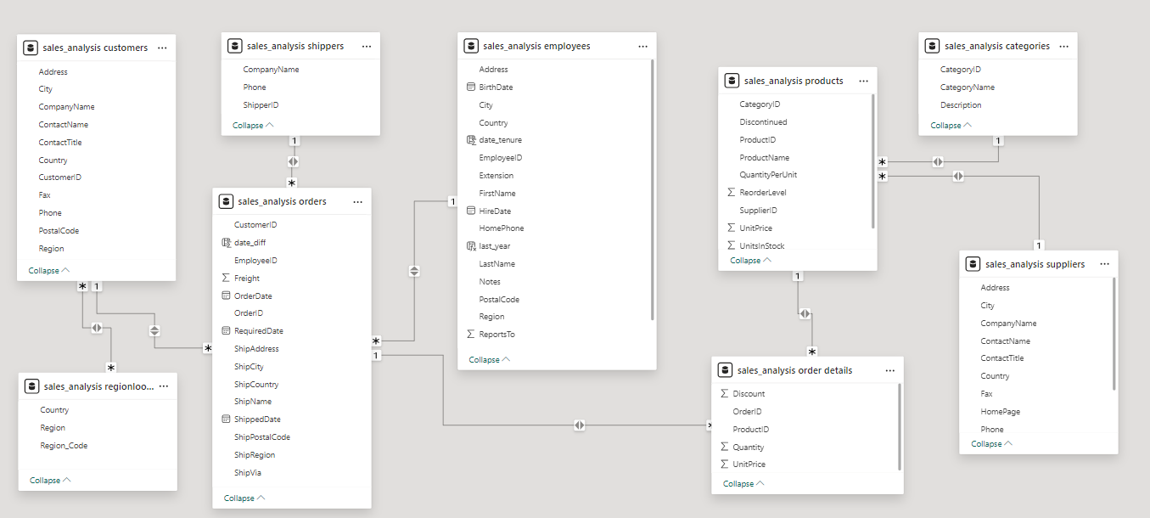
ER Diagram

Slide 10
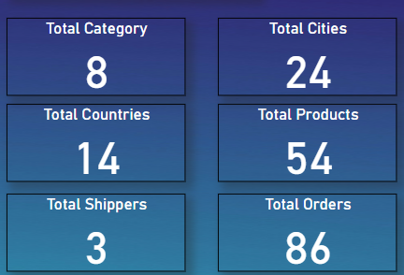
SALES ANALYSIS
KPI
There are some important KPI’s that are present in the Northwind Traders database

Slide 11
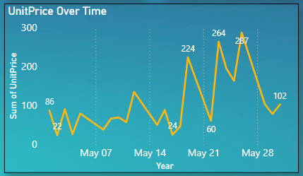
The graph shows the average unit price of a product over a five-month period. The y-axis shows the unit price and the x-axis shows the date. The highest average unit price was $300 in May 07 and the lowest average unit price was $22 in May 14. There is an upward trend in price over the five months

Slide 12
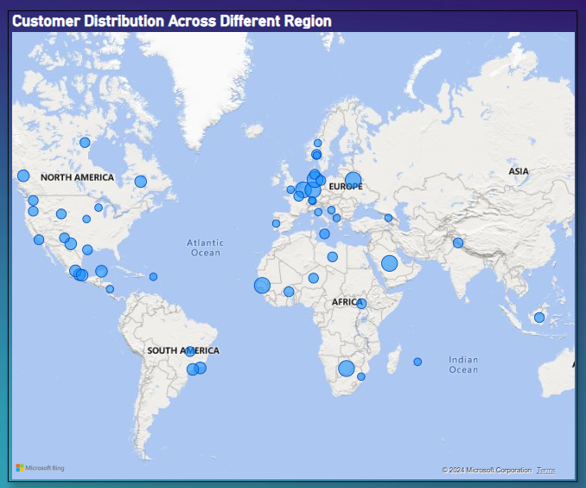
This slide depicts customer distribution across different regions of the world. It shows a world map with circles overlaid on top of it. The circles vary in size and color, and their placement reflects the regions with the most customers. The largest and darkest colored circles are in North America, Europe, and Asia. This suggests that these regions have the highest concentration of customers for the Mmsuit Corporation.

Slide 13
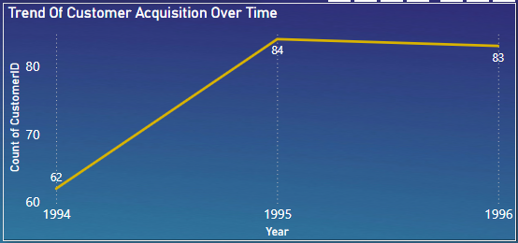
This line graph showing customer acquisition trend. The y-axis shows the count of customers and the x-axis shows the year. The graph shows an increase in customer acquisition from 1994 to 1996. In 1994, the company had 62 customers and by 1996, it had 84 customers.

Slide 14
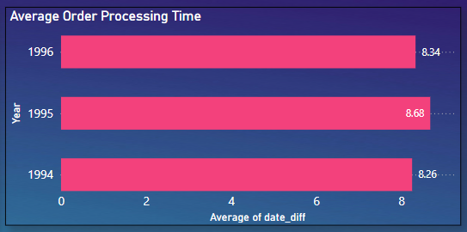
This chart illustrates the average order processing time for Northwind Traders over three consecutive years: 1994, 1995, and 1996. The processing time is measured in days, showing a slight decrease from 1995 (8.68 days) to 1996 (8.34 days), while 1994 had an average of 8.26 days. Analyzing these trends helps in understanding and optimizing the order fulfillment process.

Slide 15
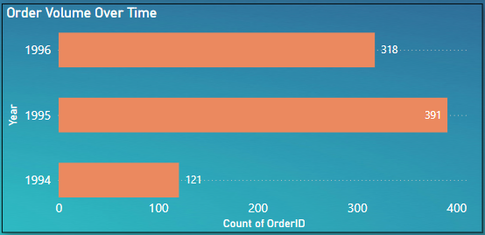
This bar graph showing a trend in order volume over time. The y-axis shows the number of orders and the x-axis shows the year. The line shows a steady increase in order volume from 1994 to 1996. There were 121 orders in 1994 and 391 orders in 1996.

Slide 16
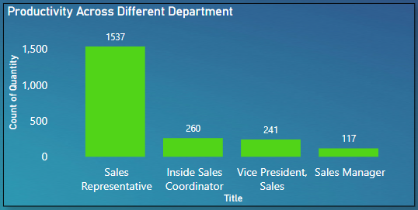
This slide shows a bar chart comparing productivity across different sales roles. The chart shows average productivity for sales representatives, coordinators, vice presidents, managers, and titles. Sales representatives have the highest average productivity at 1537, while coordinators have the lowest at 117.

Slide 17
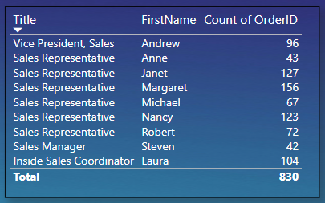
This table displays the number of orders handled by each sales employee at Northwind Traders. It lists employees by their title and first name, with the count of orders processed. Margaret leads with 156 orders, followed by Janet (127) and Nancy (123). The total number of orders processed by the team is 830, highlighting the contributions of each team member to sales operations.

Slide 18
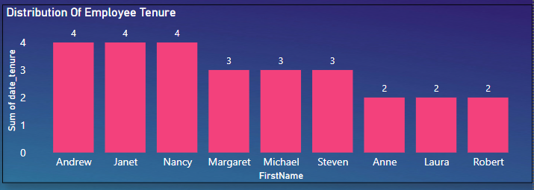
This slide shows a bar graph titled "Distribution of Employee Tenure". The x-axis lists first names of employees, and the y-axis shows the number of years of tenure. The bars show that there are more employees with 2 years of tenure than any other tenure length. There are also employees with 3 and 4 years of tenure, but none with 1 year.

Slide 19
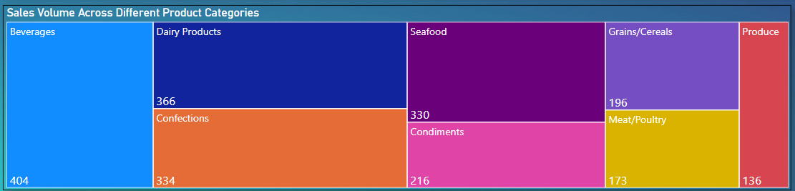
This slide shows a bar chart titled "Sales Volume Across Different Product Categories". The chart displays sales volume for seven product categories: beverages, dairy products, seafood, grains/cereals, produce, condiments, and meat/poultry. Beverages has the highest sales volume at 404, followed by condiments at 334 and meat/poultry at 330. Sales volume is lowest for produce at 136.

Slide 20
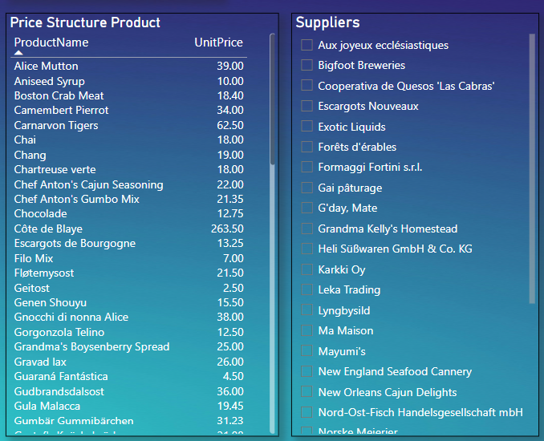
The slide presents a detailed view of the price structure for various products alongside a list of suppliers. The "Price Structure Product" section lists product names and their corresponding unit prices, ranging from everyday items like Aniseed Syrup to premium products like Côte de Blaye. The "Suppliers" section features a comprehensive list of suppliers, showcasing the diversity and breadth of the supplier network. This information aids in understanding product pricing and supplier distribution

Slide 21
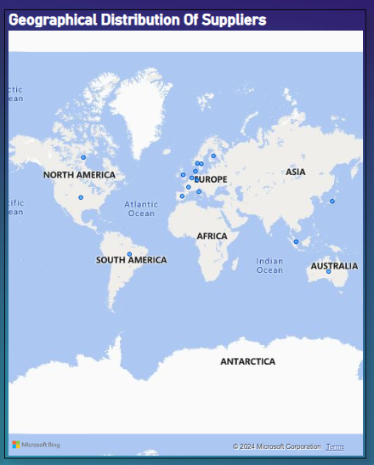
The map illustrates the geographical distribution of suppliers globally, with a notable concentration in Europe. Suppliers are also present in North America, Asia, and Australia, reflecting a diverse and widespread network. This distribution ensures efficient supply chain management and broad market reach.

Slide 22
Exploratory Data Analysis
Problem Statements

Slide 23
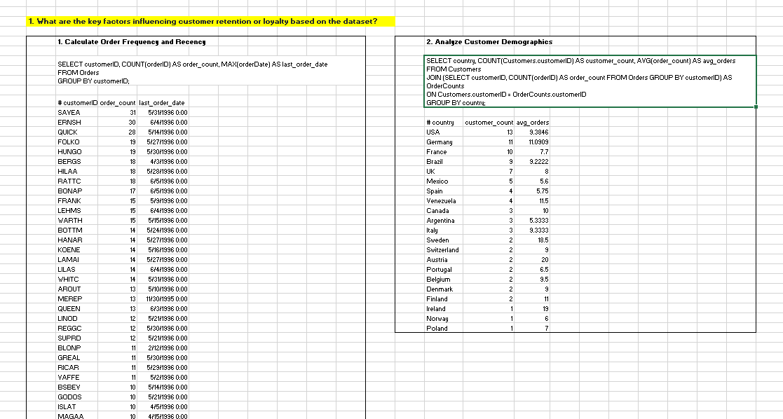

Slide 24
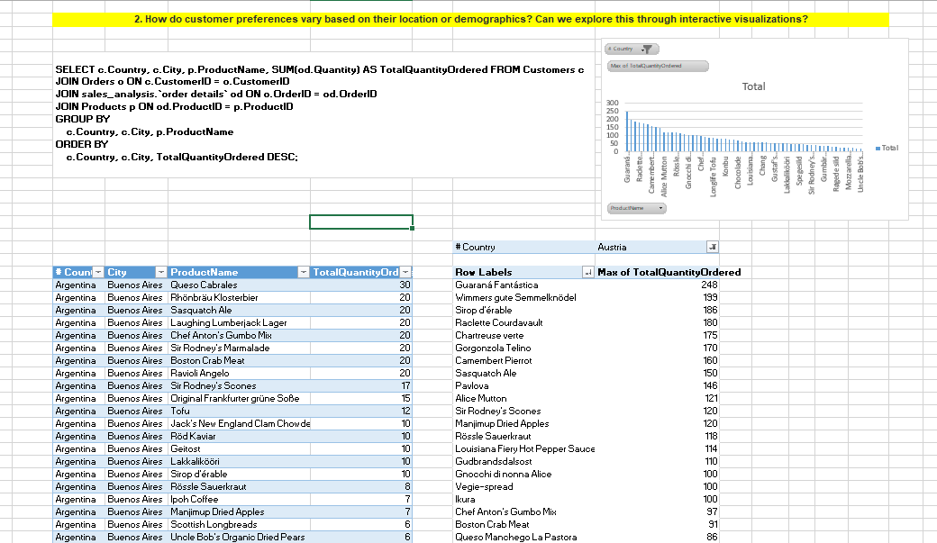

Slide 25
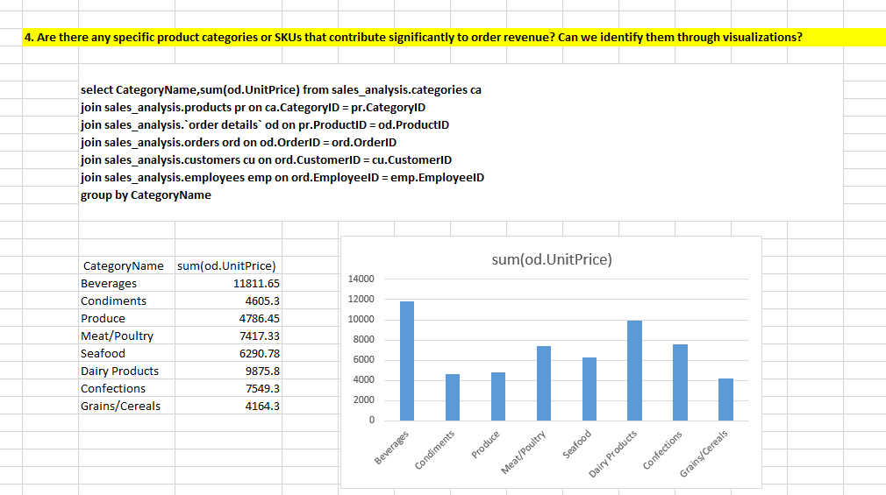

Slide 26
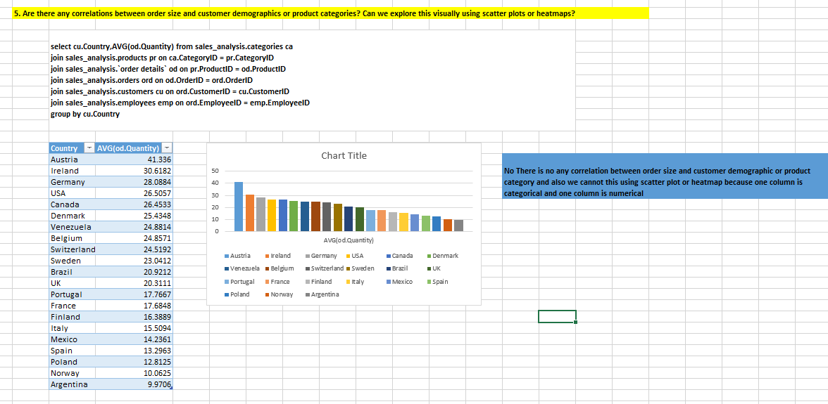

Slide 27
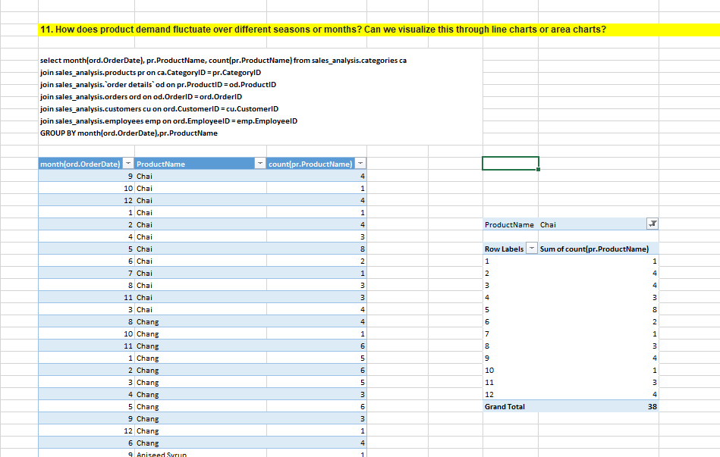

Slide 28
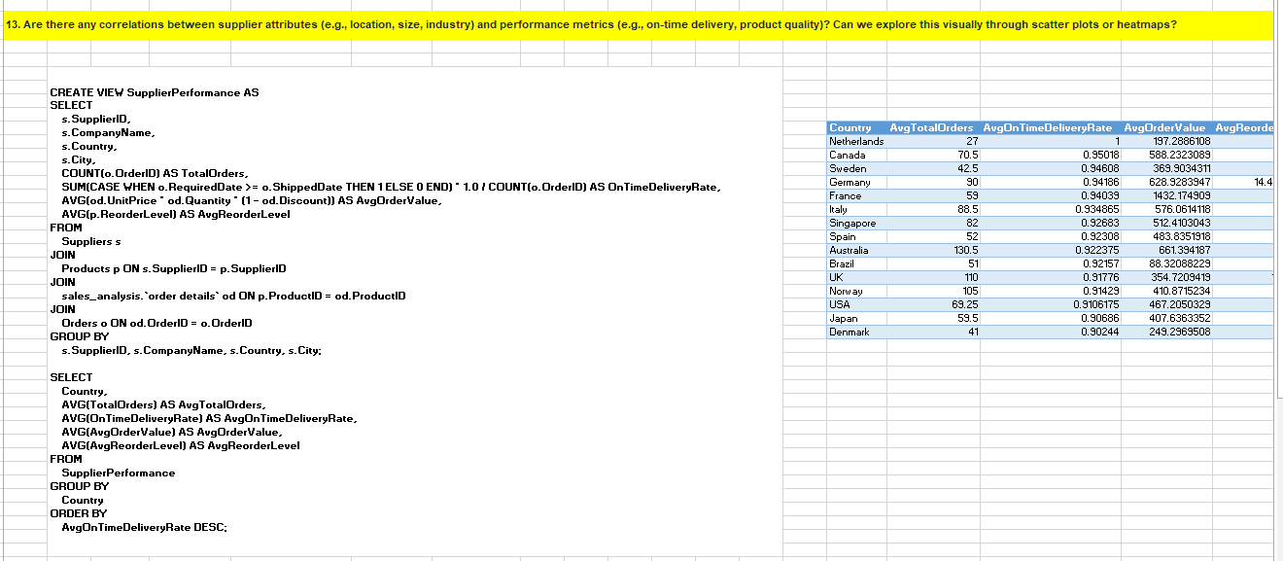

Slide 29
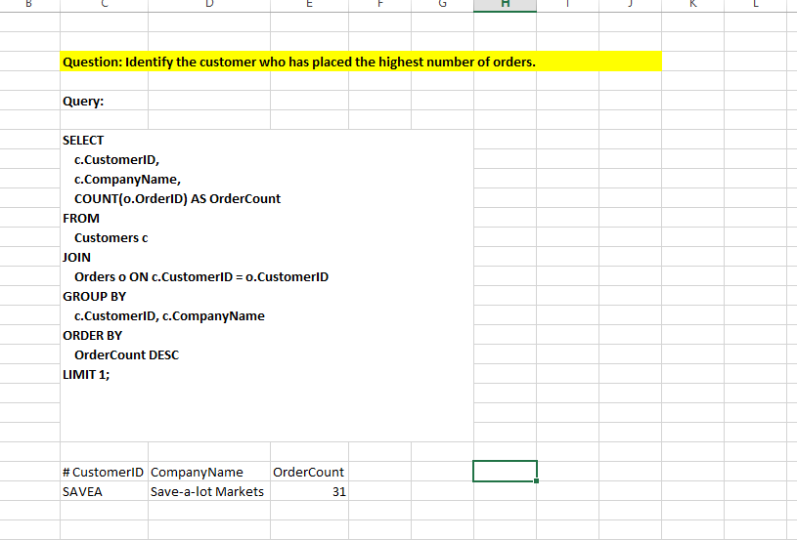

Slide 30
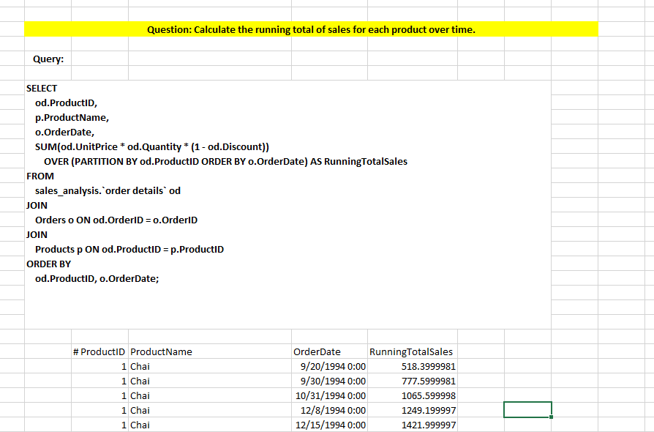

Slide 31
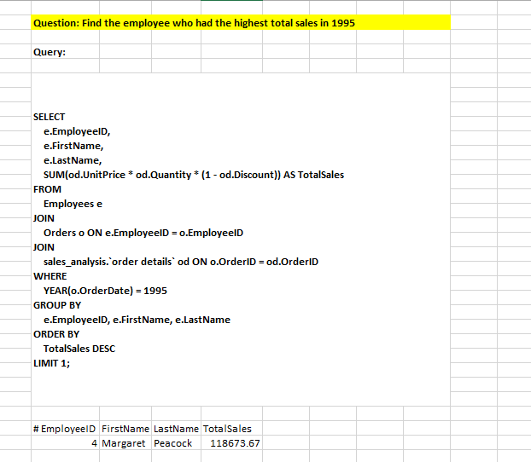

Slide 32
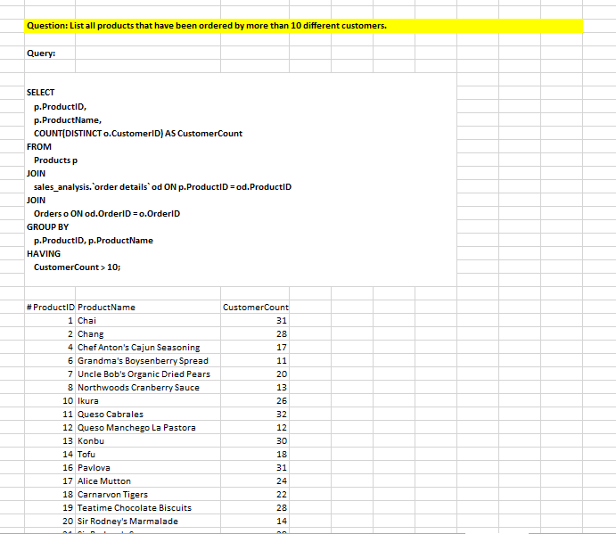

Slide 33
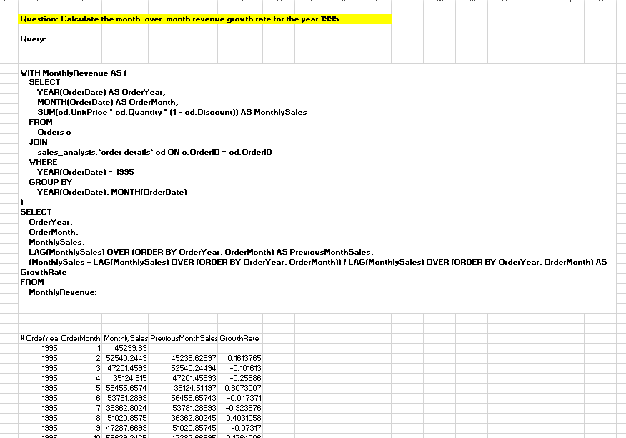

Slide 34
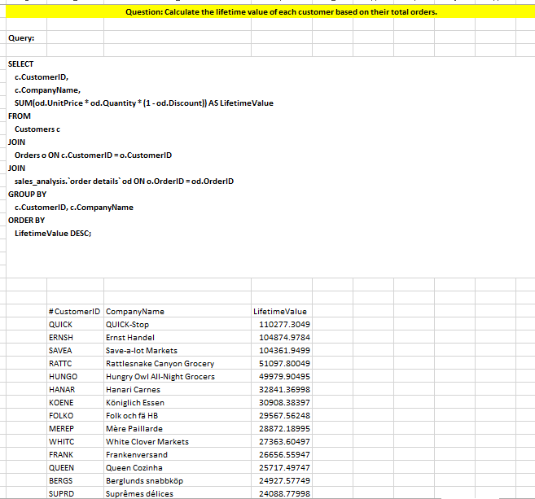

Slide 35
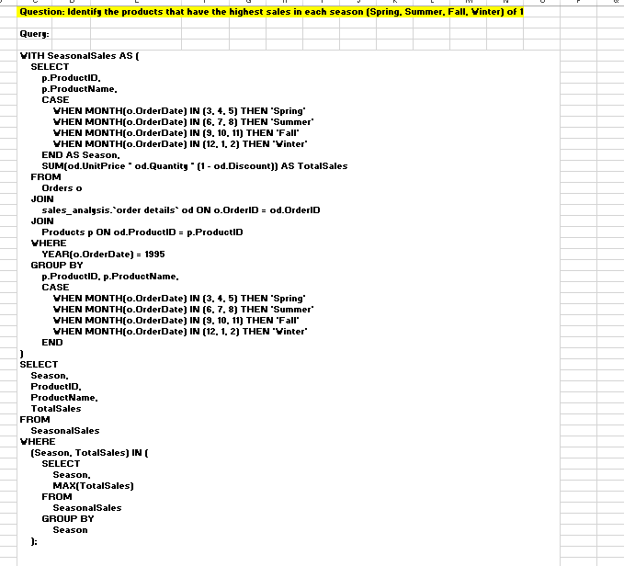

Slide 36
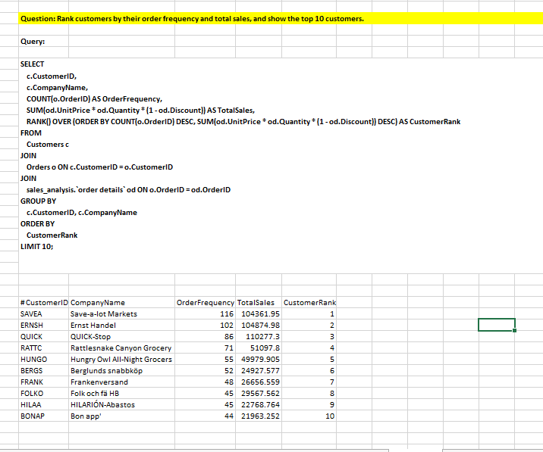

Slide 37
THANK YOU

