Slide 1
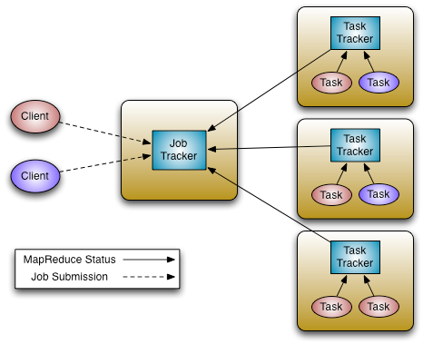
Map Reduce
MapReduce is a programming model for parallel data processing. It handles parallelization, data distribution, fault tolerance.
User runs a program on the client computer
Job contains:
Input data
Map / Reduce program
Configuration information
JobTracker
Manages cluster resources
Manages job scheduling
TaskTracker
Per-node agent
Manage tasks
Limitations
Scalability
Maximum Cluster size – 4,000 nodes
Maximum concurrent tasks – 40,000
Coarse synchronization in JobTracker
Availability
Failure kills all queued and running jobs
Hard partition of resources into map and reduce slots
Low resource utilization
Lacks support for alternate paradigms and services
iterative applications implemented using MapReduce are 10x slower

Slide 2










YARN: Taking Hadoop Beyond Batch
BATCH
(MapReduce)
INTERACTIVE
(Tez)
ONLINE
(HBase)
STREAMING
(Storm, S4,…)
GRAPH
(Giraph)
IN-­‐MEMORY
(Spark)
HPC MPI
(OpenMPI)
OTHER
(Search) (Weave…)
YARN (Cluster Resource Management)
HDFS2 (Redundant, Reliable Storage)
Apache YARN (Yet Another Resource Negotiator) is Hadoop’s cluster resource management system.
YARN was introduced in Hadoop 2 to improve the MapReduce implementation, but it is general enough to support other distributed computing paradigms as well.
Split up the two major functions of JobTracker
Cluster resource management
Application life-cycle management

Slide 3
MapReduce - Input Format
How the input files are split up and read is defined by the InputFormat class.
Selects the files that should be used for input
Defines InputSplit for a file defines a slice of work for each map task
Provides a factory for RecordReader objects that read the file
Input Split
An input split describes a unit of work that comprises a single map task in a MapReduce program, By default, the InputFormat breaks a file upto 128MB splits.
Each map task corresponds to a single input split.
By dividing the file into splits, we allow several map tasks to operate on a single file in parallel
If the file is very large, this can improve performance significantly through parallelism
Record Reader
The input split defines a slice of work but does not describe how to access it
The RecordReader class actually loads data from its source and converts it into (K, V) pairs suitable for reading by Mappers
The RecordReader is invoked repeatedly on the input until the entire split is consumed
Each invocation of the RecordReader leads to another call of the map function defined by the programmer

Slide 4
Mapper and Reducer
The Mapper performs the user-defined work of the first phase of the MapReduce program.
A new instance of Mapper is created for each split.
Map function
Operate on set of key, value pairs
Map is applied in parallel on input data set
This produces output keys and list of values for each key depending upon the functionality
The Reducer performs the user-defined work of the second phase of the MapReduce program.
A new instance of Reducer is created for each partition.
For each key in the partition assigned to a Reducer, the Reducer is called once.
Reduce function
Operate on set of key, value pairs
Reduce is then applied in parallel to each group, again producing a collection of key, values.
Total number of reducers can be set by the user.

Slide 5
DEMO- create sample MR program
Create a maven project to find maximum score of each cricket players using TextInputFormat and multiple reducer.
Write Driver, Mapper and Reducer class (refer FindMaxWithMultipleReducer program in LMS)
Add below dependency to POM.XML
<dependency>
<groupId>org.apache.hadoop</groupId>
<artifactId>hadoop-core</artifactId>
<version>1.2.1</version>
</dependency>
Build jar using maven package command
H:\Eclipse-Program\MR>mvn clean package
Move the JAR to cluster using winscp
Execute the MR program using below command
hadoop jar jar/MR-0.0.1-SNAPSHOT.jar com.programs.MR.InputFormatText.Driver SampleDataFile/CricketScore.txt output_1
Multiple Reducer
Modify the driver to add more reducer as below
job.setNumReduceTasks(4);
Run the program again by following the above process to check the multiple reducer output
hadoop fs -ls output_1

Slide 6
YARN Concepts
Resource Manager
Global resource scheduler
Manages other Nodes
Tracks heartbeats from Node Manager
Manages Containers
Handles AM requests for resources
De-allocates containers when they expires or the application completes
Manages Application Master
Creates a container from AM and tracks heartbeats
Node Manager
Communicates with RM
Registers and provides info on Node resources
Sends heartbeats and container status
Manages processes and container status
Launches AM on request from RM
Launches application process on request from AM
Monitors resource usage by containers;
Provides logging services to applications
Aggregates logs for an application and saves them to HDFS

Slide 7
YARN Concepts
Application Master
One Per-application
Manages application scheduling and task execution
Runs in a container
Requests for more container to run application task.
E.g. MapReduce Application Master
Application
Application is a job submitted to the framework
Example –Map Reduce Job
Container
Basic unit of allocation
Application run on one or more container
Created by RM upon request
Allocate certain amount of resources (memory, CPU etc.) on a slave node.
Replaces the fixed map/reduce slots

Slide 8
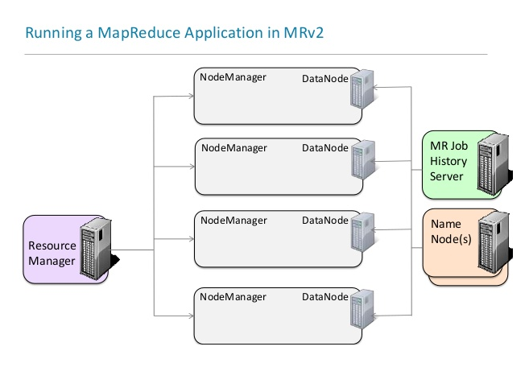
Running a MR job on Yarn

Slide 9
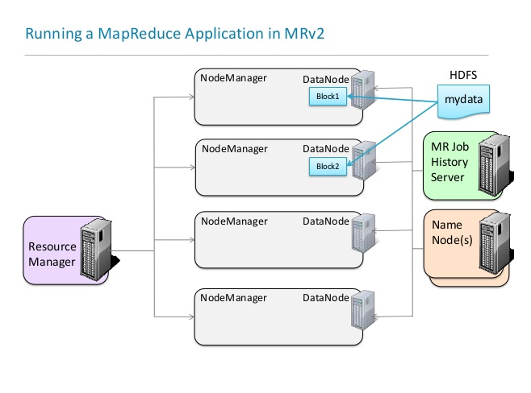
Running a MR job on Yarn

Slide 10
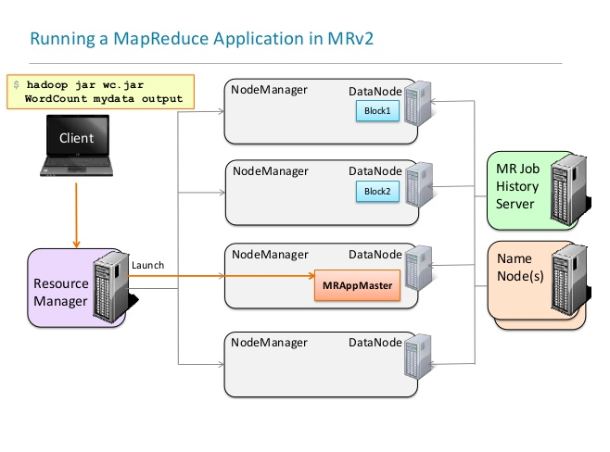
Running a MR job on Yarn

Slide 11
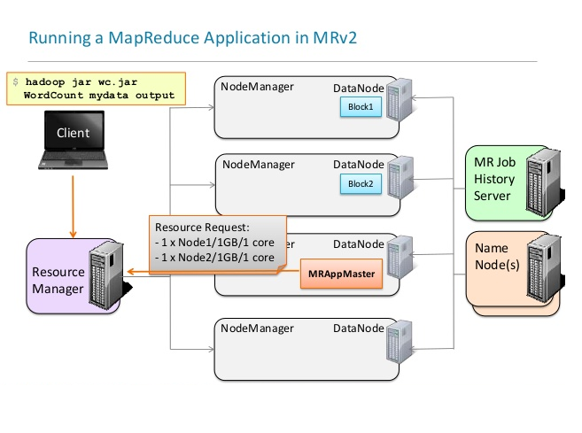
Running a MR job on Yarn

Slide 12
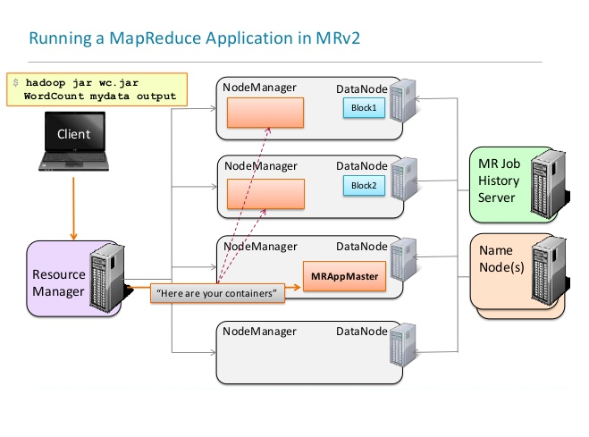
Running a MR job on Yarn

Slide 13
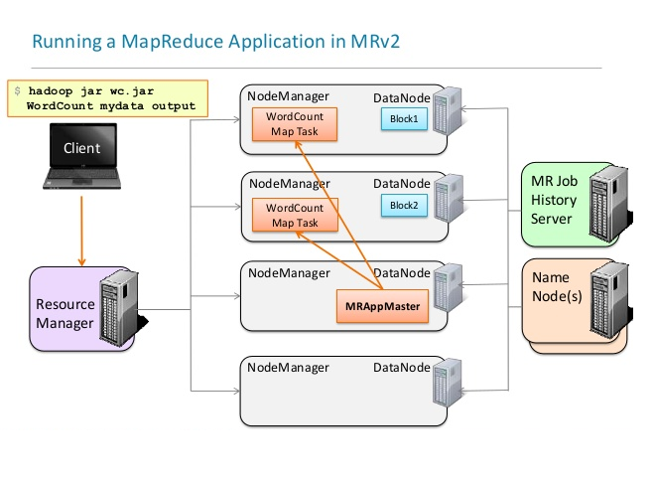
Running a MR job on Yarn

Slide 14
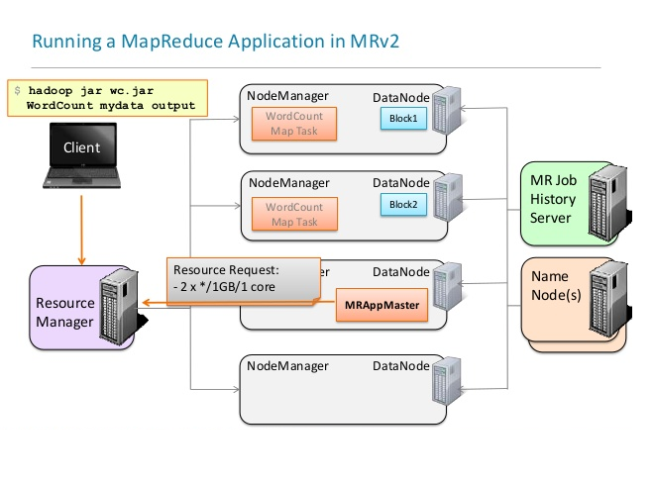
Running a MR job on Yarn

Slide 15
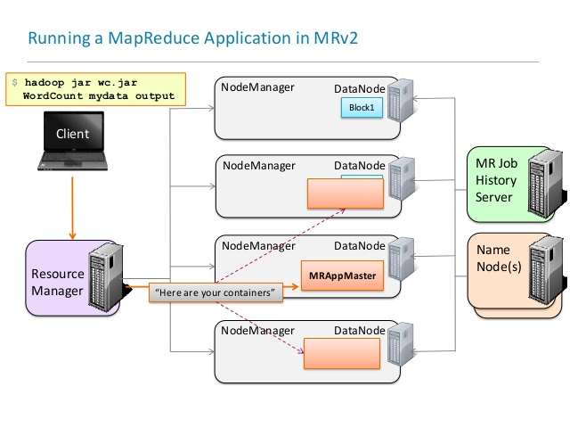
Running a MR job on Yarn

Slide 16
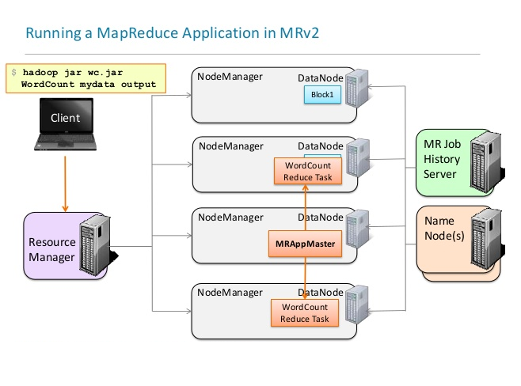
Running a MR job on Yarn

Slide 17
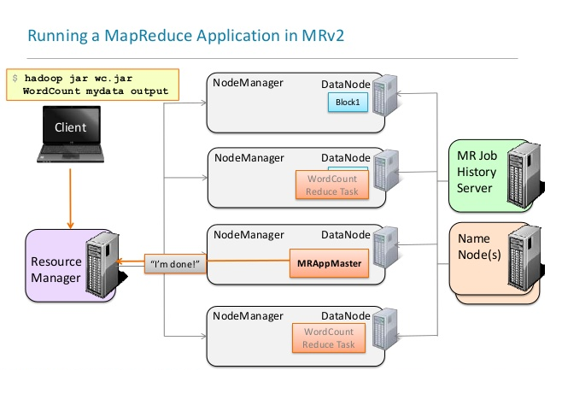
Running a MR job on Yarn

Slide 18
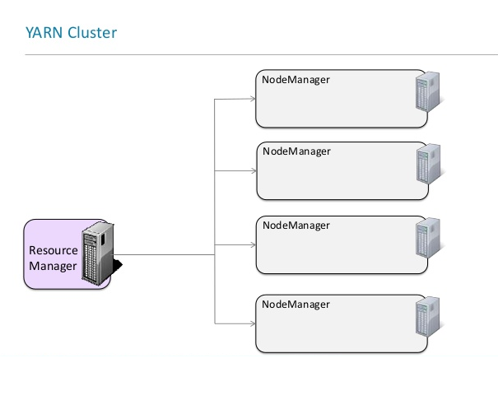
Running an application on YARN

Slide 19
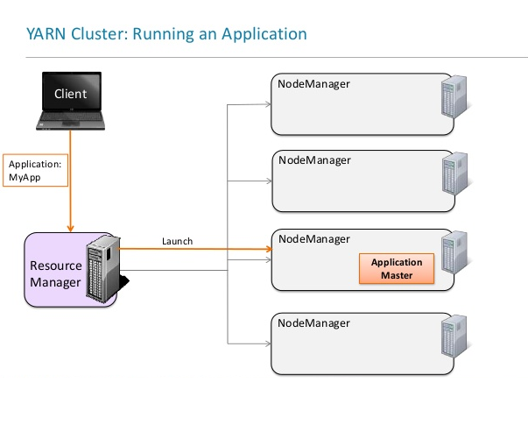
Running an application on YARN

Slide 20
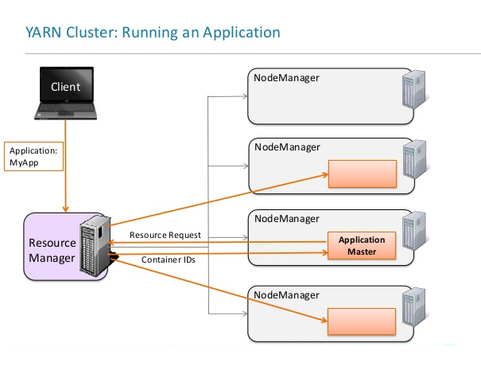
Running an application on YARN

Slide 21
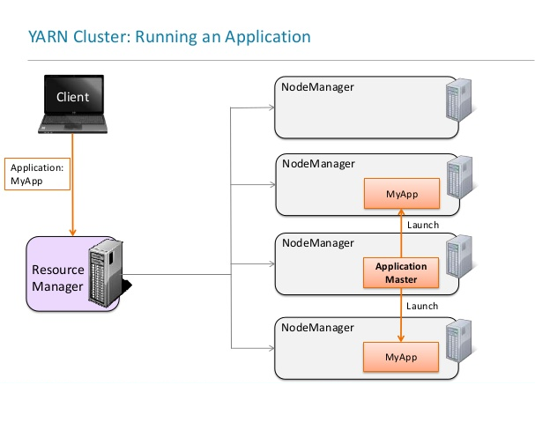
Running an application on YARN

Slide 22
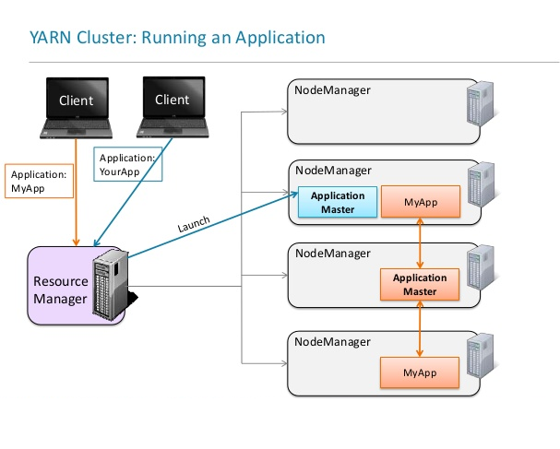
Running an application on YARN

Slide 23
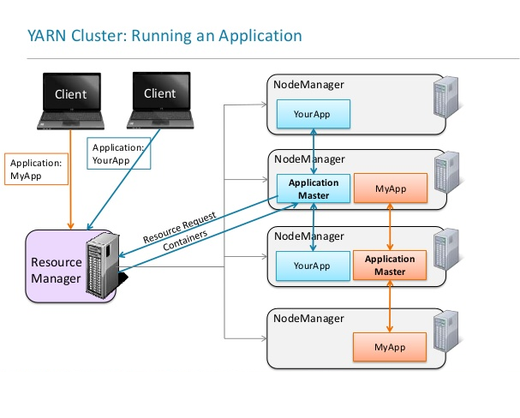
Running an application on YARN

Slide 24
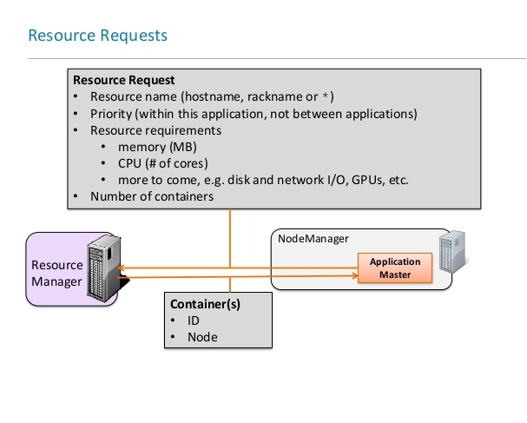
Resource request

Slide 25
Fault Tolerance
Any of the YARN component can fail
Task(Container) – Handled just like MR1
MRAppMaster will re-attempt tasks that complete with exceptions or stop responding
If task is failed for more than 4 times the job is failed.
Application Master
If AM stops sending heartbeats, RM will start a new instance of the master running in a new container.(2 times by default)
Node Manager
If NM stops sending heartbeats to RM, it is removed from list of active nodes.
Tasks on the nodes will be treated as failed by AM and will start on different nodes.
If AM node fails, then it will be treated as failed application.
Resource Manager
No application can be launched
Can be configured with HA

Slide 26
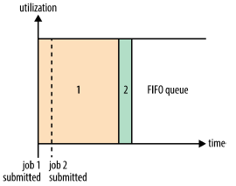
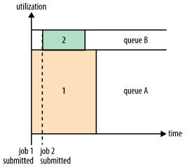
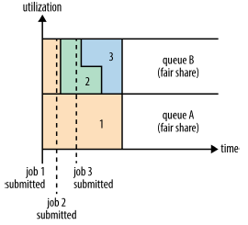
Scheduling in YARN
FIFO Schedulers
The FIFO Scheduler is simple but it’s not suitable for shared clusters as large applications will use all the resources in a cluster, so each application has to wait its turn.
Capacity Schedulers
With the Capacity Scheduler, a separate dedicated queue allows the small job to start as soon as it is submitted, although this is at the cost of overall cluster utilization since the queue capacity is reserved for jobs in that queue, the large job finishes later than using FIFO Scheduler.
Fair Schedulers
With the Fair Scheduler, there is no need to reserve a set amount of capacity, since it will dynamically balance resources between all running jobs.
Delay Scheduling
All YARN schedulers try to use locality advantage. However when any application requests for any particular node, there is a chance that other containers are running on it, Sometimes waiting a short time (no more than a few seconds) can increase the performance by getting allocated a container on the requested node than on a remote node.

Slide 27


















MR Execution
1. Copy Input Files
DFS
Job.xml. Job.jar.
Input Files
3. Get Input Files’ Info
5. Upload Job Information
Client
2. Submit Job
User
4. Create Splits
8. Read Job Files
6. Submit Job
DFS
Job Tracker
Input Spilts
As many maps as splits
Task Tracker - H2
YARN
11. Picks Tasks
(Data Local if possible)
9. Create maps and reduces
Task Tracker – H4
Maps
Reduces
Node Manager -
NM1
10. Heartbeat
12. Assign Tasks
11. Picks Tasks
(Data Local if possible)
Node Manager – NM2
10. Heartbeat
H4
7. Initialize Job
Job Queue

Slide 28
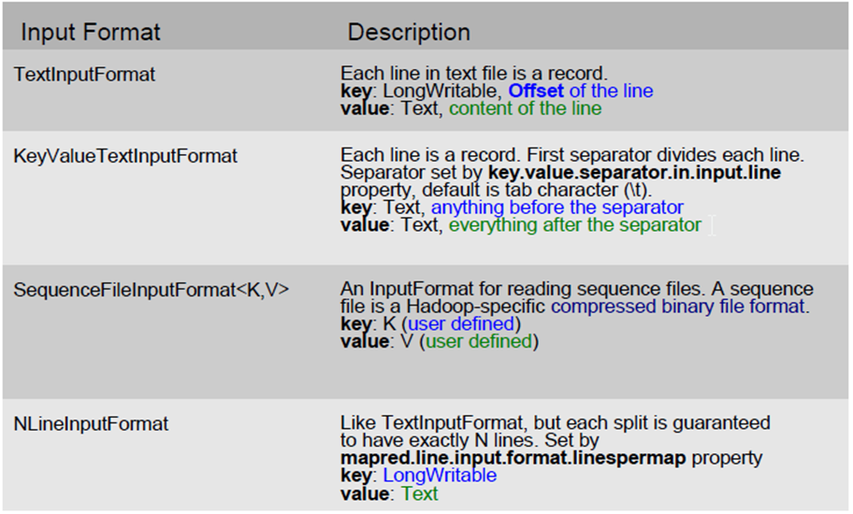
MapReduce API - InputFormats

Slide 29
Hands on - Demo Example
Find distinct player name (Using NullWritable)
Let’s find out the unique player names.
Observe the below code in mapper and reducer class
context.write(player,NullWritable.get());
Observe the below code in driver class
job.setOutputValueClass(NullWritable.class);
hadoop jar jar/MR-0.0.1-SNAPSHOT.jar com.programs.MR.DistinctPlayer.Driver SampleDataFile/CricketScore.txt output_2
Verify the player names
hadoop fs -cat output_3/part*

Slide 30
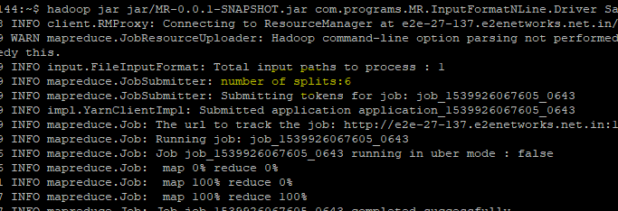
Hands on - Demo Example
NlineInputFormat
Let’s find out the max score of each player but this time using NlineInputFormat to control the split.
Observe the below code in driver class
NLineInputFormat.addInputPath(job, new Path(args[0]));
job.getConfiguration().setInt("mapreduce.input.lineinputformat.linespermap", 20);
hadoop jar jar/MR-0.0.1-SNAPSHOT.jar com.programs.MR.InputFormatNLine.Driver SampleDataFile/CricketScore.txt output_3
You can observe while execution the number of split has been 6 now instead of 1 as we are creating 20 lines per split.

Slide 31
Hands on - Demo Example
KeyValue Input Format
Let’s find out the max score of each player but this time using NlineInputFormat to control the split.
Observe the below code in driver class
Configuration conf = new Configuration();
conf.set("mapreduce.input.keyvaluelinerecordreader.key.value.separator",",");
hadoop jar jar/MR-0.0.1-SNAPSHOT.jar com.programs.MR.InputFormatKeyValue.Driver SampleDataFile/CricScoreKV.txt output_4
You can observe in mapper class the datatype is Text now instead of object as offset is no more key to mapper.

Slide 32
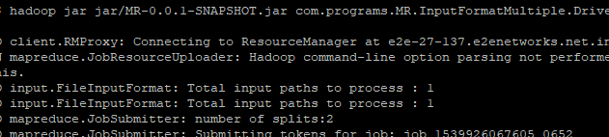
Hands on - Demo Example
Multi Input Format
Let’s find out the max score of each player but this time using MultiInputFormat to handle files of different format.
Observe there are separate mapper class for each file and below code in driver class
MultipleInputs.addInputPath(job,new Path(args[0]),TextInputFormat.class,Mapper1.class);
MultipleInputs.addInputPath(job,new Path(args[1]),TextInputFormat.class,Mapper2.class);
hadoop jar jar/MR-0.0.1-SNAPSHOT.jar com.programs.MR.InputFormatMultiple.Driver SampleDataFile/CricketScore.txt SampleDataFile/CricketScore_comma.txt output_5
You can observe while execution the number of split is 2 now.

Slide 33
Combiner, Partitioner, Shuffle & Sort
Combiner
Apply reduce function to map output before it is sent to reducer
Reduces number of records outputted by mapper!
Partitioner
Each mapper may produce (K, V) pairs to any partition.
Therefore, the map nodes must all agree on where to send different pieces of intermediate data.
The partitioner class determines which partition a given (K,V) pair will go to.
The default partitioner computes a hash value for a given key and assigns it to a partition based on this result.
Shuffle and Sort
Probably the most complex aspect of MapReduce and heart of the map reduce!
Map side
Map outputs are buffered in memory in a circular buffer.
When buffer reaches threshold, contents are “spilled” to disk.
Spills merged in a single, partitioned file (sorted within each partition): combiner runs here first.
Reduce side
First, map outputs are copied over to reducer machine.
“Sort” is a multi-pass merge of map outputs (happens in memory and on disk):
Final merge pass goes directly into reducer.

Slide 34
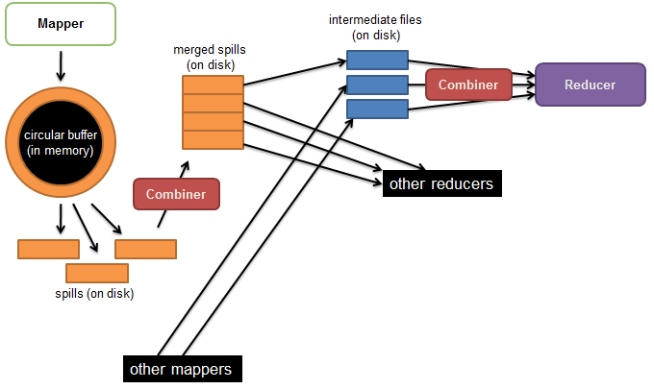
Shuffle and Sort

Slide 35
Hands on - Demo Example
Combiner Usage program
Let’s find out the max score of each player but this time using Combiner to control the split.
Observe the below code in driver class
//set Combiner Class
job.setCombinerClass(MaxScoreReducer.class);
hadoop jar jar/MR-0.0.1-SNAPSHOT.jar com.programs.MR.UseCombiner.Driver SampleDataFile/CricketScore.txt output_6
Note: with small Input files Combiner will not be effective, //mapreduce.map.combine.minspills = 3(Default) (To get combiner effective)

Slide 36
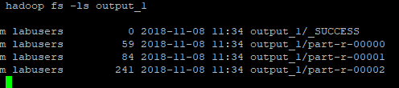
Hands on - Demo Example
Custom Partitioner program
Observe the new partitioner class is written to distribute the data among reducers to avoid skew.
hadoop jar jar/MR-0.0.1-SNAPSHOT.jar com.programs.MR.Partitioner.Driver SampleDataFile/CricketScore.txt output_7
Verify each part-r-* file to see the output key distributed as expected.

Slide 37
Output Format
The OutputFormat class defines the way (K,V) pairs produced by Reducers are written to output files.
Several OutputFormats are provided by Hadoop:
TextOutputFormat - Default; writes lines in "key \t value" format
SequenceFileOutputFormat - Writes binary files suitable for reading into subsequent MR jobs
NullOutputFormat - Generates no output files
Speculative Execution
A MapReduce job is dominated by the slowest task
MapReduce attempts to locate slow tasks (stragglers) and run redundant (speculative) tasks that will optimistically commit before the corresponding stragglers
This process is known as speculative execution
Only one copy of a straggler is allowed to be speculated
Whichever task(among the two copies) of a task commits first, it becomes the definitive copy, and the other task is killed.

Slide 38
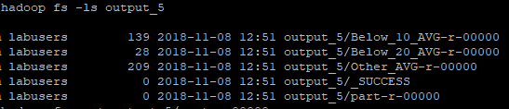
Demo
Multiple Output program
Find out the average of each player and write the output to different files using multioutput format
Please observe the reducer class and driver class changes to achieve this
hadoop jar jar/MR-0.0.1-SNAPSHOT.jar com.programs.MR.MultiOutput.Driver SampleDataFile/CricketScore.txt output_8
Verify the output file for desired result.

Slide 39
JOINS
Distributed Cache
It is preferable to distribute datasets using Hadoop’s distributed cache mechanism which provides a service for copying files to the task nodes for the tasks to use them when they run. To save network bandwidth, files are normally copied to any particular node once per job.
MAP-JOIN
A map-side join between large inputs works by performing the join before the data reaches the map function. For this to work, though, the inputs to each map must be partitioned and sorted in a particular way. Each input dataset must be divided into the same number of partitions, and it must be sorted by the same key (the join key) in each source. All the records for a particular key must reside in the same partition. This may sound like a strict requirement (and it is), but it actually fits the description of the output of a MapReduce job.
Reducer side –JOIN
Reduce-side join is more general than a map-side join, in that the input datasets don’t have to be structured in any particular way, but it is less efficient because both datasets have to go through the MapReduce shuffle. The basic idea is that the mapper tags each record with its source and uses the join key as the map output key, so that the records with the same key are brought together in the reducer.

Slide 40
Demo
Map side join program using distributed Cache
Find out player maximum score but consider there are two files
PlayerID_Name (PlayerID, PlayerName)
playerID_Score_Balls (PlayerID, PlayerScore, Balls)
Join two files at mapper side and write the mapper output as (playername, score)
Then find the max score of each player at reducer side.
Observe the distributed cache use in Driver class
Configuration config = new Configuration();
DistributedCache.addCacheFile(new URI("SampleDataFile/PlayerID_Name.csv"), config);
Observe the distributed cache use in Mapper class
Path[] files = DistributedCache.getLocalCacheFiles(context.getConfiguration());
hadoop jar jar/MR-0.0.1-SNAPSHOT.jar com.programs.MR.JoinMap.Driver SampleDataFile/playerID_Score_Balls.csv output_9
Change the number of Reducer to 0 to see the mapper output.

Slide 41
Demo
Reducer side join program
Find out player maximum score but consider there are two files of big size which can’t fit in DC.
PlayerID_Name (PlayerID, PlayerName)
playerID_Score_Balls (PlayerID, PlayerScore, Balls)
Join two files at reducer side and write the final output as (playername, maximum score)
Observe the mapper class to add keywords to understand pname and score at reducer side while context.write()
context.write(new IntWritable(Integer.valueOf(parts[0])), new Text("pscore\t" + parts[1]));
hadoop jar jar/MR-0.0.1-SNAPSHOT.jar com.programs.MR.JoinReduce.Driver SampleDataFile/PlayerID_Name.csv SampleDataFile/playerID_Score_Balls.csv output_10
Check the mapper output by setting number of reducer to zero in driver class

Slide 42
Counters
Counters are a useful channel for gathering statistics about the job: for quality control or for application-level statistics.
Task counters
Task counters gather information about tasks over the course of their execution, and the results are aggregated over all the tasks in a job.
The MAP_INPUT_RECORDS counter, for example, counts the input records read by each map task and aggregates over all map tasks in a job, so that the final figure is the total number of input records for the whole job.
Task counters are maintained by each task attempt, and periodically sent to the application master so they can be globally aggregated.
Job counters
Job counters are maintained by the application master, so they don’t need to be sent across the network, unlike all other counters, including user-defined ones. They
measure job-level statistics, not values that change while a task is running. For example, TOTAL_LAUNCHED_MAPS counts the number of map tasks that were launched over the course of a job (including tasks that failed).

Slide 43
Map Reduce – Closure look
Node 1
Node 2
Files loaded from local HDFS store
Files loaded from local HDFS store
InputFormat
InputFormat
file
Split
Split
Split
Split
Split
Split
file
file
file
RecordReaders
RR
RR
RR
RR
RR
RR
RecordReaders
Input (K, V) pairs
Input (K, V) pairs
Map
Map
Map
Map
Map
Map
Intermediate (K, V) pairs
Shuffling
Process
Intermediate
(K,V) pairs
exchanged by
all nodes
Intermediate (K, V) pairs
Partitioner
Partitioner
Sort
Sort
Reduce
Reduce
Final (K, V) pairs
Final (K, V) pairs
OutputFormat
OutputFormat
Writeback to local HDFS store
Writeback to local HDFS store

