Slide 1
Problem Statement
Running GenAI on Intel AI laptops and performing simple LLM inference on CPU and fine-tuning of LLM models using Intel® OpenVINO™.
Category: AI, ML, LLM, NLP
Pre-requisites: Understanding of ML concepts, programming skills (Python, NLP libraries), experience with NLP and text-based AI models.

Slide 2
Unique Idea Brief (Solution)
Introduction to Generative AI, performing LLM inference on CPU, and fine-tuning LLM models to create a custom chatbot using Intel AI tools.

Slide 3
Features Offered
Foundational understanding of Generative AI.
Performing simple LLM inference on CPU.
Fine-tuning LLM models for custom applications.
Creating a custom chatbot using fine-tuned LLMs.

Slide 4
Process Flow
Step-by-Step Process:
Introduction to GenAI.
Performing LLM inference on CPU.
Fine-tuning LLM models.
Creating a custom chatbot.

Slide 5
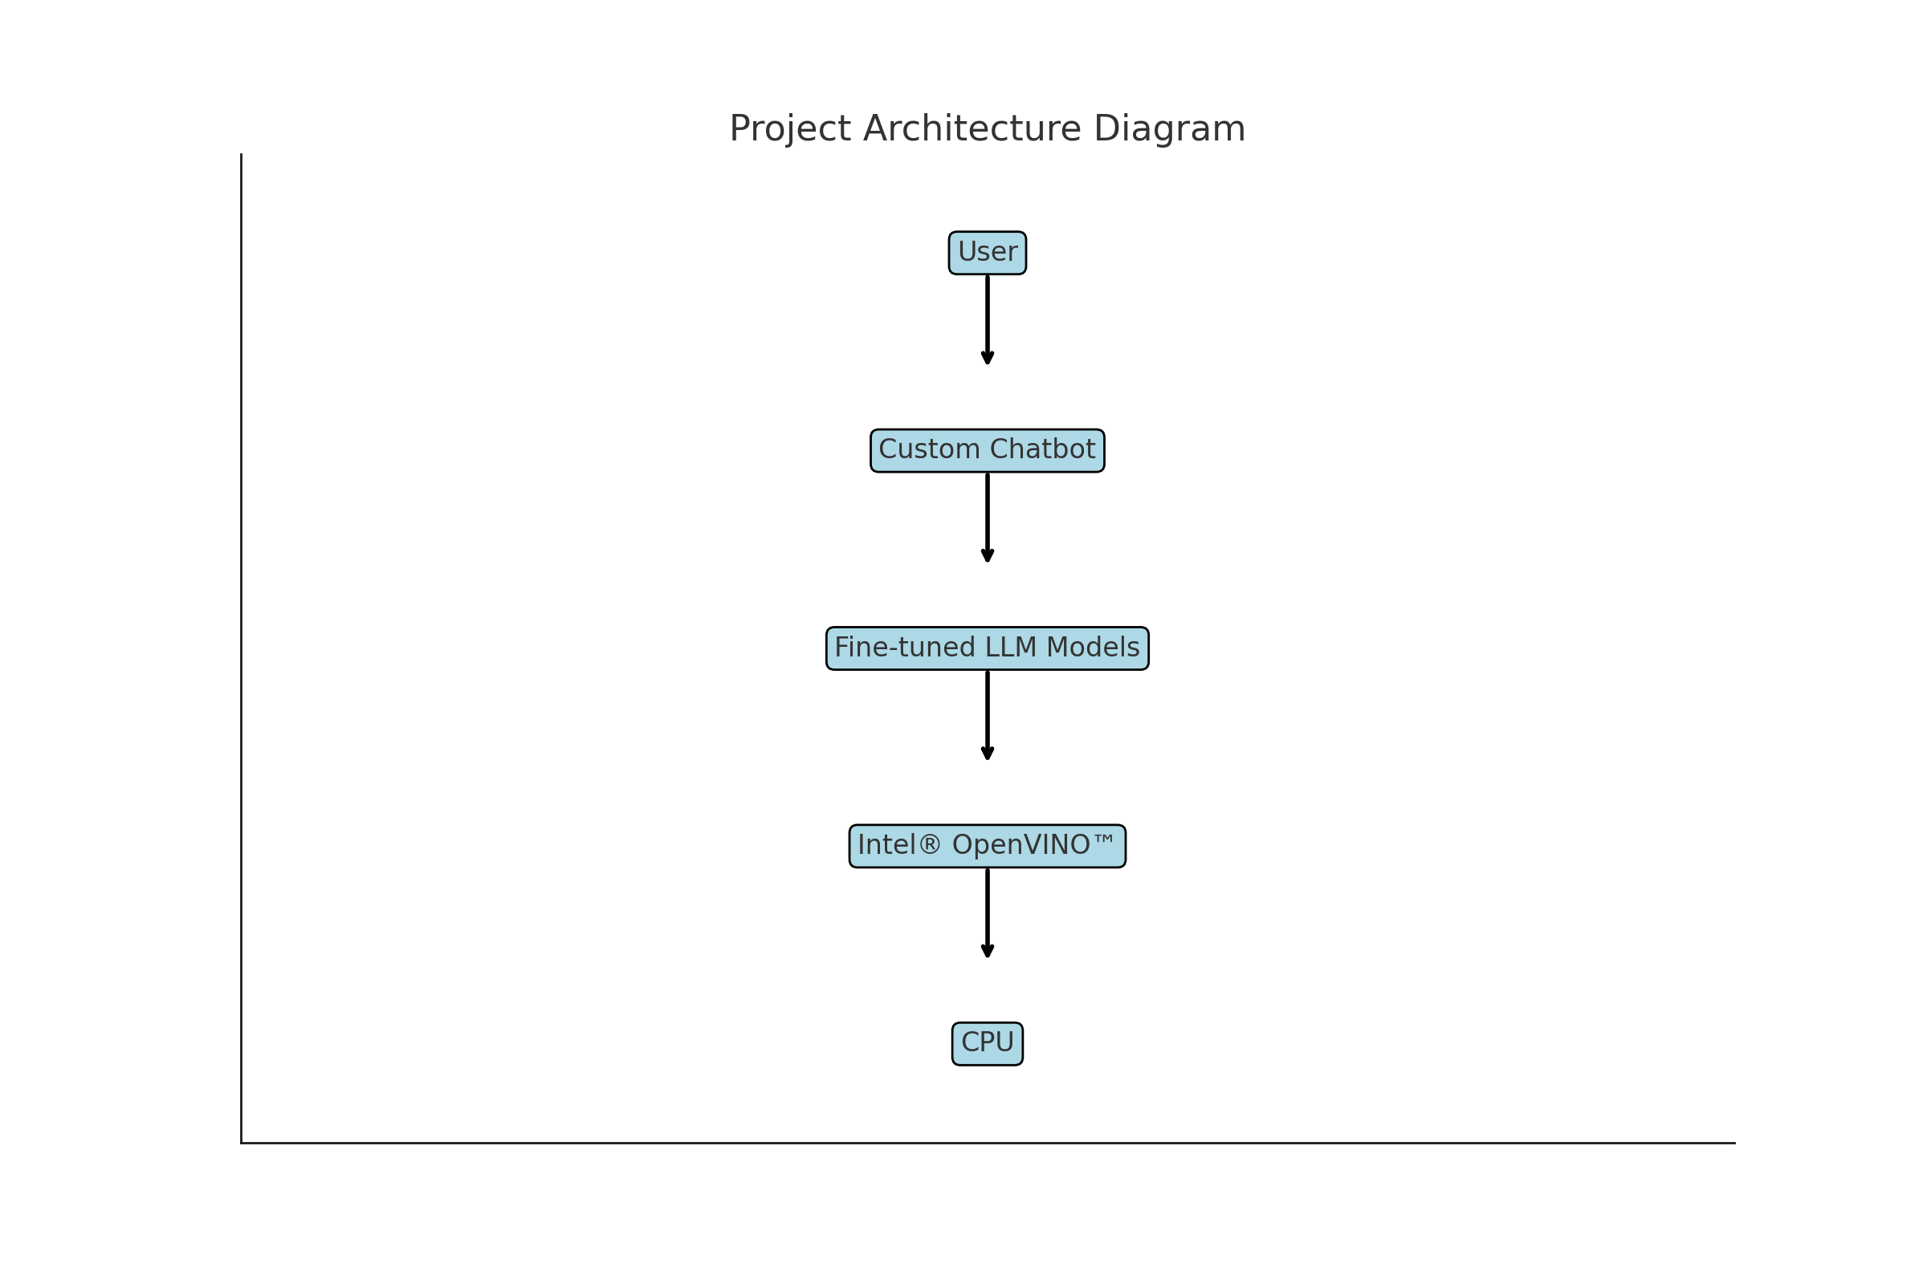
Architecture Diagram

Slide 6
Technologies Used
Intel® OpenVINO™
Python
NLP libraries (Hugging Face, transformers)
Pre-trained LLM models

Slide 7
Implementation
1. Introduction to GenAI:
!pip install transformers[torch] accelerate -U
2. Performing LLM inference on CPU:
import pandas as pd
df = pd.read_csv('/content/coursea_data.csv')
print(df.columns) # Print the column names
print(df.head()) # Print the first few rows of the DataFrame
texts = df['course_title'] + ': ' + df['course_organization']

Slide 8
Implementation
3. Fine-tuning LLM models:
with open('train.txt', 'w', encoding='utf-8') as f:
for text in texts:
f.write(f"{text}\n")

Slide 9
Implementation
Fine tuning gpt model:
import torch
from transformers import GPT2Tokenizer, GPT2LMHeadModel, TextDataset, DataCollatorForLanguageModeling
from transformers import Trainer, TrainingArguments
model_name = 'gpt2'
tokenizer = GPT2Tokenizer.from_pretrained(model_name)
model = GPT2LMHeadModel.from_pretrained(model_name)
def load_dataset(train_file_path, tokenizer):
dataset = TextDataset(
tokenizer=tokenizer,
file_path=train_file_path,
block_size=128,
)

Slide 10
Implementation
return dataset
train_dataset = load_dataset('train.txt', tokenizer)
data_collator = DataCollatorForLanguageModeling(
tokenizer=tokenizer,
mlm=False,
)
training_args = TrainingArguments(
output_dir='./results',
overwrite_output_dir=True,
num_train_epochs=1,
per_device_train_batch_size=2,
save_steps=10_000,
save_total_limit=2,
)
trainer = Trainer(
model=model,
args=training_args,
data_collator=data_collator,
train_dataset=train_dataset,
)
trainer.train()

Slide 11
Implementation
Model Conversion to format
from openvino.runtime import Core
core = Core()
model_ir = core.read_model(model="model_ir/model.xml")
compiled_model = core.compile_model(model=model_ir, device_name="CPU")
infer_request = compiled_model.create_infer_request()

Slide 12
Implementation
from openvino.runtime import Core
import numpy as np
from transformers import AutoTokenizer
# Initialize the OpenVINO runtime
ie = Core()
# Load the IR model
model_path = "./model_ir/model.xml"
compiled_model = ie.compile_model(model_path, device_name="CPU")
# Prepare the tokenizer
tokenizer = AutoTokenizer.from_pretrained('gpt2')
# Prepare the input
dummy_input = tokenizer("A Law Student's Toolkit:", return_tensors="pt")
input_ids = dummy_input['input_ids'].numpy()
# Run inference
infer_request = compiled_model.create_infer_request()
infer_request.infer({"input_ids": input_ids})
output = infer_request.get_output_tensor(0).data
print("Inference results:", output)

Slide 13
Team Members and Contribution
Team Name: Interface Initiators
Team Head: Sandeep Kaur
Team Member: Anshika Goyal

Slide 14
Conclusion
we aimed to leverage Generative AI and Intel's powerful AI tools to create a custom chatbot that performs efficient LLM inference on a CPU. By fine-tuning pre-trained LLM models using Intel® OpenVINO™, we were able to enhance the performance and usability of the chatbot on standard hardware. Here are the key takeaways:
Introduction to Generative AI: We began by understanding the fundamentals of Generative AI, which is crucial for developing intelligent conversational agents.
Efficient LLM Inference on CPU: By utilizing Intel® OpenVINO™, we successfully performed LLM inference on CPU, demonstrating that high-quality AI models can operate efficiently without the need for high-end GPUs.
Fine-Tuning LLM Models: We fine-tuned pre-trained GPT-2 models with custom datasets, ensuring that our chatbot can provide contextually relevant and accurate responses based on specific training data.
Creation of Custom Chatbot: Combining the above steps, we developed a custom chatbot capable of answering queries related to courses and organizations. This chatbot can be further adapted and scaled for various applications in education, customer service, and more.

