Slide 1

Bilateral and Guided Image Filtering
University of Burgundy
Masters in Computer Vision
Sandeep Manandhar
Advanced Image Analysis

Slide 2
Introduction
Image Filtering
  Noise Removal
  Edge Preservation
Basic filtering
  Box filtering
  Gaussian Blurring
  Median Filtering

Slide 3


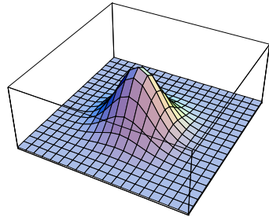
Gaussian
Gaussian Smoothing
  Distance from Neighbourhood
  Kernel Size and Noise estimation as Parameters
  No Edge Preservation
Fig: Noisy Image

Slide 4
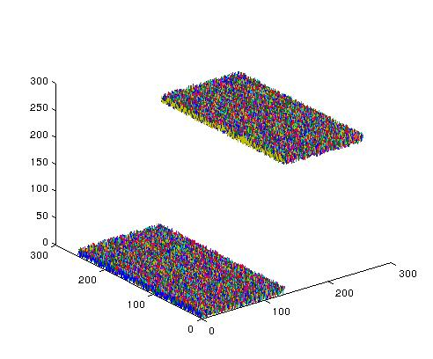
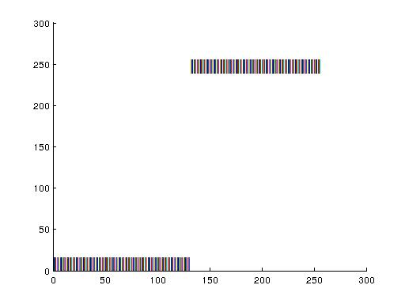
Gaussian
Fig: Noisy Image
Gaussian Smoothing
  No Edge Preservation
Fig: Spatial vs Intensity

Slide 5

Introduction
Gaussian Smoothing
  No Edge Preservation
Fig: After Gaussian Smoothing
Fig: Noisy Image

Slide 6
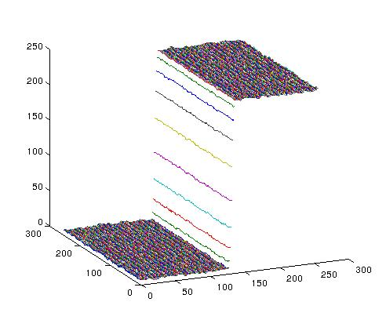
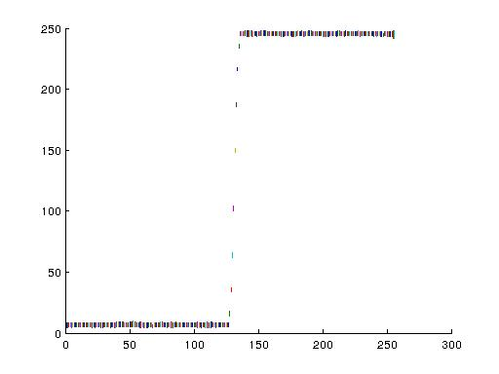
Introduction
Fig: After Gaussian Smoothing
Gaussian Smoothing
  No Edge Preservation
Fig: Spatial vs Intensity

Slide 7




Bilateral Smoothing
Bilateral Smoothing
  Edge Preservation
X
=
At pixel location (132,150)
Fig: Spatial and Range → Bilateral kernel

Slide 8
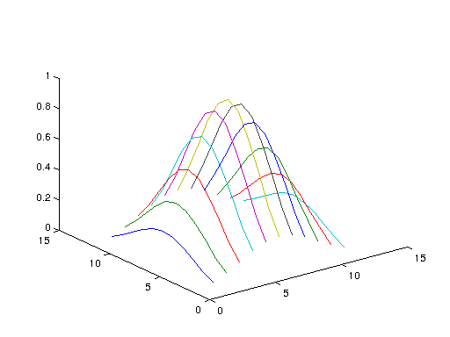
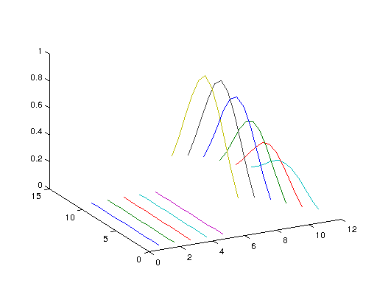
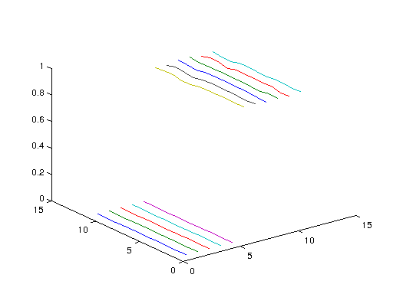
Bilateral Smoothing
Bilateral Smoothing
  Edge Preservation
Spatial
Range
Fig: Spatial and Range → Bilateral kernel

Slide 9

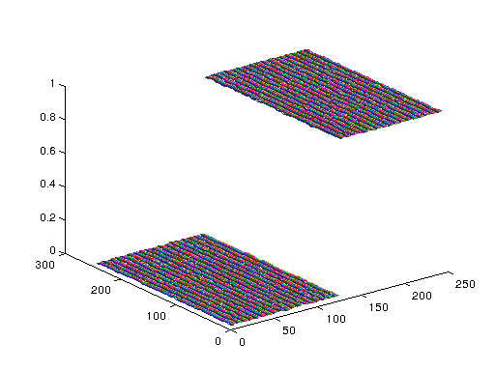
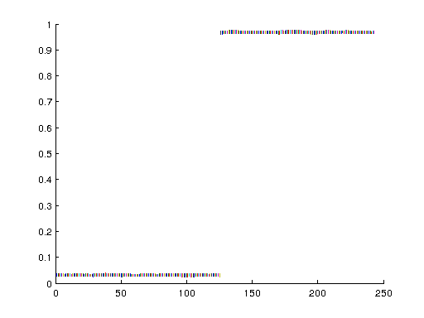
Bilateral Smoothing
Fig: Bilateral Smoothing
Bilateral Smoothing
  Edge Preservation
Fig: Spatial vs Intensity

Slide 10
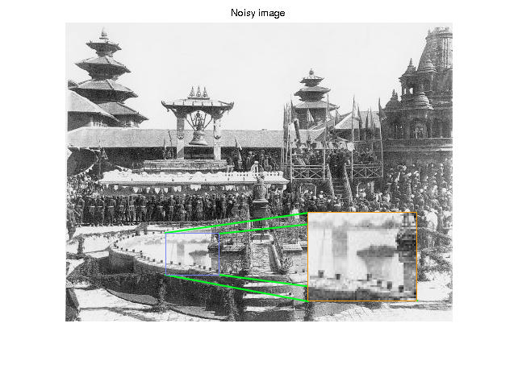
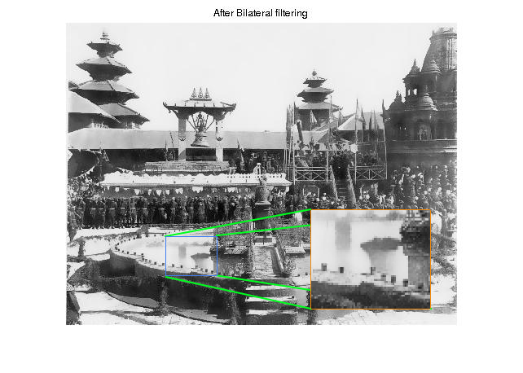
Bilateral Smoothing
Result

Slide 11
Guided Image Filtering
Bilateral Filtering
  Previous technique : Brute force
  Extremely slow
  Complexity increases with square of kernel size

Slide 12
Guided Image Filtering
Noise removal
Edge preservation
  Aware of edges through a guide
  Guide is an additional Image

Slide 13

Guided Image Filtering
Key notion:
  Some linear combination of Guided Image
output
Guide
Smooth Component
Edge Component

Slide 14

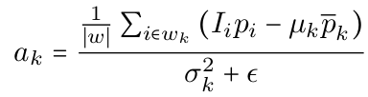

Guided Image Filtering
Key notion:
  Some linear combination of Guided Image
Equations from [3]

Slide 15
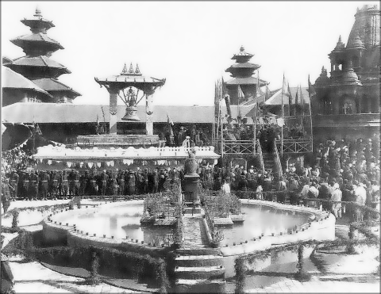
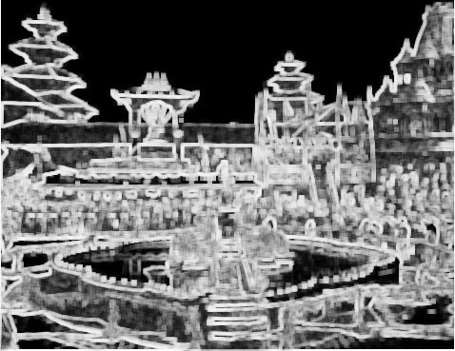
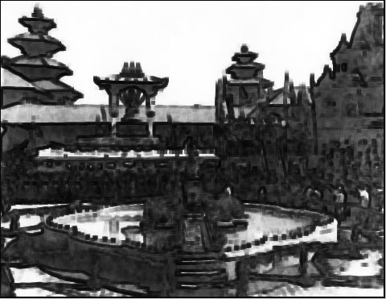
Guided Image Filtering
Filtered Image (q)
ak map
bk map

Slide 16
Guided Image Filtering
Much faster than bilateral filtering
  0.4 sec vs 8 sec
More possibility like fusing two images

Slide 17
References
[1] Bilateral Filtering: Theory and Applications, Sylvain Paris, Pierre Kornprobst, Jack Tumblin, Fredo
Durand, 2008
[2] Products and Convolutions of Gaussian Probability Density Functions, P.A. Bromiley, 2003
[3] Guided Image Filtering, Kaiming He, Jian Sun, Xiaoou Tang, Microsoft Research Asia
[4] Guided Image Filtering, Kaiming He, Jian Sun and Xiaoou Tang, IEEE TRANSACTIONS ON
PATTERN ANALYSIS AND MACHINE INTELLIGENCE, VOL. 35, 2013
[5] Bilateral Filtering for Gray and Color Images, C. Tomasi and R. Manduchi. ,In Proc. of the IEEE
,International Conference on Computer Vision, 1998.

Slide 18
Thank you …

