Slide 1
Athenaeum
Smart library gate analytics and gate-context-aware book recommendation
Sandeep M K
Data Science Ecosystem (23CS2024) · Project-Based Evaluation · Oct 2026
Notes:
Introduce the project: a smart library system with a live gate, analytics and a book recommender.

Slide 2
Problem statement
College libraries record who comes in and what they borrow, but nobody analyses it.
1
Paper registers
2
Books go undiscovered
Entry logs capture names, not patterns. Staff only learn the room is full when it is full.
Students find books by browsing or word of mouth; most of the catalogue is never borrowed.
3
Late returns
4
Opaque, unfair tools
Overdue books are noticed after the due date instead of being anticipated at issue.
Existing recommenders ignore how people use the building and rarely explain or audit their choices.
Notes:
Four problems. The project tackles all four in one pipeline.

Slide 3
Objectives
1
Scrape a real book catalogue from Open Library and clean it
5
Segment members into reader personas with clustering
2
Capture live entry and exit events at the library gate
6
Recommend books with a new gate-context-aware hybrid method
3
Explore and test usage with descriptive statistics and hypothesis tests
7
Protect privacy and audit every model for fairness
4
Predict hourly footfall, occupancy and late returns
Notes:
Seven objectives; each maps to a module of the code and a section of the report.

Slide 4
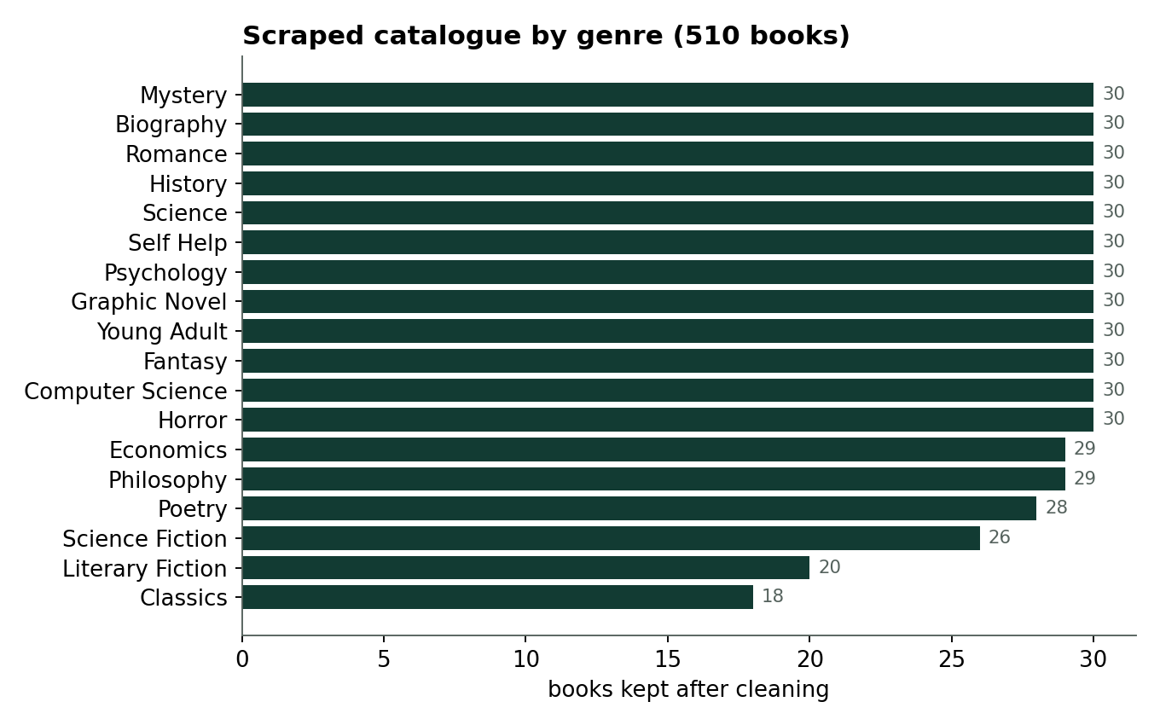
Web-scraped dataset
1,980
Polite scraper
User-Agent header, rate limits, retries with back-off and a raw JSON snapshot for reproducibility
records scraped
510
books kept after cleaning
18
genres
Source: Open Library search + work APIs (titles, authors, pages, ratings, want-to-read counts, descriptions)
Cleaning: de-duplication, English only, fiction/non-fiction checks, empty descriptions dropped
Activity: 600 members, 3,105 loans, 2,392 ratings from the gate and issue desk (simulated from stated behaviour)
30,132
gate visits logged
Notes:
The catalogue is real and scraped. Member activity is simulated because real student data cannot be shared; the code runs unchanged on real logs.

Slide 5
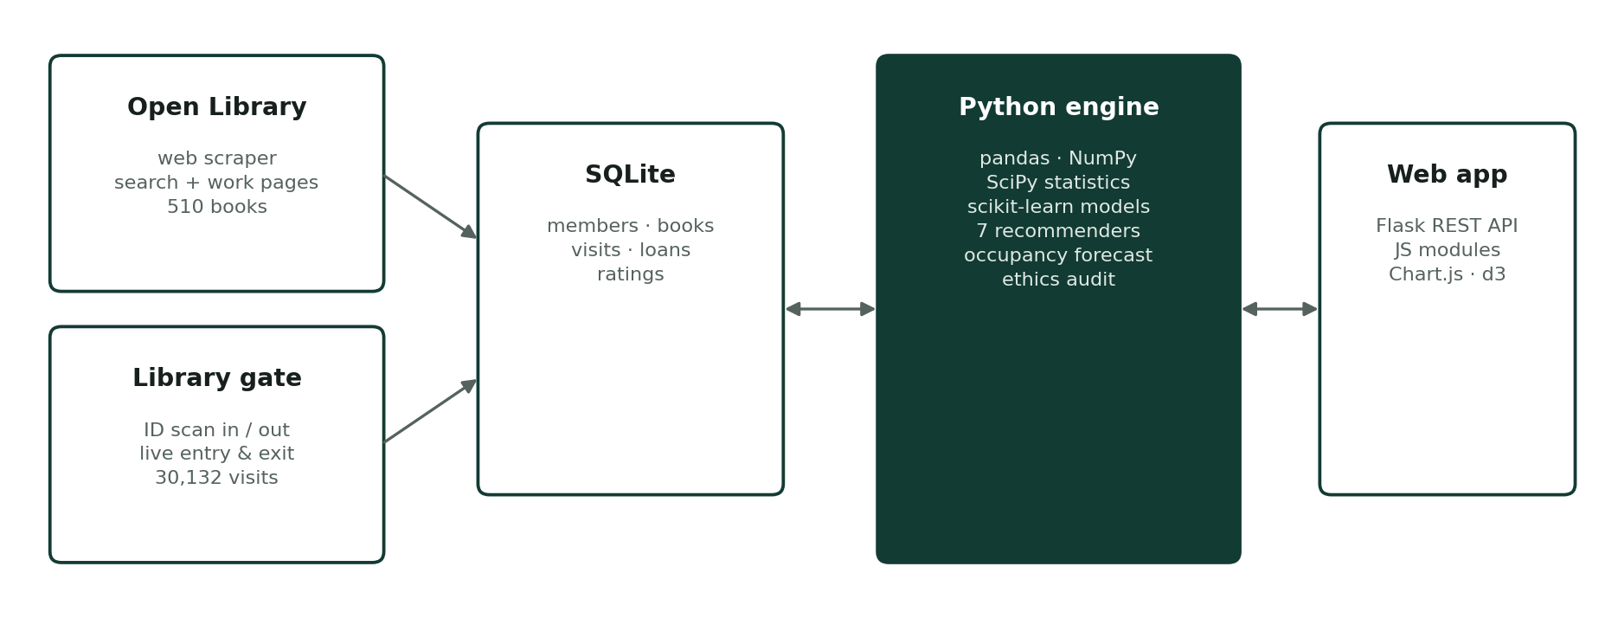
System architecture
Scraper and gate feed SQLite; a Python engine computes statistics, models and recommendations; Flask serves a browser app drawn with Chart.js and d3.

Slide 6
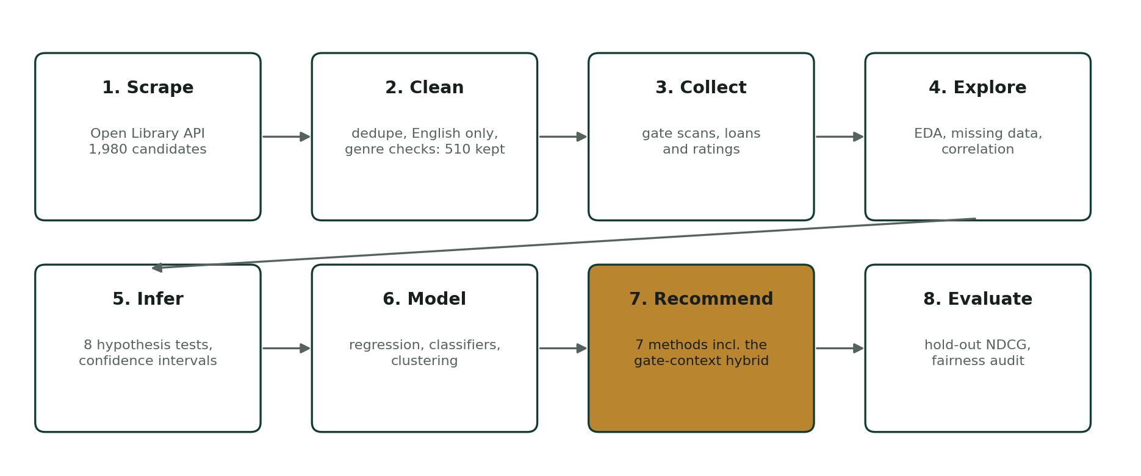
Methodology: the data science workflow
Every stage is a separate, tested Python module: scraper, seed, analytics, recommender, ethics, server.

Slide 7
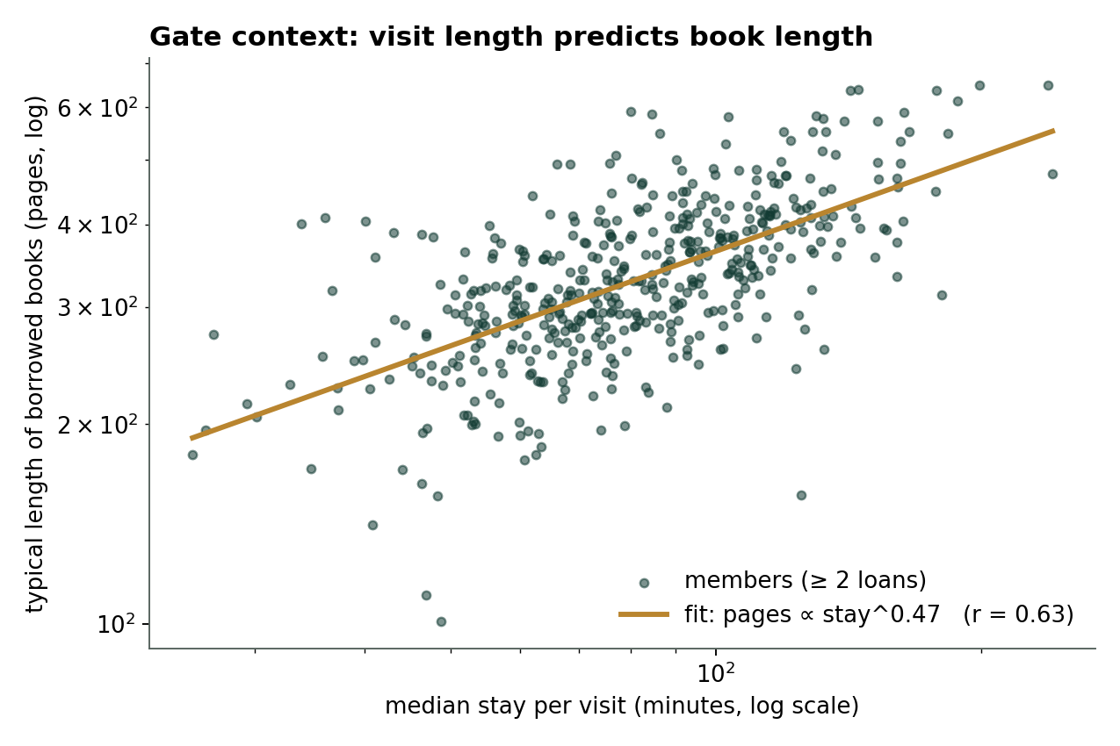
Proposed method: gate-context-aware hybrid
1 Hybrid score
Content (TF-IDF) + user CF + item CF + matrix factorisation + popularity, weights tuned on hold-out NDCG
2 Learn context from the gate
log(pages) = a·log(stay) + b, a = 0.47, r = 0.63
3 Re-weight and diversify
Score = Hybrid × (0.7 + 0.3 · length fit), then MMR re-ranking for variety. Works even for members who have only visited.
Notes:
The novel part: how long someone stays in the library predicts how long a book they pick. We use the gate log to re-weight the hybrid recommender.

Slide 8
Exploration and hypothesis testing
93.3 min
78.8 min
58.3 min
1.68
Mean stay
Median stay
Std deviation
Skewness
Question | Test | p-value | Decision
Do students stay longer on weekdays than weekends | Welch t-test | 0.820 | Fail to reject
Does average stay duration differ across departments | One-way ANOVA | < 0.001 | Reject H0
Is there an association between department and visit purpose | Chi-square | 0.344 | Fail to reject
Are the number of visits and loans per member correlated | Pearson correlation | < 0.001 | Reject H0
Do first-year students return books later than others | Mann-Whitney U | < 0.001 | Reject H0
Is the late return rate different for male vs female members | Two-proportion z-test | 0.057 | Fail to reject
Is the distribution of stay duration normal | Shapiro-Wilk | < 0.001 | Reject H0
Notes:
Stays are right-skewed. Visitors who come often borrow more; first-years return later; departments differ in stay. Weekend and gender effects are not significant.

Slide 9
Forecasting footfall and predicting late returns
Multiple regression explains 69% of hourly variation and drives the occupancy forecast. Logistic regression balances recall and F1 best and explains each risk score.

Slide 10
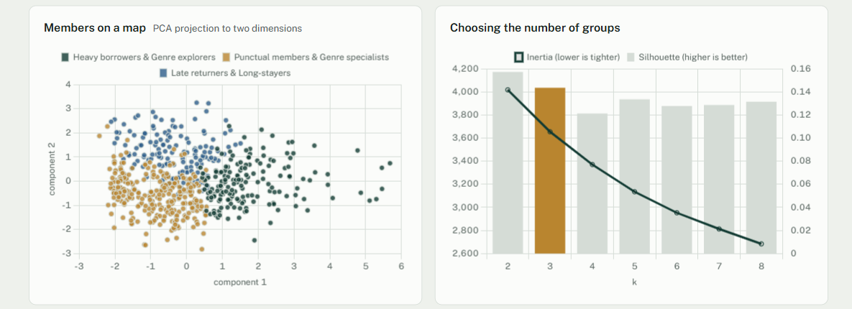
Reader personas from clustering
166
286
148
members
Heavy borrowers & Genre explorers
members
Punctual members & Genre specialists
members
Late returners & Long-stayers
K-means on 8 behaviour features; k = 3 chosen by elbow and silhouette
PCA projects members to 2-D for the map
Agglomerative (Ward) agrees with k-means: adjusted Rand index 0.19

Slide 11
Recommender evaluation
+17%
NDCG over the plain hybrid
Protocol: 20% of each member’s books hidden, models retrained, top-10 lists checked. Context weight chosen on a separate validation split.

Slide 12
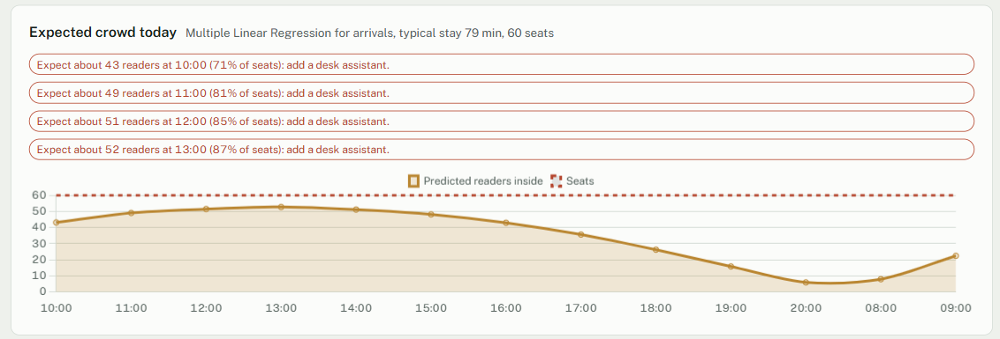
Occupancy forecast with crowding alerts
Occupancy(h) = Inside · S(h) + Σ Arrivals_j · S(h − j)
Arrivals come from the multiple-regression forecast; S(t) is the measured share of visitors still inside after t hours. Peak today: about 54 readers for 60 seats, so staff are told to open the overflow hall before it fills.

Slide 13
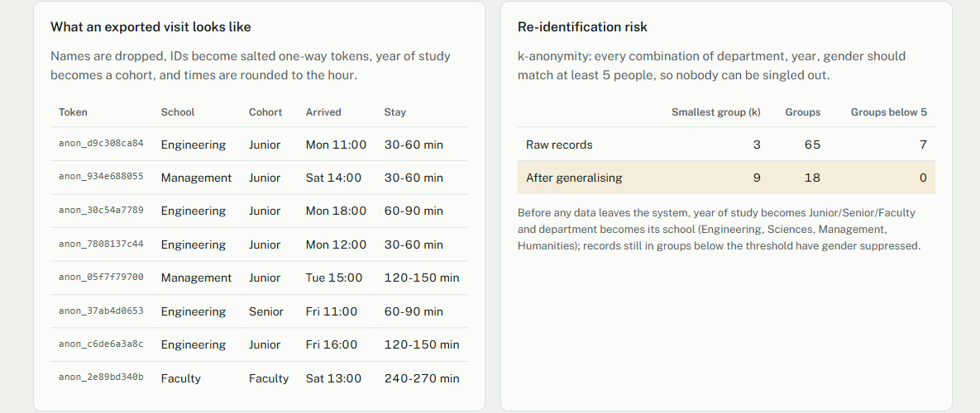
Privacy and fairness
k = 3 → 9
0.98
46
k-anonymity before and after generalising year and department
disparate impact of the late-return model (≥ 0.8 passes)
members opted out; they get only non-personal picks
Salted SHA-256 tokens replace member IDs in every export
Gender is never a model input, yet outcomes are audited per group
Every recommendation and risk score shows its reasons

Slide 14
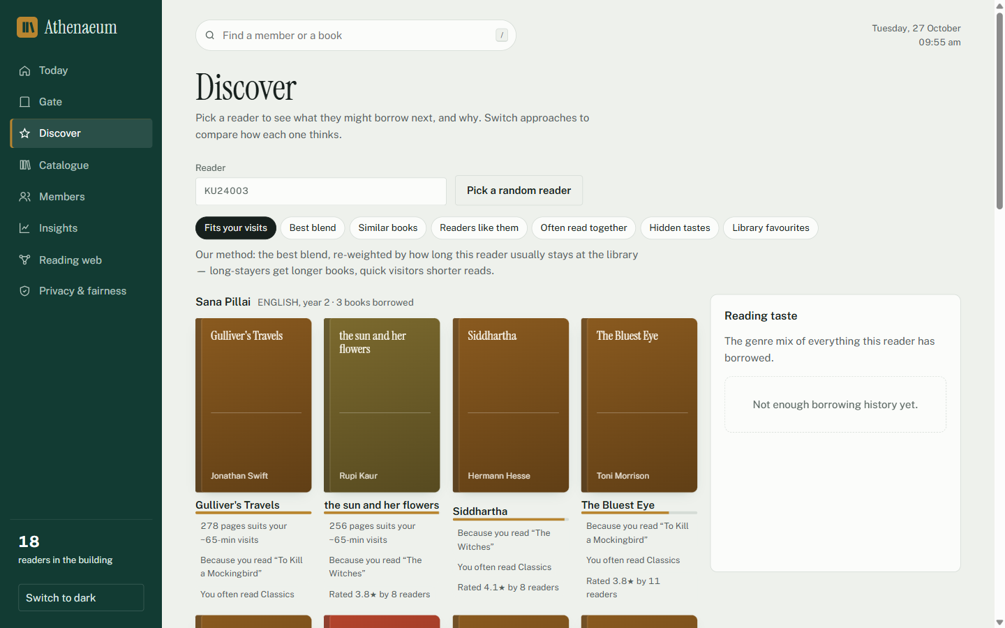
The application
Gate – scan an ID to check in or out
Today – live occupancy and forecast
Discover – 7 recommenders with reasons
Insights – EDA, tests, models, personas
Reading web – co-borrow graph, Neo4j export
Privacy & fairness – the audit
python run.py → http://127.0.0.1:5000 · 36 automated tests pass

Slide 15
Conclusion and future work
What we showed
Real scraped catalogue + live gate data in one pipeline
Gate context improves recommendations by 17% NDCG
Footfall regression becomes advance crowding alerts
Every result is explained, anonymised and fairness-checked
Next steps
Validate the context method on real library records
Connect an RFID or barcode reader to the gate
Add time-of-day context and per-member weights
E-mail crowding alerts and due-date reminders

Slide 16
Thank you
Questions welcome
github.com/sandeepmk2006/Libray-managment-with-book-recommendation

