Slide 1

SANDEEP M NAIR
5.5 Years
Associate Sr. Engineer
Date: 4th November 2025

Slide 2
Contents
Profile
Plant level Studies
Network Level Studies
Automation & support
Why Change:

Slide 3
Profile
-Family
Born & Brought up in Mumbai
Family based in kerala
Wife originally from kerala, brought up in Chennai
Married ( Feb 2025)
-Hobbies:
Learning Ukulele & violin
-Fun fact:
Trekked Mardi Himal, Nepal
Visited Kartarpur gurudwara, Pakistan (India Friendship corridor)

Slide 4
Profile
-Education
M. Tech. (Electrical Power System)
Government College of Engineering Karad
B.E. (Electrical Engineering)
University of Mumbai

Slide 5
Few words which represent Sandeep
Skilled at : Automation
Core : Transmission planner
Future : SME
Key Quality : Commitment

Slide 6
No proprietary/confidential information or CEII is being shared in the meeting

Slide 7
Org. chart
12 year
Exp
SMN
Load Interconnection group
Plant level studies group
0.5 year
Exp
1 year
Exp
1 year
Exp
2.5 years
Exp

Slide 8
Haldia
Petrochemicals
GE
Appliances
Burns & McDonnell
IIT Bombay
Research intern
& JRF
GET Engineer
Analyst Co-op
Engineer
Associate Sr. Engineer
January 2019
-July 2019
March 2021
-Dec. 2021
January 2022
-August 2022
August 2022-Dec 2024
January 2025 onwards
Mumbai
Kolkata
Bengaluru
Mumbai

Slide 9
Experience:
Softwares
PSS/E
TARA
ETAP
ASPEN
PSLF
Studies
Load Flow
SC Study
Load interconnection
Generator interconnection
GI Interconnection application (steady state)

Slide 10
Software:

Slide 11
Plant Level Studies
Load Flow Study
Short Circuit Study
Sensitivity tests

Slide 12
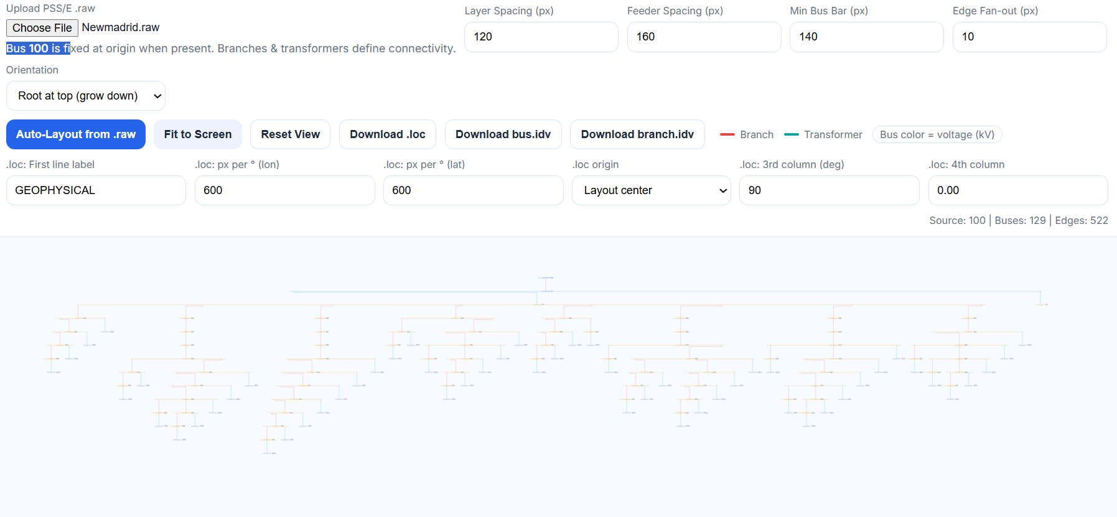
Plant Level Studies (Innovation)

Slide 13
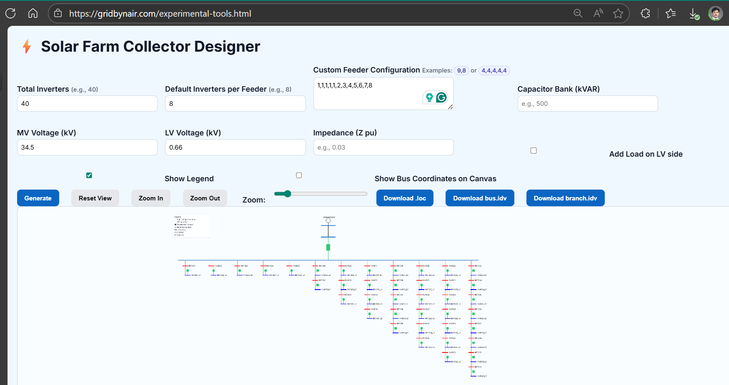
Plant Level Studies (Innovation)

Slide 14
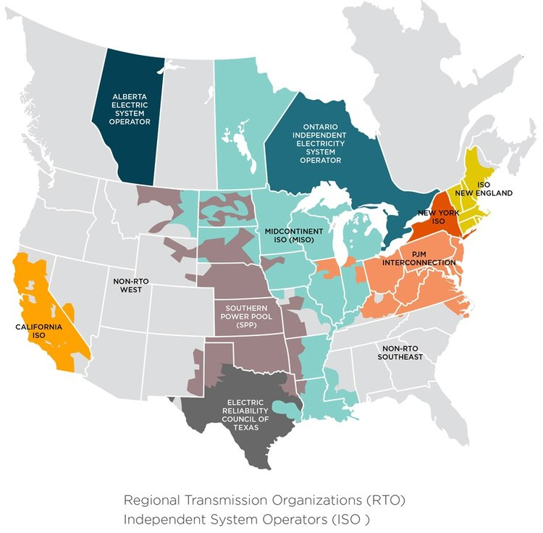
Developer Studies
(Conceptual/Prelim. to Commissioning support)
Packages (0%-60%-90%-100%-IFC)
Load Flow
Short Circuit
Sensitivity test

Slide 15
Network Level Studies
FCITC (1 count)
GI Study ( 1month PJM Window)
LI Study (25-30 sites)

Slide 16
Load Interconnection (network level)
Datacenter/mining load interconnection
Generator (lumped) interconnection

Slide 17
Generator Interconnection (Network level)
PJM GD Data Edits
Mon. file edit
Con file edit
TARA Generator deliverability tests

Slide 18
Load Interconnection Studies
Generation Interconnection Studies

Slide 19
Interconnection Application Packages
PJM ,ISO NE ,NYISO Clusters
-Steady state
Aspen, PSS/E
-Dynamics
Flat & Bump test
-Application & Additions supporting files

Slide 20
Interconnection Application (Innovation)
Auto-filling excel/forms based on master sheet
PSS/E equivalent model build based on Master sheet
Dyr syntax trained gpt

Slide 21
Interconnection Application packages

Slide 22
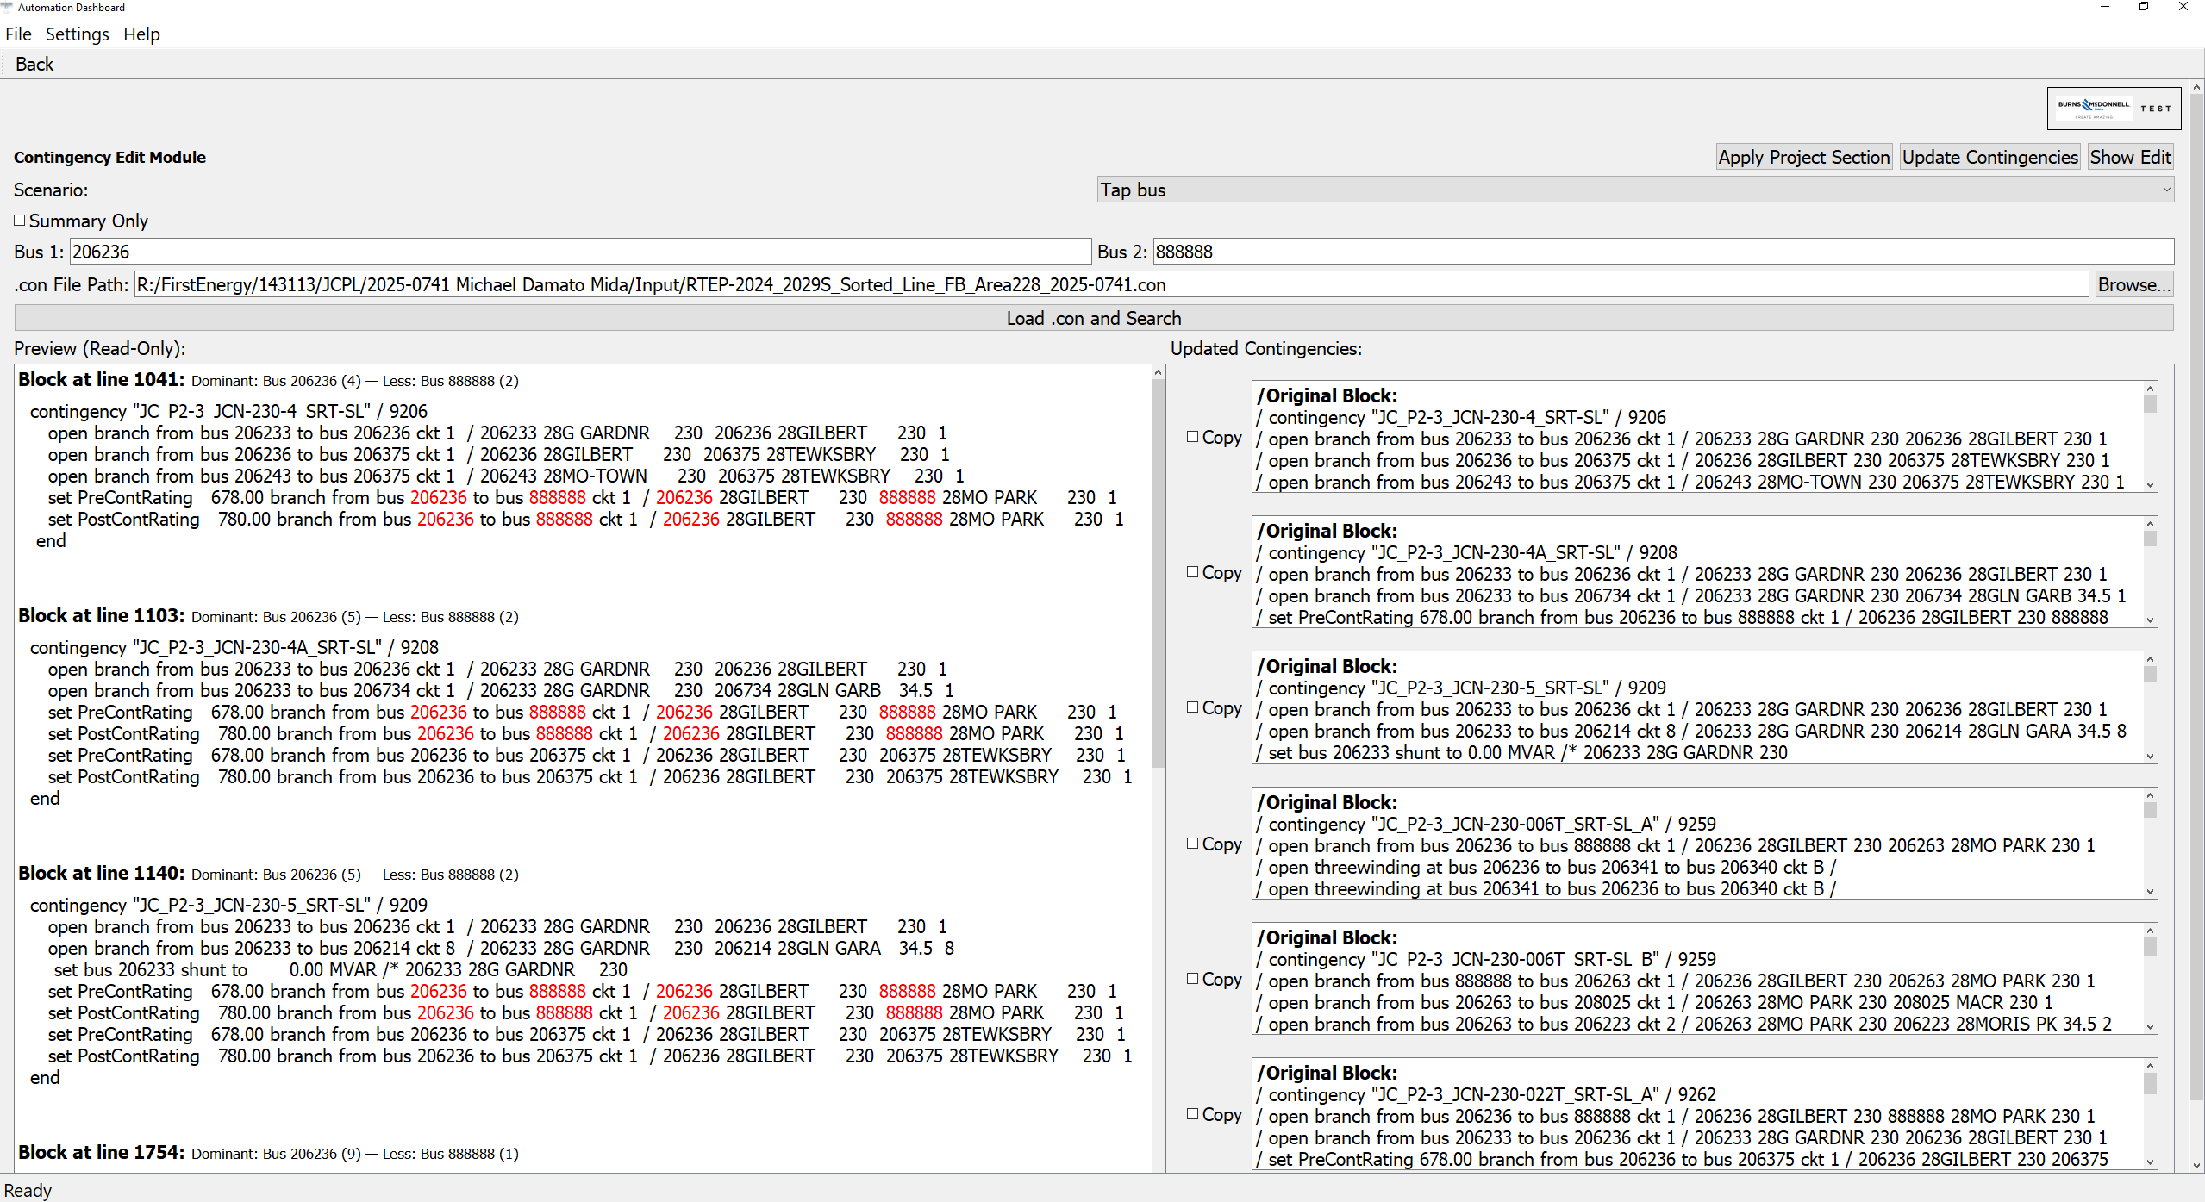
Network Level Studies (Innovation)

Slide 23
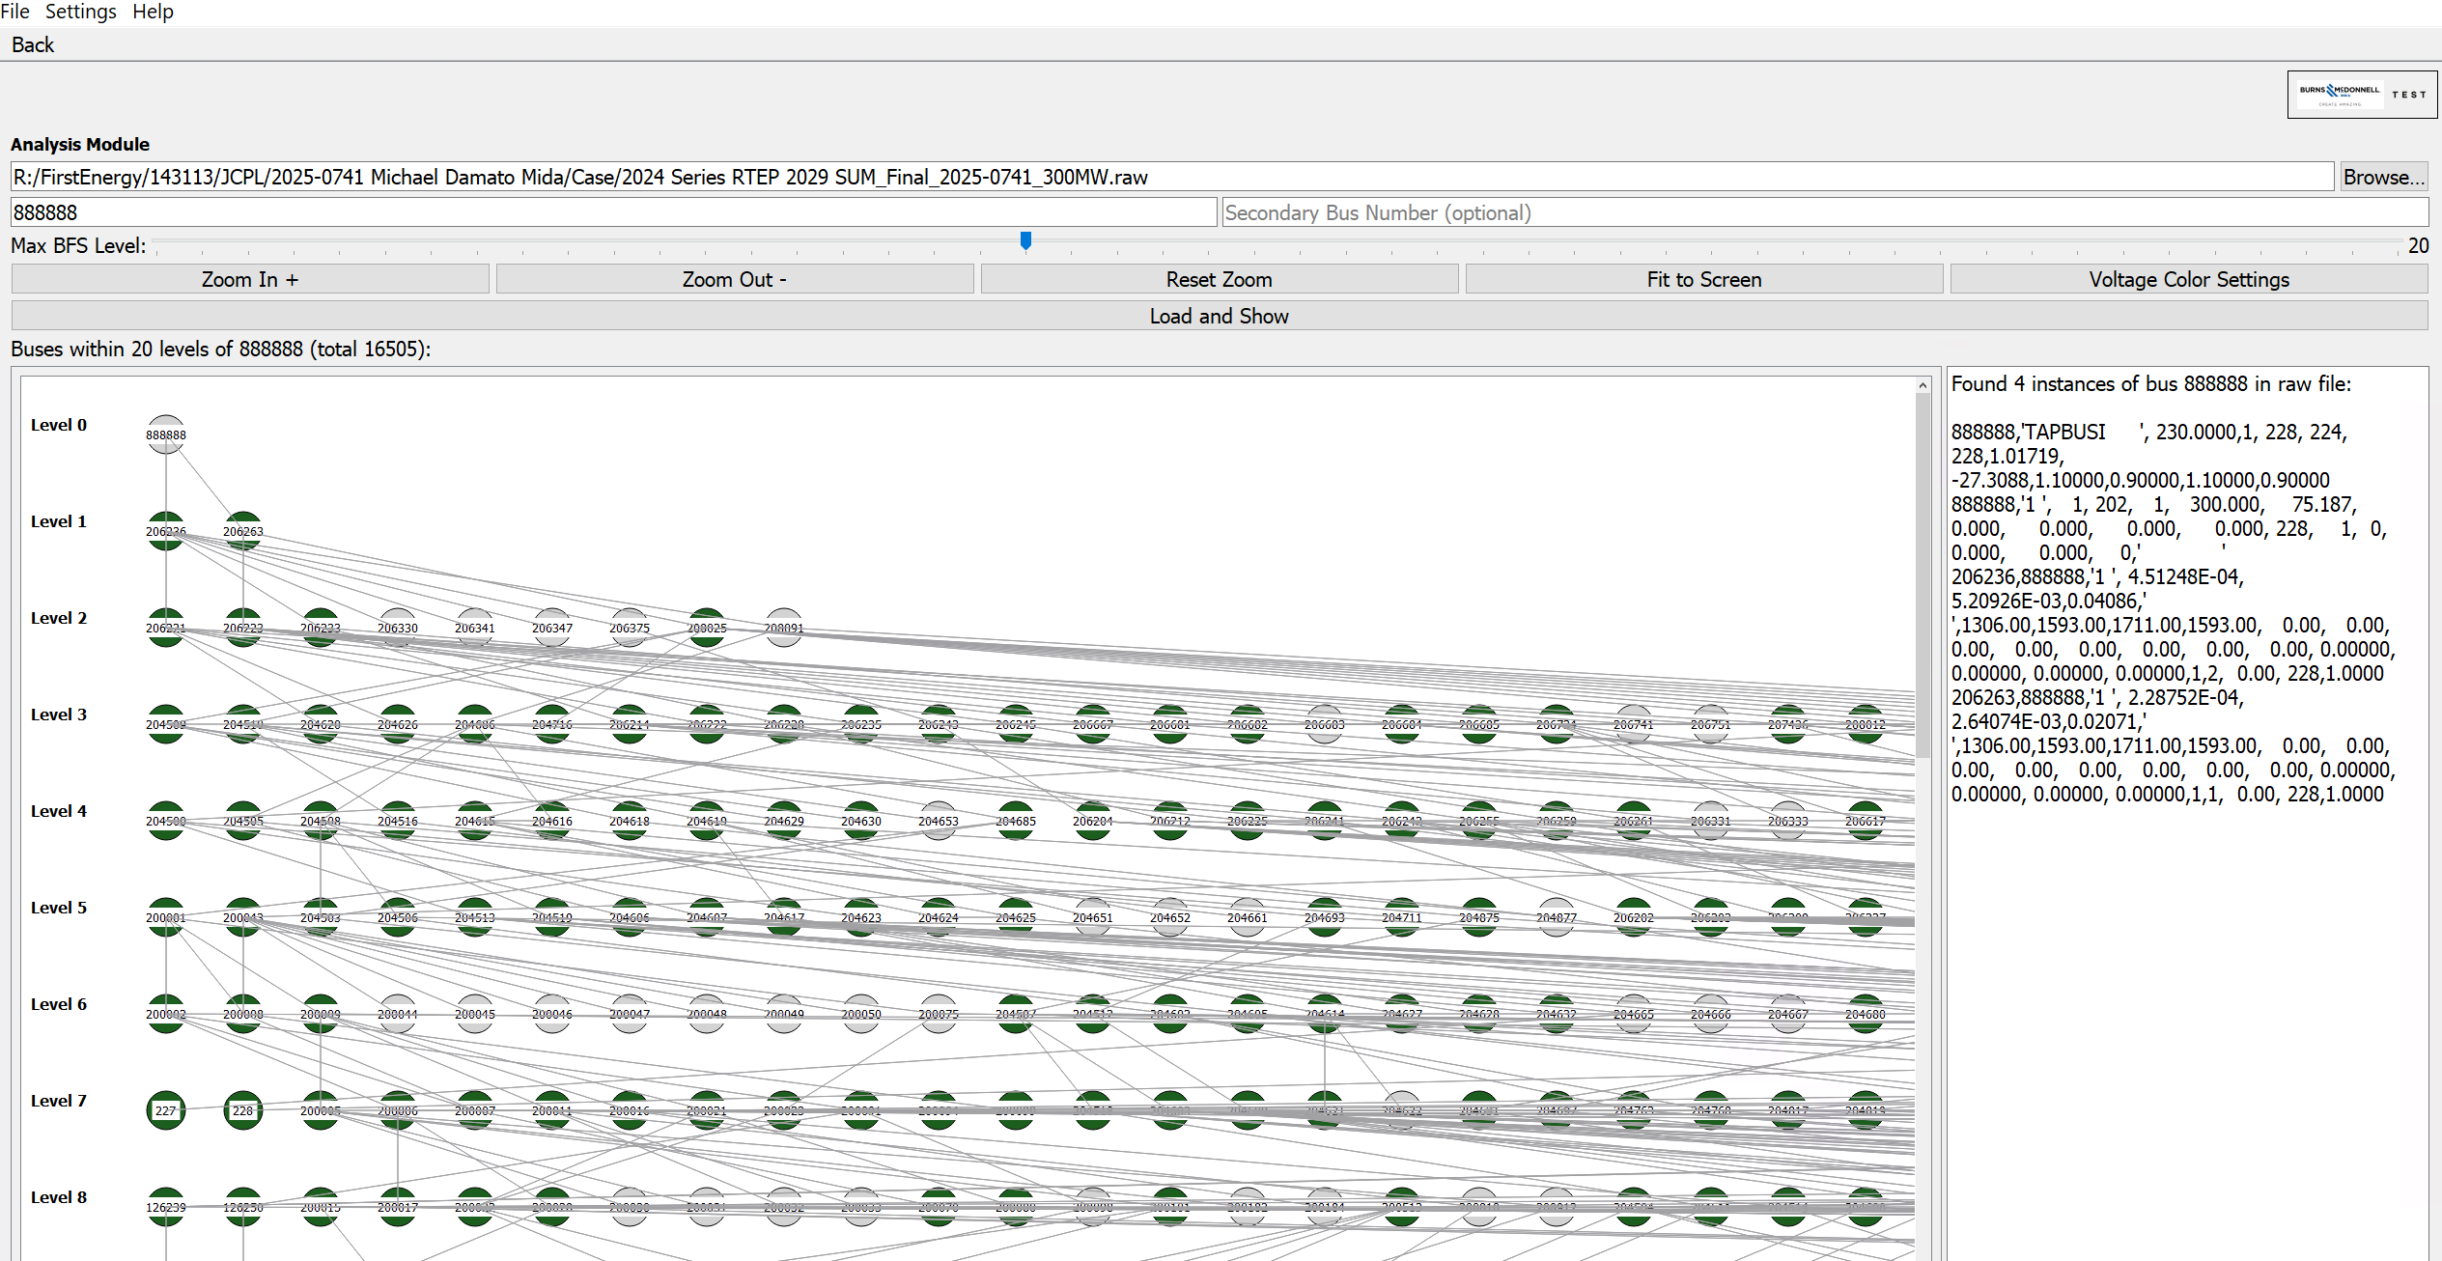
Network Level Studies (Innovation)

Slide 24
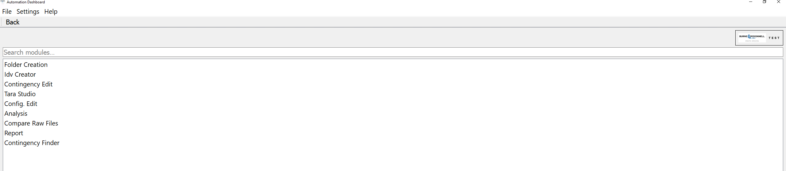
Network Level Studies (Innovation)

Slide 25
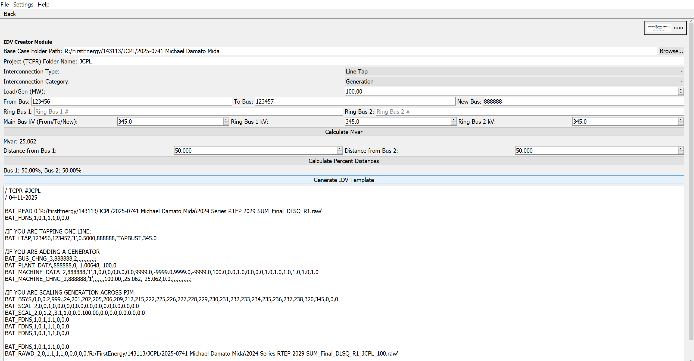
Network Level Studies (Innovation)

Slide 26
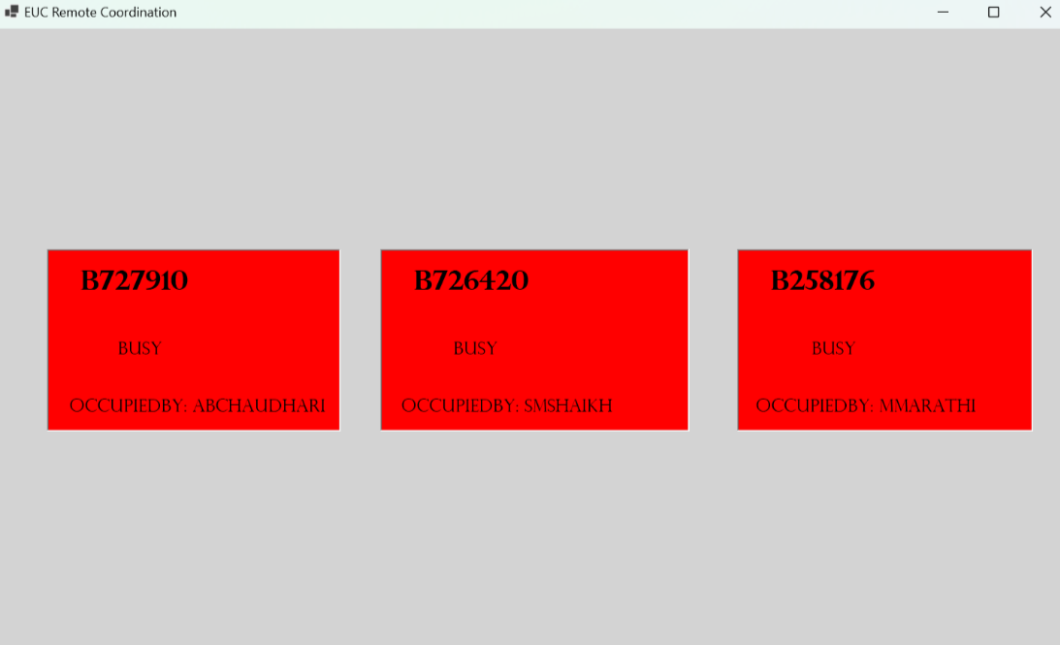
Remote machine usage

Slide 27
Why change ?

