Slide 1
Disaster Tweet Classifier (Binary)
Clean, complete project — Real vs Fake

Slide 2
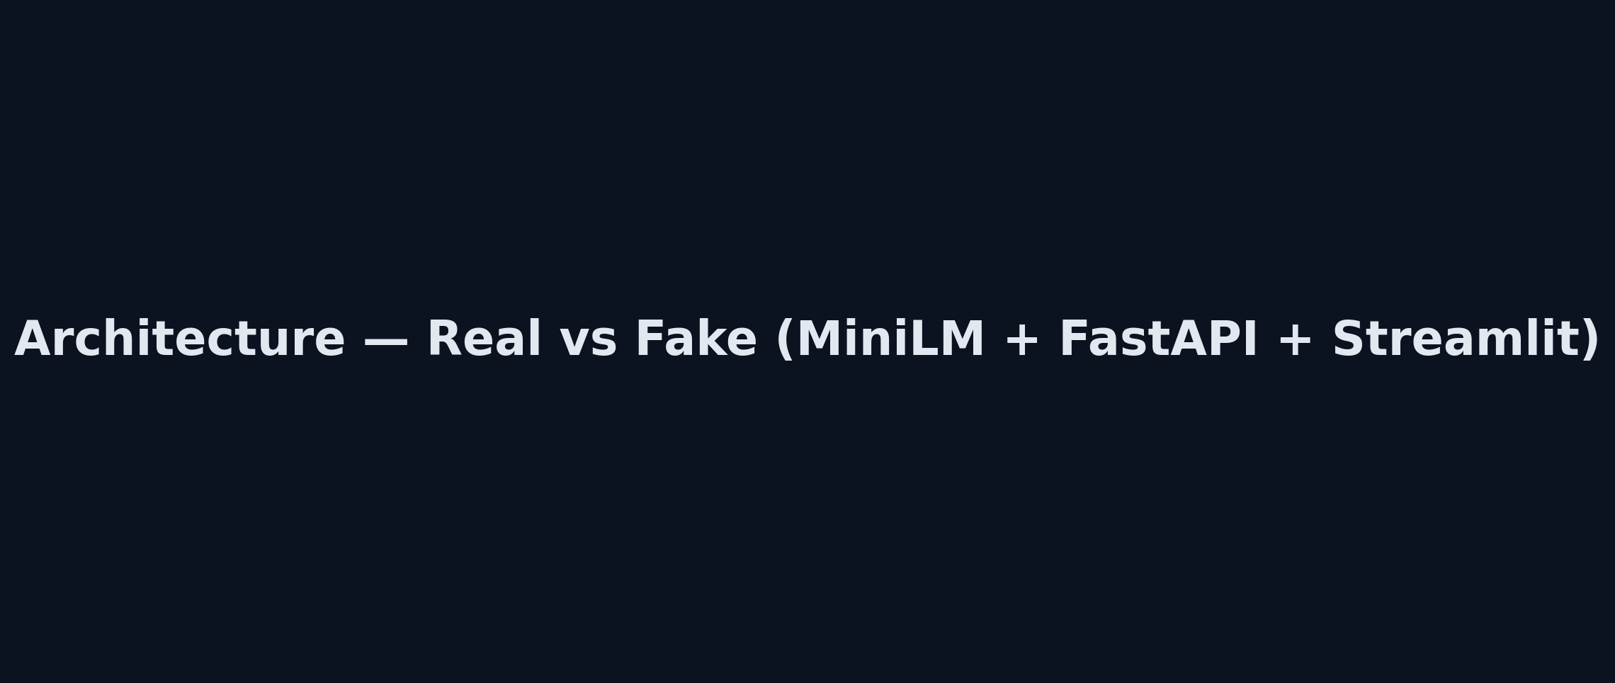
Architecture

Slide 3
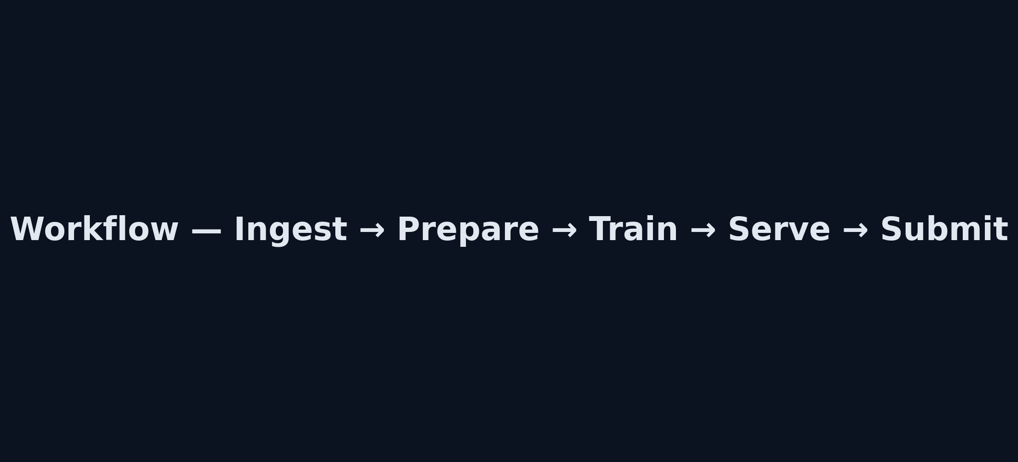
Workflow

Slide 4
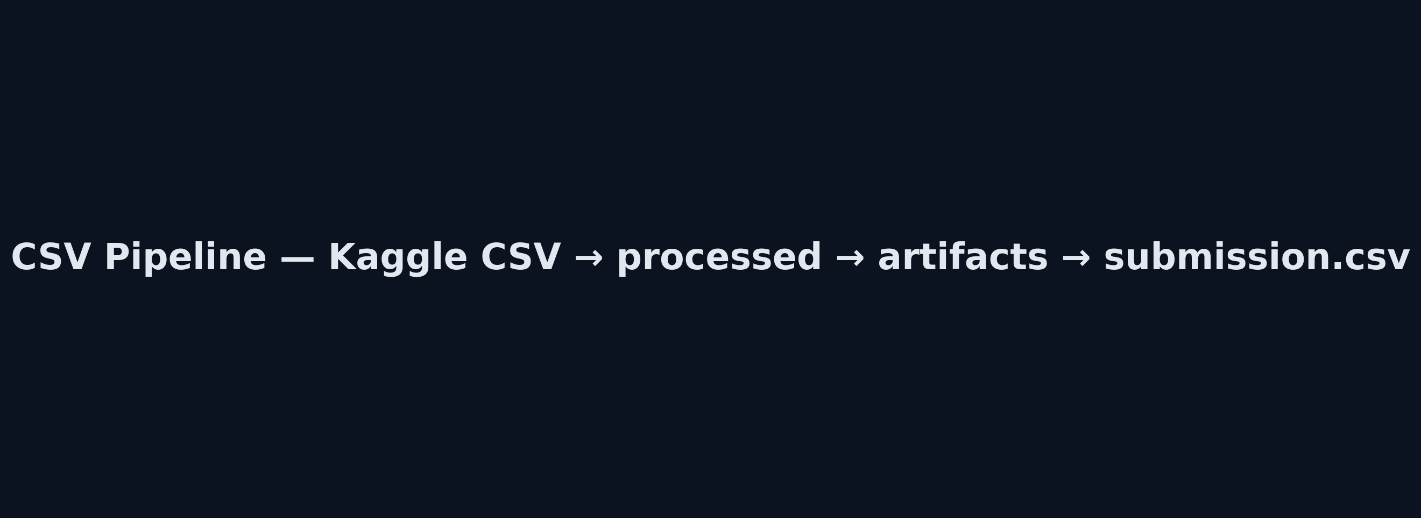
CSV Pipeline

