Slide 1
Adstock transformation techniques enable discovery of suitable decay value for each marketing channel
Modeling Considerations
The effect of marketing activity is realized over a period of time
This dynamic, or, decay effect of marketing can be mathematically modeled
Adstock transformation is an effective method of capturing the decay effect

Slide 2
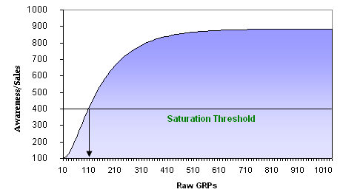
Adstock Saturation
Increasing the amount of advertising increases the percent of the audience reached by the advertising, hence increases demand
A linear increase in the advertising exposure doesn’t have a similar linear effect on demand.
Typically each incremental amount of advertising causes a progressively lesser effect on demand increase.
This is advertising saturation.
Saturation only occurs above a threshold level that can be determined by Adstock Analysis

Slide 3
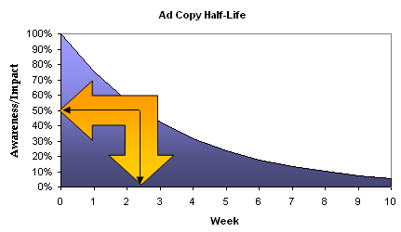
Adstock Half Life
Advertising adstock is a term coined by Simon Broadbent to describe the prolonged or lagged effect of advertising on consumer purchase behavior. It is also known as 'advertising carry-over'.
Adstock is an important component of marketing-mix models
Half Life: Half-life (t_{½}) is the time required for a quantity to fall to half its value as measured at the beginning of the time period
A 'two-week half-life' means that it takes two weeks for the awareness of a copy to decay to half its present level

Slide 4
Adstock Models
Simple Decay-Effect Model
Below is a simple formulation of the basic Adstock model of Broadbent
A_{t} = GRP_{t} + α GRP_{t-1}
This is a simple decay model, because it captures only the dynamic effect of
advertising, not the diminishing returns effect.
Maximum Period Decay Model
Mathematically, if n = t; maximum number of weeks available to be the maximum periods that week t will learn from the previous n weeks
A_{t} = Σ r^{i} *X_{t-i} ; 0 ≤ i ≤ n (maximum number of weeks available.)
Log Decay Model
The Log Decay model applies a straightforward logarithmic distribution to the advertising variable
A_{t} = LogT_{t} + α A_{t-1}
This is a relatively inflexible non-linear specification of the Adstock model, as it doesn’t allow for varying saturation levels

Slide 5
Adstock Models
Negative Exponential Decay Model
A_{t} = 1-e ^{(-v T}_{t}⁾ + α A_{t-1}
This model is comparatively more flexible as different values of the parameter can be empirically tested in a response model to correctly measure the level of current advertising saturation.
Logistic (S-Curve) Decay Model
Using a logistic distribution instead of negative exponential will impart an S shape to the Adstock variable, implying an inflexion point or ‘threshold’ level of GRPs before diminishing returns set in. Below this threshold, the logistic function imparts exponential returns
A_{t} = 1/ (1+e ^{(-vT}_{t}⁾) + α A_{t-1}
As in the negative exponential model, the parameter can be used to model different saturation levels.

Slide 6
Adstock Models
Hyperbolic Decay Model
A_{t} = 1/(1+ α A_{t-1})
This model has tendency to decay faster than the exponential function, if the data showed better fit for a hyperbolic, rather than an exponential function

