Slide 1
Cryptonite
Data Encryption-Decryption Program

Slide 2
Members
Sandeep PVN : 01FB14ECS207
Satyam Bharadwaj : 01FB14ECS214
Shreyas S Rao : 01FB14ECS231

Slide 3
Data Structures Used
Stacks
Double-Priority Queues

Slide 4
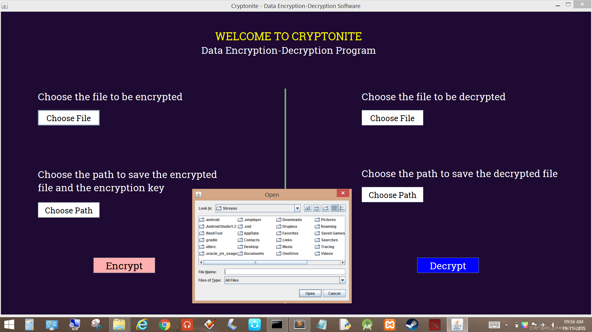
GUI-Interface
Features used:
Java Swing – JPanel, JFrame , Jbutton, Jlabel.
Dynamic Changes occur.
PathSelector/FileChooser for encryption and decryption input/output.

Slide 5
About - Encryption
The program takes input from a .txt file(temp.txt)
ReverseStack() is called on the text received from the file – this method reverses each line of the file by pushing it onto a stack and popping it back
RandomLines() is called next – this method shuffles/jumbles the lines of the file in a random order, and the original order and jumbled order as primary priority and secondary priority.
ShiftBit() is called next – this method shifts each character by a random key.

Slide 6
Encryption
I\P File
input.txt
Encrypt.txt
Encrypt2.txt
O\P File
EncryptFinal.txt
Stack Reversal
Line Shuffler
Shift BIT

Slide 7
About - Decryption
The program takes input from a .txt file(EncryptFinal.txt)
unShiftBit() is called next – this method shifts each character back to original based on the original shiftbit key .
unRandomLines() is called next – this method retrieves the lines of the file back to the original order, by sorting with respect to PrimaryPriority
ReverseStack() is called on the text received from the file – this method reverses each line of the file by pushing it onto a stack and popping it back

Slide 8
Decryption
I\P File
EncryptFinal.txt
Derypt.txt
Decrypt2.txt
O\P File
DecryptFinal.txt
Un - Shift BIT
Un - Line Shuffler
Un - Stack Reversal

Slide 9
Limitations
Decryption can be done only in the same session as that of encryption. It cannot be done without encrypting the source file in the first place.
We cannot view the file directly through the GUI
For the input to the encryption, a pre-defined file is necessary.

Slide 10
Future Enhancements
Making the decryption of an already existing encrypted file irrespective of when and where it was encrypted.
Advance GUI: e.g. Viewing input and output files of the encryption and decryption on the GUI interface, Editing the input files on the GUI itself.

Slide 11
THANK YOU

