Slide 1
Final Project Presentation-2
Fruit Stalk Recognition
Sandeep Pvn : 01FB14ECS207

Slide 2
Overview
FRUIT STALK RECOGNITION
“A drone with a stereo camera is used to recognize ripe and healthy fruits (and their stalk) in an orchard of fruits using computer vision techniques and is later used to collect the fruit.”

Slide 3
Challenges faced till date
Unavailability of hardware resources.
The methodologies used in certain models were not good enough due to data clarity issues.
Exposure to relevant topics is minimal, hence usable research resources are scarce.
3D computing has proved to be high computing thus take a lot of time and computer resources.

Slide 4
WORK COMPLETED
Finished necessary pre-project documentation.
Ordered a drone and necessary components.
Took one video from YouTube and a few photos from Google for initial training.
Started reading multiple papers.
Learning and configuring various setups/softwares and packages necessary.
Started with color and shape segmentation.

Slide 5
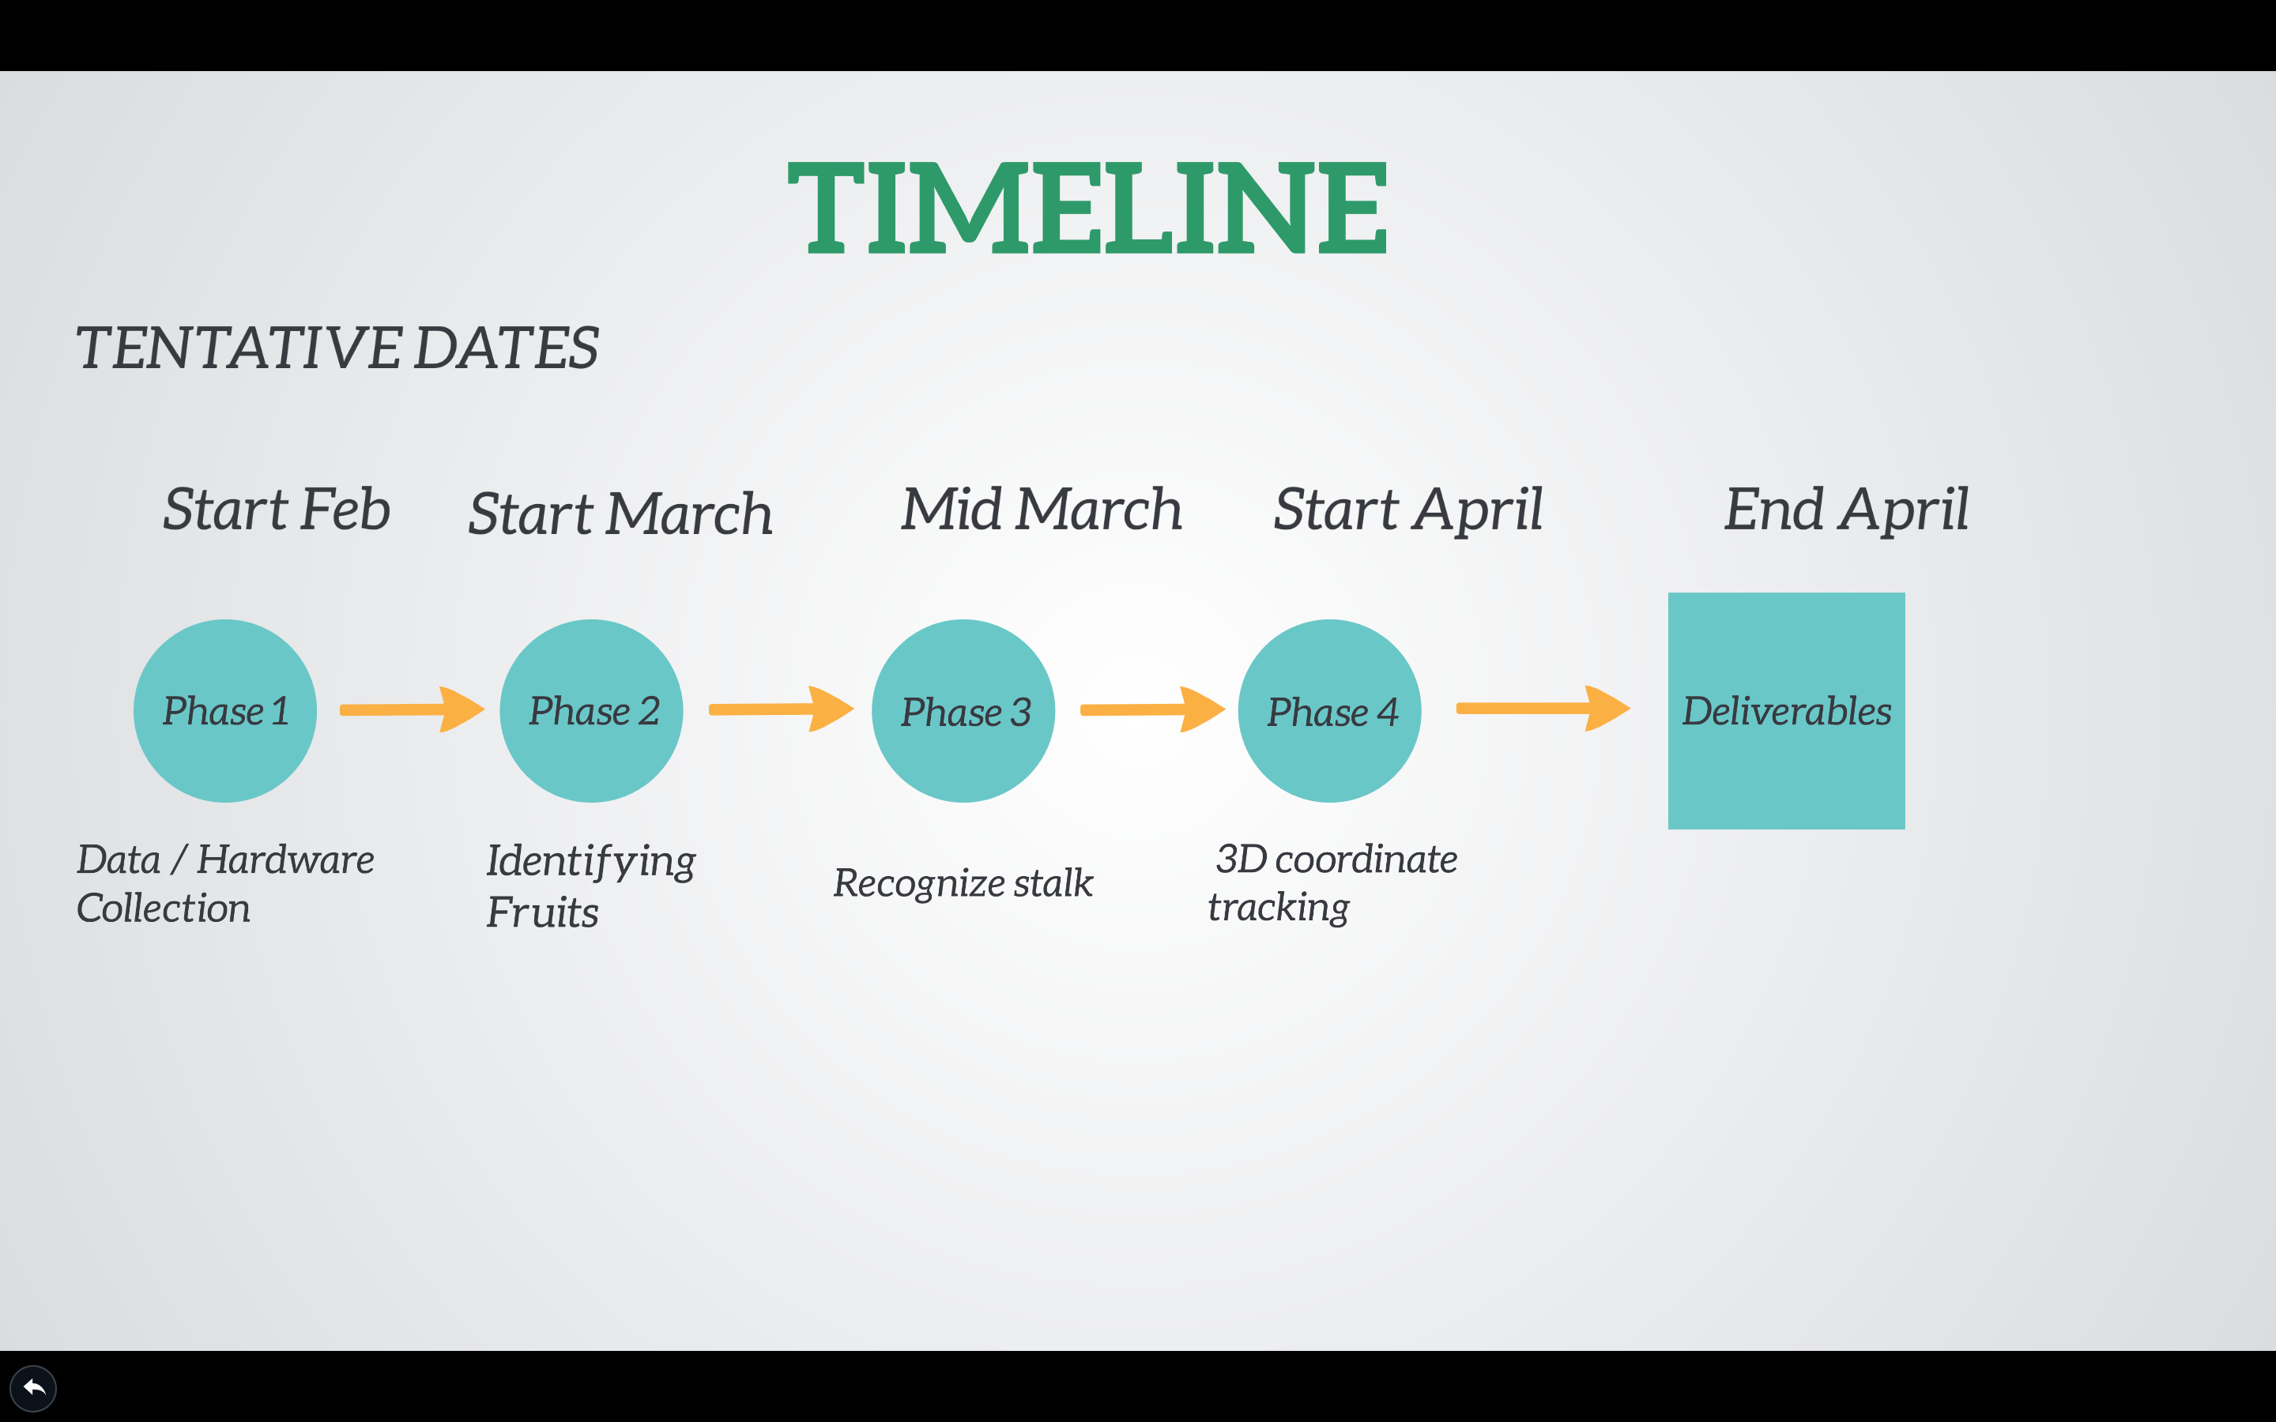
Tentative Schedule

Slide 6
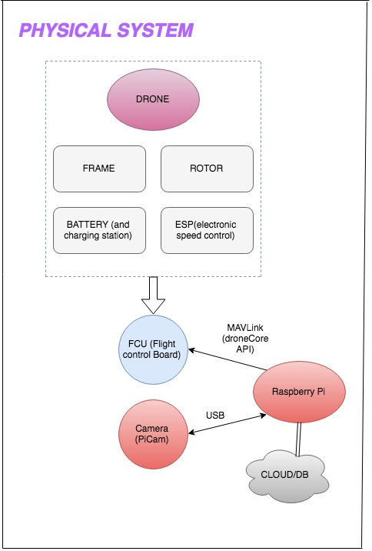
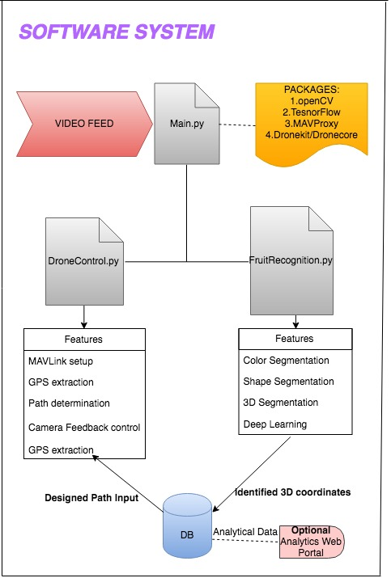
System Architecture

Slide 7
Product Perspective
This product is a fully self-contained and individual product that only needs to gain exposure to the working environment.
USER BASE:
The farmers who might be having an option to set a timer using a web or phone portal or direct interface with the drone.
The administrator/Developer would calibrate the system occasionally by coding the drone kit integrated to python.
Optional: Analysts who will use the web portal created from stored data.

Slide 8
Limitations and Assumptions
The limitations are:
Government privacy policy regarding flying drones.
Battery life of the drone.
Clarity/Resolution of camera on drone.
Inability of the simulations to provide a perfect scenario of drone maneuvering.
Safety and crash conditions regarding the drone and surrounding environment.
The assumptions are:
The fruits have a distinct feature separating them from the rest of the foliage.
The fruits are all accessible visually and physically to the camera and drone.
There is power supply for drone docking and necessary network environment for communications.

Slide 9
Other Acquired Data
Using a PICKHAWK or PXFMINI Flight control board(FCU)
Integrate the FCU with the raspberry and the ESC of the rotors.
Using MAVLink from the RaspPi to FCU using dronekit or dronecore library.
Using multi weak learning Ada-boost rather than a complex 3D vision system as we need fast real-time computations.

Slide 10
Requirements
Hardware Requirements
The simulation can be performed using SITL and dronekit-SITL. A Drone with necessary rotors, frames, battery, landing gear, ESP (electronic speed controls) integrated to a flight control board (preferably PXFMINI/Pixhawk) and controlled using a Raspberry Pi. Stereo or Mono camera will be integrated to the raspberry Pi via USB. The drone is further communicated using ZigBee modules for manual intervention.
Software Requirements
This is run as a OSX to raspberry PI integration.
A basic SQL database to store the 3D coordinates.
Python integrated with drone kit to control the drone.
Tensor Flow, opencv for recognition algorithms.
Communication Requirements
The communication protocols used are MAVProxy via a MAVLink protocol and SSH channel over Wi-Fi or ZigBee.

Slide 11
Thank You

