Slide 1
AZ-103T00A Module 01: Azure Administration

Slide 2
Module Overview
Azure Portal and Cloud Shell
Azure PowerShell and CLI
Resource Manager
ARM Templates
Notes:
Module overview – this module does not have a lab. Students should try the demonstrations, as needed, to ensure they can use the portal, cloud shell, PowerShell, CLI, and templates.

Slide 3
Lesson 01: Azure Portal and Cloud Shell

Slide 4
Azure Portal and Cloud Shell Overview
Azure Portal
Azure Mobile App
Demonstration – Azure Portal
Azure Cloud Shell
Demonstration – Cloud Shell
Notes:
Lesson overview

Slide 5
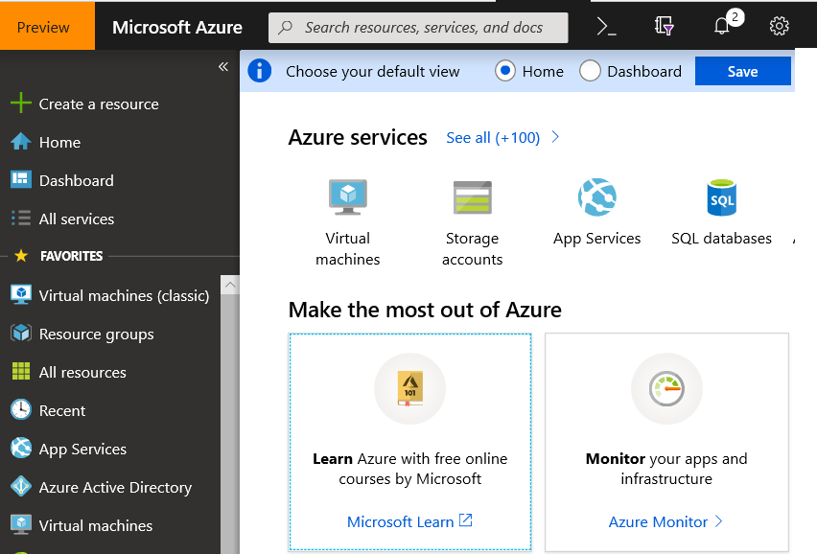
Azure Portal
Search resources, services, and docs
Manage resources
Create customized dashboards and favorites
Access the Cloud Shell
Receive notifications

Slide 6
Azure Mobile App
Stay connected to the cloud
Check status and critical metrics anytime, anywhere
Diagnose and fix issues quickly
Run commands to manage your Azure resources

Slide 7
Demonstration – Azure Portal
In this demonstration, you will explore the Azure portal
Help and keyboard shortcuts
Customizing your experience
Notes:
✔ Always consider having students walk-through the demonstrations themselves. Also, consider the overlap with the formal labs and your best use of time.

Slide 8
Azure Cloud Shell
Interactive, browser-accessible shell
Offers either Bash or PowerShell
Is temporary and provided on a per-session, per-user basis
Requires a resource group, storage account, and Azure File share
Authenticates automatically
Integrated graphical text editor
Is assigned one machine per user account
Times out after 20 minutes

Slide 9
Demonstration – Cloud Shell
In this demonstration, we will experiment with the Cloud Shell
Configure the Cloud Shell
Experiment with Azure PowerShell
Experiment with Bash shell
Experiment with Cloud Editor
Notes:
✔ Always consider having students walk-through the demonstrations themselves. Also, consider the overlap with the formal labs and your best use of time.

Slide 10
Lesson 02: Azure PowerShell and CLI

Slide 11
Azure PowerShell and CLI Overview
PowerShell Cmdlets and Modules
Azure PowerShell
Demonstration – Working with PowerShell Locally
Azure CLI
Demonstration – Working with Azure CLI Locally
Notes:
Lesson overview

Slide 12
PowerShell Cmdlets and Modules
Get-Module
# Output
ModuleType Version Name
---------- ------- ----
Manifest 3.1.0.0 Microsoft.PowerShell.Management
Manifest 3.1.0.0 Microsoft.PowerShell.Utility
Binary 1.0.0.1 PackageManagement
Script 1.0.0.1 PowerShellGet
Script 2.0.0 PSReadline
Cmdlets follow a verb-noun naming convention; shipped in modules
Modules are a DLL file with the code to process each cmdlet
Load cmdlets by loading the module containing them
Use Get-Modules to see a list of loaded modules
Notes:
Ask about the classes experience with PowerShell and Azure PowerShell

Slide 13
Azure PowerShell
New-AzVm `
-ResourceGroupName "CrmTestingResourceGroup" `
-Name "CrmUnitTests" `
-Image "UbuntuLTS" `
...
Lets you connect to your Azure subscription and manage resources
Adds the Azure-specific commands – new Az module
Available inside a browser via the Azure Cloud Shell
Available as a local installation on Linux, macOS, or Windows
Has an interactive and a scripting mode

Slide 14
Demonstration – Working with PowerShell Locally
In this demonstration, we will install Azure Az PowerShell module locally and try a few cmdlets
Launch PowerShell locally
Install the Az module
Connect to Azure and view your subscription information
Create resources
Notes:
✔ Always consider having students walk-through the demonstrations themselves. Also, consider the overlap with the formal labs and your best use of time.

Slide 15
Azure CLI
az vm restart -g MyResourceGroup -n MyVm
Cross-platform command-line program
Runs on Linux, macOS, and Windows
Can be used interactively or through scripts
Commands are structured in _groups_ and _subgroups_
Use find to locate commands
Use --help for more detailed information

Slide 16
Demonstration – Working with the CLI
In this demonstration, we will install and use the CLI locally
Install the CLI
Verify the installation
Login to Azure
Create a resource group
Verify the resource group
Notes:
✔ Always consider having students walk-through the demonstrations themselves. Also, consider the overlap with the formal labs and your best use of time.

Slide 17
Lesson 03: Resource Manager

Slide 18
Resource Manager Overview
Resource Manager
Terminology
Resource Group Deployments
Resource Manager Locks
Moving Resources
Removing Resources and Resource Groups
Demonstration- Resource Groups
Notes:
Lesson overview

Slide 19
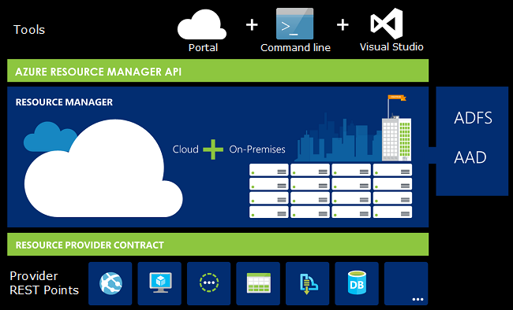
Resource Manager
Provides a consistent management layer
Enables you to work with the resources in your solution as a group
Deploy, update, or delete in a single, coordinated operation
Provides security, auditing, and tagging features
Choose the tools and APIs that work best for you

Slide 20
Terminology
A resource is simply a single service instance in Azure
A resource group is a logical grouping of resources
An Azure resource manager template is a JSON file that allows you to declaratively describe a set of resources
A declarative syntax is what a template uses to state what you intend to create
A resource provider is service that supplies the resources you can deploy and manage through Resource Manager

Slide 21
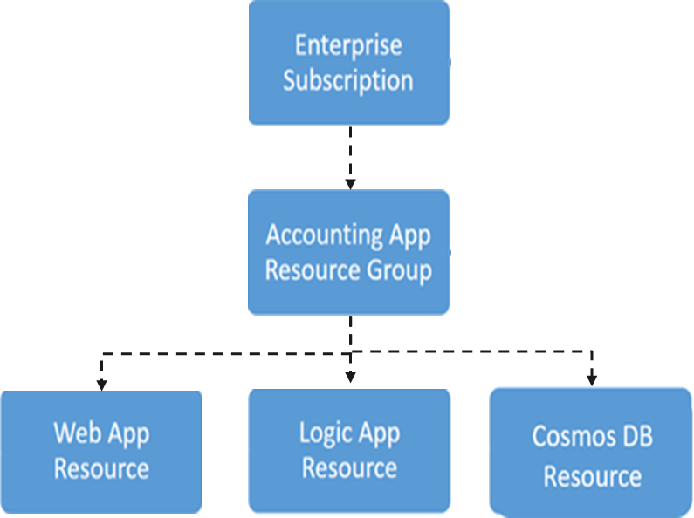
Resource Groups and Deployments
Resources can only exist in one resource group
Groups cannot be renamed
Groups can have resources of many different types (services)
Groups can have resources from many different regions
Deployments are incremental
✔️ By scoping permissions to a resource group, you can add/remove and modify resources easily

Slide 22
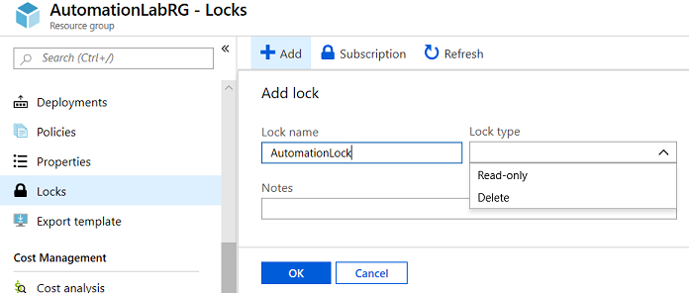
Resource Manager Locks
Associate the lock with a subscription, resource group, or resource
Locks are inherited by child resources
Read-Only locks prevent any changes to the resource
Delete locks prevent deletion
Notes:
✔ Only Owner and User Access Administrator roles can create or delete management locks.
For additional information, see:
Lock resources to prevent unexpected changes: https://docs.microsoft.com/en-us/azure/azure-resource-manager/resource-group-lock-resources

Slide 23
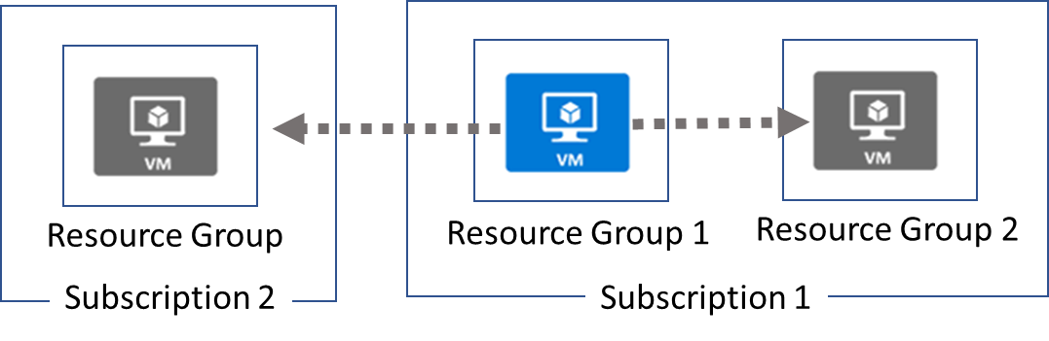
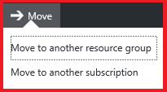
Moving Resources
When moving resources, both the source group and the target group are locked during the operation
Services that cannot be moved: AD Domain Services, ExpressRoute, and Site Recovery
Notes:
✔ Just because a service can be moved doesn’t mean there aren’t restrictions. For example, you can move a virtual network, but you must also move its dependent resources, like gateways. Learn more at the reference link.
For more information, you can see:
Move resources to new resource group or subscription - https://docs.microsoft.com/en-us/azure/azure-resource-manager/resource-group-move-resources

Slide 24
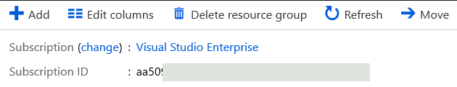
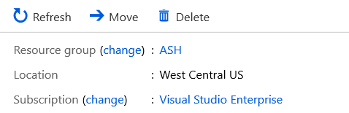
Removing Resources and Resource Groups
Resource Groups
Remove-AzResourceGroup -Name "ContosoRG01"
Resources
Remove-AzResource -ResourceId <ResourceID>

Slide 25
Demonstration – Resource Groups
In this demonstration, we will create and delete resource locks
Manage resource groups in the portal
Manage resource groups with PowerShell
Notes:
✔ Always consider having students walk-through the demonstrations themselves. Also, consider the overlap with the formal labs and your best use of time.

Slide 26
Lesson 04: ARM Templates

Slide 27
ARM Templates Overview
Template Advantages
Template Schema
Template Parameters
Template Variables
QuickStart Templates
Demonstration – QuickStart Templates
Demonstration – Run Templates with PowerShell

Slide 28
Template Advantages
Improves consistency
Express complex deployments
Reduce manual, error prone tasks
Express requirements through code
Promotes reuse
Modular and can be linked
Simplifies orchestration
ARM
Template
Development
Production
Quality
Assurance
Notes:
Use the same template across deployments so the resources are identical.

Slide 29
Template Schema
{
"$schema": "http://schema.management.
azure.com/schemas/2015-01- 01/deploymentTemplate.json#",
"contentVersion": "",
"parameters": { },
"variables": { },
"functions": [ ],
"resources": [ ],
"outputs": { }
}
Defines all the Resource Manager resources in a deployment
Written in JSON
A collection of key-value pairs
Each key is a string
Each values can be a string, number, Boolean expression, list of values, object

Slide 30
Template Parameters
"parameters": {
"adminUsername": {
"type": "string",
"metadata": {
"description": "Username for the Virtual Machine."
}
},
"adminPassword": {
"type": "securestring",
"metadata": {
"description": "Password for the Virtual Machine."
}
}
}
Specify which values are configurable when the template runs
This example has two parameters: one for a VM’s username (adminUsername), and one for its password (adminPassword)

Slide 31
Template Variables
Define values that are used throughout the template
Makes your templates easier to maintain
This example provides variables that describe networking features for a virtual machine
"variables": {
"nicName": "myVMNic",
"addressPrefix": "10.0.0.0/16",
"subnetName": "Subnet",
"subnetPrefix": "10.0.0.0/24",
"publicIPAddressName": "myPublicIP",
"virtualNetworkName": "MyVNET"
}

Slide 32
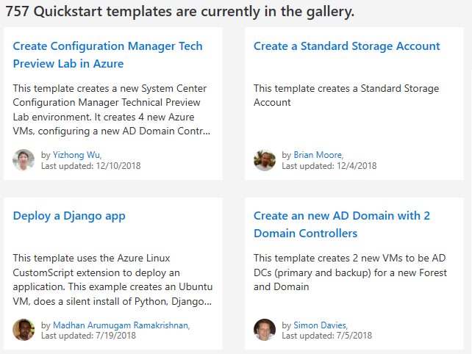
QuickStart Templates
Resource Manager templates provided by the Azure community
Provides everything you need to deploy your solution or serves as a starting point for your template
https://azure.microsoft.com/en-us/resources/templates/
Notes:
https://azure.microsoft.com/en-us/resources/templates/

Slide 33
Demonstration – QuickStart Templates
In this demonstration, you will explore QuickStart templates
Explore the QuickStart gallery
Explore a template
Notes:
✔ Always consider having students walk-through the demonstrations themselves. Also, consider the overlap with the formal labs and your best use of time.

Slide 34
Demonstration – Run Templates with PowerShell
In this demonstration, you will create new Azure resources using PowerShell and Resource Manage templates
Connect to your subscription
Create the resource group
Deploy the template into the resource group
Verify the template deployed
Notes:
✔ Always consider having students walk-through the demonstrations themselves. Also, consider the overlap with the formal labs and your best use of time.

