Slide 1
AZ-103T00A Module 02: Azure Virtual Machines
Notes:
There are two possible labs in this module. The Virtual Machines and Scale Sets lab has setup time. If you are going to do that lab, consider completing Exercise 0: Prepare the lab environment before starting the lecture.

Slide 2
Module Overview
Virtual Machine Planning
Creating Virtual Machines
Virtual Machine Availability
Virtual Machine Extensions
Lab and Review Questions
Notes:
Module overview

Slide 3
Lesson 01: Virtual Machine Planning

Slide 4
Virtual Machine Planning Overview
IaaS Cloud Services
Planning Checklist
Location and Pricing
Virtual Machine Sizing
Virtual Machine Disks
Storage Options
Supported Operating Systems
Notes:
Lesson overview

Slide 5
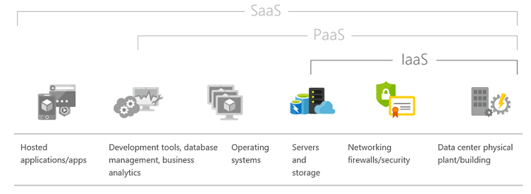
IaaS Cloud Services
Test and development
Website hosting
Storage, backup, and recovery
Web apps
High-performance computing
Big data analysis
Extended data center
Notes:
For more information, you can see:
Infrastructure as a Service - https://azure.microsoft.com/en-us/overview/what-is-iaas/

Slide 6
Planning Checklist
Start with the network
Name the VM
Decide the location for the VM
Determine the size of the VM
Understand the pricing model
Consider storage for the VM
Select an operating system
Notes:
Start with the network and name the VM are covered here. The other bullets are covered on the following slides/topics.

Slide 7
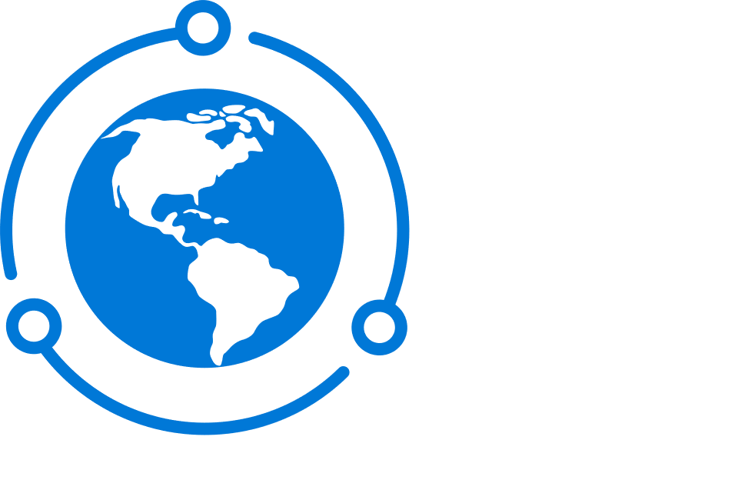
Location and Pricing
Location
Each region has different hardware and service capabilities
Locate virtual machines as close as possible to your users
Locate virtual machines to ensure compliance and legal obligations
Pricing
Compute costs
Storage costs (consumption-based and reserved instances)
54 Azure regions
Available in 140 countries

Slide 8
Virtual Machine Sizing
VM Type | Sizes | Purpose
General Purpose | B, Dsv3, Dv3, DSv2, Dv2, Av2, DC | Testing and development, small to medium databases, and low to medium traffic web servers.
Compute Optimized | Fsv2, Fs, F | Medium traffic web servers, network appliances, batch processes, and application servers.
Memory Optimized | Esv3, Ev3, M, GS, G, DSv2, Dv2 | Relational database servers, medium to large caches, and in-memory analytics.
Storage Optimized | Lsv2, Ls | Ideal for VMs running databases.
GPU | NV, NVv2, NC, NCv2, NCv3, ND, NDv2 (Preview) | Ideal for model training and inferencing with deep learning.
High Performance Compute | H | Fastest and most powerful CPU virtual machines with optional high-throughput network interfaces.
Notes:
✔️ Be cautious when resizing production VMs - they will be rebooted automatically which can cause a temporary outage and change some configuration settings such as the IP address.
For more information, you can see:
Sizes for Windows virtual machines in Azure - https://docs.microsoft.com/en-us/azure/virtual-machines/windows/sizes?toc=%2Fazure%2Fvirtual-machines%2Fwindows%2Ftoc.json#size-tables
Sizes for Linux virtual machines in Azure - https://docs.microsoft.com/en-us/azure/virtual-machines/linux/sizes?toc=%2fazure%2fvirtual-machines%2flinux%2ftoc.json

Slide 9
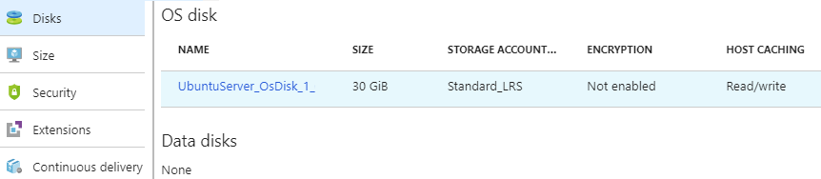
Virtual Machine Disks
Operating System Disks are SATA drives, labeled as C:
Temporary Disks provides short term storage
Data Disks are SCSI drives and depend on your virtual machine type
Notes:
✔️ Don’t store data on the temporary disk. It provides temporary storage for applications and processes and is intended to only store data such as page or swap files.

Slide 10
Storage Options
Premium storage offers high-performance, low-latency SSD disk support
Use premium storage for virtual machines with input/output (I/O)-intensive workloads
Two types of disks: Unmanaged and Managed
Unmanaged disks require you to manage the storage accounts and VHDs
Managed disks are maintained by Azure (recommended)
Notes:
✔ For the best performance for your application, we recommend that you migrate any VM disk that requires high IOPS to Premium Storage. If your disk does not require high IOPS, you can help limit costs by keeping it in standard Azure Storage. In standard storage, VM disk data is stored on hard disk drives (HDDs) instead of on SSDs.

Slide 11
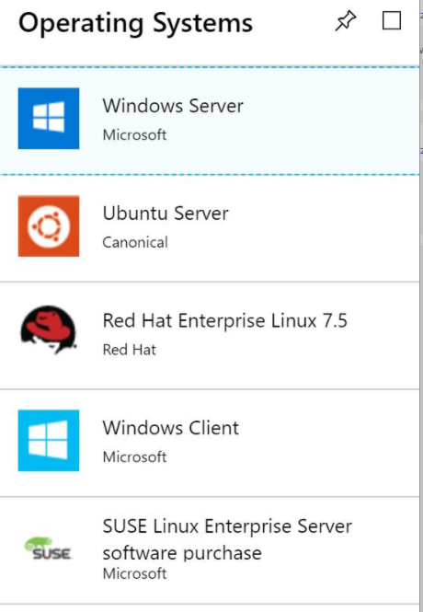
Supported Operating Systems
Windows Server includes many common products, requires a license, doesn’t support OS upgrades
Linux distributions are supported, upgrade of the OS is supported
Notes:
For more information, you can see:
Microsoft server software support for Microsoft Azure virtual machines - https://support.microsoft.com/en-us/help/2721672/microsoft-server-software-support-for-microsoft-azure-virtual-machines
Linux on distributions endorsed by Azure - https://docs.microsoft.com/en-us/azure/virtual-machines/linux/endorsed-distros#supported-distributions–versions.

Slide 12
Lesson 02: Creating Virtual Machines

Slide 13
Creating Virtual Machines Overview
Creating Virtual Machines in the Portal
Windows Virtual Machines
Windows VM Connections
Demonstration – Creating a VM in the Portal
PowerShell – Example (Part 1)
PowerShell – Example (Part 2)
Demonstration – Creating a Virtual Machine with PowerShell
Linux Virtual Machines
Linux VM Connections
Demonstration – Connect to Linux Virtual Machines
Notes:
Lesson overview

Slide 14

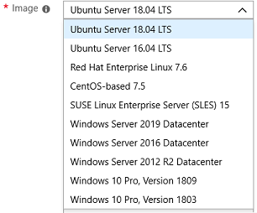
Creating Virtual Machines in the Portal
Basic (required) - Project details, Administrator account, Inbound port rules
Disks - OS disk type, data disks
Networking - Virtual networks, load balancing
Management - Monitoring, Auto-shutdown, Backup
Guest config - Add additional configuration, agents, scripts or applications

Slide 15
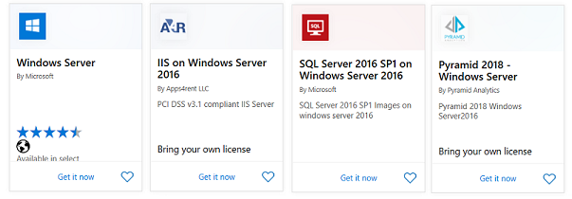
Windows Virtual Machines
Unique hybrid capabilities
Advanced multi-layer security
Faster innovation for applications
Unprecedented hyper-converged infrastructure
Notes:
Windows Virtual Machines Documentation - https://docs.microsoft.com/en-us/azure/virtual-machines/windows/

Slide 16
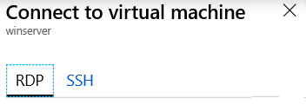
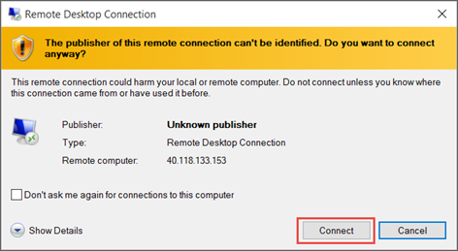
Windows VM Connections
Remote Desktop Protocol (RDP) creates a GUI session and accepts inbound traffic on TCP port 3389
WinRM creates a command-line session so can run scripts

Slide 17
Demonstration – Create a VM in the Portal
Create the virtual machine
Connect to the virtual machine
Install the Web Server role
View the IIS welcome page
Notes:
✔ Always consider having students walk-through the demonstrations themselves. Also, consider the overlap with the formal labs and your best use of time.

Slide 18
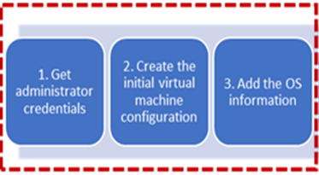
PowerShell - Example (Part 1)
# 1. Set the admin username and pwd
$cred = Get-Credential
# 2. Create the initial configuration
$vm = New-AzVMConfig -VMName myVM
-VMSize Standard_D1
# 3. Add the OS information
$vm = Set-AzVMOperatingSystem `
-VM $vm `
-Windows `
-ComputerName myVM `
-Credential $cred `
-ProvisionVMAgent `
-EnableAutoUpdate
Notes:
Steps continue on the next page.

Slide 19
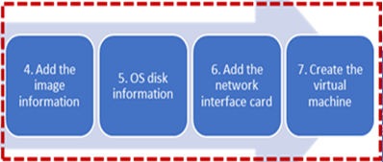
PowerShell - Example (Part 2)
# 4. Add the image information
$vm = Set-AzVMSourceImage -VM $vm -PublisherName MicrosoftWindowsServer -Offer WindowsServer -Skus 2016-Datacenter
# 5. Add the OS settings
$vm = Set-AzVMOSDisk -VM $vm -Name myOsDisk -DiskSizeInGB 128 -CreateOption FromImage -Caching ReadWrite
# 6. Add the NIC
$vm = Add-AzVMNetworkInterface -VM $vm –Id $nic.Id
# 7. Create the VM
New-AzVM -ResourceGroupName myResourceGroupVM -Location EastUS -VM $vm

Slide 20
Demonstration – Creating a VM with PowerShell
Create the virtual machine with PowerShell
Verify the machine creation in the portal
Connect to the virtual machine
Notes:
✔ Always consider having students walk-through the demonstrations themselves. Also, consider the overlap with the formal labs and your best use of time.

Slide 21
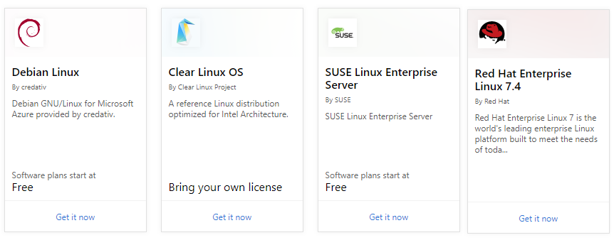
Linux Virtual Machines
Hundreds of community-built images in the Azure Marketplace
Linux has the same deployment options as for Windows VMs
Manage Linux VMs with many popular open-source DevOps tools
Notes:
Linux virtual machines (Documentation) - https://docs.microsoft.com/en-us/azure/virtual-machines/linux/

Slide 22
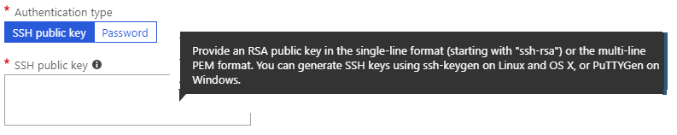
Linux VM Connections
Authenticate with a SSH public key or password
SSH is an encrypted connection protocol that allows secure logins over unsecured connections
There are public and private keys
Notes:
✔️ Azure currently requires at least a 2048-bit key length and the SSH-RSA format for public and private keys.

Slide 23
Demonstration – Connect to Linux VMs
Create the SSH keys
Create the Linux machine and assign the public SSH key
Access the server using SSH
Notes:
✔ Always consider having students walk-through the demonstrations themselves. Also, consider the overlap with the formal labs and your best use of time.

Slide 24
Lesson 03: Virtual Machine Availability

Slide 25
Virtual Machine Availability Overview
Maintenance and Downtime
Availability Sets
Update and Fault Domains
Scale Sets
Implementing Scale Sets
Autoscale
Implementing Autoscale
Notes:
Lesson overview

Slide 26
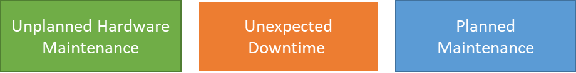
Maintenance vs. Downtime
When the platform predicts a failure, it will issue an unplanned hardware maintenance event. Action: Live migration.
Unexpected Downtime is when a virtual machine fails unexpectedly. Action: Automatically migrate (heal).
Planned Maintenance events are periodic updates made to the Azure platform. Action: No action.
Notes:
✔️ To reduce the impact of downtime due to one or more of these events, we recommend placing multiple virtual machines into an availability set (next topic).

Slide 27
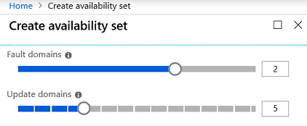
Availability Sets
Two or more instances in two or more availability zones = 99.99% uptime
Configure multiple virtual machines in an Availability Set
Configure each application tier into separate Availability Sets
Combine a Load Balancer with Availability Sets
Use managed disks with the virtual machines
Notes:
✔️ You can create a virtual machine and an availability set at the same time. A VM can only be added to an availability set when it is created. To change the availability set, you need to delete and then recreate the virtual machine.

Slide 28
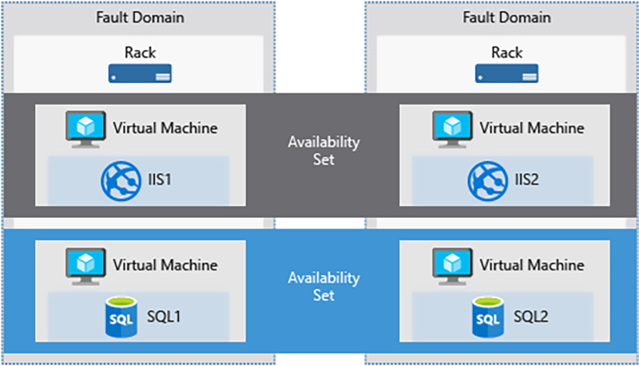
Update and Fault Domains
Update domains lets Azure to perform incremental or rolling upgrades across a deployment. During planned maintenance, only one update domain is rebooted at a time.
Fault Domains are a group of virtual machines that share a common set of hardware, switches, that share a single point of failure. VMs in an availability set are placed in at least two fault domains.
Notes:
✔️ Placing your virtual machines into an availability set does not protect your application from operating system or application-specific failures, it does limit the impact of potential physical hardware failures, network outages, or power interruptions. Can you see why this important and how this is implemented?

Slide 29
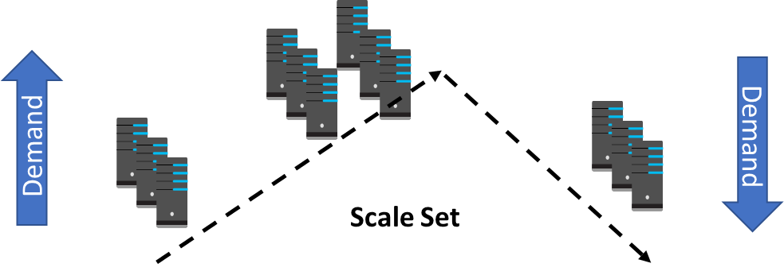
Scale Sets
Scale sets deploy a set of identical VMs
No pre-provisioning of VMs is required
As demand goes up VMs are added
As demand goes down VM are removed
The process can be manual, automated, or a combination of both

Slide 30
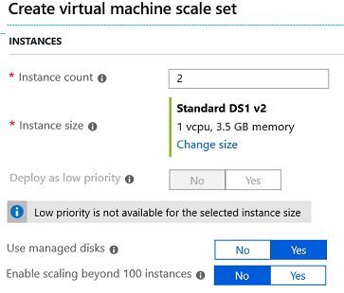
Implementing Scale Sets
Instance count. Number of VMs in the scale set (0 to 1000)
Instance size. The size of each virtual machine in the scale set
Deploy as low priority. Can save up to 80%
Use managed disks
Enable scaling beyond 100 instances

Slide 31
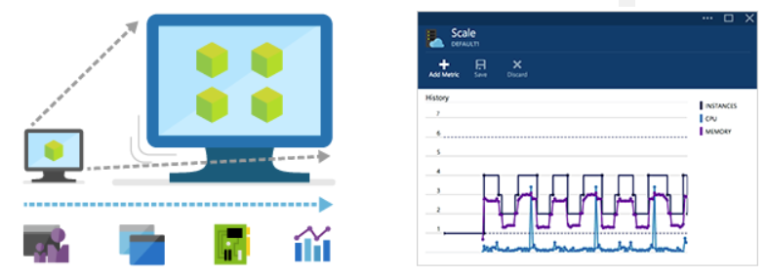
Autoscale
Define rules to automatically adjust capacity
Scale out (increase) the number of VMs in the set
Scale in (reduce) the number of VMs in the set
Schedule events to increase or decrease at a fixed time
Reduces monitoring and optimizes performance
Notes:
✔️ Autoscale minimizes the number of unnecessary VM instances that run your application when demand is low, while customers continue to receive an acceptable level of performance as demand grows and additional VM instances are automatically added.

Slide 32
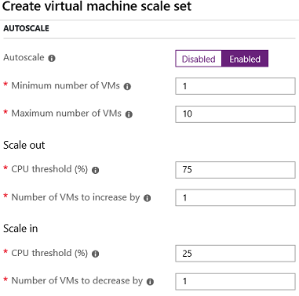
Implementing Autoscale
Define a minimum, maximum, and default number of VM instances
Create more advanced scale sets with scale out and scale in parameters
Notes:
For more information, you can see:
Best Practices for Autoscale - https://docs.microsoft.com/en-us/azure/monitoring-and-diagnostics/insights-autoscale-best-practices

Slide 33
Lesson 04: Virtual Machine Extensions

Slide 34
Virtual Machine Extensions Overview
Virtual Machine Extensions
Custom Script Extensions
Desired State Configuration
Demonstration – Custom Script Extension
Notes:
Lesson overview

Slide 35
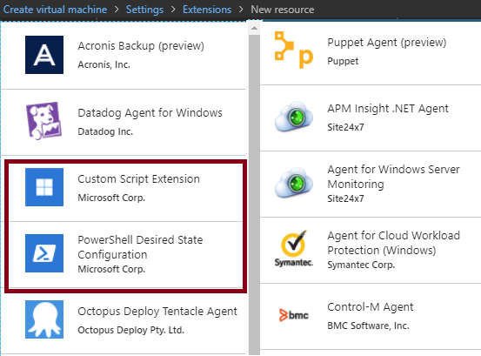
Virtual Machine Extensions
Extensions are small applications that provide post-deployment VM configuration and automation tasks
Managed with Azure CLI, PowerShell, Azure Resource Manager templates, and the Azure portal
Bundled with a new VM deployment or run against any existing system
Different for Windows and Linux machines.
Notes:
✔️ In this lesson we will focus on two extensions: Custom Script Extensions and Desired State Configuration. Both tools are based on PowerShell.
For more information, you can see:
Virtual machine extensions and features for Windows - https://docs.microsoft.com/en-us/azure/virtual-machines/extensions/features-windows?toc=%2Fazure%2Fvirtual-machines%2Fwindows%2Ftoc.json
Virtual machine extensions and features for Linux - https://docs.microsoft.com/en-us/azure/virtual-machines/extensions/features-linux

Slide 36
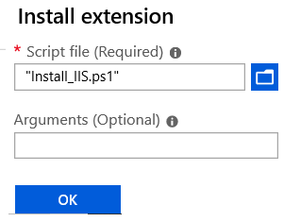
Custom Script Extensions
Extension scripts can be simple or complex
Extensions have 90 minutes to run
Double check dependencies to ensure availability
Account for any errors that might occur
Protect/encrypt sensitive information
✔️ For PowerShell use the Set-AzVmCustomScriptExtension command
Notes:
✔ Can you think of any custom script extensions that you might want to create?

Slide 37
Desired State Configuration
Configuration block(s) have a name
Node blocks define the computers or VMs that you are configuring
Resource block(s) configure the resource and it’s properties
There are many built-in configuration resources
configuration IISInstall
{
Node “localhost”
{
WindowsFeature IIS
{
Ensure = “Present”
Name = “Web-Server”
}
}
}
Notes:
✔️ The Windows PowerShell DSC comes with a set of built-in configuration resources. For example, File Resource, Log Resource, and User Resource. Use the reference link to view the resources that are available to you. Are there any resources that you might be interested in? Take a few minutes to discuss the resources and configuration parameters.

Slide 38
Demonstration – Custom Script Extension
Run a PowerShell script to install the Web Server role on a virtual machine
Notes:
✔ Always consider having students walk-through the demonstrations themselves. This is not covered in the lab.

Slide 39
Lesson 05: Labs and Review Questions

Slide 40
Lab - Deploy and Manage Virtual Machines
Adatum Corporation wants to implement its workloads by using Azure virtual machines (VMs) and Azure VM scale sets.
Exercise 1. Deploy Azure VMs by using the Azure portal, Azure PowerShell, and Azure Resource Manager templates
Exercise 2. Configure networking settings of Azure VMs running Windows and Linux operating systems
Exercise 3. Deploy and configure Azure VM scale sets
Lab time: 60 minutes

Slide 41
Lab – Virtual Machines and Scale Sets
Adatum Corporation wants to scale compute and storage resources for workloads running on Azure VMs and Azure VM scale sets.
Exercise 0. Prepare the lab environment
Exercise 1. Configure compute and storage resources of Azure VMs
Exercise 2. Configure compute and storage resources of Azure VM scale sets
Lab time: 60 minutes

Slide 42
Module Review Questions
Notes:
As you have time go through the Module Review questions in the student materials.

