Slide 1
AZ-103T00A Module 03: Azure Storage
Notes:
The Implement and Manage Storage lab for this module has setup time. If you are going to do the lab, consider completing Exercise 0: Prepare the lab environment before starting the lecture.

Slide 2
Module Overview
Storage Accounts
Blob Storage
Azure Files
Storage Security
Lab and Review Questions
Notes:
Module overview

Slide 3
Lesson 01: Storage Accounts

Slide 4
Storage Accounts Overview
Azure Storage
Azure Storage Services
Standard and Premium Accounts
Storage Types
Accessing Storage
Demonstration – Creating Storage Accounts
Azure Storage Explorer
Storage Explorer Connection Options
Demonstration – Storage Explorer
Notes:
Lesson overview

Slide 5
Azure Storage
A service that you can use to store files, messages, tables, and other types of information
Durable, secure, scalable, managed, accessible
Manage data with multiple storage accounts
Three categories of Azure storage:
Storage for virtual machines – Disks and File Shares
Unstructured data – Blobs and Data Lake Store
Structured data - Tables, Cosmos DB, and Azure SQL DB
Notes:
For more information, you can see:
Azure Storage - https://azure.microsoft.com/en-us/services/storage/

Slide 6
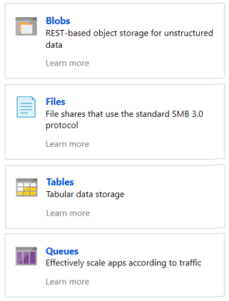
Azure Storage Services
Azure Blobs: A massively scalable object store for text and binary data
Azure Files: Managed file shares for cloud or on-premises deployments
Azure Tables: A NoSQL store for schema less storage of structured data
Azure Queues: A messaging store for reliable messaging between application components
Notes:
Blobs and Files each have a lesson. This is the only time Tables and Queues are discussed.

Slide 7

Standard and Premium Storage Accounts
Standard:
Backed by magnetic drives (HDD)
Lowest cost per GB
Premium:
Backed by solid state drives (SSD)
Can only be used with Azure VM disks
Notes:
This topic was touched on in the Virtual Machines lesson.
✔️ It is not possible to convert a Standard storage account to Premium storage account or vice versa. You must create a new storage account with the desired type and copy data, if applicable, to a new storage account.

Slide 8
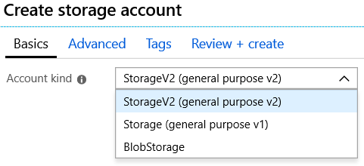
Storage Types
Storage V2 – latest version, lowest price, supports all services, recommended
Storage V1 – legacy account
Blob Storage - specialized for storing unstructured object data
✔️ You can easily upgrade a general-purpose v1 or Blob storage account to a general-purpose v2 account with no downtime and without the need to copy data

Slide 9
Accessing Storage
Every object has a unique URL address
The storage account name forms the subdomain of that address
The subdomain and domain name forms an endpoint
Blob service: http://mystorageaccount.blob.core.windows.net
Table service: http://mystorageaccount.table.core.windows.net
Queue service: http://mystorageaccount.queue.core.windows.net
File service: http://mystorageaccount.file.core.windows.net
If you prefer you can configure a custom domain name
CNAME record | Target
blobs.contoso.com | contosoblobs.blob.core.windows.net
Notes:
Endpoints are covered in more detail in the Virtual Networking lesson.
✔️A Blob storage account only exposes the Blob service endpoint. And, you can also configure a custom domain name to use with your storage account.

Slide 10
Demonstration – Creating a Storage Account
Create a storage account in the portal
Create a storage account using PowerShell
Create a storage account using CLI
Notes:
✔ Always consider having students walk-through the demonstrations themselves. Also, consider the overlap with the formal labs and your best use of time.

Slide 11
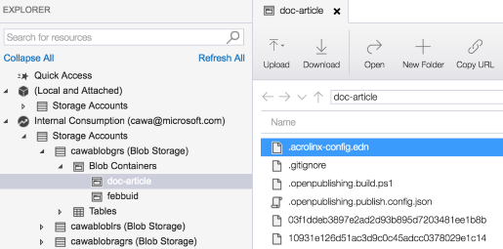
Azure Storage Explorer
Access multiple accounts and subscriptions
Create, delete, view, edit storage resources
View and edit Blob, Queue, Table, File, Cosmos DB storage and Data Lake Storage
Obtain shared access signature (SAS) keys
Available for Windows, Mac, and Linux

Slide 12
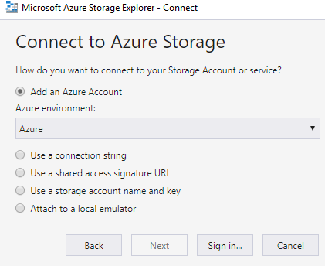
Storage Explorer Connection Options
Connect to an Azure subscription
Work with local development storage (emulator)
Attach to external storage
Attach a storage account or storage service by using a shared access signature
Connect to an Azure Cosmos DB account by using a connection string

Slide 13
Demonstration – Storage Explorer
Download and install Storage Explorer
Connect to an Azure subscription
Attach an Azure storage account
Notes:
✔ Always consider having students walk-through the demonstrations themselves. Also, consider the overlap with the formal labs and your best use of time.

Slide 14
Lesson 02: Blob Storage

Slide 15
Blob Storage Overview
Blob Storage
Blob Containers
Blob Performance Tiers
Uploading Blobs
Blob Access Policies
Blob Storage Pricing
Demonstration – Blob Storage
Notes:
Lesson overview

Slide 16
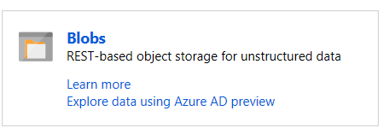
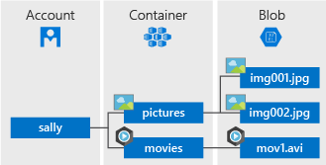
Blob Storage
Stores unstructured data in the cloud
Can store any type of text or binary data
Also referred to as object storage
Common uses:
Serving images or documents directly to a browser
Storing files for distributed access
Streaming video and audio
Storing data for backup and restore, disaster recovery, archiving
Storing data for analysis by an on-premises or Azure-hosted service
Notes:
For more information, you can see:
Azure Blob Storage - https://azure.microsoft.com/en-us/services/storage/blobs/

Slide 17
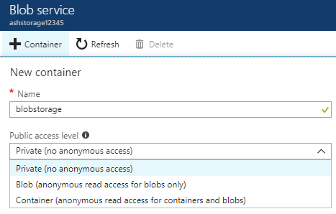
Blob Containers
All blobs must be in a container
Accounts have unlimited containers
Containers can have unlimited blobs
Private blobs - no anonymous access
Blob access - anonymous public read access for blobs only
Container access - anonymous public read and list access to the entire container, including the blobs
Notes:
✔️ You can also create the Blob container with PowerShell using the New-AzureStorageContainer command.
✔️ Have you thought about how you will organize your containers?

Slide 18
Blob Performance Tiers
Hot tier (inferred) - Optimized for frequent access of objects in the storage account
Cool tier - Optimized for storing large amounts of data that is infrequently accessed and stored for at least 30 days
Archive - Optimized for data that can tolerate several hours of retrieval latency and will remain in the Archive tier for at least 180 days
✔️ You can switch between these access tiers at any time.

Slide 19
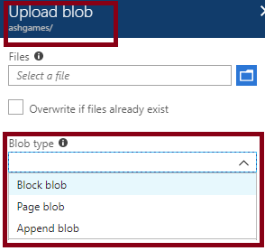
Uploading Blobs
Block blobs (default) - useful for storing text or binary files
Page blobs - More efficient for frequent read/write operations
Append blobs - useful for logging scenarios
You cannot change a blob type once it has been created
Notes:
✔️ Once the blob has been created, its type cannot be changed.

Slide 20
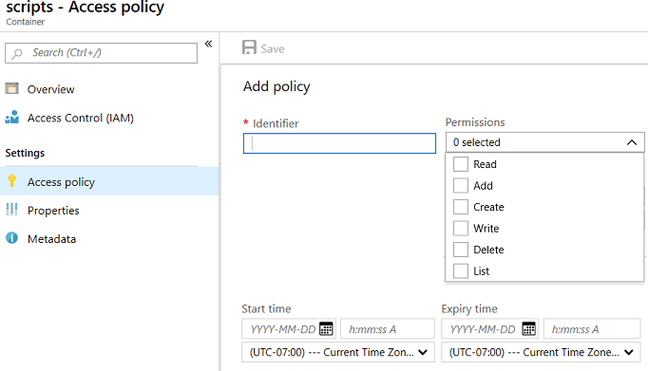
Blob Access Policies
Provides an additional level of control over server-side SAS
Groups SAS to provide additional restrictions for signatures bound to the policy
Supported for Blob containers, File shares, Tables, and Queues
Notes:
SAS is covered in more detail in the last lesson.

Slide 21
Storage Pricing
Storage costs
Blob storage
Data access costs
Transaction costs
Geo-Replication data transfer costs
Outbound data transfer costs
Changing the storage tier

Slide 22
Demonstration – Blob Storage
Create a container
Upload a block blob
Download a block blob
Explore with Storage Explorer (optional)
Notes:
✔ Always consider having students walk-through the demonstrations themselves. Also, consider the overlap with the formal labs and your best use of time.

Slide 23
Lesson 03: Azure Files

Slide 24
Azure Files Overview
Azure Files
Files vs Blobs
Creating File Shares
Mapping File Shares (Windows)
Mapping File Shares (Linux)
Secure Transfer Required
File Share Snapshots
Demonstration – File Shares
Notes:
Lesson overview

Slide 25
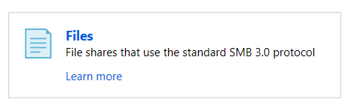
Azure Files
Managed file shares in the cloud that are accessible via SMB
Common uses:
Replace and supplement
Lift and shift
Azure File Sync
Shared applications
Diagnostic data
Tools and utilities
Notes:
✔️ Which of the usage cases for file shares are you most interested in?
For more information, you can see:
What is Azure Files?- [https://docs.microsoft.com/en-us/azure/storage/files/storage-files-introduction](https://docs.microsoft.com/en-us/azure/storage/files/storage-files-introduction)

Slide 26
Files vs Blobs
Feature | Description | When to use
Azure Files | SMB interface, client libraries, and a REST interface that allows access from anywhere to stored files. | Lift and shift an application to the cloud. Store shared data across multiple virtual machines. Store development and debugging tools that need to be accessed from many virtual machines.
Azure Blobs | Client libraries and a REST interface that allows unstructured data (flat namespace) to be stored and accessed at a massive scale in block blobs. | Support streaming and random-access scenarios. Access application data from anywhere.
Notes:
✔️ When selecting which storage feature to use, you should also consider pricing.

Slide 27
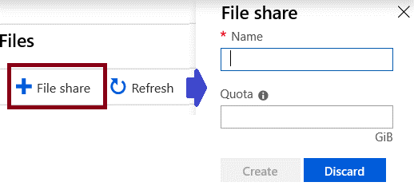
Creating File Shares
Portal
PowerShell
# Retrieve storage account and storage account key
$storageContext = New-AzStorageContext <storage-account-name> <storage-account-key>
# Create the file share, in this case “logs”
$share = New-AzStorageShare logs -Context $storageContext

Slide 28
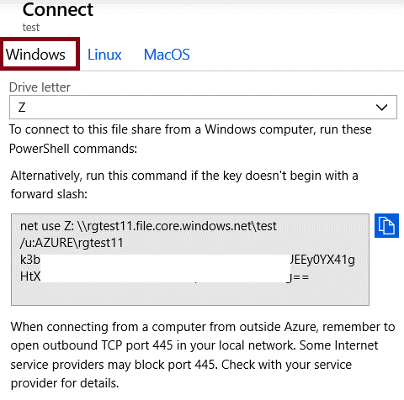
Mapping File Shares (Windows)
Mapping drive letter
UNC path
Account user
Storage Account Key
✔️ Ensure port 445 is open
Notes:
Storage account has been redacted.

Slide 29
Mounting File Shares (Linux)
sudo mount -t cifs //<storage-account-name>.file.core.windows.net/<share-name> <mount-point> -o vers=<smb-version>,username=<storage-account-name>,password=<storage-account-key>,dir_mode=0777,file_mode=0777,serverino
Install the cifs-utils package
Meet the SMB client requirements
Decide on the directory file chmod permissions
Create an entry in /etc/fstab to persist the mount
Notes:
For more information, you can see:
Use Azure Files with Linux - https://docs.microsoft.com/en-us/azure/storage/files/storage-how-to-use-files-linux
Create a persistent mount point for the Azure file share with /etc/fstab - https://docs.microsoft.com/en-us/azure/storage/files/storage-how-to-use-files-linux#create-a-persistent-mount-point-for-the-azure-file-share-with-etcfstab

Slide 30
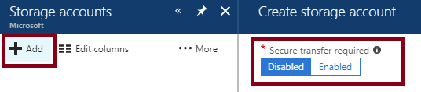
Secure Transfer Required
Only allows requests by secure connection such as HTTPs
Portal
PowerShell
Set-AzStorageAccount
-Name "{StorageAccountName}"
-ResourceGroupName "{ResourceGroupName}"
-EnableHttpsTrafficOnly $True
Notes:
✔️ Because Azure storage doesn’t support HTTPs for custom domain names, this option is not applied using a custom domain name.
For more information, you can see:
Require secure transfer in Azure Storage - https://docs.microsoft.com/en-us/azure/storage/common/storage-require-secure-transfer

Slide 31
File Share Snapshots
Captures the share state at that point in time
Is read-only copy of your data
Snapshot at the file share level
Retrieve at the individual file level
Incremental in nature
Uses:
Protection against application error and data corruption.
Protection against accidental deletions or unintended changes.
General backup purposes.

Slide 32
Demonstration – File Shares
Create a file share and upload a file
Manage snapshots
Create a file share (PowerShell)
Mount a file share (PowerShell)
Notes:
✔ Always consider having students walk-through the demonstrations themselves. Also, consider the overlap with the formal labs and your best use of time.

Slide 33
Lesson 04: Storage Security

Slide 34
Storage Security Overview
Storage Security
Shared Access Signatures
Configuring SAS Parameters
URI and SAS Parameters
Demonstration – SAS (Portal)
Storage Service Encryption
Customer Managed Keys
SAS Best Practices
Demonstration – SAS (Storage Explorer)
Notes:
Lesson overview

Slide 35
Storage Security
Storage Encryption Services
Authentication with Azure AD and RBAC
Client-side encryption, HTTPS, and SMB 3.0 for data in transit
Azure disk encryption
Shared Access Signatures – delegated access
Shared Key – encrypted signature string
Anonymous access to containers and blobs

Slide 36

Shared Access Signatures (SAS)
Provides delegated access to resources
Grants access to clients without sharing your storage account keys
The account SAS delegates access to resources in one or more of the storage services: Blob, Queue, Table, or File service
The service SAS delegates access to a resource in just one of the storage services
Notes:
For more information, you can see:
What is a shared access signature? - https://docs.microsoft.com/en-us/azure/storage/common/storage-dotnet-shared-access-signature-part-1?toc=%2fazure%2fstorage%2fblobs%2ftoc.json#what-is-a-shared-access-signature

Slide 37
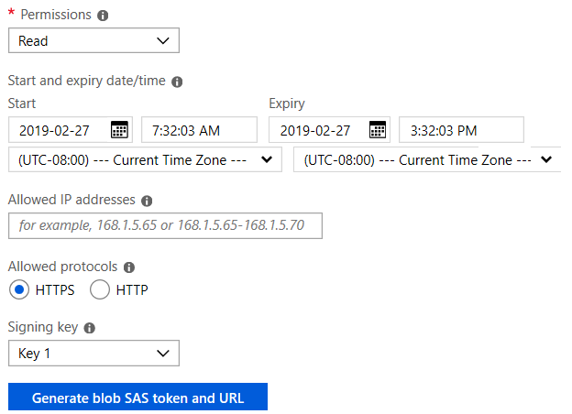
Configuring SAS Parameters
Account level SAS, full permissions
New-AzStorageAccountSASToken
-Service Blob,File,Table,Queue
-ResourceType Service,Container,Object
-Permission "racwdlup"
Blob level SAS, full permissions
New-AzStorageBlobSASToken
-Container "ContainerName"
-Blob "BlobName"
-Permission rwd

Slide 38
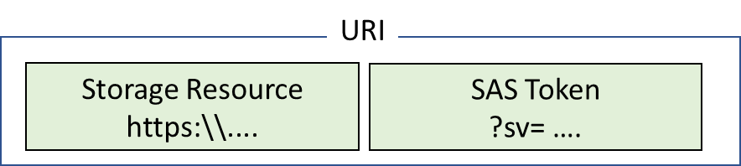
URI and SAS Parameters
A SAS is a signed URI that points to one or more storage resources
Consists of a storage resource URI and the SAS token
https://myaccount.blob.core.windows.net/?restype=service&comp=properties&sv=2015-04-05&ss=bf&srt=s&st=2015-04-29T22%3A18%3A26Z&se=2015-04-30T02%3A23%3A26Z&sr=b&sp=rw&sip=168.1.5.60-168.1.5.70&spr=https &sig=F%6GRVAZ5Cdj2Pw4txxxxx
Includes parameters for resource URI, storage services version, services, resource types, start time, expiry time, resource, permissions, IP range, protocol, signature
Notes:
For more information, you can see:
Shared access signature parameters - https://docs.microsoft.com/en-us/azure/storage/common/storage-dotnet-shared-access-signature-part-1?toc=%2fazure%2fstorage%2fblobs%2ftoc.json#shared-access-signature-parameters

Slide 39
Demonstration – SAS (Portal)
Create a SAS at the service level
Create a SAS at the account level
Notes:
✔ Always consider having students walk-through the demonstrations themselves. Also, consider the overlap with the formal labs and your best use of time.

Slide 40
Storage Service Encryption
Protects your data for security and compliance
Automatically encrypts and decrypts your data
Encrypted through 256-bit AES encryption
Is enabled for all new and existing storage accounts and cannot be disabled
Is transparent to users
✔️ You can use your own key (next topic)
Notes:
✔️ SSE is enabled for all new and existing storage accounts and cannot be disabled. Because your data is secured by default, you don't need to modify your code or applications.

Slide 41
Customer Managed Keys
Use the Azure Key Vault to manage your encryption keys
Create your own encryption keys and store them in a key vault
Use Azure Key Vault's APIs to generate encryption keys
Custom keys give you more flexibility and control
Notes:
✔️ To use customer-managed keys with SSE, you can either create a new key vault and key or you can use an existing key vault and key. The storage account and the key vault must be in the same region, but they can be in different subscriptions.
✔️ The key vault can also be used to store BitLocker keys.

Slide 42
Best Practices
Always use HTTPS to create or distribute an SAS
Reference stored access policies where possible
Use near-term expiration times on an ad hoc SAS
Have clients automatically renew the SAS if necessary
Be careful with SAS start time
Be specific with the resource to be accessed
Understand that your account will be billed for any usage
Validate data written using SAS
Don't assume SAS is always the correct choice
Use Storage Analytics to monitor your application

Slide 43
Demonstration – SAS (Storage Explorer)
Generate a SAS connection string for the account you want to share
Attach to a storage account by using a SAS Connection string
Notes:
✔ Always consider having students walk-through the demonstrations themselves. Also, consider the overlap with the formal labs and your best use of time.

Slide 44
Lesson 05: Lab and Review Questions

Slide 45
Lab: Implement and Manage Storage
Adatum Corporation wants to leverage Azure Storage for hosting its data
Exercise 0. Prepare the lab environment
Exercise 1. Implement and use Azure Blob Storage
Exercise 2. Implement and use Azure File Storage
Lab time: 60 minutes
Notes:
There are two topics in the Data Service module, Import and Export Service lesson, that discuss AzCopy. That tool is used in the lab, if you want to review the syntax.

Slide 46
Module Review Questions
Notes:
As you have time go through the Module Review questions in the student materials.

