Slide 1
AZ-103T00A Module 04: Virtual Networking

Slide 2
Module Overview
Virtual Networks
IP Addressing and Endpoints
Azure DNS
Network Security Groups
Lab and Review Questions
Notes:
Module overview

Slide 3
Lesson 01: Virtual Networks

Slide 4
Virtual Networks Overview
Azure Networking Components
Virtual Networks
Subnets
Implementing Virtual Networks
Demonstration – Creating Virtual Networks
Multiple NICs in Virtual Machines
Demonstration – Create VMs with Multiple NICs
Notes:
Lesson overview

Slide 5
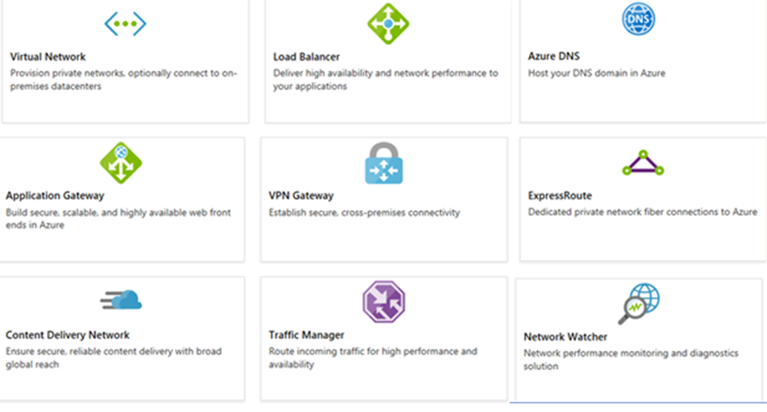
Azure Networking Components
Adopting cloud solutions can save time and simplify operations
Azure requires the same types of networking functionality as on-premises infrastructure
Azure networking offers a wide range of services and products
Notes:
For more information, you can see:
Azure Virtual Networks - https://azure.microsoft.com/en-us/services/virtual-network/

Slide 6
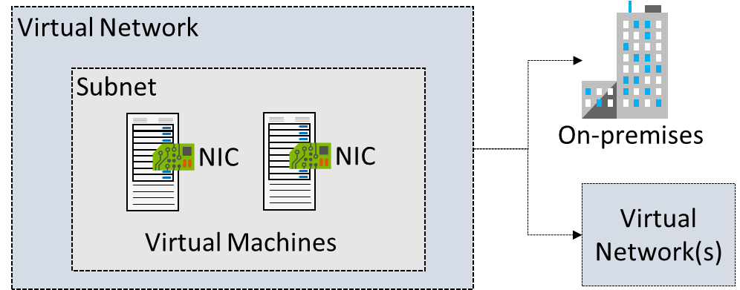
Virtual Networks
Logical representation of your own network
Create a dedicated private cloud-only VNet
Securely extend your datacenter With VNets
Enable hybrid cloud scenarios

Slide 7
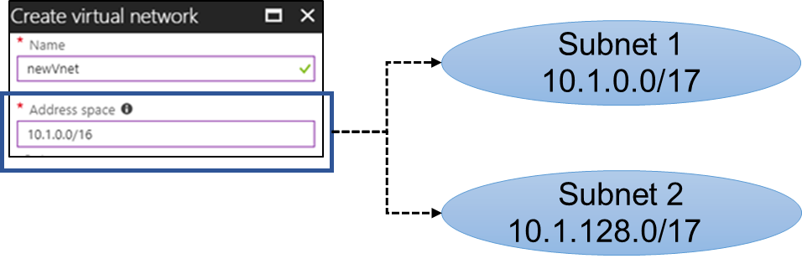
Subnets
A virtual network can be segmented into one or more subnets
Subnets provide logical divisions within your network
Subnets can help improve security, increase performance, and make it easier to manage the network
Each subnet must have a unique address range - cannot overlap with other subnets in the virtual network in the subscription
Notes:
✔️ Azure reserves the first three IP addresses and the last IP address in each subnet address range.

Slide 8
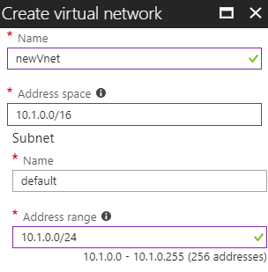
Implementing Virtual Networks
Create new virtual networks at any time
Add virtual networks when you create a virtual machine
Need to define the address space, and at least one subnet
Be careful with overlapping address spaces
Notes:
✔️ Always plan to use an address space that is not already in use in your organization, either on-premises or in other VNets. Even if you plan for a VNet to be cloud-only, you may want to make a VPN connection to it later. If there is any overlap in address spaces at that point, you will have to reconfigure or recreate the VNet. The next lesson will focus on IP addressing.

Slide 9
Demonstration – Creating Virtual Networks
Create a virtual network in the portal
Create a virtual network with PowerShell

Slide 10
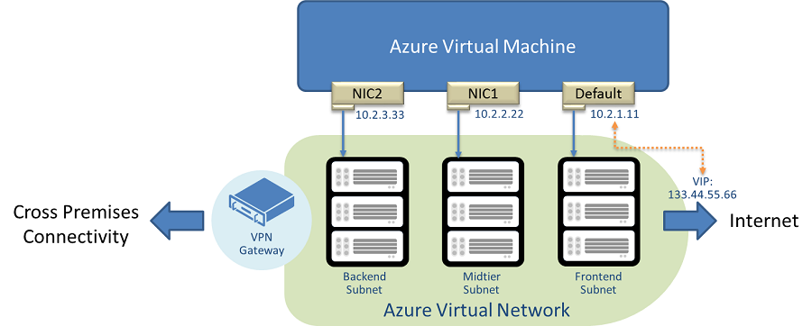
Multiple NICs in Virtual Machines
You can create virtual machines with multiple NICs
Useful for virtual appliances, network traffic management, and isolation of traffic
The VM size determines the number of NICs that can be supported

Slide 11
Demonstration – Create VMs with Multiple NICs (CLI)
Create a VNet, subnet, and NSG
Create and configure multiple NICs
Create a VM and attach the NICs
Notes:
✔ Always consider having students walk-through the demonstrations themselves. Also, consider the overlap with the formal labs and your best use of time.

Slide 12
Lesson 02: IP Addressing and Endpoints

Slide 13
IP Addressing Overview
IP Addressing
Public IP Addresses
Private IP Addresses
Demonstration – Manage IP Addresses
Service Endpoints
Service Endpoint Services
Secure Access to Storage
Demonstration – Service Endpoints
Notes:
Lesson overview

Slide 14
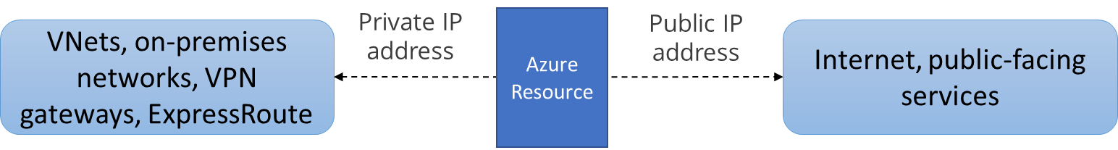
IP Addressing
Private IP addresses are used within an Azure virtual network (VNet), and your on-premises network, when you use a VPN gateway or ExpressRoute circuit to extend your network to Azure
Public IP addresses is used for communication with the Internet, including Azure public-facing services
Notes:
✔️ As a best practice you may decide to separate dynamically and statically assigned IP resources into different subnets. And, IP Addresses are never managed from within a virtual machine.

Slide 15
Public IP Addresses
Public IP addresses | IP address association | Dynamic | Static
Virtual Machine | NIC | Yes | Yes
Load Balancer | Front-end configuration | Yes | Yes
VPN Gateway | Gateway IP configuration | Yes | No
Application Gateway | Front-end configuration | Yes | No
A public IP address resource can be associated with virtual machine network interfaces, internet-facing load balancers, VPN gateways, and application gateways.

Slide 16
Private IP Addresses
Private IP Addresses | IP address association | Dynamic | Static
Virtual Machine | NIC | Yes | Yes
Internal Load Balancer | Front-end configuration | Yes | Yes
Application Gateway | Front-end configuration | Yes | Yes
Dynamic (default). Azure assigns the next available unassigned or unreserved IP address in the subnet's address range
Static. You select and assign any unassigned or unreserved IP address in the subnet's address range

Slide 17
Demonstration - Manage IP Addresses
Retrieve static private IP address information
Remove a static private IP address
Notes:
✔ Always consider having students walk-through the demonstrations themselves. Also, consider the overlap with the formal labs and your best use of time.

Slide 18
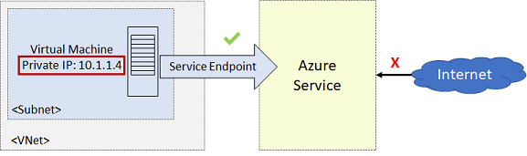
Service Endpoints
Endpoints limit network access to specific subnets and IP addresses
Improved security for your Azure service resources
Optimal routing for Azure service traffic from your virtual network
Endpoints use the Microsoft Azure backbone network
Simple to set up with less management overhead
Notes:
✔️ Can you see a use for service endpoints in your organization?
For more information, you can see:
Virtual network service endpoints - https://docs.microsoft.com/en-us/azure/virtual-network/virtual-network-service-endpoints-overview

Slide 19
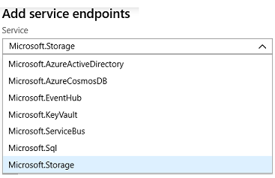
Service Endpoint Services
✔️ Adding service endpoints can take up to 15 minutes to complete

Slide 20
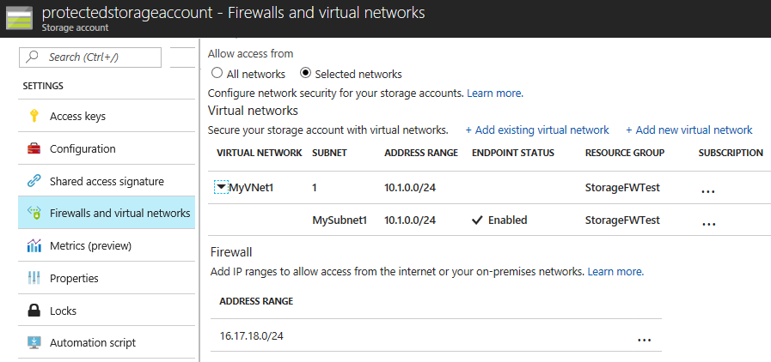
Secure Access to Storage Endpoints
Must configure both sides of the endpoints. For example, the virtual network side and the storage account side.
Each service endpoint has its own Azure documentation page
Notes:
✔️It is important to test and ensure the service endpoint is limiting access as expected. You will do this in the practice exercise.

Slide 21
Demonstration – Service Endpoints
Create a storage account
Create a subnet service endpoint
Secure the storage to the service endpoint
Test the storage endpoint

Slide 22
Lesson 03: Azure DNS

Slide 23
Azure DNS Overview
Domains and Custom Domains
Verifying Custom Domain Names
Azure DNS Zones
DNS Record Sets
DNS Delegation
DNS for Private Domains
Private Zones Scenarios
Demonstration – DNS Name Resolution
Notes:
Lesson overview

Slide 24
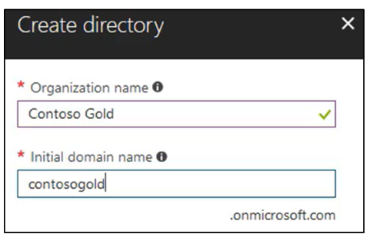
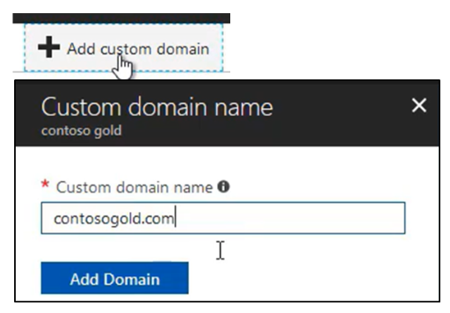
Domains and Custom Domains
When you create an Azure subscription an Azure AD domain is created for you
The domain has initial domain name in the form domainname.onmicrosoft.com
You can customize/change the name
After the custom name is added it must be verified (next topic)

Slide 25
Verify the Custom Domain Name
Verification demonstrates ownership of the domain name
Add a DNS record (MX or TXT) that is provided by Azure into your company’s DNS zone
Azure will query the DNS domain for the presence of the record
This could take several minutes or several hours

Slide 26
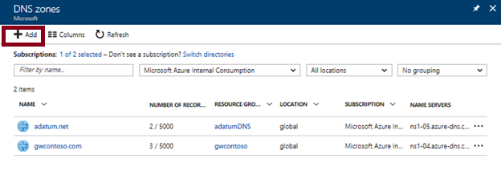
Azure DNS Zones
A DNS zone hosts the DNS records for a domain
The name of the zone must be unique within the resource group
Where multiple zones share the same name, each instance is assigned different name server addresses
Only one set of addresses can be configured with the domain name registrar
Notes:
✔️ You do not have to own a domain name to create a DNS zone with that domain name in Azure DNS. However, you do need to own the domain to configure the domain.
For more information, you can see:
DNS Zones - https://docs.microsoft.com/en-us/azure/dns/dns-zones-records#dns-zones

Slide 27
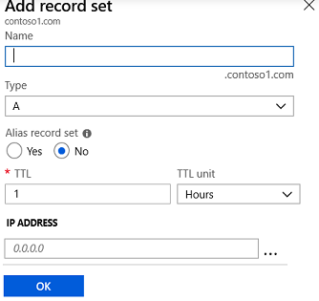
DNS Record Sets
A record set is a collection of records in a zone that have the same name and are the same type
You can add up to 20 records to any record set
A record set cannot contain two identical records
Changing the drop-down Type, changes the information required

Slide 28
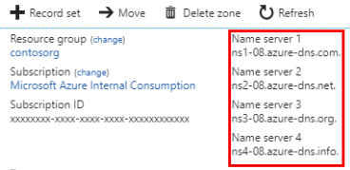
DNS Delegation
When delegating a domain to Azure DNS, you must use the name server names provided by Azure DNS – use all four
Once the DNS zone is created, update the parent registrar
For child zones, register the NS records in the parent domain
Notes:
The PowerShell slide is coming up.

Slide 29
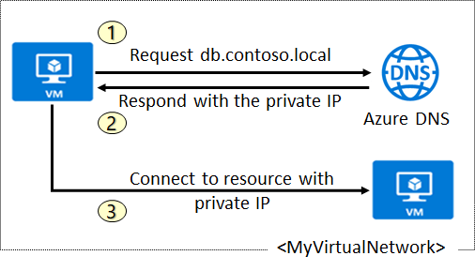
DNS for Private Domains
Use your own custom domain names
Provides name resolution for VMs within a VNet and between VNets
Automatic hostname record management
Removes the need for custom DNS solutions
Use all common DNS records types
Available in all Azure regions

Slide 30
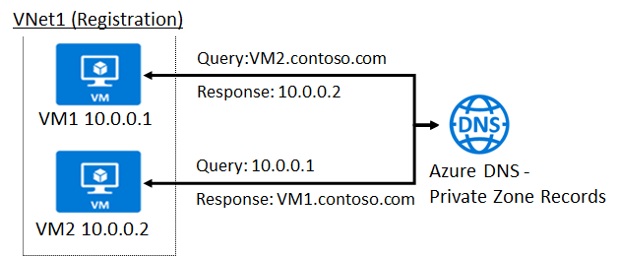
Private Zone Scenarios
VNet2
Resolution
DNS resolution in VNet1 is private and not accessible from the Internet
DNS queries across the virtual networks are resolved
Reverse DNS queries are scoped to the same virtual network

Slide 31
Demonstration – DNS Name Resolution
Create a DNS zone
Add a DNS record set
Use PowerShell to view DNS information
View your name servers
Test the resolution
Explore DNS metrics
Notes:
✔ Always consider having students walk-through the demonstrations themselves. Also, consider the overlap with the formal labs and your best use of time.

Slide 32
Lesson 04: Network Security Groups (NSGs)

Slide 33
Network Security Groups Overview
Network Security Groups
NSG Rules
NSG Effective Rules
Creating NSG Rules
Demonstration - NSGs
Notes:
Lesson overview

Slide 34
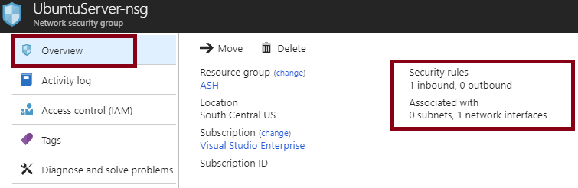
Network Security Groups (NSG)
You can limit network traffic to resources in a virtual network using a NSG
A NSG contains a list of security rules that allow or deny inbound or outbound network traffic
An NSG can be associated to a subnet or a network interface
Notes:
✔️ To simplify management of security rules, it's recommended that you associate a network security group to individual subnets, rather than individual network interfaces within the subnet.
For more information, you can see:
Network Security Groups - https://docs.microsoft.com/en-us/azure/virtual-network/security-overview#network-security-groups

Slide 35
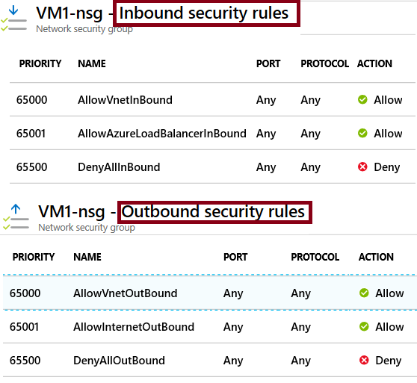
NSG Rules
Security rules in NSGs enable you to filter network traffic that can flow in and out of virtual network subnets and network interfaces.
There are default security rules. You cannot delete the default rules, but you can add other rules with a higher priority.

Slide 36
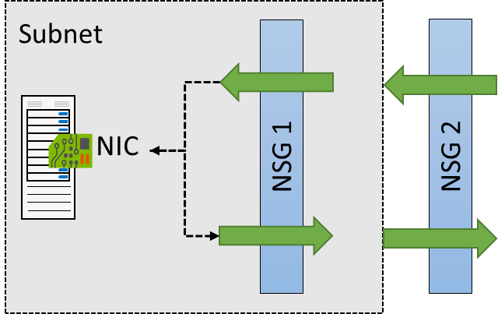

NSG Effective Rules
NSGs are evaluated independently for the subnet and NIC
An “allow” rule must exist at both levels for traffic to be admitted
Use the Effective Rules link if you are not sure which security rules are being applied

Slide 37
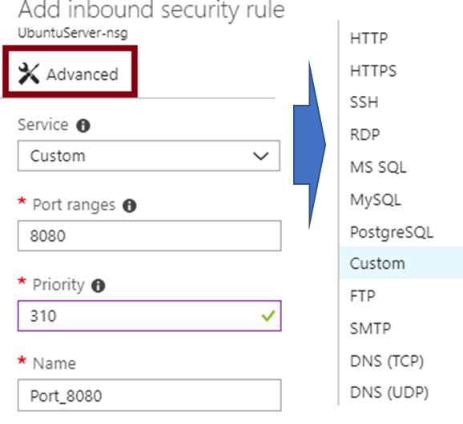
Creating NSG Rules
Select from a large variety of services
Service - The destination protocol and port range for this rule
Port ranges – Single port or multiple ports
Priority - The lower the number, the higher the priority

Slide 38
Demonstration – Network Security Rules
Access the NSGs blade
Add a new NSGs
Explore inbound and outbound rules
Notes:
✔ Always consider having students walk-through the demonstrations themselves. Also, consider the overlap with the formal labs and your best use of time.

Slide 39
Lesson 05: Lab and Review Questions

Slide 40
Lab – Configure Azure DNS
Adatum Corporation wants to implement public and private DNS service in Azure without having to deploy its own DNS servers.
Exercise 1. Configure Azure DNS for public domains
Exercise 2. Configure Azure DNS for private domains
Lab time: 60 minutes

Slide 41
Module Review Questions
Notes:
As you have time go through the Module Review questions in the student materials.

