Slide 1
AZ-103T00A Module 07: Data Protection

Slide 2
Module Overview
Data Replication
File and Folder Backups
Virtual Machine Backups
Lab and Review Questions
Notes:
Module overview

Slide 3
Lesson 01: Data Replication

Slide 4
Data Replication Overview
Replication Options
Locally-redundant Storage
Zone-redundant Storage
Geo-redundant Storage
Comparing Replication Strategies
Notes:
Lesson overview

Slide 5
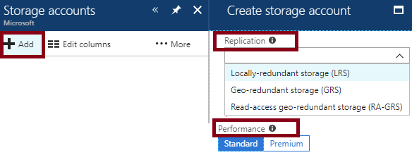
Replication Options
Replication ensures durability and high availability
Replicate your data within the same data center, across zonal data centers within the same region, and even across regions
If you select Premium performance only LRS replication will be available
Notes:
For more information, you can see:
Azure storage replication - https://docs.microsoft.com/en-us/azure/storage/common/storage-redundancy

Slide 6
Locally-redundant Storage
Replication | Copies | Strategy
Locally redundant storage (LRS) | Maintains three copies of your data. | Data is replicated three time within a single facility in a single region.
Maintains three copies of your data at a single facility
All copies of the data exist within the same region
Use if data can be easily reconstructed
Use if there are regional governance requirements
Low-cost option

Slide 7
Zone-redundant Storage
Replication | Copies | Strategy
Zone-redundant storage (ZRS) | Maintains three copies of your data. | Data is replicated three times across two to three facilities, either within a single region or across two regions.
Replicates your data across three storage clusters in a single region
Each storage cluster is physically separated from the others and resides in its own availability zone
Each availability zone, and the ZRS cluster within it, is autonomous, with separate utilities and networking capabilities
Not available in all regions
Notes:
✔️Consider ZRS for scenarios that require strong consistency, strong durability, and high availability even if an outage or natural disaster renders a zonal data center unavailable.

Slide 8
Geo-redundant Storage
Replication | Copies | Strategy
Geo-redundant storage (GRS) | Maintains six copies of your data. | Data is replicated three times within the primary region and is also replicated three times in a secondary region hundreds of miles away from the primary region.
Read access geo-redundant storage (RA-GRS) | Maintains six copies of your data. | Data is replicated to a secondary geographic location and provides read access to your data in the secondary location.
GRS replicates your data to another data center in a secondary region, but that data is available to be read only during a failure
RA-GRS is based on GRS and replicates data to another data center in another region. Provides read access from the secondary region, even without a failure
Consider RTO and RPO
Notes:
✔️ If you enable RA-GRS and your primary endpoint for the Blob service is myaccount.blob.core.windows.net, then your secondary endpoint is myaccount-secondary.blob.core.windows.net. The access keys for your storage account are the same for both the primary and secondary endpoints.

Slide 9
Comparing Replication Strategies
Replication Option | LRS | ZRS | GRS | RA-GRS
Node unavailability within a data center | Yes | Yes | Yes | Yes
An entire data center (zonal or non-zonal) becomes unavailable | No | Yes | Yes | Yes
A region-wide outage | No | No | Yes | Yes
Read access to your data (in a remote, geo-replicated region) for region-wide unavailability | No | No | No | Yes
Available in storage account types | GPv1, GPv2, Blob | Standard, GPv2 | GPv1, GPv2, Blob | GPv1, GPv2, Blob

Slide 10
Lesson 02: File and Folder Backups

Slide 11
File and Folder Backups Overview
Azure Backup
Recovery Service Vault Backup Options
Demonstration – Backup Azure File Shares
Implementing On-Premises File and Folder Backups
Microsoft Azure Recovery Services (MARS) Agent
Demonstration – Backup Files and Folders
Notes:
Lesson overview

Slide 12
Azure Backup
Azure-based service used to back up and restore data in Microsoft cloud
Automatic Storage Management
Multiple storage options
Unlimited data transfer
Data encryption
Application consistent backup
Long-term retention
Notes:
✔️ What are some of the reasons your organization might choose Azure Backup?
For more information, you can see:
Why use Azure Backup? - https://docs.microsoft.com/en-us/azure/backup/backup-introduction-to-azure-backup#why-use-azure-backup

Slide 13
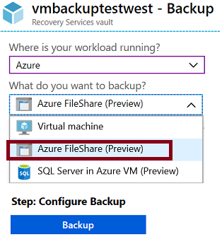
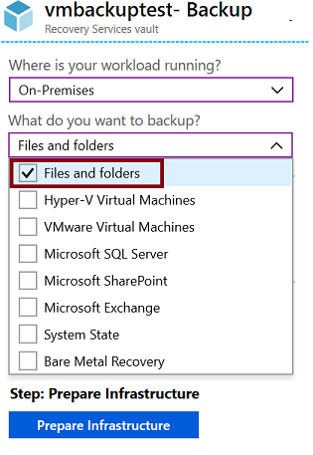
Recovery Services Vault Backup Options
Azure Workloads
On-Premises workloads
Notes:
Focus on the choices when you select Azure or On-Premises and want to backup files and folders.
✔️ Within an Azure subscription, you can create up to 25 Recovery Services vaults per region.
✔️ Notice your backup choices for virtual machines. This will be covered in another lesson.

Slide 14
Demonstration – Backup Azure File Shares
Create a Recovery Services vault
Configure the vault
Explore monitoring information

Slide 15
Implementing On-Premises File and Folder Backup
Create the recovery services vault
Download the agent and credential file
Install and register agent
Configure the backup

Slide 16
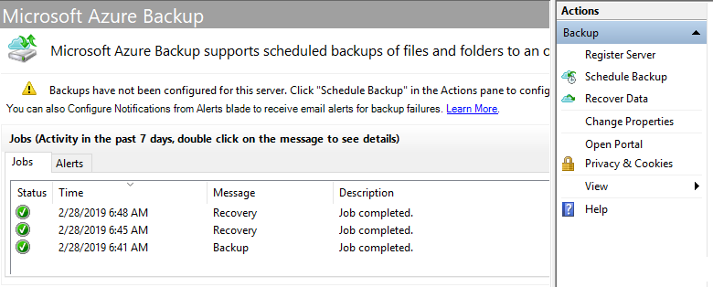
MARS Agent
Backup or recover files and folders on physical or virtual Windows OS (VMs can be on-premises or in Azure)
No separate backup server required
Not application aware; file, folder, and volume-level restore only
No support for Linux

Slide 17
Demonstration – Backup Files and Folders
Create a Recovery Services vault
Configure the vault
Install and register the agent
Create the backup policy
Backup files and folders
Explore the recover settings
Explore the backup properties
Delete your backup schedule

Slide 18
Lesson 03: Virtual Machine Backups

Slide 19
Virtual Machine Backups Overview
Azure Site Recovery (ASR) Scenarios
Virtual Machine Data Protection
Workload Protection Needs
Azure to Azure Architecture
Recovery Services Vault VM Backup Options
Implementing VM Backups
Implementing VM Restore
Azure Backup Server
Backup Component Comparison
Notes:
Lesson overview

Slide 20
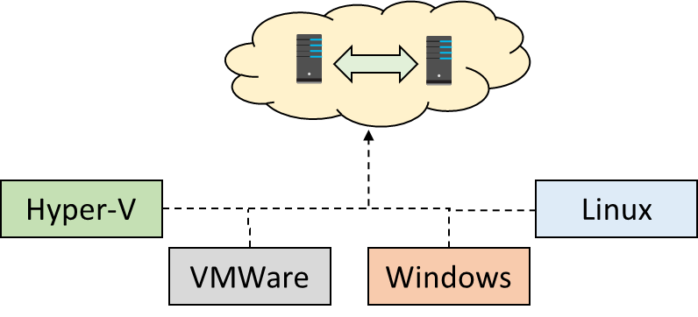
Azure Site Recovery (ASR) Scenarios
Replicate Azure VMs from one Azure region to another
Replicate on-premises VMware VMs, Hyper-V VMs, physical servers (Windows and Linux), Azure Stack VMs to Azure
Replicate on-premises VMware VMs, Hyper-V VMs managed by System Center VMM, and physical servers to a secondary site
Notes:
We will concentrate on replication within Azure and not migration scenarios from on-premises.

Slide 21
Virtual Machine Data Protection
Managed snapshots provide a quick and simple option for backing up VMs that use Managed Disks
Azure Backup supports application-consistent backups for both Windows and Linux VMs
Azure Site Recovery protects your VMs from a major disaster scenario when a whole region experiences an outage
Notes:
✔️ Have you tried any of these backup methods? Do you have a backup plan?

Slide 22
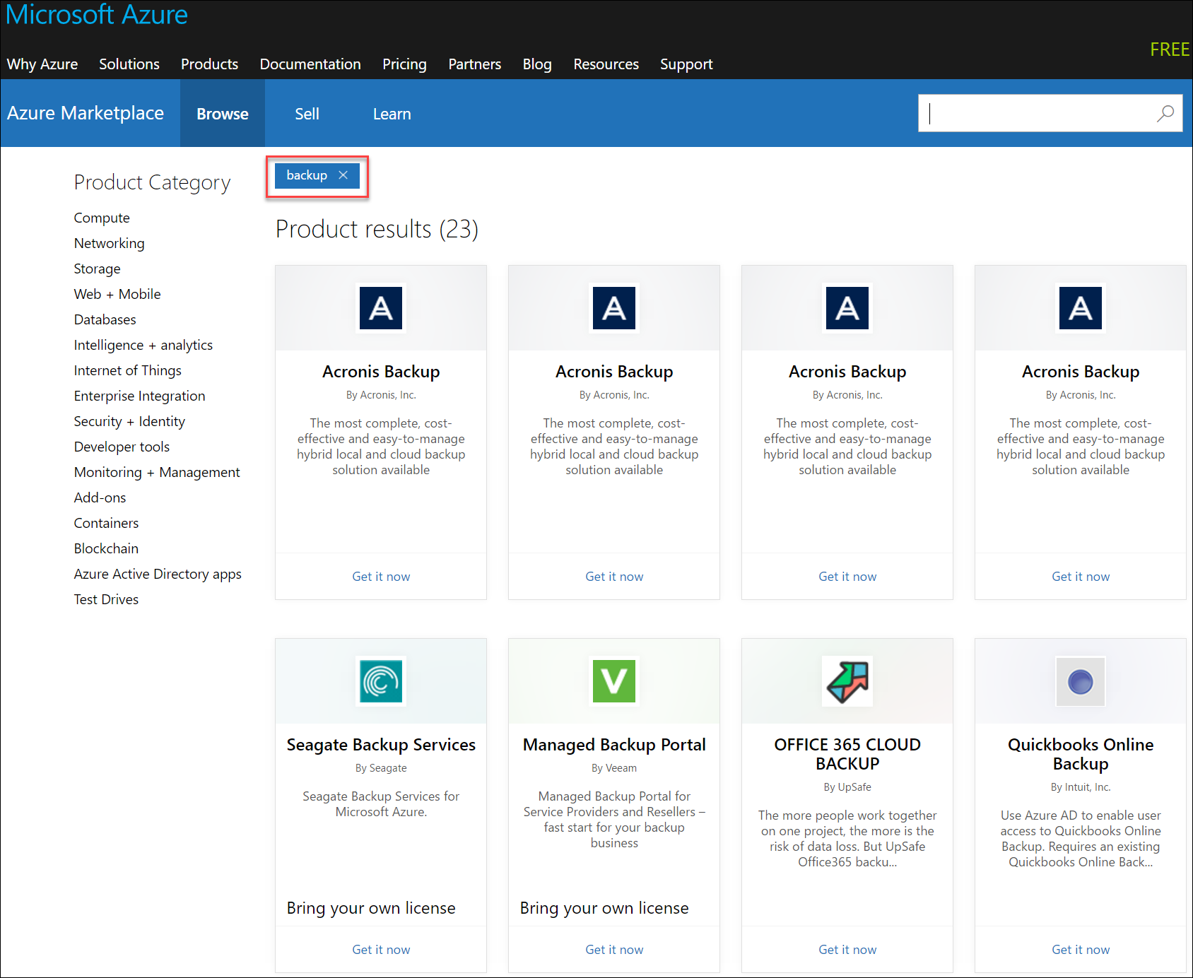
Workload Protection Needs
Many backup options are available
How the workload is being protected today?
How often is the workload is backed up?
What types of backups are being done?
Is disaster recovery protection in place?

Slide 23
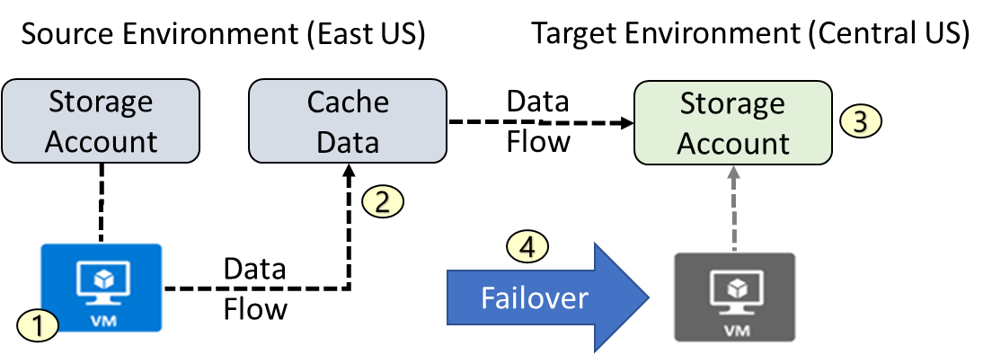
Azure to Azure Architecture
VM is registered with Azure Site Recovery
Data is continuously replicated to cache
Cache is replicated to the target storage account
During failover the virtual machine is added to the target environment

Slide 24
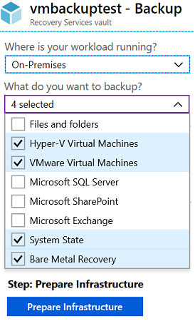
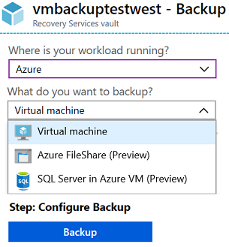
Recovery Services Vault VM Backup Options
Azure Workloads
On-Premises Workloads
✔️ Multiple servers can be protected using the same Recovery Services vault
Notes:
Focus on the choices when you select Azure or On-Premises and want to backup virtual machines.

Slide 25
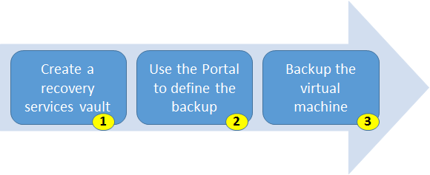
Implementing VM Backups
Use a Recovery Services vault in the region where you want to store the data To backup your files and folders. Also determine how you want your storage replicated.
Take snapshots (recovery points) of your data at defined intervals. These snapshots are stored in recovery services vaults.
For the Backup extension to work, the Azure VM Agent must be installed on the Azure virtual machine.
Notes:
For more information, you can see:
Plan your VM backup infrastructure in Azure - https://docs.microsoft.com/en-us/azure/backup/backup-azure-vms-introduction

Slide 26
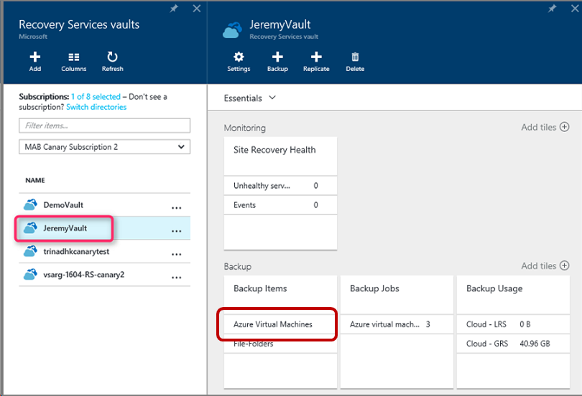
Implementing VM Restore
Once you trigger the restore operation, the Backup service creates a job for tracking the restore operation
The Backup service also creates and temporarily displays notifications, so you monitor how the backup is proceeding

Slide 27

Azure Backup Server
Specialized Workloads
Virtual Machines
Files/Folders/Volumes
Azure
System Center DPM
Or Azure Backup Server
App-aware backups, file/folder/volume backups, and machine state backups (bare-metal, system state)
Each machine runs the DPM/MABS protection agent, and the MARS agent runs on the MABS/DPM
Flexibility and granular scheduling options
Manage backups for multiple machines in a protection group

Slide 28
Backup Component Comparison
Component | Benefits | Limits | Protects | Backup Storage
Azure Backup (MARS) agent | Backup files and folders on physical or virtual Windows OS No separate backup server required. | Backup 3x per day Not application aware File, folder, and volume-level restore only No support for Linux | Files Folders | Recovery services vault
Azure Backup Server | App aware snapshots Full flex for when to backups Recovery granularity Linux support on Hyper-V and VMware VMs Backup and restore VMware VMs Doesn't require a System Center license | Cannot backup Oracle workloads Always requires live Azure subscription No support for tape backup | Files Folders, Volumes VMs Applications Workloads | Recovery services vault Locally attached disk

Slide 29
Lesson 04: Lab and Review Questions

Slide 30
Lab – Azure Site Recovery Between Regions
Adatum Corporation wants to implement Azure Site Recovery to facilitate migration and protection of Azure VMs between regions.
Exercise 1: Implement prerequisites for migration of Azure VMs by using Azure Site Recovery
Exercise 2: Migrate an Azure VM between Azure regions by using Azure Site Recovery
Lab time: 60 minutes
Notes:
As you have time go through the Module Review questions in the student materials.

Slide 31
Module Review Questions

