Slide 1
AZ-103T00A Module 08: Network Traffic Management
Notes:
The Load Balancer and Traffic Manager lab for this module has setup time. If you are going to do the lab, consider completing Exercise 0: Prepare the lab environment before starting the lecture.

Slide 2
Module Overview
Network Routing
Azure Load Balancer
Azure Traffic Manager
Lab and Review Questions
Notes:
Module overview

Slide 3
Lesson 01: Network Routing

Slide 4
Network Routing Overview
System Routes
User Defined Routes
Routing Examples
Create a Routing Table
Create a Custom Route
Associate the Route

Slide 5
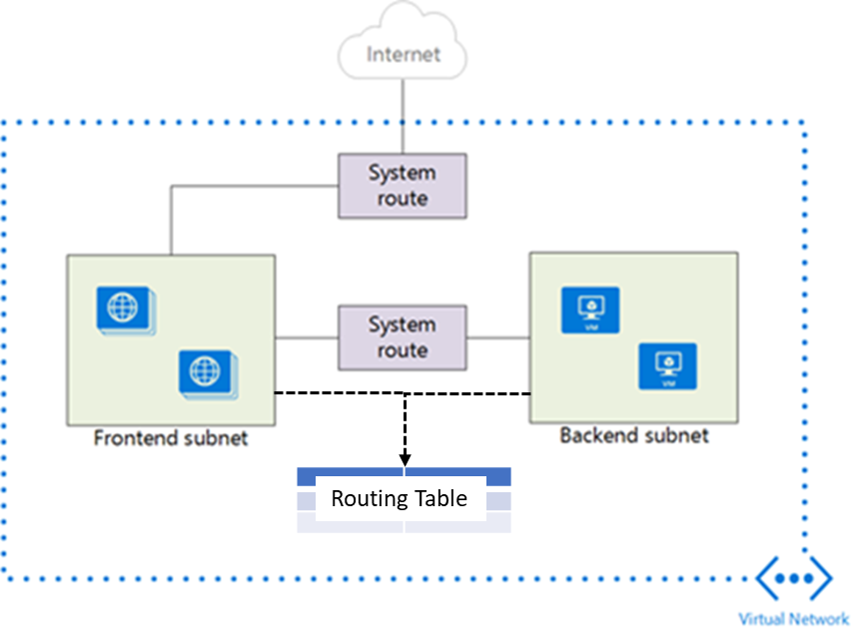
System Routes
System routes direct network traffic between virtual machines, on-premises networks, and the Internet
Traffic between VMs in the same subnet
Between VMs in different subnets in the same virtual network
Data flow from VMs to the Internet
Communication between VMs using a VNet-to-VNet VPN
Site-to-Site and ExpressRoute communication through the VPN gateway
Notes:
For more information, you can see:
System routes - https://docs.microsoft.com/en-us/azure/virtual-network/virtual-networks-udr-overview#system-routes

Slide 6
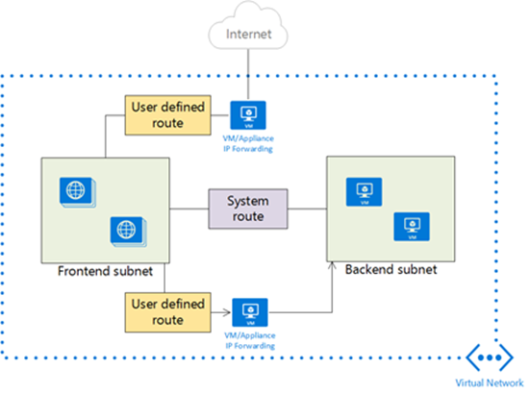
User Defined Routes
A route table contains a set of rules, called routes, that specifies how packets should be routed in a virtual network
User-defined routes are custom routes that control network traffic by defining routes that specify the next hop of the traffic flow
The next hop can be a virtual network gateway, virtual network, internet, or virtual appliance
Notes:
✔ Each route table can be associated to multiple subnets, but a subnet can only be associated to a single route table. There are no additional charges for creating route tables in Microsoft Azure. Do you think you will need to create custom routes?

Slide 7
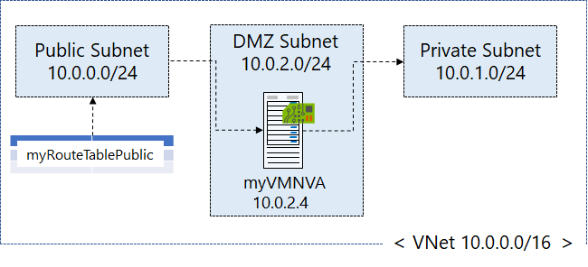
Routing Example
Create a routing table
Create a custom route
Associate the route to the subnet
Notes:
The next three topics will cover this information.

Slide 8
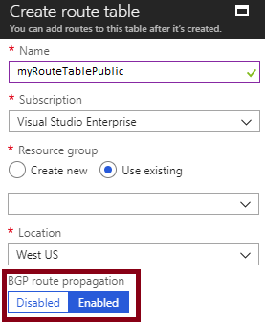
Create a Routing Table
Border Gateway Protocol (GBP) is a standard routing protocol used to exchange routing and reachability information between two or more networks
Routes are automatically added to the route table of all subnets with BGP propagation enabled
In most situations you will want to enable BGP route propagation

Slide 9
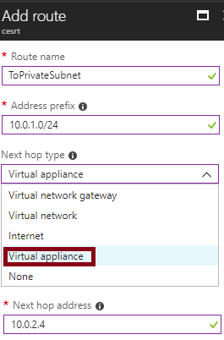
Create a Custom Route
When you create a route there are several Next hop types
In this example, any private subnet IP addresses will be sent to the virtual appliance
Other choices are Virtual network gateway, Virtual network, Internet, and None

Slide 10
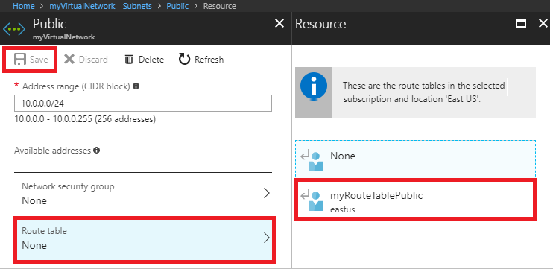
Associate the Route
Each subnet can have zero or one route table associated to it
In our example, the Public subnet will be associated with the routing table
Notes:
✔️ In this case the virtual appliance should not have a public IP address and IP forwarding should be enabled.

Slide 11
Demonstration – Custom Routing Tables
Create a route table
Add a route
Associate a route table to a subnet
Use PowerShell to view your routing information

Slide 12
Lesson 02: Azure Load Balancer

Slide 13
Azure Load Balancer Overview
Azure Load Balancer
Public Load Balancer
Internal Load Balancer
Load Balancer SKUs
Backend Pools
Load Balancer Rules
Session Persistence
Health Probes
Notes:
Lesson overview

Slide 14
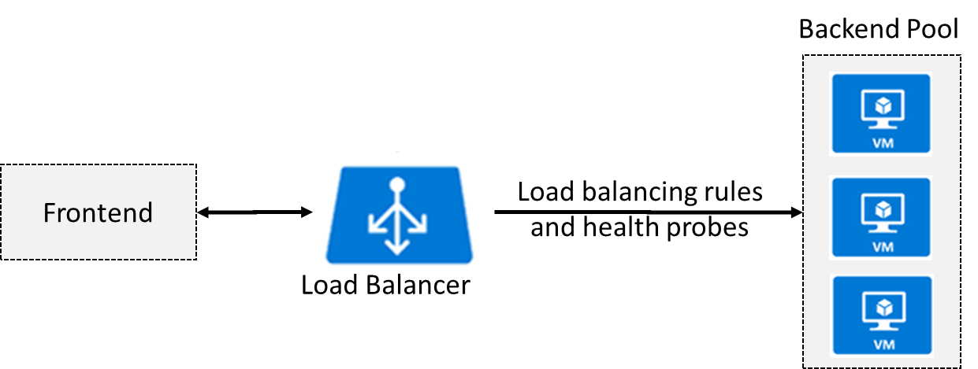
Azure Load Balancer
Distributes inbound traffic to backend resources using load-balancing rules and health probes
Can be used for both inbound/outbound scenarios
Protect on-premises web applications with secure remote access
Extend Active Directory to the cloud
Two types: Public and Internal
Notes:
✔ Keep this diagram in mind since it covers the four components that must be configured for your load balancer: Frontend IP configuration, Backend pools, Health probes, and Load balancing rules.
For more information, you can see:
Load Balancer documentation - https://docs.microsoft.com/en-us/azure/load-balancer/

Slide 15
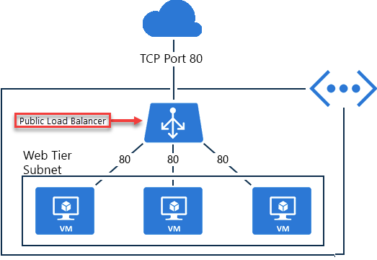
Public Load Balancer
Maps public IP addresses and port number of incoming traffic to the VM’s private IP address and port number, and vice versa.
Apply load balancing rules to distribute traffic across VMs or services.

Slide 16
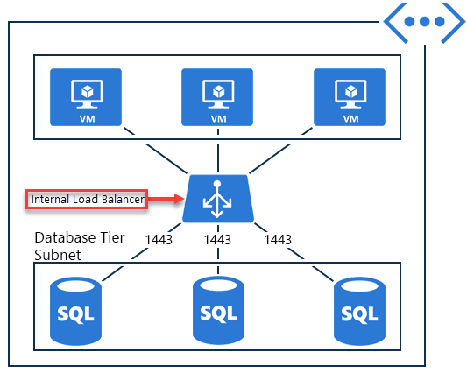
Internal Load Balancer
Directs traffic only to resources inside a virtual network or that use a VPN to access Azure infrastructure.
Frontend IP addresses and virtual networks are never directly exposed to an internet endpoint.
Enables load balancing within a virtual network, for cross-premises virtual networks, for multi-tier applications, and for line-of-business applications.
Notes:
✔ Can you see how a public load balancer could be placed in front of the internal load balancer to create a multi-tier application.

Slide 17
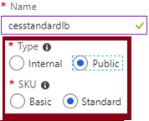
Load Balancer SKUs
Load balancer supports both Basic and Standard (newer) SKUs
SKUs are not mutable
Load Balancer rule cannot span two virtual networks
No charge for the Basic load balancer
Load Balancer frontends are not accessible across global virtual network peering

Slide 18
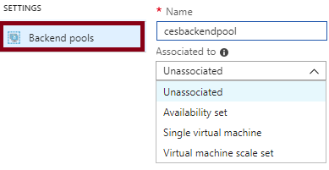
Backend Pools
SKU | Backend pool endpoints
Basic SKU | VMs in a single availability set or VM scale set.
Standard SKU | Any VM in a single virtual network, including a blend of VMs, availability sets, and VM scale sets.
To distribute traffic, a back-end address pool contains the IP addresses of the virtual NICs that are connected to the load balancer.
Notes:
✔ In the Standard SKU you can have up to 1000 instances in the backend pool. In the Basic SKU you can have up to 100 instances.

Slide 19
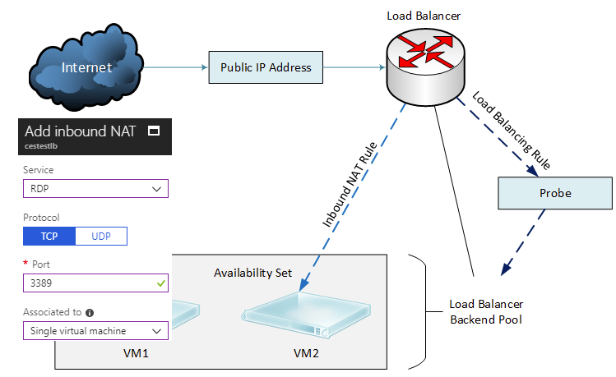
Load Balancer Rules
Maps a frontend IP and port combination to a set of backend IP addresses and port combination
Rules can be used in combination with NAT rules
A NAT rule is explicitly attached to a VM (or network interface) to complete the path to the target
Notes:
✔ Can you see the difference between load balancing rules and NAT rules? Remember, this approach should only be used when you need connectivity from the Internet. Most normal communications would occur from on-premises to Azure connections such as site-to-site VPN and ExpressRoute.

Slide 20
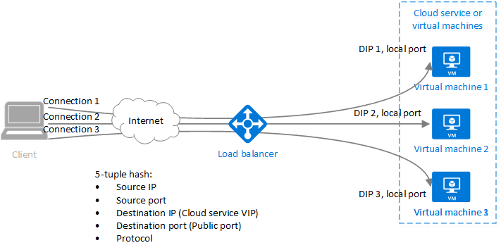
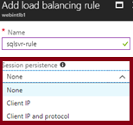
Session Persistence
Session persistence specifies how client traffic is handled
Client IP (default) requests can be handled by any virtual machine
Client IP and protocol specifies that successive requests from the same address and protocol will be handled by the same virtual machine
Notes:
✔Keeping session persistence information is very important in applications that use a shopping cart. Can you think of any other applications?

Slide 21
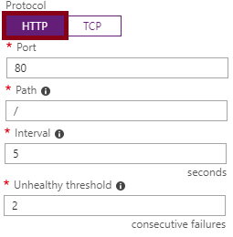
Health Probes
Allows the load balancer to monitor the status of an app
Dynamically adds or removes VMs from the load balancer rotation based on their response to health checks
HTTP custom probe (preferred) pings every 15 seconds
TCP custom probe tries to establish a successful TCP session
Notes:
✔ There is also a guest agent probe. This probe uses the guest agent inside the VM. It is not recommended when HTTP or TCP custom probe configurations are possible. Relate back to the original diagram to ensure all the components are covered.

Slide 22
Lesson 03: Azure Traffic Manager

Slide 23
Azure Traffic Manager Overview
Azure Traffic Manager
Traffic Manager Features
Priority Routing
Performance Routing
Geographic Routing
Weighted Routing
Implementing Traffic Manager Profiles
Implementing Traffic Manager Endpoints
Traffic Manager vs Load Balancer
Notes:
Lesson overview

Slide 24
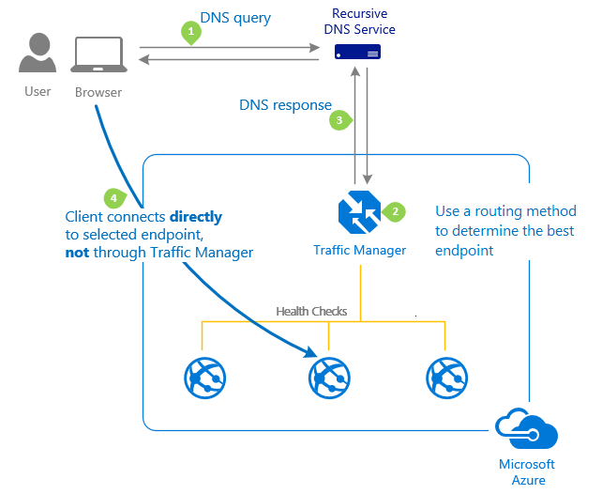
Azure Traffic Manager
Allows you to control distribution of user traffic to service endpoints around the world
Uses DNS to direct end-user requests to the most appropriate endpoint
Selects an endpoint based on the configuring traffic-routing method
Provides endpoint health checks and automatic endpoint failover
Notes:
For more information, you can see:
Traffic Manager - https://azure.microsoft.com/en-us/services/traffic-manager/

Slide 25
Traffic Manager Features
Improve availability of critical applications
Improve responsiveness for high performance applications
Upgrade and perform service maintenance without downtime
Combine on-premises and Cloud-based applications
Distribute traffic for large, complex deployments
Create profiles for different routing scenarios
Several routing algorithms (next topics)

Slide 26
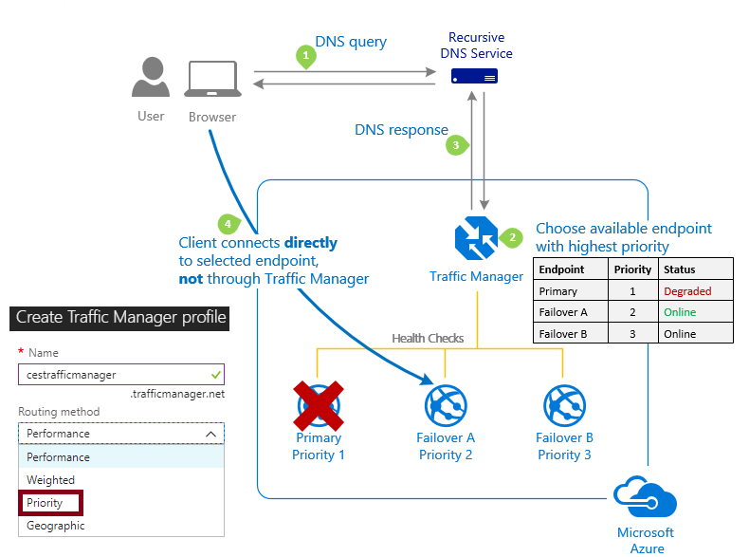
Priority Routing
Routes traffic to a prioritized list of service endpoints
Sends all traffic to the primary (highest-priority) endpoint first

Slide 27
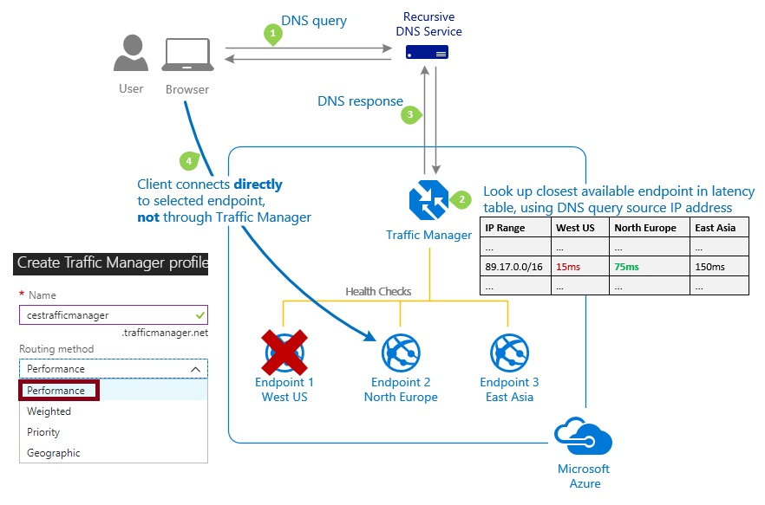
Performance Routing
Routes traffic to the location closest to the user
The closest endpoint is measured by network latency recorded in a table
Notes:
✔ Remember Traffic Manager does not receive DNS queries directly from clients. Rather, DNS queries come from the recursive DNS service that the clients are configured to use. Therefore, the IP address used to determine the 'closest' endpoint is not the client's IP address, but it is the IP address of the recursive DNS service. In practice, this IP address is a good proxy for the client.

Slide 28
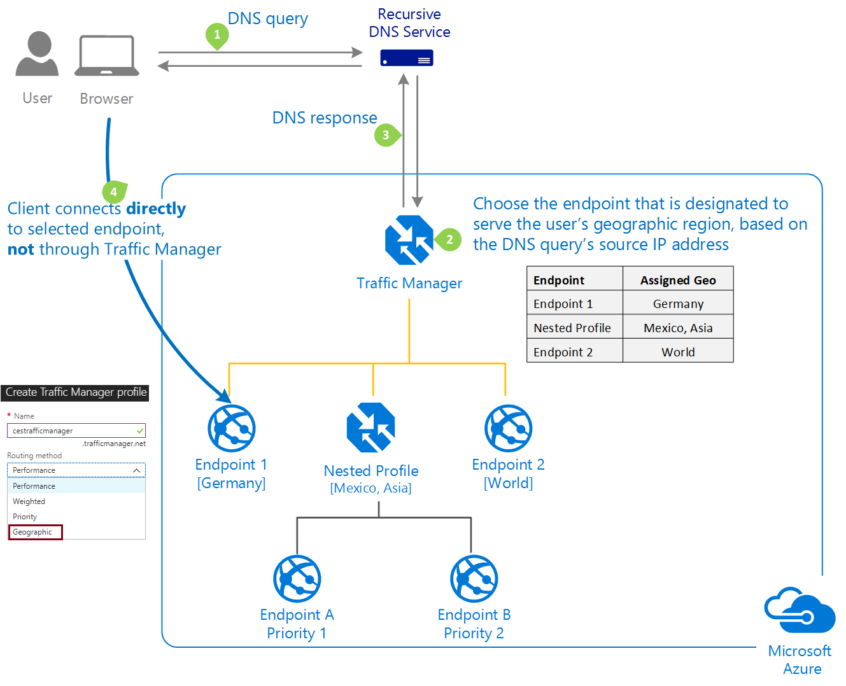
Geographic Routing
Routes traffic to a set of geographic locations
A location cannot be in more than one endpoint
Regional Grouping
Country/Region
State/Province
Notes:
✔ Similar to Performance routing Traffic Manager uses the source IP address of the DNS query to determine the region from which a user is querying from. Usually, this is the IP address of the local DNS resolver doing the query on behalf of the user.

Slide 29
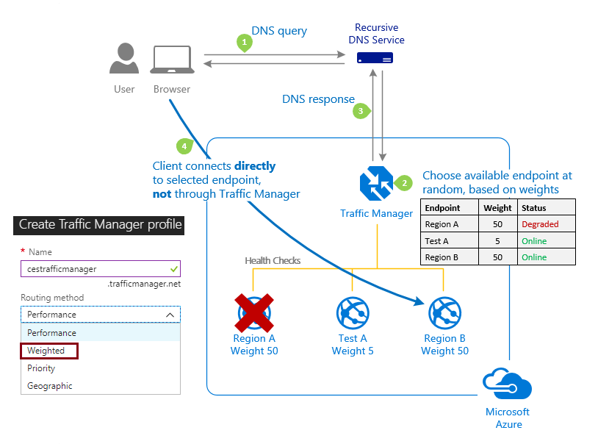
Weighted Routing
Distributes traffic evenly using a pre-defined weighting
Higher weight equals higher priority
Notes:
✔ Using the same weight across all endpoints results in an even traffic distribution. Using higher or lower weights on specific endpoints causes those endpoints to be returned frequently in the DNS responses.

Slide 30
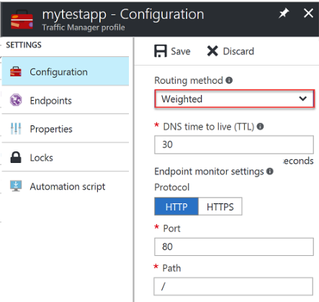
Implementing Traffic Manager Profiles
Select the routing method in the Traffic Manager profile
The DNS TTL determines how often to query for updated DNS entries
Configure each endpoint with the same monitoring settings
You can Enable or Disable your profile at anytime

Slide 31
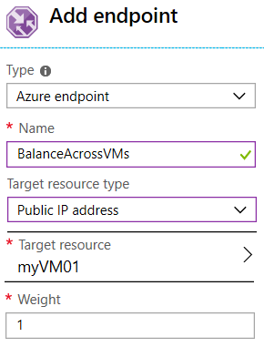
Implementing Traffic Manager Endpoints
Azure endpoints - Use this type of endpoint to load balance traffic to a Cloud service, Web app, or Public IP address in the same subscription
External endpoints - Use this type of endpoint to load balance traffic to any fully-qualified domain name, even for applications not hosted in Azure

Slide 32
Distributing Network Traffic
Service | Azure Load Balancer | Traffic Manager
Technology | Transport layer (level 4) | DNS
Protocols | Any | Any HTTP/S endpoint needed for endpoint monitoring
Endpoints | Azure VMs and Cloud Services role instances | Azure VMs, Cloud Services, Azure Web Apps, and external endpoints
Network connectivity | Both internet-facing and internal (VNet) applications | Internet-facing
Azure has several options to distribute network traffic
They can each be used in isolation or in combination

Slide 33
Lesson 04: Lab and Review Questions

Slide 34
Lab – Load Balancer and Traffic Manager
Adatum Corporation wants to implement Azure VM-hosted web workloads by leveraging load balancing and Network Address Translation (NAT) features of Azure Load Balancer.
Exercise 0: Deploy Azure VMs by using Azure Resource Manager templates
Exercise 1: Implement Azure Load Balancing
Exercise 2: Implement Azure Traffic Manager load balancing
Lab time: 60 minutes

Slide 35
Module Review Questions
Notes:
As you have time go through the Module Review questions in the student materials.

