Slide 1
AZ-103T00A Module 09: Active Directory

Slide 2
Module Overview
Azure Active Directory
Azure AD Connect
AD Join
Lab and Review Questions
Notes:
Module overview

Slide 3
Lesson 01: Azure Active Directory

Slide 4
Azure Active Directory Overview
Azure Active Directory
Azure Active Directory Benefits
Azure Active Directory Differences
Azure Active Directory Editions
Azure AD Directories (Tenants)
Notes:
Lesson overview

Slide 5
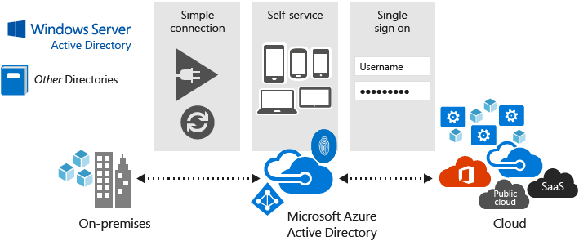
Azure Active Directory
Microsoft’s multi-tenant cloud-based directory and identity management service
Provides SSO access
Identity management capabilities and integration
Integrates with Windows Server Active Directory
Notes:
✔️ If you are an Office365, Azure or Dynamics CRM Online customer, you might not realize that you are already using Azure AD. Every Office365, Azure and Dynamics CRM tenant is already an Azure AD tenant. Whenever you want you can start using that tenant to manage access to thousands of other cloud applications Azure AD integrates with.
For more information, you can see:
Azure Active Directory Documentation - https://docs.microsoft.com/en-us/azure/active-directory/

Slide 6
Azure Active Directory Benefits
Single sign-on to any cloud or on-premises web app
Compatible with iOS, Mac OS X, Android, and Windows devices
Protect on-premises web applications with secure remote access
Extend AD to the cloud
Help protect sensitive data and applications
Notes:
✔️ What reasons do you have for considering Azure Active Directory?

Slide 7
Azure Active Directory Differences
Azure AD is primarily an identity solution, and designed for HTTP and HTTPS communications
Queried using the REST API over HTTP and HTTPS. Instead of LDAP.
Uses HTTP and HTTPS protocols such as SAML, WS-Federation, and OpenID Connect for authentication (and OAuth for authorization). Instead of Kerberos
Includes federation services, and many third-party services (such as Facebook)
Azure AD users and groups are created in a flat structure, and there are no Organizational Units (OUs) or Group Policy Objects (GPOs)
Notes:
✔️ Azure AD is a managed service. You only manage the users, groups, and policies. Deploying AD DS with virtual machines using Azure means that you manage the deployment, configuration, virtual machines, patching, and other backend tasks. Do you see the difference? How are they similar?

Slide 8
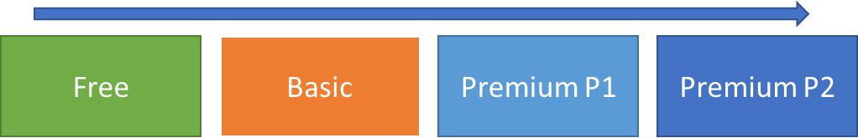
Azure Active Directory Editions
Azure Active Directory Free designed to introduce system administrators to Azure Active Directory.
Azure Active Directory Basic designed for task workers with cloud-first needs, this edition provides cloud-centric application access and self-service identity management solutions.
Azure Active Directory Premium P1 designed to empower organizations with more demanding identity and access management needs.
Azure Active Directory Premium P2 includes every feature of all other Azure Active Directory editions enhanced with advanced identity protection and privileged identity management capabilities.
Notes:
✔️ Did you look through the pricing list to determine which features your organization needs and to compare edition capabilities?
For more information, you can see:
Azure AD Pricing Editions - https://azure.microsoft.com/en-us/pricing/details/active-directory/

Slide 9
Azure AD Directories (Tenants)
A tenant is a dedicated instance of an Azure AD directory
You can have multiple tenants for:
Resource independence
Administrative independence
Synchronization independence

Slide 10
Lesson 02: Azure Active Directory Connect

Slide 11
Azure Active Directory Connect Overview
Azure AD Connect
Authentication Options
Password Hash Synchronization (PHS)
Pass-through Authentication (PTA)
Federation with Azure AD
Password Writeback
Azure AD Connect Health
Notes:
Lesson overview

Slide 12
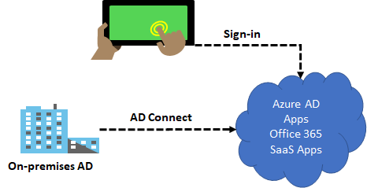
Azure AD Connect
Integrate your on-premises directories with Azure Active Directory
Provides a common identity for your users for Office 365, Azure, and SaaS applications integrated with Azure AD
There are several authentication options
Enables hybrid identity

Slide 13
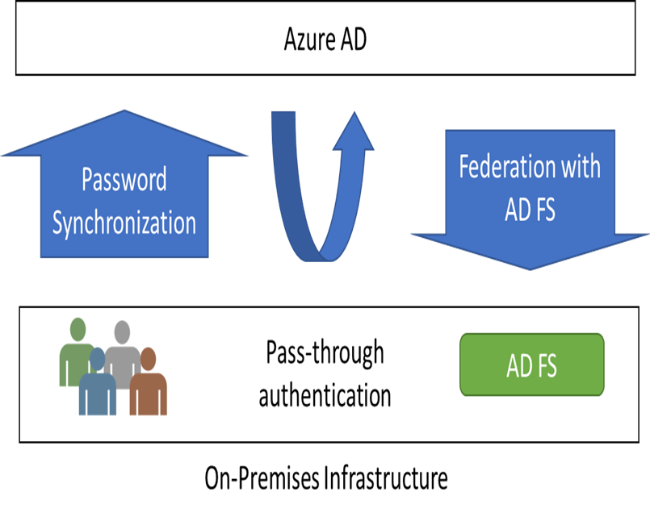
Authentication Options
Password Hash Synchronization (PHS) can synchronize an encrypted version of the password hash for user accounts
Pass-through authentication (PTA) authenticates the username and password with the on-premises domain controllers
AD FS is the Microsoft implementation of an identity federation solution that uses claims-based authentication
Notes:
Take time to look at the decision flow chart in the student materials.

Slide 14
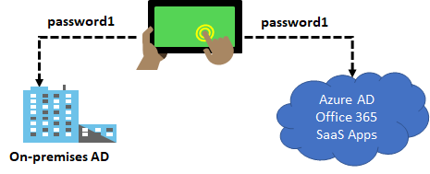
Password Hash Synchronization
Password hash synchronizes user passwords from on-premises Active Directory to cloud-based Azure AD
Sign in to Azure AD services using the on-premises password
Improve the productivity of your users and reduce your helpdesk costs
Notes:
✔️ This is same sign-in, not single sign-on. The user still authenticates against two separate directory services.

Slide 15
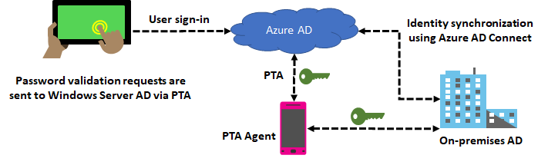
Pass-through Authentication
Supports user sign-in into all web browser-based applications and into Microsoft Office client applications
Is a free feature and can be enabled via Azure AD Connect
Is not only for user sign-in but allows an organization to use other Azure AD features – MFA and Self-Service Password Reset

Slide 16
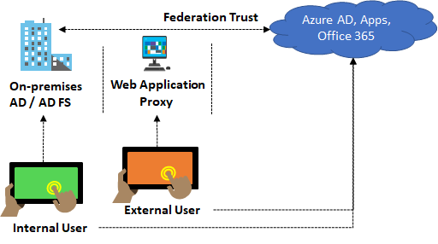
Federation with Azure AD
Federation is a collection of domains that have established trust
You can federate your on-premises environment with Azure AD and use this federation for authentication and authorization
This sign-in method ensures that all user authentication occurs on-premises

Slide 17
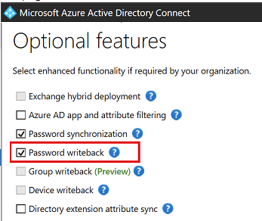
Password Writeback
Use Password Writeback to configure Azure AD to write passwords back to your on-premises Active Directory
A component of Azure AD Connect
Available to subscribers of Premium Azure Active Directory editions
Removes the need to set up and manage an on-premises SSPR solution
Notes:
✔️ Use the link below to read about the password writeback features. Which of the features are you most interested in?

Slide 18
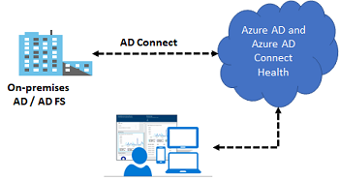
Azure AD Connect Health
Monitor and gain insights into AD FS servers, Azure AD Connect, and AD domain controllers
Monitor and gain insights into the synchronizations that occur between your on-premises AD DS and Azure AD
Monitor and gain insights into your on-premises identity infrastructure that is used to access Office 365 or other Azure AD applications

Slide 19
Lesson 03: Azure AD Join

Slide 20
Azure AD Join Overview
Device Management
Azure AD Joined Devices
Hybrid AD Joined Devices
Configuring Azure AD Join
Notes:
Lesson overview

Slide 21
Device Management
Azure AD enables SSO to devices from anywhere (BYOD)
Registering a device
Enable a registered device to authenticate when the user signs-in
Disable the device, as needed
Joining a device
Extends a registered device - all the benefits of registration
Changes the local state of device
Sign-in using an organizational work or school account instead of a personal account
Notes:
✔️ Registration combined with a mobile device management (MDM) solution such as Microsoft Intune, provides additional device attributes in Azure AD. This allows you to create conditional access rules that enforce access from devices to meet your standards for security and compliance.
For more information, you can see:
Introduction to device management - https://docs.microsoft.com/en-us/azure/active-directory/device-management-introduction

Slide 22
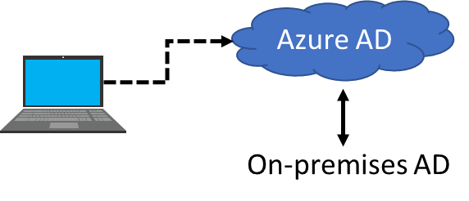
Azure AD Joined Devices
Single-Sign-On (SSO) to your Azure managed SaaS apps and services
Enterprise compliant roaming of user settings across joined devices
Access to Windows Store for Business
Windows Hello support
Restriction of access to apps from only compliant devices
Seamless access to on-premise resources
Notes:
✔️ Although AD Join is intended for organizations that do not have on-premises Windows Server Active Directory infrastructure it can be used for other scenarios like branch offices. Read more at the reference link.

Slide 23
Hybrid Azure AD Joined Devices
 | Registered Devices | Azure AD Joined Devices | Hybrid AD Joined Devices
Device Type | Personal | Organization owned | Organization owned
Registration | Manual | Manual | Automatic
Operating System | Windows 10 | Windows 10 | Windows 7, 8, and 10
Devices joined to both devices on-premises AD and Azure AD
Central management of work-owned
Users to sign in to their devices with their AD work or school accounts
Notes:
✔️ Are you understanding the different types of joined devices? Which do you think your organization needs?

Slide 24
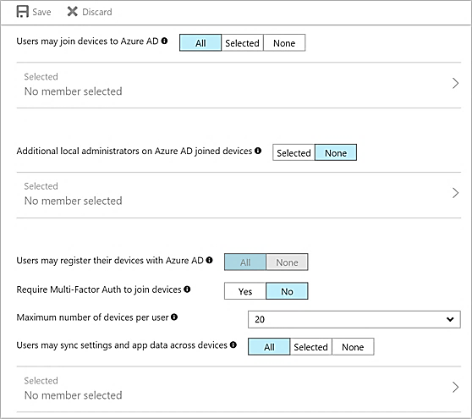
Configuring Azure AD Join
Select the users who can join devices to Azure AD
Select the users that are granted local administrator rights on a device
Allow Azure AD joined or hybrid Azure AD joined to register with Azure AD
Require MFA to join devices
Select the maximum number of devices a user can have
Allow user’s settings and app data to sync across their Windows 10 devices

Slide 25
Lesson 04: Lab and Review Questions

Slide 26
Lab – Implement Directory Synchronization
Adatum Corporation wants to integrate its Active Directory with Azure Active Directory.
Exercise 1. Deploy an Azure VM hosting an Active Directory domain controller.
Exercise 2. Create and configure an Azure Active Directory tenant
Exercise 3. Synchronize Active Directory forest with an Azure Active Directory tenant
Lab time: 60 minutes

Slide 27
Module Review Questions
Notes:
As you have time go through the Module Review questions in the student materials.

