Slide 1
AZ-103T00A Module 10: Securing Identities
Notes:
The Azure AD Identity Management lab for this module has setup time. If you are going to do the lab, consider completing Exercise 0: Prepare the lab environment before starting the lecture.

Slide 2
Module Overview
Multi-Factor Authentication
Azure AD Identity Protection
Self-Service Password Reset
Lab and Review Questions
Notes:
Module overview

Slide 3
Lesson 01: Multi-Factor Authentication

Slide 4
Multi-Factor Authentication (MFA) Overview
Azure MFA Concepts
MFA Authentication Options
Enabling MFA
Requiring MFA
Trusted IPs
One-time Bypass
Fraud Alerts
MFA Licensing and Pricing
Notes:
Lesson overview

Slide 5
Azure MFA Concepts
The security of MFA two-step verification lies in its layered approach
Authentication methods include:
Something you know (typically a password)
Something you have (a trusted device that is not easily duplicated, like a phone)
Something you are (biometrics)
Notes:
✔️ How many methods can you identify in this graphic? Can you think of any ways to overcome the two-step authentication? For example, phishing, stolen devices, or malware.
For more information, you can see:
Multi-factor authentication - https://azure.microsoft.com/en-us/services/multi-factor-authentication/

Slide 6
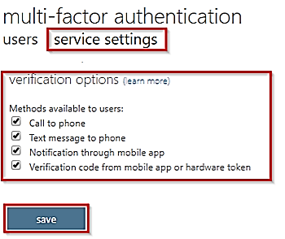
MFA Authentication Options
Phone Call - automated
Text Message - A six-digit code is sent to the user’s cell phone
Mobile App Notification – push notification
Mobile app verification code - A six-digit code is sent to the user mobile app

Slide 7
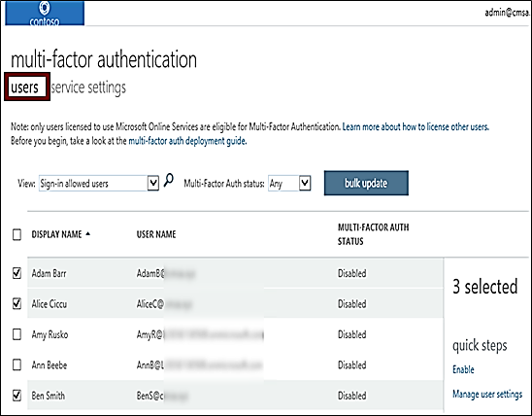
Enabling MFA
Select the users that you want to modify and enable for MFA
Can also bulk enable groups of users with PowerShell
On first-time sign-in, after MFA has been enabled, users are prompted to configure their MFA settings
Azure MFA is included free of charge for global administrator security
Notes:
✔️ On first-time sign-in, after MFA has been enabled, users are prompted to configure their MFA settings. For example, if you enable MFA so that users must use a mobile device, users will be prompted to configure their mobile device for MFA. Users must complete those steps, or they will not be permitted to sign in, which they cannot do until they have validated that their mobile device is MFA-compliant.

Slide 8
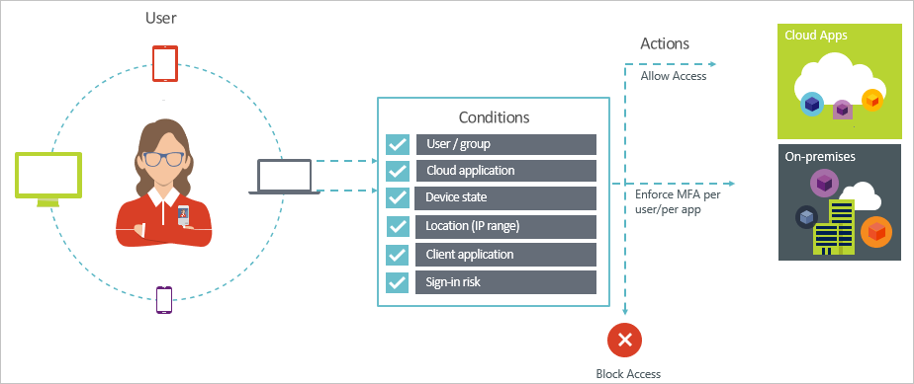
Requiring MFA
Conditions – “When this happens”
Access controls – “Then do this”
Lets you enforce controls on access to apps based on specific conditions
The combination of your conditions with your access controls represents a conditional access policy
Notes:
✔️ Do you think conditional access would be something your organization is interested in?

Slide 9
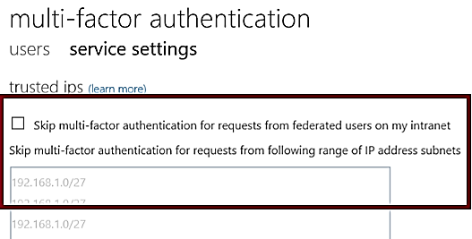
Trusted IPs
Allows federated users or IP address ranges to bypass two-step authentication
For managed tenants, you can specify IP ranges that can skip MFA
For federated tenants, you can specify IP ranges and you can also exempt AD FS claims users
Notes:
✔️ The Trusted IPs bypass works only from inside of the company intranet. If you select the All Federated Users option and a user signs in from outside the company intranet, the user must authenticate by using two-step verification. The process is the same even if the user presents an AD FS claim.

Slide 10
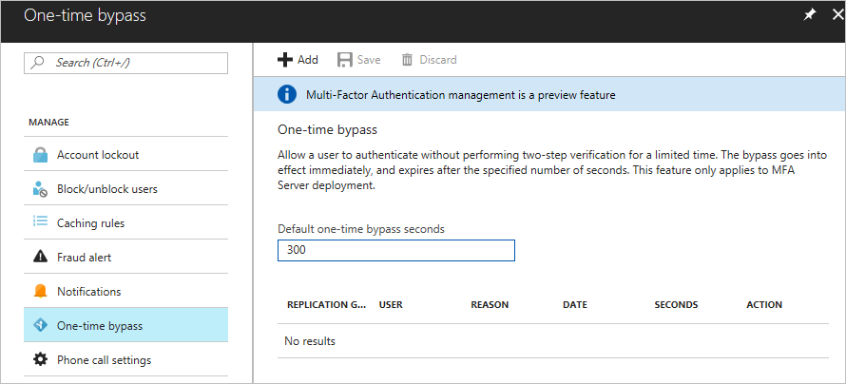
One-time Bypass
Allows a user to authenticate a single time without performing two-step verification
The bypass is temporary and expires after a specified number of seconds.
Notes:
✔️ In situations where the mobile app or phone is not receiving a notification or phone call, you can allow a one-time bypass, so the user can access the desired resource.

Slide 11
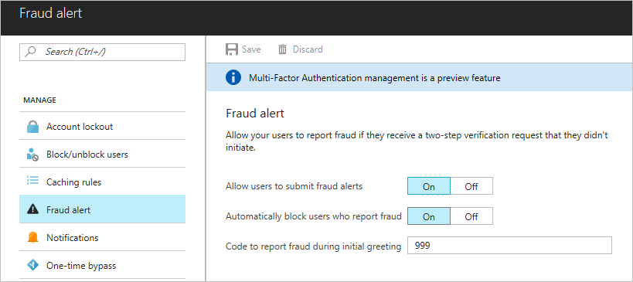
Fraud Alerts
Users can report fraudulent attempts to access their resources
Report fraud attempts by using the mobile app or through their phone
Block user when fraud is reported
Notes:
✔️ The default voice greetings from Microsoft instruct users to press 0# to submit a fraud alert. If you want to use a code other than 0, record and upload your own custom voice greetings with appropriate instructions for your users.

Slide 12
MFA Licensing and Pricing
Consumption based billing
Per user. You can pay per user. Each user has unlimited authentications. Use this model if you know how many users you have and can accurately estimate your costs.
Per authentication. You can pay for a bundle (10) of authentications. Use this model when you are unsure how many users will participate in MFA authentication.
MFA licenses included in other products
Direct and Volume licensing
Notes:
✔️ Which of these licensing options is appropriate for your organization?
For more information, you can see:
MFA Pricing - https://azure.microsoft.com/en-us/pricing/details/multi-factor-authentication/

Slide 13
Lesson 02: Azure AD Identity Protection
Notes:
There is a lab on Azure AD Identity Protection. If you are going to do this lab, you may want to do the lab after this lesson rather than wait until the end of the module.

Slide 14
Azure AD Identity Protection Overview
Azure AD Identity Protection
Azure AD Risk Events
User Risk Policy
Sign-in Risk Policy
Security Best Practices
Notes:
Lesson overview

Slide 15
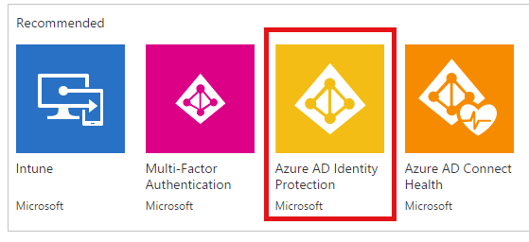
Azure AD Identity Protection
Protect your organization from compromised accounts, identity attacks, and configuration issues.
Get a consolidated view of identity threats and vulnerabilities.
Receive notifications of new identity risks, perform recommended remediation, and automate future response with Conditional Access policies.

Slide 16
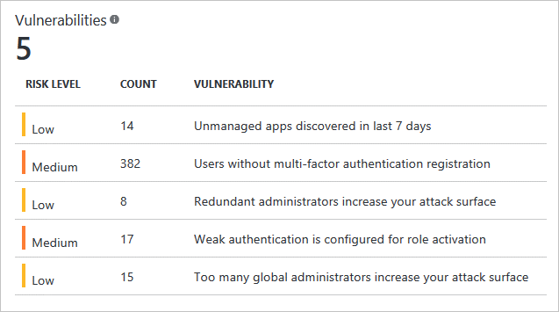
Azure AD Risk Events
Linked credentials
Sign-ins from anonymous IP addresses
Impossible travel to atypical locations
Sign-in from unfamiliar locations
Sign-ins from infected devices
Sign-ins from IP addresses with suspicious activity
Each detected suspicious action is stored in a record called a risk event

Slide 17
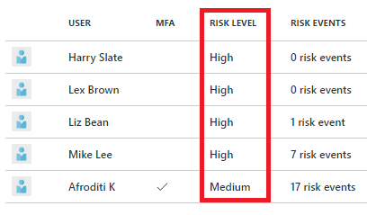
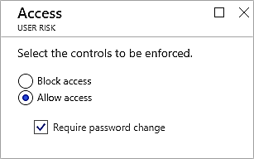
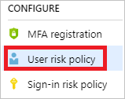
User Risk Policy
Applied to user sign-ins
Automatically respond based on a specific user’s risk level
Provide the condition (risk level) and action (block or allow)
Use a high threshold during policy roll out
Use a low threshold for greater security

Slide 18
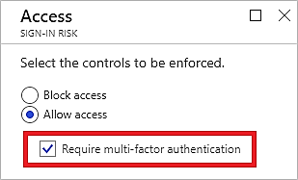
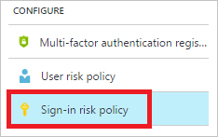
Sign-In Risk Policy
Applied to all browser traffic and sign-ins using modern authentication
Automatically respond to a specific risk level
Provide the condition (risk level) and action (block or allow)
Target all policies to specific users – omit certain types of users

Slide 19
Security Best Practices
Centralize your identity management
Enable Single Sign-On (SSO)
Deploy password management
Enforce MFA for users
Use role-based access control (RBAC)
Control Resource Manager resource locations
Guide developers to leverage identity capabilities for SaaS apps
Actively monitor for suspicious activities

Slide 20
Lesson 03: Self-Service Password Reset

Slide 21
Self-Service Password Reset (SSPR) Overview
Self-Service Password Rest
SSPR Authentication Methods
SSPR Registration
Comparing SSPR to MFA
Notes:
Lesson overview

Slide 22
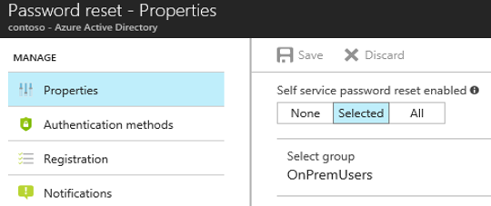
Configuring Self-Service Password Reset
Determine who will be enabled to use self-service password reset
Narrow your selection to specific groups
Notes:
Azure Administrator accounts will always be able to reset their passwords no matter what this option is set to.

Slide 23
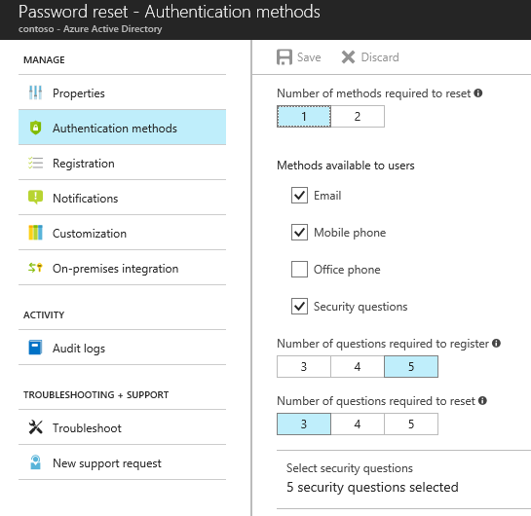
Authentication Methods for Password Reset
Choose the:
Number of authentication methods required to reset a password
Number of authentication methods available to users
Authentication methods include:
Email notification
Text or code sent to phone
Number of security questions to be registered and how many must be correctly answered

Slide 24
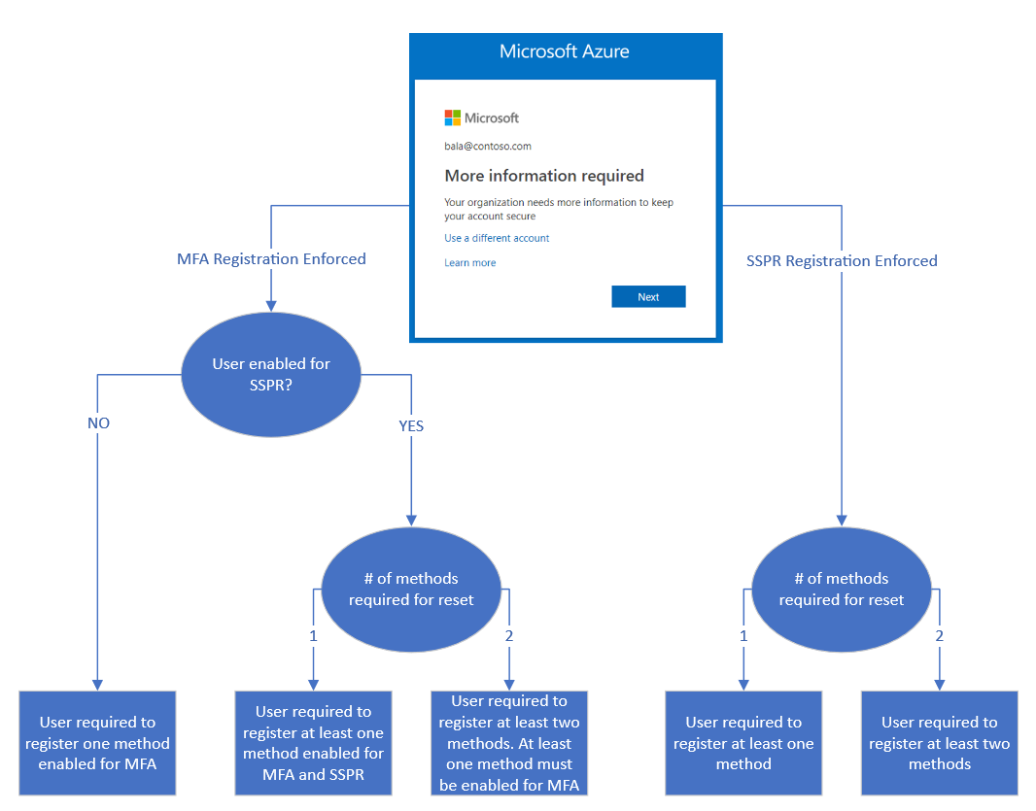

SSPR Registration
You can require users to register for SSPR
Two modes: interrupt and manage
MFA and SSPR now use the same registration process
Notes:
For more information, you can see:
Video - Deploying self-service password reset | Azure Active Directory - https://www.youtube.com/watch?v=Pa0eyqjEjvQ

Slide 25
Comparing SSPR to MFA
Authentication Method | Usage
Password | MFA and SSPR
Security questions | SSPR Only
Email address | SSPR Only
Microsoft Authenticator app | MFA and Public Preview for SSPR
SMS | MFA and SSPR
Voice call | MFA and SSPR
App passwords | MFA only in certain cases
Notes:
✔️ Your Azure AD password is considered an authentication method. It is the one method that cannot be disabled.

Slide 26
Lesson 04: Lab and Review Questions
Notes:
Pick the lab(s) most appropriate for your audience.

Slide 27
Lab – Azure AD Identity Protection
Adatum Corporation wants to take advantage of Azure AD Premium features for Identity Protection
Exercise 0. Prepare the environment
Exercise 1. Implement Azure MFA
Exercise 2. Implement Azure AD Identity Protection
Lab time: 60 minutes

Slide 28
Lab – Self-Service Password Reset
Adatum Corporation wants to take advantage of Azure AD Premium features for Self-Service Password Reset
Exercise 1. Manage Azure AD users and groups
Exercise 2. Manage Azure AD-integrated SaaS applications.
Lab time: 60 minutes

Slide 29
Module Review Questions
Notes:
As you have time go through the Module Review questions in the student materials.

