Slide 1
AZ-103T00A Module 11: Governance and Compliance

Slide 2
Module Overview
Subscriptions and Accounts
Role-based Access Control (RBAC)
Users and Groups
Azure Policy
Lab and Review Questions

Slide 3
Lesson 01: Subscriptions and Accounts

Slide 4
Subscriptions and Accounts Overview
Management Group
Creating Management Groups
Azure Subscriptions
Getting a Subscription
Subscription Usage
Subscription User Types
Check Resource Limits
Resource Tags
Billing
Notes:
Lesson overview

Slide 5
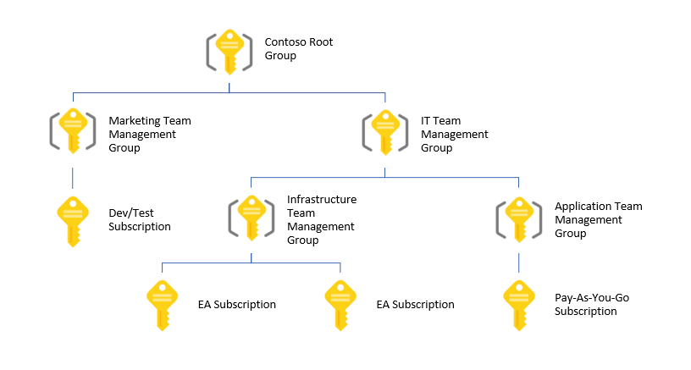
Management Groups
Provides a level of scope above subscriptions
Organizational alignment for your Azure subscriptions through custom hierarchies and grouping
Targeting of policies and spend budgets across subscriptions and inheritance down the hierarchies
Compliance and cost reporting by organization (business/teams)

Slide 6
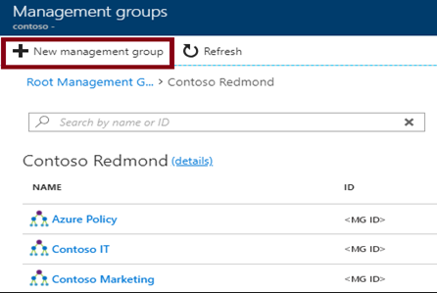
Creating Management Groups
The Management Group ID is the directory unique identifier that is used to submit commands on this management group
The Display Name field is the name that is displayed within the Azure portal

Slide 7
Azure Subscriptions
A subscription is a logical unit of Azure services that is linked to an Azure account
Subscriptions help you organize access to cloud service resources
Subscriptions have accounts
An Azure account is simply an identity in Azure Active Directory (Azure AD) or in a directory that is trusted by Azure AD, such as a work or school organization
Users,
groups, and service principles
Azure Active Directory
Authentication
& Authorization
Azure resources in resource groups
Azure Subscription(s)
Notes:
✔️ Do you know how many subscriptions your organization has? Do you know how resources are organized into resource groups?

Slide 8
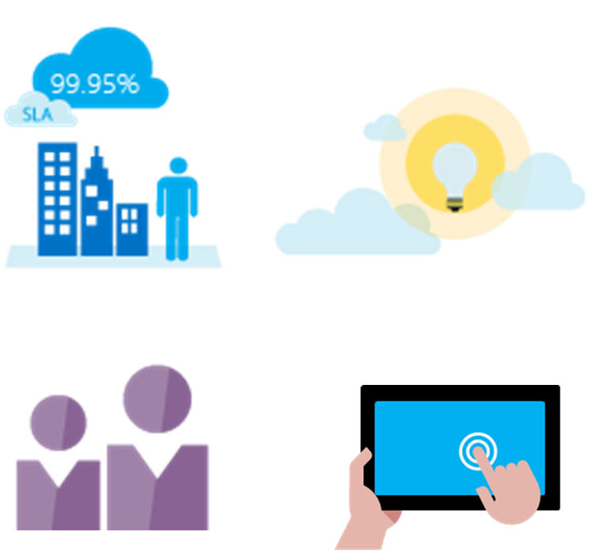
Getting a Subscription
Enterprise Agreement customers make an upfront monetary commitment and consume services throughout the year
Resellers provide a simple, flexible way to purchase cloud services
Partners can design and implement your Azure cloud solution
Personal free account -start right away
Notes:
✔️ Which subscription model are you most interested in?
For more information, you can see:
Solution providers - https://www.microsoft.com/en-us/solution-providers/home

Slide 9
Subscription Usage
Subscription | Usage
Free | Includes a $200 credit for the first 30 days, free limited access for 12 months
Pay-As-You-Go | Charges you monthly
Enterprise | One agreement, with discounts for new licenses and Software Assurance - targeted at enterprise-scale organizations.
Student | Includes $100 for 12 months – must verify student access
Notes:
Note: Credit card information is used for identity verification only. You won’t be charged for any services until you upgrade.

Slide 10
Subscription User Types
Administrative Role | Limit | Summary
Account Administrator | 1 per Azure account | Authorized to access the Account Center
Service Administrator | 1 per Azure subscription | Authorized to access the Azure Management Portal for all subscriptions in the account
Co-administrator | 200 per subscription | Same as the Service Administrator but can’t change the association of subscriptions to Azure directories
Notes:
✔️ Account Administrators using a Microsoft account must log in every 2 years (or more frequently) to keep the account active. Inactive accounts are cancelled, and the related subscriptions removed. There are no login requirements if using a work or school account.

Slide 11
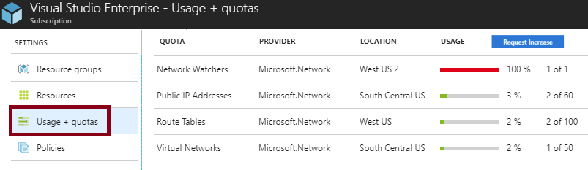
Check Resource Limits
All resources have a maximum limit listed in Azure limits
Helpful to track current usage, and plan for future use
You can request an increase

Slide 12
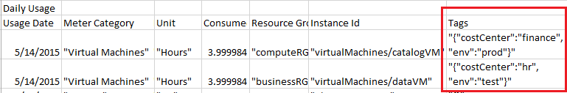
Resource Tags
Tags logically organize your resources
Tags consist of a name and value
Useful especially in billing
Notes:
✔️ If you must create a lot of tags you will want to do that programmatically. You can use PowerShell or the CLI.

Slide 13
Billing
Pricing Calculator – estimate expenditures in all areas of Azure
Billing Alert Service - monitor and manage billing activity
Create and Manage a Budget - plan for and drive organizational accountability
Azure Reservations - helps you save money by pre-paying for services

Slide 14
Lesson 02: Role-based Access Control

Slide 15
Role-based Access Control Overview
RBAC Concepts
RBAC Roles
Administrator Permissions
Role Assignment
Role Definitions
Demonstration - RBAC
Notes:
Lesson overview

Slide 16
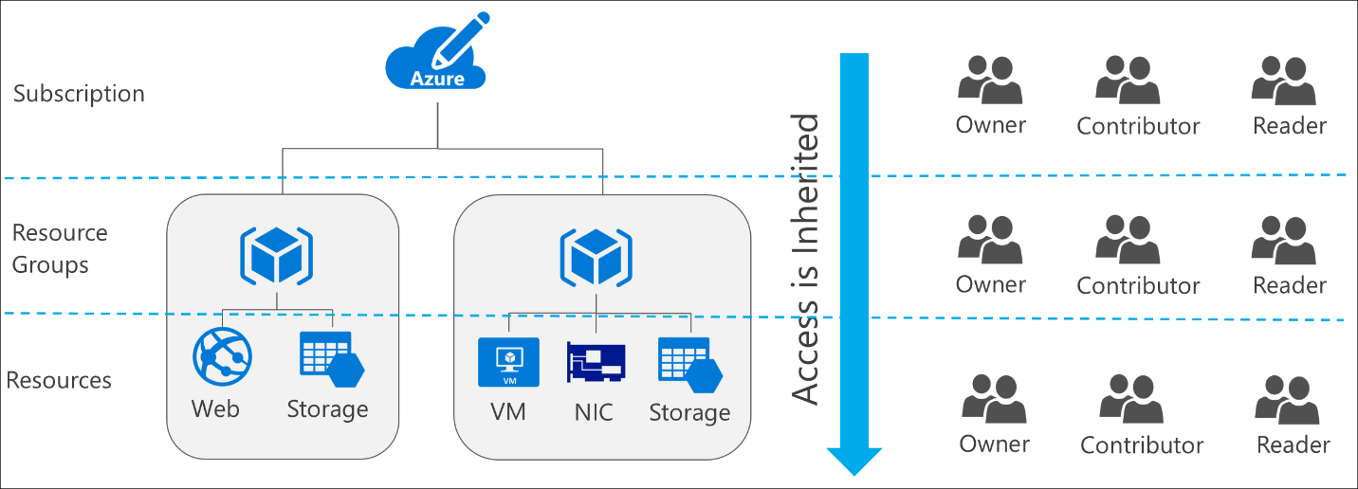
RBAC Concepts
Define what actions are allowed and/or denied
Associate the role with a user, group or service principal
Scope to a subscription, a resource group, or specific resources
Notes:
✔️ Users and groups are sourced from Azure Active Directory, which is commonly populated with credentials from on-premises directories, such as Active Directory. Note that RBAC access that you grant at parent scopes is inherited at child scopes.

Slide 17
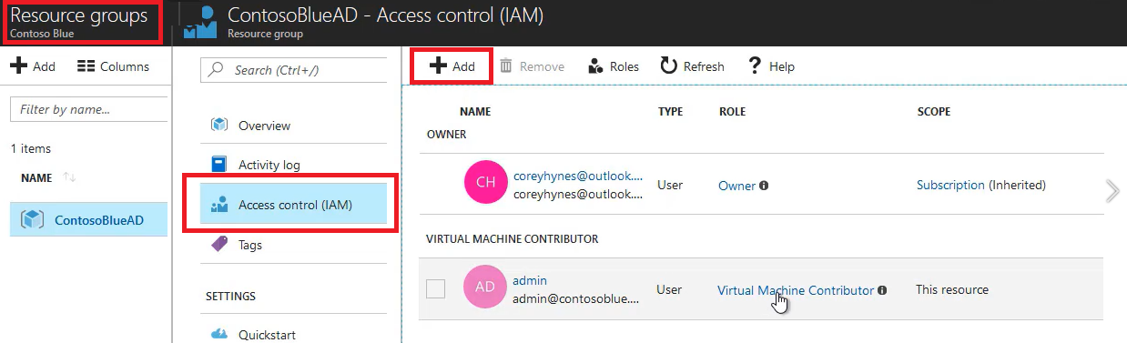
RBAC Roles
Owner can manage everything, including access
Contributors can manage everything except access
Readers can view everything but can't make changes

Slide 18
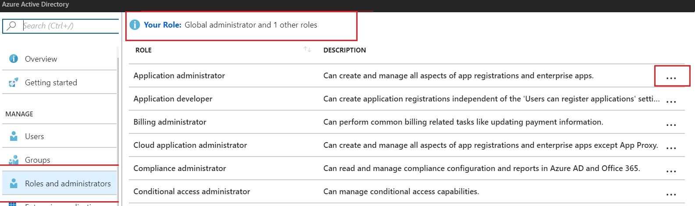
Administrator Permissions
Designate separate administrators for different functions
Global administrators can access all administrative features
Global administrators can assign other administrators

Slide 19
Role Assignment
Users
Assigned to organizational users in the AD associated with the subscription
Or, external Microsoft accounts in the same directory
Groups
Assigned to Azure AD security groups
Best practice: manage access through groups, adding roles, and assigning users
Service Principals
Service identities represented as service principals in the directory
Authenticate with Azure AD and securely communicate with one another

Slide 20
Role Definitions
Built-in Role | Action | NotActions
Owner (allow all actions) | *
Contributor (allow all actions except writing or deleting role assignment) | * | Microsoft.Authorization/*/Delete, Microsoft.Authorization/*/Write, Microsoft.Authorization/elevateAccess/Action
Reader (allow all read actions) | */read
Name : Owner
ID : 8e3af657-a8ff-443c-a75c-2fe8c4bcb65
IsCustom : False
Description : Manage everything, including access to resources
Actions : {*}
NotActions : {}
AssignableScopes : {/}
Notes:
For more information, you can see:
Built-in roles in Azure - https://docs.microsoft.com/en-us/azure/role-based-access-control/built-in-roles
Create custom roles for Azure Role-Based Access Control - https://docs.microsoft.com/en-us/azure/active-directory/role-based-access-control-custom-roles

Slide 21
Demonstration - RBAC
Locate the Access Control blade
Review role permissions
Add a role assignment
Explore PowerShell commands
Notes:
✔ Always consider having students walk-through the demonstrations themselves. Also, consider the overlap with the formal labs and your best use of time.

Slide 22
Lesson 03: Users and Groups

Slide 23
Users and Groups Overview
User Accounts
Adding User Accounts
Bulk User Accounts
Group Accounts
Adding Group Members
Adding a Group Owner
Demonstration – Users and Groups
Notes:
Lesson overview

Slide 24
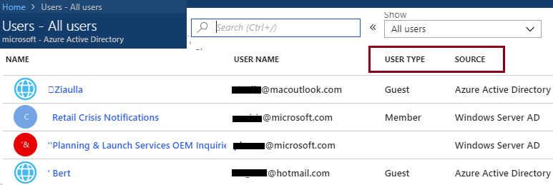
User Accounts
All users must have a user account
The account is used for authentication and authorization
Identity Sources: Cloud, Directory-synchronized, and Guest
Notes:
✔️ Have you given any thought as to the type of users you will need?

Slide 25
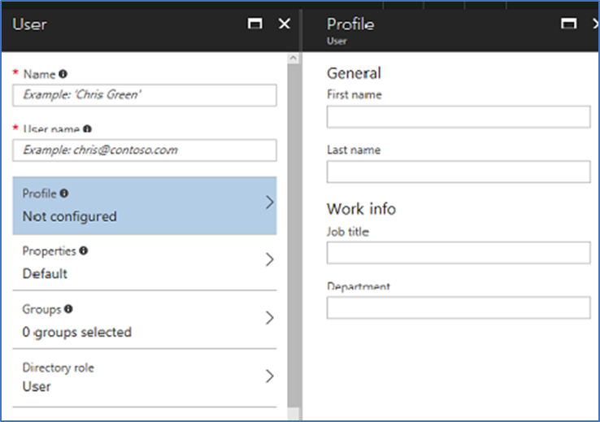
Adding User Accounts
# Create a password object
$PasswordProfile = New-Object -TypeName Microsoft.Open.AzureAD.Model.PasswordProfile
# Assign the password
$PasswordProfile.Password = "<Password>“
# Create the new user
New-AzureADUser -AccountEnabled $True -DisplayName "Abby Brown" -PasswordProfile $PasswordProfile -MailNickName "AbbyB" -UserPrincipalName AbbyB@contoso.com
Notes:
✔️ Users can also be added to Azure AD through Office 365 Admin Center, Microsoft Intune admin console, and the CLI. Which of the options mentioned in this topic do you prefer?

Slide 26
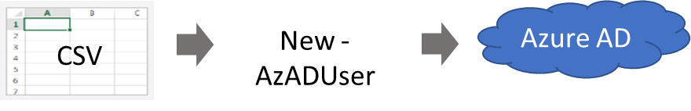
Bulk User Accounts
Use Connect-AzureAD to create a PowerShell connection to your directory
Create a new Password Profile for the new users
Use Import-CSV to import the csv file
Loop through the users in the file constructing the user parameters
Use New-AzADUser to create each user
Be sure to enable each account
Notes:
✔️ Establish or implement a naming convention for usernames, display names and aliases. The password for the new users needs to conform to the password complexity rules you have set for your directory. User parameters include User Principal Name, Display Name, Given Name, Department, and Job Title.
For more information, you can see:
Importing data into my directory - https://docs.microsoft.com/en-us/powershell/azure/active-directory/importing-data?view=azureadps-2.0
New-ADUser - https://docs.microsoft.com/en-us/powershell/module/azuread/new-azureaduser?view=azureadps-2.0

Slide 27
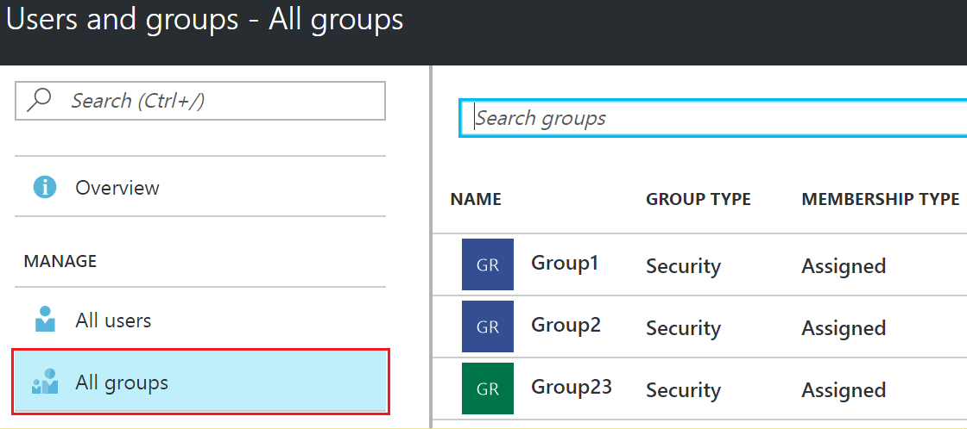
Group Accounts
Security groups
Distribution groups
Directly assigned
Dynamically assigned
New-AzADGroup -Description "Marketing" -DisplayName "Marketing" -MailEnabled $false -SecurityEnabled $true -MailNickName "Marketing"
Notes:
✔️ Have you given any thought to which groups you need to create? Would you directly assign or dynamically assign membership?

Slide 28
Adding Group Members
# Create a new group
New-AzADGroup -DisplayName Developers -MailNickname Developers
# Retrieve the group ObjectId
Get-AzADGroup –DisplayName Developers
# Retrieve the new member ObjectId
Get-AzADUser –DisplayName “Chris Green”
# Add the user to the group
Add-AzADGroupMember -ObjectId <group ObjectId> -RefObjectId <user ObjectId>
# Verify the members of the group
Get-AzADGroupMember -GroupObjectId <group ObjectId>

Slide 29
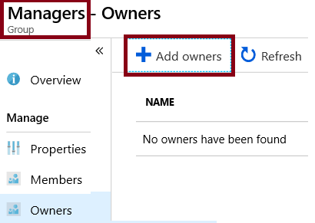
Adding a Group Owner
# Get the group ObjectId
Get-AzADGroup
# Get the owner (user) RefObjectId
Get-AzADUser
# Add the user as a group owner
Add-AzADGroupOwner -ObjectId <group ID> -RefObjectId <user ID>
# Verify group ownership
Get-AzADGroupOwner -ObjectId <group ID>

Slide 30
Demonstration – Users and Groups
Determine domain information
Explore user accounts
Explore group accounts
Explore PowerShell for group management
Notes:
✔ Always consider having students walk-through the demonstrations themselves. Also, consider the overlap with the formal labs and your best use of time.

Slide 31
Lesson 04: Azure Policy

Slide 32
Azure Policy Overview
Azure Policy
Implementing Azure Policy
Policy Definitions
Create Initiative Definitions
Scope the Initiative Definition
Determine Compliance
Demonstration – Azure Policy
Notes:
Lesson overview

Slide 33
Azure Policy
Azure Policy is a service in Azure that you use to create, assign and, manage policies
Azure Policy runs evaluations and scans for non-compliant resources
Advantages:
Enforcement and compliance
Apply policies at scale
Remediation
Notes:
For more information, you can see:
Azure Policy Documentation - https://docs.microsoft.com/azure/azure-policy/

Slide 34
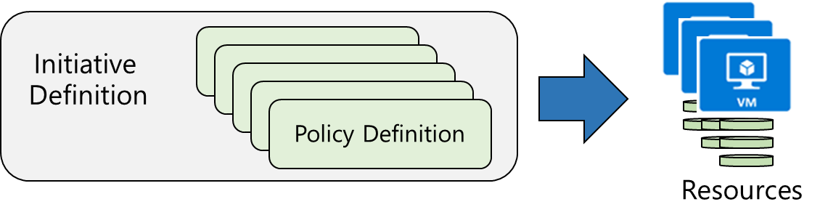
Implementing Azure Policy
Browse Policy Definitions
Create Initiative Definitions
Scope the Initiative Definition
View Policy evaluation results
Notes:
The next four topics step you through creating an Azure policy.
✔ Even if you have only a few Policy Definitions, we recommend creating an Initiative Definition.

Slide 35
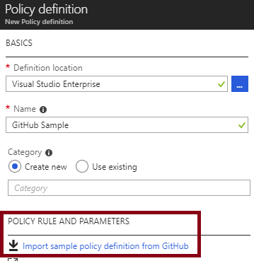
Policy Definitions
Many policy definitions are available
You can import policies from GitHub
Policy Definitions have a specific JSON format
You can create custom policy definitions
Notes:
✔️ Policy Definitions have a specific JSON format. As an Azure Administrator you will not need to create files in this format, but you may want to take a look so you are familiar. Review the available definitions in the portal and in GitHub.

Slide 36
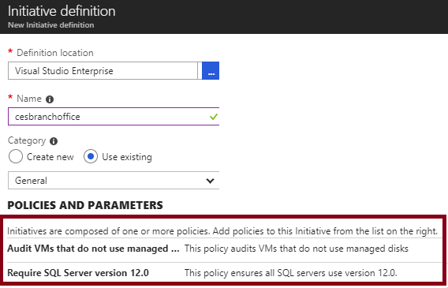
Create Initiative Definitions
Group policy definitions
Include one or more policies
Requires planning
Notes:
✔️ Can you see how this will require some planning to organize your policies?

Slide 37
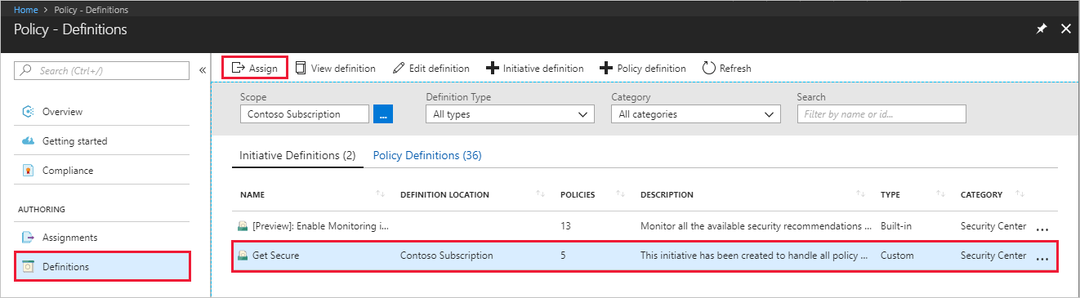
Scope the Initiative Definition
Assign the definition to a scope
The scope enforces the policy
Select the subscription, and optionally the resource group
Notes:
✔️ Currently, an Initiative Definition can have up to 100 policies.

Slide 38
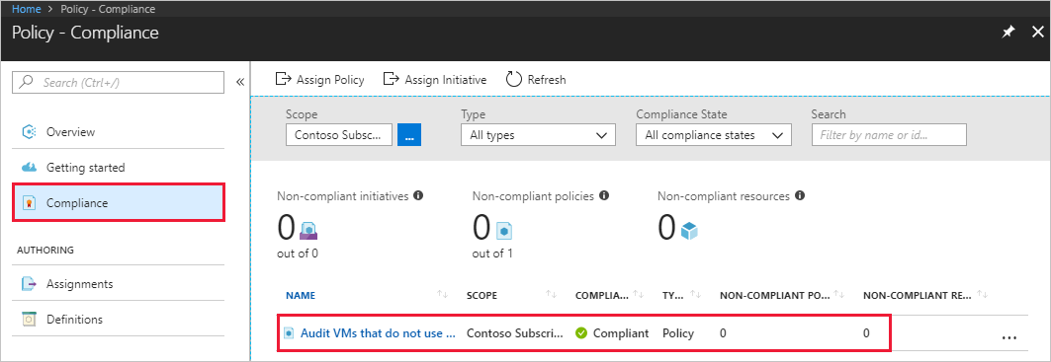
Determine Compliance
Non-compliant initiatives
Non-compliant policies
Non-compliant resources
Notes:
✔️ Policy evaluation happens about once an hour, which means that if you make changes to your policy definition and create a policy assignment then it will be re-evaluated over your resources within the hour.
For more information, you can see:
Video - Azure Resource Manager (ARM) Policies & RBAC - https://www.youtube.com/watch?v=CGxNV_qKmqA

Slide 39
Demonstration – Azure Policy
Assign a policy
Create and assign an initiative definition
Check for compliance
Notes:
✔ Always consider having students walk-through the demonstrations themselves. Also, consider the overlap with the formal labs and your best use of time.

Slide 40
Lesson 05: Lab and Review Questions
Notes:
Pick the lab(s) most appropriate for your audience.

Slide 41
Lab – Role-Based Access Control
Adatum Corporation wants to use Azure Role Based Access Control and Azure Policy to control provisioning and management of their Azure resources. It also wants to be able to automate and track provisioning and management tasks.
Exercise 1. Configure delegation of provisioning and management of Azure resources by using built-in Role-Based Access Control (RBAC) roles and built-in Azure policies.
Exercise 2. Verify delegation by provisioning Azure resources as a delegated admin and auditing provisioning events.
Lab time: 60 minutes

Slide 42
Lab: Governance and Compliance
Adatum Corporation wants to use Azure policies and initiatives in order to enforce resource tagging in its Azure subscription. Once the environment is compliant, Adatum wants to prevent unintended changes by implementing resource locks.
Exercise 1. Implement Azure tags by using Azure policies and initiatives
Exercise 2. Implement Azure resource locks
Lab time: 60 minutes

Slide 43
Module Review Questions
Notes:
As you have time go through the Module Review questions in the student materials.

