Slide 1
AZ-103T00A Module 12: Data Services
Notes:
The Implement File Sync lab for this module has setup time. If you are going to do the lab, consider completing Exercise 0: Prepare the lab environment before starting the lecture.

Slide 2
Module Overview
Content Delivery Network
File Sync
Import and Export Service
Data Box
Lab and Review Questions
Notes:
Module overview

Slide 3
Lesson 01: Content Delivery Network

Slide 4
Content Delivery Network Overview
CDN Benefits
How CDN Works
CDN Profiles
CDN Endpoints
CDN Time-to-Live
CDN Compression
Notes:
Lesson overview

Slide 5
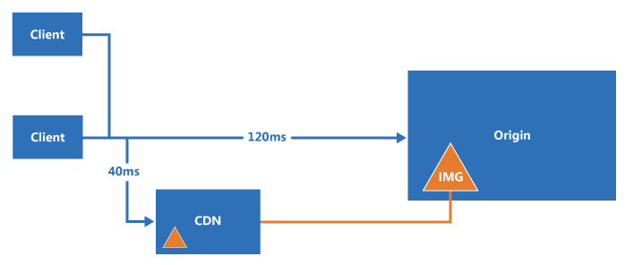
Content Delivery Network Benefits
CDN is a distributed network of servers that can efficiently deliver content (usually static content) to users
CDNs cache content on edge servers that are close to end-users
Lower latency and faster delivery of content
Reduced load on the server or application
Notes:
✔️ CDN provides a faster, more responsive user experience. Do you think your organization would be interested in this feature?
✔️ Use the following link to review some of the challenges with deploying CDN including security, deployment, versioning, and testing.
For more information, you can see:
Content Delivery Network Documentation - https://docs.microsoft.com/en-us/azure/cdn/cdn-overview

Slide 6
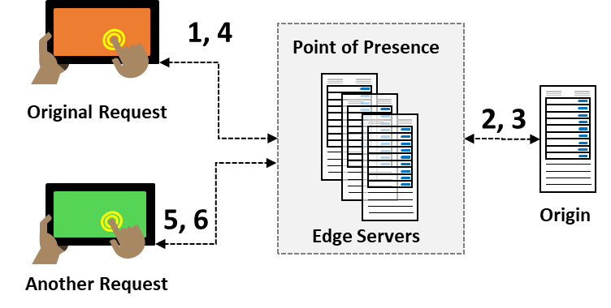
How CDN Works
User requests a file
Edge server requests file from origin
Origin returns the file to the edge server
Edge server caches the file and returns the file to the original requestor
Additional user requests the same file
Edge server returns the file from the cache
Notes:
✔️ After you enable CDN access to a storage account, all publicly available objects are eligible for CDN edge caching. If you modify an object that's currently cached in the CDN, the updated content will not be available via CDN until CDN refreshes its content after the time-to-live period for the cached content expires.

Slide 7
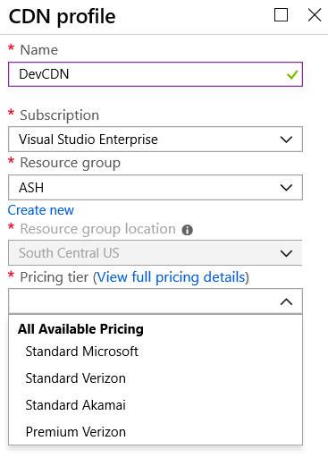
CDN Profiles
A CDN profile is a collection of CDN endpoints with the same pricing tier and provider (origin)
Can create multiple profiles to organize endpoints
Up to eight profiles per subscription
Different pricing tiers
Notes:
✔️ Can you think of different scenarios that would require different CDN profiles?

Slide 8
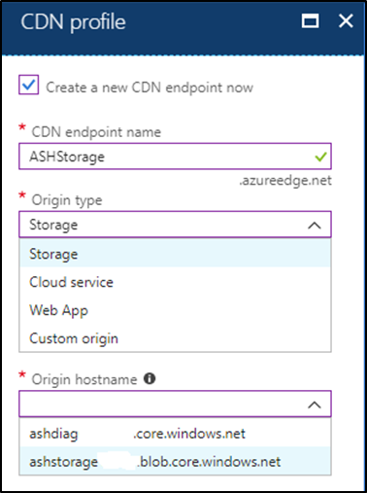
CDN Endpoints
Origin types: Storage, Cloud Service, Web App, and Custom origin
The CDN endpoint for this storage example: ASHStorage.azureedge.net/…
Add custom domain mapping to your CDN endpoint and enable custom domain HTTPS
Additional CDN features for your delivery, such as compression, query string, and geo filtering
Notes:
✔️ Because it takes time for the registration to propagate, the endpoint isn't immediately available for use. For Azure CDN from Akamai profiles, propagation usually completes within one minute. For Azure CDN from Verizon profiles, propagation usually completes within 90 minutes, but in some cases can take longer. Be sure to review the Troubleshooting pages reference link.

Slide 9
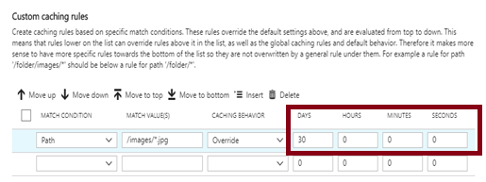
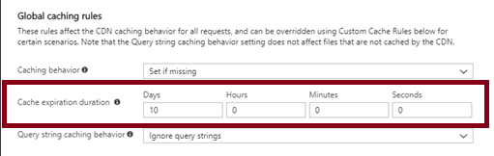
CDN Time-to-Live
Global caching rules set the Cache Expiration Duration for each endpoint in your profile.
Custom caching rules match specific paths and file extensions, are processed in order, and override the global caching rule.

Slide 10
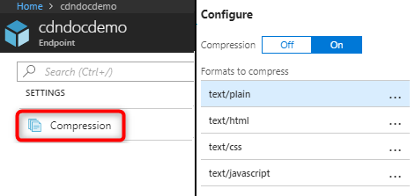
CDN Compression
Improve file transfer speed and increase page-load performance
Reduce bandwidth costs and provide a more responsive experience
Enable compression on the origin server or on the CDN edge servers
Specify which MIME formats are compressed
Notes:
✔️Although it is possible, it is not recommended to apply compression to compressed formats. For example, ZIP, MP3, MP4, or JPG.

Slide 11
Lesson 02: File Sync

Slide 12
File Sync Overview
Azure File Sync
File Sync Components
File Sync – Initial Steps
File Sync - Synchronization
Notes:
Lesson overview

Slide 13
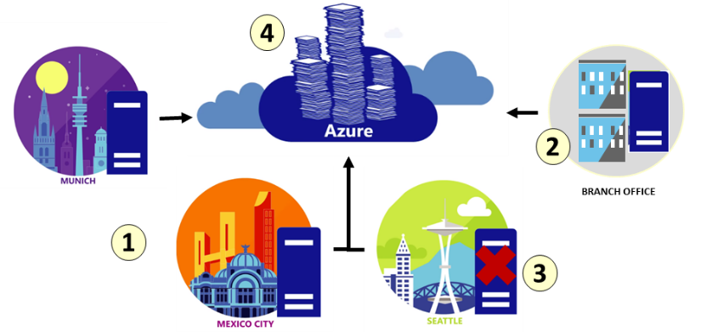
Azure File Sync
Centralize file shares in Azure Files
Lift and shift
Branch Office backups
Backup and Disaster Recovery
File Archiving
Notes:
✔ At the time of this writing Azure File Sync is in preview. Be sure to consult the documentation for any new updates.
✔️ Cloud tiering is an optional feature of Azure File Sync in which frequently accessed files are cached locally on the server while all other files are tiered to Azure Files based on policy settings.
For more information, you can see:
Planning for an Azure File Sync deployment - https://docs.microsoft.com/en-us/azure/storage/files/storage-sync-files-planning

Slide 14
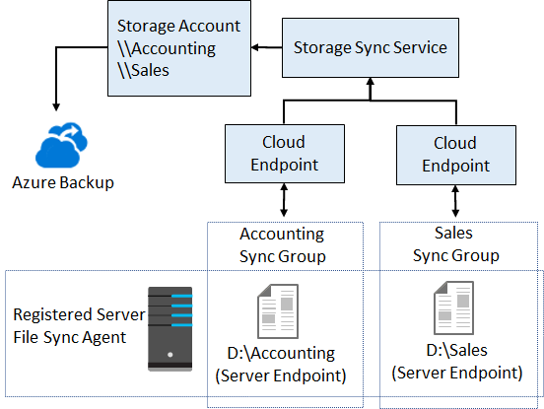
File Sync Components
The Storage Sync Service is the top-level resource.
The registered server object represents a trust relationship between your server (or cluster) and the Storage Sync Service
The Azure File Sync agent is a downloadable package that enables Windows Server to be synced with an Azure file share
A server endpoint represents a specific location on a registered server, such as a folder
A cloud endpoint is an Azure file share
A sync group defines which files are kept in sync

Slide 15
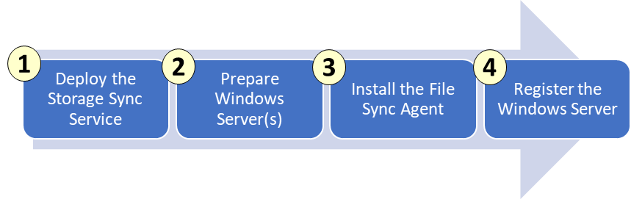
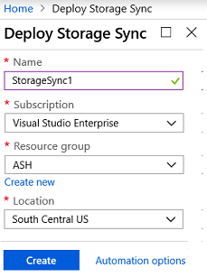
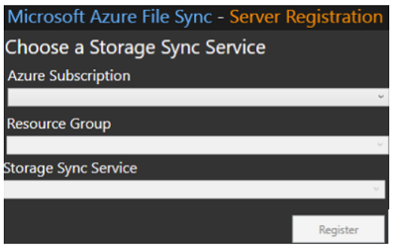
File Sync - Initial Steps
Notes:
✔ Continue to the next topic for an explanation of how files are synchronized.

Slide 16
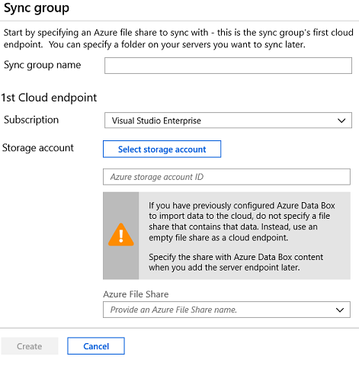
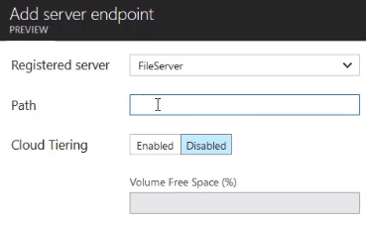
File Sync - Synchronization
Create a sync group with at least one cloud endpoint. The endpoint will have a storage account and file share
Create a server endpoint with the registered server, path, and optional cloud tiering information
Notes:
The module lab is on File Sync.
✔ Regardless of whether cloud tiering is enabled, your Azure file share always has a complete copy of the data in the sync group.
✔ Azure File Sync moves file data and metadata exclusively over HTTPS and requires port 443 to be open outbound. Based on policies in your datacenter, branch or region, further restricting traffic over port 443 to specific domains may be desired or required.

Slide 17
Lesson 03: Import and Export Service

Slide 18
Import and Export Service Overview
Import and Export Service
Components and Requirements
Import and Export Tool
Import Jobs
Export Jobs
AzCopy
Demonstration - AzCopy
Notes:
Lesson overview

Slide 19
Import and Export Service
Import/transfer large amounts of data to Azure Blob storage and Azure Files
Export/transfer data from Azure storage to hard disk drives
Migrating data to the cloud
Content distribution
Backup
Data recovery
Notes:
✔️ A single job can include up to 10 disks. You can create jobs directly from the Azure portal. You can also accomplish this programmatically by using Azure Storage Import/Export REST API.

Slide 20
Components and Requirements
Components
Import/Export service helps the user create and track jobs
WAImportExport tool command line tool for drive preparation and repair
Disk Drives can be SSDs (2.5”) or HDDs (2.5” and 3.5”)
Requirements
Windows Server (64-bit and BitLocker) or Client (WMF and BitLocker)
General Purpose v2 storage accounts is recommended
Import jobs can include Azure Blob storage, Azure File storage, Blob blobs, and Page blobs.
Export jobs can include Azure Blob storage, Block blobs, Page blobs, and Append blobs. Azure Files not supported.

Slide 21
Import and Export Tool
WAImportExport.exe PrepImport /j:<JournalFile> /id:<SessionId> /DataSet:<dataset.csv>
Copy data to the hard drives for shipment to an Azure datacenter
Repair any blobs that were not useable (import or export)
Internal SATA II/III HDDs or SSDs
Handles data copy, volume encryption, and creation of journal files
Journal files track a set of drives and records the progress
Session Id identifies a copy session
A CSV file contains a list of directories/files for copying

Slide 22
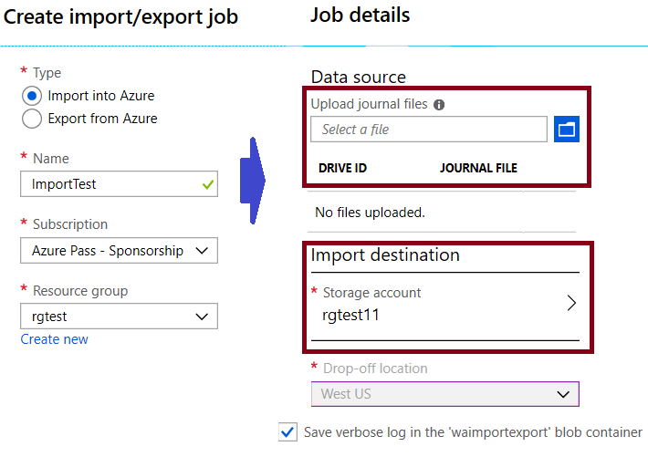
Import Jobs
Create an Azure Storage account
Identify the number of disks
Install the WAImportExport tool
Use the tool to copy the data, encrypt the drive with BitLocker, and generate journal files
Create the import job in the portal
Ship the disks to the import destination
Datacenter imports and returns the disks
Notes:
For more information, you can see:
Inside an import job - https://docs.microsoft.com/en-us/azure/storage/common/storage-import-export-service#inside-an-import-job

Slide 23
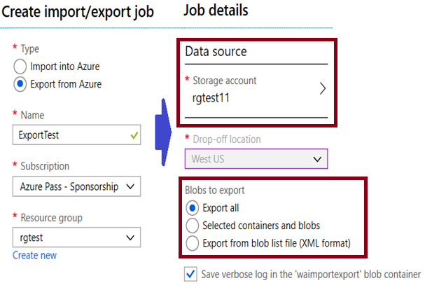
Export Jobs
Identify the data to export
Identify the number of disks
Create the export job in the portal, including your return address
Ship the required number of disks
Datacenter staff will export and encrypt the data.
Copied disks are shipped to you.
BitLocker keys will be in the portal.
Notes:
For more information, you can see:
Inside an export job - https://docs.microsoft.com/en-us/azure/storage/common/storage-import-export-service#inside-an-export-job

Slide 24
AzCopy
AzCopy /Source:<source> /Dest:<destination> [Options]
Command-line utility
Available on Windows, Linux, and MacOS
Designed for copying data to and from Azure Blob, File, and Table storage
Authentication options include Active Directory or SAS token
Example 1: Copy a Blob service account to another account
Example 2: List/Remove files and blobs in a given path (wildcard support)
Notes:
For more information, you can see:
Download and install AzCopy on Windows - https://docs.microsoft.com/en-us/azure/storage/common/storage-use-azcopy#download-and-install-azcopy-on-windows

Slide 25
Demonstration - AzCopy
Install the AzCopy tool
Explore the help
Download a blob from Blob storage to the file system
Upload files to Azure blob storage
Notes:
✔ Always consider having students walk-through the demonstrations themselves. Also, consider the overlap with the formal labs and your best use of time.

Slide 26
Lesson 04: Data Box

Slide 27
Data Box Overview
Data Box
Offline – Use Cases
Offline – Data Box Products
Offline – Product Selection
Offline – Implementation Offline Products
Online – Data Product Gateway
Online – Data Box Edge
Online – Implementation Online Products
Notes:
Lesson overview

Slide 28
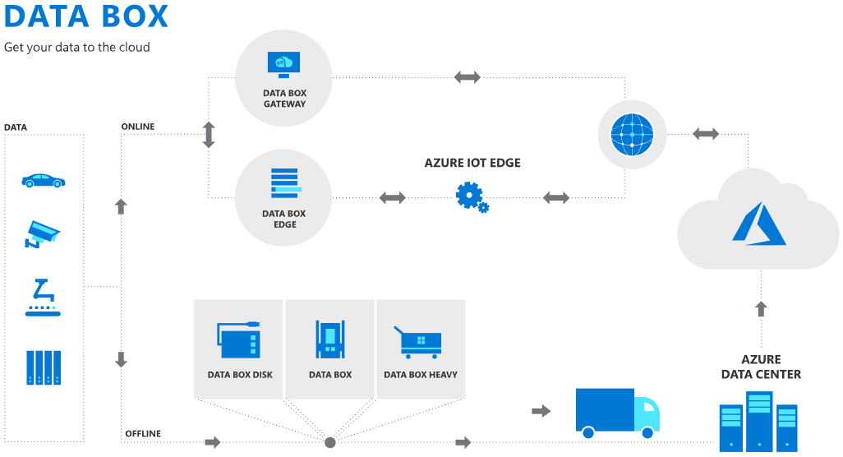
Data Box
Data Box Offline
Data Box
Data Box Disk
Data Box Heavy
Data Box Online
Data Box Edge
Data Box Gateway
Notes:
For more information, you can see:
Azure Data Box Products - https://azure.microsoft.com/en-us/services/storage/databox/
Azure Data Box - https://docs.microsoft.com/en-us/azure/databox-family/

Slide 29
Offline: Use Cases
One-time migration
Moving data from offline tapes to archival data in Azure cool storage
Moving a media library from offline tapes into Azure to create an online media library
Migrating your VM farm, SQL server, and applications to Azure
Moving historical data to Azure for in-depth analysis and reporting using HDInsight
Moving backup data to Azure for offsite storage
Incremental transfer
Periodic uploads
Notes:
Video -Case Study: Azure Data Box | Oceaneering Intl - https://www.youtube.com/watch?v=y0nGRHw3Zqc)

Slide 30
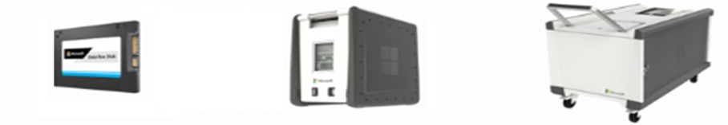
Offline: Data Box Products
Data Box Disk
Best for projects that require a smaller form factor
Capacity: 8 TB ea.
Secure, ruggedized USB drives orderable in packs of 5 (up to 40 TB)
Data Box
Bulk migration to Azure when a network isn’t an option
Capacity: 100 TB
Weight: ~ 50 lbs.
Secure, ruggedized appliance
Data Box Heavy
Same service as Data Box, but targeted to petabyte-sized datasets
Capacity: 1 PB
Weight: 500+ lbs.
Secure, ruggedized appliance

Slide 31
Offline: Product Selection
Speed and time
Security
Product | Network Interfaces
Data Box Disk | USB 3.0 connection
Data Box | 1 Gbps or 10 Gbps network interfaces
Data Box Heavy | High performance 40 Gbps network interfaces
Product | Physical security | Encryption
Data Box Disk | The disks are tamper-resistant and support secure update capability. | The data is secured with AES 128-bit encryption.
Data Box | Rugged device casing secured by tamper-resistant screws and tamper-evident stickers | The data is secured with AES 256-bit encryption.
Data Box Heavy | Rugged device casing secured by tamper-resistant screws and tamper-evident stickers | The data is secured with AES 256-bit encryption.
Notes:
✔️ Once your data is uploaded to Azure, the disks on the device are wiped clean, in accordance with NIST 800-88r1 standards.

Slide 32
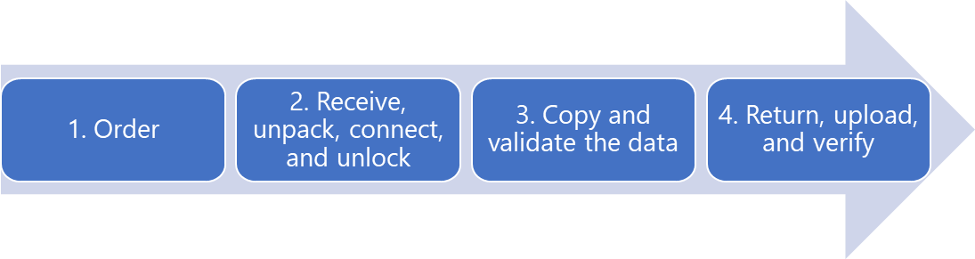
Offline: Implementation Workflow
Create an order in the portal and the products are shipped to you.
Receive, unpack, connect, and unlock – configure the network and mount share on the host computer.
Copy and validate the data.
Return, upload, verify.
✔️ Device disks are securely erased as per the NIST guidelines.

Slide 33

Online: Data Box Gateway
Use cases:
Cloud archival
Data aggregation
Integration with on-premises workloads
Benefits:
Easy data transfer
High speed performance
Fast access
Limited bandwidth usage
Data Box Gateway
Virtual network transfer appliance, runs on your choice of hardware
Device provisioned in our hypervisor
Supports storage gateway, SMB, NFS, Azure blob, and files

Slide 34

Online: Data Box Edge
Use cases:
Pre-process data
Inference Azure Machine Learning
Transfer data over the network
Benefits:
Easy data transfer
High speed performance
Fast access
Limited bandwidth usage
Transform data
Data Box Edge
Manages uploads to Azure and can pre-process data prior to upload
Local cache capacity: ~12 TB
Includes Data Box Gateway and Azure IoT Edge

Slide 35
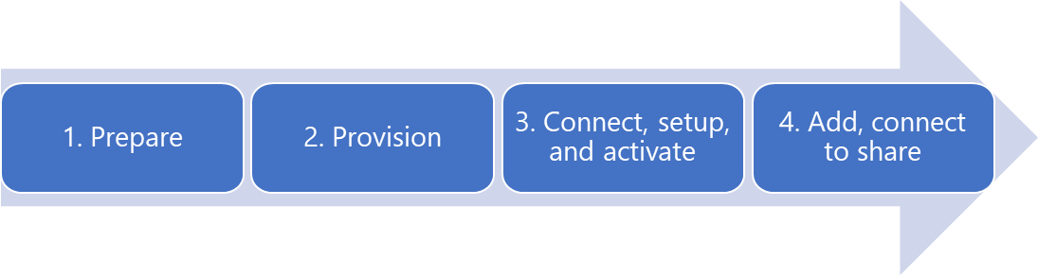
Online: Implementation Workflow
Prepare. Checking prerequisites, creating a new Data Box Gateway in the portal, downloading the virtual device image for Hyper-V or VMware, and obtaining the activation key.
Provision. Verify requirements, provision the device, start the device, and get the IP address.
Connect, setup, and activate. Connect to the local web UI setup page. Provide the device name and activation key.
Add, connect to the share. Once your SMB or NFS share is created you can connect and begin transferring data.
Notes:
For more information, you can see:
Tutorial: Prepare to deploy Azure Data Box Edge - https://docs.microsoft.com/en-us/azure/databox-online/data-box-edge-deploy-prep

Slide 36
Lesson 05: Lab and Review Questions

Slide 37
Lab: Implementing File Sync
Adatum Corporation is implementing Azure File Sync as an efficient method to replicate its on-premises data to Azure file shares.
Exercise 0. Prepare the lab environment
Exercise 1. Prepare Azure File Sync infrastructure
Exercise 2. Implement Azure File Sync
Lab time: 60 minutes

Slide 38
Module Review Questions
Notes:
As you have time go through the Module Review questions in the student materials.

