Slide 1

SmartDots
Project Guide
Prof. D Krupesha
Team
Sadan Sohan M
1PI09CS076
Sandeep Raju P
1PI09CS081
Mobile Application Development Using QML and JavaScript

Slide 2
About
SmartDots is an exciting strategy game which consists of a grid. This game is basically a 2-player game. The game is played alternatively by the 2 players where in each player is expected to mark a line in his turn. The player who completes a box by marking a line gets to play the next chance as well. Ultimately the player with the highest number of boxes is declared the winner.

Slide 3
Highlights
An eye-catching user interface to enhance user experience has been designed.
‘Reverse dots’, an add-on which brings about even more excitement to the game.
A flexible artificial intelligence algorithm with adequate levels for both smart and reverse version of the game has been designed.
High scores will be stored which increases the competitiveness of the games.

Slide 4
Implementation Details
The game was implemented majorly in two programming languages
QML
JavaScript
QML was used extensively to design the User Interface and the animations in it.
QML consisted of defining the actions for various components of the design. Its was seamlessly combined with the designs generated using Adobe Photoshop CS5.
JavaScript was extensively used to define and implement the algorithm initially designed in C++. JavaScript beautifully and seamlessly handled the AI algorithm and its responses which should trigger appropriate actions in the User Interface end.

Slide 5
Integration
We had to cope with two kinds of integrations.
1. Photoshop - QML
2. QML – JavaScript
Photoshop – QML
This phase of QML formed the front end of our project. It dealt with using images in various aspects of the user interface in order to beautify the game and help user in all possible ways to get through the initial part of the application with ample ease and comfort.

Slide 6
Integration (contd…)
QML – JavaScript
This formed the back end and quite easily the most challenging part of the project. Relevant parts of the algorithm had to be employed in different areas of the user interface to ensure the correct working of the game. We faced some constraints regarding the integration such as some parts of JavaScript being disabled while being integrated into QML. So we suitably changed the implementation quite a number of times to ensure the integrated final product works absolutely fine.

Slide 7
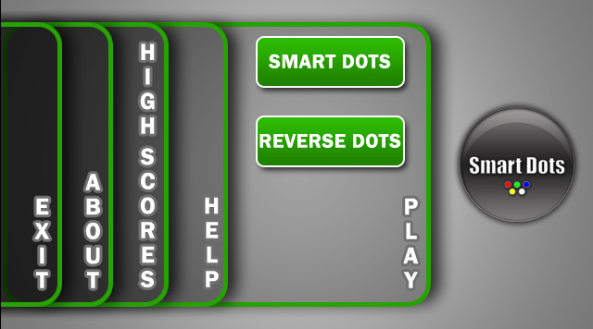
Screen Shots

Slide 8
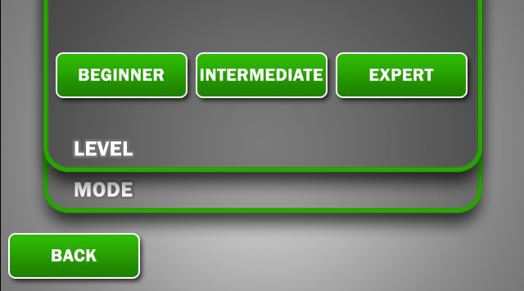

Slide 9
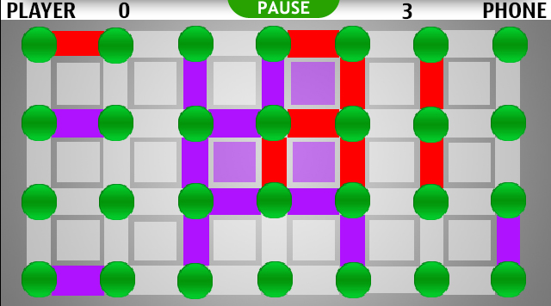

Slide 10
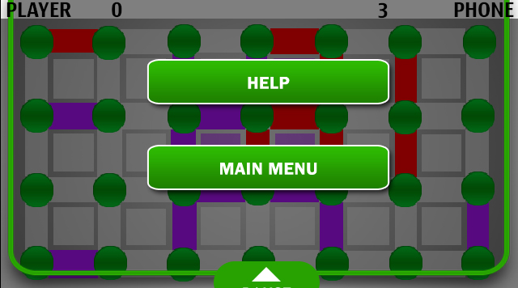

Slide 11
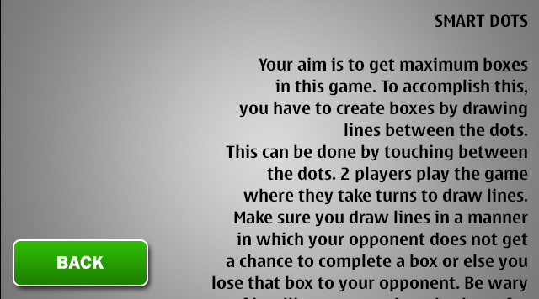

Slide 12
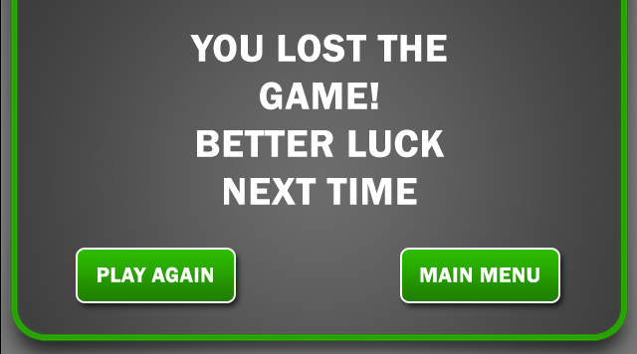

Slide 13
