Slide 1
Cassava Leaf Disease Detection
using CNN with TensorFlow

Slide 2
Project Description
Cassava Bacterial Blight (CBB)
Cassava Bacterial Blight (CBB)
Cassava Bacterial Blight (CBB)
Building a custom ResNet model to classify Cassava plant into one of the 5 different categories mentioned below.
1) Cassava Bacterial Blight (CBB)
2) Cassava Brown Streak Disease (CBSD)
3) Cassava Green Mottle (CGM)
4) Cassava Mosaic Disease (CMD)
5) Healthy

Slide 3
Cassava Dataset on Kaggle
The Datasets for this project are available on Kaggle.
Cassava Leaf Disease Classification is a competition hosted on Kaggle.
There are around 21K training images.
We split the available training images into 2 datasets:
Training dataset
Validation dataset

Slide 4
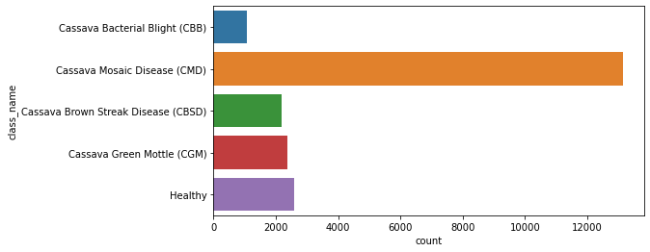
Understanding the data
The training data is biased towards CMD class

Slide 5
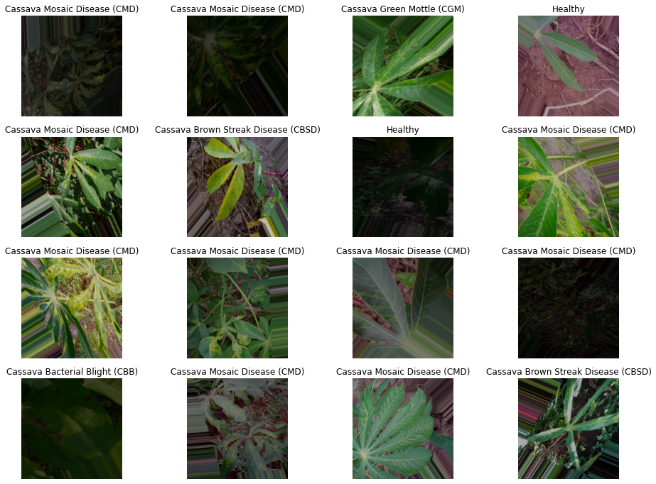
Training Data Image Samples

Slide 6
Loading Datasets and Preprocessing
Loading Dataset
Load the training images into tensor batches using the
Tensorflow’s “ImageDataGenerator” function.
Data Augmentation
Data Augmentation produces the variations in the training data and the model can be trained on different variations of data for each different epoch

Slide 7
Building and Training the model
Building a customized ResNet model for training which included 20k+ parameters
Used Adam’s optimizer to optimize the model
Used Learning Rate Scheduler, Early Stopping, Model Check Point features from TensorFlow
Learning Rate Scheduler – varies learning rate during the training
Early Stopping – monitors the accuracy of the model
Model Check Point – used to save the model weights

Slide 8
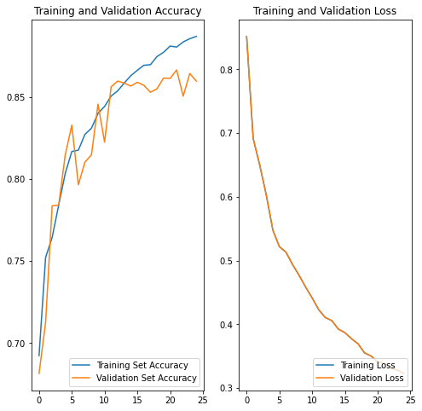
Monitoring Accuracy and Plotting Learning Curves
After training for 25 epochs, the trained model produced an accuracy of 88.6% on training set and an accuracy of 86.6% on the validation set

