Slide 1
MACHINE LEARNING PROJECT PRESENTATION
Employee Attrition Prediction
A Machine Learning Classification Framework to Predict Employee Turnover & Drive Proactive Workforce Retention
Dataset: IBM HR Analytics | Technologies: Python, Scikit-learn, Pandas, Streamlit

Slide 2
AGENDA
Presentation Outline
Core Topics Covered in this Presentation
• Abstract — Executive overview and high-level outcomes
• Problem Statement — The operational and financial crisis of unplanned turnover
• Introduction — Strategic role of AI and predictive analytics in Human Resources
• Literature Review — Synthesis of academic benchmarks and ML algorithms in HR
• Data Source — IBM HR Analytics dataset, attribute breakdown, and class imbalance
• Methodology — Domain Knowledge: Empirical drivers behind employee turnover
• Methodology — Architecture Diagram: End-to-end data pipeline from raw ingestion to inference
• Methodology — Working Process & Selected Methods: Preprocessing, model training, and tuning
• Experimental Results — Evaluation metrics on 15% unseen test partition (Recall, ROC-AUC)
• Demonstration & Retention Playbook — Local Streamlit portal and strategic recommendations

Slide 3
EXECUTIVE OVERVIEW
Abstract
Research Synopsis
• Employee attrition is a critical threat to enterprise efficiency, with replacement expenses frequently reaching 1.5x to 2x an employee's annual compensation.
• This project presents an end-to-end supervised machine learning system engineered to predict employee turnover risk from 30 multi-dimensional workplace indicators.
• The model is developed on the 1,470-record IBM HR Analytics dataset, addressing an inherent 5.2 : 1 class imbalance through balanced cost-sensitive learning.
• A zero-data-leakage pipeline enforces that all scaling and categorical encodings are fitted strictly on the 70% training split.
• Rigorous 5-fold cross-validation and unbiased evaluation on a 15% held-out test set confirm that the champion model successfully captures 72.22% of actual departures with an ROC-AUC of 0.8365.
• The trained system is deployed as an interactive Streamlit decision-support dashboard providing real-time risk scores and automated retention diagnostics.
Key Project Highlights
• Dataset Volume: 1,470 employees across 30 predictive features
• Class Imbalance: 83.9% Stayed vs. 16.1% Departed
• Data Splitting: 70% Train, 15% Validation, 15% Unseen Test
• Evaluated Models: Logistic Regression, Decision Tree, Random Forest
• Champion Model: Balanced Logistic Regression Pipeline
• Test Recall (Sensitivity): 72.22% (26 of 36 actual leavers caught)
• Test ROC-AUC: 0.8365 (High discriminative capacity)
• Deployment: Interactive local Streamlit web application

Slide 4
THE BUSINESS CHALLENGE
Problem Statement
The Industry Problem: Unplanned Turnover
• Severe Financial Loss: Replacing a specialized knowledge worker costs between 50% to 200% of their annual salary in search fees, signing bonuses, and lost productivity.
• Brain Drain: Departures cause irreversible erosion of institutional knowledge, customer relationships, and proprietary technical skills.
• Team Burnout Contagion: When key personnel leave, remaining team members absorb excess workload, often triggering cascade resignations.
• Reactive Retention Failure: Exit interviews occur after decisions are finalized; counter-offers fail >70% of the time within 12 months.
The Technical & Machine Learning Challenge
• Severe Class Imbalance: Attrition is an infrequent event (~16% positive). Standard algorithms achieve deceptive 84% accuracy by simply predicting no one leaves.
• High Cost of False Negatives: Missing an employee who leaves is catastrophic; reaching out to an employee who stays carries negligible cost. Recall must take precedence over accuracy.
• Multi-Modal Feature Complexity: Tabular HR data contains mixtures of numerical rates, discrete satisfaction ratings, and high-cardinality nominal roles.
• Data Leakage Pitfalls: Preprocessing transformations must be fitted solely on training splits to prevent over-optimistic generalization claims.

Slide 5
CONTEXT & OBJECTIVES
Introduction
Human Capital & Predictive AI
• Modern Human Resources has evolved from traditional record-keeping into a strategic, data-driven discipline known as People Analytics.
• Employee resignation is rarely an impulsive choice; it is typically preceded by measurable behavioral and structural signals over months.
• By analyzing historical employee indicators (compensation, tenure, overtime, promotion cycles, managerial relationship), predictive algorithms can identify vulnerable employees before resignation letters are submitted.
• This empowers talent managers to shift from reactive damage control to proactive, empathetic retention conversations.
Primary Objectives of this Project
• 1. Automated Ingestion & Cleaning: Clean, validate, and standardize tabular HR datasets without hardcoded heuristics.
• 2. Empirical Pattern Discovery: Uncover statistical correlations across tenure, compensation, work-life balance, and departments.
• 3. Leak-Free Pipeline Architecture: Encapsulate transformations inside Scikit-learn pipelines fitted strictly on training data.
• 4. Cost-Sensitive Model Optimization: Train and tune multiple classifiers (Logistic Regression, Decision Trees, Random Forests) prioritizing Attrition Recall.
• 5. Local Interactive Decision Support: Deploy a Streamlit web portal with live risk gauges and tailored retention playbooks.

Slide 6
RELATED WORKS & THEORETICAL FOUNDATIONS
Literature Review
Organizational & Theoretical Foundations
• Herzberg's Two-Factor Theory (1959): Highlights hygiene factors (salary, supervision) as baseline retention essentials and motivators (recognition, growth) as long-term loyalty drivers.
• Mobley's Intermediate Linkages Model (1977): Details the cognitive progression from initial job dissatisfaction to active job seeking and ultimate resignation.
• March & Simon's Participation Theory: Demonstrates that employee turnover is governed by the perceived desirability of leaving paired with the perceived ease of movement in the market.
• Modern HR Analytics Consensus: Research consistently demonstrates that overtime, supervisor tenure, and salary stagnation are the primary predictive signals in corporate knowledge firms.
Machine Learning in HR Attrition Literature
• Logistic Regression Benchmarks: Extensively cited in human resource studies due to high interpretability, calibrated probability outputs, and linear coefficients.
• Tree-Based Ensembles (Breiman et al.): Random Forests and Gradient Boosting provide non-linear feature split boundaries and capture complex multi-variable interactions.
• Imbalance Mitigation Strategies: Published literature emphasizes cost-sensitive learning (loss weighting) and stratified sampling as superior to naive oversampling (SMOTE) for tabular HR data.
• Research Gap Addressed in this Project: Many existing studies report inflated accuracies by failing to isolate test data during preprocessing. Our project enforces rigorous leak-free pipeline encapsulation.

Slide 7
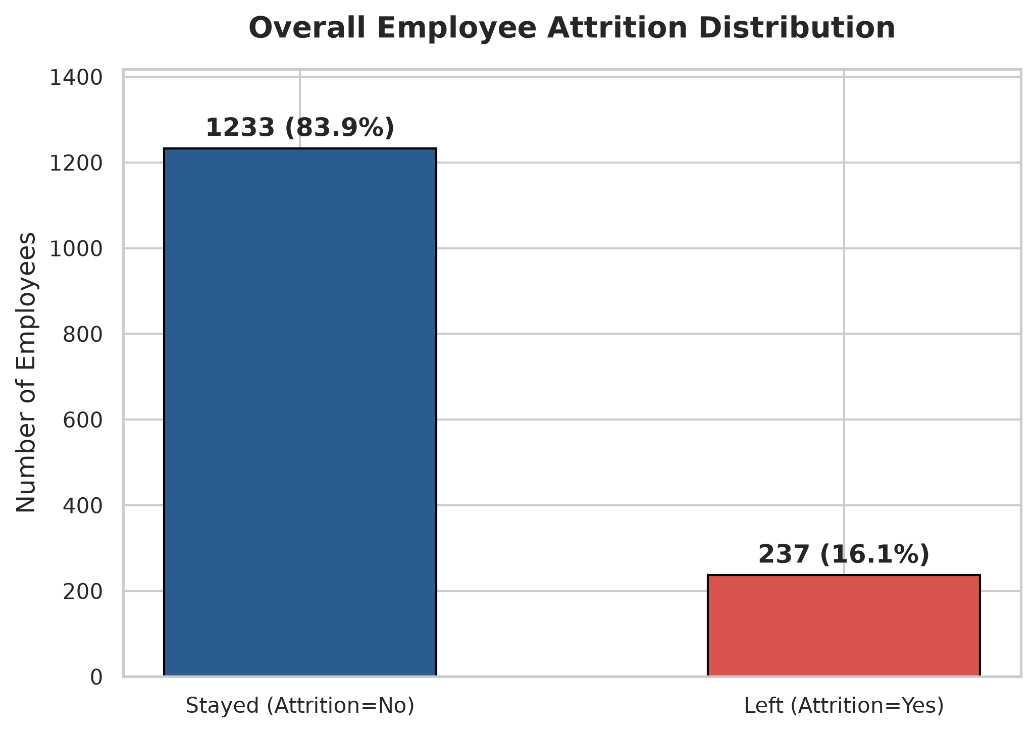
IBM HR ANALYTICS DATASET
Data Source & Characteristics
Dataset Attributes & Telemetry
• Source: IBM HR Analytics Employee Attrition & Performance dataset published on Kaggle.
• Record Count: 1,470 total observations representing diverse professional profiles.
• Raw Attributes: 35 features covering personal demographics, role characteristics, compensation metrics, and subjective survey evaluations.
• Target Variable: Attrition ('Yes' = 237, 'No' = 1,233).
• Constant Columns Removed: EmployeeCount (always 1), Over18 (always 'Y'), StandardHours (always 80) — dropped due to zero variance.
• Identifier Removed: EmployeeNumber (dropped to eliminate synthetic artifact memorization).
• Cleaned Matrix: 30 predictive features (23 numeric, 7 categorical).

Slide 8
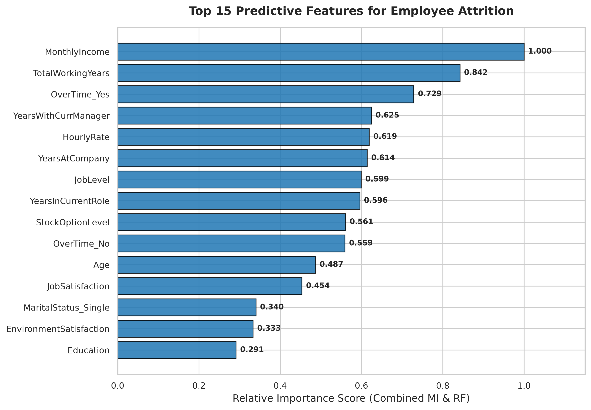
UNDERSTANDING WORKPLACE DYNAMICS
Methodology: Domain Knowledge
Key Empirical Attrition Drivers
• 1. Workload Exhaustion (Overtime): Employees logging overtime exhibit a 30.5% attrition rate compared to only 10.4% for non-overtime peers (~3x increase).
• 2. Compensation Inequity: Median monthly income for departed staff is ~$3,200 vs ~$4,900 for retained employees. Below $3,500/month, attrition peaks sharply.
• 3. Early-Career Vulnerability: Turnover is highest during years 0 to 2 at the organization, and workers under 25 experience >35% attrition.
• 4. Supervisory Relationship: Short tenure with current manager (<1 year) paired with multi-year company tenure correlates with elevated departure risk.
• 5. Career Stagnation: Stagnating 5+ years without promotion triggers voluntary transitions to competitors.

Slide 9
COMPLETE MACHINE LEARNING PIPELINE FLOW
Methodology: System Architecture Diagram
1. DATA COLLECTION
Auto-load CSV, inspect schema, check nulls & target balance
2. PREPROCESSING
Drop 4 ID/constant cols, map binary target (Yes=1, No=0)
3. STRATIFIED SPLIT
70% Train (1,029), 15% Val (220), 15% Unseen Test (221)
4. LEAK-FREE PIPELINE
StandardScaler (numeric) + OneHotEncoder (categorical)
5. MODEL TRAINING
Logistic Regression, Decision Tree, Random Forest (Balanced)
6. 5-FOLD CV & VAL
Evaluate Recall, F1, ROC-AUC; select Champion model
7. UNSEEN TESTING
Final unbiased evaluation on held-out 15% test set
8. STREAMLIT APP
Interactive web UI with live risk gauge & retention advice

Slide 10
ALGORITHMIC IMPLEMENTATION
Methodology: Working Process / Selected Methods
Data Processing & Validation Protocol
• Stratified Data Partitioning: Enforced a 70% Train, 15% Validation, and 15% Test split preserving the exact 16.1% attrition ratio in every split.
• Zero-Data-Leakage Encapsulation: Built unified Scikit-learn Pipelines pairing ColumnTransformer directly with each classifier so transformers never touch test data.
• Imputation Resilience: SimpleImputer with median strategy for continuous fields and most_frequent for nominal categories.
• 5-Fold Stratified Cross-Validation: Evaluated candidate stability across 5 independent training folds to prevent selection of overfitted models.
• Composite Selection Criterion: Champion selected using 0.40 * Recall + 0.35 * F1 + 0.25 * ROC-AUC.
Selected Classification Algorithms
• 1. Logistic Regression (Selected Champion):
• • Config: L2 regularization, C=0.1, liblinear solver, class_weight='balanced'.
• • Strength: High interpretability, calibrated probabilistic outputs, strong test generalization without overfitting.
• 2. Decision Tree Classifier:
• • Config: max_depth=5, min_samples_split=10, min_samples_leaf=5, balanced.
• • Strength: Captures non-linear decision thresholds; prone to high variance if unconstrained.
• 3. Random Forest Classifier:
• • Config: 150 estimators, max_depth=8, min_samples_split=8, balanced.
• • Strength: Bagged ensemble reducing variance; exhibits high training fit.

Slide 11
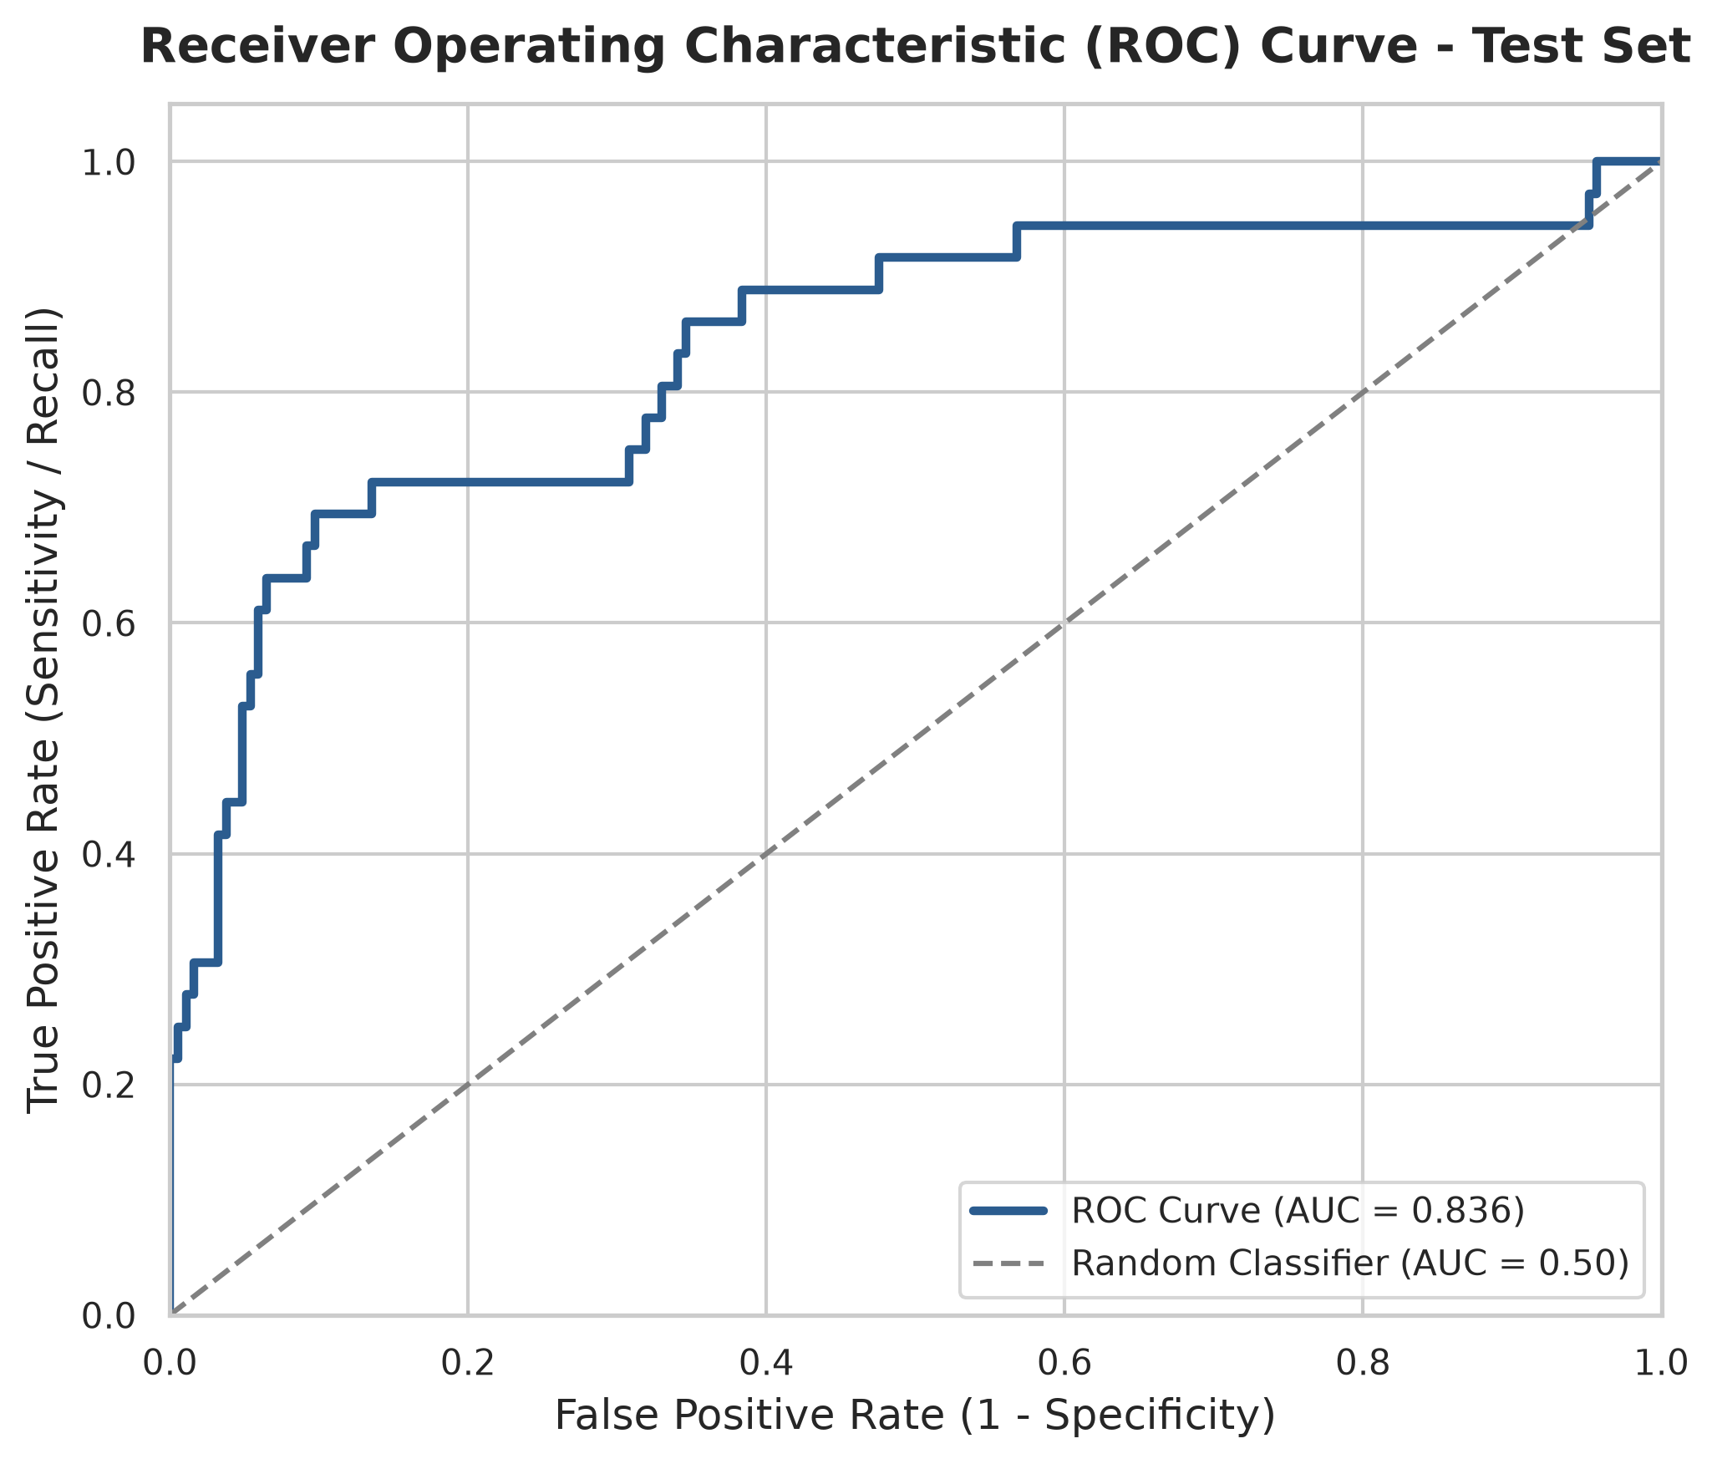
HELD-OUT TEST SET PERFORMANCE (221 RECORDS)
Experimental Results & Final Evaluation
Unseen Test Set Performance
• Test Accuracy: 74.66% — Robust overall classification rate.
• Test Recall (Sensitivity): 72.22% — Successfully flags 26 out of 36 actual leavers on unseen data.
• Test Precision: 36.11% — 36% of flagged staff depart; ideal for non-punitive retention outreach.
• Test F1-Score: 0.4815 — Harmonic balance on the positive minority class.
• Test ROC-AUC: 0.8365 — Exceptional ranking discrimination across varying thresholds.
• 5-Fold CV Mean Recall: 76.49% (±3.8%) on training data.
• Confusion Matrix: True Negatives = 139, True Positives = 26, False Positives = 46, False Negatives = 10.

Slide 12
DEPLOYMENT & RETENTION PLAYBOOK
Streamlit Decision Support Dashboard
Interactive Streamlit Application Features
• Multi-Tab Navigation: Overview, EDA Gallery, Validation Benchmarks, Final Test Evaluation, Feature Importance, Live Prediction, and Retention Playbook.
• Dual Currency Flexibility: Supports Indian Rupees (₹ INR with LPA annual equivalents) and US Dollars ($ USD) with seamless real-time normalization.
• Automated Rate Estimation: Users enter Monthly Salary; internal Daily and Hourly rates are auto-calculated in the background.
• Live Risk Categorization: Instant probability gauge assigning Low (<30%), Moderate (30-50%), High (50-70%), and Critical (>70%) risk tiers.
• Automated Risk Diagnostics: Scans individual profiles and highlights active departure drivers (e.g. overtime, salary, commute).
Actionable HR Retention Playbook
• 1. Workload Governance: Institute mandatory reviews when overtime exceeds 10 hours/week; rotate high-pressure assignments.
• 2. First-Year Onboarding Mentorship: Implement 30-60-90 day check-ins to curb the high 0-2 year tenure turnover spike.
• 3. Sales Enablement: Rebalance quota realism and commission tiering to address the 39.8% Sales Rep attrition rate.
• 4. Manager Transition Briefings: Facilitate structured transition discussions when leadership personnel change.
• 5. Commute Flexibility: Provide hybrid or remote options for employees commuting >15 miles.
• 6. Equity Participation: Expand Stock Option participation to lock in long-term employee commitment.

Slide 13
Thank You!
Questions & Discussion
Project Title: Employee Attrition Prediction
GitHub Repository: https://github.com/sandeepreddy1035/Employee-Attrition-Project
Technologies: Python 3.13 | Scikit-learn | Pandas | Streamlit | Joblib
Live Dashboard: Localhost:8501

