Slide 1




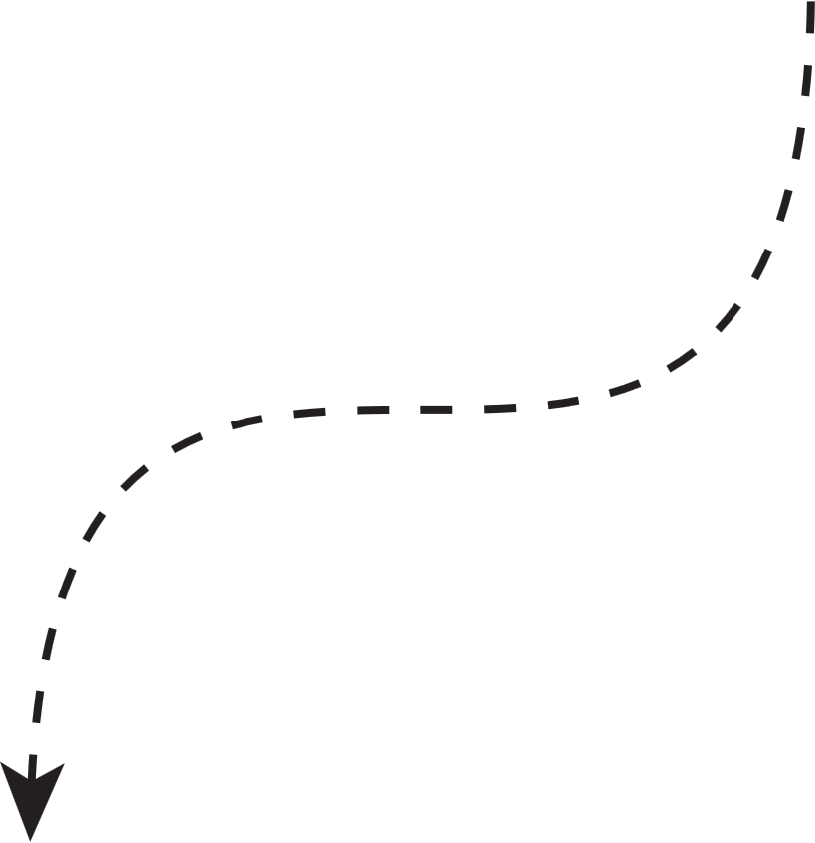


Presentation on
DESIGN AND ANALYSIS OF A
TOTAL OSSICULAR REPLACEMENT PROSTHESIS (TORP)
BY: SANDEEP ROY,
ROLL NO. 230710102098
GUIDE: DR. APURBA DAS, IIEST SHIBPUR
DEPARTMENT OF MECHANICAL ENGINEERING,

Slide 2
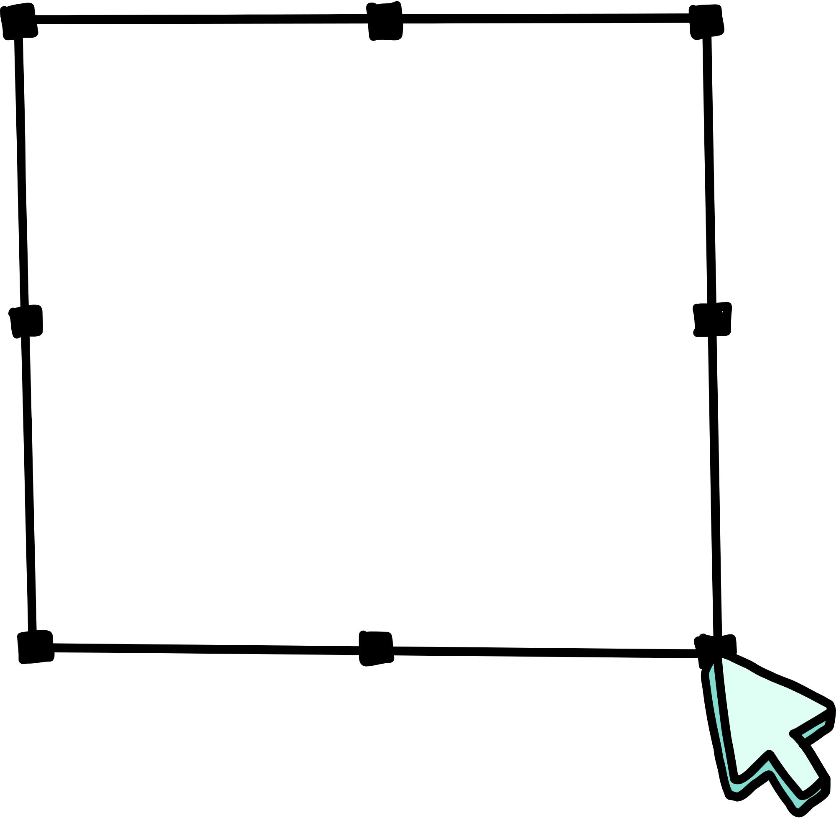
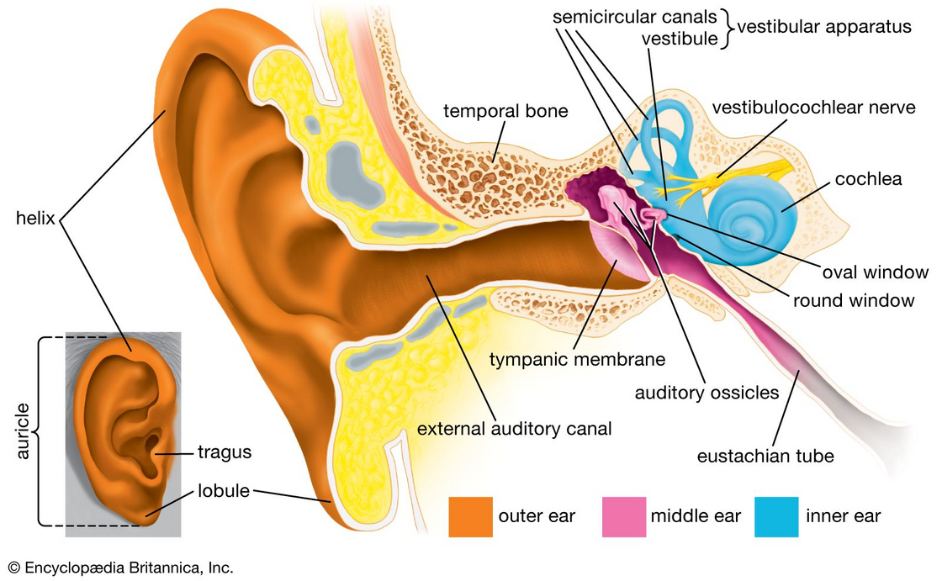
Introduction
Conductive hearing loss → caused by damaged ossicles
TORP → surgical implant to restore sound transmission
Requirements:
1. Biocompatible material
2. Strong yet lightweight
3. No resonance in 100–6000 Hz range
“Why this matters: restoring hearing & quality of life”

Slide 3



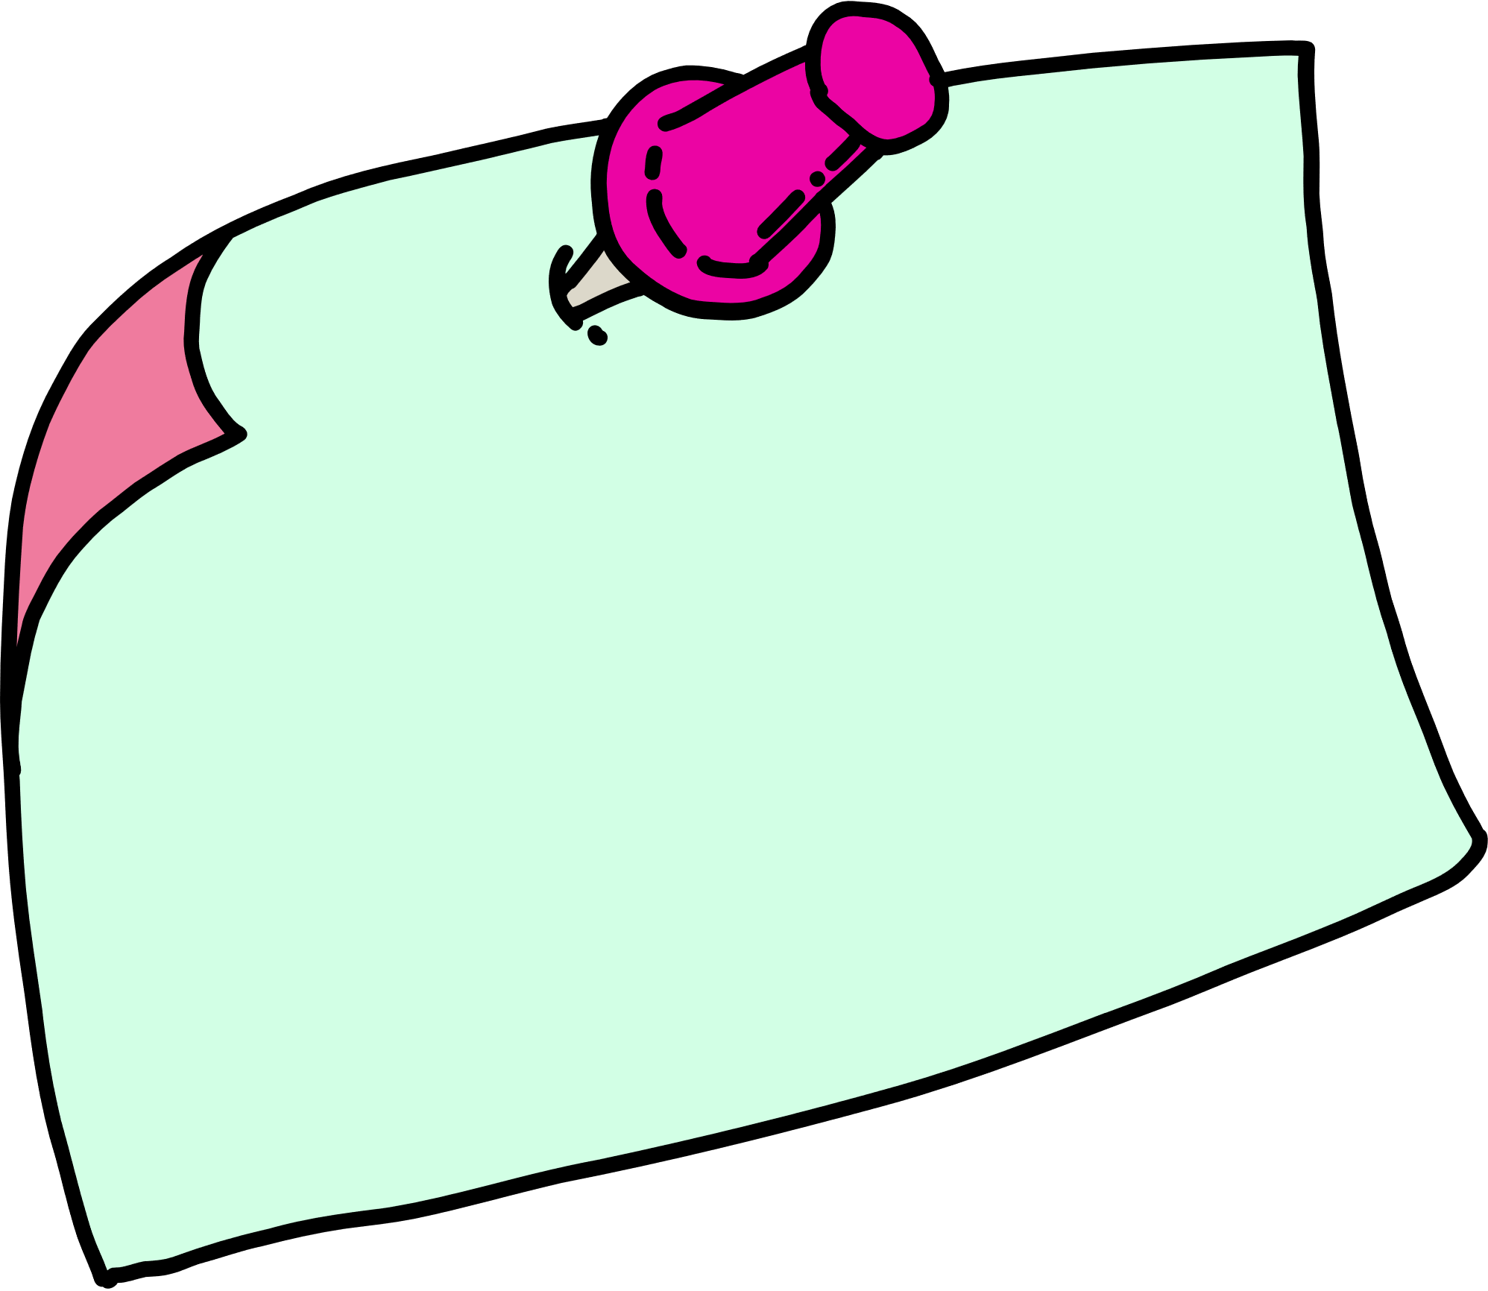

Objectives
Build CAD model of TORP (Fusion 360)
Select implant-grade material (Ti-6Al-4V)
Perform static stress analysis under acoustic load
Perform modal frequency analysis
Evaluate mechanical safety & reliability

Slide 4

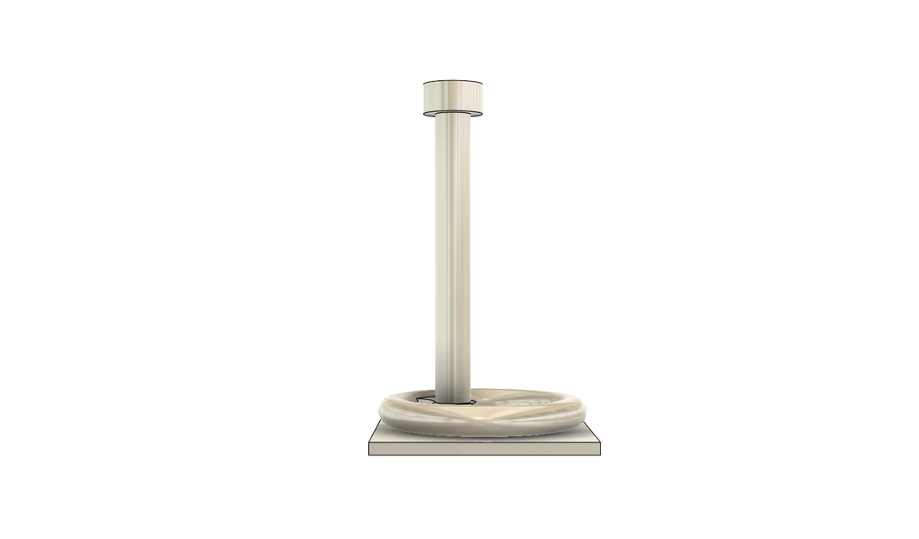

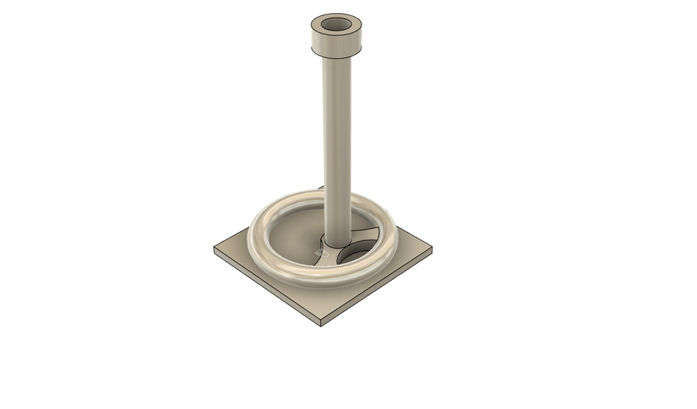
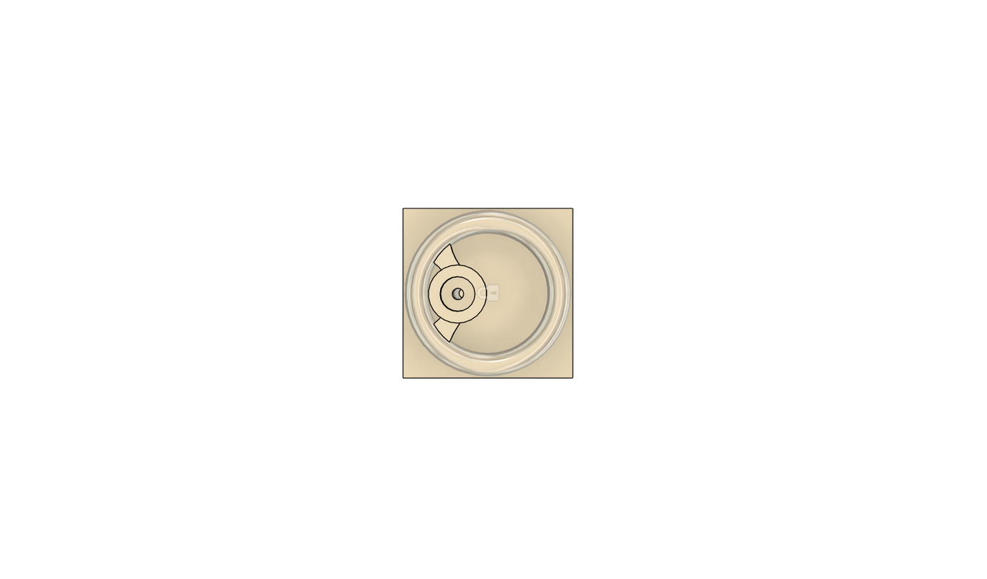
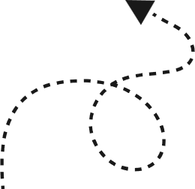
CAD Design
Head
MAIN PARTS:
Footplate – stable contact with stapes
2. Shaft – connects base to head
3. Head – contact with the tympanic membrane
Key Features: Compact | Lightweight | Smooth transitions | Manufacturable
Shaft
Footplate

Slide 5
Material Selection
High strength-to-weight ratio
High Stiffness
Corrosion Resistant
Ti-6Al-4V Alloy
Excellent Fatigue & Wear Resistance
Biocompatible
MRI-Compatible & Non-Magnetic

Slide 6

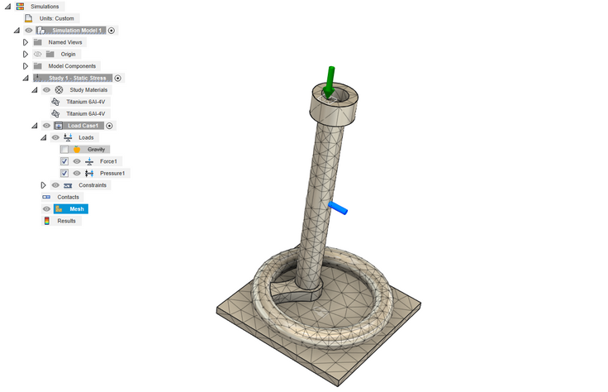
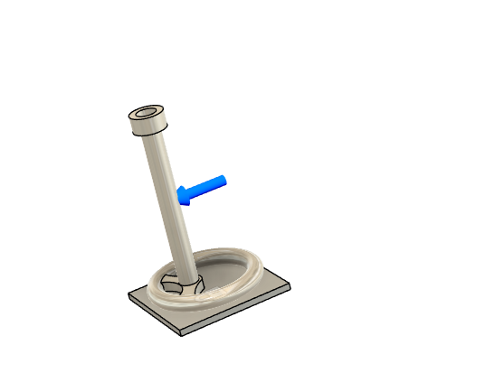

Simulation Methodology
Static Stress Analysis
Modal Analysis
Load = 5.0 × 10⁻⁵ N
Pressure = 1.0 × 10⁻⁶ MPa
Footplate fixed
8 eigenmodes
Goal: Avoid resonance in 100–6000 Hz
Flowchart:
CAD
Static
Mesh
Modal

Slide 7

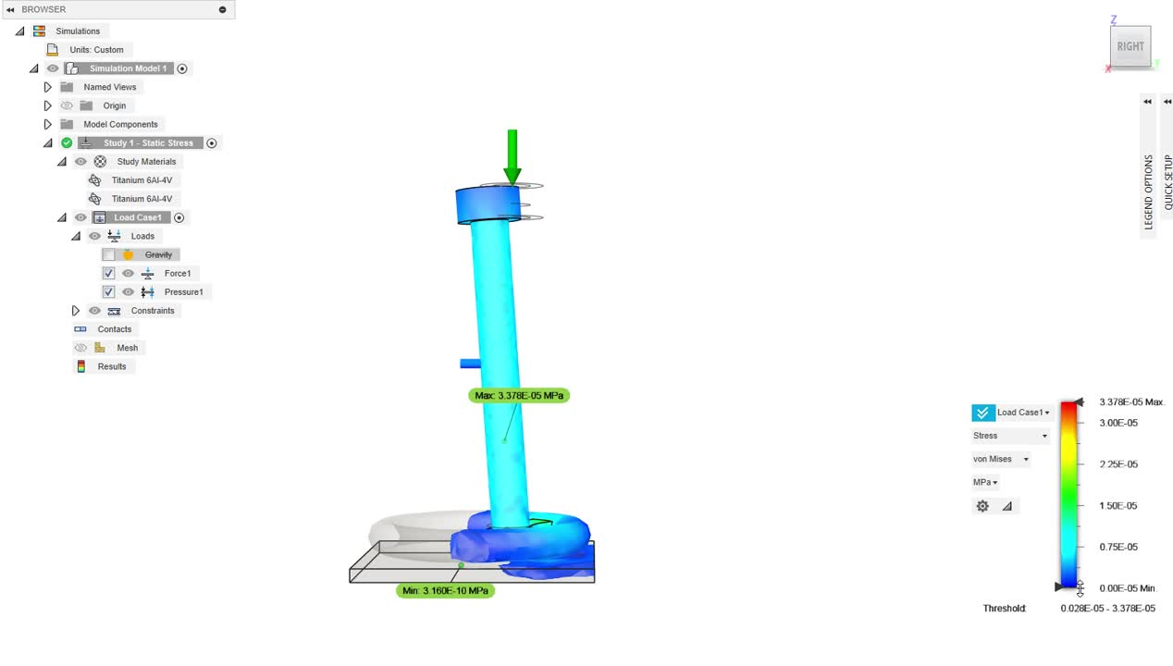
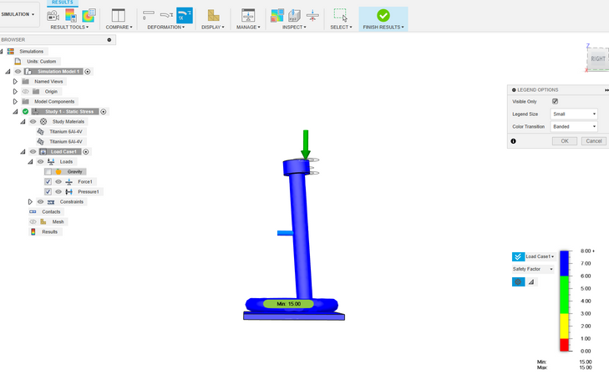
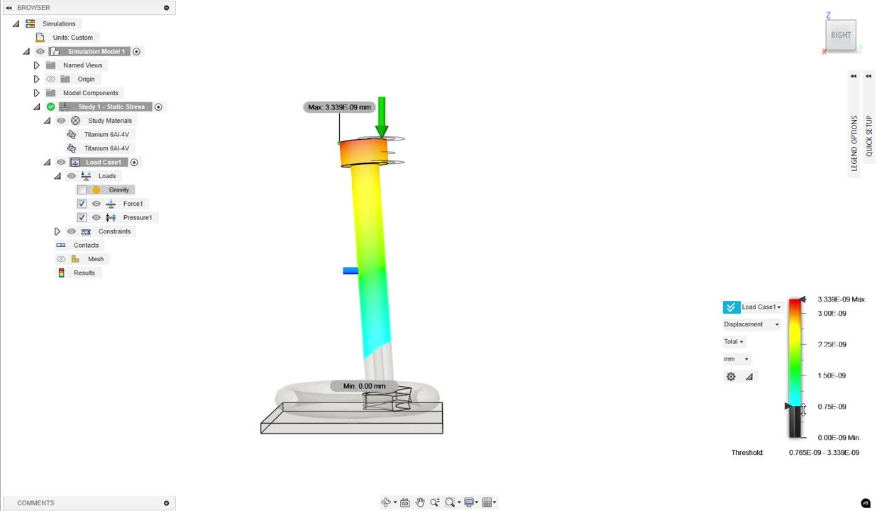
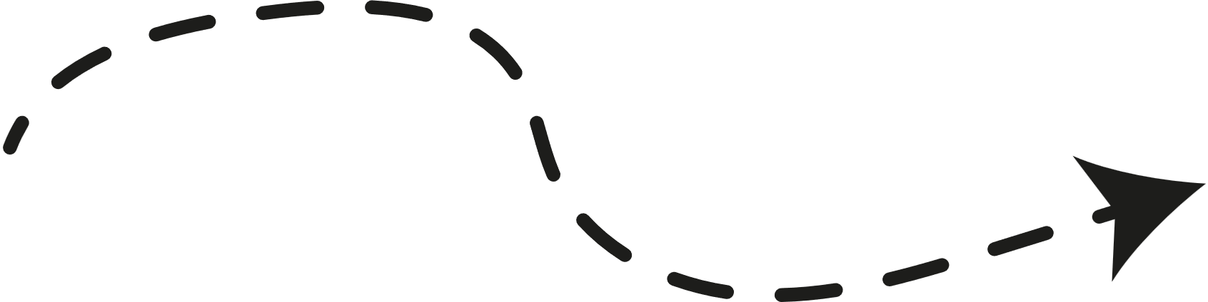
Static Analysis Results
1
Max displacement: 3.339 × 10⁻⁹ mm → negligible
2
Max stress: 3.378 × 10⁻⁵ MPa
<< yield strength
Stress distribution plot
3
Safety factor: 15.0 → very safe
Safety factor plot
4
Prosthesis behaves like rigid body
Displacement plot

Slide 8
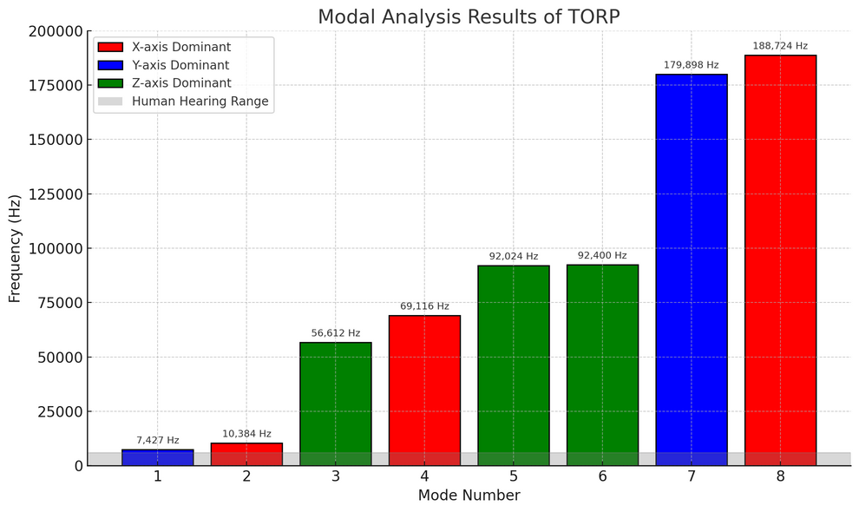
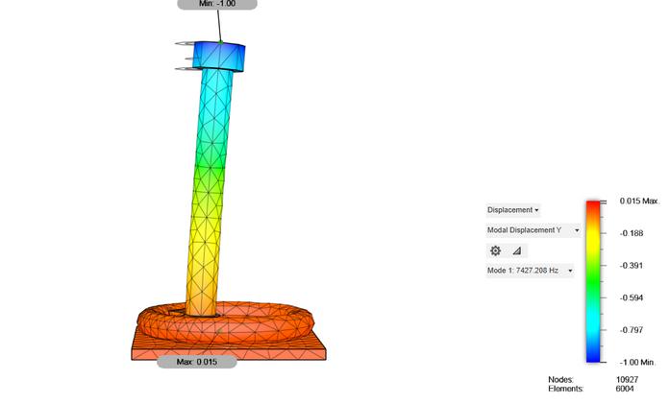
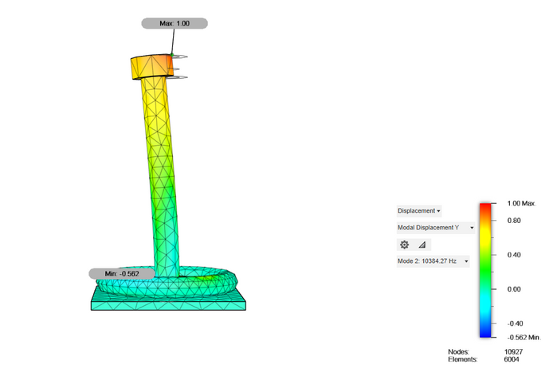
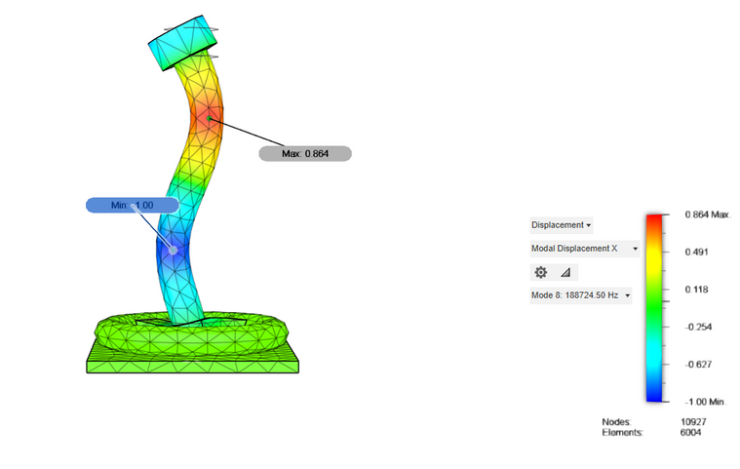
Modal Analysis Results
1
Natural frequencies: 7.4 kHz – 188.7 kHz
All modes lie above the 100–6000 Hz hearing band → resonance avoided
2
Modal frequencies of TORP – all above hearing range, with bars colored by dominant axis.
Mode 1 deformation shape at 7427 Hz, dominated by Y-axis participation.
3
Vibrations are stable.
4
Only bending/twisting in higher modes
Mode 2 deformation shape at 10,384 Hz, dominated by X-axis participation.
Mode 8 deformation shape at 188,724 Hz, dominated by X-axis participation.

Slide 9
Discussion
Static Analysis
Modal Analysis
Near-rigid behavior (displacement in nanometres)
1
Natural frequencies = 7.4 kHz to 188.7 kHz
1
2
All above 100–6000 Hz → no resonance
2
Stress far below yield strength
Stable, well-defined vibration modes
High safety factor (15.0)
3
3
Implication
1
TORP is mechanically safe & dynamically reliable
Provides strong base for prototyping & trials
2

Slide 10
Limitations & Future Work
1
LIMITATIONS:
No tissue interaction/damping modeled
Fatigue, corrosion, extreme loads not analyzed
Simplified linear elastic model
2
FUTURE WORK:
Nonlinear & fatigue analysis
Prototype fabrication (CNC / 3D printing)
In-vitro middle-ear testing
Animal/clinical validation with surgeons

Slide 11


CONCLUSIONS
CONCLUSION 1
CONCLUSION 2
CONCLUSION 3
CONCLUSION 4
Designed & simulated TORP using CAD + FEA
Results confirm:
Structurally safe (negligible stress/displacement)
Dynamically reliable (no resonance in the hearing band)
Strong candidate for prototyping & clinical validation
Internship provided valuable experience in biomedical design & simulation

Slide 12
THANK
YOU!

