Slide 1

A Emotion And Context-Aware Chatbot
How Can An Emotion And Situation-Aware Chatbot Help To Make Individuals And Communities More Resilient?
Presented By:
Sandeep Reddy Salkuti
Sumanth Medavarapu

Slide 2

PROBLEM STATEMENT AND SOLUTION
ProblEM: How Can An Emotion And Situation-Aware Chatbot Help To Make Individuals And Communities More Resilient?
Solution: this can be achieved by creating a predictive CHATBOT model which
predicts THE CONTEXT OF USER AND RESPONDS WITH ACTIONS ACCORDINGLY.
Potential solutions can be:
Creating a chatbot which understands user context and maintain human like conversation with user by engaging user in conversation as well as understanding user emotions and responding to them .
Advantages:
They are helpful to every individual like students, faculties, patients etc. by responding to their queries in all different ways in informative, using images, navigation links etc .
They make people stronger by offering emotional support, providing info .

Slide 3
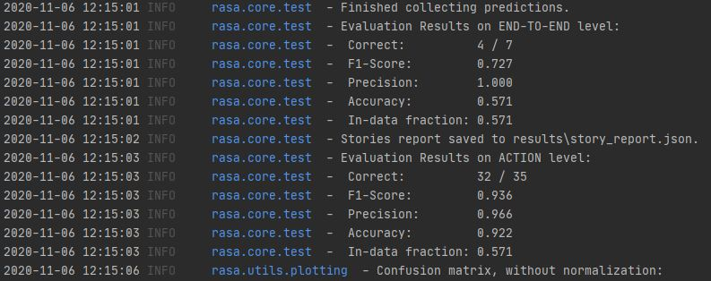

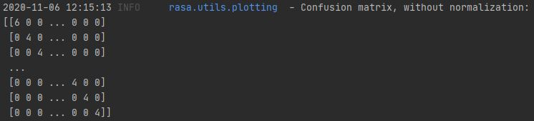
Implementation steps:
Below are the steps followed:
Collecting Data
Initializing project
Preparing Intent, domain, stories
Training and testing model
Checking confidence and viewing in application

Slide 4
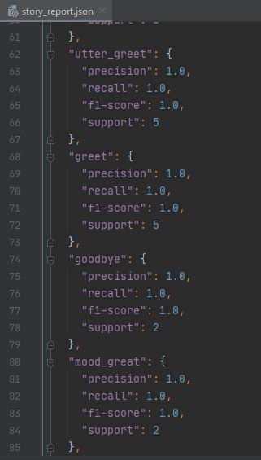
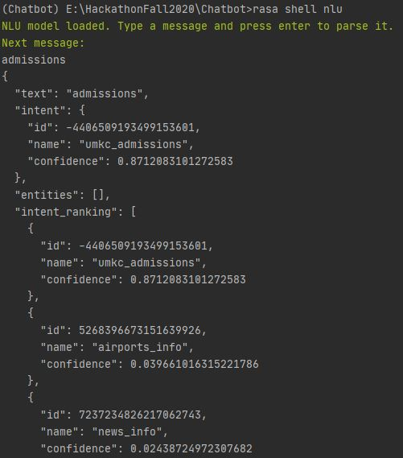

ALGORITHM IMPLEMENTATION & VISUALIZATIONS:
Algorithms compared

Slide 5
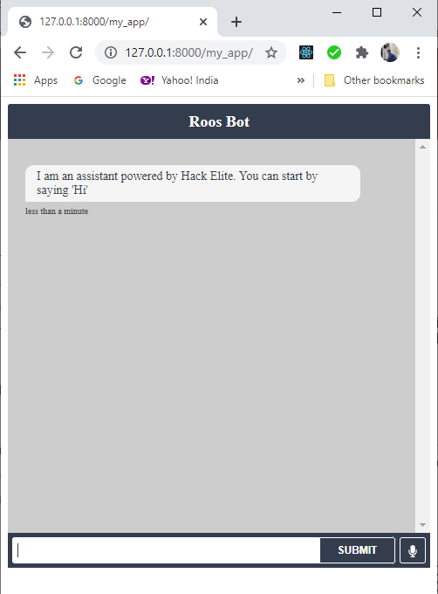
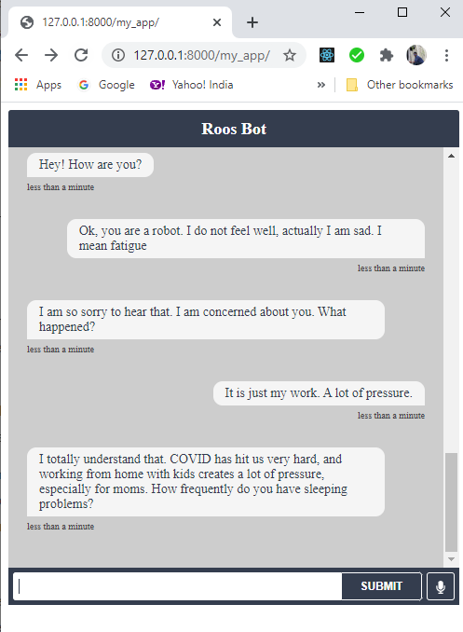
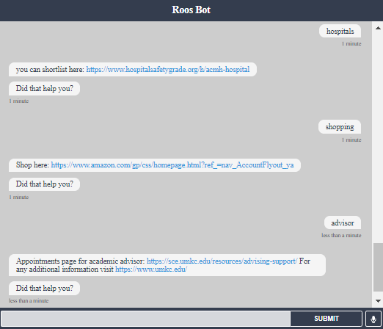
Outputs:
REFERENCES:
https://rasa.com/docs/rasa/
https://www.youtube.com/watch?v=XMAw_bKTLbA&t=35s

