Slide 1
Implementation of Minimax, Alpha-Beta Pruning, and Random Agent in Slime Volleyball
TEAM: SANDEEP KUMAR (CS24M112) , ABHISHEK KUMAR (CS24M120)
Submission Date: 30/04/2025
Course Name: AI
Instructor Name: Ajin George Joseph
GitHub Repo: https://github.com/sandeepshakya2019/AI_Asgn_3

Slide 2
Problem Statement & Environment Overview
Objective:
Implement Minimax and Alpha-Beta Pruning algorithms to control agents in the Slime Volleyball (Slime Volley-v0) environment and compare their performance with a Random Agent.
Environment Highlights:
Dynamic 2-player game involving physics-based interactions (movement, jumping, ball behavior).
Each agent tries to score by hitting the ball over the opponent.
Key Goals:
Develop intelligent agents capable of strategic decision-making.
Evaluate and compare the performance of Minimax, Alpha-Beta Pruning, and Random strategies.

Slide 3
Algorithms Overview
Minimax Algorithm
Classic decision-making algorithm exploring all possible moves up to a fixed depth.
Evaluation Function: Distance between player and ball (closer = better).
Depth of Search: 3 levels.

Slide 4
Algorithms Overview
Alpha-Beta Pruning
Optimized Minimax that prunes unnecessary branches to improve efficiency.
Evaluation Function: Same as Minimax.
Depth of Search: 3 levels.
Advantage: Reduced computation time through pruning.

Slide 5
Algorithms Overview
Random Agent
Selects actions randomly from the action set.
Serves as a baseline for performance comparison.

Slide 6
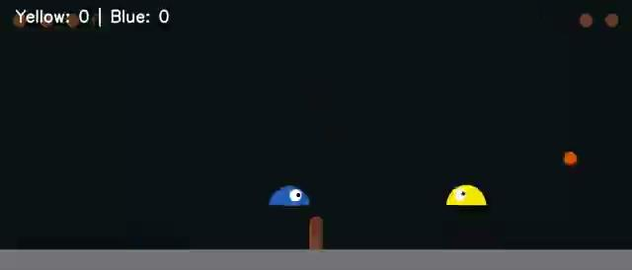
Results & Observations
Total Score (Yellow vs Blue):
Minimax: Yellow 0 - Blue 10
Gameplay Details:
Frames Played: 1200 frames per game (~40 seconds at 30 FPS)
Execution Time:
Minimax: 266.04 seconds
Key Observations:
Minimax and Alpha-Beta Pruning outperformed the Random Agent through strategic decision-making.
MINIMAX VIDEO PLAY
Note: Blue is the maximizing player (controlled by Minimax/AlphaBeta)

Slide 7
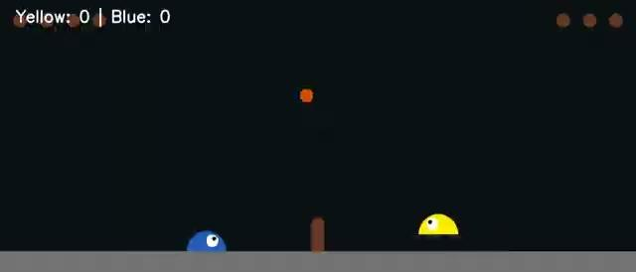
Results & Observations
Total Score (Yellow vs Blue):
Alpha-Beta: Yellow 0 - Blue 10
Gameplay Details:
Frames Played: 1200 frames per game (~40 seconds at 30 FPS)
Execution Time:
Alpha-Beta: 123.68 seconds
Key Observations:
Alpha-Beta executed nearly twice as fast as Minimax, highlighting the efficiency of pruning redundant branches.
ALPHA-BETA VIDEO PLAY

Slide 8
Key Takeaways & Challenges
Minimax vs. Alpha-Beta Pruning
Alpha-Beta Pruning achieves similar results to Minimax while being significantly faster by pruning irrelevant branches.
Random Agent Behavior
The Random Agent performs poorly, lacking strategic behavior and consistency.
Evaluation Function
A simple distance-to-ball heuristic is effective for basic control and decision-making.
Challenges:
Search Depth Limitation: Limited depth restricts foresight and complex long-term planning.

