Slide 1

GENBA SOPANRAO MOZE COLLEGE OF ENGINEERING BALEWADI, PUNE-411045.
PROJECT REPORT ON
“boat9.com”
Project By,
Dhanshree D. Shete.
MCA-III
Roll No-48 (A).
Project Guide,
Prof. Namrata Shinde.
“MASTER OF COMPUTER APPLICATION”
2013-14

Slide 2
Boat9.com
Guided By
Prof. Namrata Shinde.
Presented By
Dhanshree Shete 48 (A)

Slide 3
Introduction
This system is basically developing for American countries. Now days most people get problems for find a rental/Buy or Lease Boats in Different cities. With IT revolution as its peak, this task should also be a computerized process and keeping this in mind we thought of buildings this web site which all reduces the time, energy and efforts for systematic processing of data. These days Internet is a very popular mode of communication because most of the people are computer literate. Using the programming skills all the operations involved could be easily made efficient flawless and user friendly.
The proposed solution is a website through which users can easily find their requirement . The system will be a database driven web-based solution that can provide easy and faster access and find the information related boats for users. The website will be dynamic with a backend Admin Control panel and will allow site administrator to manage site content including management of users, Boats categories and other Properties.

Slide 4
Company Introduction
Euclid helps organizations to realize ways to address their business problems. Listening is key to getting it right. We work closely with and are accountable to our customers' business stakeholders, enabling us to deliver an optimal result. We combine the right people, processes and tools so that each solution—and the documentation that supports it—is achieved with flexibility, commitment and clarity. Euclid's approach enables us to be our customers’ trusted adviser for technology solutions—from vision to realization and operation.
Our proven project management methodology ensures that industry best practices are complemented with solutions that fit our customers’ business requirements. Consistent quality and service is ensured with our repeatable engagement model, quality endorsed processes, and use of industry standards and best practices. We understand it's our customer's solution, and we work with them to deliver it.

Slide 5
We understand it's our customer's solution, and we work with them to deliver it. Euclid understands the value of experience. We share what we learn and embed it in our practices. Project managers, business and technical specialists are supported with our quality management system and its library of methods and templates.
We emphasize communication: Keeping customers informed of our process, listening to their feedback, and preparing documentation that clearly reflects their requirements. This approach guarantees consistent, effective and efficient delivery of services that are tailored to the nature and scale of each assignment. So, when managing a total lifecycle project or performing a short-term consultancy, we meet the differing needs of our customers’ stakeholders. The full resources of Euclid are dedicated to ensuring that every engagement is successful.

Slide 6
3. EXISTING SYSTEM
The conventional wisdom is that buyers and sellers go together like oil and water. That is to say, they don’t go together at all. Some say they are at odds simply by virtue of sitting across the bargaining table from one another, which - along with negotiation and legal issues that are par for the boat buying course - create the presumption that they want to tally different things. The prime example of competing buyer and seller interests is this: the buyer wants to pay as little as possible, while the seller wants to get top dollar for the boat.

Slide 7
Drawbacks of the existing system:-
Manpower:-
Man power is needed for processes like maintenance of register customers, records of boats.
Time Consuming:-
The existing system is very time consuming that increases customers searching time.
Storing & Retrieving:-
Storing & retrieving process is very slow and also it requires a separate storage area.
Hectic Job:-
It is very hectic job to search in previous records.

Slide 8
4.Scope of New System
Time Effective and Cost :
This website is available to anybody and anywhere. This saves lot of communication time of the registered users and in a very little time span the registered user can know the information about boats, details of that boats in their required area.
Database Creation:
A database of the registered users will be created and this will help the users to fetch the details of particular boats as per requirements. There is a separate table for administrator for updating ,deleting & inserting .
Mobility:
Internet is available to everybody anywhere anytime here, this makes the site highly mobile.

Slide 9
Informative :
The site has all the necessary details about boats, service centre of some cities of American countries. Hence, provides all the relevant information therefore. For example, Details of the boats, Amount range for rent/lease/buy etc.
Wide Approach :
The site is such that any person can visit it. Therefore it has a wide range of users.
Security :
Proper authorization and authentication provisions have been made for the security of the site so that only the authorized users can make changes to the site. Without proper authentication no one is allowed to update site.
Flexible:
The site is flexible to any expansion or contraction in the future. For example: Sending telegrams can be included etc.

Slide 10
5.Modules of Project
Web site Contains following modules:
Admin.
User.
Manufacturer.
Service Provider.

Slide 11
1) Admin:-
This module keeps all the information about Users, Manufacturer and boats details.
Admin has all the authorities like registering the Users, deleting them and keeps the track of daily sales etc. Bill will generate. Purchase details will maintain by the admin. Category wise boat details are maintained by admin. Admin maintain the payment details of customers.
2) Manufacturer:-
Manufacturer can register and view information about boat. He can check their availability and rates. Manufacturer can post new boat and view/Subscribe package. Manufacturer can view their customer list.
3) Customer:-
Customer can register themselves, view information about boats and view boat details. Customer can view and subscribe tour package. He can take boat on lease/rent/buy.
4) Service Provider:-
Service Provider can register themselves, view information about boats and view and updated details. Service Provider can view and subscribe package. Service Provider has the boat for lease/rent/buy. Service Provider can offer the tour packages. He can add images & videos of boats.

Slide 12
6. Software Requirement
Operating System | Windows 2000, ME, XP, NT
Web Browser | IE4 or Netscape 4x or upwards.
Development Tools | ASP.NET, C#, HTML, DHTML, JavaScript
Database | Microsoft SQL Server 2008

Slide 13
7.Hardware Requirement
Server :
Processor: Pentium 3,500 MHz (or above).
RAM: 2GB (or above).
HDD: 20 GB Free (or Above).
Client :
Processor: Celeron 500 MHz or above, Pentium 2,350 MHz or above.
RAM: 512 MB (or Above).
HDD: 10 GB Free (or Above).

Slide 14
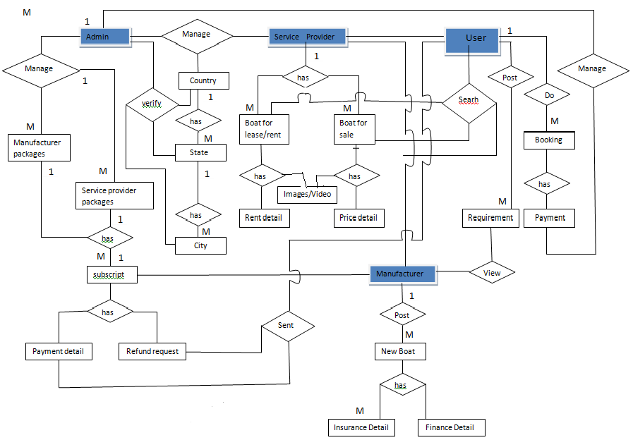
Entity Relationship Diagram(ERD)

Slide 15
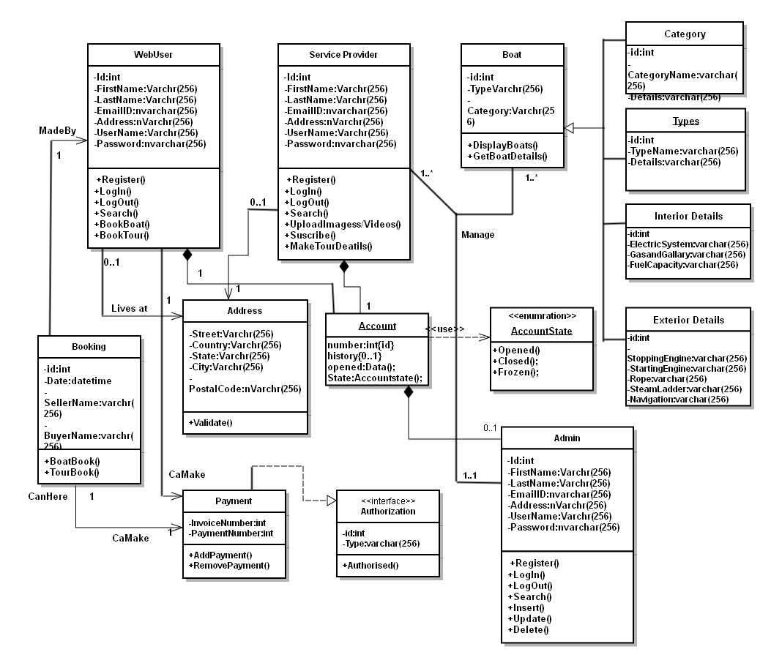
Class Diagram

Slide 16
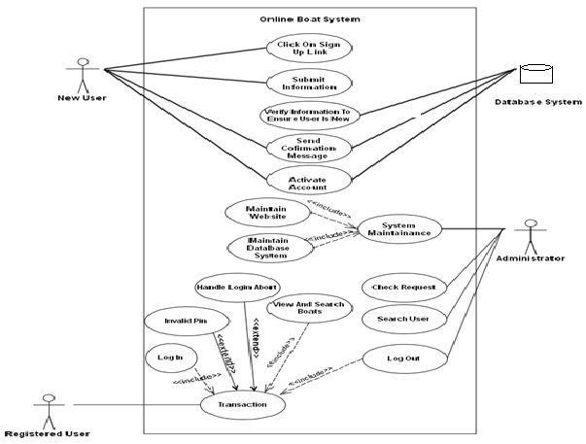
Use case Diagram Admin

Slide 17
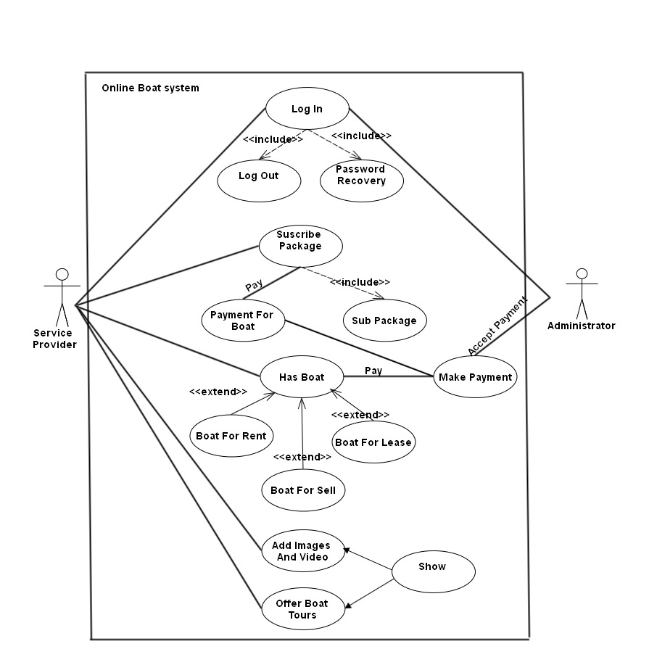
Use case Diagram Service provider

Slide 18
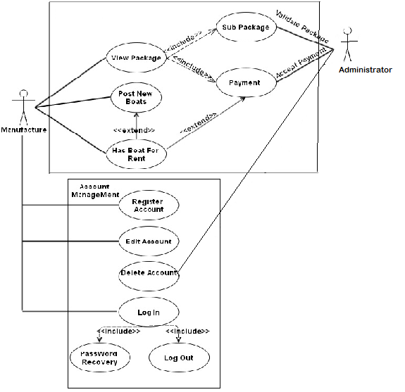
Use case Diagram Manufacturer

Slide 19
Activity Diagram Admin
Login
Valid
Invalid Admin
Maintain Registration
Accept payment
Maintain Boat Details (Rent/lease/sell)
Maintain Advertise packages
Verify Images Videos
Payment details(u,sp,mf)
Log Out

Slide 20
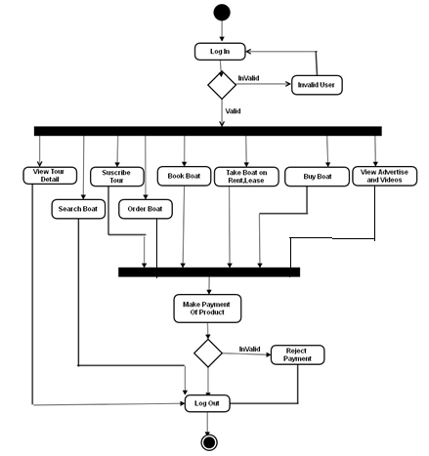
Activity Diagram User

Slide 21
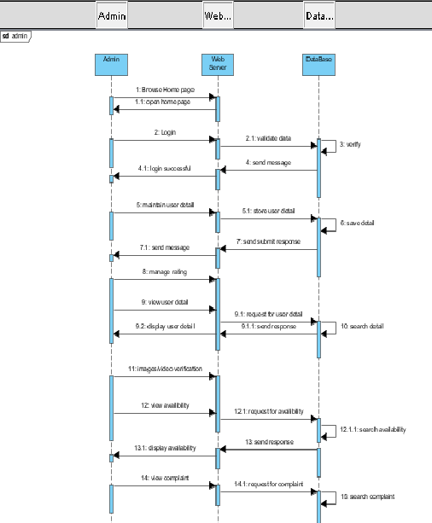
Sequence Diagram Admin

Slide 22
User Sequence Diagram

Slide 23
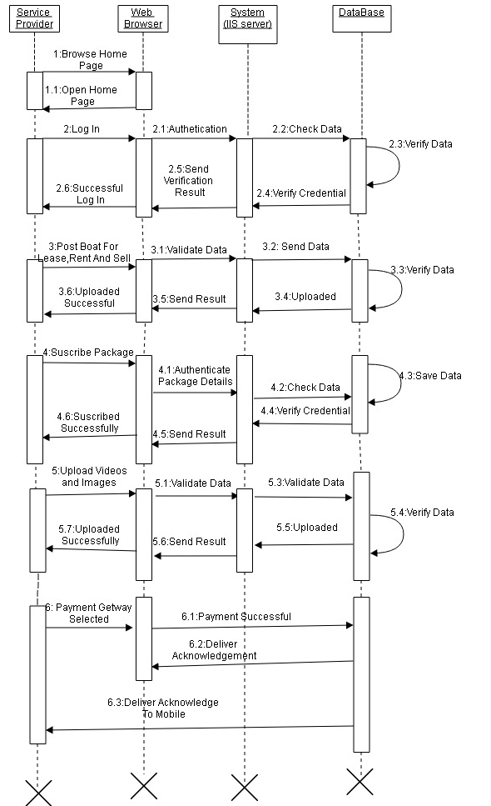
Service Provider Sequence Diagram

Slide 24
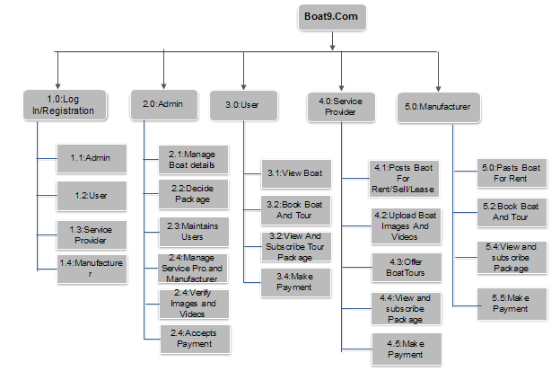
Module Hierarchy Diagram

Slide 25
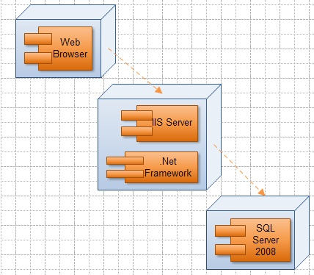
Component Diagram

Slide 26
Table Name: dbo.login
Primary key: id
Description: This table stores the information of login User.
Column name | Data Type | Allow Nulls | DESCRIPTION
User_Id | int | PK(Not Null) | User Id
User_Name | varchar(128) | Not Null | User Name
Password | nvarchar(50) | Not Null | Password

Slide 27
Table Name: dbo.admin
Primary key: id
Description: This table stores the information of admin such as id, name, Password.
Column name | Data Type | CONSTRAINT | DESCRIPTION
adminId | int | PK(Not Null) | Id
First_Name | varchar(128) | Not Null | First_Name of admin
Middle_name | varchar(128) | Allow Null | Middle_name of admin
Last_name | varchar(128) | Not Null | Last_name of admin
Email_Id | varchar(256) | Not Null | Email_Id of admin
Current_Address | varchar(256) | Not Null | Current_Address of admin
Permanent_Address | varchar(256) | Null | Permanent_Address
Dob | datetime | Null | Date of birth
Contact_no | varchar(15) | Not Null | Contact_no of admin
password | nvarchar | Not Null | password

Slide 28
Table Name: dbo.BoataExtraDtl
Primary key: Boat_Id
Description: This table stores extra details about boat.
Column name | Data Type | Allow Nulls | DESCRIPTION
Boat_Id | int | PK(Not Null) | Boat Id
Is_Insurance | varchar(50) | Null | Is Insurance for boat
InsuranceRemaingDays | int | Not Null | Insurance Remaining Days
InsuranceCompanyID | int | FK(Not Null) | Insurance Company ID
PolicyName | varchar(128) | Not Null | Insurance Policy Name
IsAnyLoan | varchar(128) | Null | Is Any Loan for boat
LoanCompanyID | int | FK(Not Null) | Loan CompanyID
LoanAmount | decimal(18, 2) | Not Null | LoanAmount
RemainingAmount | decimal(18, 2) | Not Null | RemainingAmount
Other_Detail | varchar(256) | Null | Other_Detail

Slide 29
Table Name: dbo. City_Detail
Primary key: id
Description: This table stores information of city.
Column name | Data Type | Allow Nulls | DESCRIPTION
Id | int | PK(Not Null) | City Id
Name | varchar(128) | Not Null | Name of city
State_Id | int | FK(Not Null) | State Id

Slide 30
Table Name: dbo. Boat_For_Details
Primary key: id
Description: This table stores information of boat for buy,rent,lease,sell.
Column name | Data Type | Allow Nulls | DESCRIPTION
Id | int | PK(Not Null) | Id
Boat_Type | varchar(128) | Not Null | Boat Type
Boat_Id_For_Buy | int | Not Null | Boat Id For Buy boat
Boat_Id_For_Sell | int | Not Null | Boat Id For Sell boat
Boat_Id_For_Rent | int | Not Null | Boat Id For Rent boat
Boat_Id_For_Lease | int | Not Null | Boat Id For boat on Lease
Boat_Id_For_Booking | int | Not Null | Boat Id For Booking boat

Slide 31
Table Name: dbo. Boat_Specification
Primary key: Boat_id
Description: This table stores information of boat specification.
Column name | Data Type | Allow Nulls | DESCRIPTION
Boat_Id | int | PK(Not Null) | Boat Id
Catagory | varchar(128) | Not Null | Category of boat
Type | varchar(128) | Not Null | Type of boat
Brand | nchar(10) | Not Null | Brand of boat
Length | decimal(18, 2) | Not Null | Length of boat
Price | decimal(18, 2) | Not Null | Price of boat
Speed | nchar(100) | Null | Speed of boat
Sequirty | varchar(50) | Not Null | Sequirty about boat
Engine_Type | varchar(50) | Not Null | boat Engine Type
Hull_Type | varchar(128) | Not Null | Hull Type
Average | nchar(50) | Not Null | Average of boat
BuiltMaterial | varchar(128) | Null | Built Material used
InsuranceStatus | varchar(128) | Null | Insurance Status
InsuranceRemainigDays | int | Not Null | Insurance Remainig Days
AddForSale | varchar(128) | Not Null | Add For Sale
AddForRent | varchar(128) | Not Null | Add For Rent
AddForLease | varchar(128) | Not Null | Add For Lease
UserID | int | FK(Not Null) | UserID

Slide 32
Table Name: dbo. Exterior_Boat_Detail
Primary key: Engine_Id
Description: This table stores information of boat exterior details.
Column name | Data Type | Allow Nulls | DESCRIPTION
Engine_Id | int | PK(Not Null) | Engine Id
Exterior_Engine | varchar(128) | Null | Exterior Engine
Starting_Engine | varchar(128) | Not Null | Starting Engine
Stopping_Engine | varchar(128) | Not Null | Stopping Engine
Anchor | varchar(128) | Null | Anchor
Fuel | varchar(128) | Not Null | Fuel
Sail | varchar(128) | Not Null | Sail
Rope | varchar(128) | Not Null | Rope
Steam_ladder | varchar(128) | Null | Steam ladder
Navigation | varchar(128) | Not Null | Navigation
Tender_and_Outbords | varchar(128) | Null | Tender_and_Outbords

Slide 33
Table Name: dbo. Finance_Detail
Description: This table stores information of finance details of boat.
Column name | Data Type | Allow Nulls | DESCRIPTION
Payment_Type | varchar(128) | Not Null | Payment_Type
Boat_Name | varchar(128) | Not Null | Name of boat
Payment_Duration | datetime | Not Null | Payment_Duration
Down_Payment | decimal(18, 2) | Not Null | Amount for Down Payment
Interest | decimal(18, 2) | Not Null | Interest rate
Boat_Catagory | varchar(128) | Not Null | Boat of Catagory
Emi_Method1 | decimal(18, 2) | Not Null | Emi Method1
Emi_Method2 | decimal(18, 2) | Not Null | Emi Method2
Emi_Method3 | decimal(18, 2) | Not Null | Emi Method3
Emi_Method4 | decimal(18, 2) | Not Null | Emi Method4

Slide 34
Table Name: dbo. Insurance_company
Primary key: Id
Description: This table stores information of Insurance company details.
Column name | Data Type | Allow Nulls | DESCRIPTION
Id | int | PK(Not Null) | Insurance company Id
Company_Name | varchar(128) | Not Null | Company Name
Insurance_Type | varchar(128) | Not Null | Insurance Type
TermsConditions | varchar(128) | Not Null | Terms & Conditions
Address | varchar(256) | Not Null | Address of company
Period | int | Not Null | Period
website | varchar(50) | Not Null | website

Slide 35
Table Name: dbo. Manufacturer_Table
Primary key: Manufacturer_Id
Description: This table stores information about Manufacturer of boat.
Column name | Data Type | Allow Nulls | DESCRIPTION
Manufacturer_Id | Int | Pk(Not Null) | Manufacturers Id
Company_Name | varchar(128) | Not Null | His Company Name
Logo_Path | varchar(MAX) | Not Null | Logo_Path
Website | varchar(128) | Null | Website of company
Email_Id | nvarchar(256) | Not Null | Manufacturers Email_Id
Service_Center_no | int | Not Null | Service_Center_no
Added_By_admin | varchar(50) | Not Null | Added_By_admin
Add_Date | datetime | Null | Add_Date

Slide 36
Table Name: dbo. Service_ProviderTable
Primary key: Service_ProviderId
Description: This table stores information about Service Provider.
Column name | Data Type | Allow Nulls | DESCRIPTION
Service_ProviderId | int | PK(Not Null) | Service Providers Id
First_Name | varchar(128) | Not Null | His First Name
Last_Name | varchar(128) | Not Null | Last Name
Company_Name | varchar(128) | Not Null | Company Name
Logo_Path | varchar(MAX) | Not Null | Logo Path
Website | varchar(128) | Null | Website
Email_Id | nvarchar(256) | Not Null | Email Id of service provider
Current_Address | nvarchar(256) | Not Null | Current_Address
Permanent_Address | nvarchar(256) | Null | Permanent_Address
Contact_No | nvarchar(50) | Not Null | Contact_No
Service_Center_no | int | Not Null | Service_Center_no
Added_By_admin | varchar(50) | Not Null | Added_By_admin
Add_Date | datetime | Null | Add_Date

Slide 37
Table Name: dbo. Service Provider Package
Primary key: Package_Id
Description: This table stores information about Service Providers package details.
Column name | Data Type | Allow Nulls | DESCRIPTION
Package_Id | int | PK(Not Null) | Service providers Package_Id
Name | varchar(128) | Not Null | Package Name
Amount | decimal(18, 2) | Not Null | Amount
BoatOnSell | int | Null | No of Boat On Sell
BoatOnRent | int | Not Null | No of Boat On Rent
NoOfTourPackages | int | Not Null | No Of Tour Packages
PageArea | varchar(128) | Not Null | Page Area
ImagesPerAdds | int | Not Null | Images Per Adds
MaxVideos | int | Not Null | Max Videos
PackageRank | int | Not Null | PackageRank
OtherDescription | nvarchar(1000) | Null | Other Description
AddedBy | varchar(128) | Not Null | AddedBy
AddeDate | datetime | Null | AddeDate

Slide 38
Table Name: dbo. Tour_Booking
Primary key: Booking_id
Description: This table stores information about users tour booking details.
Column name | Data Type | Allow Nulls | DESCRIPTION
Booking_id | int | PK(not null) | Tour booking id
Name | varchar(128) | Not Null | Users Name
Email_Id | nvarchar(128) | Not Null | Users Email_Id
Payment_Type | varchar(128) | Not Null | Payment_Type
Account_Type | varchar(128) | Not Null | Account_Type
Contact_no | nvarchar(50) | Not Null | Contact_no
Adults | int | Not Null | Adults in family
Childrens | int | Not Null | Childrens in family
Address | varchar(256) | Not Null | Address of user
TDate | datetime | Not Null | TDate

Slide 39
Table Name: dbo. User_Table
Primary key: ID
Description: This table stores information about users details.
Column name | Data Type | Allow Nulls | DESCRIPTION
ID | int | PK(Not Null) | Users ID
First_Name | varchar(128) | Not Null | Users First_Name
Middle_Name | varchar(128) | Not Null | Middle_Name
Last_Name | varchar(128) | Not Null | Last_Name
Email_Id | varchar(256) | Not Null | Email Id of users
Current_Address | varchar(256) | Not Null | Current Address
Permanent_Address | varchar(256) | Not Null | Permanent Address
Dob | datetime | Not Null | Dob of users
Contact_no | nvarchar(50) | Not Null | Contact no
Country_Id | int | FK(Not Null) | Country Id
State_Id | int | FK(Not Null) | State Id
City_Id | int | FK(Not Null) | City Id

Slide 40
Table Name: dbo. Login_Log
Primary key: ID
Description: This table stores information about login details.
Column name | Data Type | Allow Nulls | DESCRIPTION
Id | int | PK(Not Null) | Log in Id
Log_In_Time | datetime | Not Null | Users Log In Time
Log_Out_Time | datetime | Not Null | Users Log Out Time
Ip_Address | nchar(50) | Not Null | Ip Address
User_Id | int | FK(Not Null) | User_Id

Slide 41
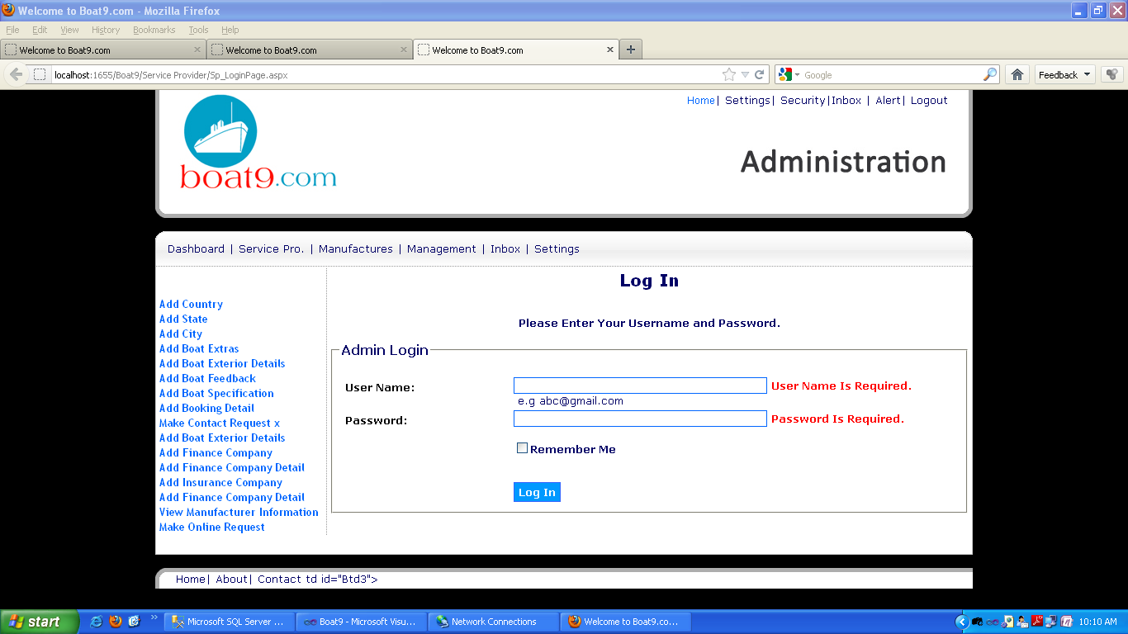
Admin Login

Slide 42
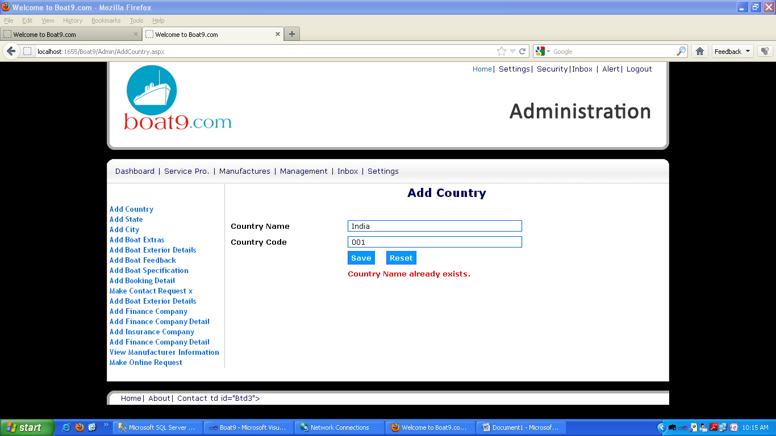
Add Country(Validation)
c

Slide 43
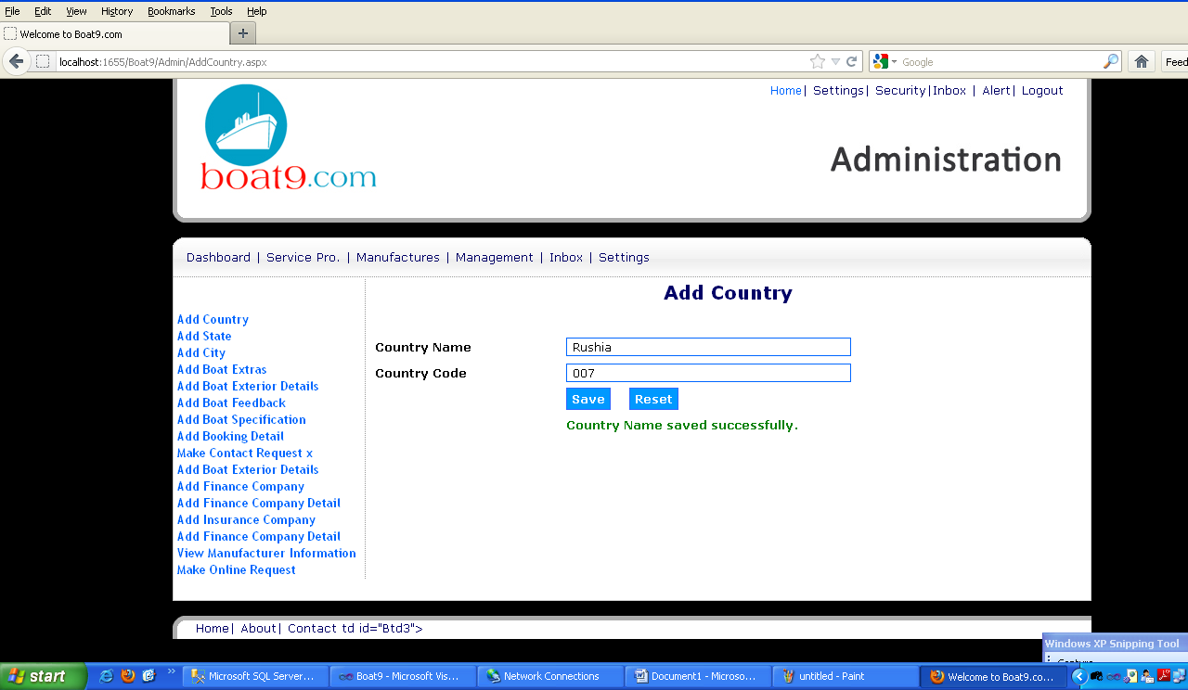
Add Country

Slide 44
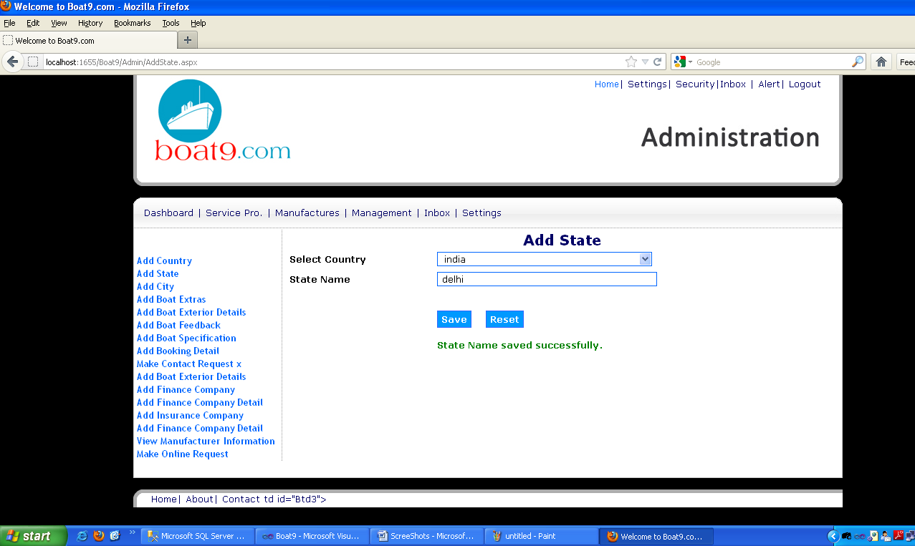
Add State

Slide 45
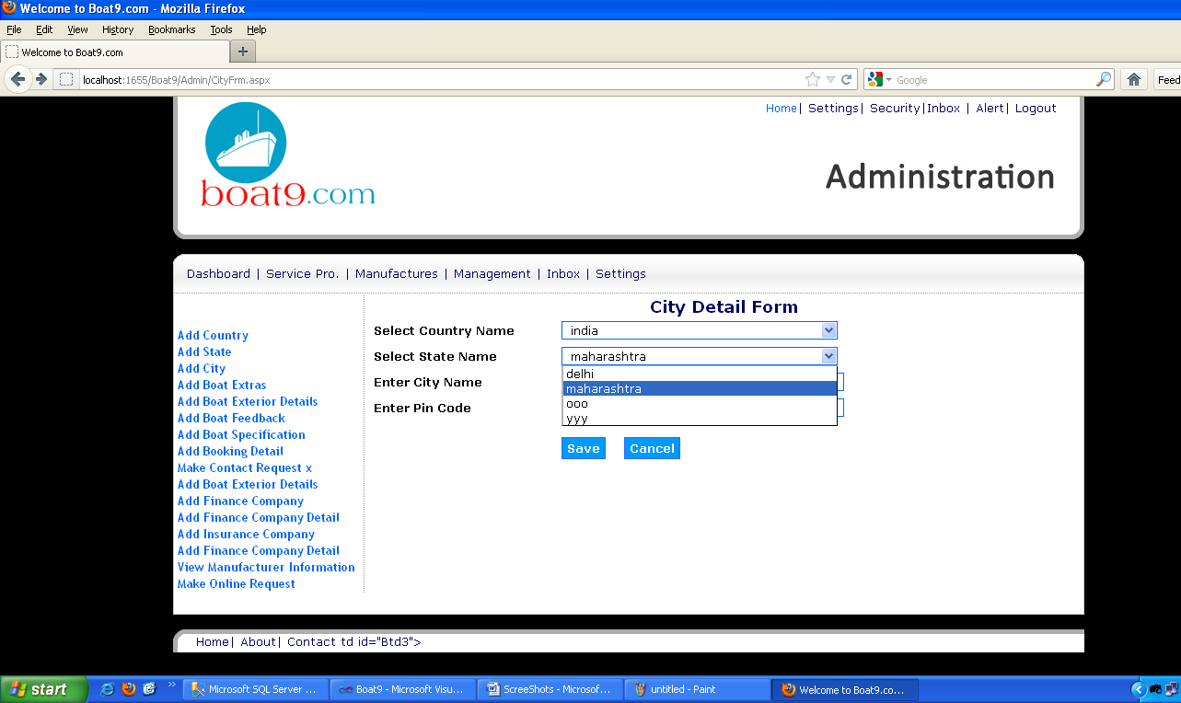
City Detail Form

Slide 46
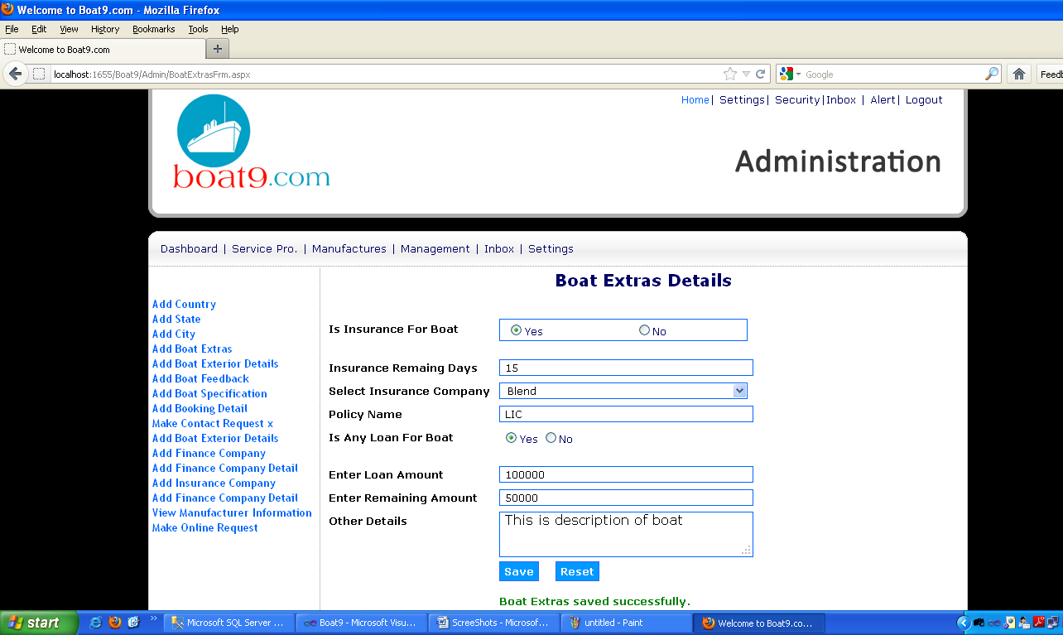
Boat Extras Details

Slide 47
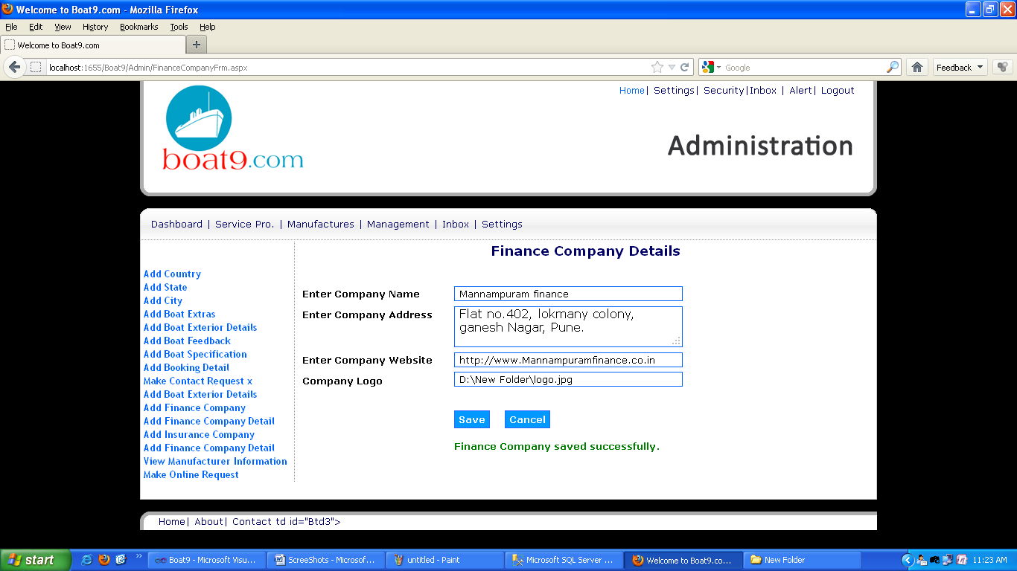
Finance Company Details

Slide 48
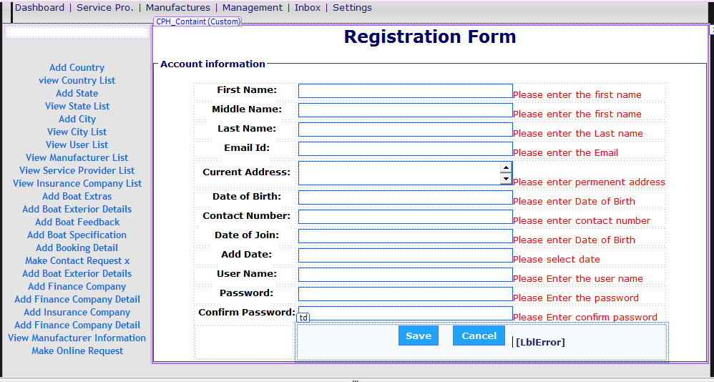
Registration Form

Slide 49
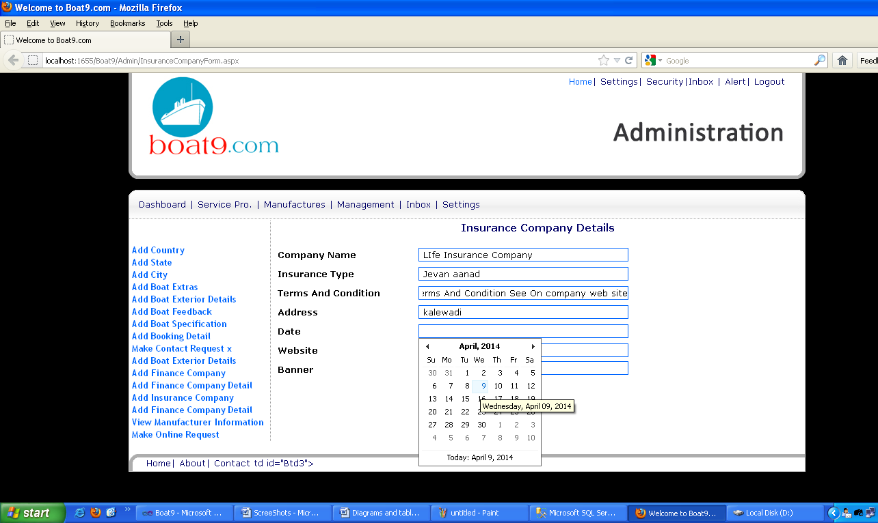
Insurance Company Details

Slide 50
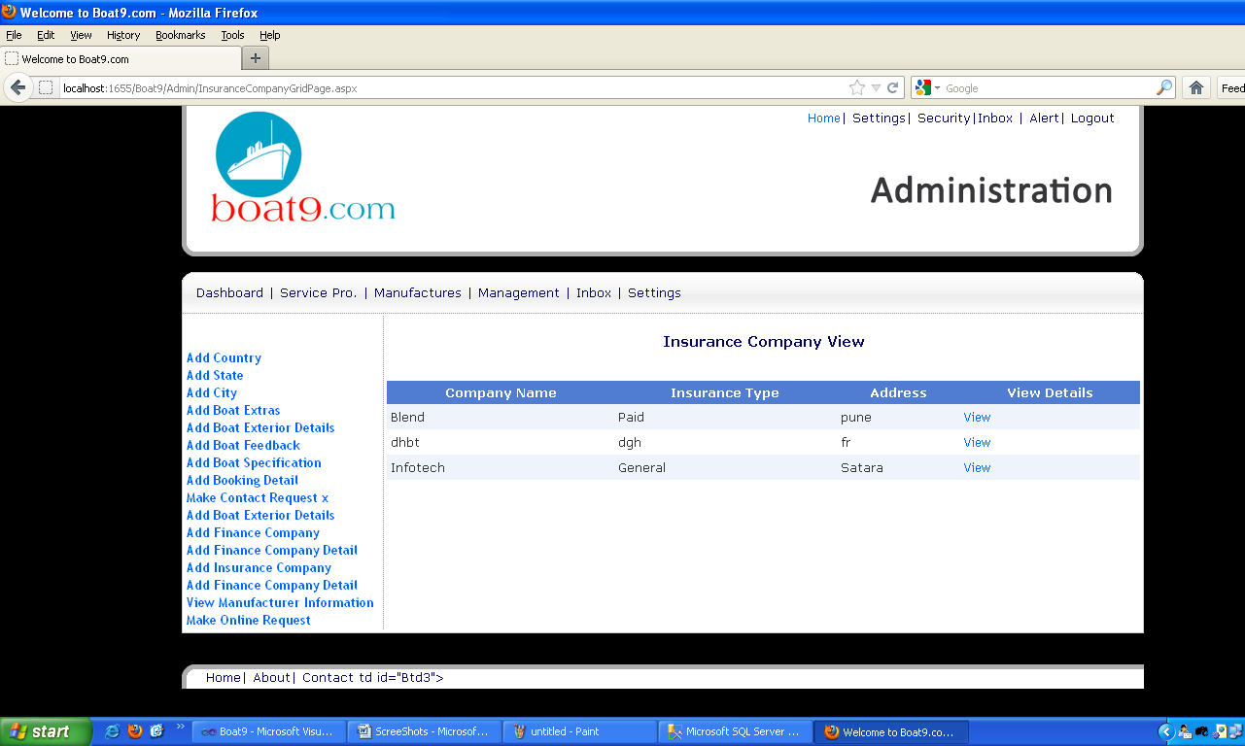
Insurance Company View

Slide 51
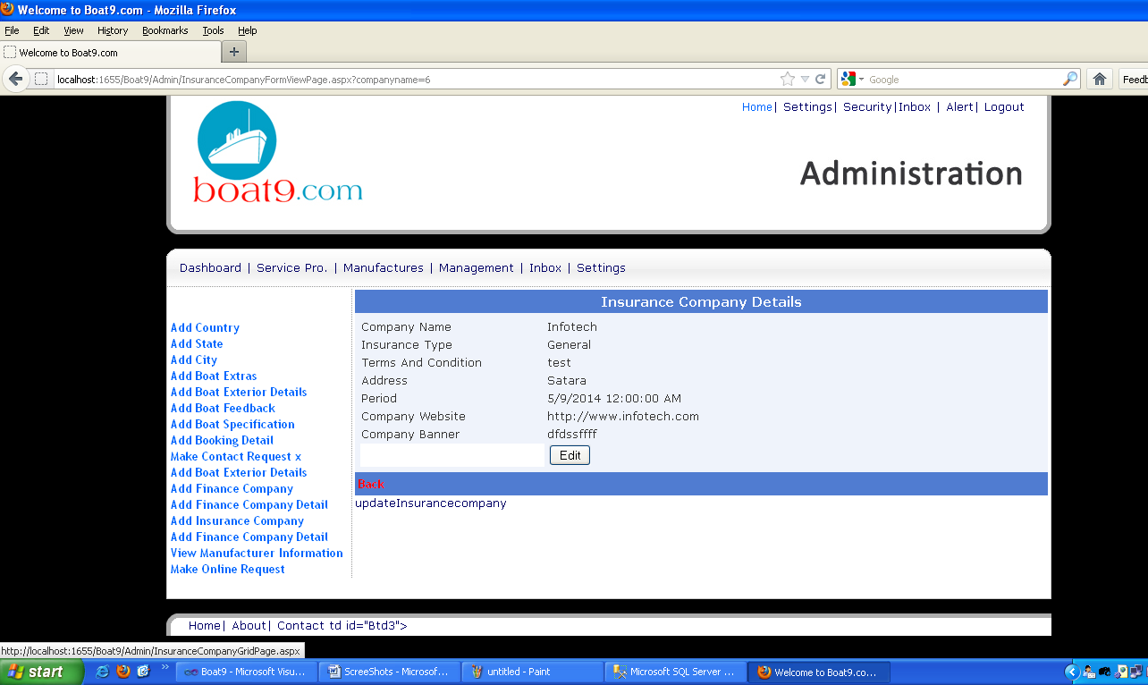
Insurance Company Details

Slide 52
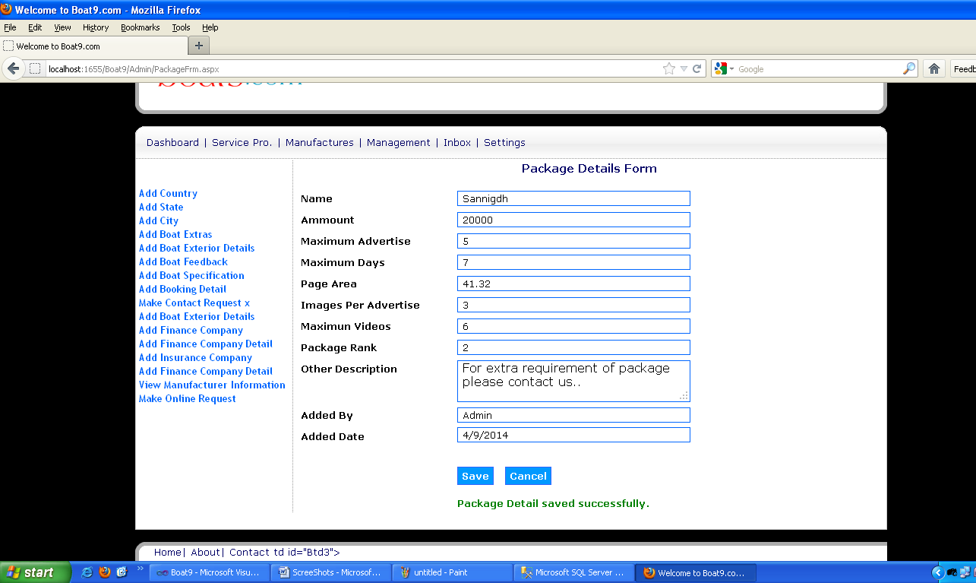
Package Details From

Slide 53
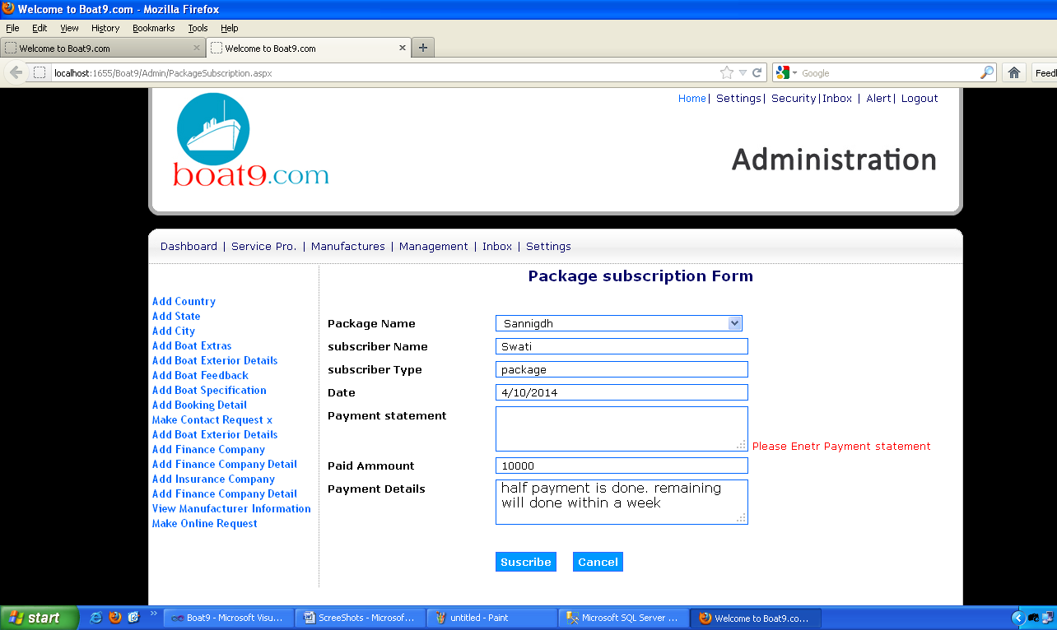
Package subscription From

Slide 54
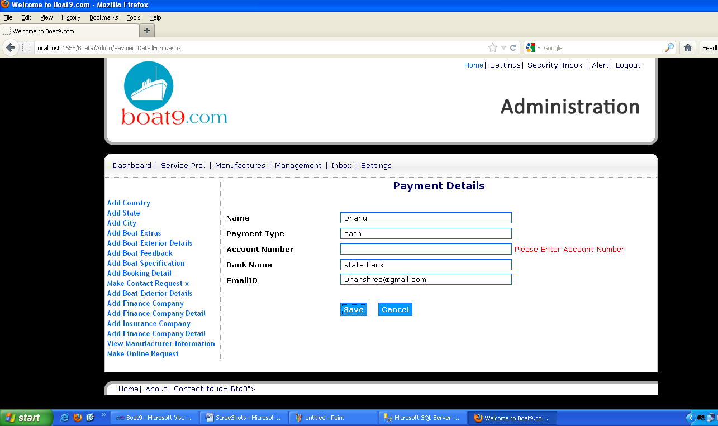
Payment Details

Slide 55
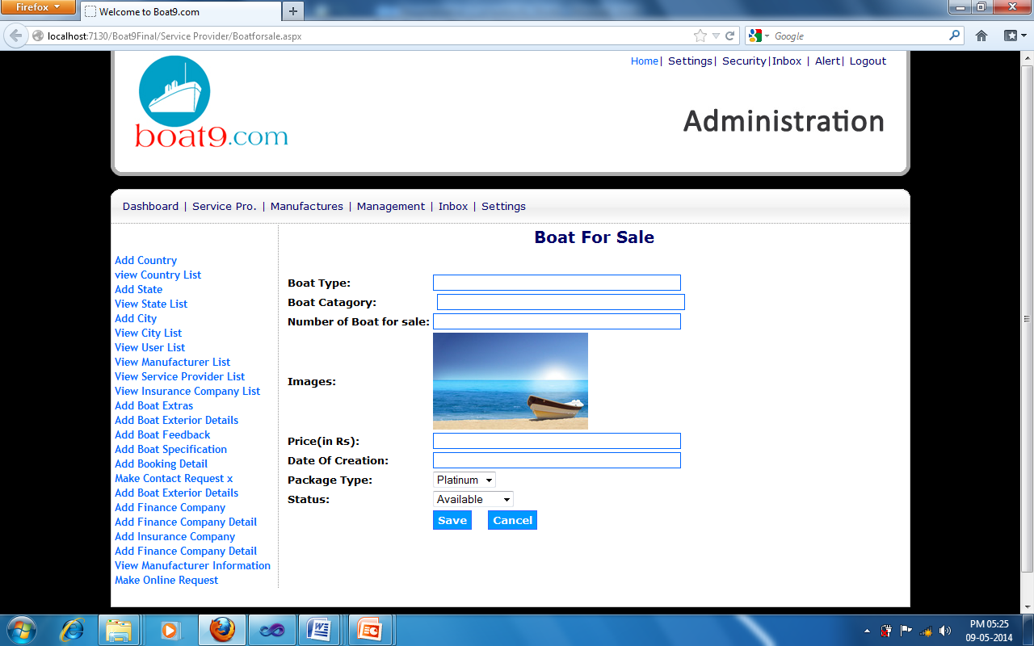
Boat For Sale

Slide 56
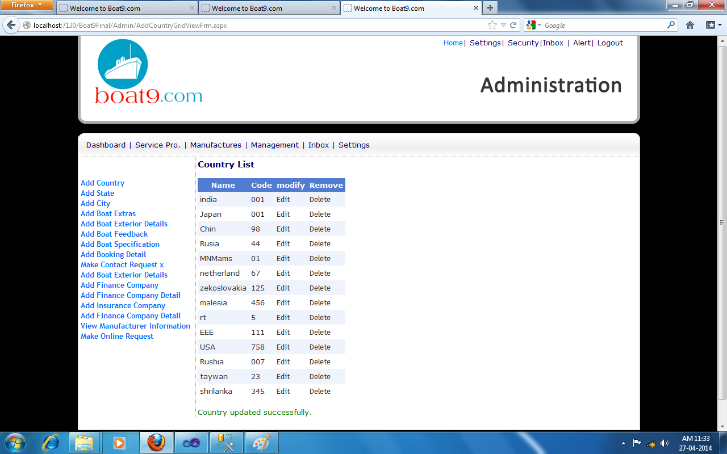
Country List View

Slide 57
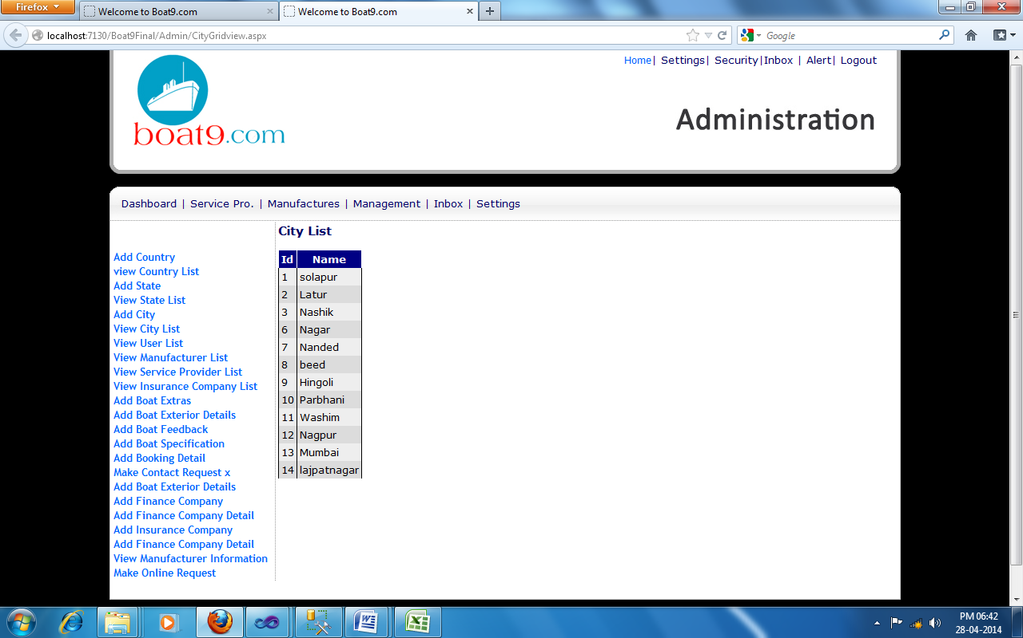
City List View

Slide 58
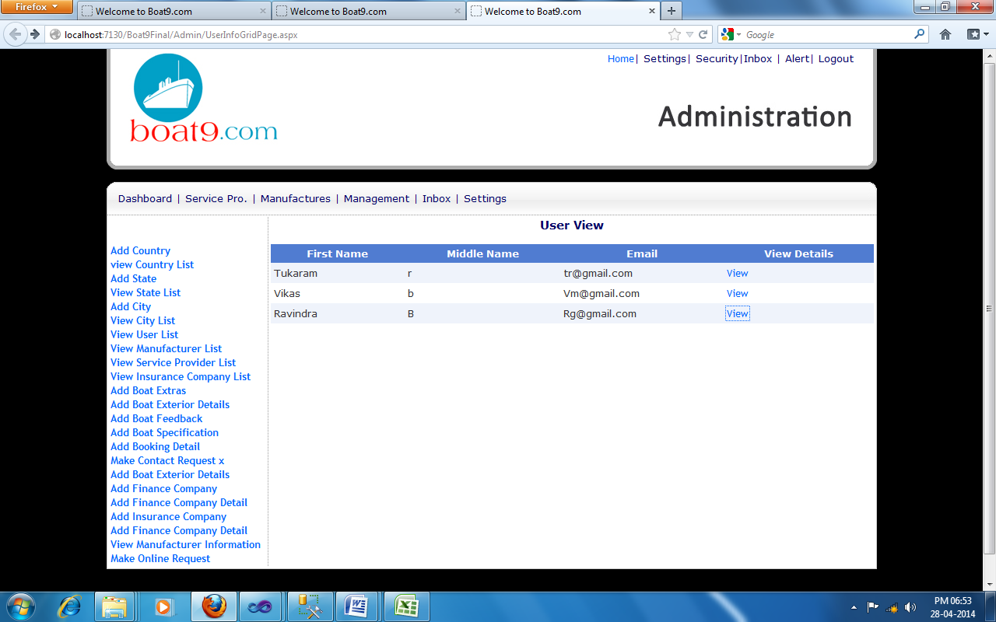
User List View

Slide 59
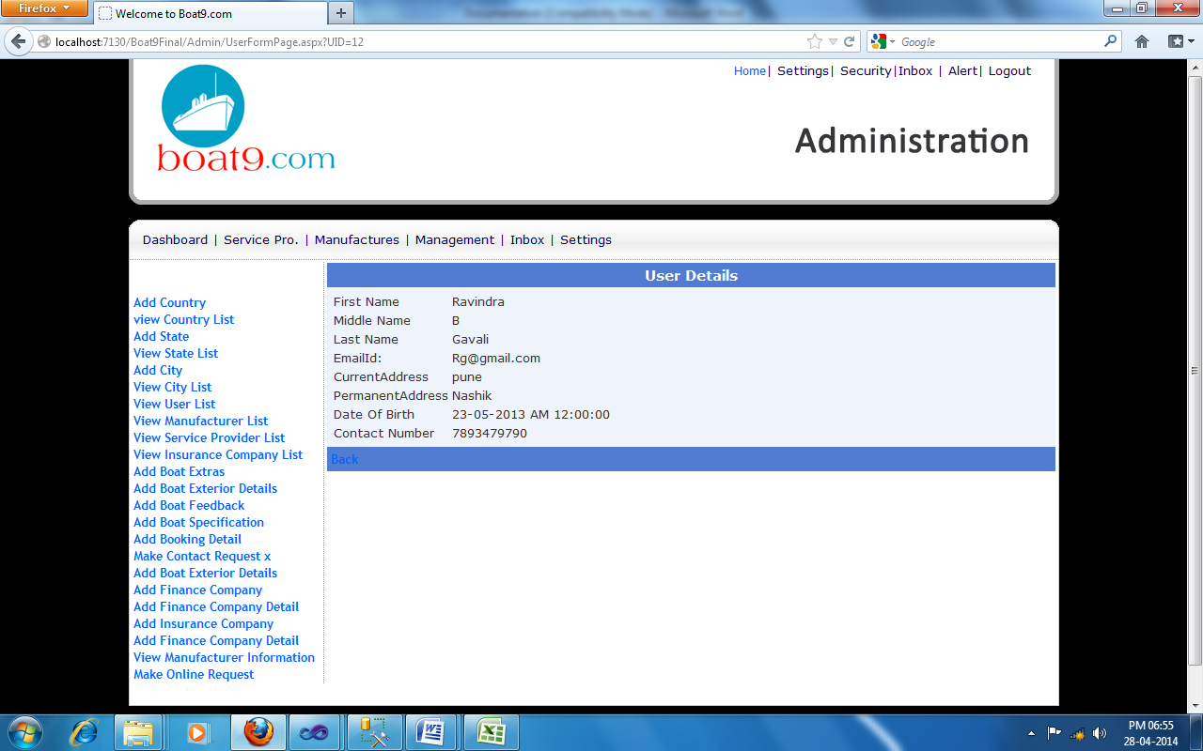
User Detail View

Slide 60
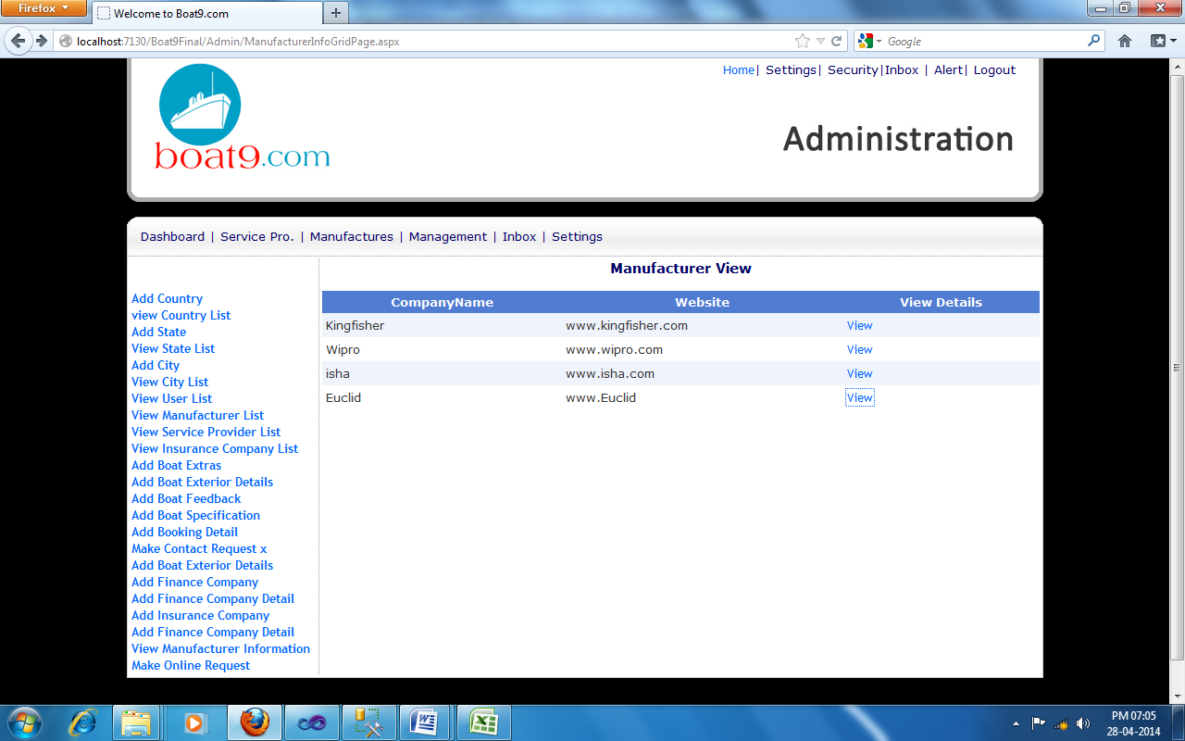
Manufacturer List View

Slide 61
Drawbacks and Limitations
This system will be used online only. Network connectivity is required.
Only computer literate person can use this site.
For online paid participation net baking or credit card or debit card is required.
Browsers There are different types of browsers. The two biggest are Microsoft Internet Explorer and Mozilla Firefox. They are different and display the pages slightly differently. As a webmaster I have both installed on my system to compare the results but older versions do not recognize some of the latest HTML commands and therefore will not display properly.
There are also many other browsers (the web interface) so just be aware that not everyone has the latest version of Explorer or Mozilla Firefox.

Slide 62
Future Enhancement
Reusability is possible when we require this application.
We can update its next version.
In future enhancement we can make android application by reusing this application.
SMS facility can provided to the supplier and customer about payment details.
Based on the future security issues, security can be improved using emerging technologies.

Slide 63
Conclusion
The website “Boat9.com” is useful for many users but also has some limitations. We are going to take the purchase detail of boats which customer required. It can give details about various modules. The system successfully handles the database concepts. We can view the details for customer records.
The system is online and work on client-server application. The system is platform independent, so it can work in any environment. Some menus in the system are not covered yet So the conclusion is the system is useful but not the perfect one. Finally I can conclude that the system I have developed will eliminate the existing system drawbacks and limitations to maximum extent and provide the user with a product with a high quality, standard, and excellence.
1) From our proposed system it can be seen that it will be possible to meet our objective for the system.
2) System developed by us is efficient to handle most of tedious task with good accuracy and fast processing.
3) System can keep the registration records.

Slide 64
Bibliography
1)ASP. Net 4.0 framework black book
2HTML, DHTML, JavaScript
1 | ASP.NET4.0 with C# .NET 2010 | Matthew MacDonald | APress
2 | Complete Reference C# 4.0 | Schildt | McGraw Hill
3 | Asp.Net 4.0 AJAX | Bill Evjen | Wrox
4 | SQL Server 2008 | Dusan Petkovic | Apress

Slide 65
References
www.w3schools.com/asp
2) www.w3schools.com/javascript
3) www.w3schools.com/jquery
4) www.w3schools.com/sql
5) www.w3schools.com/css
6) www.codeguru.com

