Slide 1



WORKSHOP
The 100x Enterprise Software Development Age
Applied AI Software Development Masterclass
SPEAKER
Sandeep Singh
Expert Senior Director · Bain & Company
August 05–08, 2026 · The Leela Bhartiya City, Bengaluru
Human × AI

Slide 2

00
THE THESIS
From writing code to directing agents.
Not faster typing — a shift in who can build, how much of the lifecycle one person owns, and how fast each step runs. The data now backs it.
August 05–08, 2026 · The Leela Bhartiya City, Bengaluru
Human × AI

Slide 3



Already the default — not the frontier
90%
of the Fortune 100 use GitHub Copilot
8 / 10
Fortune 10 firms are Claude customers
51%
of developers now use AI tools every day
D A T A H A C K S U M M I T 2 0 2 6

Slide 4
The gains are measured, not hyped
Controlled studies and enterprise RCTs — not vendor slideware.
75% shorter PR cycle time 9.6 days to 2.4 days in a controlled enterprise study (Accenture RCT).
2 wks
3.6 hours saved per developer, weekly Daily users save 4.1 hours and open 60% more pull requests (DX, 2025).
a 4–8 month project, delivered (Augment Code)
500,000 hours saved at TELUS About 40 minutes back on every AI interaction, across the whole org.
55%
7 hours of autonomous work Claude Code completed a complex implementation end-to-end at Rakuten.
faster task completion, controlled study (GitHub, n=95)
D A T A H A C K S U M M I T 2 0 2 6

Slide 5





Why it compounds to 100x
01
02
03
=
WHO can build
LIFECYCLE owned
SPEED per step
100x
Barrier to near-zero — PMs, QA, architects now ship.
One person: PRD → design → build → docs → deploy.
Agentic loops and specs turn days into minutes.
Three multipliers, compounding — that’s the math.
Multiply, don’t add — each factor amplifies the others.
D A T A H A C K S U M M I T 2 0 2 6

Slide 6
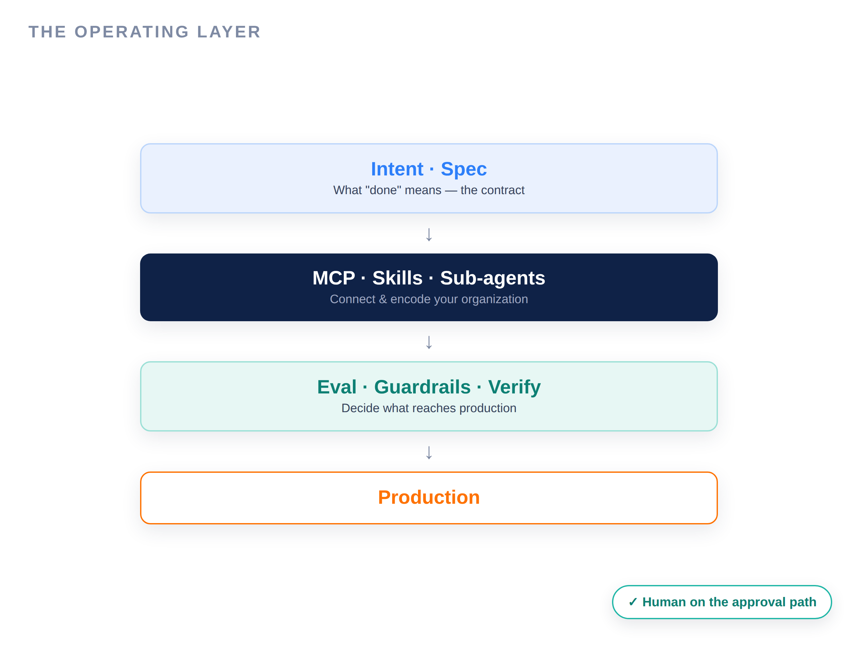

The catch — and why it is the whole point
The model is a commodity. The leverage is the operating layer.
45% of AI-generated code carries a vulnerability. Developer trust has fallen to 29%. Only 0–20% of tasks are safely auto-delegated today.
Structured specs turn ambiguity into a contract
MCP, Skills & Sub-Agents wire in your org
Verification and guardrails gate what ships
Humans stay on the approval path
D A T A H A C K S U M M I T 2 0 2 6

Slide 7
“
The model was never the product. The operating layer around it is.
That operating layer is what the next seven hours teach.
August 05–08, 2026 · The Leela Bhartiya City, Bengaluru
Human ×AI

Slide 8
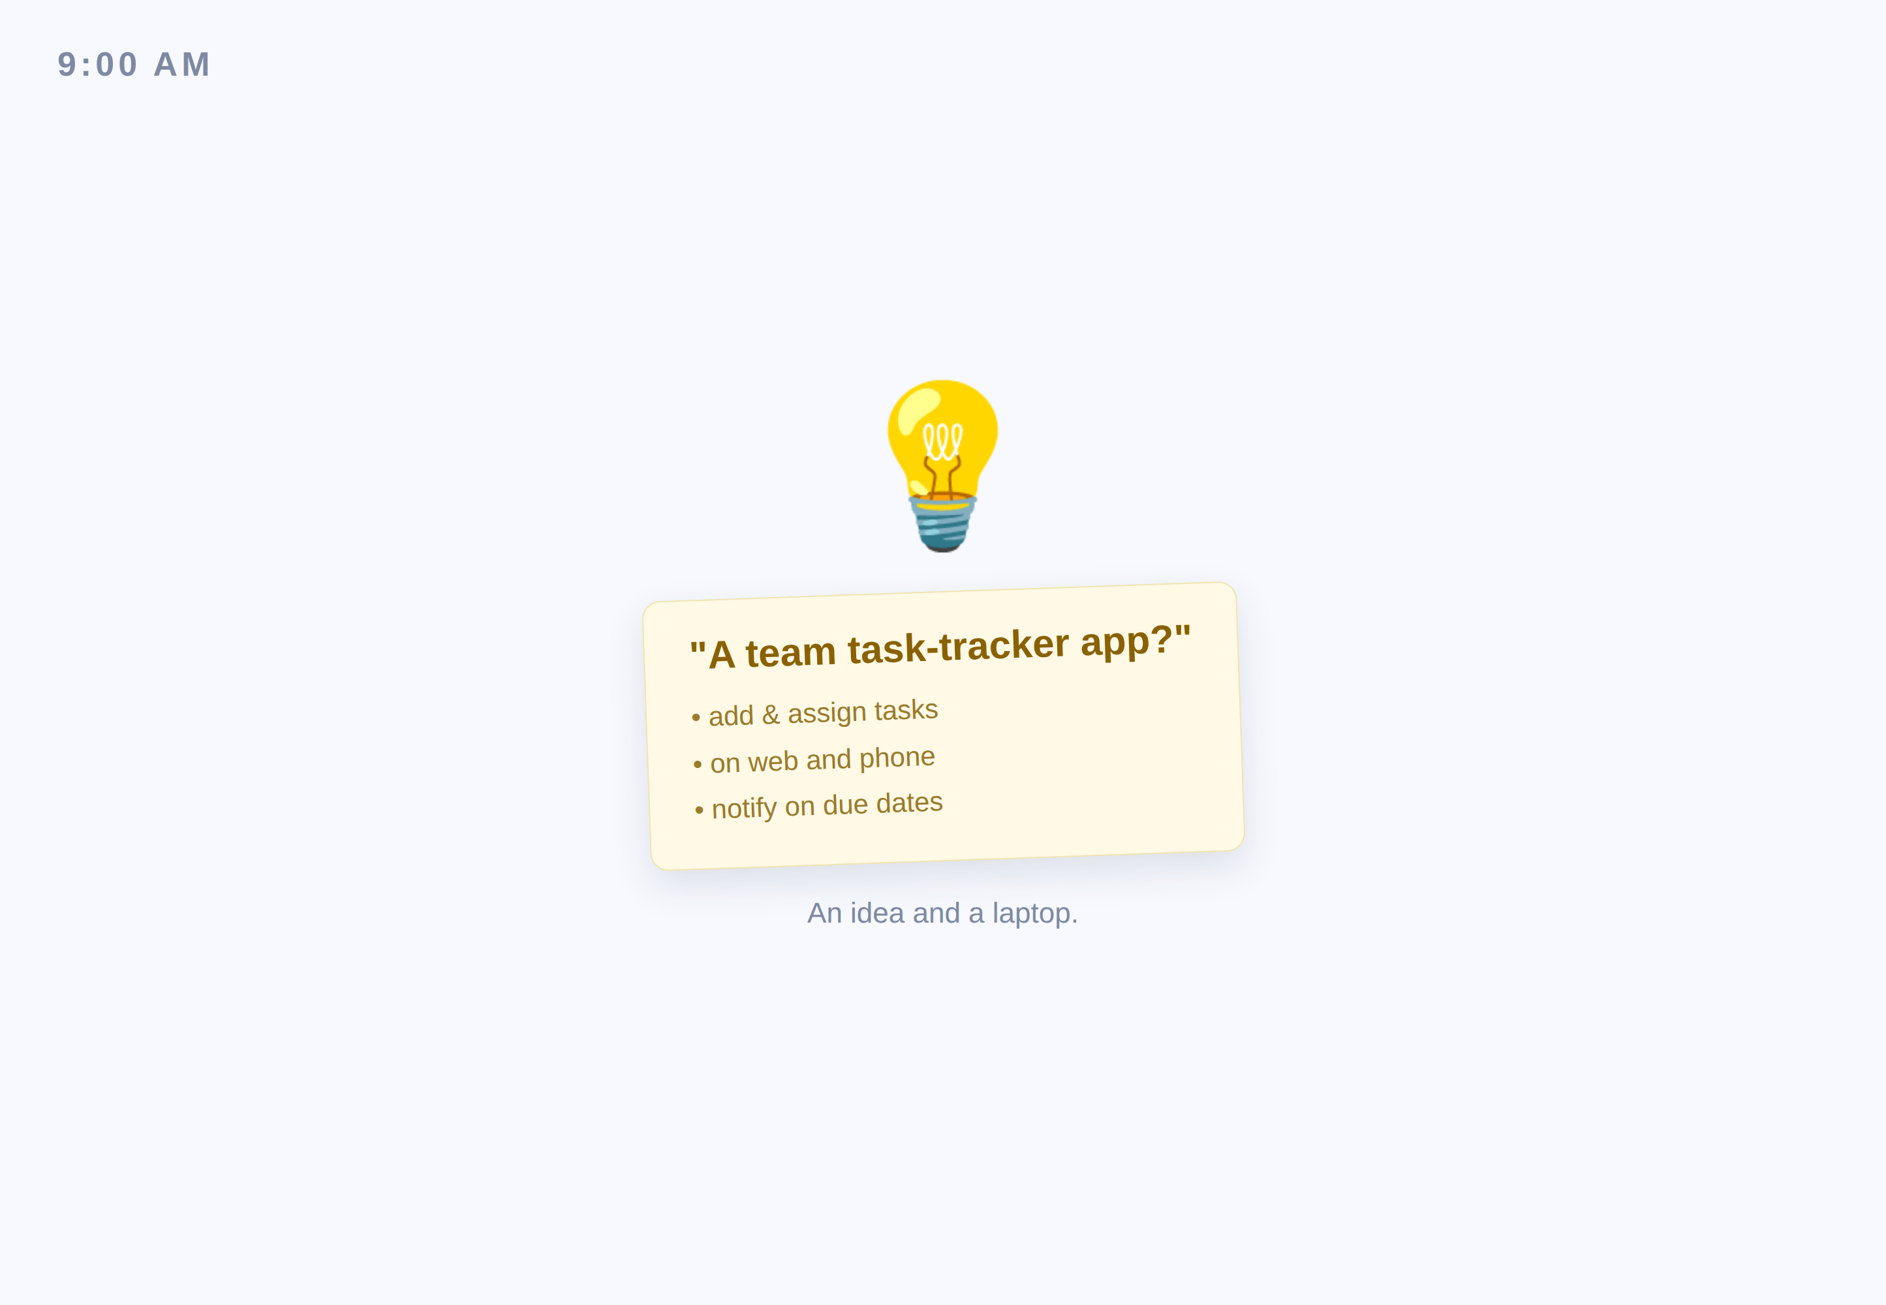
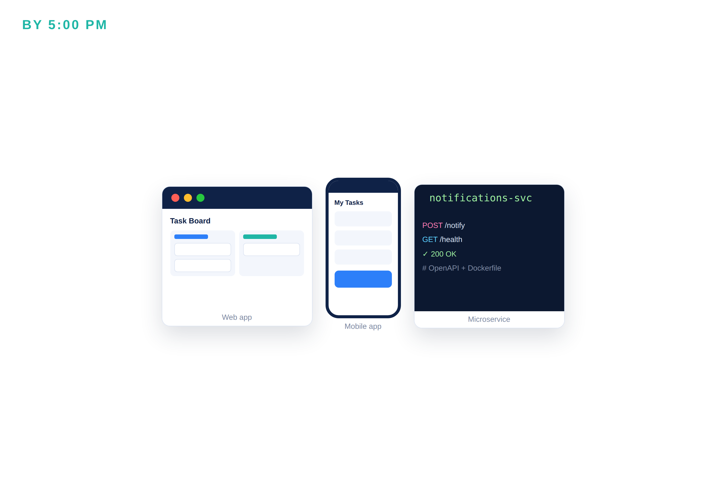
What you walk out with
→
You arrive with an idea and a laptop.
3 apps · full doc suite · live CI/CD pipeline
D A T A H A C K S U M M I T 2 0 2 6

Slide 9
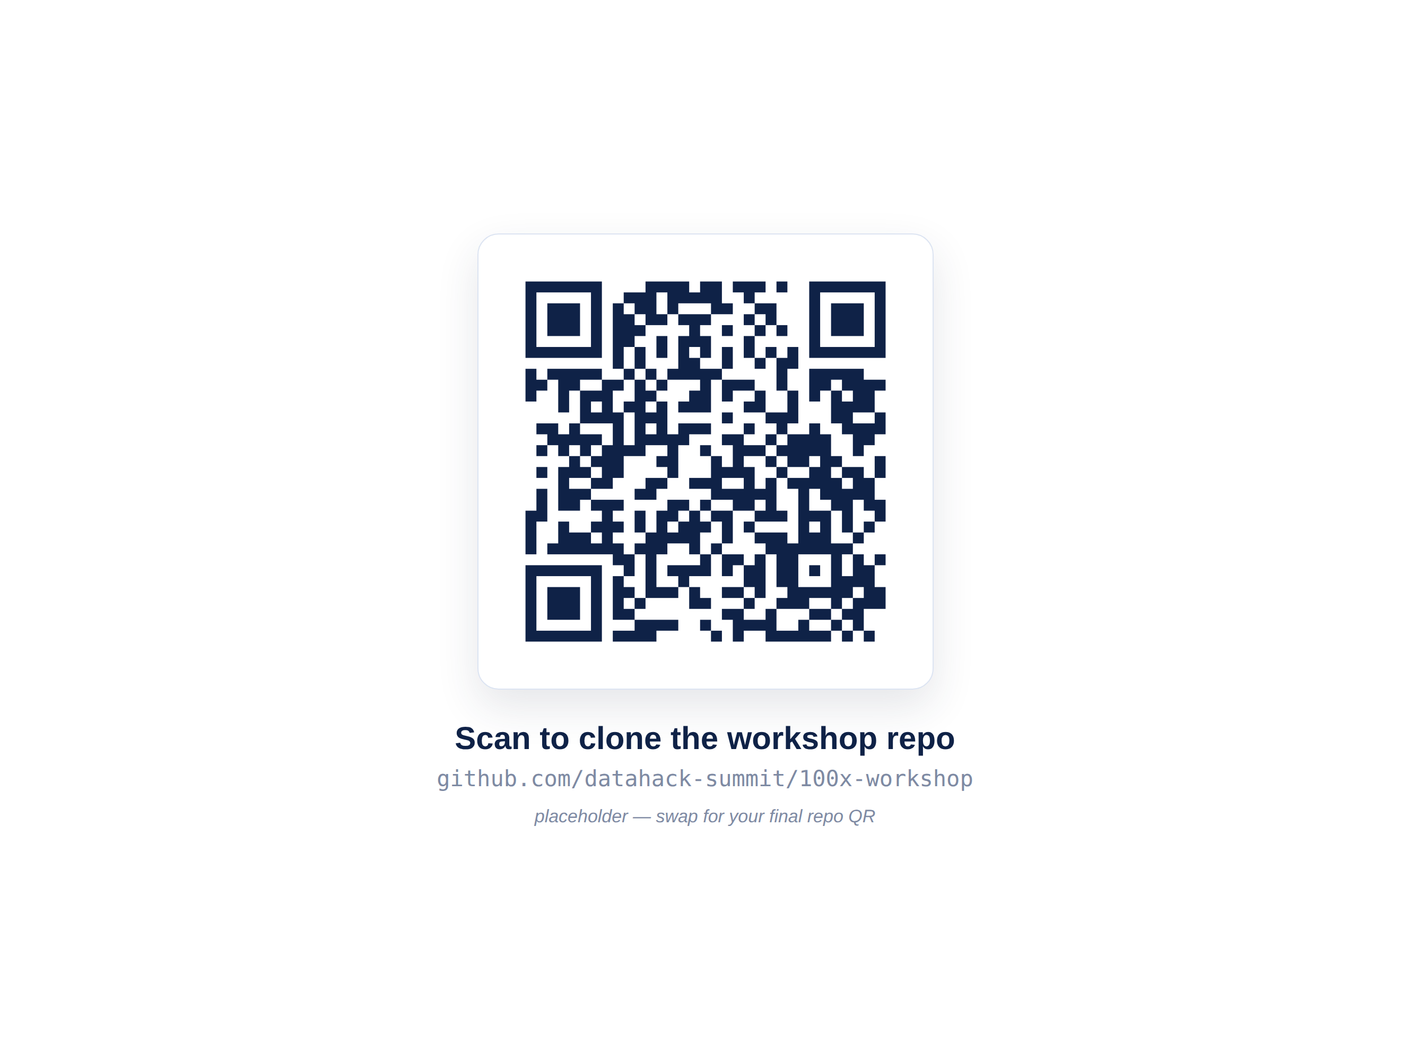
ENVIRONMENT CHECK
Two checks, then the repo
Verify each item — TAs are circulating to help
Claude Code — logged in with your Pro account
Node 18+ · Git · VS Code installed
GitHub + free Cursor / Replit / V0 / Gemini logins
Smoke test: run a one-line prompt in Claude Code
Your files: Pre-Flight_Environment_Guide.md · Environment_Checklist_Card.md
D A T A H A C K S U M M I T 2 0 2 6

Slide 10
Welcome — your files & the flow
File | What it is | When you use it
Pre-Flight_Environment_Guide.md | Full setup guide — macOS + Windows | ① The day before — install everything
Environment_Checklist_Card.md | One-page quick checklist | ② Workshop morning — verify + smoke test
D A T A H A C K S U M M I T 2 0 2 6

