Slide 1


M1
MODULE 1 · 9:15–10:00
Foundations of AI-Native Software Development
The agentic loop, the platform landscape, the prompting patterns that carry across every tool — then build one feature four ways.
August 05–08, 2026 · The Leela Bhartiya City, Bengaluru
Human × AI

Slide 2

“
You’ve stopped writing code. You’re directing agents.
The unit of work is now intent — specified and verified, not lines typed.
August 05–08, 2026 · The Leela Bhartiya City, Bengaluru
Human ×AI

Slide 3





The agentic loop — how the work actually happens
01
02
03
04
Perceive
Plan
Act
Verify
Load the codebase, the task, and the acceptance criteria.
Break the goal into ordered, tool-bound steps.
Edit files, run commands and tests — one step at a time.
Run tests, check against the criteria — you approve.
Loop until it meets the criteria — you can intervene at any step. This is taught live in Claude Code.
D A T A H A C K S U M M I T 2 0 2 6

Slide 4
The platform landscape — where each tool fits
Six platforms, three families. Claude Code teaches every concept; the others shine in their lane.
IDE-native — the agent lives in your editor Cursor: autocomplete + agent inside a familiar VS Code. Best for hands-on-keyboard developers.
6
Terminal · agentic — the agent runs your project Claude Code, OpenAI Codex CLI, Gemini CLI. Full-repo, multi-step work; where this workshop lives.
platforms, one landscape you can navigate
Cloud · prototyping — idea to running app in a browser Replit and V0: fastest path from a prompt to something you can click and share.
3
One open standard underneath Claude Code, Cursor, Codex and Gemini all speak MCP — learn it once, use it everywhere.
families: IDE-native · terminal · cloud
D A T A H A C K S U M M I T 2 0 2 6

Slide 5
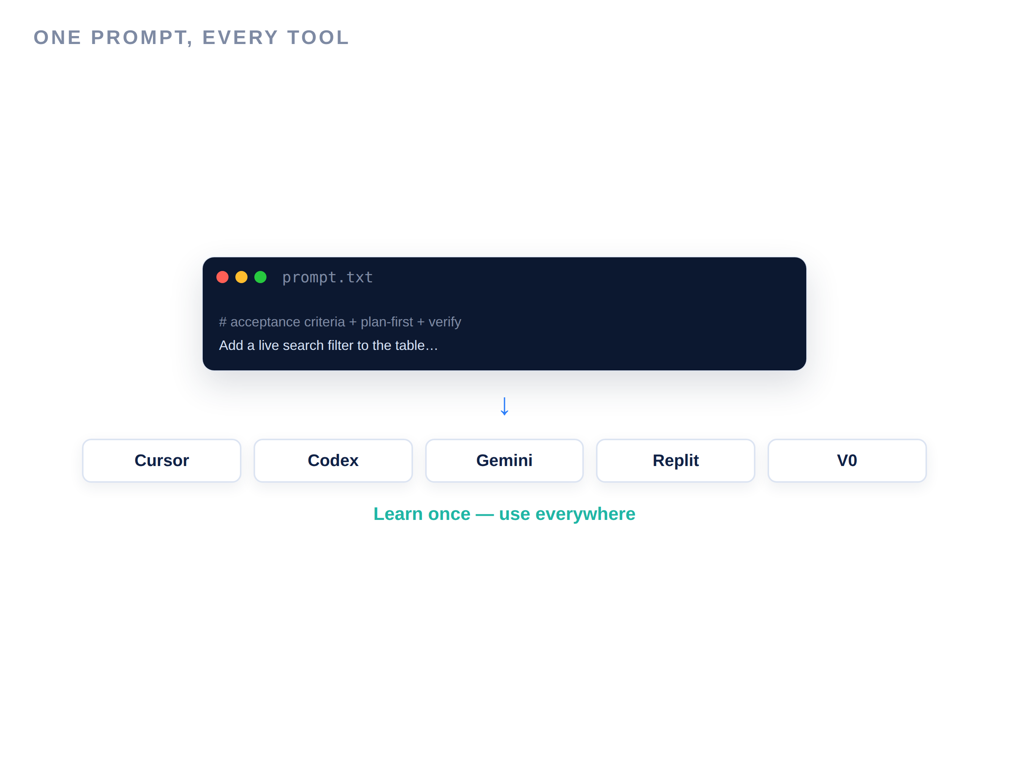

Prompting patterns that carry across every tool
Context is king: the agent knows only what you put in front of it.
The same four moves work in Cursor, Codex, Gemini, Replit and V0. Master them here, once — every tool gets better.
State explicit acceptance criteria — define what “done” means
Show an example — one sample beats a paragraph of description
Ask for a plan first, approve it, then let it build
Iterate with specific feedback — name the file, line, behavior
D A T A H A C K S U M M I T 2 0 2 6

Slide 6
Anatomy of a strong prompt
build0-prompt.txt
What makes it work
# Feature: live search filter for the table # File: index.html — one file, inline CSS, no framework Acceptance criteria: 1. Labeled search box above the table 2. Filter rows as I type: Name OR Department 3. Live "Showing X of Y" count 4. Friendly empty state when nothing matches 5. One file, no libraries, keep the style First outline your plan. Then implement. Then tell me how to verify each criterion.
Role + context: file, stack, limits
Acceptance criteria: a testable contract
Plan-first: approve before it builds
Self-verify: it checks each criterion
D A T A H A C K S U M M I T 2 0 2 6

Slide 7
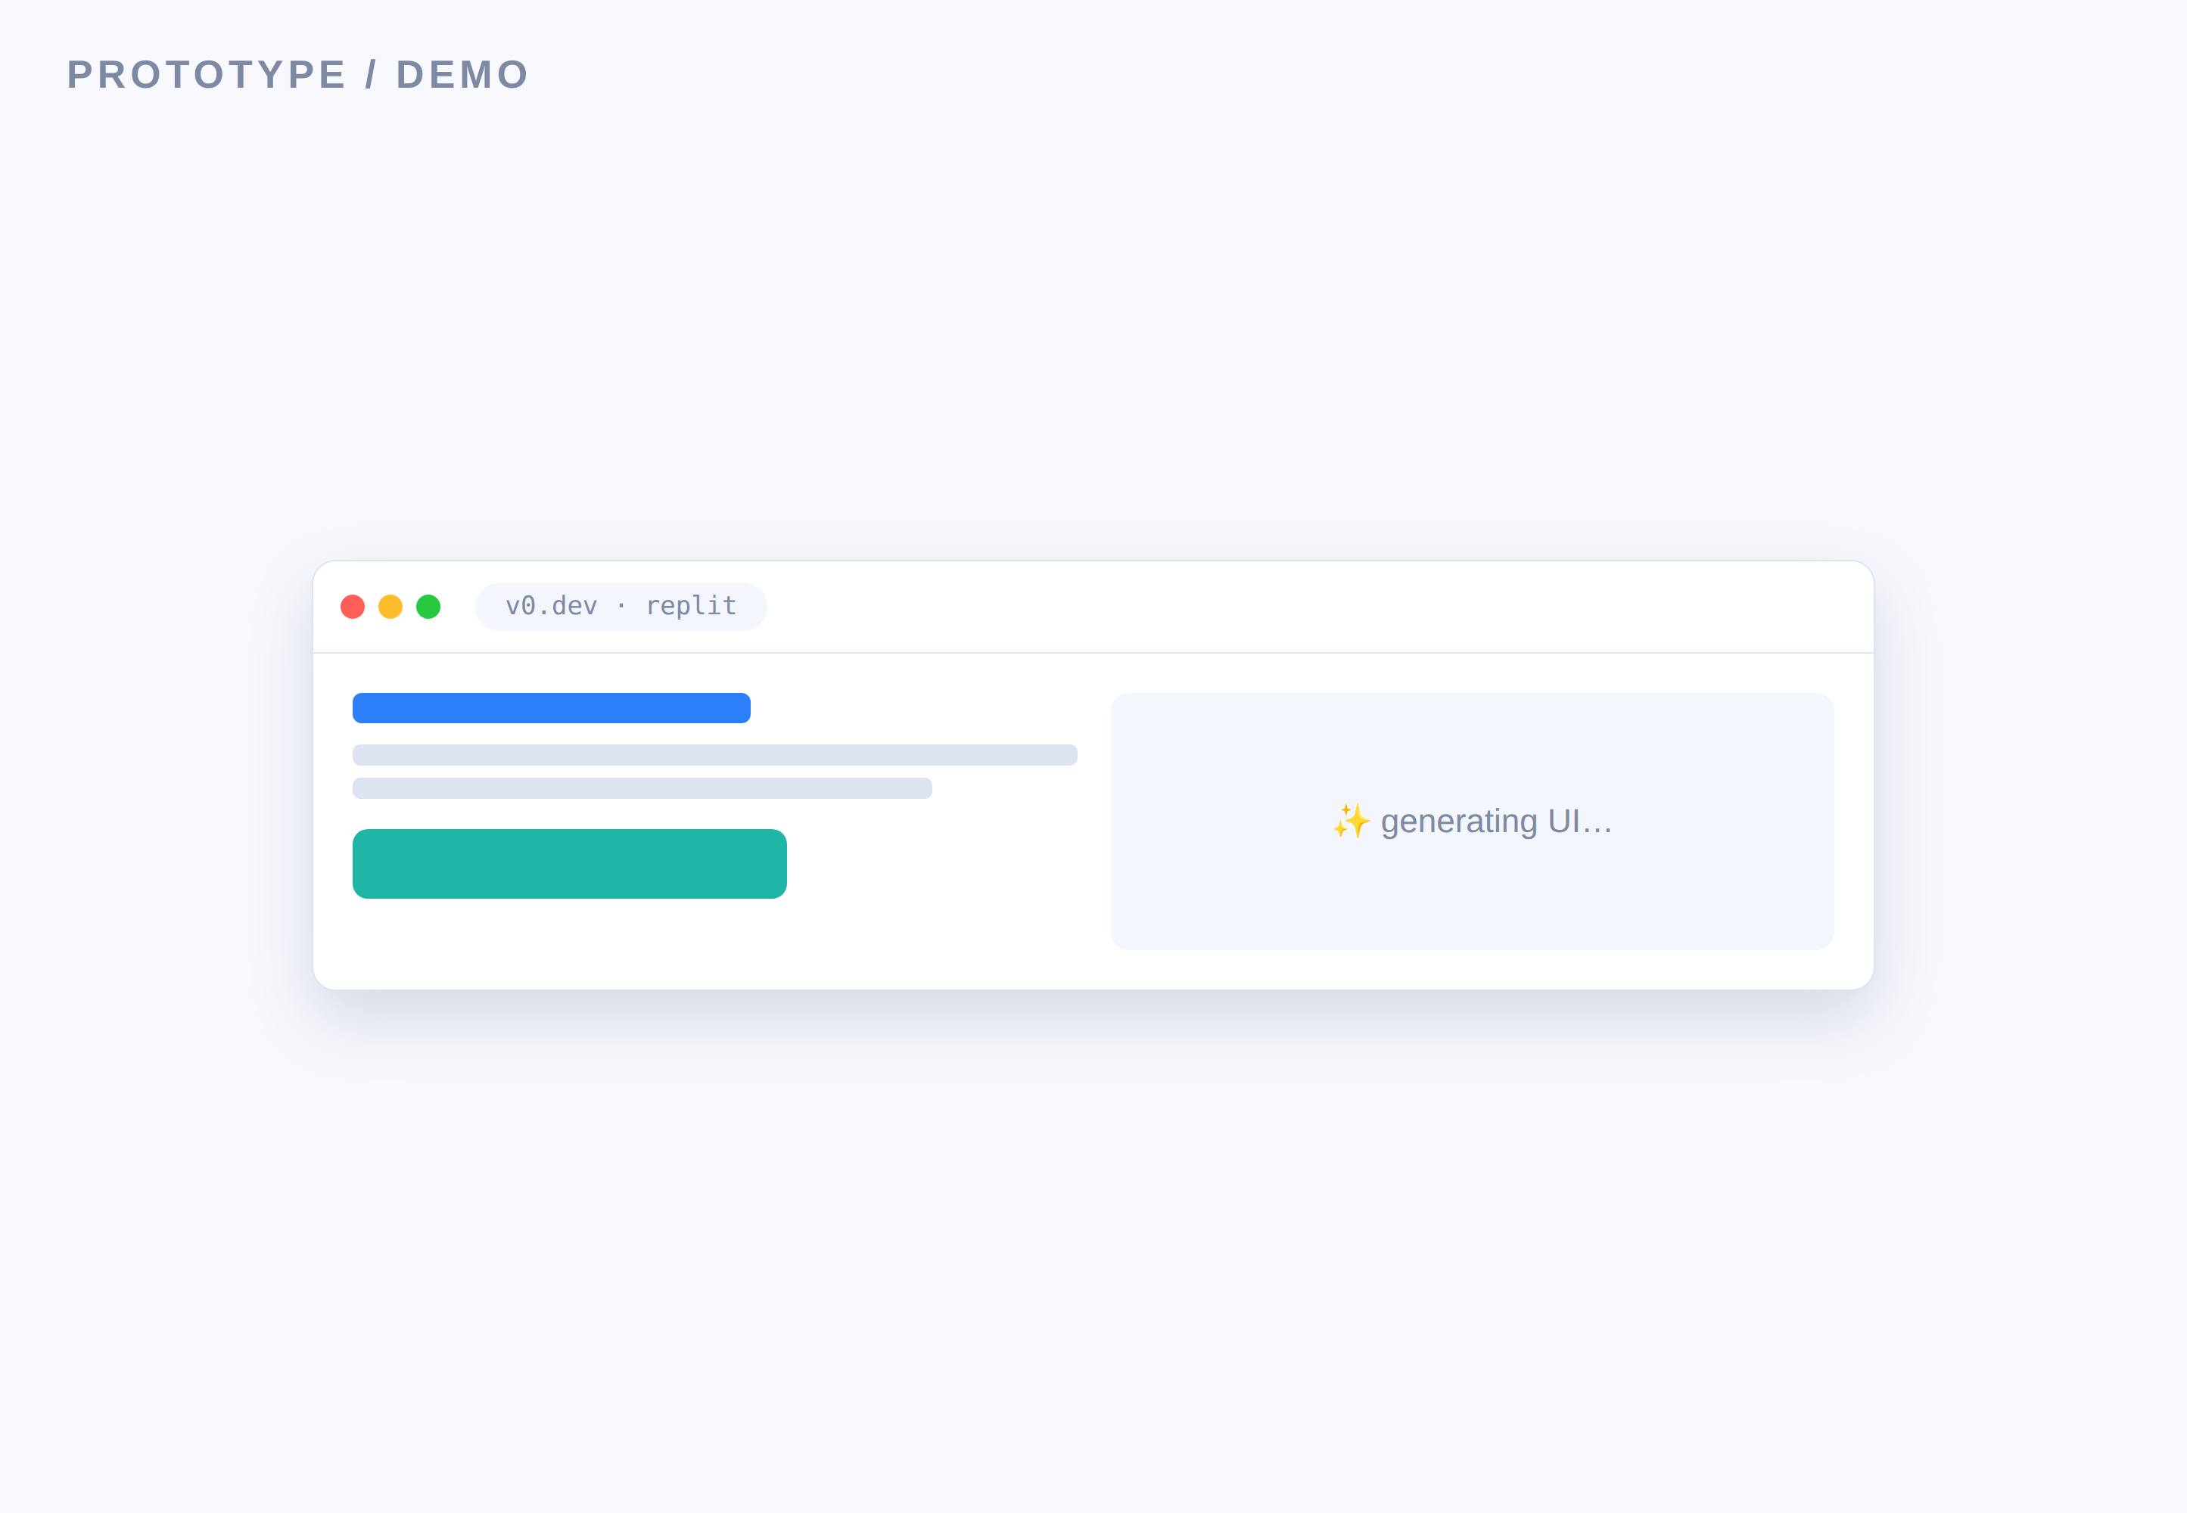
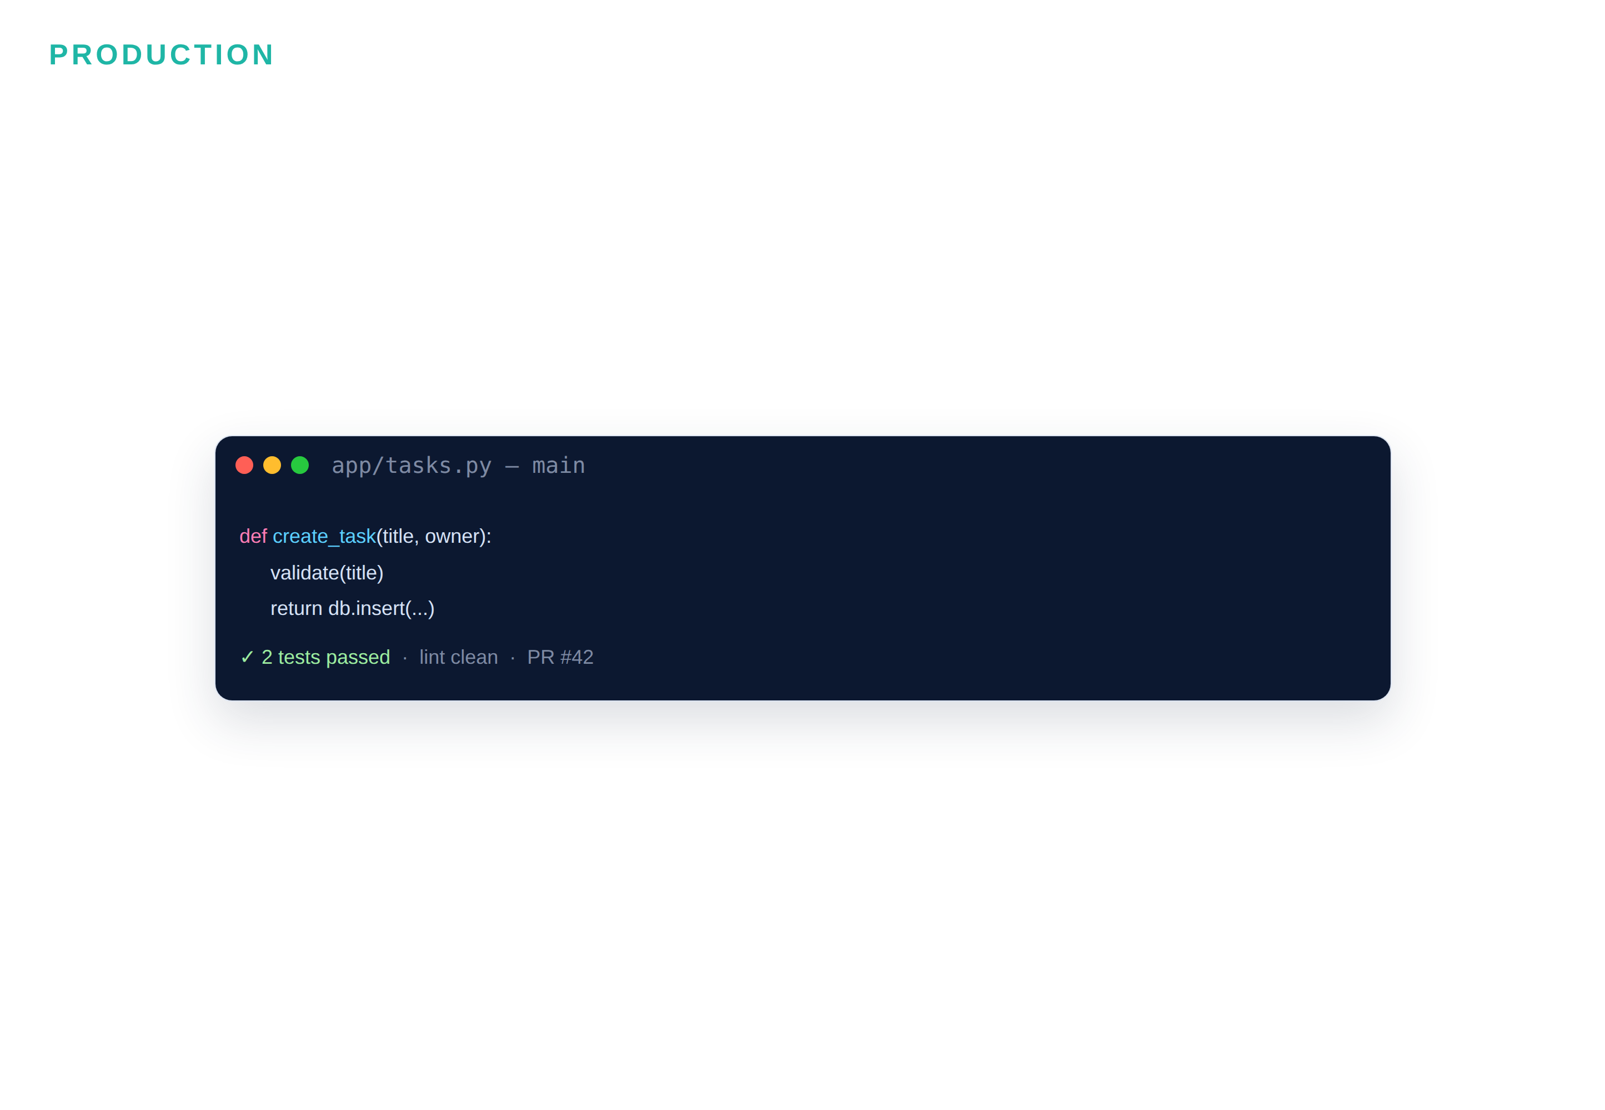

Which tool for which job — the fast call
VS
V0 · Replit · Cursor — speed, UI-first, solo, throwaway-ok
Claude Code · Cursor — real repo, tests, team, regulated
D A T A H A C K S U M M I T 2 0 2 6

Slide 8
Module 1 — your files & the flow
File | What it is | When you use it
Build0_Lab_Guide.md | Step-by-step Build #0 | ① Follow during the lab
lab-kit/index.html | The starter page | ② Open this in Claude Code
Prompt_Pattern_Cards.md | The five prompting patterns | Keep open while prompting
Tool_Decision_Matrix.md | Which tool for which job | Take-home reference
D A T A H A C K S U M M I T 2 0 2 6

Slide 9
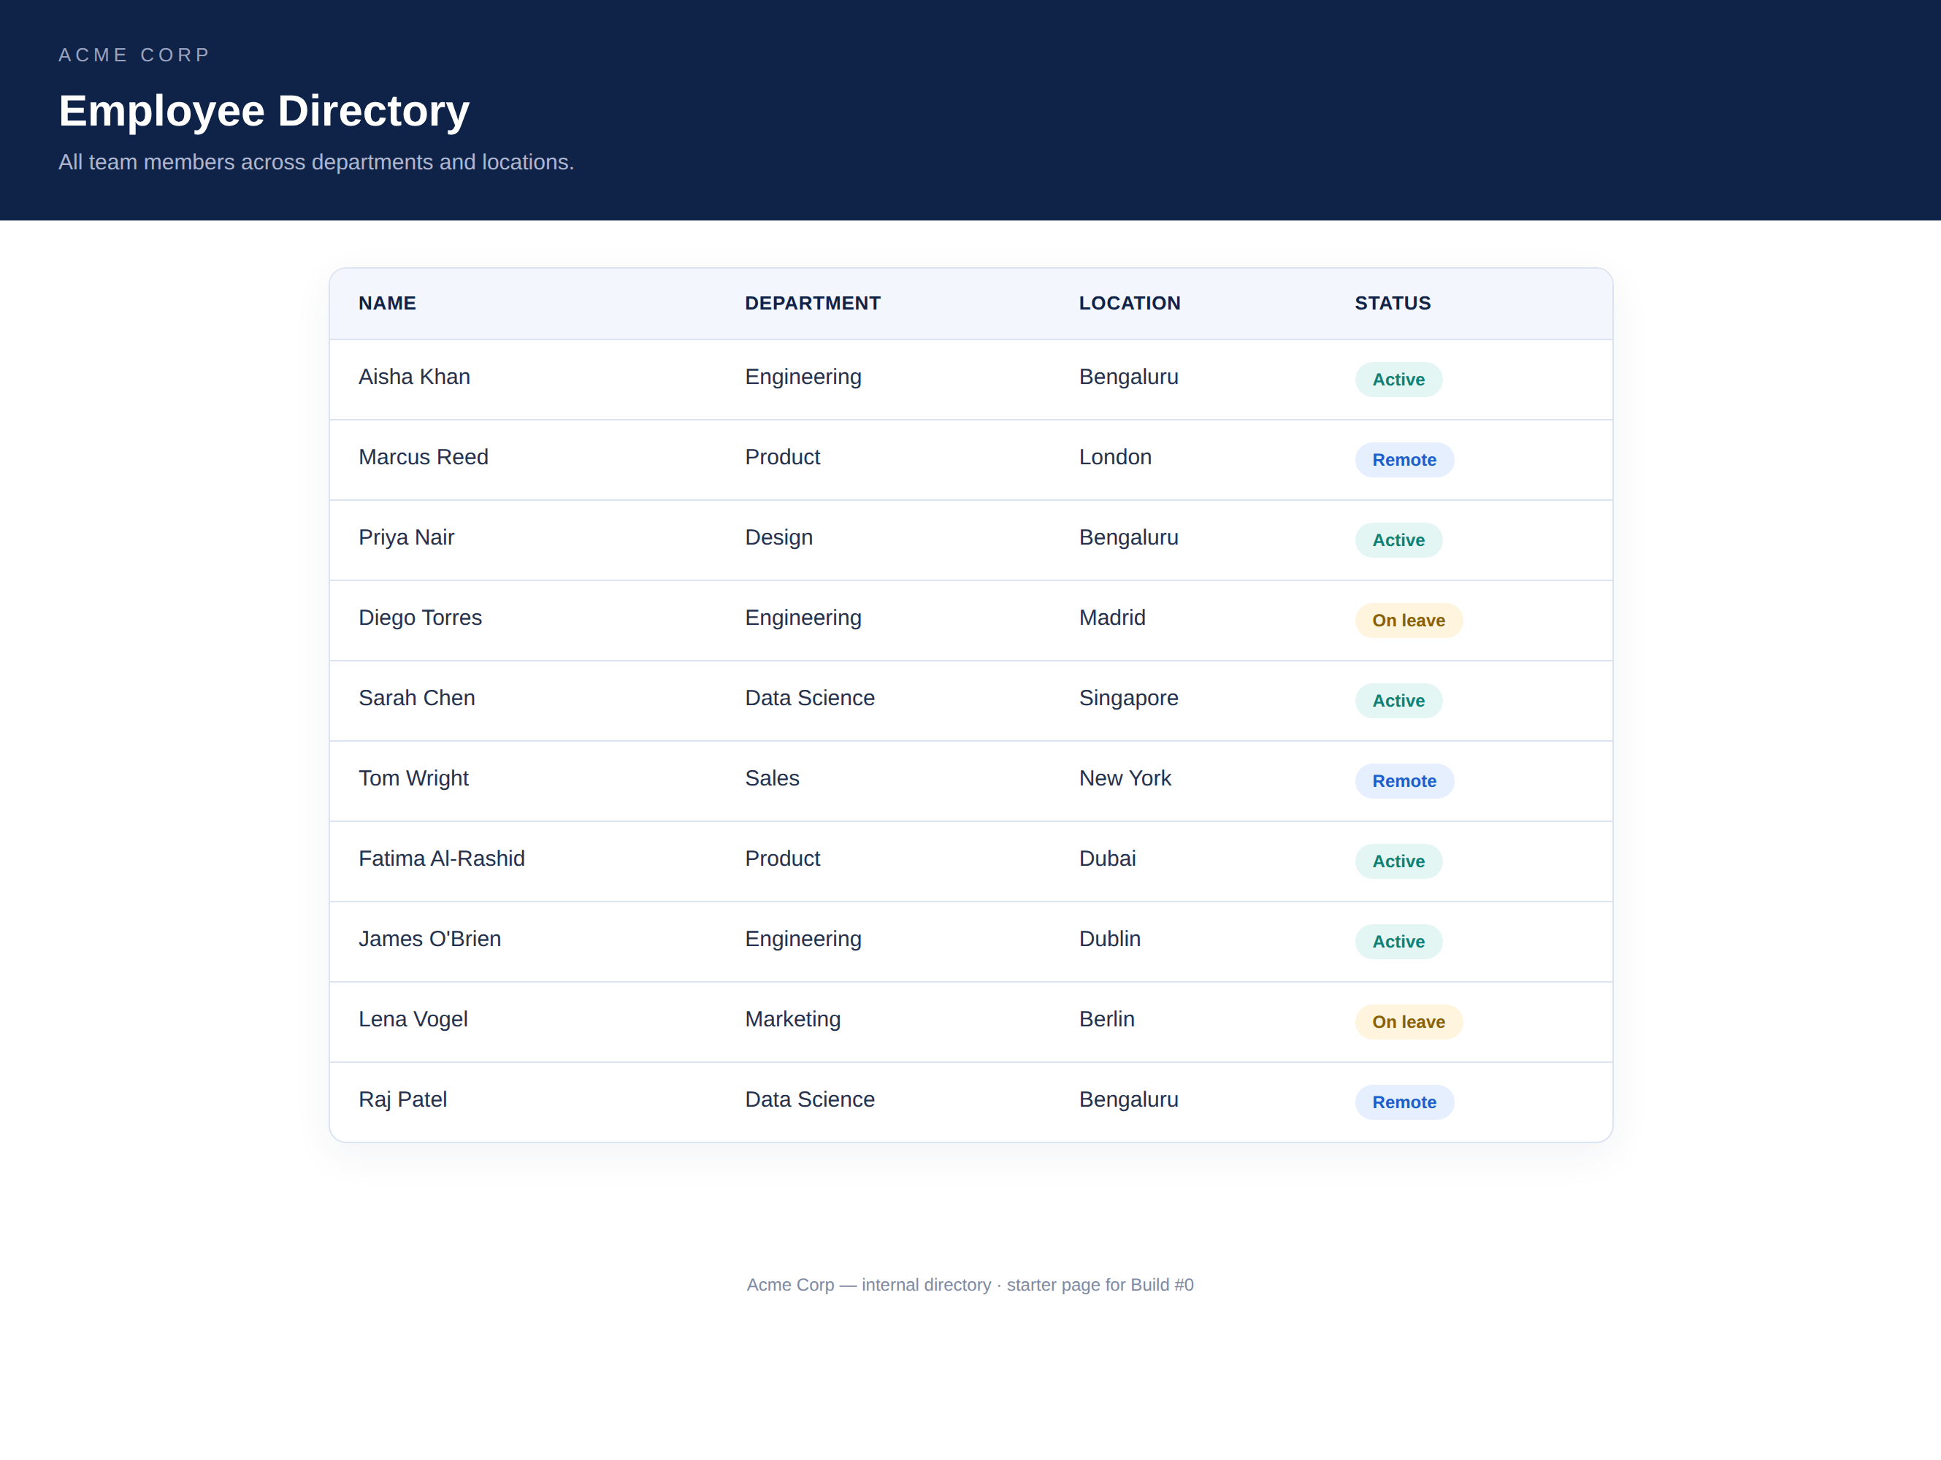
BUILD #0 — first feature, four ways
Your task — 20 minutes
Same prompt, four tools. You run Claude Code; I mirror it live.
Open the starter index.html in Claude Code
Paste the structured prompt from your lab guide
Add a live search filter to the employee table
Compare with Cursor, Codex & Gemini on screen
Your files: Build0_Lab_Guide.md · index.html · Prompt_Pattern_Cards.md · Tool_Decision_Matrix.md
D A T A H A C K S U M M I T 2 0 2 6

Slide 10
What to watch as the four tools run
01
02
03
04
Output quality
Control
Transparency
Speed & fit
Does it meet every acceptance criterion — first try?
Can you see and approve the plan before it edits?
Does it show its work — files touched, commands run?
How fast, and is this the right tool for the job?
Same prompt, four behaviors — that contrast is the lesson. Your reference matrix follows.
D A T A H A C K S U M M I T 2 0 2 6

Slide 11
Which tool for which job — the 30-second call
which-tool.txt
How to read this
# take the FIRST line that matches your task throwaway prototype / first-look UI -> V0 or Replit AI alongside me inside my editor -> Cursor real, production work on a real repo -> Claude Code (or Cursor) delegate a big task to background / CI -> OpenAI Codex (cloud) free / open-source, in the terminal -> Gemini CLI specs, MCP, skills, sub-agents, docs, CI -> Claude Code
Take the first line that matches
“Production” = real repo, tests, review
All four CLIs speak MCP — portable
Claude Code spans the whole lifecycle
D A T A H A C K S U M M I T 2 0 2 6

Slide 12
The six platforms — at a glance (1 of 2)
Tool | Family | Best at | Reach for it when | Watch-out
Claude Code | Terminal · agentic | Full-lifecycle work on real repos: specs, MCP, skills, sub-agents, docs, CI | One tool from planning → build → review → docs → pipeline, humans on approval | Terminal tool — non-editor folks need a few minutes
Cursor | IDE-native | Hands-on-keyboard coding: AI autocomplete + an in-editor agent | A developer wants AI inside familiar VS Code, with inline diffs | Editor-centric; less for hands-off delegation
OpenAI Codex | Terminal + cloud | Delegating tasks to run in the background / in CI | Hand off a scoped task and get a PR back; AI review in the pipeline | Cloud delegation shines with clear, self-contained tasks
D A T A H A C K S U M M I T 2 0 2 6

Slide 13
The six platforms — at a glance (2 of 2)
Tool | Family | Best at | Reach for it when | Watch-out
Gemini CLI | Terminal · agentic | Free / open-source terminal agent; very large context | A no-cost, inspectable option, or a huge context window | Quality varies by task; newer ecosystem
Replit | Cloud · prototyping | Idea → deployed app in the browser, zero local setup | Something running & shareable fast, or a locked-down machine | Prototype-grade by default; harden before production
V0 (Vercel) | Cloud · prototyping | Design-to-code UI (React / Next / Tailwind); now production-capable | A polished UI or component fast; a non-engineer ships a UI change | UI-focused & conversational — not a full IDE agent
D A T A H A C K S U M M I T 2 0 2 6

Slide 14
Match the task to the tool
If your task is… | Lean toward
Prototype / demo — speed to something clickable | V0 · Replit · Cursor
Production — real repo, tests, review, maintainability | Claude Code · Cursor
Solo — one person, fast iteration | Cursor · Replit · V0
Team — shared specs, review, traceability | Claude Code (+ Codex for CI tasks)
UI-first — screens, components, layout | V0 · Replit · Cursor
Backend / full-stack — APIs, data, services, pipelines | Claude Code · Cursor
Open / cost-sensitive | Gemini CLI (open-source, free tier)
Regulated / auditable — guardrails, approval trail | Claude Code · Cursor
D A T A H A C K S U M M I T 2 0 2 6

Slide 15
“
One open standard underneath it all: MCP.
Claude Code, Cursor, Codex and Gemini all speak it — build a connector or skill once, and it travels across tools.
August 05–08, 2026 · The Leela Bhartiya City, Bengaluru
Human ×AI

