Slide 1


M2
MODULE 2 · 10:00–10:55
Methodologies & Frameworks
Why the spec is the contract — SpecKit and OpenSpec, and the anchor project the rest of the day builds on.
August 05–08, 2026 · The Leela Bhartiya City, Bengaluru
Human × AI

Slide 2

“
Ambiguity in, chaos out. The spec is the contract.
Raw prompting improvises. A methodology makes intent explicit, reviewable, and repeatable across a team.
August 05–08, 2026 · The Leela Bhartiya City, Bengaluru
Human ×AI

Slide 3
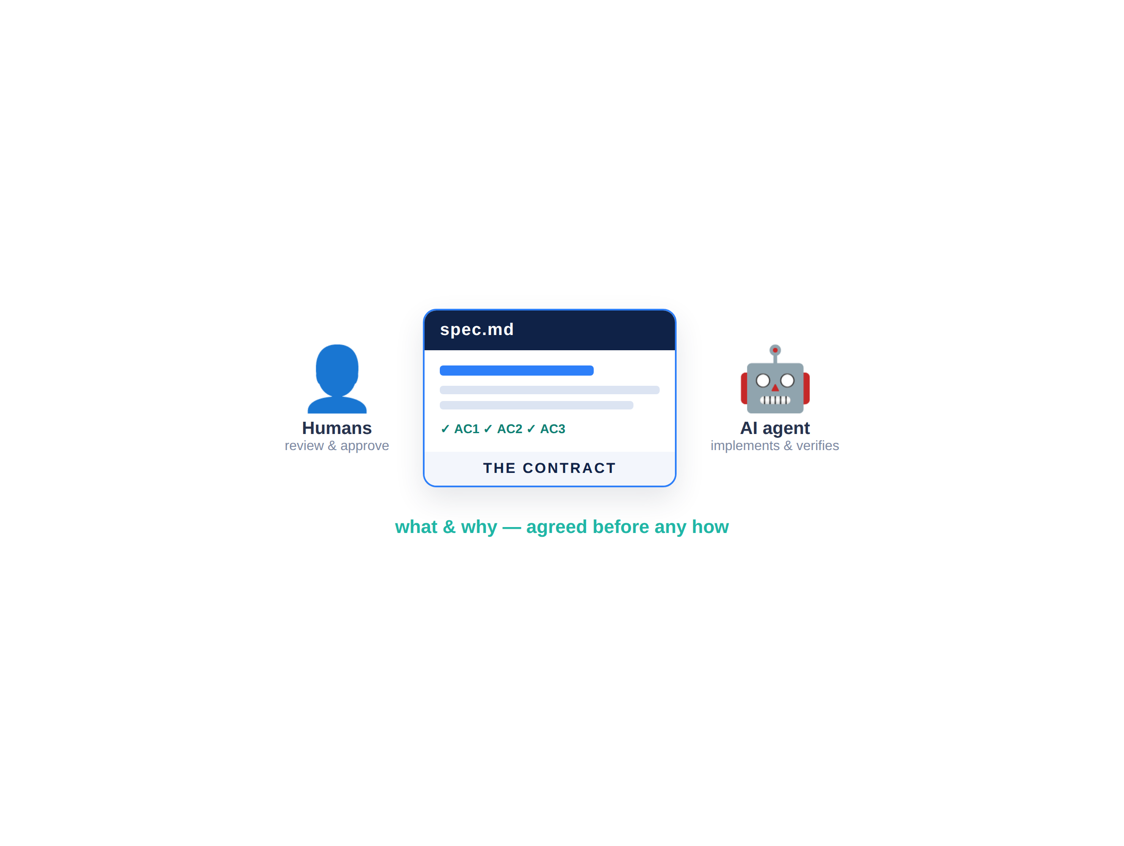


The spec is the contract
One artifact both the humans and the AI agree to build.
A spec pins down the what and why before any how. It is what you review, what the agent implements, and what you verify against.
Removes ambiguity — the #1 cause of rework
Reviewable by the whole team before code
The single source of truth for docs and tests
Survives model and tool changes
D A T A H A C K S U M M I T 2 0 2 6

Slide 4
SpecKit — a phase-gated spec pipeline
speckit-flow
Five core phases
# SpecKit — spec-driven, phase by phase # run these inside Claude Code /speckit.constitution project principles /speckit.specify what & why -> spec.md /speckit.clarify (optional) de-risk gaps /speckit.plan tech & architecture /speckit.analyze (optional) consistency /speckit.tasks ordered tasks [P]=parallel /speckit.implement build, in order
Constitution: rules every session obeys
Specify → Plan: what/why, then how
Tasks: ordered, traceable, parallelizable
Implement: executes against the spec
D A T A H A C K S U M M I T 2 0 2 6

Slide 5




OpenSpec — a collaborative change loop
01
02
03
04
Propose
Review
Apply
Archive
/opsx:propose — a change with rationale, spec deltas, tasks.
The team reviews the proposal before any code is written.
/opsx:apply — implement the tasks from the approved change.
/opsx:archive — fold the change into the living spec.
Fluid, not rigid — proposals iterate freely; alignment happens before code. Great for teams and existing codebases.
D A T A H A C K S U M M I T 2 0 2 6

Slide 6
OpenSpec — the change loop, step by step
openspec-flow
The idea
# 1) install once npm install -g @fission-ai/openspec openspec init # scaffolds openspec/, wires agent # 2) per change, inside Claude Code /opsx:propose "due-date reminders" -> proposal.md + spec deltas + tasks.md -> TEAM REVIEWS before any code /opsx:apply # implement approved tasks /opsx:archive # fold into the living spec
Propose the change before any code
The team reviews the diff first
Fluid — no hard phase gates
Best for existing codebases
D A T A H A C K S U M M I T 2 0 2 6

Slide 7
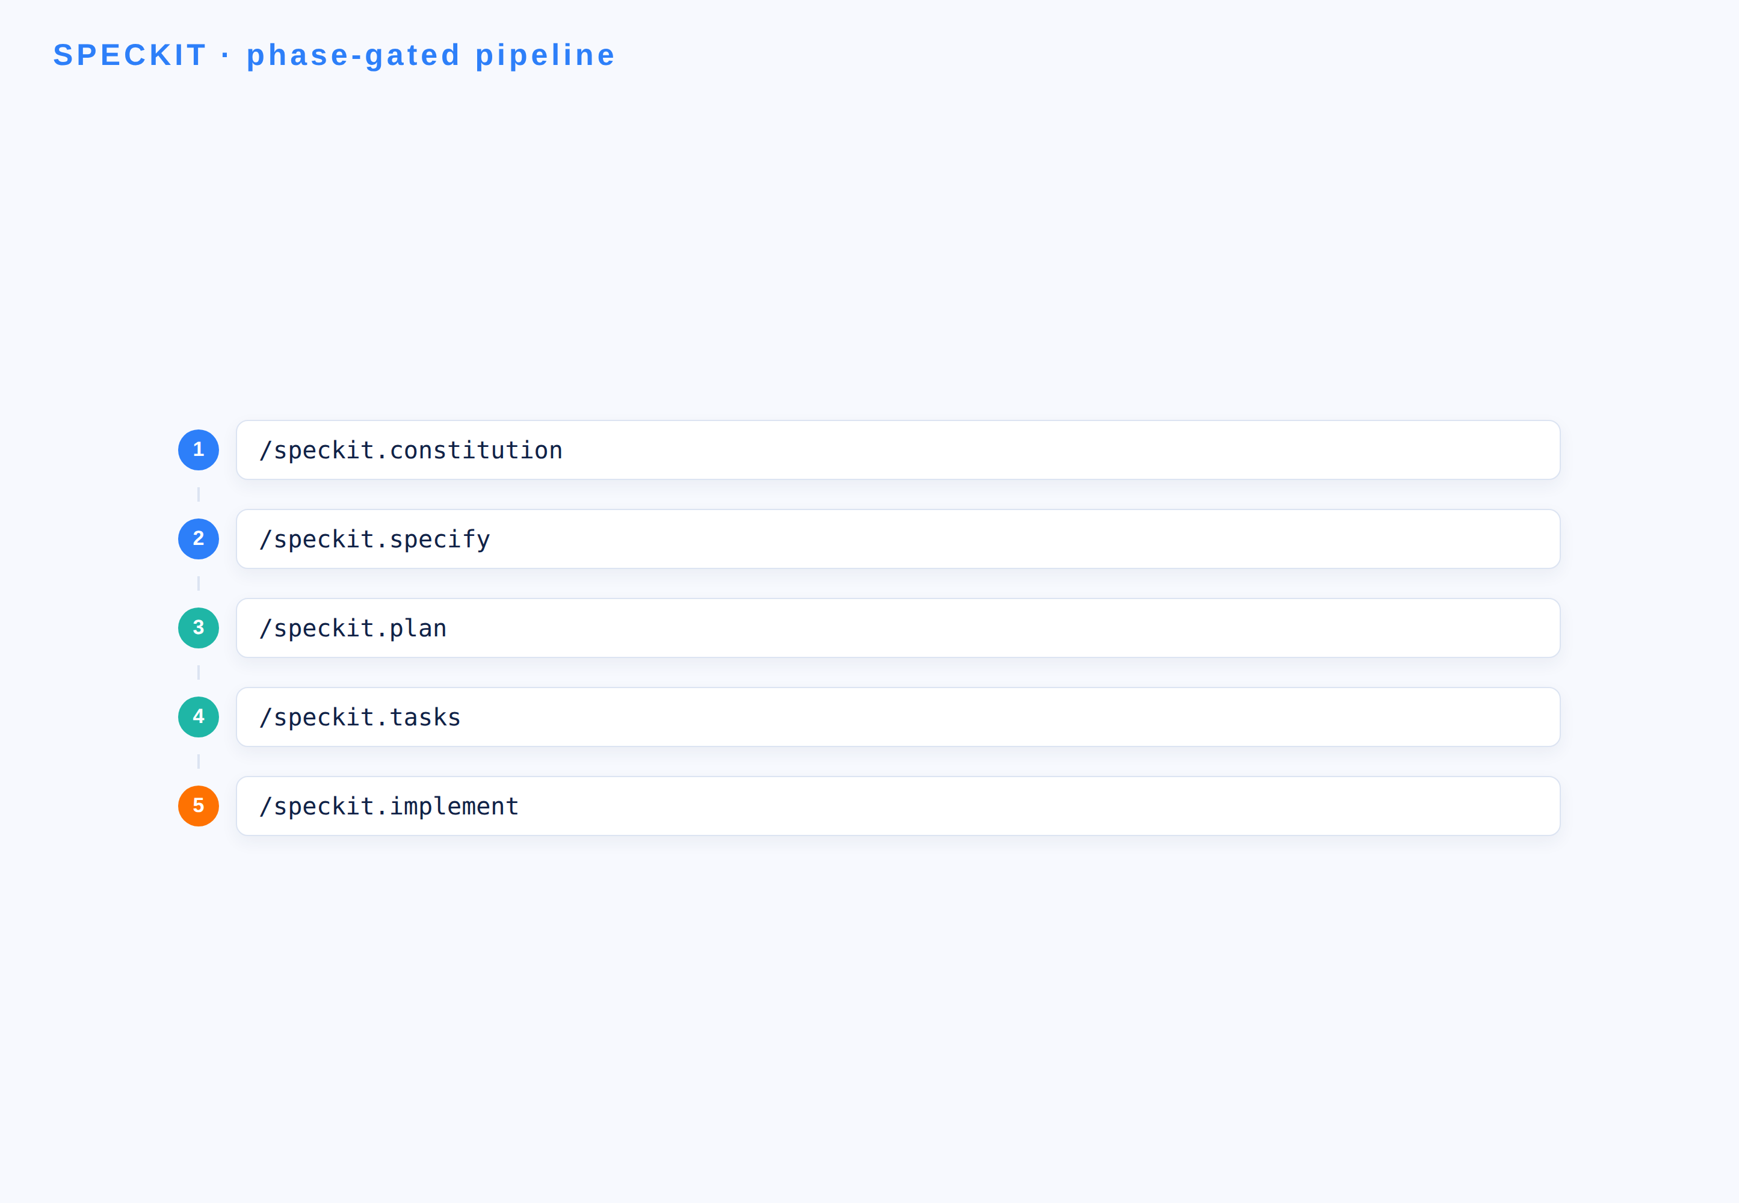
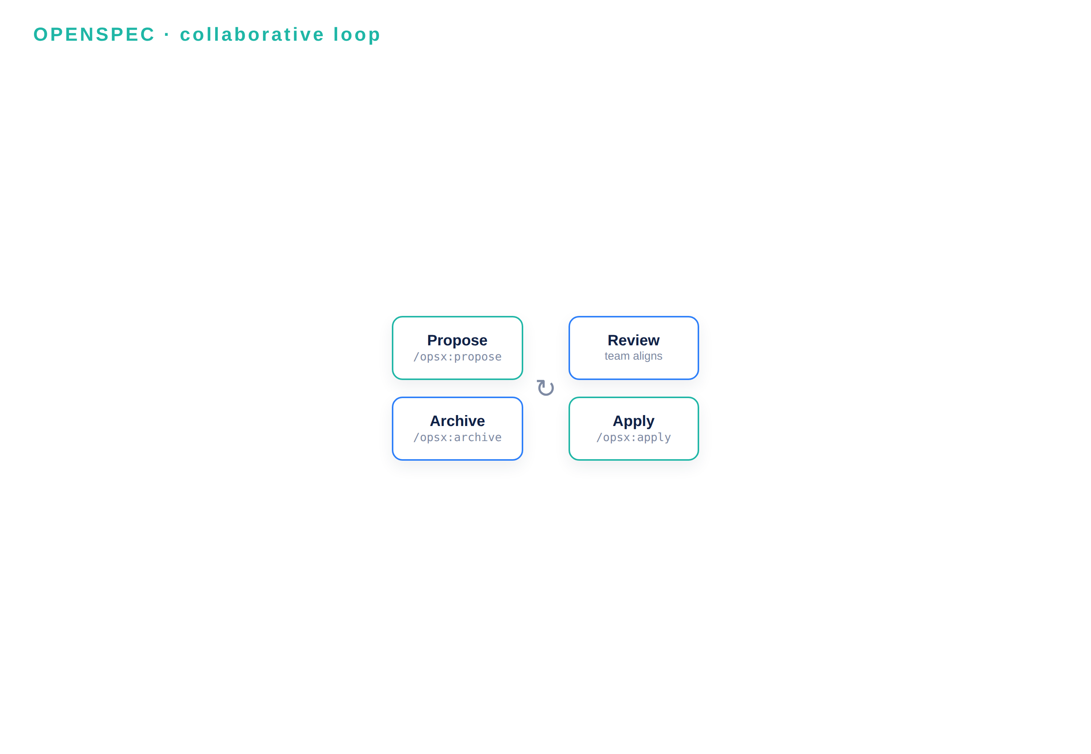

SpecKit vs OpenSpec — same goal, different shape
vs
Phase-gated pipeline · greenfield · governed by a constitution
Change proposals · fluid & reviewable · team-first, existing code
D A T A H A C K S U M M I T 2 0 2 6

Slide 8
From spec to orchestrated execution
The spec is not a document that rots — it drives the build, end to end.
PRD → plan → tasks A one-line ask becomes a spec, then a plan, then ordered, traceable tasks.
1→N
Claude Code plan mode See and approve the plan before a single file changes — you stay in control.
one ask becomes ordered tasks
Parallel & traceable Tasks marked [P] run in parallel; each one traces back to a line in the spec.
100%
The spec stays the source of truth Regenerate docs, tests and code from it as the project evolves — no drift.
of tasks trace back to the spec
D A T A H A C K S U M M I T 2 0 2 6

Slide 9
Turning a vague ask into a testable spec
spec.md
What changed
# BEFORE — what the stakeholder says "we need a task tracker for the team" # AFTER — /speckit.specify makes it testable User story: as a member I create a task with a title, assignee and due date. AC1 a task requires a title AC2 status = To-Do | In Progress | Done AC3 I can filter the board by assignee
Vague → measurable
Every AC is testable
No tech stack yet — that is /plan
The contract both sides sign
D A T A H A C K S U M M I T 2 0 2 6

Slide 10
Module 2 — your files & the flow
File | What it is | When you use it
TaskFlow_Brief.md | The 3-line anchor-project brief | ① Read first — before the build
Build1_Lab_Guide.md | Step-by-step SpecKit walkthrough | ② Follow during Build #1
reference-spec.md | An example of a "good" spec | ③ Compare your spec against it
SpecKit_Cheatsheet.md | SpecKit setup, phases & commands | Keep open during the build
OpenSpec_Cheatsheet.md | OpenSpec walkthrough & commands | Reference for the OpenSpec demo
D A T A H A C K S U M M I T 2 0 2 6

Slide 11
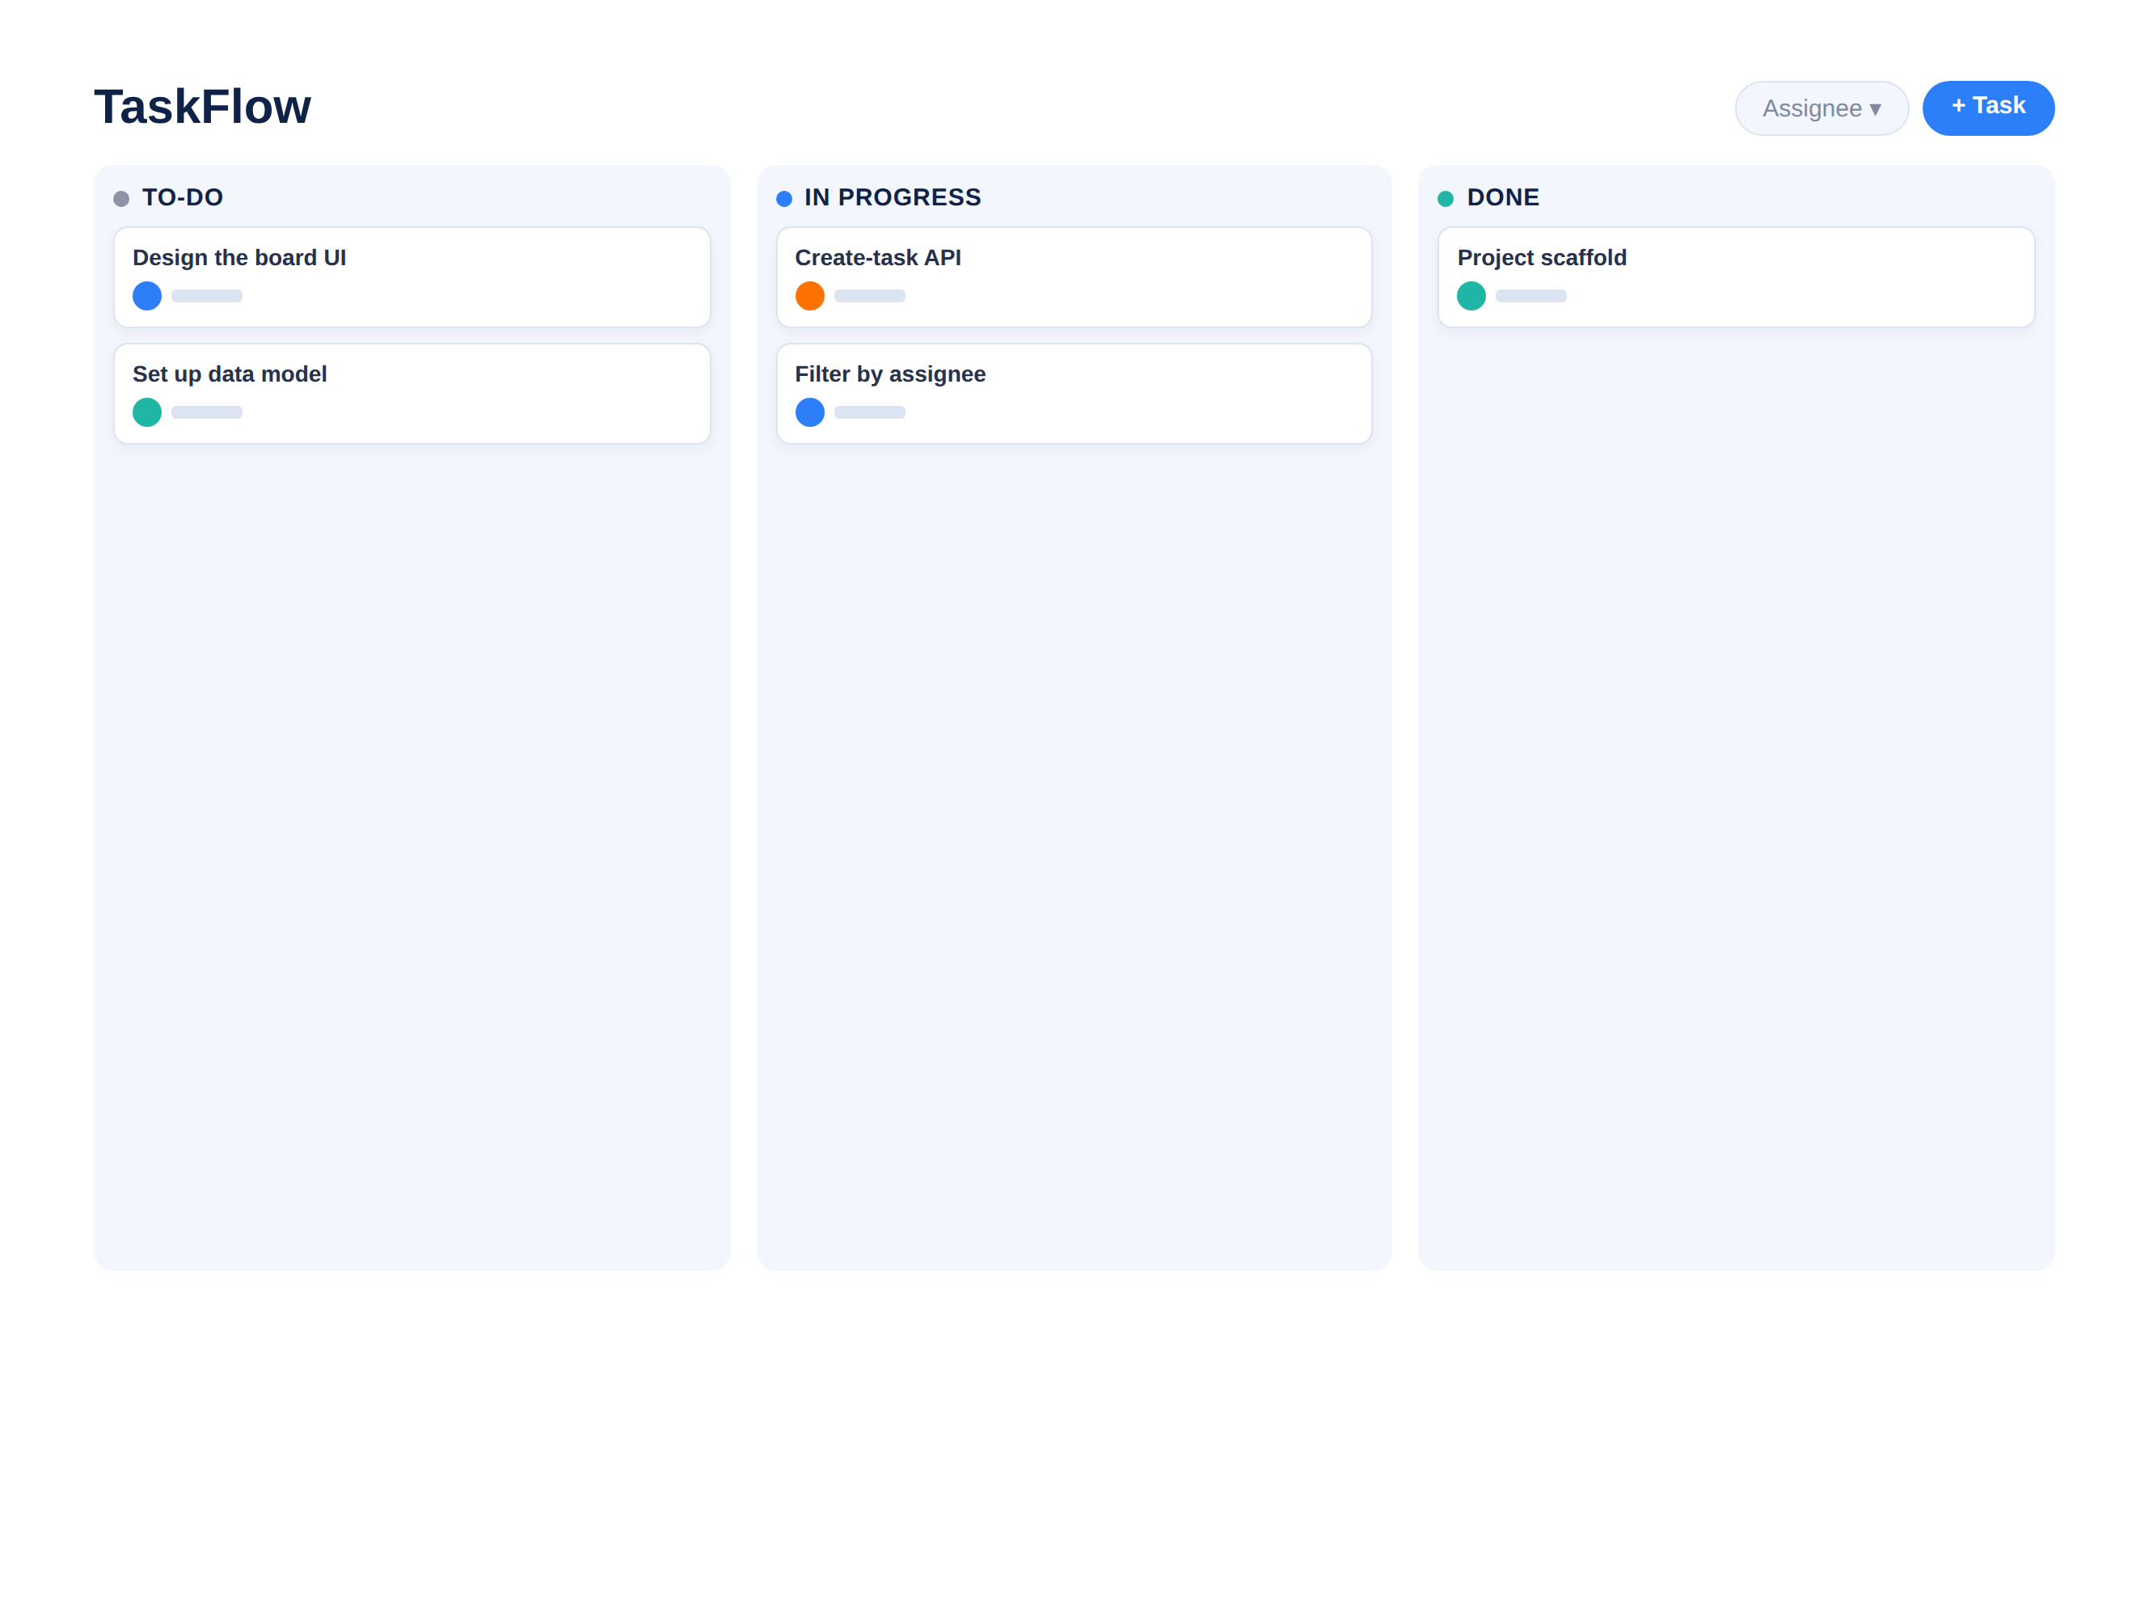
BUILD #1 — TaskFlow, the anchor project
The brief — three lines
Take it through SpecKit → spec + plan → a thin working slice.
Create tasks: title, assignee, due date
Move across To-Do → In Progress → Done
Filter the board by assignee or status
This project threads through M3 → M7
Your files: TaskFlow_Brief.md · Build1_Lab_Guide.md · reference-spec.md
D A T A H A C K S U M M I T 2 0 2 6

Slide 12
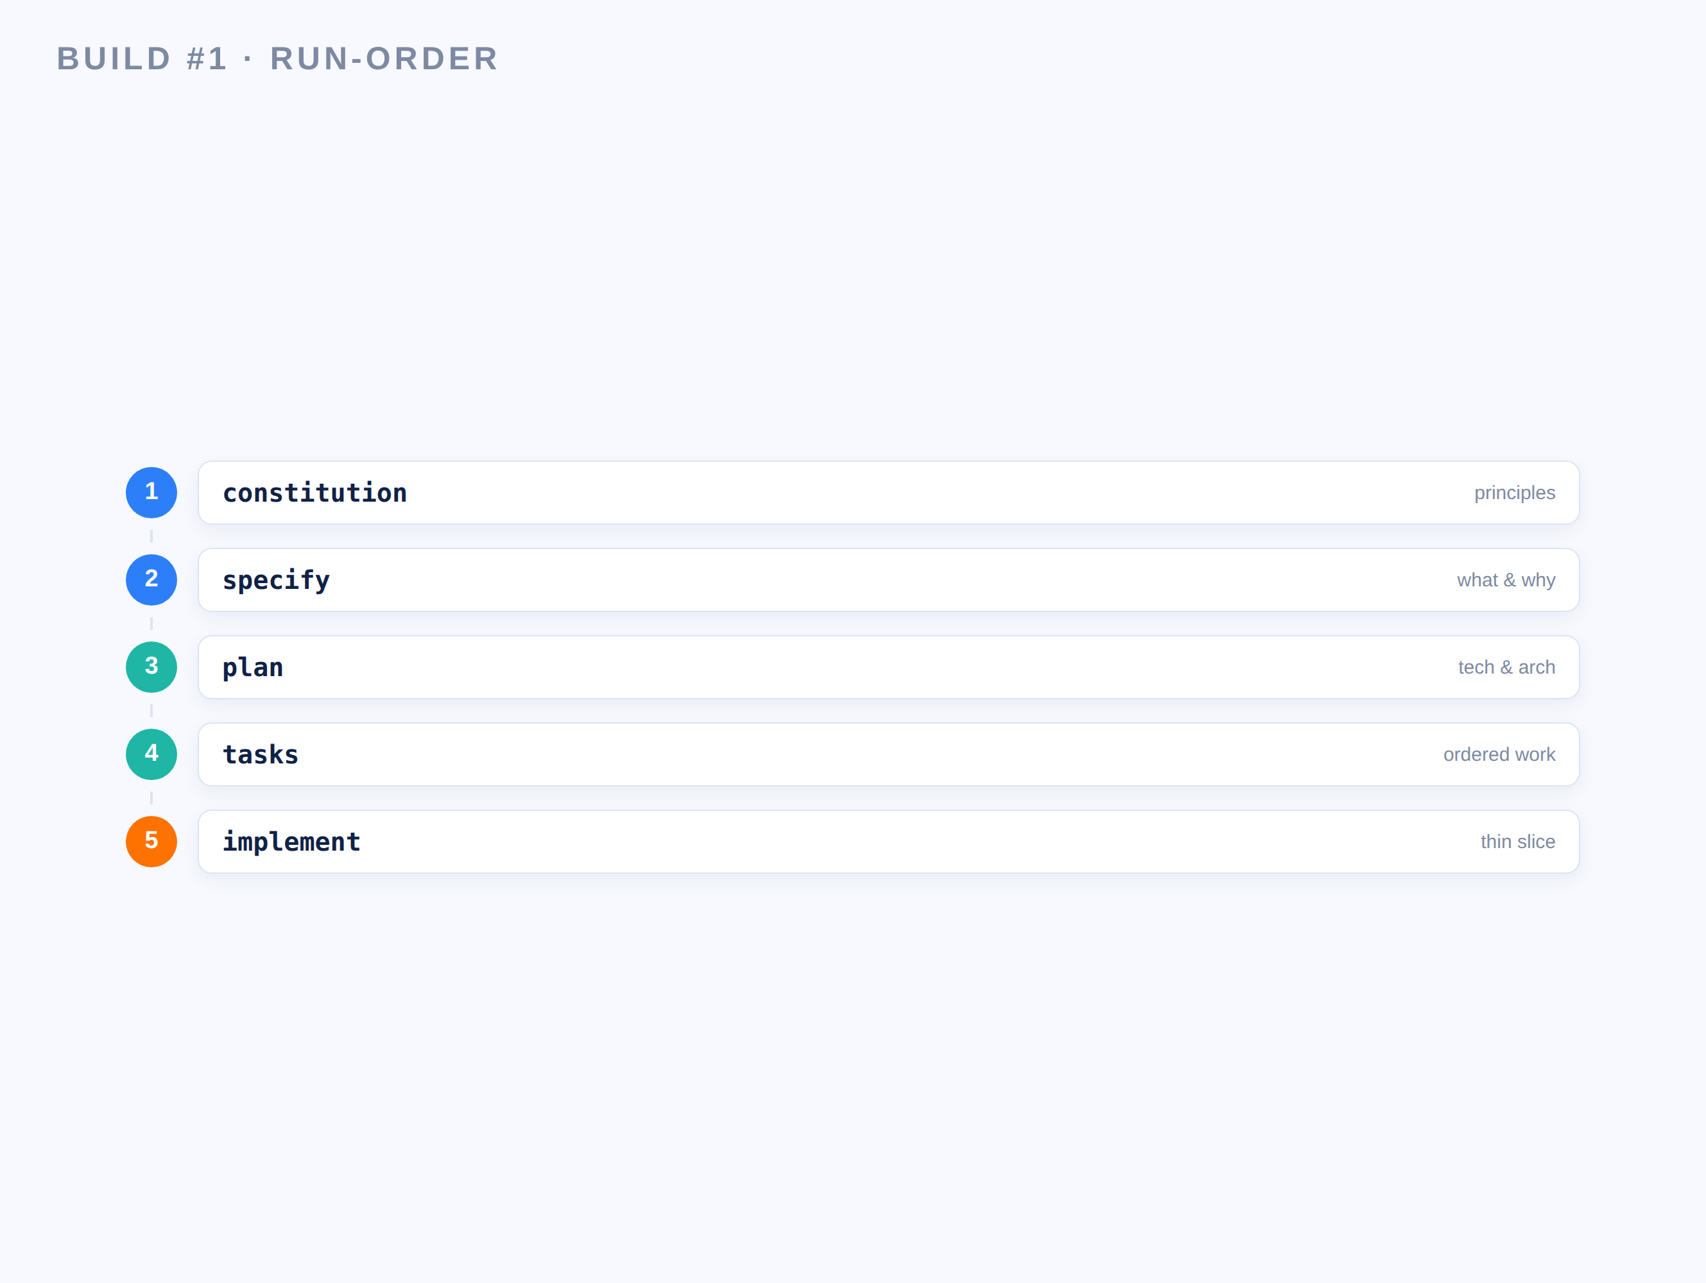
Your Build #1 run-order (SpecKit)
Five commands turn the 3-line brief into a working slice.
Run them in order inside Claude Code, approving each artifact before you move on.
constitution — set TaskFlow’s principles
specify — the what & why, with acceptance criteria
plan → tasks — tech choices, then ordered tasks
implement — a thin slice: model + API + tiny UI
D A T A H A C K S U M M I T 2 0 2 6

Slide 13
Debrief — what to compare across methodologies
01
02
03
04
Clarity
Traceability
Team fit
Speed to slice
Did the spec remove ambiguity before any code?
Can you trace each task back to a line in the spec?
Which felt right for a team vs. a solo greenfield start?
How fast from a 3-line brief to a working slice?
Same brief, two philosophies. Next: turn your slice into a real, deployed web app.
D A T A H A C K S U M M I T 2 0 2 6

Slide 14
SpecKit & OpenSpec — the cheatsheet
 | SpecKit | OpenSpec
Install | uv tool install specify-cli | npm i -g @fission-ai/openspec
Start | specify init → pick Claude Code | openspec init
Core commands | /speckit.constitution · specify · plan · tasks · implement | /opsx:propose · apply · archive
Unit of work | a phased pipeline (greenfield) | a reviewable change proposal
Shape | phase-gated, governed by a constitution | fluid — no hard gates
Best for | starting a project the right way | teams evolving an existing codebase
D A T A H A C K S U M M I T 2 0 2 6

