Slide 1


M3
MODULE 3 · 11:10–12:10
Building Web Applications with AI
Two tiers — prototype fast, harden for production — and TaskFlow goes live with a URL you can open on your phone.
August 05–08, 2026 · The Leela Bhartiya City, Bengaluru
Human × AI

Slide 2

“
Prototype where speed wins. Harden where it ships.
The prototyping tier gets you something clickable in minutes; the production tier makes it real.
August 05–08, 2026 · The Leela Bhartiya City, Bengaluru
Human ×AI

Slide 3
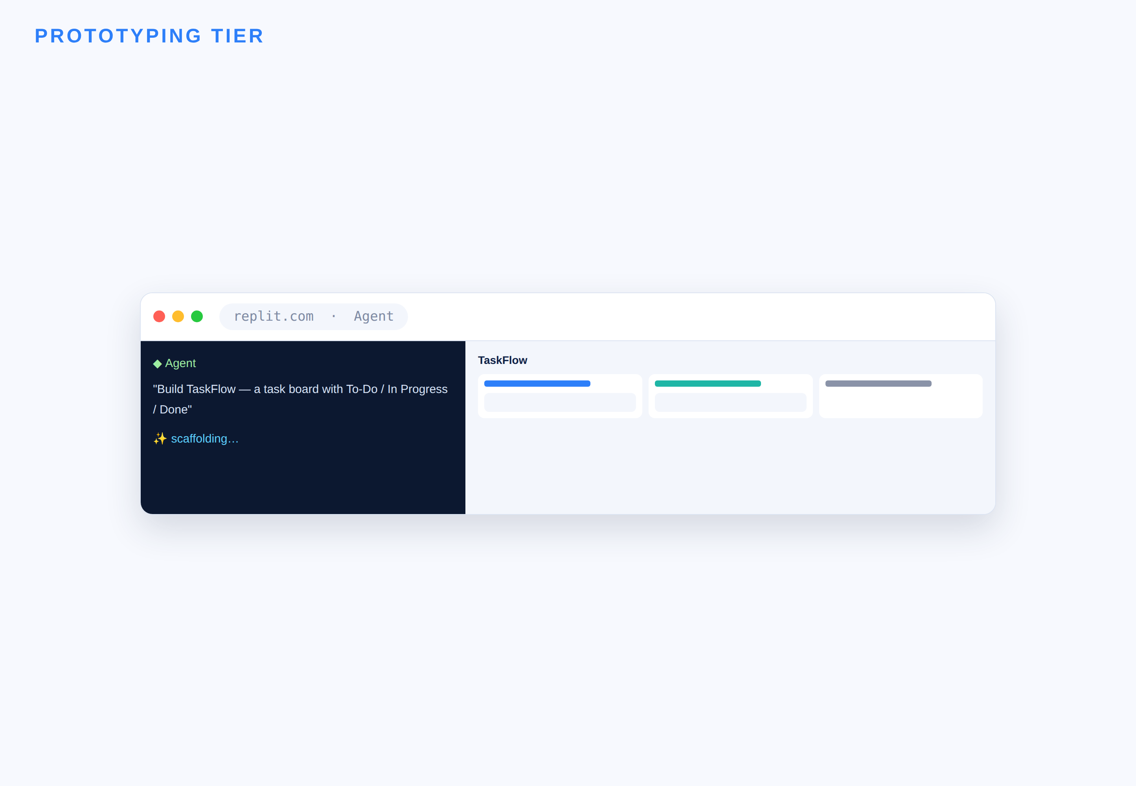
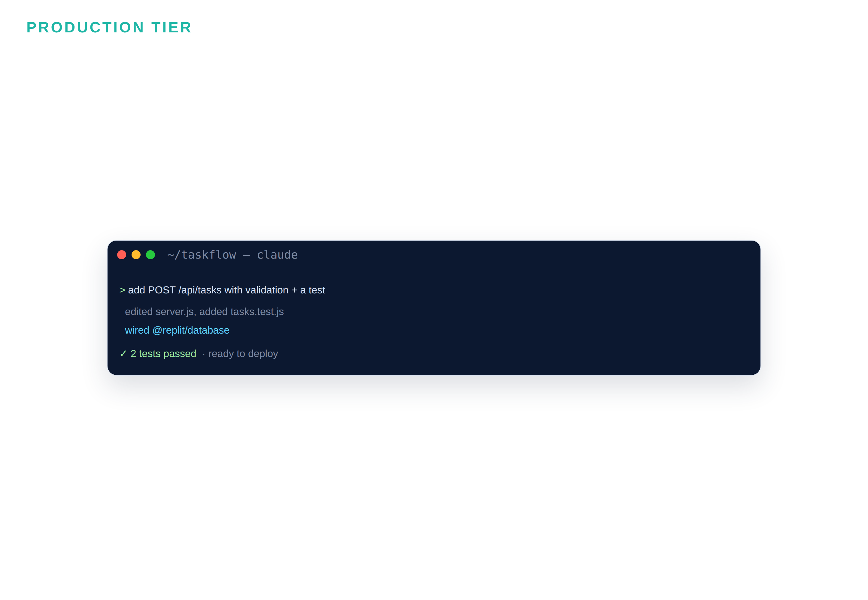


Two tiers — pick by what the task needs
→
V0 · Replit — idea → clickable in minutes
Cursor · Claude Code — real repo, tests, review
D A T A H A C K S U M M I T 2 0 2 6

Slide 4
Rapid prototyping tier — when speed-to-demo wins
Get to something you can click and share before you invest in hardening.
Replit — idea to running app Describe the app; Replit Agent scaffolds it and runs it — all in the browser.
min
V0 — design to React Prompt or sketch a UI; V0 generates polished React/Next components to iterate on.
idea to clickable prototype
Speed is the point Throwaway-friendly: explore layouts and flows fast, keep what works.
0
Then hand off to harden A prototype is a starting point, not a shipping product — the next tier makes it real.
local setup — it all runs in the cloud
D A T A H A C K S U M M I T 2 0 2 6

Slide 5
Replit, end to end — prototype, harden, deploy
replit-flow
The flow
# 1) PROTOTYPE — Replit Agent (in browser) New Repl -> Agent -> describe TaskFlow # scaffolds + runs it. (free: ~10 checkpoints/mo) # 2) HARDEN — Claude Code, in the Repl shell npm i -g @anthropic-ai/claude-code claude # log in with Pro — no Replit credits used # 3) DEPLOY — get a live URL Run -> public *.replit.dev preview URL Publish -> permanent *.replit.app URL
Agent scaffolds fast — spend checkpoints wisely
Claude Code hardens (uses your Pro, not credits)
Run = instant public preview URL
Publish = a permanent .replit.app URL
D A T A H A C K S U M M I T 2 0 2 6

Slide 6
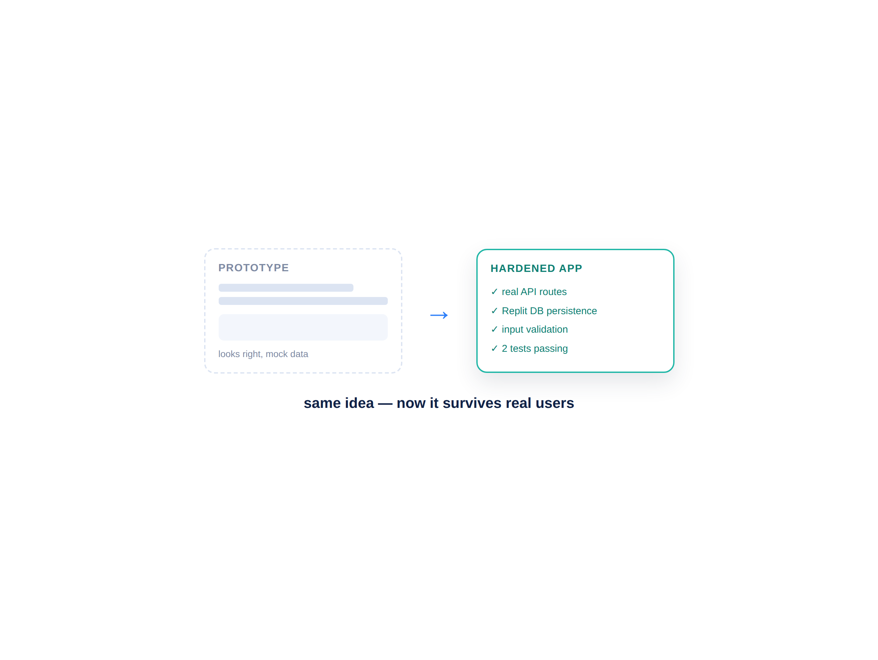


Production tier — make the prototype real
A demo is easy; a product that survives users is the work.
Cursor and Claude Code turn a rough prototype into a real app — routes, a data model, validation, and tests you can trust.
Real API routes, not mocked data
A data model + persistence (Replit DB)
Input validation and error handling
Tests that guard the core paths
D A T A H A C K S U M M I T 2 0 2 6

Slide 7
Frontend generation patterns
How to get the UI you actually want — fast, and consistent.
Scaffold, then iterate Generate the whole screen first; refine one component at a time.
1
Iterate by screenshot Paste a screenshot and say what to change — faster than describing in words.
example component sets the whole style
Design consistency Give it your colors, spacing, and one example component to match.
shot
Lock & reuse Once a card or header looks right, reuse it across every screen.
a screenshot is the fastest UI feedback
D A T A H A C K S U M M I T 2 0 2 6

Slide 8
Backend & APIs — the spec carries forward
server.js
What to prompt for
# routes come straight from the M2 spec POST /api/tasks create (validate: title required) GET /api/tasks list ?assignee= &status= PATCH /api/tasks/:id move status # persistence — Replit DB, zero config import Client from "@replit/database" const db = new Client() await db.set(`task:${id}`, task) const tasks = await db.list("task:")
Each route ties to an acceptance criterion
Validate every input; handle errors
Replit DB = storage with zero setup
Ask Claude Code to add 2 tests
D A T A H A C K S U M M I T 2 0 2 6

Slide 9



The Build #2 pipeline — prototype to live
01
02
03
04
Prototype
Harden
Persist + test
Deploy
Replit Agent scaffolds the TaskFlow UI, running in-browser.
Claude Code in the shell adds real API routes and validation.
Wire Replit DB for storage; add two tests for the core paths.
Run for a preview URL, or Publish for a permanent one.
One spec, four steps, one live URL. Everyone leaves with a link they can open on their phone.
D A T A H A C K S U M M I T 2 0 2 6

Slide 10
Module 3 — your files & the flow
File | What it is | When you use it
Build2_Lab_Guide.md | Step-by-step Build #2 (Replit) | ① Follow during the lab
TaskFlow_Brief.md | The anchor-project brief (from M2) | Your spec / contract — reference
Prototype_vs_Production.md | When to prototype vs harden | Keep open while building
Replit_Deploy_Cheatsheet.md | Replit Agent, DB & deploy steps | ② For the deploy step
D A T A H A C K S U M M I T 2 0 2 6

Slide 11
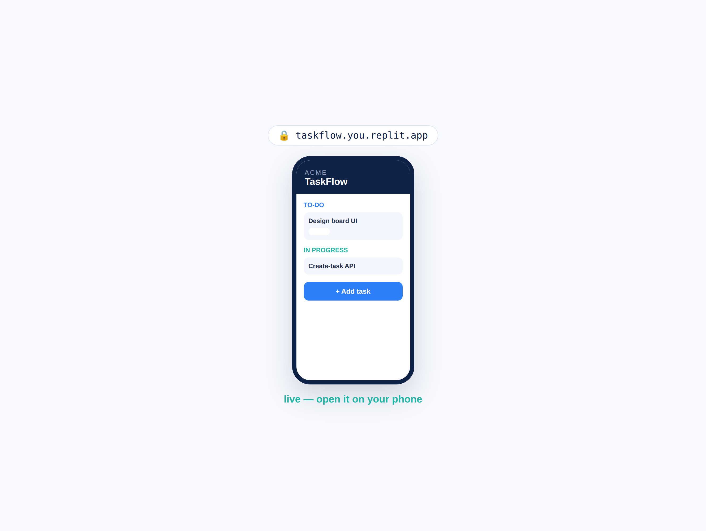
BUILD #2 — TaskFlow goes live
Your task — 35 minutes
Prototype → harden → deploy. Everyone leaves with a live URL.
Prototype the UI in Replit (Agent)
Harden with Claude Code in the shell
Persist with Replit DB + add 2 tests
Deploy → share your live link
Your files: Build2_Lab_Guide.md · TaskFlow_Brief.md · Replit_Deploy_Cheatsheet.md
D A T A H A C K S U M M I T 2 0 2 6

Slide 12
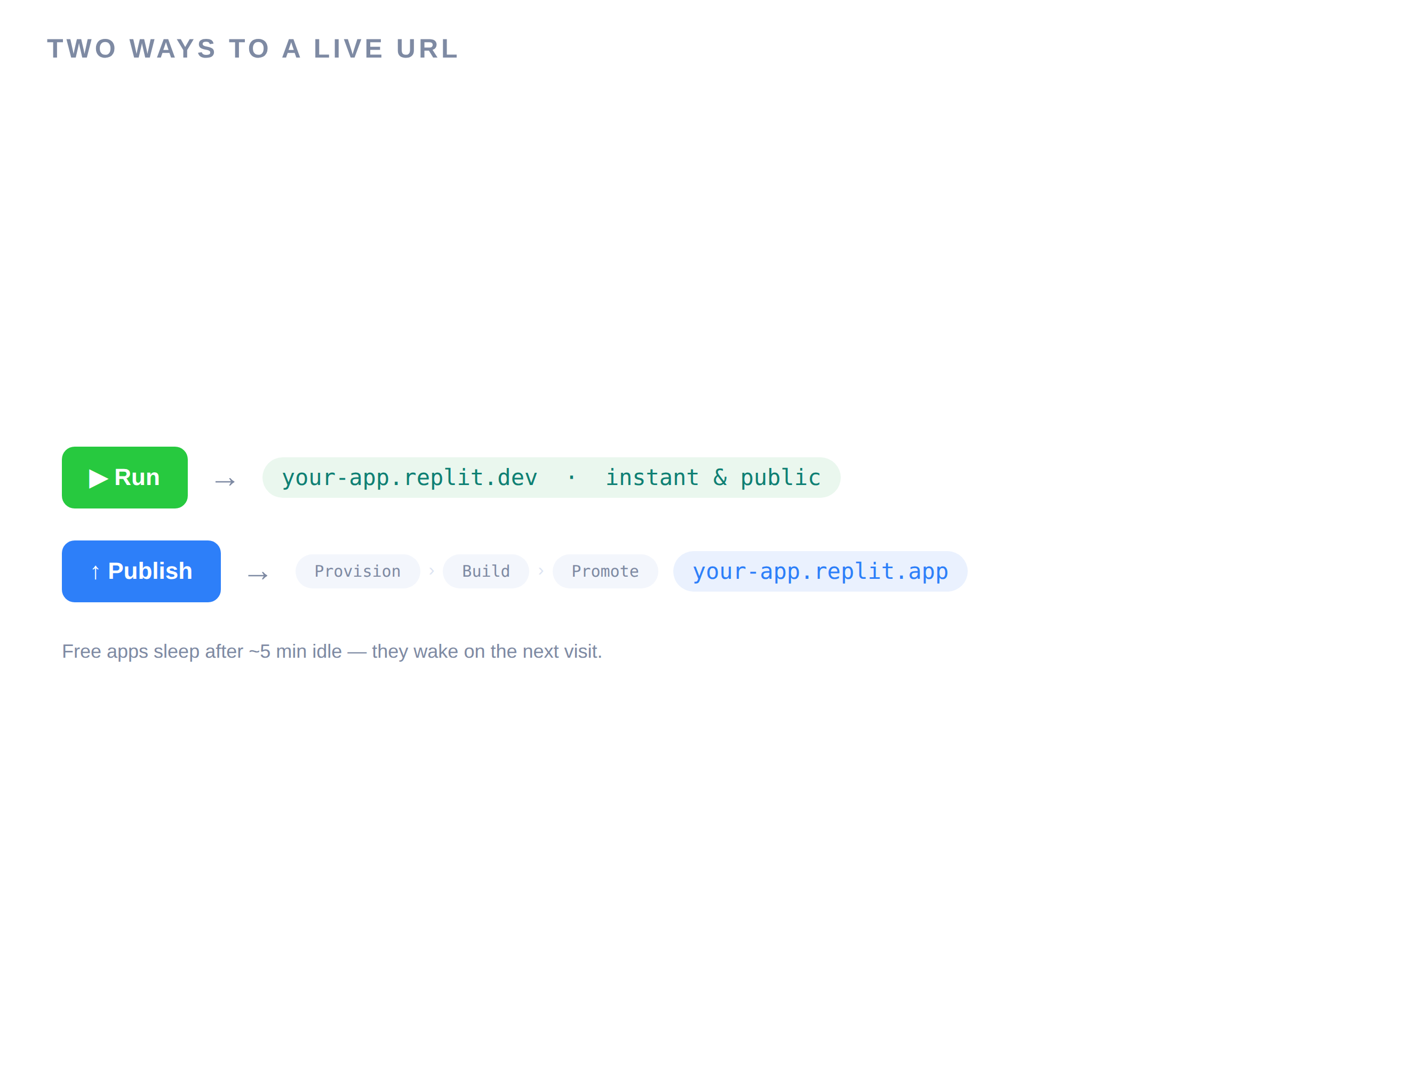
Deploy — get your live URL
Two ways to a live URL — one instant, one permanent.
Hit Run and your app is already public at a *.replit.dev preview URL. Publish promotes it to a permanent *.replit.app link.
Run → instant public preview URL
Publish → Provision → Build → Promote
Free apps sleep after ~5 min — they wake on visit
Share the link — open it on your phone
D A T A H A C K S U M M I T 2 0 2 6

Slide 13
Debrief — what you just shipped
01
02
03
04
It is live
Spec → app
Two tiers
No local setup
A real URL, on the internet, that others can open.
The M2 acceptance criteria are now working features.
You felt when speed wins vs. when hardening matters.
Prototype, harden and deploy — entirely in the cloud.
You built and shipped a web app by directing agents. Next: the same app on a phone, plus a microservice.
D A T A H A C K S U M M I T 2 0 2 6

Slide 14
Prototype vs production — the fast call
 | Prototyping tier | Production tier
Goal | Something clickable, fast | Something real, shippable
Tools | Replit Agent · V0 | Claude Code · Cursor
Data | Mock / hardcoded | Replit DB, validated
Tests | None yet | Core paths covered
Use it when | Explore, demo, pitch | Users depend on it
In Build #2 | Step 1 (prototype) | Steps 2–4 (harden → deploy)
D A T A H A C K S U M M I T 2 0 2 6

