Slide 1

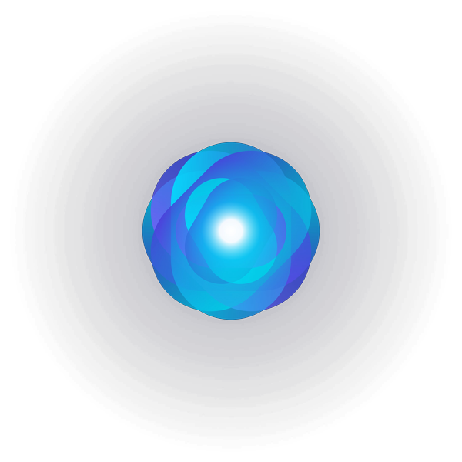
M4
MODULE 4 · 12:55–1:45
Mobile Apps & Microservices
TaskFlow lands on your phone via Expo, and gains a notifications microservice with generated API docs.
August 05–08, 2026 · The Leela Bhartiya City, Bengaluru
Human × AI

Slide 2

“
Two more app types, one afternoon — a phone app and a service.
Same spec, new shapes: React Native for the phone, a microservice for the backend — with Claude as your architecture sparring partner.
August 05–08, 2026 · The Leela Bhartiya City, Bengaluru
Human ×AI

Slide 3
Cross-platform mobile with AI
One prompt-driven path from idea to a real app on your own phone.
React Native + Expo One codebase runs on iOS and Android — no native tooling to install.
1
Idea to phone in minutes Describe the screens; run them live on your device via a QR code.
codebase — both iOS and Android
Expo Go on your phone A free app that loads your project instantly — no App Store, no build.
QR
It talks to your web app The mobile companion calls the same TaskFlow API you built in M3.
scan to run it on your phone
D A T A H A C K S U M M I T 2 0 2 6

Slide 4
Expo Snack — idea to phone via QR
App.js · Expo Snack
The flow
# 1) GENERATE the screens with Claude "React Native (Expo) screens for TaskFlow: a task list + an add-task form" -> paste the code into snack.expo.dev # 2) RUN on your phone Expo Go app -> Snack "My Device" tab -> QR scan it (iOS: Camera · Android: in Expo Go) -> live on your phone, reloads as you edit # 3) No phone? Snack "Web" tab = preview
All in the browser — no local setup
Expo Go is free (App Store / Play)
Live reload as you edit the code
Web tab is the no-phone fallback
D A T A H A C K S U M M I T 2 0 2 6

Slide 5
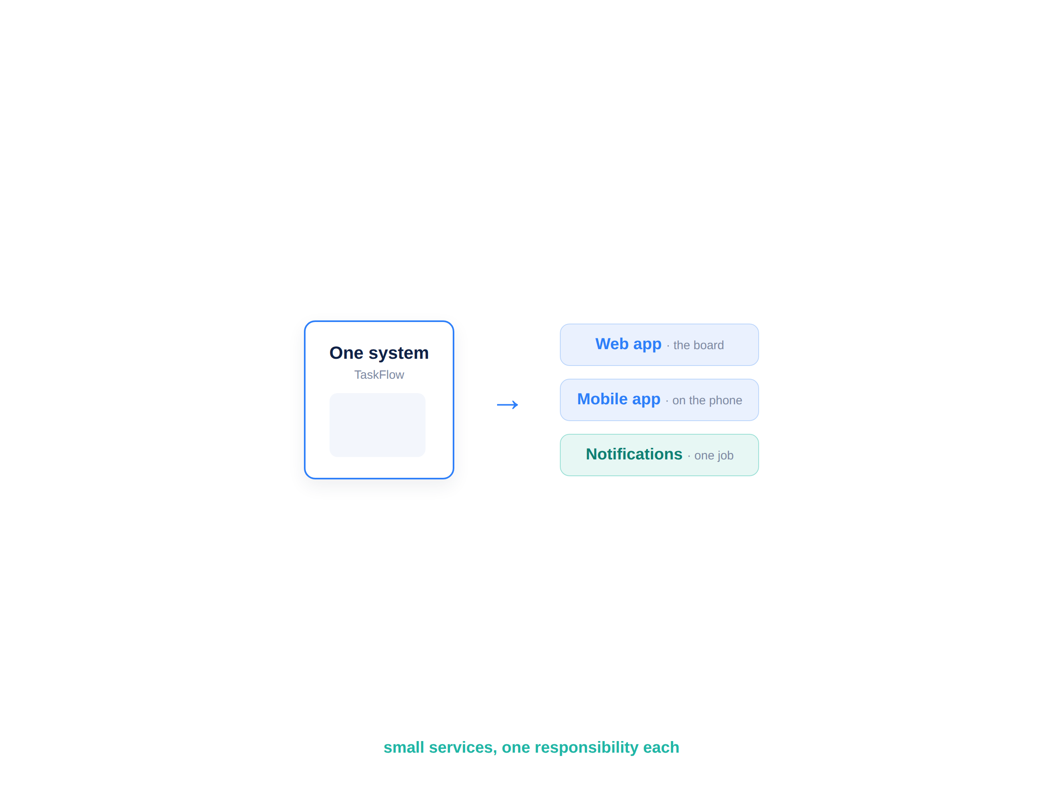


Microservices with AI assistance
Split a system into small services — but only when it earns its keep.
Claude is your architecture sparring partner: it proposes service boundaries, flags premature splitting, and says when a monolith is still right.
One service, one responsibility
Clear boundaries and an API contract
Independent to deploy and scale
A monolith is fine — until it isn’t
D A T A H A C K S U M M I T 2 0 2 6

Slide 6
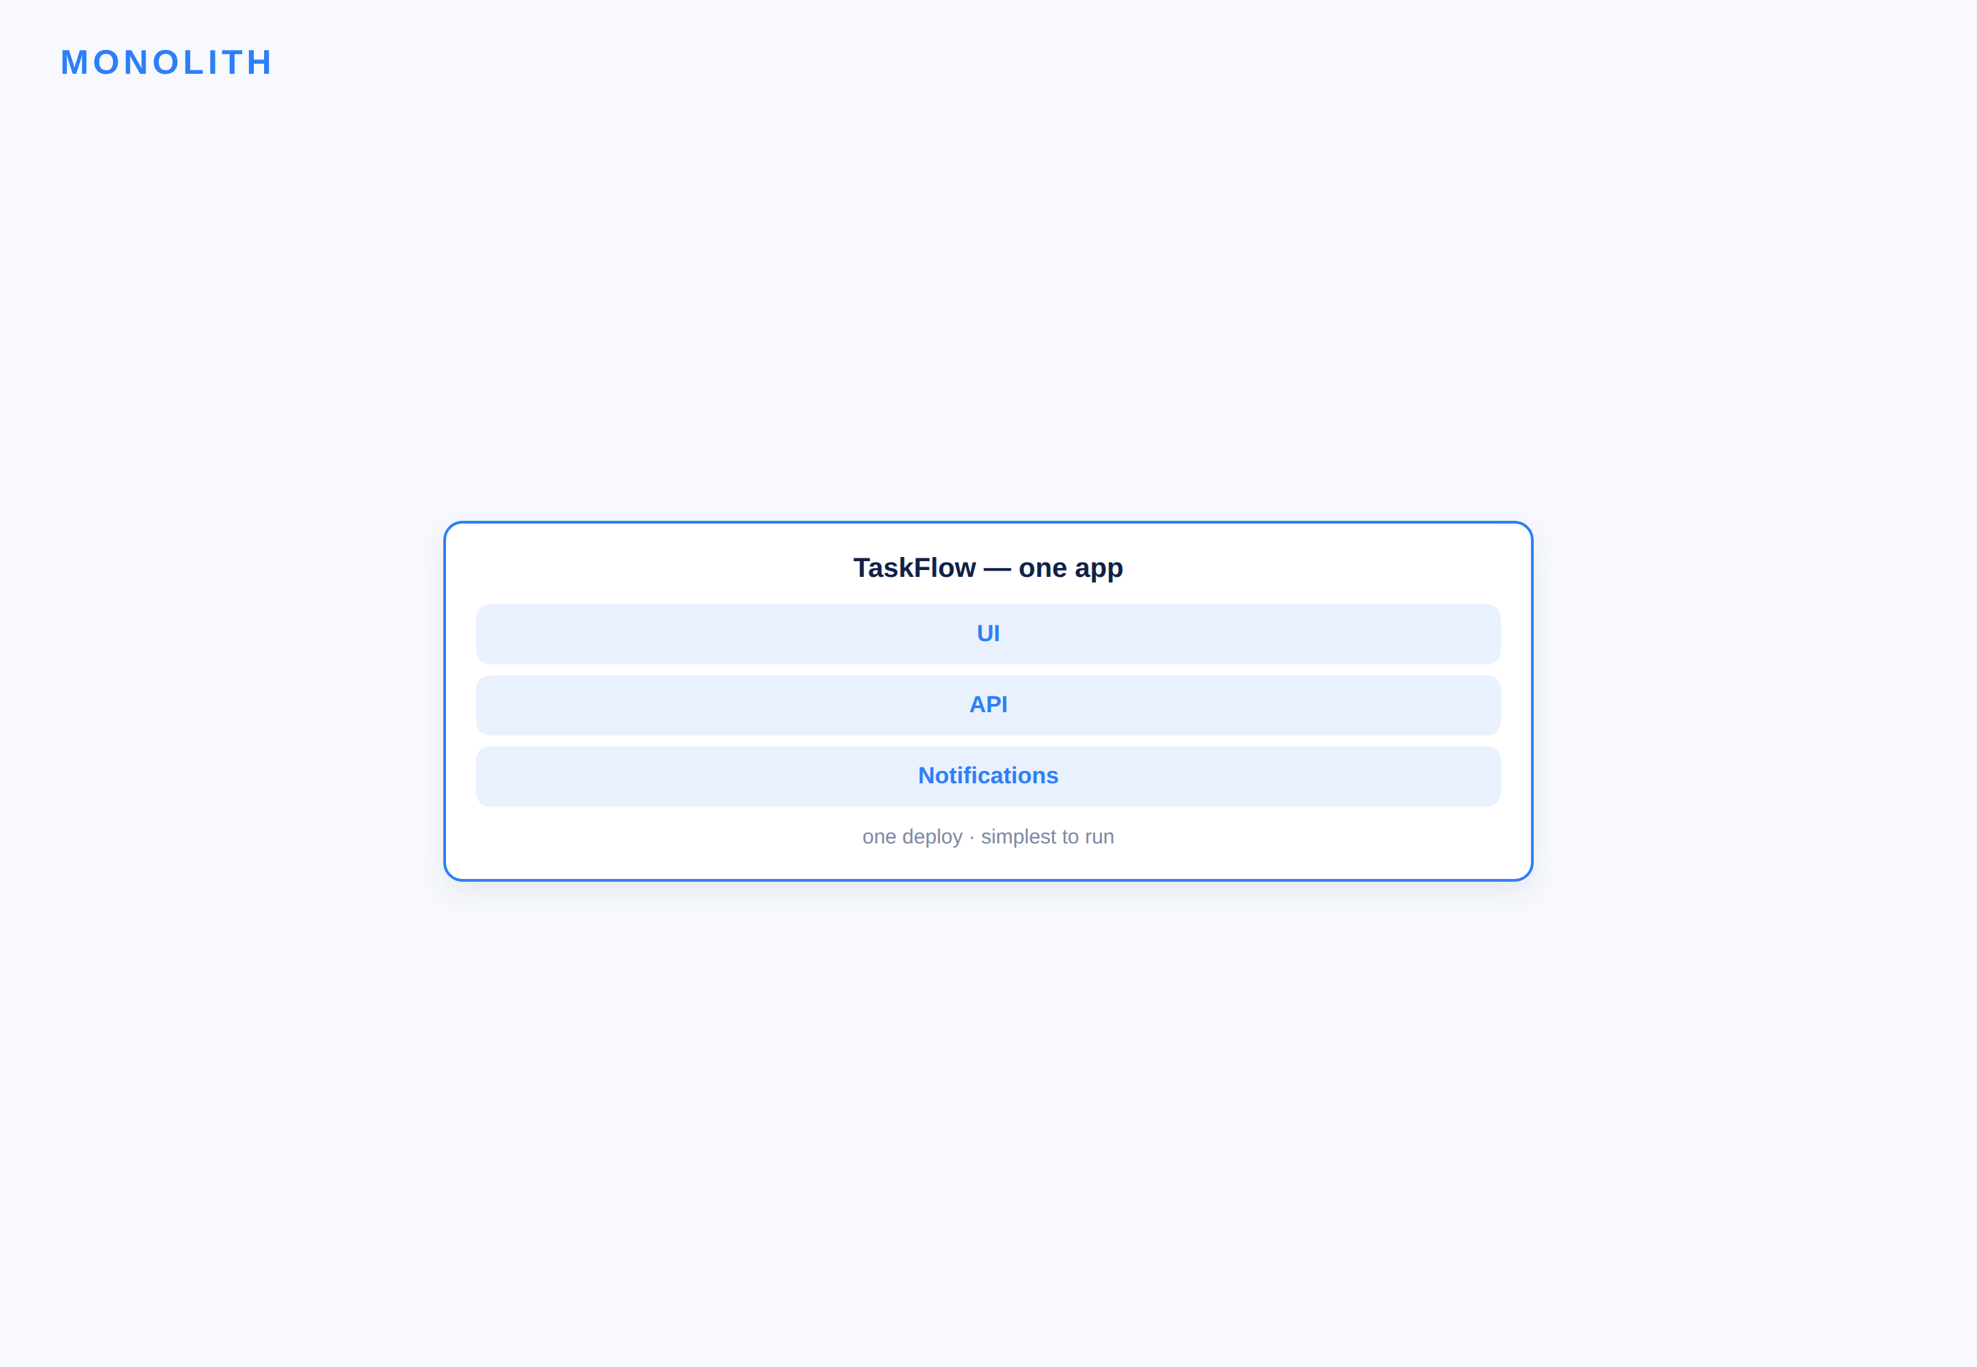
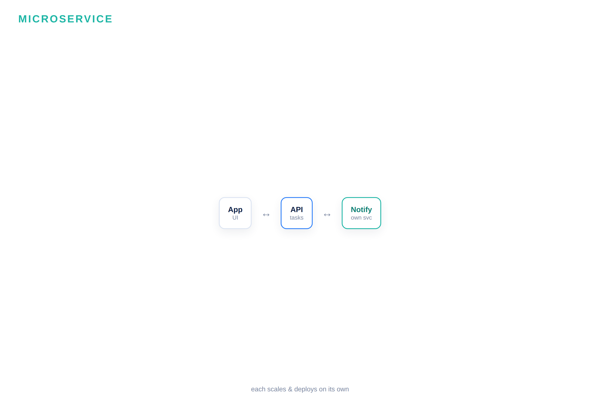
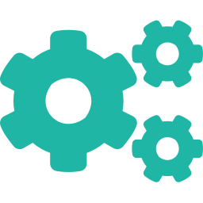

Monolith vs microservice — when to split
vs
One app, one deploy — simplest to build & run. Start here.
Separate service — independent scale & lifecycle. Split when needed.
D A T A H A C K S U M M I T 2 0 2 6

Slide 7
API design & docs — OpenAPI, kept in sync
openapi.yaml
Why it matters
# generated from the service — openapi.yaml openapi: 3.0.0 info: { title: TaskFlow Notifications, v: 1.0 } paths: /notify: post: summary: notify about a task body: { taskId, message } responses: { 200: sent, 400: invalid } /health: get: liveness check
Generated from code — not hand-written
One source of truth for the API
Regenerate on every change — no drift
Feeds docs, clients and tests
D A T A H A C K S U M M I T 2 0 2 6

Slide 8
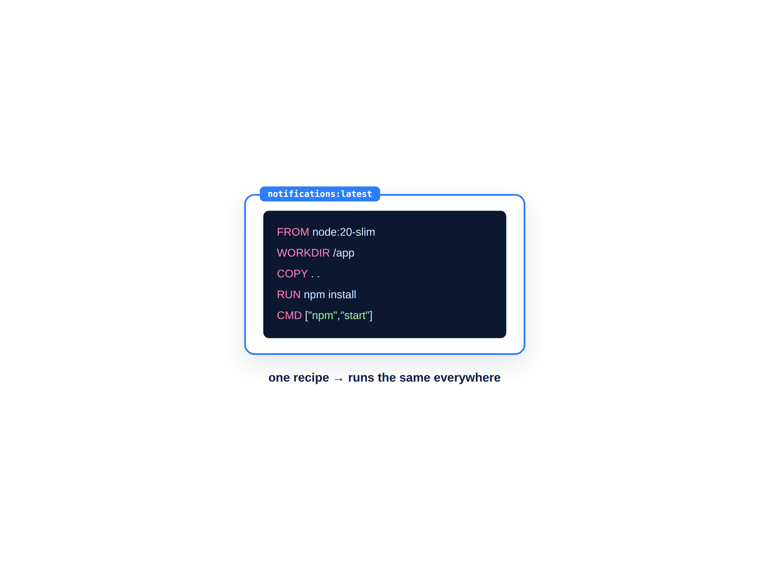
Containerization — ship it anywhere
A container packages your service so it runs the same everywhere.
Claude generates a Dockerfile from your service — no DevOps degree needed. Think of it as a recipe: base image, copy code, install, run.
Dockerfile = the recipe to build the image
The same image runs on any machine
No more “works on my machine”
Survey-level today — the concept, not the deep end
D A T A H A C K S U M M I T 2 0 2 6

Slide 9



The Build #3 pipeline — phone + service
01
02
03
04
Generate
Run on phone
Add a service
Document
Claude writes the React Native screens for TaskFlow.
Paste into Expo Snack; scan the QR with Expo Go.
Claude Code builds a small notifications microservice.
Auto-generate its OpenAPI doc and a Dockerfile.
Two app types in 30 minutes — mostly hands-on mobile, a guided tour of the service.
D A T A H A C K S U M M I T 2 0 2 6

Slide 10
Module 4 — your files & the flow
File | What it is | When you use it
Build3_Lab_Guide.md | Step-by-step Build #3 (mobile + service) | ① Follow during the lab
TaskFlow_Brief.md | The anchor-project brief (from M2) | Your spec — reference
Monolith_vs_Microservice.md | When to split vs stay a monolith | Keep open for the service part
Mobile_and_Microservices_Cheatsheet.md | Expo Snack, OpenAPI & Docker steps | ② Deploy / run reference
D A T A H A C K S U M M I T 2 0 2 6

Slide 11
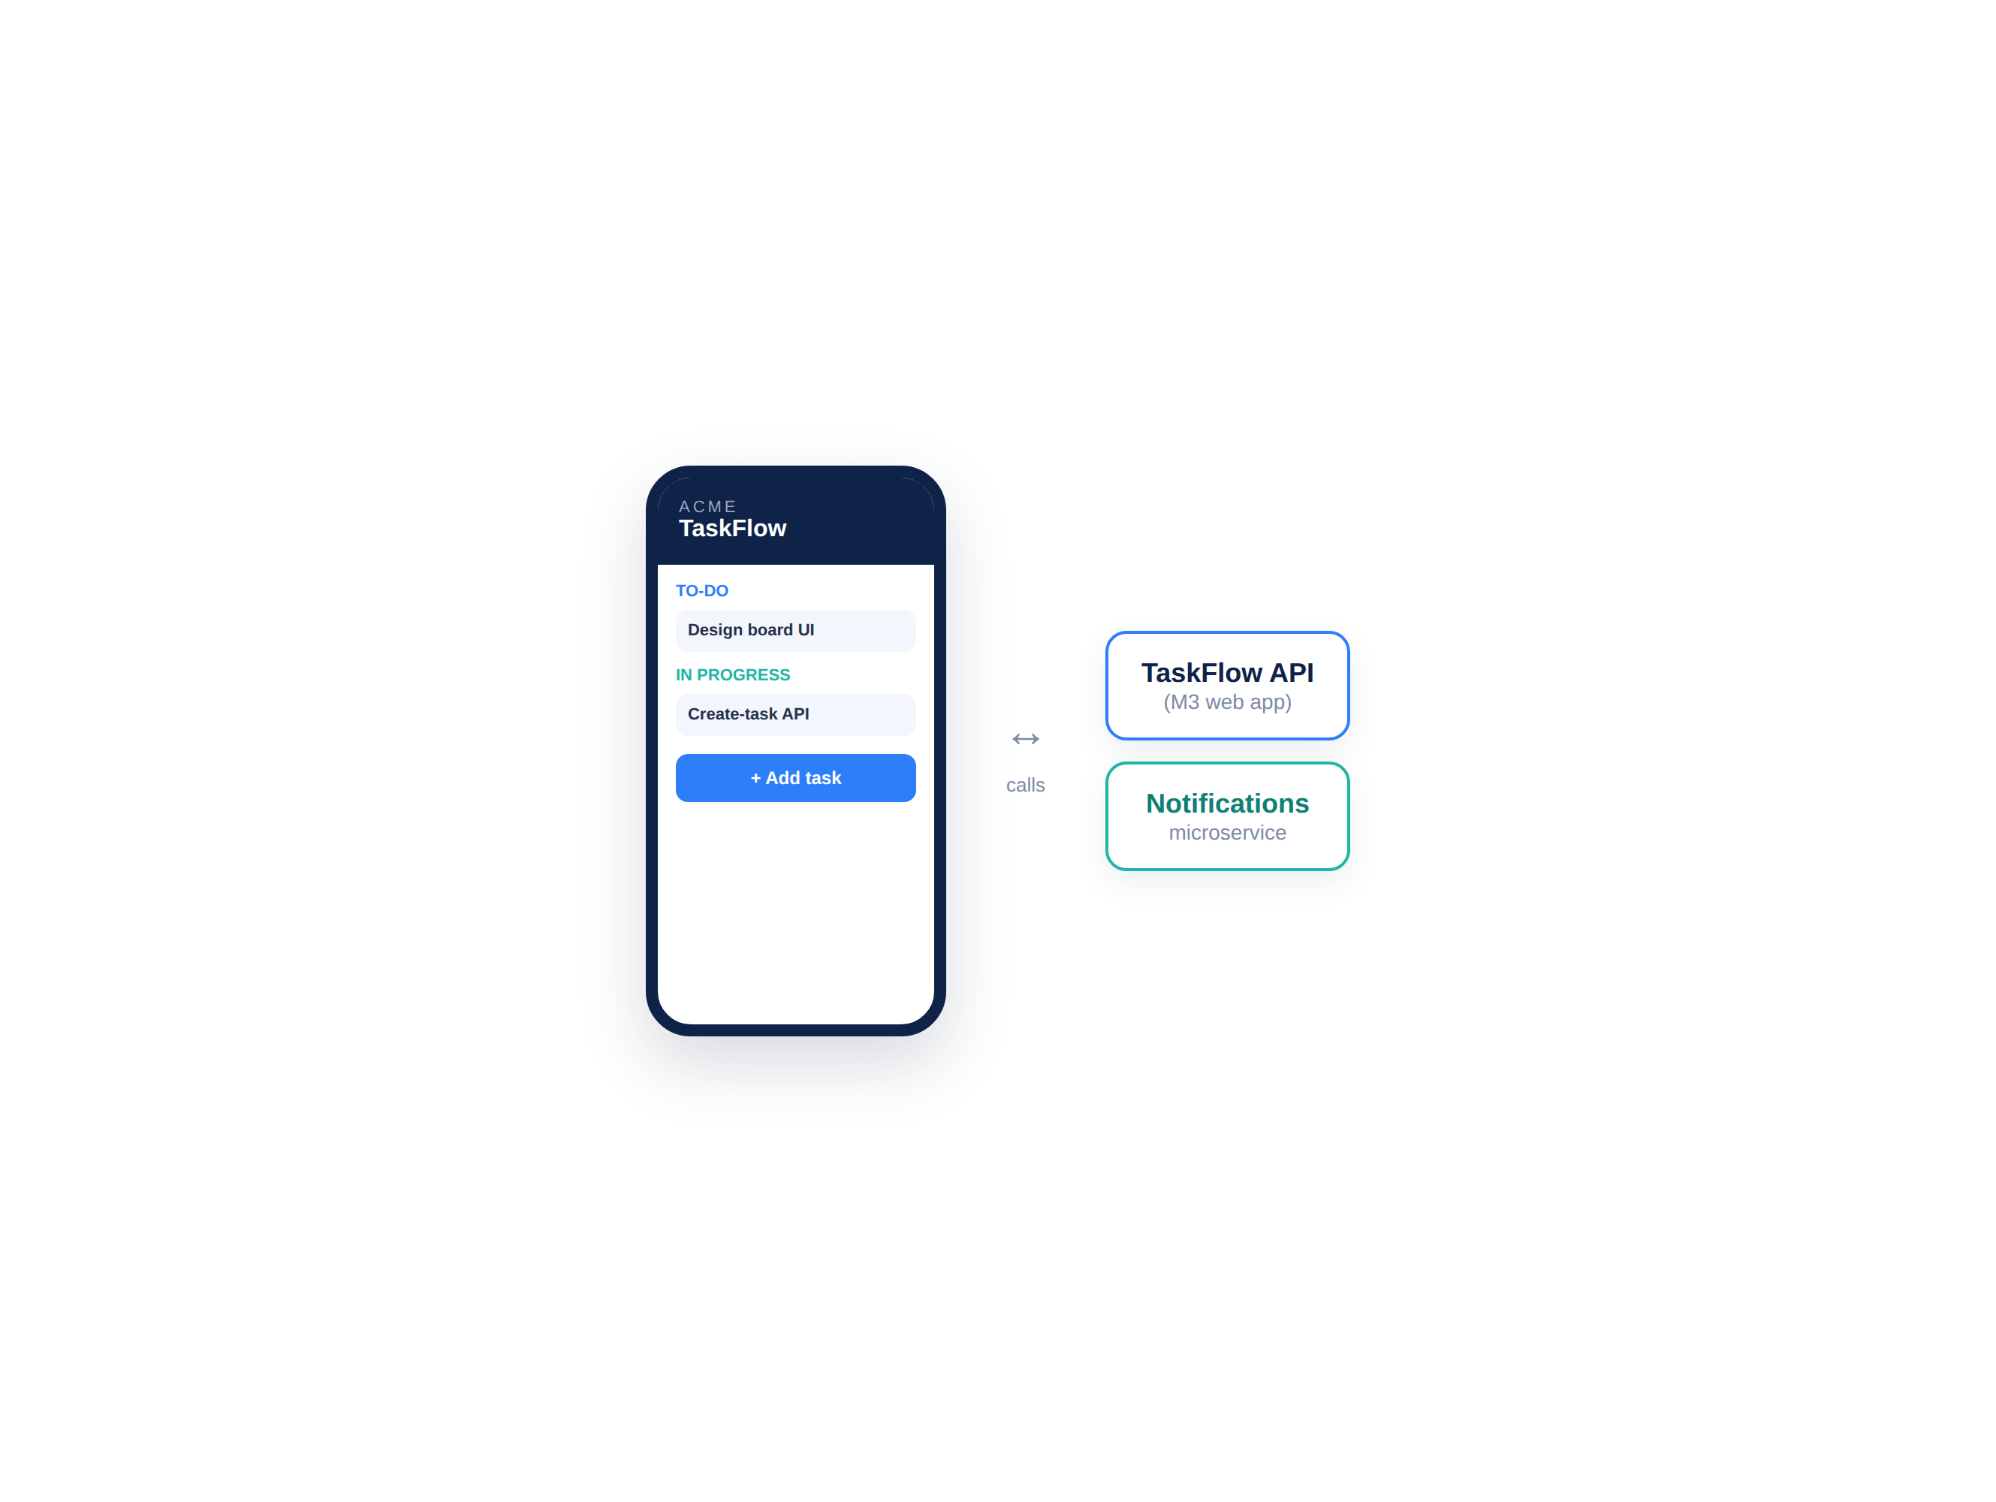
BUILD #3 — on a phone + a service
Your task — 30 minutes
Mobile first (live on your phone); then a quick notifications service.
Generate RN screens → paste into Expo Snack
Scan the QR → TaskFlow on your phone
Claude Code: a small notifications service
Generate its OpenAPI doc + Dockerfile
Your files: Build3_Lab_Guide.md · TaskFlow_Brief.md · Mobile_and_Microservices_Cheatsheet.md
D A T A H A C K S U M M I T 2 0 2 6

Slide 12
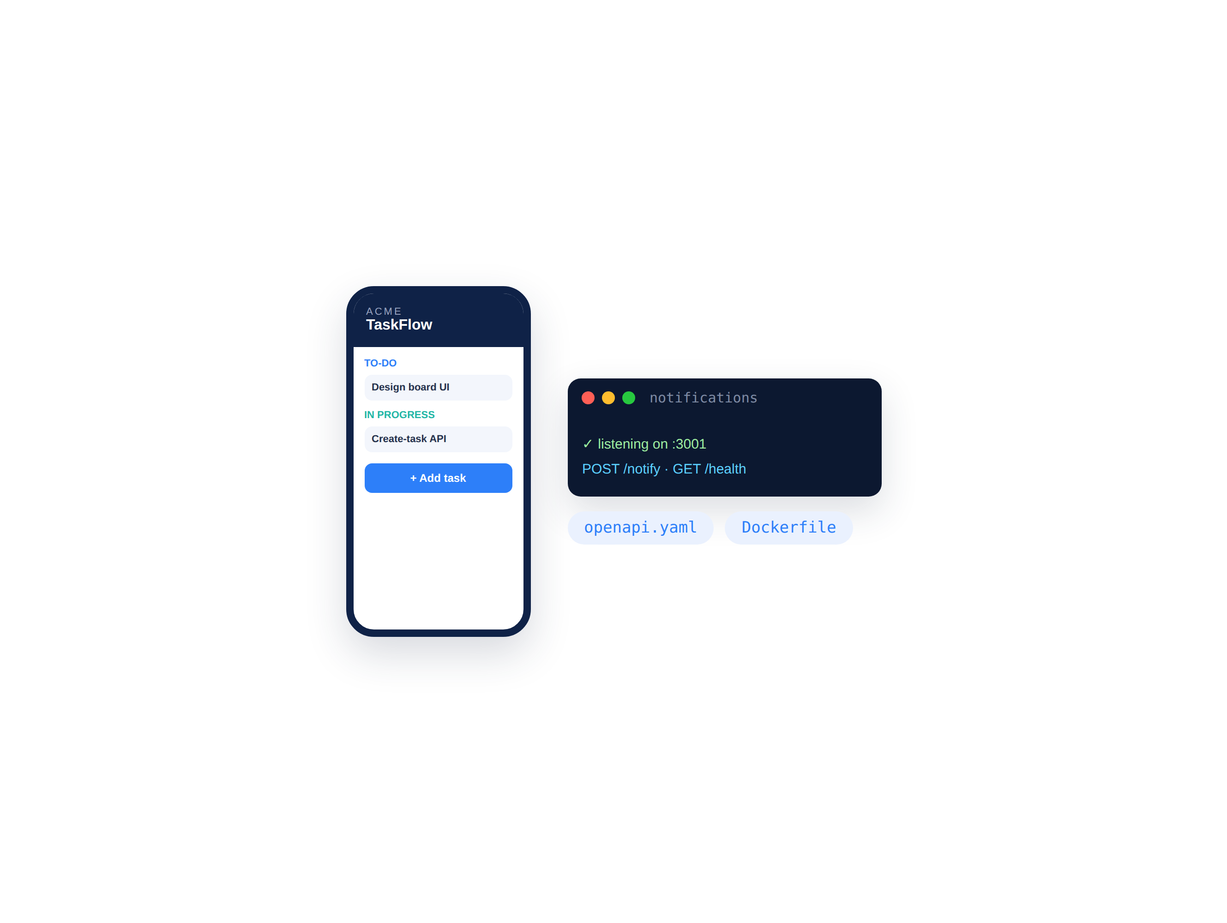
Run it — live on your phone, service up
In 30 minutes: TaskFlow on your phone and a documented service.
Show your neighbour the app on your actual phone — then the OpenAPI doc and Dockerfile Claude generated for the notifications service.
TaskFlow list + add, live via Expo Go
It talks to your M3 web API
Notifications service running in Replit
OpenAPI + Dockerfile as artifacts
D A T A H A C K S U M M I T 2 0 2 6

Slide 13
Debrief — three app types, one spec
01
02
03
04
On a phone
Decomposed
Documented
Portable
TaskFlow now runs on your actual device.
You split off a service — and know when not to.
The API describes itself with OpenAPI.
A Dockerfile means it runs anywhere.
Web, mobile and a service — all from one spec. Next: extend TaskFlow with MCP, Skills and sub-agents.
D A T A H A C K S U M M I T 2 0 2 6

Slide 14
When to split — the honest guide
Stay a monolith when… | Split into a service when…
Small team, early product | A part needs to scale on its own
One deploy keeps life simple | A piece has its own release cadence
The domain is still changing | A clear, stable boundary exists
Simplicity matters most | A separate team owns that piece
Default — start here | Split when the pain is real
D A T A H A C K S U M M I T 2 0 2 6

