Slide 1


M5
MODULE 5 · 1:45–2:40
MCP, Skills & Sub-Agents
The extensibility layer: give the agent your tools (MCP), your rules (Skills), and your specialists (Sub-Agents).
August 05–08, 2026 · The Leela Bhartiya City, Bengaluru
Human × AI

Slide 2

“
Connect. Encode. Delegate.
MCP gives the agent your tools, Skills give it your rules, sub-agents give it specialists — the operating layer, in your hands.
August 05–08, 2026 · The Leela Bhartiya City, Bengaluru
Human ×AI

Slide 3





Three ways to extend the agent
01
02
03
04
MCP
Skills
Sub-agents
You
Connect — wire in your tools and systems (GitHub, Jira, Jenkins).
Encode — teach it your standards, templates and procedures.
Delegate — hand tasks to specialists with their own tools.
Orchestrate — stay on strategy while they do the work.
One open standard, your knowledge, your specialists — the operating layer from this morning, made real.
D A T A H A C K S U M M I T 2 0 2 6

Slide 4
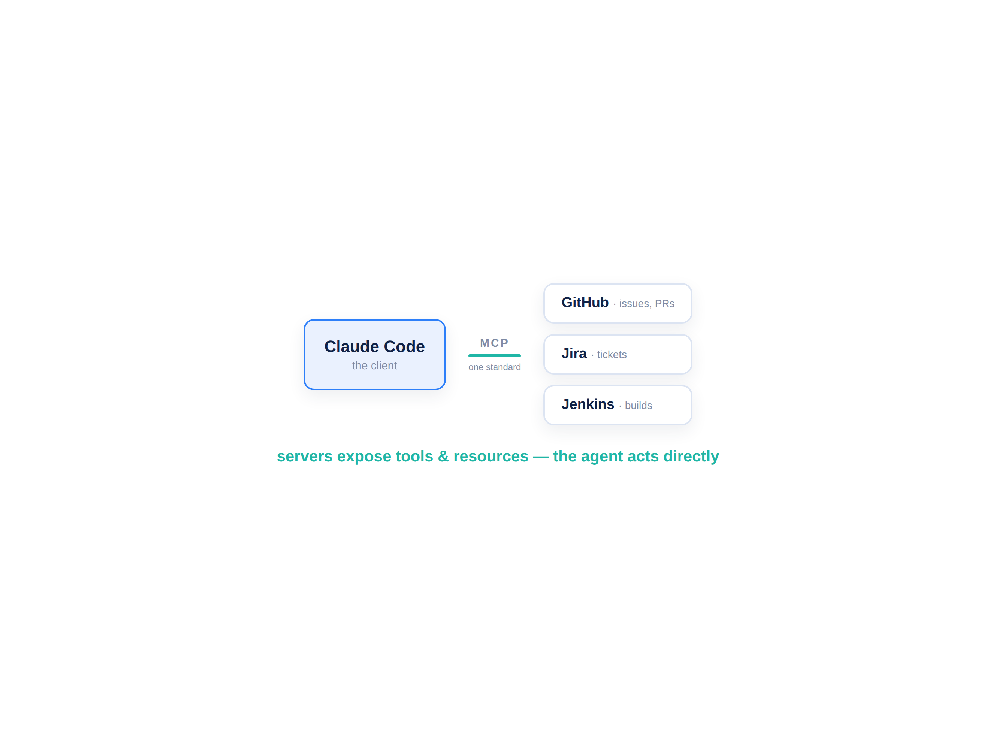

MCP — the open standard for AI + your systems
MCP is a USB-C port for AI: one standard to plug in any tool.
A client (Claude Code) talks to servers (GitHub, Jira, Jenkins…) that expose tools and resources. Stop pasting data in — the agent reads and acts on the system directly.
Client: Claude Code (Cursor, Codex, Gemini too)
Servers: GitHub, Jira, Jenkins, databases…
Tools & resources: what the agent can do & read
Learn once — the same servers work across tools
D A T A H A C K S U M M I T 2 0 2 6

Slide 5
Wiring MCP servers into Claude Code
connect-mcp
Good to know
# add servers in Claude Code, then /mcp to auth # GitHub — remote, PAT header claude mcp add --transport http github \ https://api.githubcopilot.com/mcp/ \ --header "Authorization: Bearer $PAT" # Jira/Confluence — Atlassian remote (OAuth) claude mcp add --transport http atlassian \ https://mcp.atlassian.com/v1/mcp # then, from chat: "create a GitHub issue: fix the date filter"
/mcp lists servers & does OAuth login
--scope project writes a shared .mcp.json
Tools show as mcp__github__… , mcp__jira__…
Jenkins: a community server (verify first)
D A T A H A C K S U M M I T 2 0 2 6

Slide 6
Connecting enterprise systems — safely
The same wiring reaches GitHub, Jira and Jenkins — power that needs guardrails.
GitHub · Jira · Jenkins Issues, PRs, tickets and builds — one agent, many systems, one standard.
3
Least-privilege scopes Fine-grained tokens, scoped to the repos and projects the agent truly needs.
systems, one MCP standard
Secrets hygiene Keep tokens in env vars, never in prompts or committed files; rotate them.
least
Third-party server risk A server can see everything you connect — prefer official/vetted ones, read the tools.
privilege — scope every token
D A T A H A C K S U M M I T 2 0 2 6

Slide 7
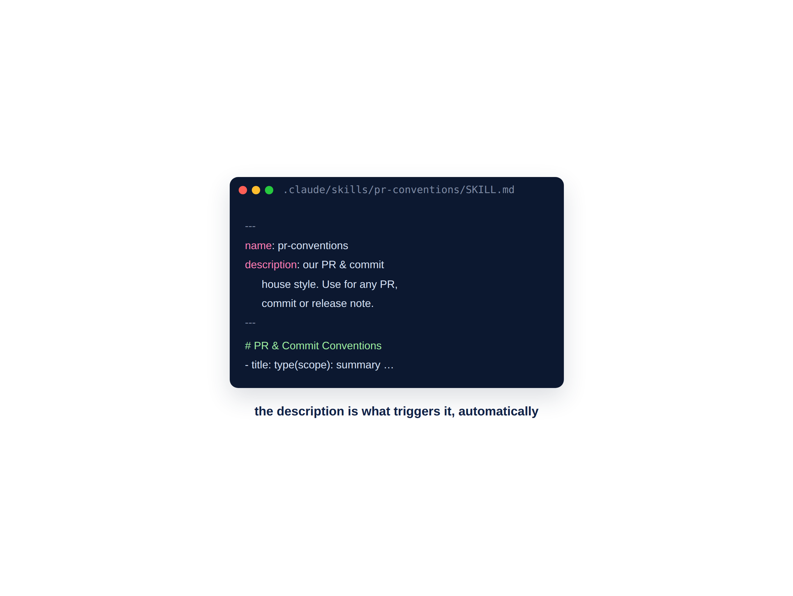
Skills — encode your organization’s knowledge
Teach the agent your standards once; it follows them everywhere.
Skills are model-invoked automatically when their description matches. Drop them in .claude/skills/ (project) or ~/.claude/skills/ (personal).
.claude/skills/<name>/SKILL.md
Frontmatter: name + description (this triggers it)
Body: your rules, templates and examples
Today: our PR & commit conventions
D A T A H A C K S U M M I T 2 0 2 6

Slide 8
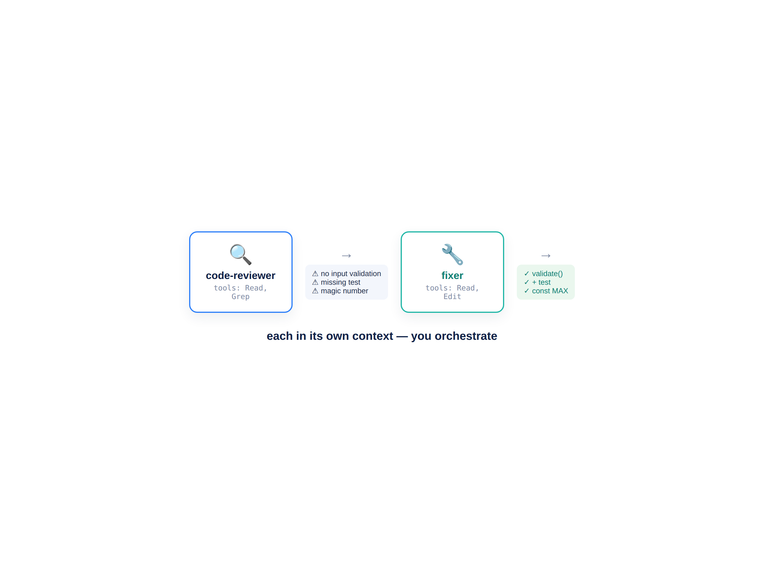
Sub-Agents — specialists you delegate to
Autonomous workers with their own instructions, tools and context.
Each sub-agent runs in its own context and returns a summary. Claude auto-delegates by the description. Limit their tools to keep them safe and focused.
.claude/agents/<name>.md
Frontmatter: name, description, tools, model
Restrict tools = safer, cheaper, sharper
Today: a reviewer → fixer workflow
D A T A H A C K S U M M I T 2 0 2 6

Slide 9
The Build #4 pipeline — extend TaskFlow
01
02
03
04
Wire MCP
Create an issue
Build a Skill
Run sub-agents
Connect GitHub (then Jira, Jenkins) to Claude Code.
From chat: open a GitHub issue on your TaskFlow repo.
Encode your PR & commit conventions as a Skill.
Reviewer flags issues; fixer proposes the changes.
Tools, rules and specialists — your TaskFlow repo is now enterprise-grade.
D A T A H A C K S U M M I T 2 0 2 6

Slide 10
Module 5 — your files & the flow
File | What it is | When you use it
Build4_Lab_Guide.md | Step-by-step Build #4 (3 parts) | ① Follow during the lab
pr-conventions_SKILL.md | The Skill template to drop in | ② Your PR & commit Skill
code-reviewer.md / fixer.md | The two sub-agent definitions | ③ Copy into .claude/agents/
MCP_Security_Card.md | Scopes, secrets, third-party risk | Read before wiring tokens
MCP_Skills_Subagents_Cheatsheet.md | All the commands & file formats | Keep open throughout
D A T A H A C K S U M M I T 2 0 2 6

Slide 11
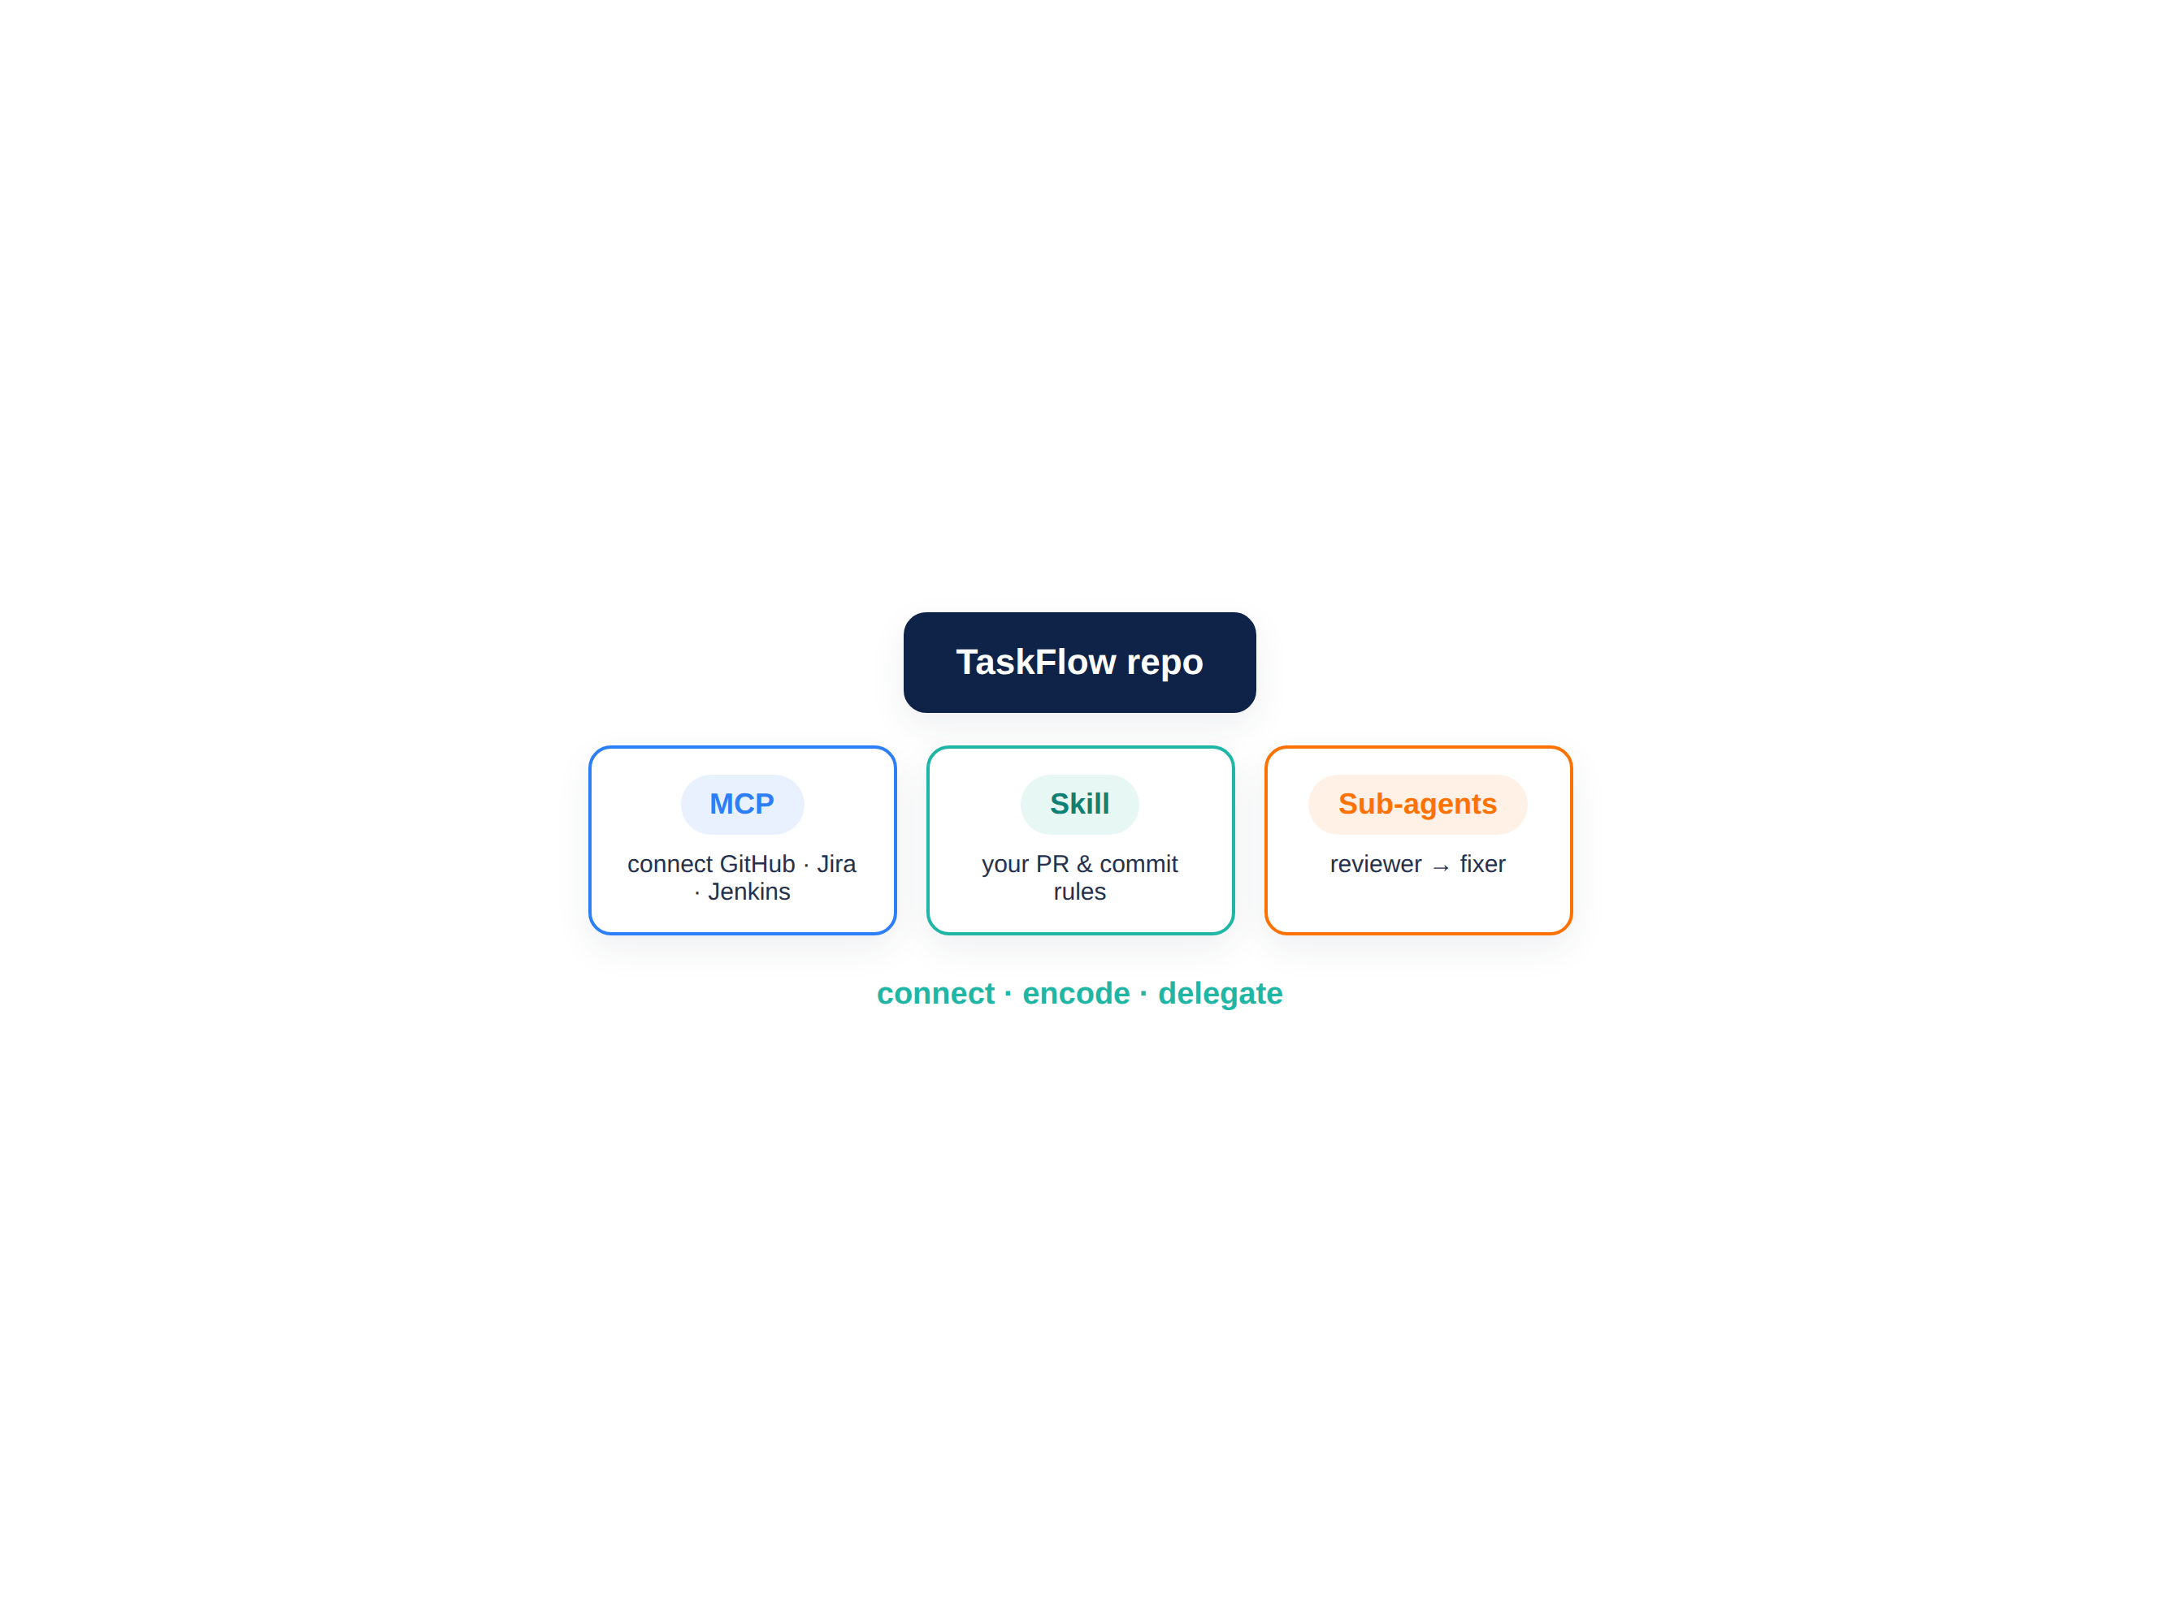
BUILD #4 — MCP, a Skill & sub-agents
Your task — 30 minutes
Three parts: connect, encode, delegate — on your TaskFlow repo.
Wire the GitHub MCP; create an issue from chat
Build a Skill: your PR & commit conventions
Create a code-reviewer + a fixer sub-agent
Run reviewer → fixer on the TaskFlow repo
Your files: Build4_Lab_Guide.md · pr-conventions_SKILL.md · code-reviewer.md · fixer.md
D A T A H A C K S U M M I T 2 0 2 6

Slide 12
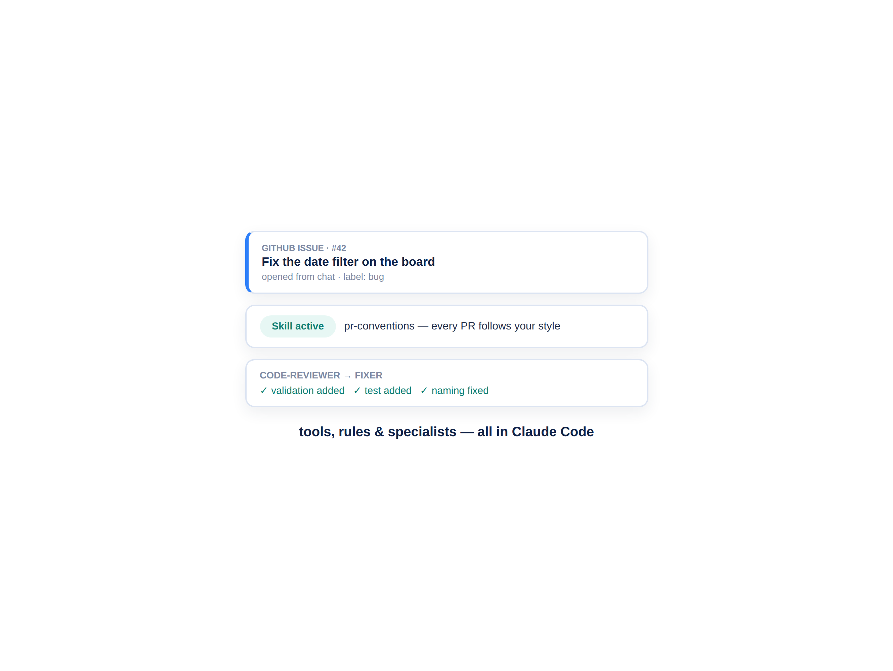
What you just extended
Same agent — now with your tools, your rules and your specialists.
You opened a real GitHub issue from chat, made the agent follow your PR conventions, and had a reviewer and fixer work the TaskFlow repo — all without leaving Claude Code.
A GitHub issue, created from a sentence
A Skill your whole team can share (.mcp / repo)
A reviewer sub-agent with a real checklist
A fixer that turns findings into changes
D A T A H A C K S U M M I T 2 0 2 6

Slide 13
Debrief — the operating layer, in your hands
This is the “operating layer” from the Welcome — no longer a slide, but your setup.
One standard, many systems MCP connected GitHub, Jira and Jenkins through the same wiring.
3
Your rules, encoded A Skill makes every session follow your conventions — governance that scales.
extensions: tools, rules, specialists
Specialists on tap Sub-agents did focused work in their own context and reported back.
1
It travels The same MCP servers work in Cursor, Codex and Gemini. Next: bug triage → fix → CI.
standard — portable across tools
D A T A H A C K S U M M I T 2 0 2 6

Slide 14
MCP · Skills · Sub-agents — the cheatsheet
 | What it is | How you add it
MCP | Connect the agent to a tool/system | claude mcp add --transport http <name> <url> · /mcp
Skill | Encode your rules, model-invoked | .claude/skills/<name>/SKILL.md (name + description)
Sub-agent | A specialist in its own context | .claude/agents/<name>.md (name, description, tools, model)
Invoke | How each one fires | Just ask — all three are triggered by description/intent
Portable | Works beyond Claude Code | Same MCP servers work in Cursor · Codex · Gemini
D A T A H A C K S U M M I T 2 0 2 6

